Slide 1
Optimization of Water Networks
for Nablus Municipality

Slide 2
Optimization of Water Networks for Nablus Municipality
Nada Sweedan
Waed Bouzia
Haytham Yahya
Introducing

Slide 3
Agenda
Introduction
Project Objectives
Past Works
Current State
Optimization
scenarios

Slide 4
The Objectives
Studying the current structure of the water network
Improving and optimizing the water resources system
Reducing the operational cost through the network
Time effects on the network

Slide 5
Introduction
Water is the most vital matter in the world
And, water demand is radically increasing
HUGE DEMAND VS FEW RESOURCES
REAL need for Optimal state

Slide 6
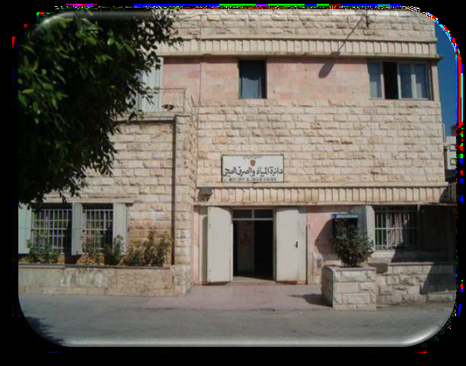
Water Network for Nablus Municipality
In Nablus Municipality , the water department is the water network controlling and managing unit.

Slide 7
The network
Network
Wells
Reservoirs
Pressure Zones
Notes:
Include :
1- Wells: feed water to the network.
Examples : Odala and Badan
2- Reservoirs: where the water collect then distributed to PZ
Examples : Junied and Junblat.
3-Pressure Zones: areas which receive water from reservoir to feed houses .
4- links between the network parts

Slide 8
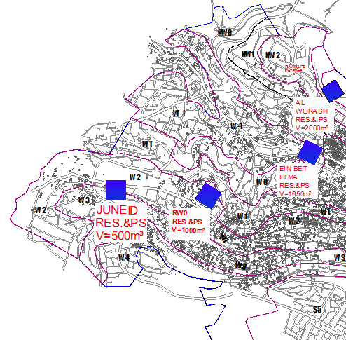

Slide 9
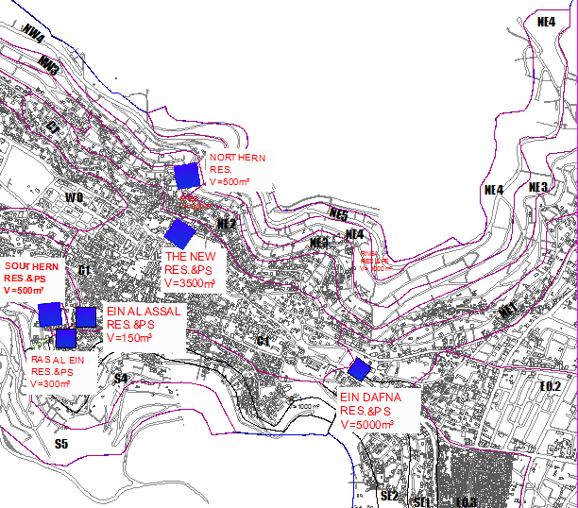

Slide 10
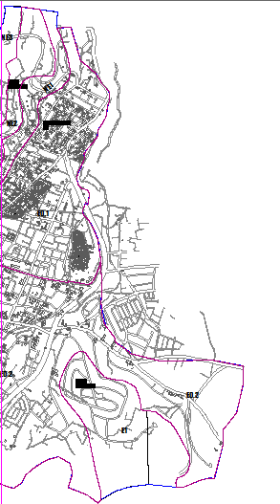

Slide 12
PAST WORK
Recently, huge efforts were done in the field of networks optimization.
Most of them are based on mathematical programming.
One of that:
Lim, Suh, Kim, & Park, 2010

Slide 13
Segun- Adeyefa 2011 :
Multi-Objective Stochastic LP in comparison with the traditional Model. critical and optimal decision analysis are intertwined to address situations where the attendance of several objective functions and the stochastic nature of data are under one roof in a linear optimization context
Elimam & Girgis, 2012
Optimization of Water Resources Planning for Jordan’s Aqaba Special Economic Zone.
Mainly aiming to minimize the overall water production and delivery costs, in addition of conserving fresh water supplies.

Slide 14


Data Gathering
Data Analysis
Formulating and modeling
Scenarios Analysis
Results
THE METHODOLOGY

Slide 15
Reservoirs
It’s the water basins in the network,
Reservoir’s Notation | Reservoir Name
A | Ein_ Dafna
B | Northern Reservoir
C | New_Reservoire
D | Southern
E | Ein_Bait_Elma
F | Al-juneed
G | Kamal_Junblat
H | RNE4
I | Al sumarah
J | Al masaken
K | Aseera

Slide 16
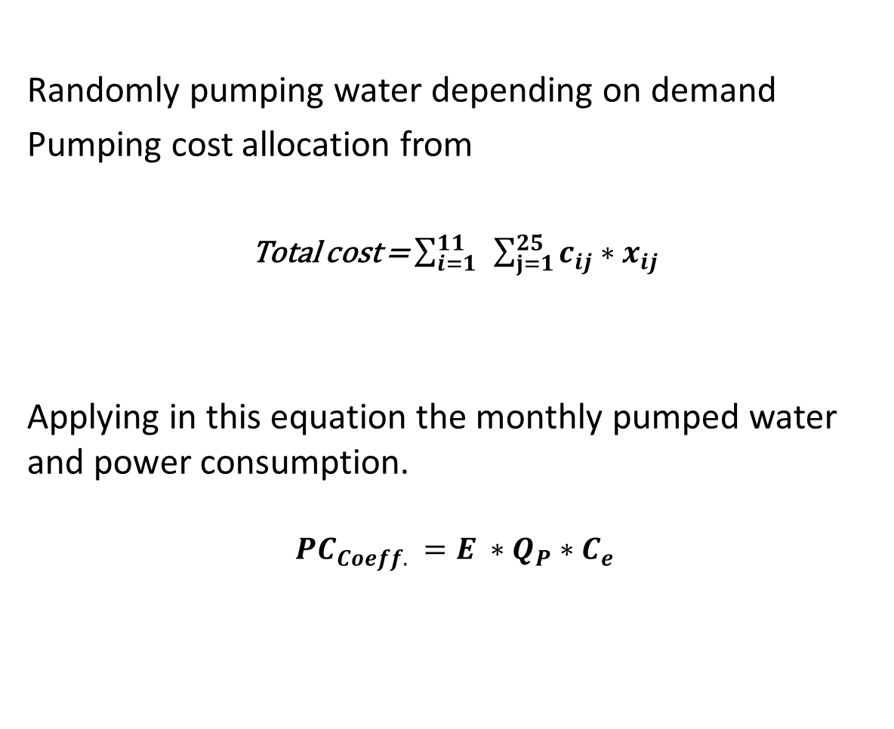
Current state
Randomly pumping water depending on demand
Pumping cost allocation from
Total cost = $\sum_{i=1}^{11}{ }\sum_{j=1}^{25}{c_{ij}∗x_{ij}}$
Applying in this equation the monthly pumped water and power consumption.
$${{PC}_{Coeff.}}_{ }=E_{ }∗Q_{P}∗C_{e}$$

Slide 17
The Electricity Consumption
See appindex
Pressure zone Names | Electrical power consumption Kwh | Kwh/m³
NE3 | Gravity | 0
NE4 | 616.5 | 0.392
NE2 | Gravity | 0
W1 | 16581 | 0.694
W0 | 15188 | 0.56
W-1 | 7813 | 0.305
W2 | 40283 | 0.57
S3 | 7740 | 0.48

Slide 18
Pumped water(Qij)
W4 | W3 | W2 | W-1 | W1 | W0 | NE4 | NE3 | NE2 | NE1
0 | 0 | 0 | 0 | 0 | 0 | 1540 | 25829 | 0 | 0 | RNE4(بلوطات)
0 | 0 | 0 | 0 | 0 | 0 | 0 | 0 | 28098 | 0 | Nothern(RNE2)
0 | 0 | 0 | 23080 | 22771 | 22663 | 0 | 0 | 0 | 0 | Beit Alma
0 | 0 | 64747 | 0 | 0 | 0 | 0 | 0 | 0 | 0 | Junblat(RW0)
0 | 40565 | 0 | 0 | 0 | 0 | 0 | 0 | 0 | 0 | Alsumara
See appendix

Slide 19
Results
Applying for this, then the total resultant cost is
100,000 NIS/month
monthly to pump water through all the network

Slide 20
Current State Optimization
Want to pump water from the reservoir to the pressure zone
reservoir
Least cost
Optimal Quantity
Pressure zone

Slide 21
Network analysis
We have 11 reservoirs noted as i=1….,11
And 25 pressure zone, j=1….,25
In addition of the pressure zones demand dj
Want to send xij from I to j with the least cost , in order to cover the demand

Slide 22
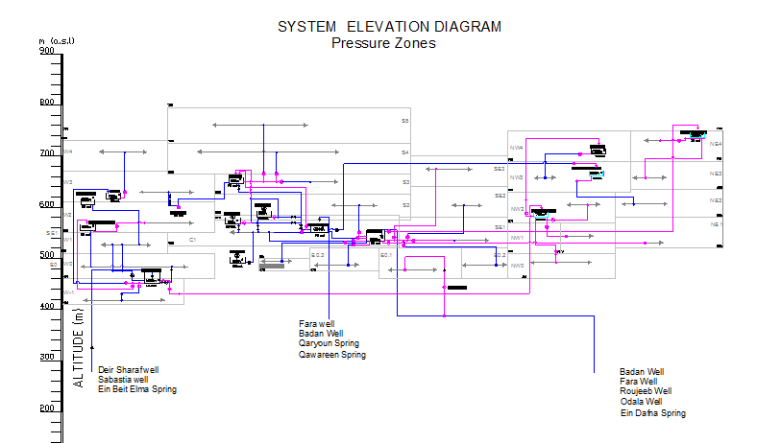

Slide 23
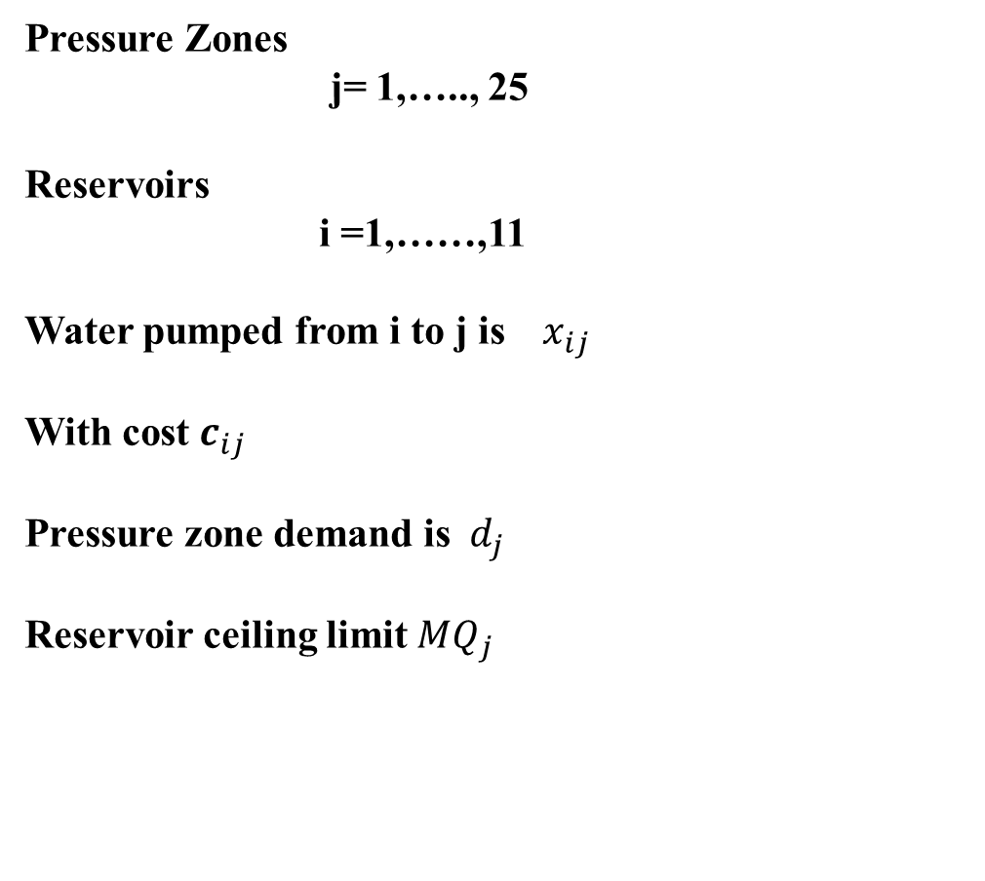
Formulation
Pressure Zones
j= 1,….., 25
Reservoirs
i =1,……,11
Water pumped from i to j is ${ x}_{ij}$
With cost $c_{ij }$
Pressure zone demand is ${ d}_{j}$
Reservoir ceiling limit ${MQ}_{j}$

Slide 24
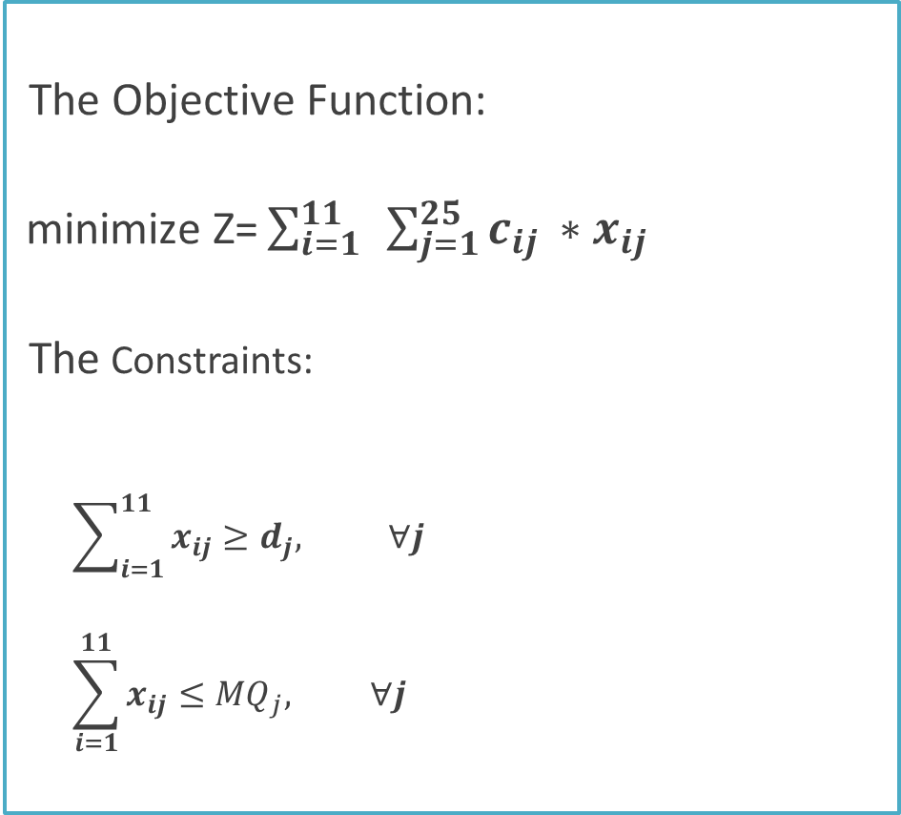
THE MODEL
The Objective Function:
$\text{minimize} \text{Z}\text{=}\sum_{i=1}^{11}{ }\sum_{j=1}^{25}{c_{ij }∗x_{ij}}$
The Constraints:
$$\sum_{i=1}^{11}{x_{ij}≥d_{j}, ∀j}$$
$$\sum_{i=1}^{11}{x_{ij}≤{MQ}_{j}, ∀j}$$

Slide 25
Current state optimization
Use LP SOLVE to solve the previous model
The model resulted in 50,000 NIS as the total monthly pumping cost

Slide 26
 | Current Situation | Optimized water distribution system
Concept | Randomly Pump water monthly through the network | Modeled optimized water distribution system
Methodology | Pump randomly depending on common sense. Simple calculations to find the total cost depending on the quantity that had already been pumped. | Pump by the planned systematic optimized routs due to formulation. Optimized Pumping quantities that attain the minimum total cost.
Total pumping cost /month | 100,000 NIS | 50,000 NIS

Slide 27
NEXT STEP
Scenarios that consider the demand change after five years
The population increase annually in a range from 15%-25% in Nablus city
the water demand then will increase exactly by this range
Its clear that, the demand increasing its not the same in all the city regions.

Slide 28
First Scenario
Demand increasing by the range 15%-25%
25% in the west
north west 20%,
in the east 15%
In the middle increased by 17.5%

Slide 29
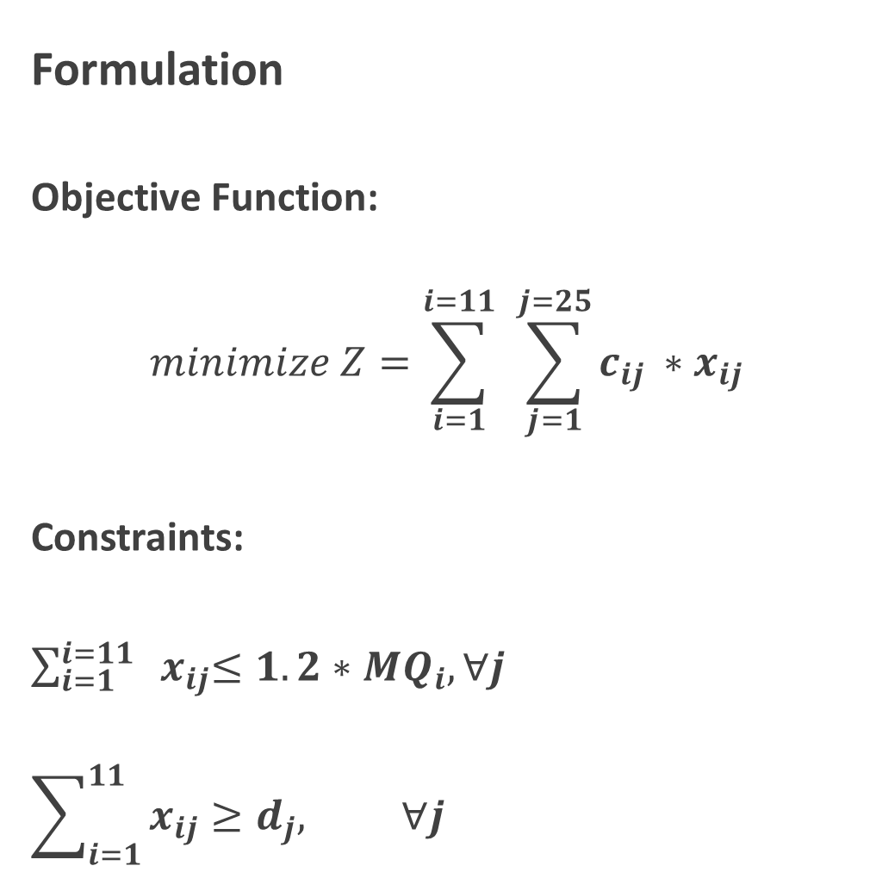
Formulation
Objective Function:
$$minimize Z=\sum_{i=1}^{i=11}{ }\sum_{j=1}^{j=25}{c_{ij }∗x_{ij}}$$
Constraints:
$\sum_{i=1}^{i=11}{ { x}_{ij}≤1.2∗{MQ}_{i}, ∀j}$
$$\sum_{i=1}^{11}{x_{ij}≥d_{j}, ∀j}$$

Slide 30
Pressure zones demand
J | Pressure zone Names | The pressure zone j demand m³/ month
1 | NE1 | 21645
2 | NE2 | 28098
3 | NE3 | 25829
4 | NE4 | 1540
5 | W0 | 22663
See appendix

Slide 31
The Reservoir’s Maximum Quantity
I | Reservoir’s Notation | Reservoir Name | MQ(m³/month)
1 | A | Ein_ Dafna | 29703
2 | B | Northern Reservoir | 32313
3 | C | New_Reservoire | 57313.75
4 | D | Southern | 80933
See appendix

Slide 32
Result
The model resulted in 65269.05 NIS as the total monthly pumping cost

Slide 33
Second Scenario
Investment

Slide 34
THE PRESSURE ZONE MONTHLY DEMAND (M³/MONTH)
J | Pressure zone Names | The pressure zone j demand m³
1 | NE1 | 24892
2 | NE2 | 32313
3 | NE3 | 31474
4 | NE4 | 1771
5 | W0 | 28329
6 | W1 | 28464
See appendix

Slide 35
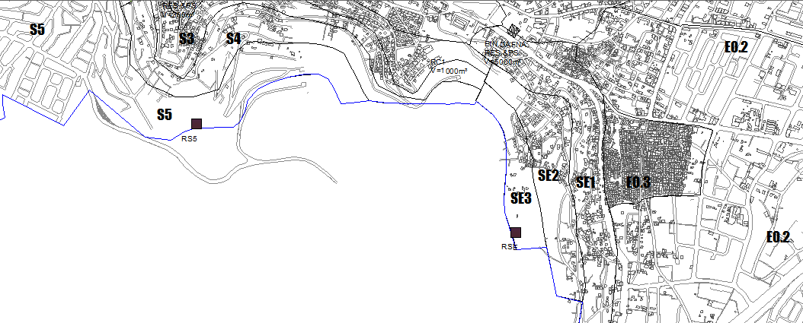
The location of New Reservoirs

Slide 36

Formulation
Objective function
$$min. Z=\sum_{i}^{11}{ \sum_{j}^{25}{x_{ij}∗c_{ij}}}$$
Subjected to:
$\sum_{i=1}^{i=11}{x_{ij}≥d_{j} ,∀j}$
$\sum_{i=1}^{i=11}{x_{ij} ≤{1.2MQ}_{i }, ∀j}$

Slide 37
Result
The model resulted in 57834.05 NIS as the total monthly pumping cost

Slide 38
third Scenario
Hybrid System

Slide 39
THE MINIMUM QUANTITY OF THE RESERVOIRS (M³/MONTH)
THE MINIMUM QUANTITY OF THE RESERVOIRS (M³/MONTH)
Reservoir’s Notation | Reservoir Name | MMQ(m3/month)
A | Ein_ Dafna | 29703
B | Northern Reservoir | 32313
C | New_Reservoire | 57313.75
D | Southern | 80933
See appendix

Slide 40
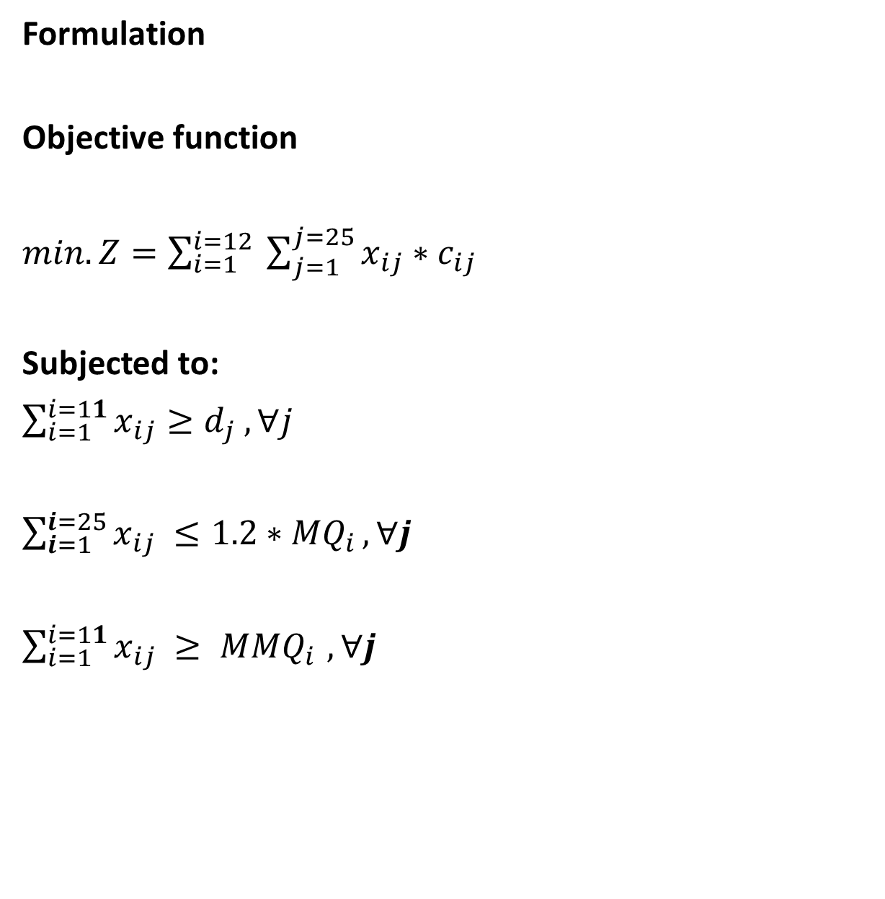
Formulation
Objective function
$min. Z=\sum_{i=1}^{i=12}{ \sum_{j=1}^{j=25}{x_{ij}∗c_{ij}}}$
Subjected to:
$\sum_{i=1}^{i=11}{x_{ij}≥d_{j} ,∀j}$
$\sum_{i=1}^{i=25}{x_{ij} ≤1.2∗{MQ}_{i }, ∀j}$
$\sum_{i=1}^{i=11}{x_{ij} ≥ {MMQ}_{i }, ∀j}$

Slide 41
Result
The model resulted in 52770 NIS as the total monthly pumping cost

Slide 42
Table 21:Scenarios Summary
Aspects | First scenario | Second scenario |  | Third scenario | Fourth scenario
Concept | Applying the original Optimizing System | Using Investment alternative to compensate the shortage |  | Adjusting ceiling and bottom limits for the pumped quantity in the modeled optimized system | A hybrid system for the previous scenarios
Methodology | Using LP-Solve formulation to solve the original LP model | Adding two reservoirs( RS5, RSE) and eliminating Al-junaid reservoir LP- modeling and Zimple formatting to solve it by LP-Solve |  | Adding a minimum limit of X_{j} pumped from j Modeling for this and solving by LP-Solve | Adding Two reservoirs(RS5,RSE) and eliminating Al-Junaid Adding a minimum limit of X_{j} pumped from j Parameter Modeling for this using LP-solve
Cost NIS/month | 65165 | 57834 |  | 65165 52770

Slide 43
Conclusions
If the Municipality use our model The cost of pumping water will be reduced to the half value so they will save a lot of money and enrich there budget .
The scenarios help municipality to have long term strategic planning .

Slide 44
recommendations
Use the modeling as a guide to improve the water pumping system.
put a strategic plan as in three scenarios to have least cost of pumping water through the network .

