Slide 1

AN-Najah National University
Faculty of Engineering & Information Technology
Mechanical and Mechatronics Engineering Department
Graduation Project 2
Integrating Automation Systems into Pharmaceutical Machinery for Enhanced Efficiency
DONE BY:
Waleed Qartallo
Adnan Abutahnat
Taha Qanazeh
SUPERVISOR:
Dr. Mohammad Abuabiah
m.abuabiah@najah.edu
6/25/2025

Slide 2

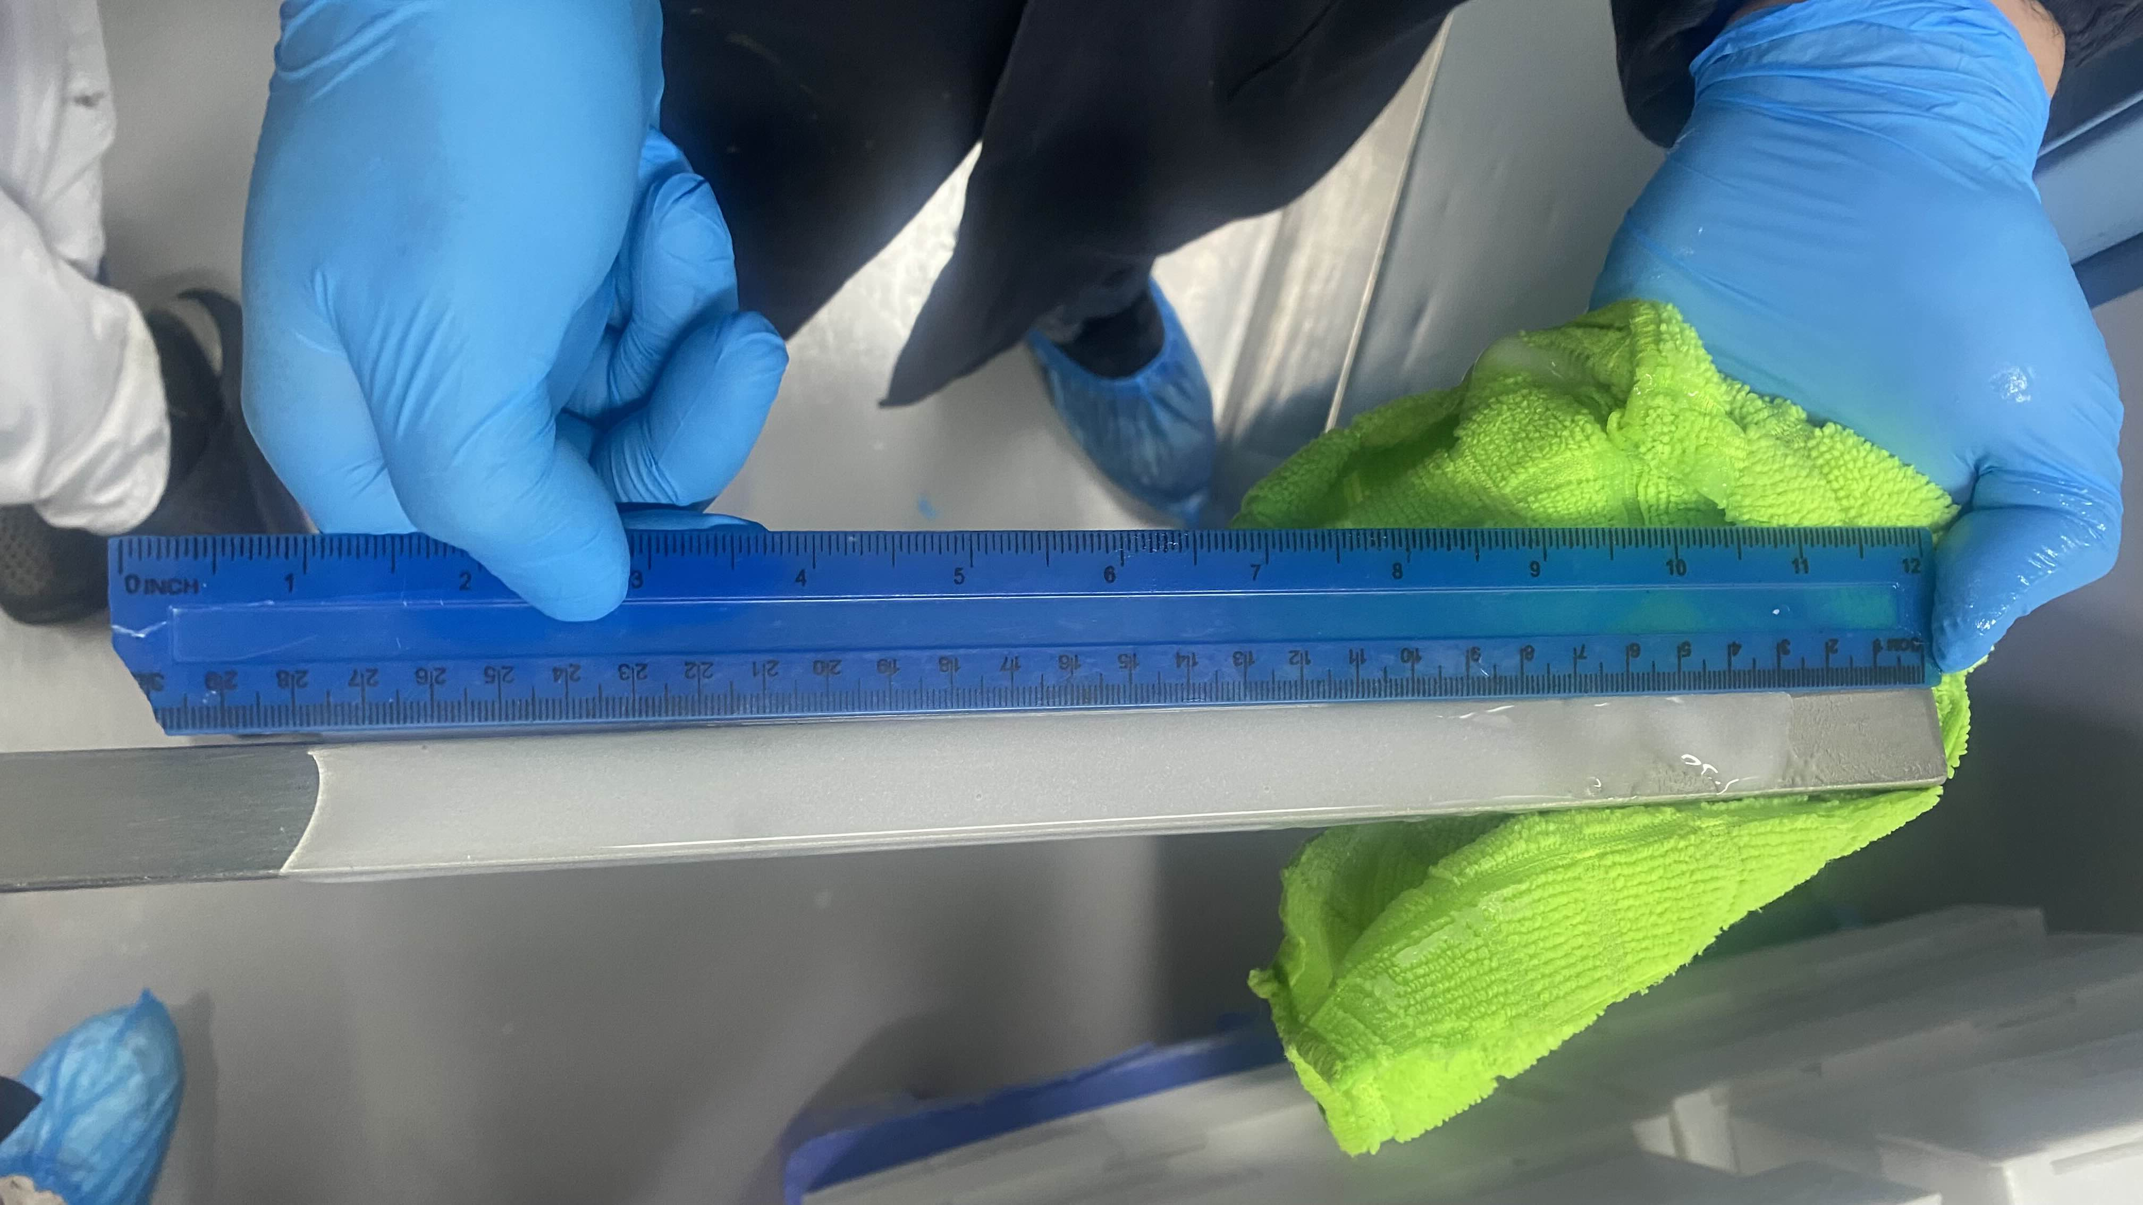
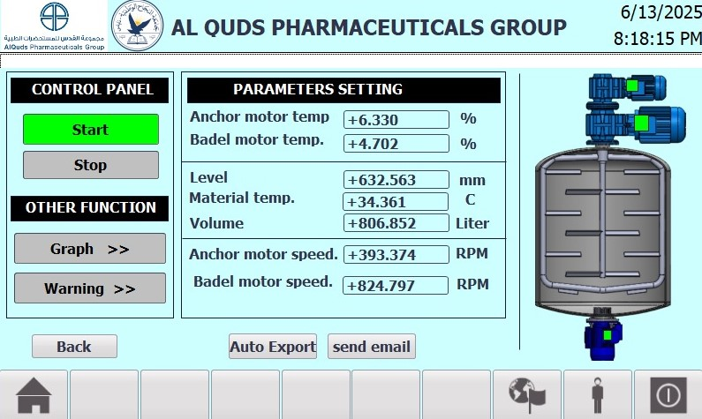
Motivation
2/28

Slide 3

Outline
Introduction
Objective
Methodology
Conclusion
3/28

Slide 4
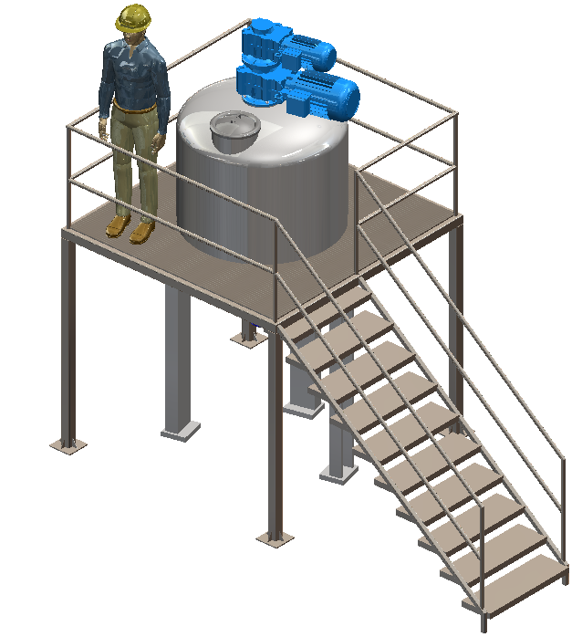
Introduction
The project aims to digitalize a traditional mixing machine using PLC and HMI technologies.
This digital transformation improves operational efficiency and aligns with Pharma 4.0 standards.
The system enables real-time monitoring through sensors, reducing human intervention and error.

Slide 5
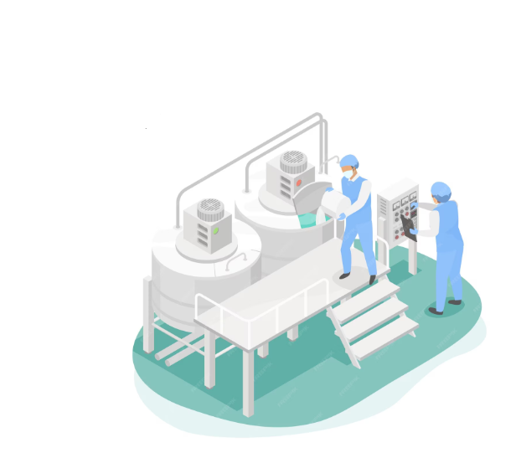
Objective
Simplify the operation and monitoring of the mixing machine through automation.
Display all critical process values on an HMI screen for real-time monitoring.
Record and store process data in an Excel sheet for documentation and analysis.
Move towards implementing Pharma 4.0 standards by integrating smart and connected technologies.

Slide 6
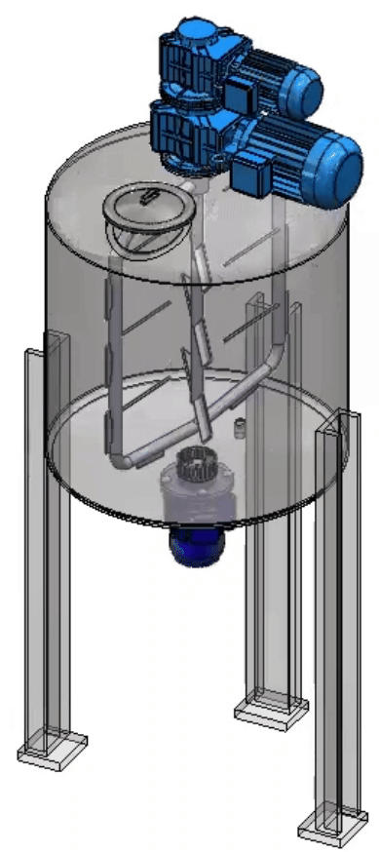
Mixing Machine Overview
The mixing machine is a device used to blend and process various materials into a homogeneous mixture. It is essential in many industries, especially in the pharmaceutical and medical fields, where it is used to mix ingredients with high precision to produce high-quality products such as creams, ointments, and medicinal preparations.

Slide 7
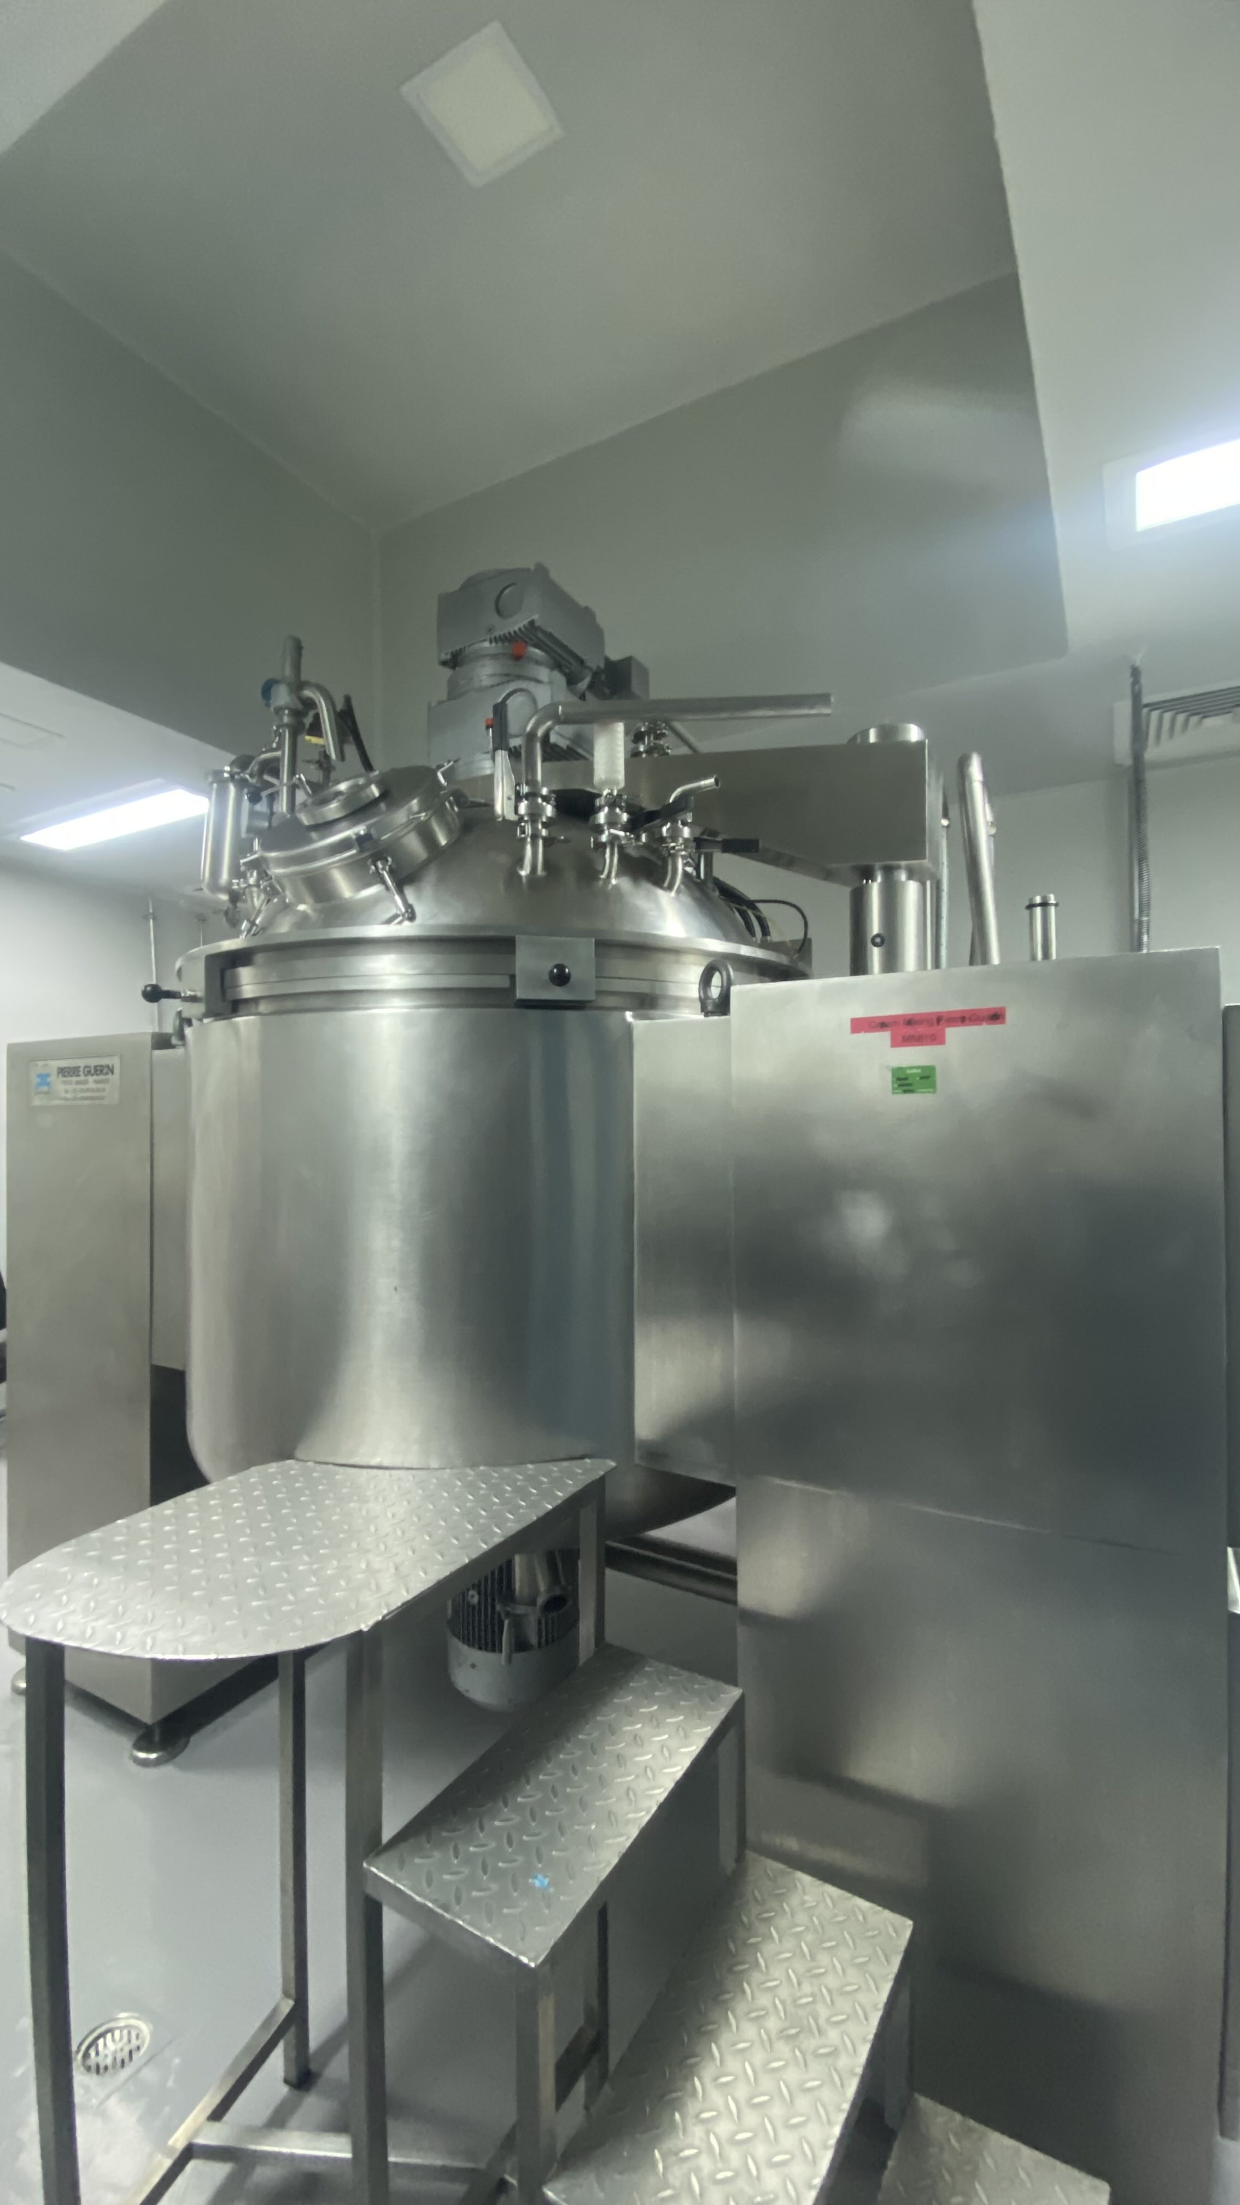
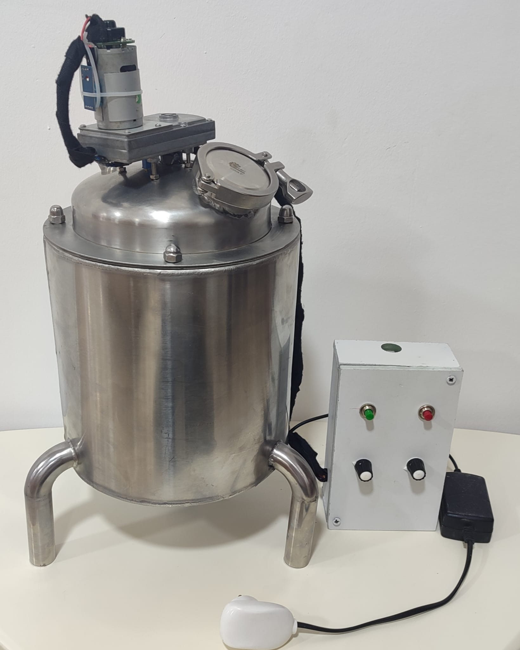
Methodology
The project is structured into two parallel phases:
Real Machine Phase
Prototype Phase

Slide 8
Prototype System Specification
Characteristics of Prototype Mixing Machine
Specification | Details
Tank Material | Stainless steel with double-jacket design
Mixing System | Two DC-powered mixers
Temperature Sensor | DHT11 sensor
Speed Sensor | Hall Effect sensor
Level Sensor | Ultrasonic sensor (HC-SR04)
Control Unit | Arduino Mega 2560 board housed in a wooden control box
Motor Driver | H-Bridge Motor Driver (e.g., L298N)
User Controls | On/Off buttons and potentiometer for motor speed adjustment
Monitoring Interface | Real-time data display using App Designer GUI
System Interaction | Live feedback and control via graphical user interface

Slide 9
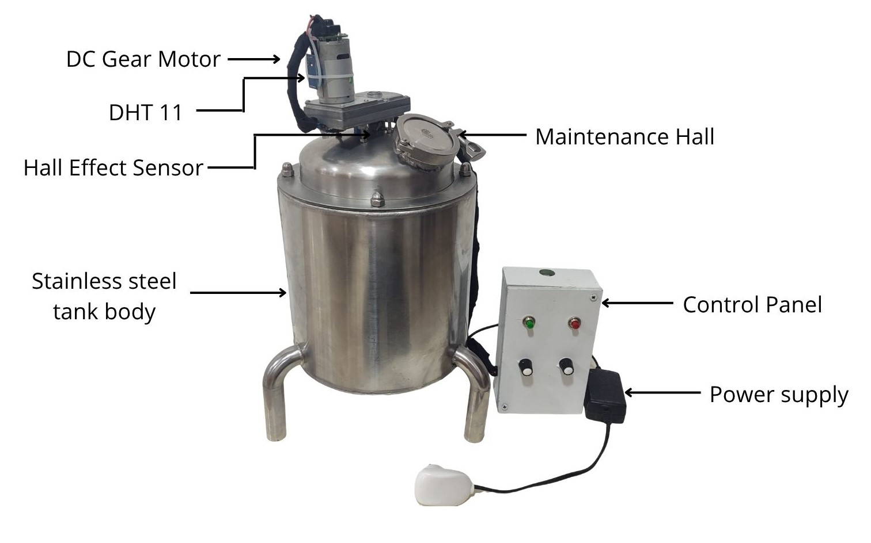
Prototype System Overview

Slide 10
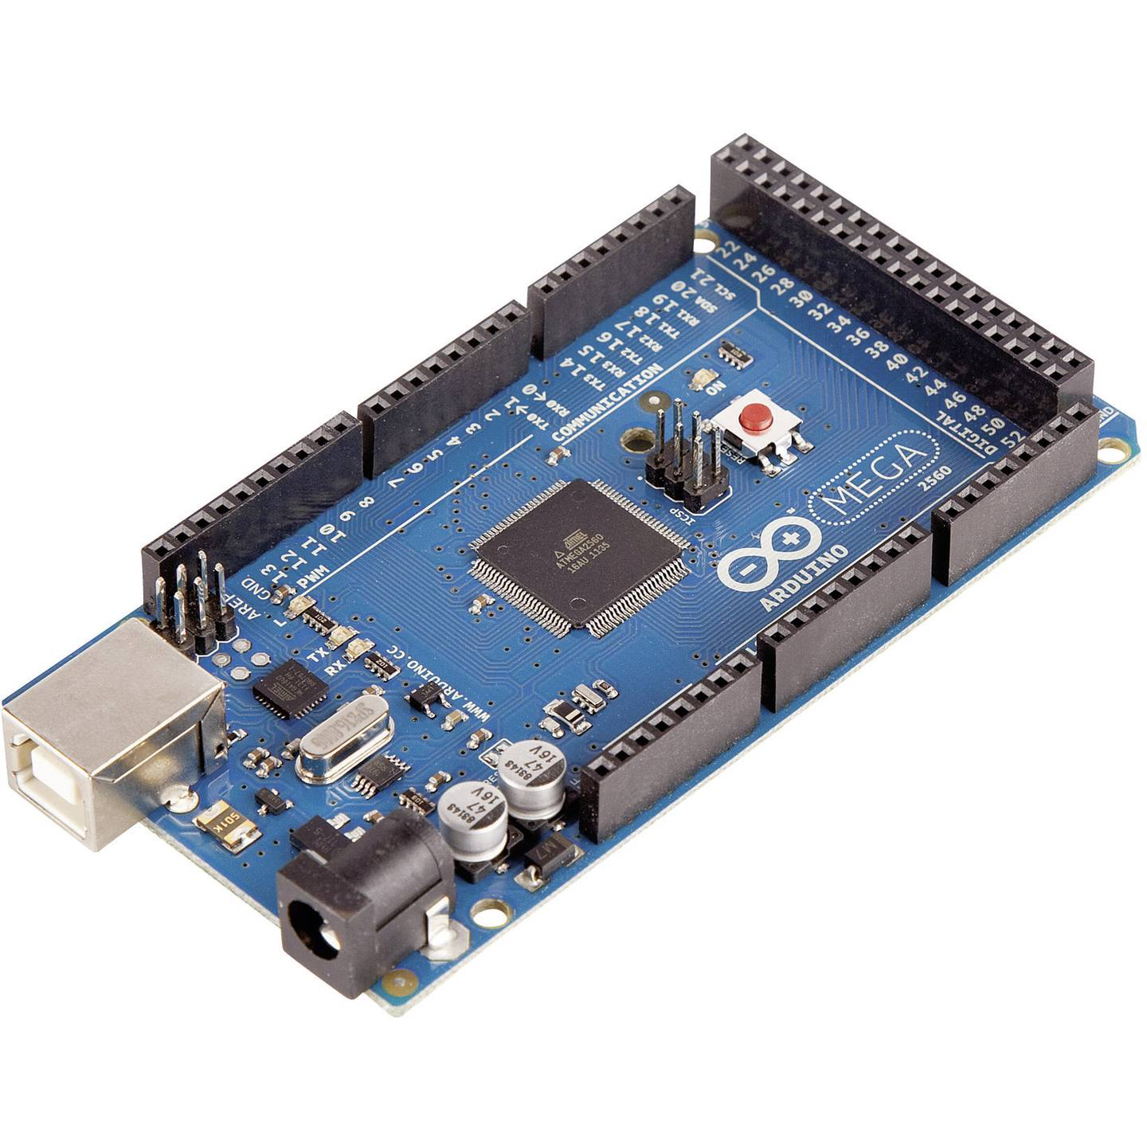
Electrical Components
Arduino Mega 2560
/28

Slide 11
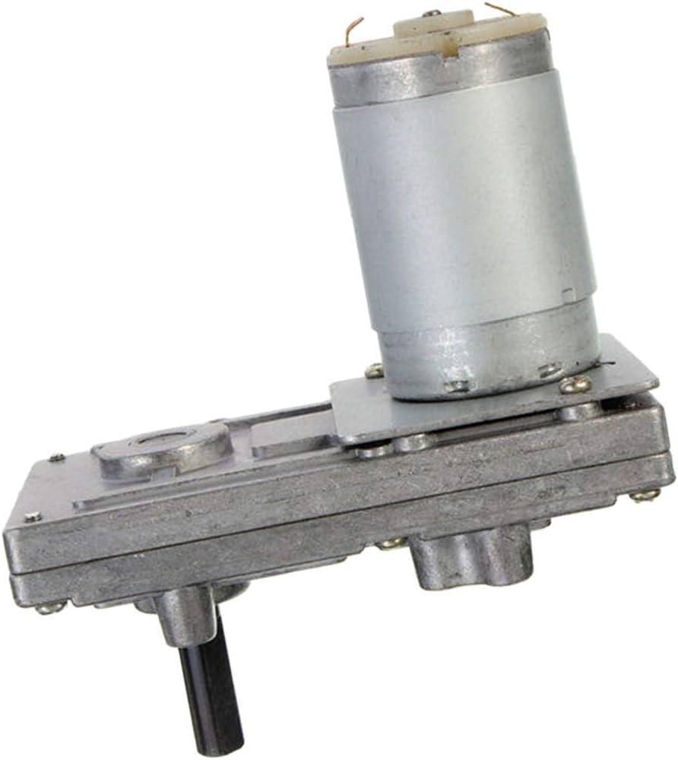
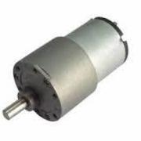
Electrical Components
DC Gear Motors 12V
/28

Slide 12
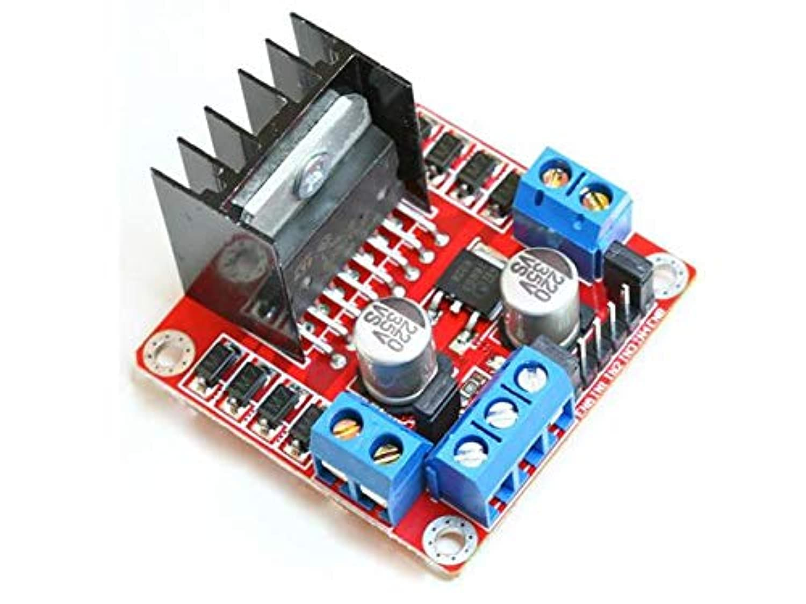
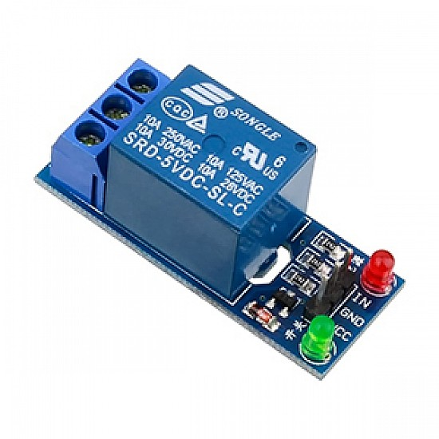
Electrical Components
H-Bridge Motor Driver L298N
Relay module
/28

Slide 13
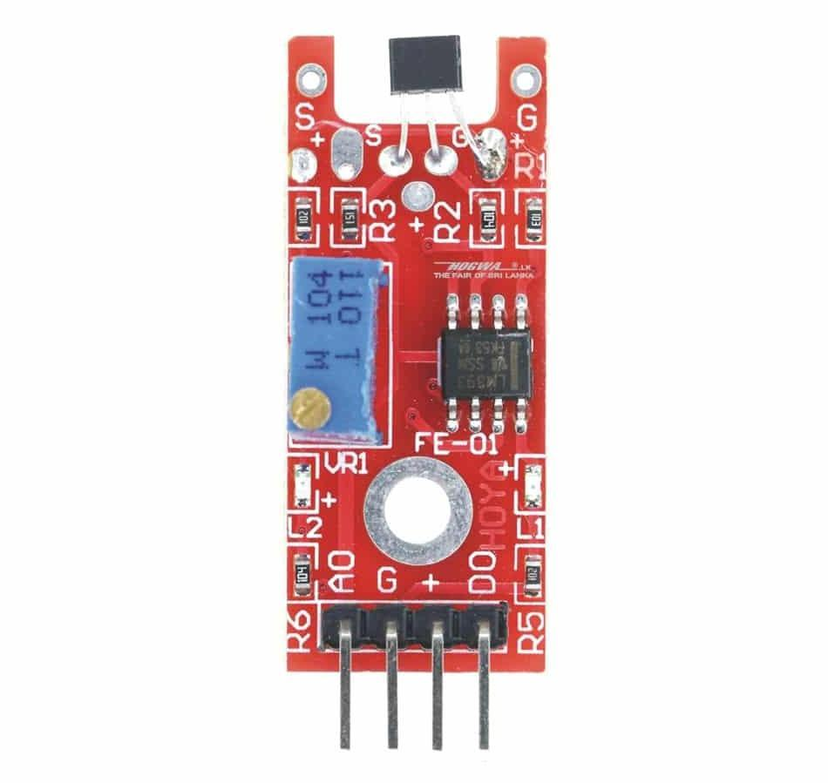
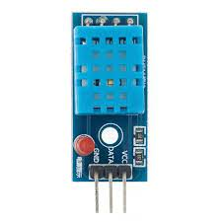
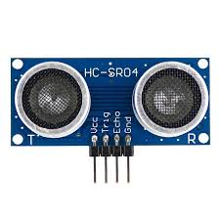
Sensors
Hall effect sensor
DHT11 sensor
Ultrasonic sensor
/28

Slide 14
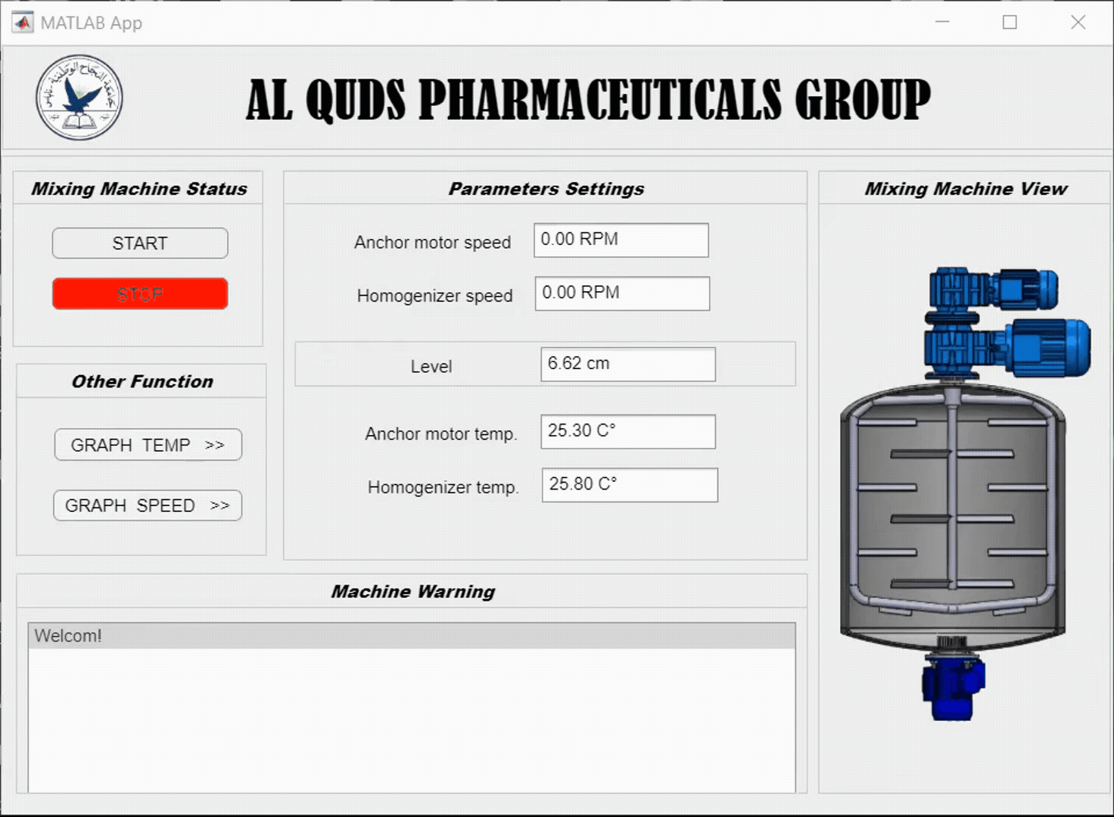
Graphical User interface
14/28

Slide 15
Methodology
The project is structured into two parallel phases:
Real Machine Phase
Prototype Phase

Slide 16
Real System Specification
Characteristics of Real Mixing Machine
Specification | Details
Machine Type | Industrial Mixing Machine
Control System | PLC-based with HMI interface
Material Capacity | e.g., 1000 Liters
Motor Type | AC Motor
Speed Monitoring | real-time display on HMI
Temperature Monitoring | RTD pt100 sensors with alarm system
Data Logging | Real-time logging to Excel sheet via PC
Main Structure Material | Stainless Steel (Pharma Grade)
Mixing Mechanism | e.g., Paddle / Homogenizer / Anchor
Automation Level | Semi or Fully Automated
Power Supply | e.g., 220V / 380V, 3 Phase
Safety Features | Emergency stop, Overheat alarm

Slide 17
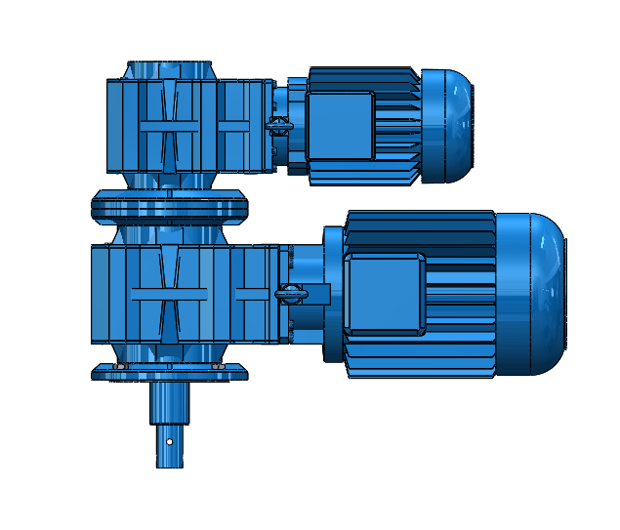
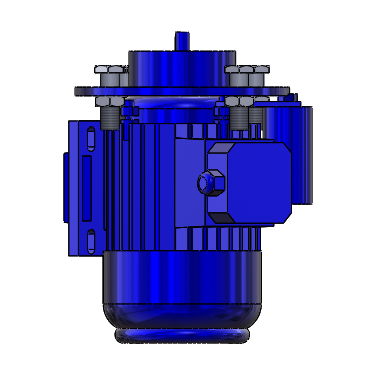
Electrical Components
Three-phase Motor
Several types of motors will be used in this project, including:
Anchor motor.
Blade paddle motor.
Homogenizer motor.

Slide 18
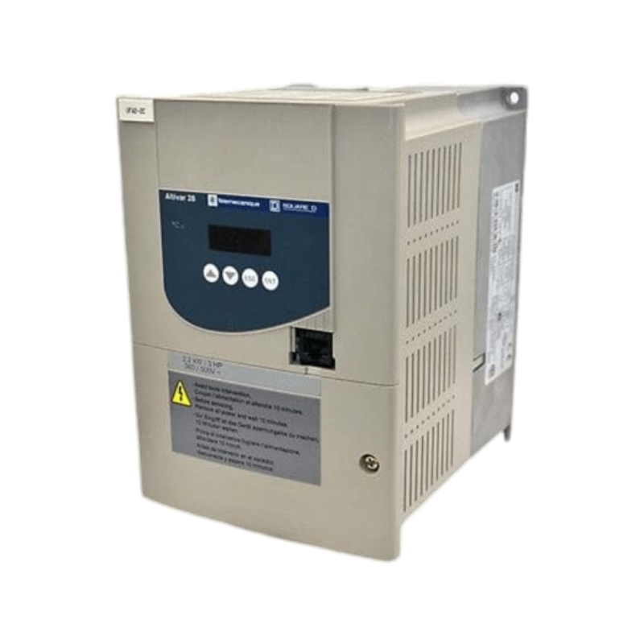
Electrical Components
Variable Frequency Driver (VFD)
Programmable Logic Controller (PLC)

Slide 19
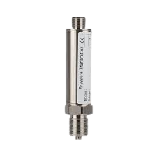
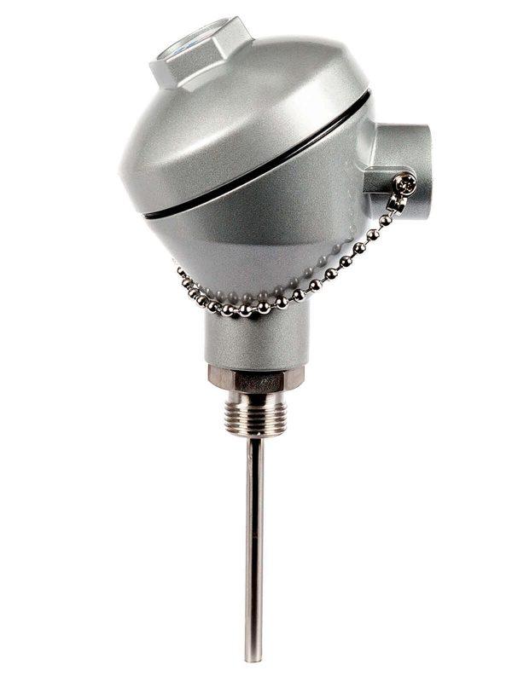
Sensors
Pressure transmitter
RTD sensor (pt100)
19/28

Slide 20
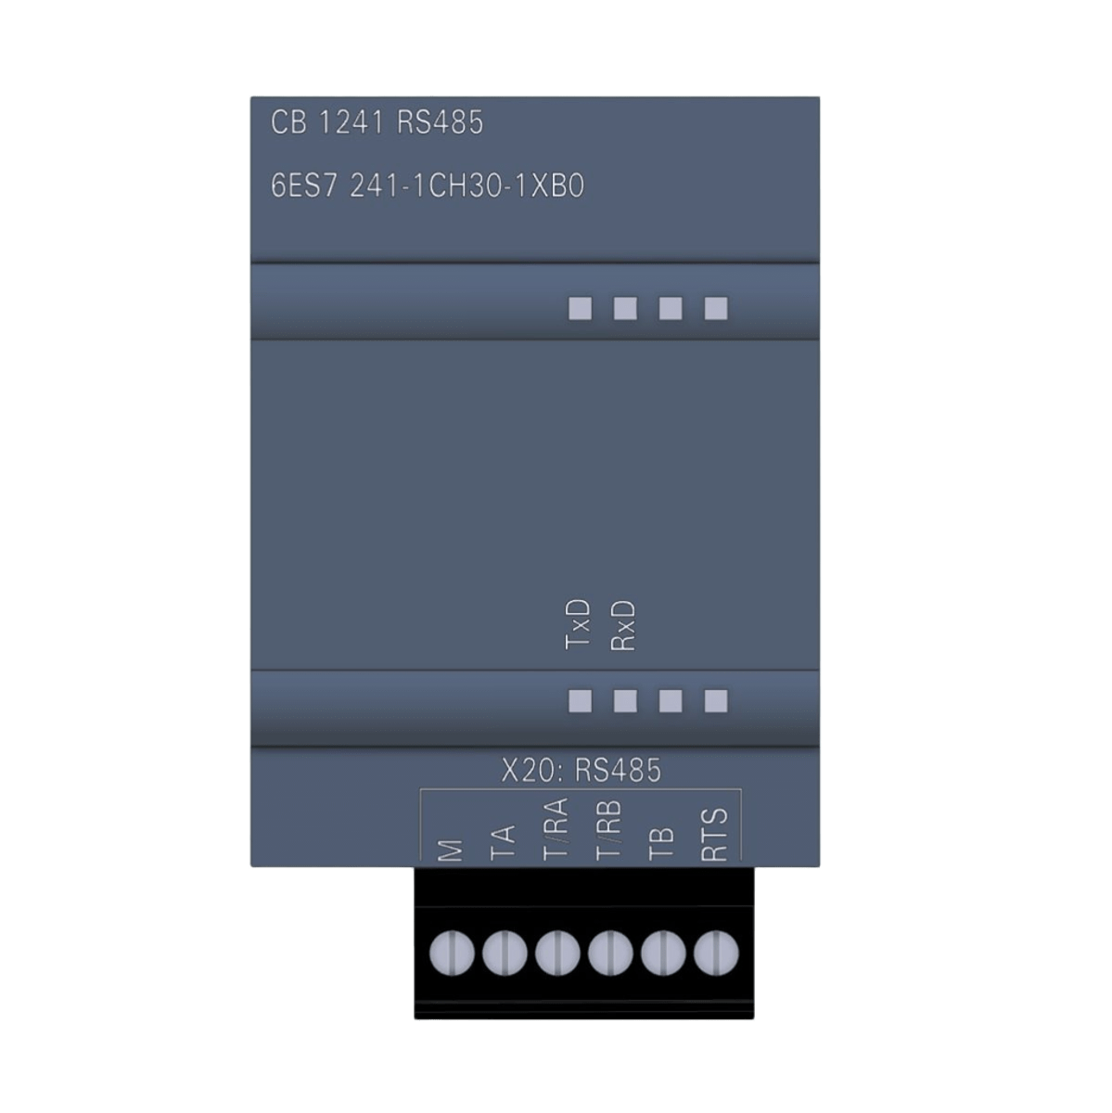
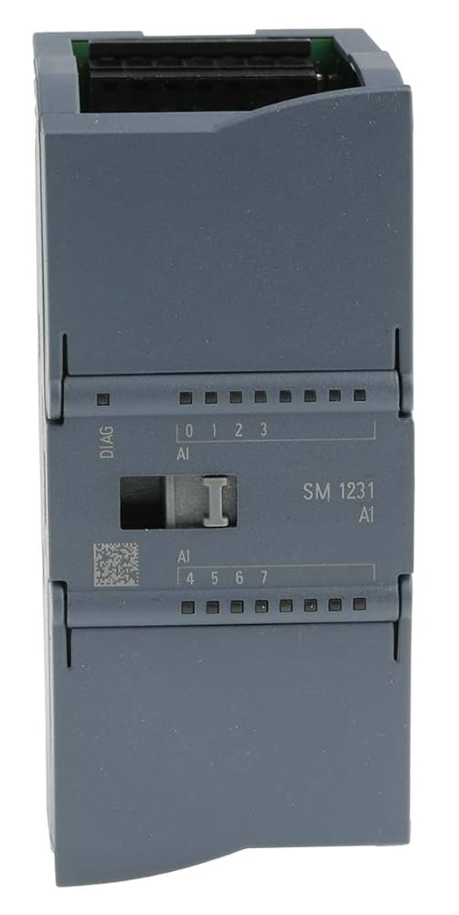
PLC Modules
CB 1241
Analoge input module
20/28

Slide 21
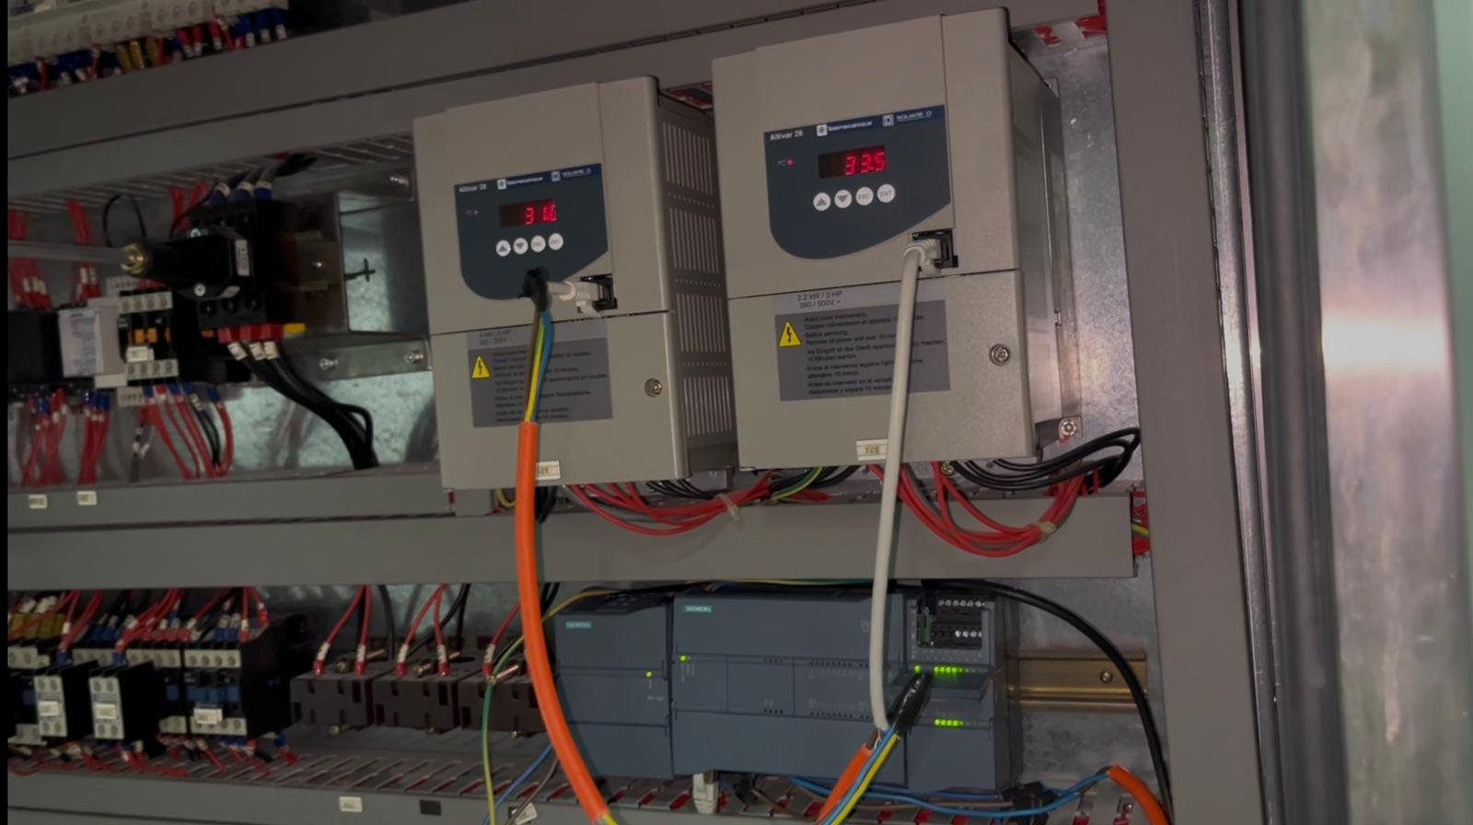
Integrated PLC System

Slide 22

Human-Machine Interface
22/28

Slide 23
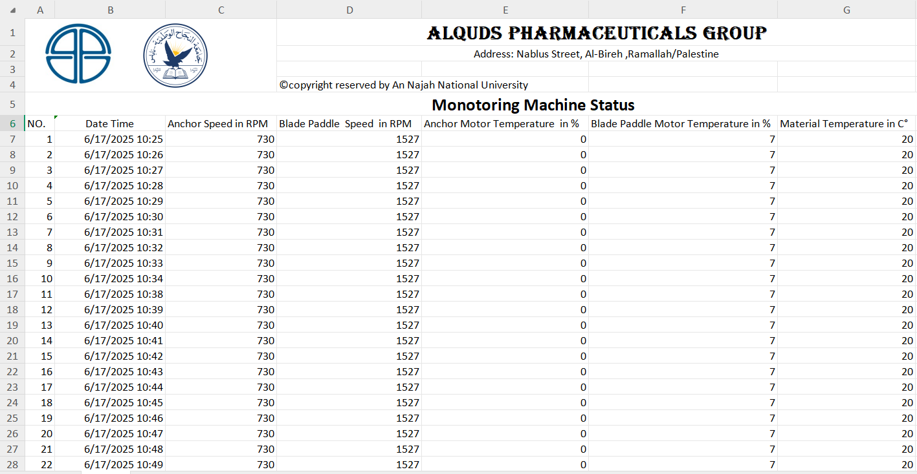
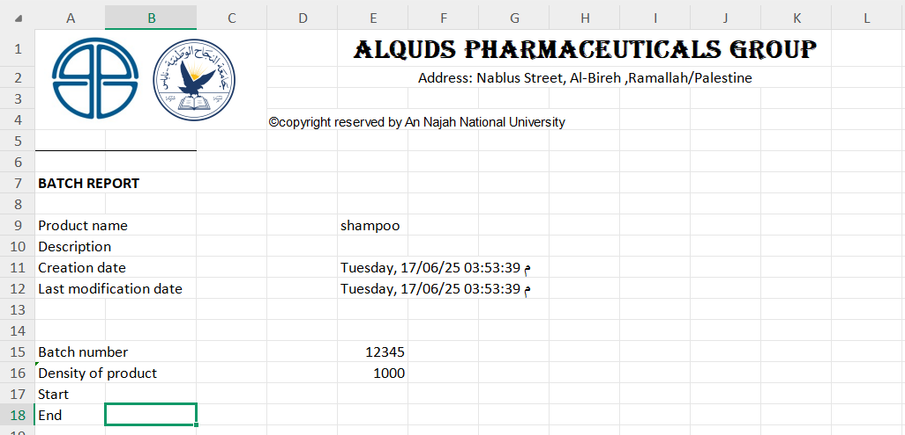
Data storage
Machine status
Recipe information

Slide 24

Conclusion
In this project, we focused on developing a monitoring system for an existing pharmaceutical mixing machine.
I designed the mechanical model using SOLIDWORKS, and we selected the sensors, motors, and the appropriate PLC unit for real-time data reading.
We created a user-friendly interface that enables the operator to monitor key variables such as temperature, speed, and liquid level.
We built a complete prototype that integrates the mechanical design, electrical circuits, and programming, and it demonstrated efficiency during practical tests.

Slide 25
Enhanced Efficiency
Old system | New system
Difficulty taking readings | Readings are displayed in real-time on the HMI screen
Difficulty storing data | Data is automatically logged and saved in an Excel sheet
Difficulty handling the machine | Easier and safer operation through an automated control system
Not knowing if the engines are overheating or not | Real-time temperature monitoring with alerts for overheating

Slide 26
Bill of Martial for real machine
# | Piece type | Comment | QTY | price (NIS)
1 | CPU | S7-1200 CPU 1215C | 1 | 2740.31
2 | Analog Input | SM 1231 AI – 8x13bit |  | 1750.29
3 | Power supply | SITOP PSU100C – 24V / 2.5A | 1 | 434.42
4 | CB 1241 (RS485) | CB 1241 – Communication board | 1 | 889.28
5 | Pressure transmitter | Autonics TPS20 Series, 0–0.5kg/cm² | 1 | 603.45
6 | RTD pt100 | - | 1 | 222
 |  | Total Price |  | 6639.75

Slide 27
Bill of Martial for Prototype machine
# | Piece type | QTY | Price (NIS) | # |  | Piece type | QTY | Price (NIS)
1 | DC Motor with Gear | 2 | 130 | 10 |  | H-Bridge Motor Driver L298N | 1 | 25
2 | Arduino Mega 2560 |  | 90 | 11 |  | relay module | 1 | 15
3 | DHT11 sensor | 2 | 25 | 12 |  | Variable resistors | 2 | 3
4 | Prototype Build | 1 | 850 | 13 |  | Magnetic | 2 | 1
5 | Ultrasonic Sensor | 1 | 10 | 14 | Fabric |  | 1 | 48
6 | Hall effect sensor | 2 | 10 | Total Price |  |  | 1457 NIS
7 | Push Button(On/Off) | 2 | 5.5
8 | Wires | 1 | 30
9 | Power Supply | 1 | 40

Slide 28
Thanks !
Any questions ?

Slide 29
Backup Slides

Slide 30
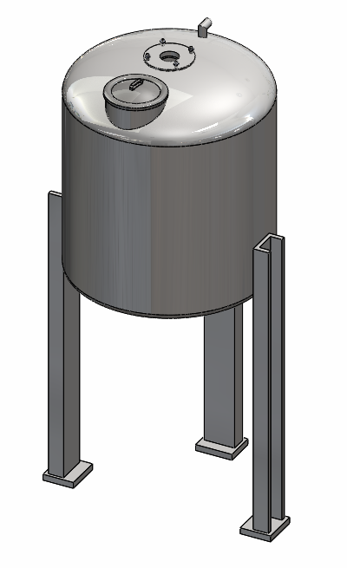
Mechanical Design
The mechanical design consists of :
Tank Body: A 1250mm diameter, 1500mm high, and 5mm thick will be used in this project.

Slide 31
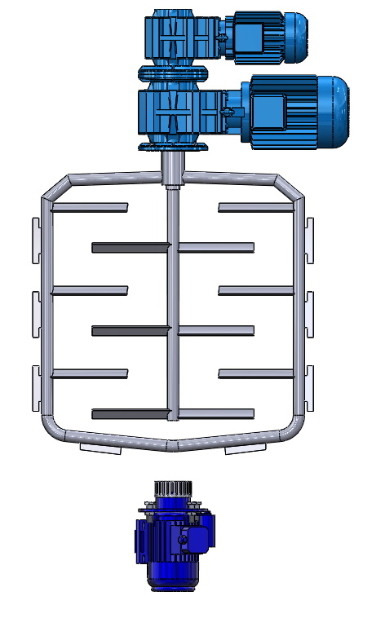
Mechanical Design
Blade Paddles Motor
Anchor Motor
Anchor
Scrapers
Blade Paddles
Shear Homogenizer
Emulsifying head

Slide 32
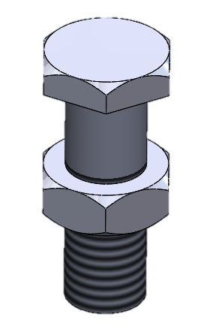
Mechanical Design
Tank access platform: This is used to facilitate access to the engines above for maintenance work or to access the maintenance hole.
Screw and bolt: Are used to securely fasten the motors to the tank body in the mixing machine, ensuring a strong and safe attachment of both the motors and the body.
The screws and bolts are tightened using a torque wrench, with a gasket added to prevent leaks.

Slide 33
Electrical Design
Three-phase Motor
Several types of motors will be used in this project, including:
Gear motor flender (HP5.5 –KW4-VOLT 230/400 -Hz50-4 POLI), called anchor motor
Gear motor flender (HP3-KW2,2 -VOLT 230/400 -Hz50-4 POLI), called blade paddle motor
Electronic motor G160 (KW11/9 -VOLT 230/400 -Hz50-4POLI),
called homogenizer motor

Slide 34
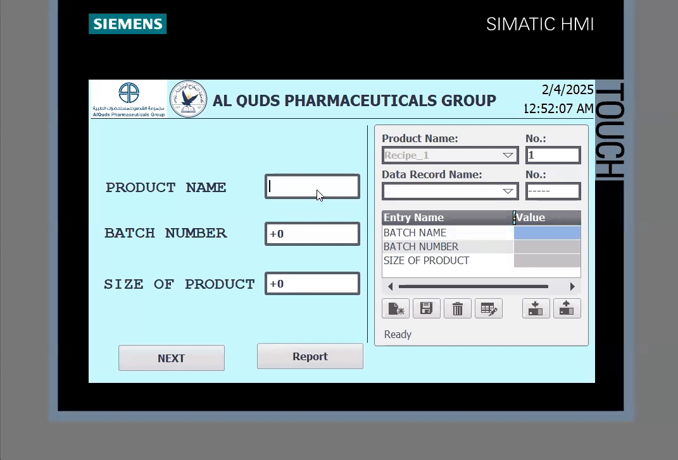
Recipe information

Slide 35
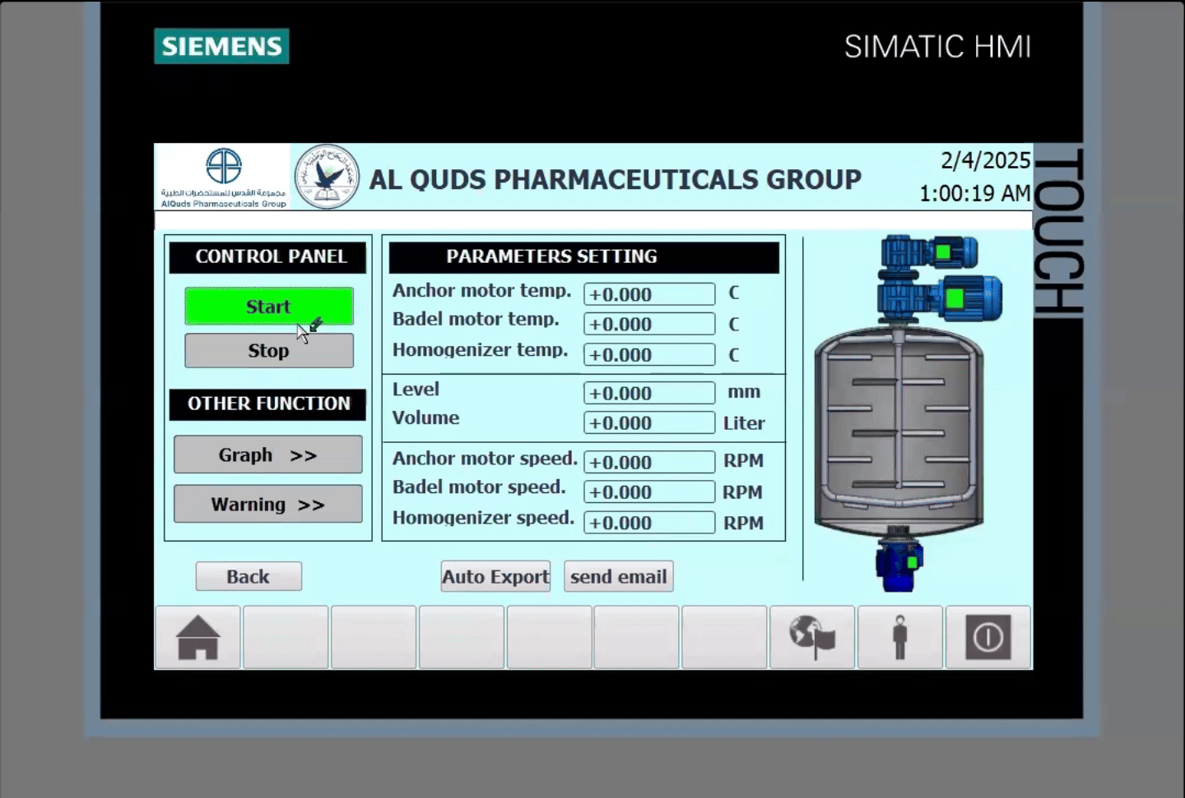
Control and monitoring system

Slide 36
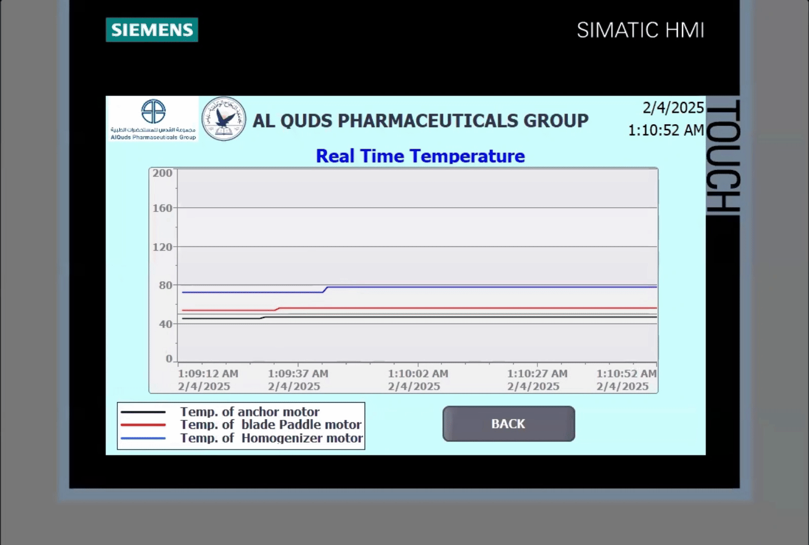
Real-time data graph

Slide 37
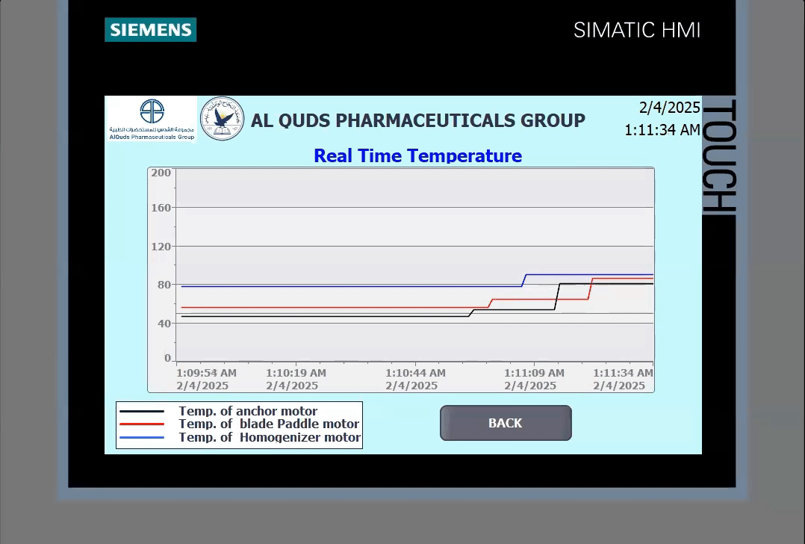
Warning

Slide 38
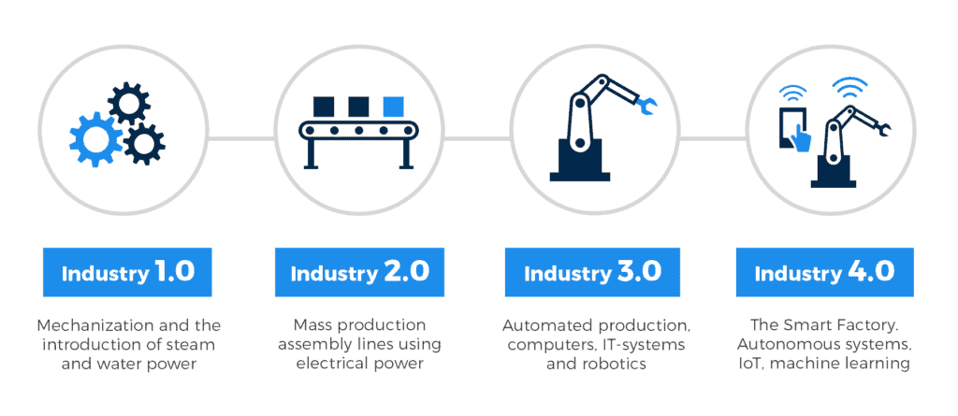
Industrial Revolutions

