Slide 1
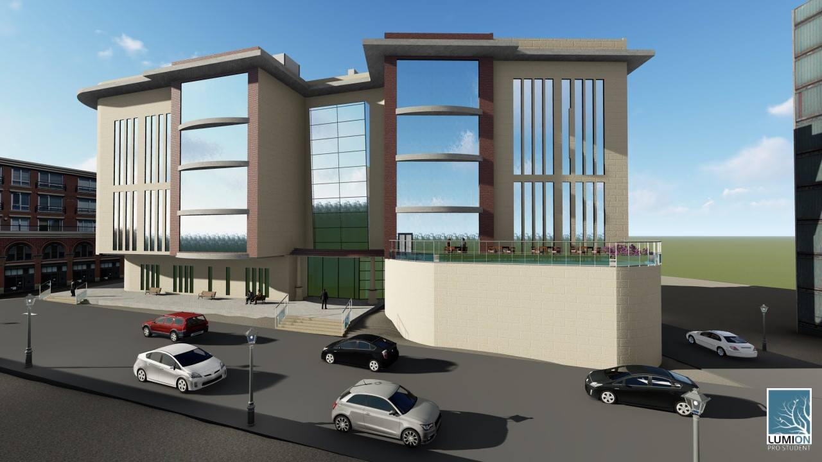
An-Najah National university
Faculty of engineering
Building engineering departmenet
Graduation project ||
Redesign of Nablus Municipality building.
Prepared By :
Arwa Hindi
Aya Hamadi
Roqaya jayyosi
Supervisor To:
Dr. Luay Dwaikat.

Slide 2
Environmental Design
Electro-mechanical Design
Quantity surveying
Introduction
Site Description
Architectural Design
Structural Design

Slide 3
Introduction

Slide 4
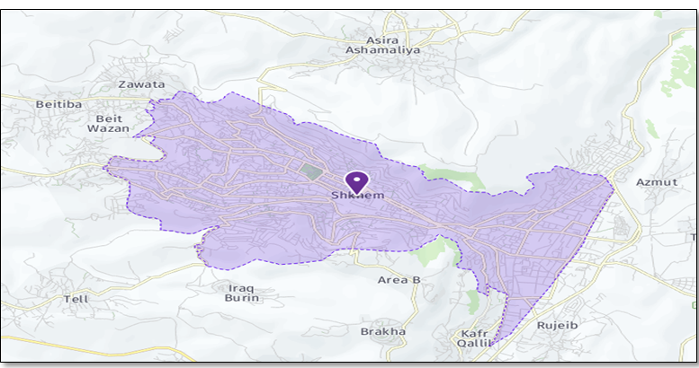
Site Location

Slide 5
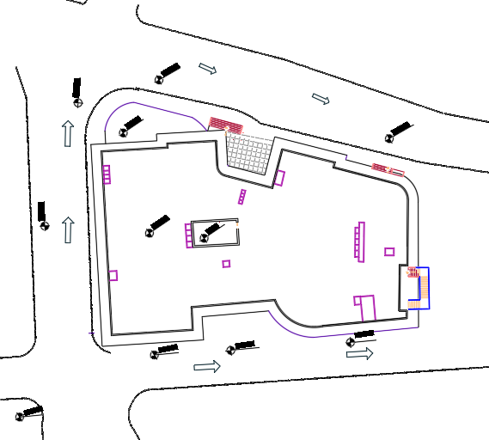
Site Plan

Slide 6
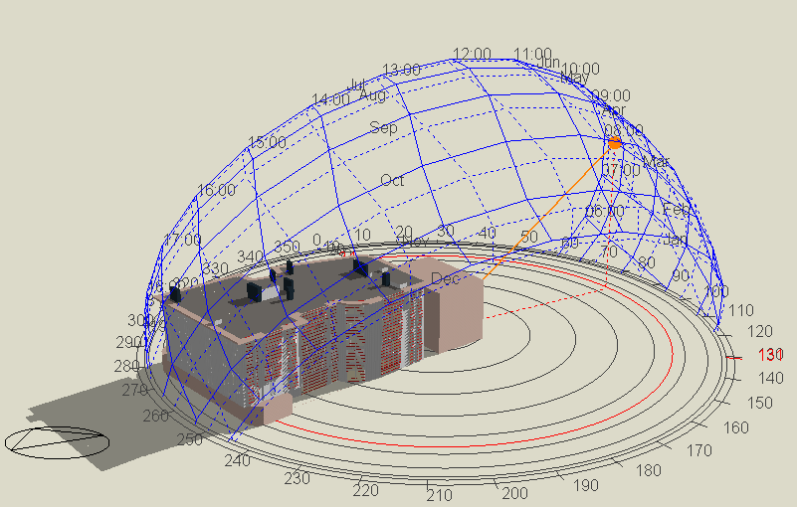
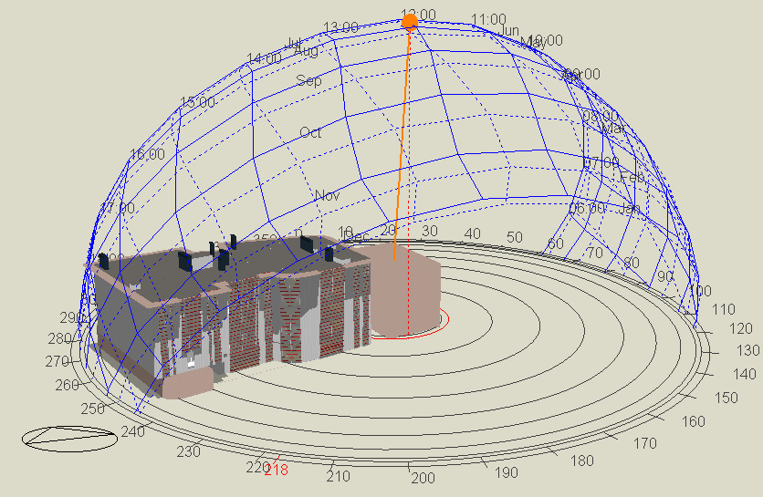
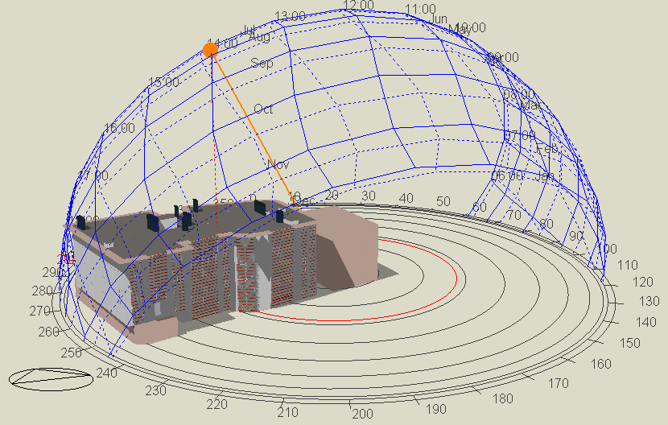
Shading
Shadow in July 21 @ 8.00 am
Shadow in July 21 @ 12.00 pm
Shadow in July 21 @ 2.00 pm

Slide 7
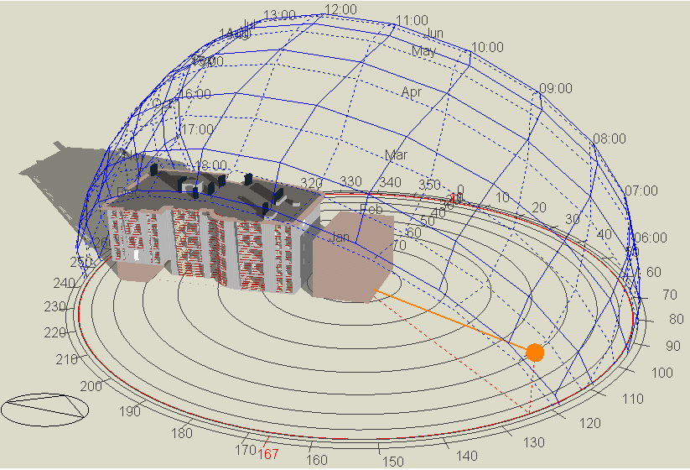
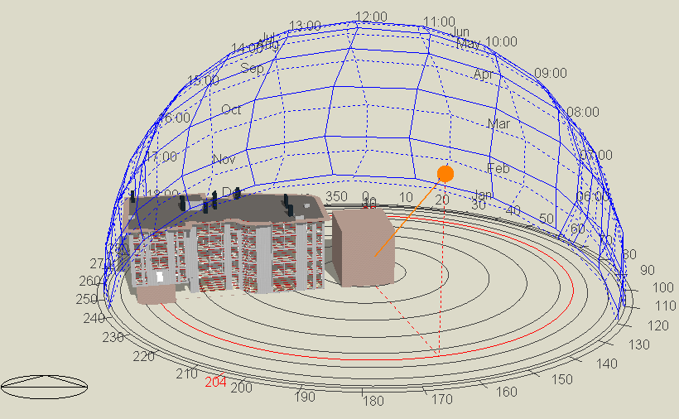
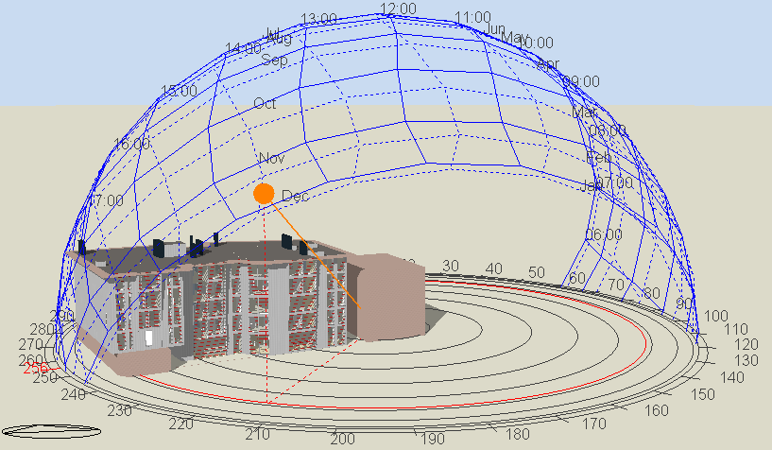
Shadow in Jan 21 @ 8.00 am
Shadow in Jan 21 @ 11.00 am
Shadow in Jan 21 @ 2.00 pm

Slide 8
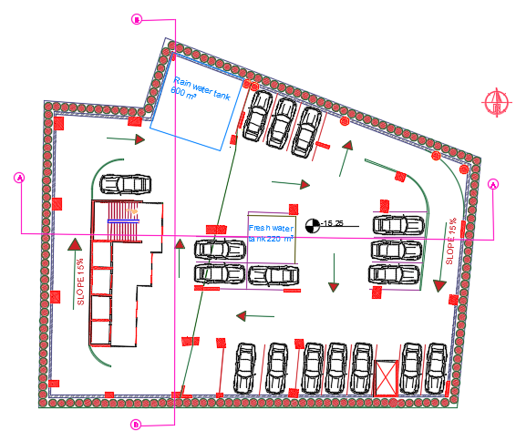
Basement Floor 4

Slide 9
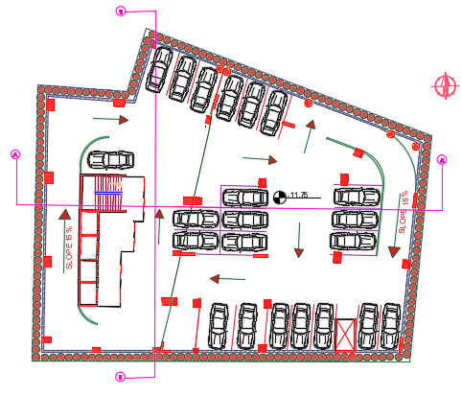
Basement Floor 3

Slide 10
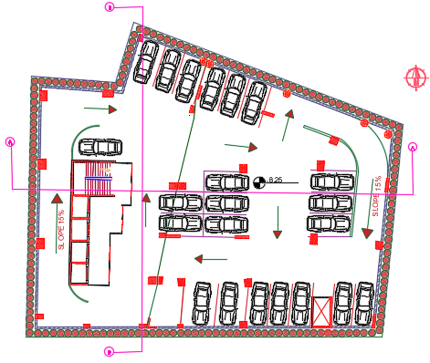
Basement Floor 2

Slide 11
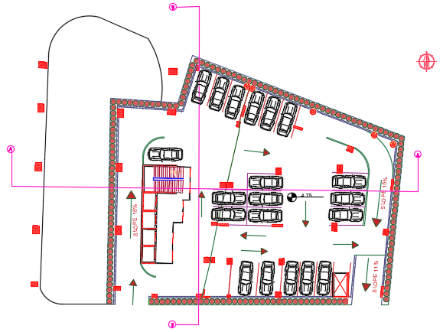
Basement Floor 1

Slide 12
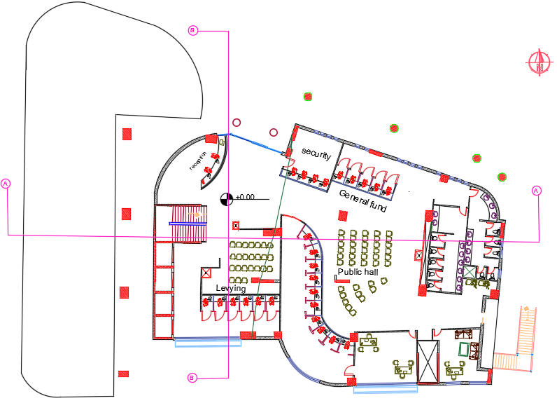
Ground Floor

Slide 13
 | The current municipality |  |  | The redesigned municipality
Space | Existing area (m2) | Number of employees | Exiting Area (m² / employees) | Existing area (m2) | Number of employees | Exiting Area (m² / employees)
Reception | 4.7 | 2.0 | 2.4 | 45.0 | 2.0 | 22.5
Secretary’s room | 16.0 | 5.0 | 3.2 | 30.0 | 4.0 | 7.5
General fund | 13.2 | 5.0 | 2.6 | 26.5 | 5.0 | 5.3
levying tax fund | 12.0 | 6.0 | 2.0 | 86.0 | 10.0 | 8.6
Director's fund | 14.2 | 1.0 | 7.1 | 28.0 | 1.0 | 28.0

Slide 14
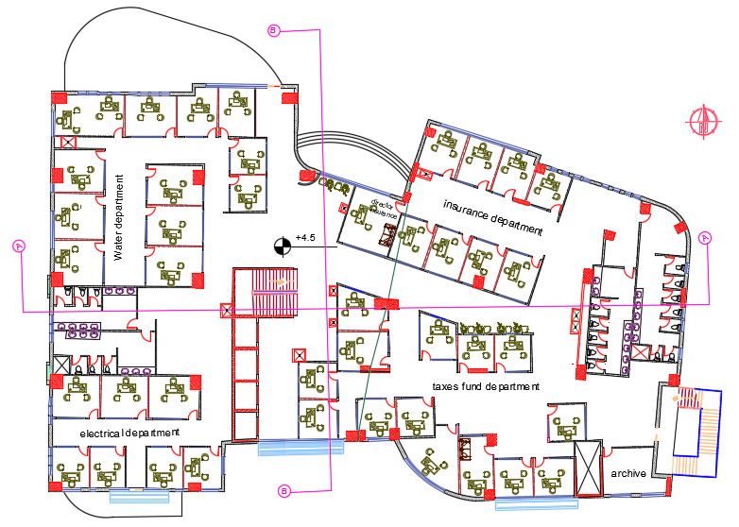
First Floor

Slide 15
 | The current municipality |  |  | The redesigned municipality
Space | Existing area (m2) | Number of employees | Exiting Area (m² / employees) | Existing area (m2) | Number of employees | Exiting Area (m² / employees)
Water department | 40.4 | 22.0 | 1.8 | 230.0 | 13.0 | 9.0
Electrical department | 35.4 | 20.0 | 1.8 | 139.0 | 7.0 | 9.0
Director insurance | 17.0 | 1.0 | 17.0 | 18.0 | 1.0 | 18.0
Director taxes fund | 14.2 | 2.0 | 7.1 | 19.0 | 1.0 | 19.0
Taxes fund department | 41.0 | 15.0 | 2.7 | 144.0 | 13.0 | 9.0
Insurance department | 29.7 | 4.0 | 7.4 | 136.0 | 8.0 | 9.0
Archive | 7.2 | 1.0 | 7.2 | 18.0 | 1.0 | 18.0

Slide 16
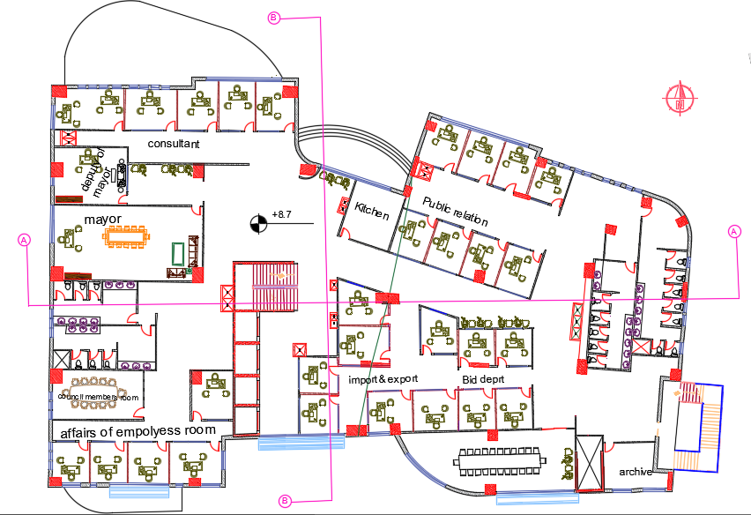
Second Floor

Slide 17
 | The current municipality |  |  | The redesigned municipality
Space | Existing area (m2) | Number of employees | Exiting Area (m² / employees) | Existing area (m2) | Number of employees | Exiting Area (m² / employees)
Affairs of employees room | 24.0 | 5.0 | 4.8 | 75.0 | 5.0 | 9.0
Council members | 45.0 | 14.0 | 3.2 | 31.0 | 12.0 | 2.6
mayor room | 47.7 | 1.0 | 47.7 | 68.0 | 1.0 | 68.0
Deputy of mayor room | 26.6 | 1.0 | 26.6 | 33.0 | 1.0 | 33.0
consultant | 163.0 | 4.0 | 4.1 | 55.0 | 6.0 | 9.0
Conference Hall | 73.0 | 16.0 | 4.6 | 67.0 | 24.0 | 2.8
kitchen | 24.0 | N/A | N/A | 18.0 | N/A | N/A
Important &export | 27.0 | 5.0 | 5.4 | 45.0 | 4.0 | 9.0
Public relation | 43.2 | 8.0 | 5.4 | 136.0 | 8.0 | 9.0

Slide 18
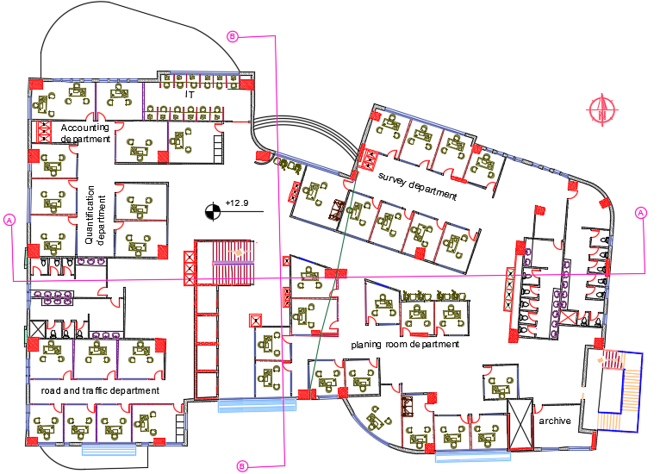
Third Floor

Slide 19
 | The current municipality |  |  | The redesigned municipality
Space | Existing area (m2) | Number of employees | Exiting Area (m² / employees) | Existing area (m2) | Number of employees | Exiting Area (m² / employees)
Accounting department | 15.8 | 4.0 | 3.9 | 56.0 | 3.0 | 9.0
Quantification department | 23.5 | 5.0 | 4.7 | 107.0 | 6.0 | 9.0
road and traffic depart | 16.6 | 4.0 | 4.2 | 101.0 | 6.0 | 9.0
IT department | 96.4 | 38.0 | 2.5 | 19.8 | 1.0 | 19.8
planning department | 72.9 | 17.0 | 4.3 | 261.0 | 14.0 | 9.0
Surveyor department | 33.8 | 7.0 | 4.8 | 136.0 | 8.0 | 9.0

Slide 20
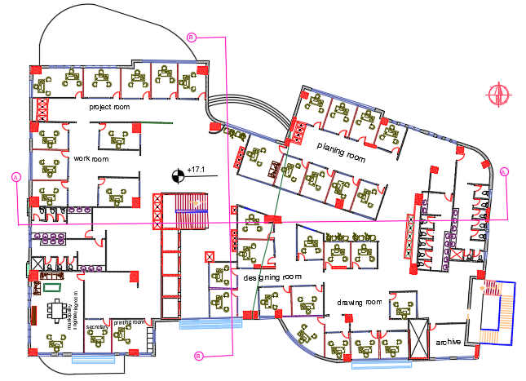
Fourth Floor

Slide 21
 | The current municipality |  |  | The redesigned municipality
Space | Existing area (m2) | Number of employees | Exiting Area (m² / employees) | Existing area (m2) | Number of employees | Exiting Area (m² / employees)
Project room | 35.5 | 7.0 | 5.1 | 106.0 | 6.0 | 9.0
work room | 18.8 | 6.0 | 3.1 | 116.0 | 7.0 | 9.0
Municipality engineering room | 26.8 | 1.0 | 26.8 | 53.0 | 1.0 | 53.0
Secretary room | 23.5 | 6.0 | 3.9 | 13.0 | 1.0 | 13.0
Printing room | 8.0 | 1.0 | 8. | 17.0 | 1.0 | 17.0
Designing room | 28.0 | 6.0 | 4.7 | 129.0 | 7.0 | 10.0
Drawer room | 24.4 | 4.0 | 6.1 | 130.0 | 7.0 | 10.0
planning room | 67.0 | 12.0 | 5.6 | 124.0 | 8.0 | 9.0

Slide 22
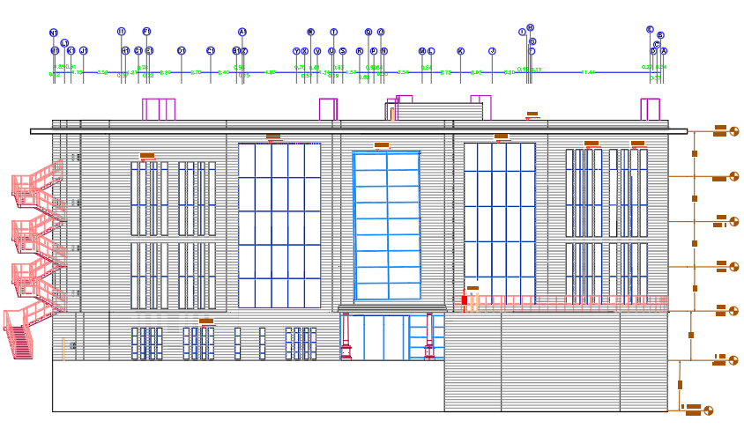
North Elevation

Slide 23
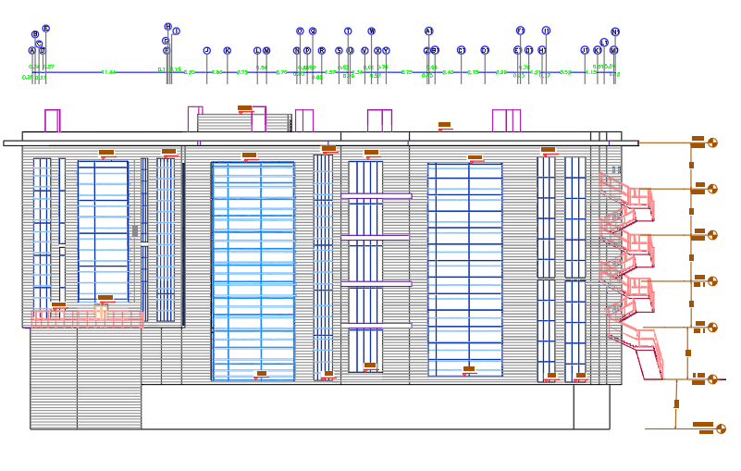
South Elevation

Slide 24
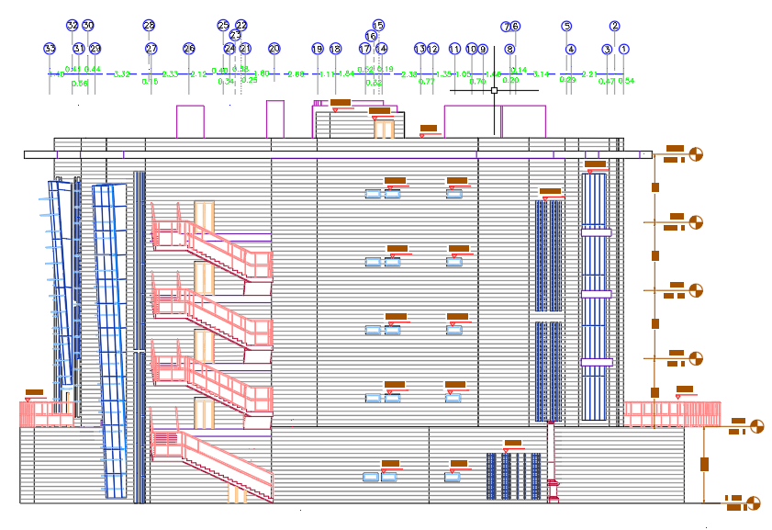
East Elevation

Slide 25
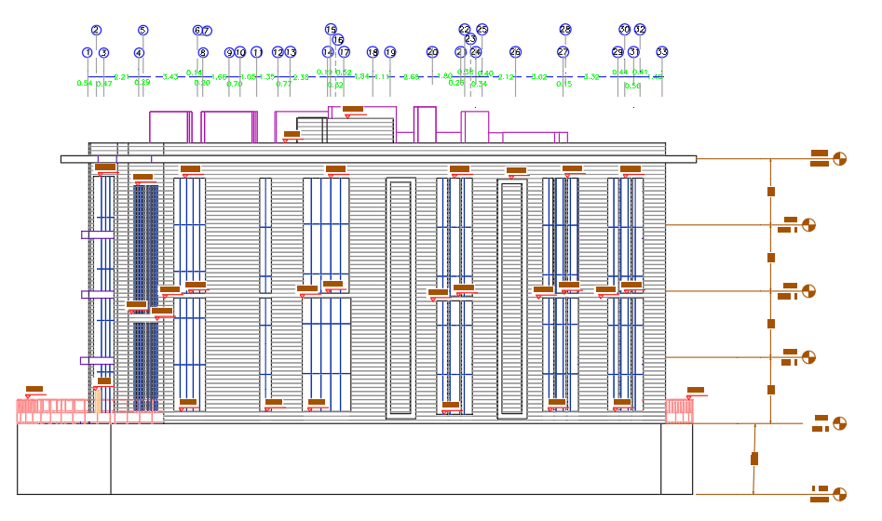
West Elevation

Slide 26
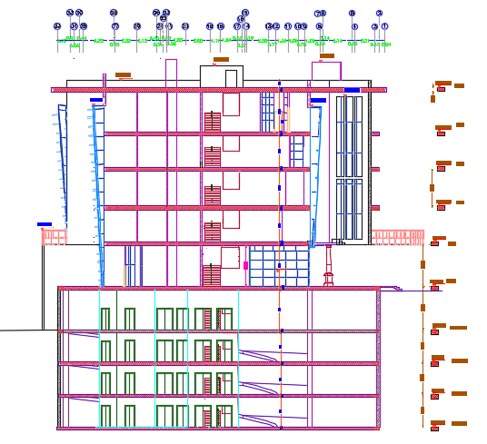
Section B-B

Slide 27
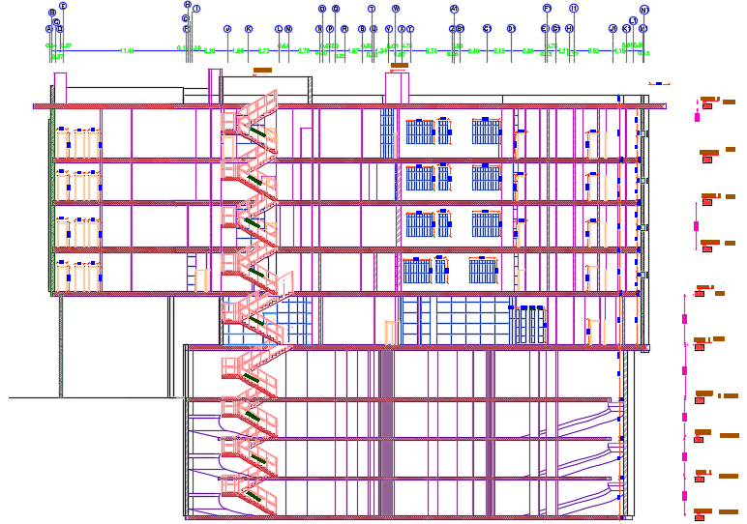
Section A-A

Slide 28
3D Views

Slide 29
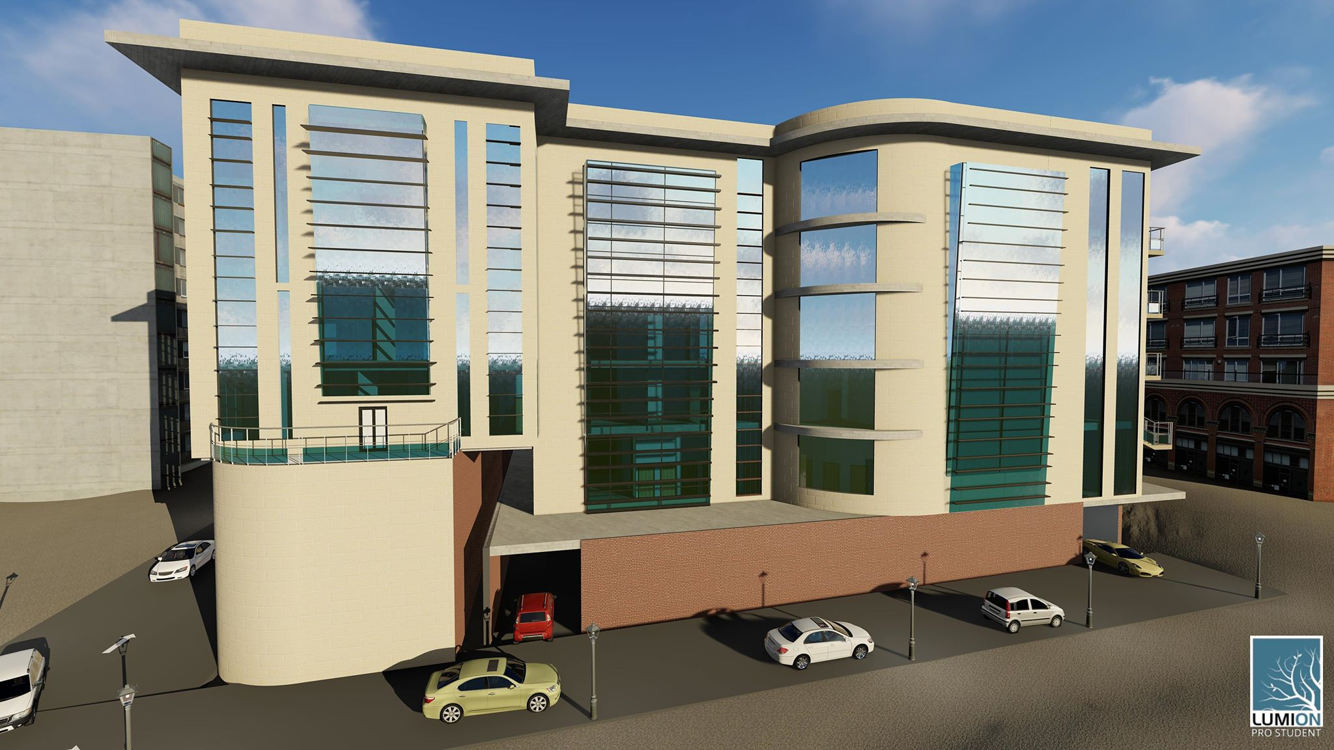

Slide 30
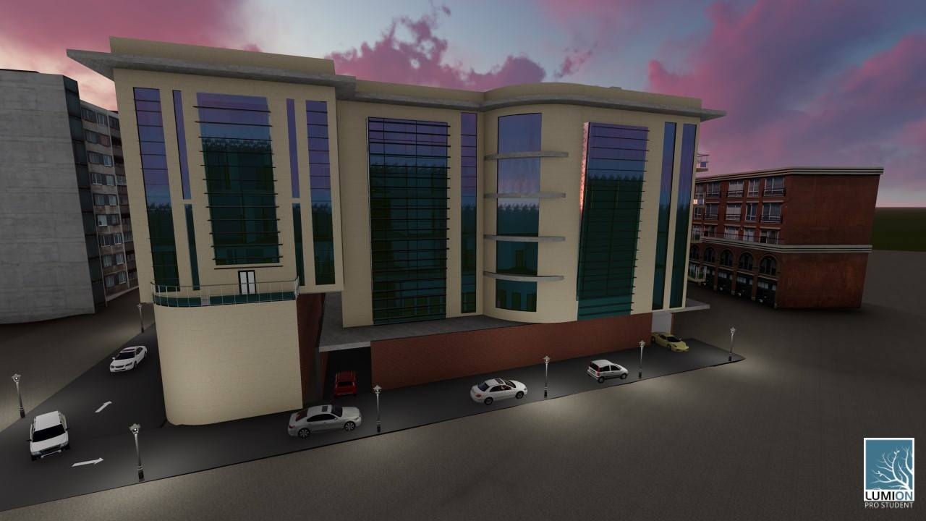

Slide 31
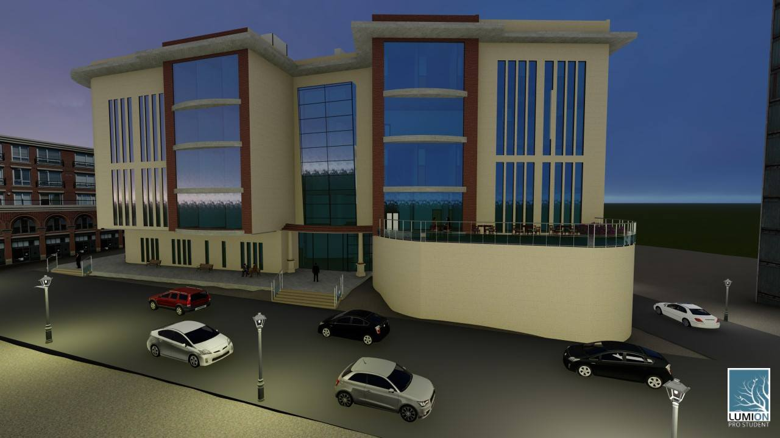

Slide 32
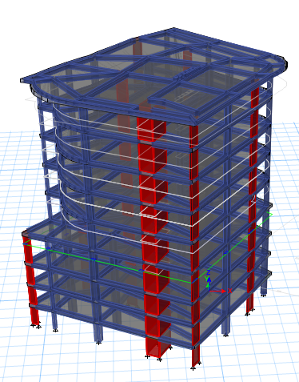
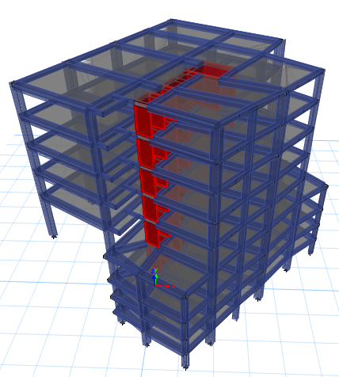
Structural Design

Slide 33
Codes and Standards:
Building Code Requirements for Structural Concrete ACI 318-14(ACI Committee 318 2014).
UBC -97 for earthquake design.
ASCE for loads computations.

Slide 34
Designing data:
Compressive strength of concrete for slabs and beams fʹ_{c} = 28MPa.
Compressive strength of concrete for columns and shear walls fʹ_{c} = 32MPa.
Yielding strength of steel fy = 420 MPa.
Bearing capacity of soil at street level = 110 KN/m².
Live loads = 3 KN/m².
Super imposed dead load = 4KN/m².

Slide 35
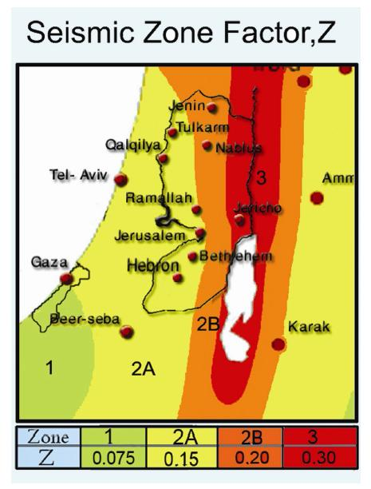
Lateral loads:
The seismic zone of Nablus is 2B (Z = 0.20)
The soil profile is type Sd.
The acceleration seismic coefficient Ca=0.28
The velocity seismic coefficient Cv=0.4
The Seismic importance factor is 1.25
The structural design type is building frame R=5.5

Slide 36
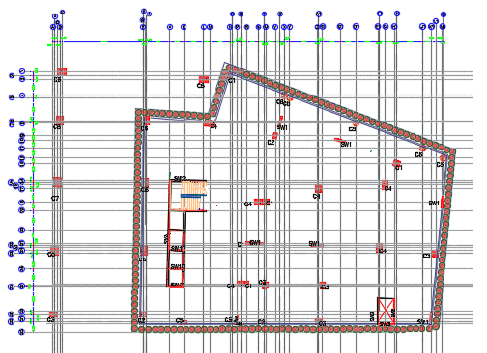
Columns center lines

Slide 37
Verification of models
Compatibility check
Equilibrium check
Internal force check
Deflection check
Drift check
Period check
Model participating mass ratio check
Base shear check

Slide 38
Model 1

Slide 39
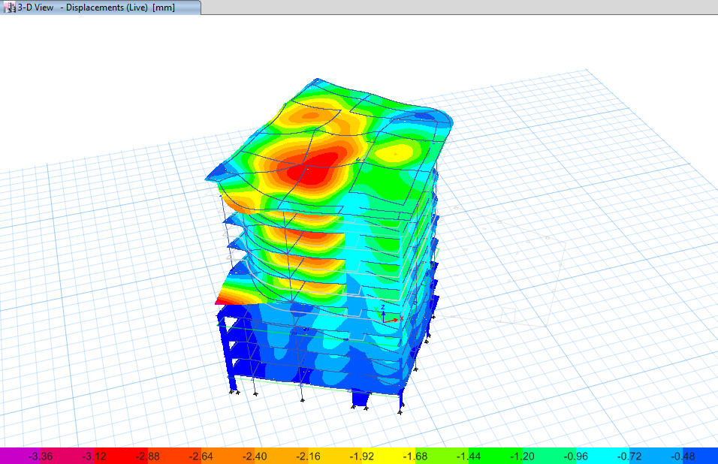
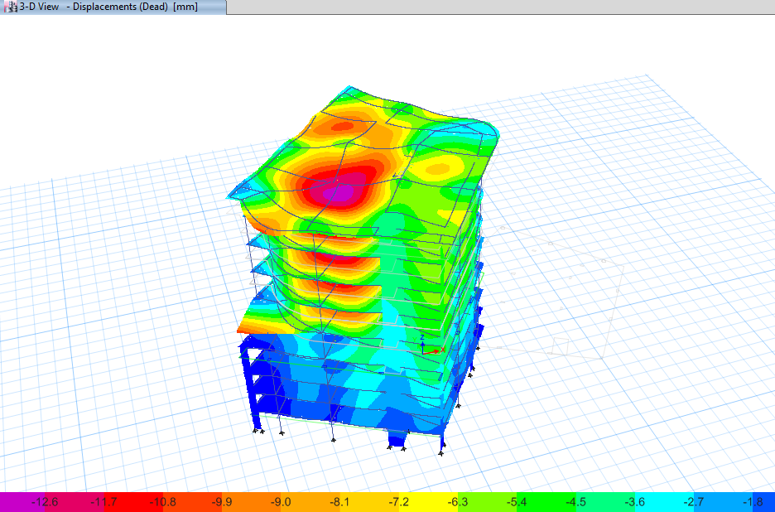
Compatibility check

Slide 40
Equilibrium check
Percentage of difference | FZ by manual (KN) | FZ from ETAB(KN) | Load Case
4.6% | 87‚258 | 91‚506 | Dead
1.8% | 18‚274 | 18‚607 | Live
3.2% | 34‚724 | 33‚650 | SID

Slide 41
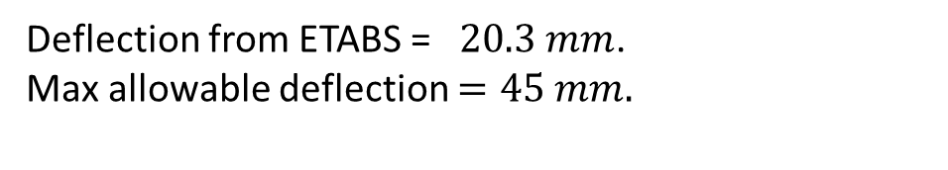
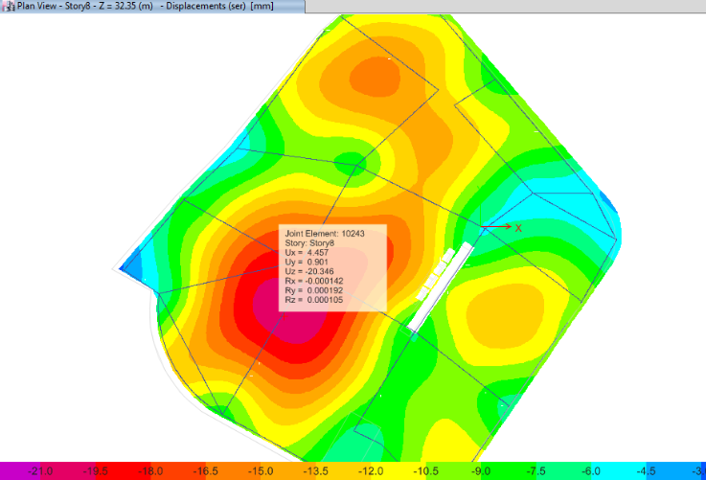
Deflection check

Slide 42
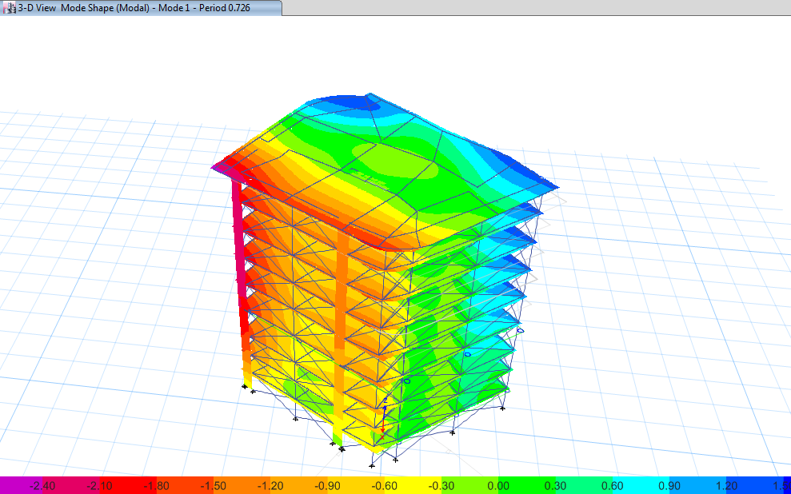
Period check
T manual= 0.725sec

Slide 43
Modal mass participation ratio
Sum UZ | Sum UY | Sum UX | UZ | UY | UX | Period | Mode | Case
0 | 0.2727 | 0.5189 | 0 | 0.2727 | 0.5189 | 0.726 | 1 | Modal
0 | 0.7768 | 0.7966 | 0 | 0.5041 | 0.2778 | 0.635 | 2 | Modal
0 | 0.7774 | 0.7968 | 0 | 0.0006 | 0.0001 | 0.391 | 3 | Modal
0 | 0.8092 | 0.8938 | 0 | 0.0318 | 0.0971 | 0.231 | 4 | Modal
0 | 0.9156 | 0.9231 | 0 | 0.1064 | 0.0292 | 0.201 | 5 | Modal
0 | 0.9214 | 0.959 | 0 | 0.0058 | 0.036 | 0.139 | 6 | Modal
0 | 0.9216 | 0.9593 | 0 | 0.0002 | 0.0003 | 0.127 | 7 | Modal
0 | 0.9621 | 0.9649 | 0 | 0.0405 | 0.0057 | 0.117 | 8 | Modal
0 | 0.9635 | 0.977 | 0 | 0.0014 | 0.0121 | 0.102 | 9 | Modal
0 | 0.9773 | 0.9779 | 0 | 0.0137 | 0.0009 | 0.084 | 10 | Modal
0 | 0.9775 | 0.9858 | 0 | 0.0003 | 0.0079 | 0.082 | 11 | Modal
0 | 0.9783 | 0.9859 | 0 | 0.0008 | 0.0001 | 0.079 | 12 | Modal

Slide 44
Base shear check
V manual = 16143 KN.
FZ (KN) | FY (KN) | FX (KN) | Load Case/Combo
93288.5325 | 8.43E-07 | -3.02E-06 | Dead
18607.8832 | 0 | -7.67E-07 | Live
33650.152 | 8.20E-07 | -3.32E-06 | SID
0.0001 | 6449.1187 | 16144.6579 | Eqx Max
3.91E-05 | 16154.2421 | 8765.3461 | Eqy Max

Slide 45
Drift
delta limit (mm) | Drift y (mm) | Drift x (mm) | Delta my (mm) | Delta mx (mm) | Dis– y (mm) | Dis- x (mm) | height (m) | Story
84 | 57.7 | 30.8 | 500.5 | 200.2 | 130 | 52 | 4.2 | 9
84 | 46.2 | 23.1 | 442.8 | 169.4 | 115 | 44 | 4.2 | 8
84 | 34.7 | 23.1 | 396.6 | 146.3 | 103 | 38 | 4.2 | 7
84 | 46.2 | 38.5 | 361.9 | 123.2 | 94 | 32 | 4.2 | 6
90 | 77.0 | 19.25 | 315.7 | 84.7 | 82 | 22 | 4.5 | 5
95 | 92.4 | 23.1 | 238.7 | 65.45 | 62 | 17 | 4.75 | 4
70 | 61.6 | 19.25 | 146.3 | 42.35 | 38 | 11 | 3.5 | 3
70 | 52.0 | 15.4 | 84.7 | 23.1 | 22 | 6 | 3.5 | 2
70 | 32.7 | 7.7 | 32.7 | 7.7 | 8.5 | 2 | 3.5 | 1

Slide 46
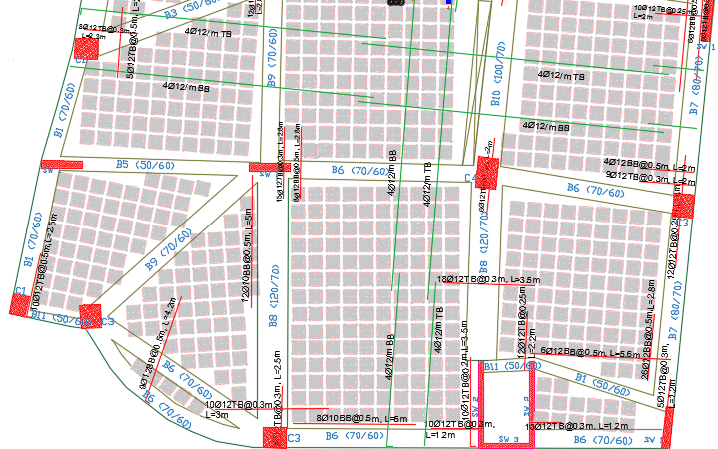
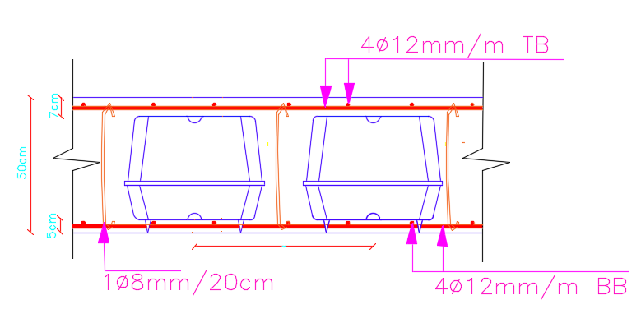
Slab reinforcement and details

Slide 47

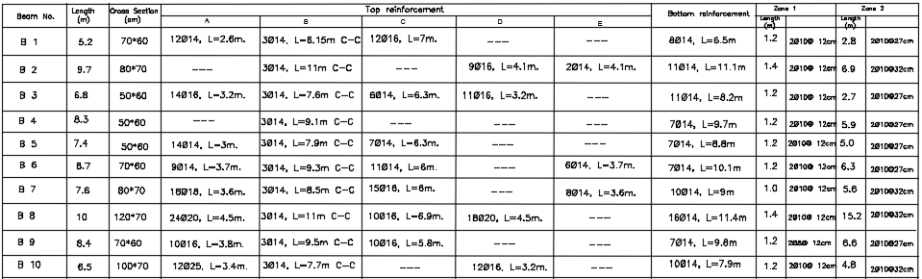
Beams reinforcement and details

Slide 48
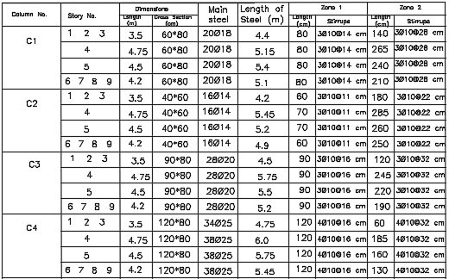
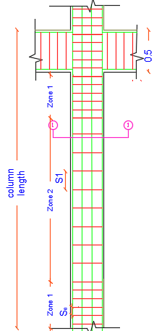

Columns reinforcement and details

Slide 49
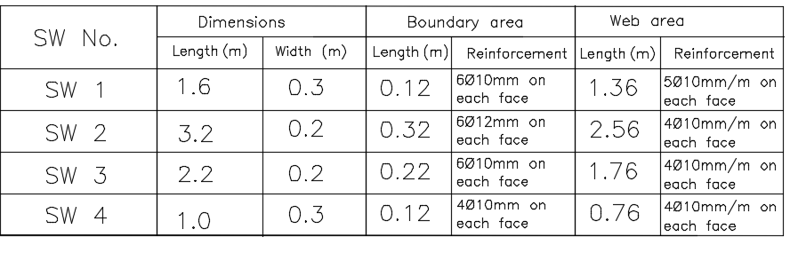
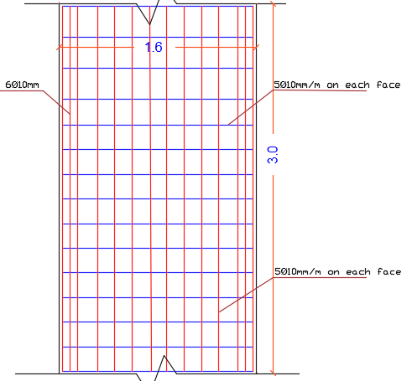
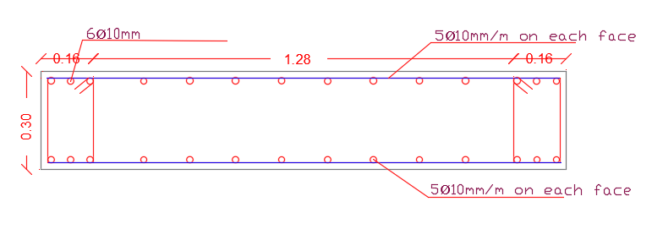
Shear walls reinforcement and Details

Slide 50
Model 2

Slide 51
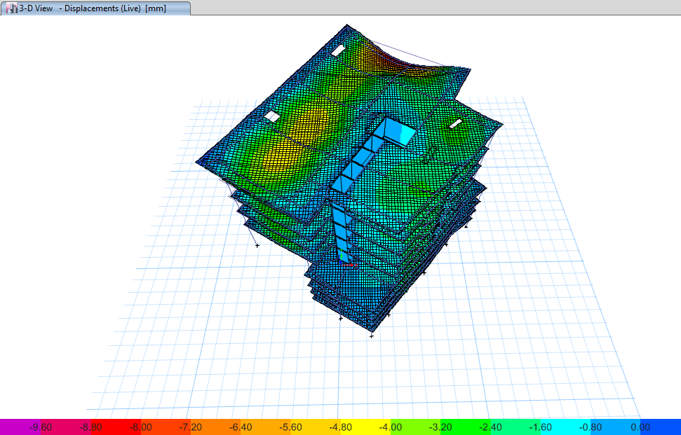
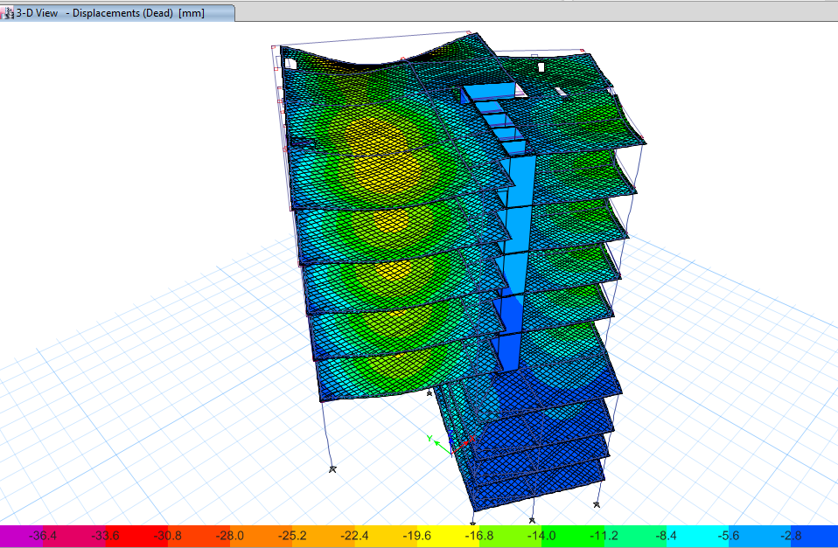
Compatibility check

Slide 52
Equilibrium check
Percentage of difference | FZ by manual (KN) | FZ from ETAB(KN) | Load Case
4.89% | 84,546 | 88,902 | Dead
0.35% | 16‚920 | 169,71.5 | Live
1.92% | 29,714 | 29,154 | SID

Slide 53
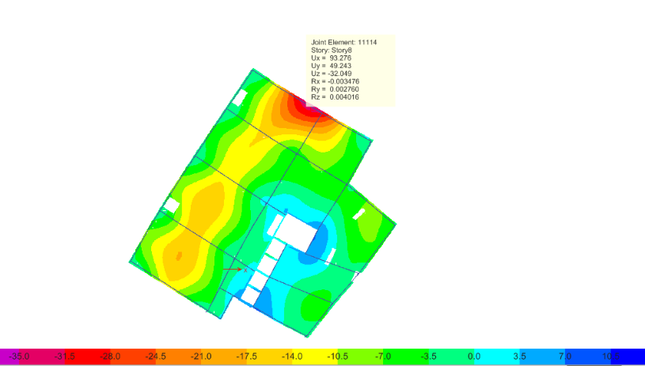
Deflection check
Deflection from ETABS = 35 mm.
Max allowable deflection = 83mm.

Slide 54
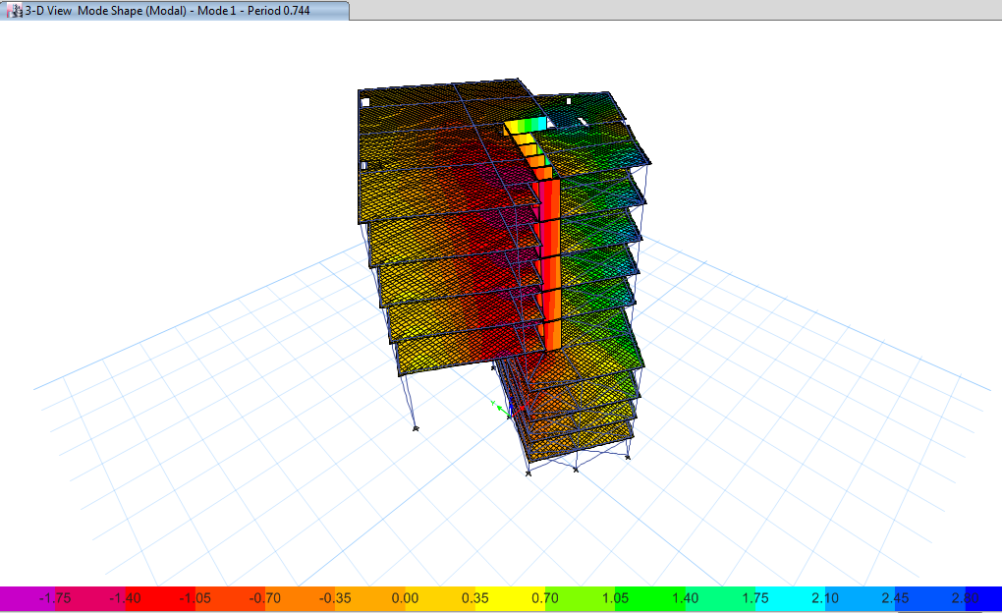
Period check
T manual=0.725sec

Slide 55
Modal mass participation ratio
Sum UZ | Sum UY | Sum UX | UZ | UY | UX | Period | Mode | Case
0 | 0.1151 | 0.5778 | 0 | 0.1151 | 0.5778 | 0.744 | 1 | Modal
0 | 0.5308 | 0.6054 | 0 | 0.4157 | 0.0276 | 0.441 | 2 | Modal
0 | 0.7289 | 0.693 | 0 | 0.1981 | 0.0875 | 0.336 | 3 | Modal
0 | 0.7551 | 0.8321 | 0 | 0.0262 | 0.1391 | 0.217 | 4 | Modal
0 | 0.864 | 0.8571 | 0 | 0.1088 | 0.025 | 0.152 | 5 | Modal
0 | 0.8692 | 0.913 | 0 | 0.0052 | 0.0559 | 0.124 | 6 | Modal
0 | 0.9259 | 0.9153 | 0 | 0.0567 | 0.0023 | 0.121 | 7 | Modal
0 | 0.9327 | 0.9378 | 0 | 0.0068 | 0.0224 | 0.104 | 8 | Modal
0 | 0.9337 | 0.9379 | 0 | 0.001 | 0.0002 | 0.096 | 9 | Modal
0 | 0.9537 | 0.9449 | 0 | 0.02 | 0.0069 | 0.095 | 10 | Modal
0 | 0.9584 | 0.9563 | 0 | 0.0047 | 0.0114 | 0.085 | 11 | Modal
0 | 0.9584 | 0.9563 | 0 | 2.58E-06 | 1.15E-06 | 0.077 | 12 | Modal

Slide 56
Base shear check
V manual = 152,09 KN.
FZ (KN) | FY (KN) | FX (KN) | Load Case/Combo
88901.9505 | -4.31E-05 | -15.3543 | Dead
16971.4729 | -1.30E-05 | -4.9621 | Live
29154.4192 | -2.07E-05 | -7.1742 | SID
0.0005 | 15178.9345 | 15167.6567 | Eqx Max
0.0006 | 16827.8634 | 14657.0483 | Eqy Max

Slide 57
Drift
delta limit (mm) | Drift y (mm) | Drift x (mm) | Delta my (mm) | Delta mx (mm) | Dis– y (mm) | Dis- x (mm) | height (m) | Story
84 | 30.8 | 42.4 | 223.3 | 423.5 | 58 | 110 | 4.2 | 9
84 | 23.1 | 53.9 | 192.5 | 381.15 | 50 | 99 | 4.2 | 8
84 | 34.7 | 50.1 | 169.4 | 327.25 | 44 | 85 | 4.2 | 7
84 | 34.7 | 69.3 | 134.8 | 277.2 | 35 | 72 | 4.2 | 6
90 | 15.4 | 50.1 | 100.1 | 207.9 | 26 | 54 | 4.5 | 5
95 | 38.5 | 59.7 | 84.7 | 157.85 | `22 | 41 | 4.75 | 4
70 | 19.3 | 44.3 | 46.2 | 98.175 | 12 | 25.5 | 3.5 | 3
70 | 11.6 | 30.8 | 27.0 | 53.9 | 7 | 14 | 3.5 | 2
70 | 15.4 | 23.1 | 15.4 | 23.1 | 4 | 6 | 3.5 | 1

Slide 58
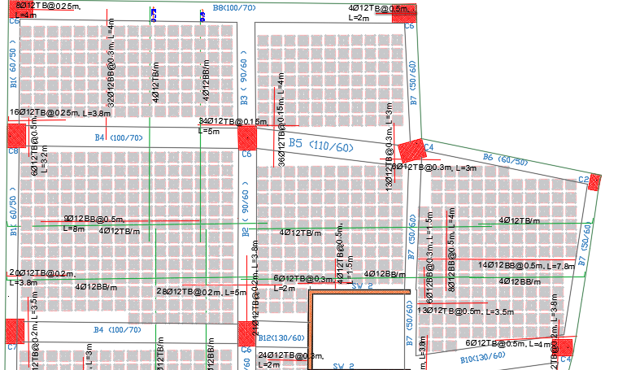
Slab reinforcement and details

Slide 59
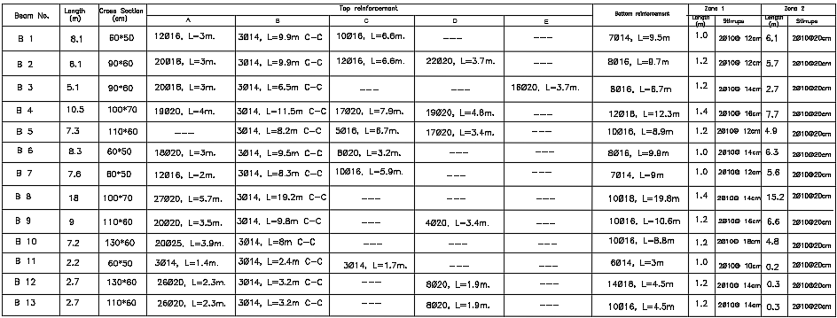
Beams reinforcement and details

Slide 60

Columns Reinforcement and Details

Slide 61


Shear walls reinforcement and Details

Slide 62
Foundations
Settlement check.
Max deflection in piles cap is less than 10mm.
2. Punching check.
punching ratio in piles that is less than one.
3. Wide beam shear.
Shear force in pile cap is less than Shear capacity.

Slide 63


Piles cap reinforcement and details

Slide 64



Cap piles reinforcement and details

Slide 65

Mat Footing Reinforcement and Details

Slide 66

Section in mat foundation

Slide 67


Piles
Allowable bearing capacity (Qall) = 1000KN.
Length of piles (L) = 15m.
Diameter of piles (d) = 60cm.

Slide 68

Stair reinforcement and details

Slide 69


Excavation shoring
Sheet piles properties from Spw911 software program .
Diameter of piles = 80cm.
There is no distance between piles.
Length of piles = 22.5 m.
Max shear of piles = 315KN/m.
Max moment of piles = 1396.8 KN.m/m.

Slide 70
Cost analysis
Two way ribbed slab |  |  |  |  | U-boot slab |  |  |  |  | Waffle slab
Material | Units | Material unit cost | Quantity (per m²) | Cost (NIS/m²) | Material | Units | Material 96t cost | Quantity (per m²) | Cost (NIS/m²) | Material | Units | Material unit cost | Quantity (per m²) | Cost (NIS/m²)
Concrete | m³ | 320 | 0.3 | 96 | Concrete | m³ | 320 | 0.18 | 58 | Concrete | m³ | 320 | 0.17 | 55
Steel | Ton | 2800 | 0.033 | 92 | Steel | Ton | 2800 | 0.003 | 84 | Steel | Ton | 2800 | 27 | 76
Ribs | Number | 2.5 | 6.4 | 16 | U-boot | Number | 12.5 | 4.5 | 56 | waffle | Number | 2 | 1.3 | 2.6
Total cost | 200 |  |  |  | Total cost | 198 |  |  |  | total cost | 133.6

Slide 71

Environmental Design

Slide 72




Original building wall Redesigned building wall

Slide 73




Original building floor Redesigned building floor

Slide 74




Original building internal wall Redesigned building internal wall

Slide 75




Redesigned building
Curtain wall Solar chimney

Slide 76
Thermal Performance
 | Original building | New building
Total heating load (KW/yr) | 271.45 | 193.64
Heating load (W/m²/yr) | 99.15 | 38.72
Total cooling load (KW/yr) | 292.22 | 261.37
Cooling load (W/m² /yr) | 106.73 | 52.27
Energy consumption (KWh/m² /yr) | 164.65 | 58.87
Cost of annual energy consumption (NIS ) | 338‚084.25 | 214‚044.67

Slide 77

Natural lighting
Ground floor
DF% = 0.44
Fail

Slide 78

DF% = 0.52
Fail
Floor | Average DF% | Minimum DF% | Maximum DF%
Ground floor | 0.44 | 0 | 4.84
First floor | 0.52 | 0 | 9.20
Seconf floor | 0.59 | 0 | 9.18
Third floor | 0.59 | 0 | 9.30
Four floor | 0.52 | 0 | 8.84

Slide 79
Acoustical Design
For meeting room
Reverberation time (RT60) by Sabine method.
Recommended value (0.6 – 1.2sec).
Frequency | 50% | Full
63Hz | 1.68 | 1.64
125Hz | 1.61 | 1.57
250Hz | 1.20 | 1.14
500Hz | 1.07 | 1.02
1kHz | 0.97 | 0.94
2kHz | 0.94 | 0.91
4kHz | 0.83 | 0.82
8kHz | 0.54 | 0.54
16kHz | 0.52 | 0.53

Slide 80
Sound transmission class (STC)
The STC value within recommended .
Meeting room
Boundary | Office | Exterior | Exterior | Shaft
STC | 43dB | 40 dB | 40 dB | 43 dB
STC standard | 43dB | 38dB | 38dB | 40dB
Noise reduction (NR)
Recommended value (< 35dB).
Noise level in site =67dB.
STC composed (external wall)=40dB.
Remaining passing noise =22.9dB.
The NR value within recommended.

Slide 81

Solar PVs design
The module type is Poly 320Wp72cells
Energy produced(KWh/yr) | 292000 KWh/yr.
Energy produced(KWh/m² /yr) | 58.40
Performance ratio | 0.79

Slide 82
Electrical design
Lighting design
Socket
Control panel

Slide 83
Simulation process
Standard aspect
Design
Areas | Recommended illuminance (lux) | Glare | Uniformity
Waiting area | 200 | 22 | ≥ 0.6
Meeting room | 500 | 19 | ≥ 0.6
Administration | 500 | 19 | ≥ 0.6
Areas | Illuminance (lux) | Glare | Uniformity
Waiting area | 275 | 17.7 | 0.63
Meeting room | 644 | 18.80 | 0.86
Administration | 523 | 18.80 | 0.68

Slide 84





Meeting room
Public hall
Administration

Slide 85



Lighting distribution

Slide 86


Sockets distribution

Slide 87



Control panel

Slide 88
Mechanical design
Drainage system
Water supply
Mechanical design
Safety system
HVAC system

Slide 89


Water supply system

Slide 90



Volume of water tank =220
$m³$.
Volume of rain water tank =600
$$m^{3}.$$
Rain water tank feeds 7% of the amount of daily water consumption.

Slide 91


Drainage system

Slide 92


Slide 93

Drainage of rain water
The percentage of storage rain water equal 75%.

Slide 94

HVAC system

Slide 95



Safety system

Slide 96

Escape plan

Slide 97
Quantity surveying
Item | Total cost (NIS) | Unit cost (NIS/m²)
Architectural work | 8,861,856 | 715.24
Structural work | 11‚111‚525 | 896.8
Mechanical work | 1,769,364 | 142.80
Electrical work | 485‚800 | 39.2
Total cost of building | 22‚061‚510 | 1794.1

Slide 98


