Slide 1

An-Najah National University
Faculty Of Engineering
Department Of Building Engineering
Stock Exchange building design
Prepared By:
Hamza Abu-Obiad
Huthaifa Zyuod
Hussain Ismaeel
Mohammed Alayaseh
Supervisor:
Eng. Hasan Mathar

Slide 2
Outline:
Site of the project.
Architectural design.
Environmental design.
Structural design.
Electrical design.
Mechanical design.
Safety design.
Conclusion.

Slide 3
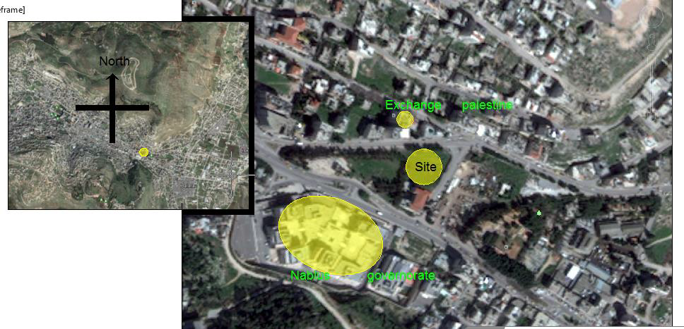
Site of the project: location and site area: 2400 square meter

Slide 4
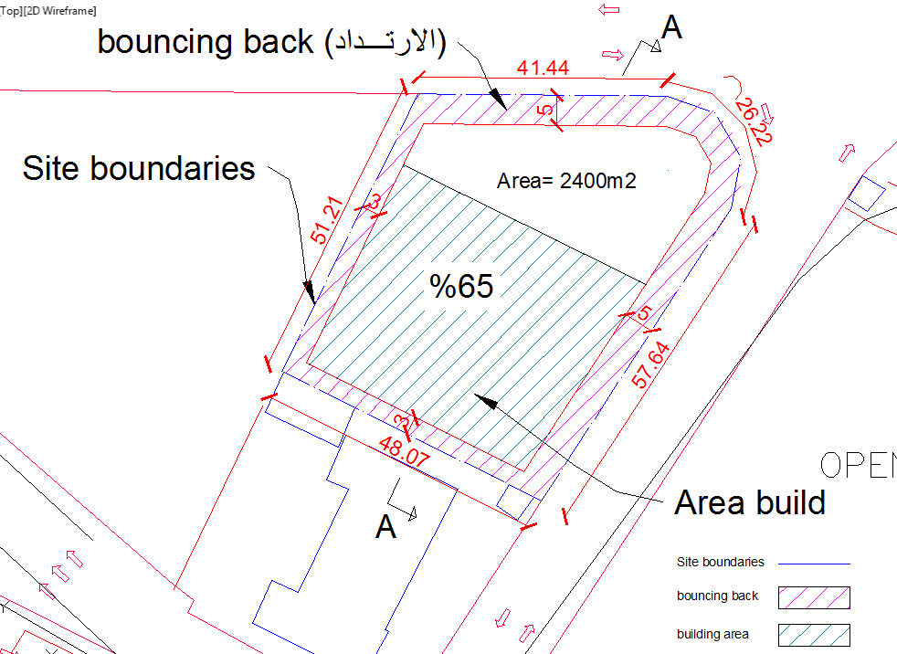
Site of the project: location and site area

Slide 5
Architectural design.
Total Area=7680 square meter

Slide 6
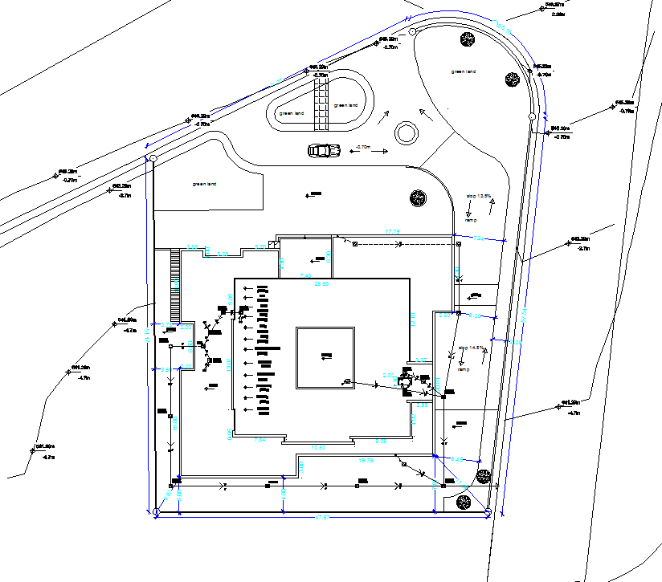
Architectural design:
Site plan:

Slide 7
Architectural design:
Areas floors:
Floors | Function | Area(m²)
B2 | Garages | 1162
B1 | Garages | 1162
GF | Reception Hall, Waiting Hall, Conference Hall Mosque and Cafeteria | 1162
F1 | Hall for Training , Library, Bathroom and Computer Lab | 624.5
F2 | Bathroom, Reception Hall and Meeting Halls | 619
F3 | Offices, Bathroom and Meeting Hall | 473.5
F4 | Offices, Archives Room, Bathroom and Meeting Rooms | 619
F5 | Offices, Archives Room, Story, Control Room, Bathroom and Meeting Rooms | 619
F6 | Offices, Meeting Rooms and Bathroom | 619
F7 | Offices, Meeting Rooms and Bathroom | 619

Slide 8
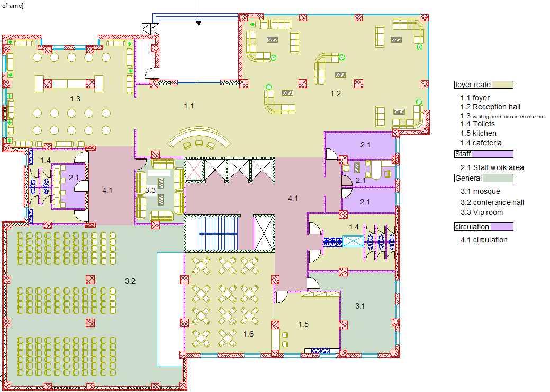
Architectural design:
Ground floor: area 1160 square meter

Slide 9
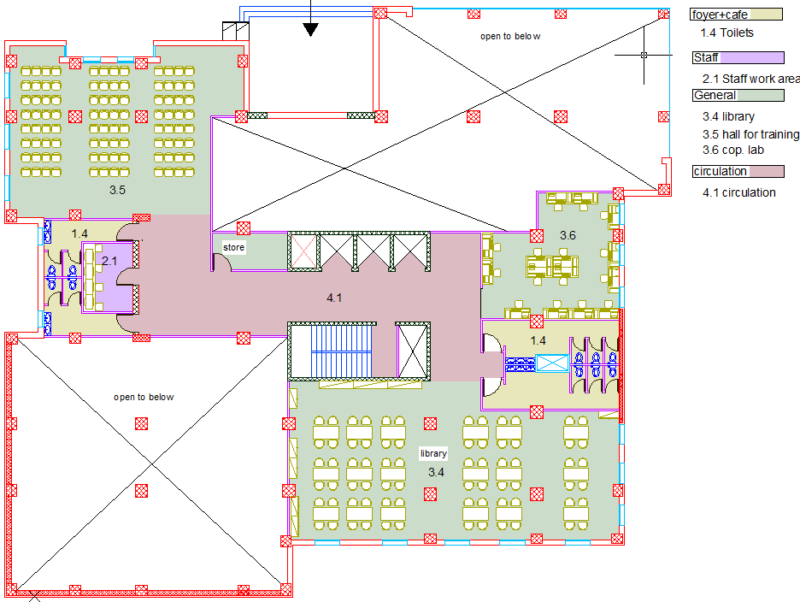
Architectural design:
First floor: area 625 square meter

Slide 10
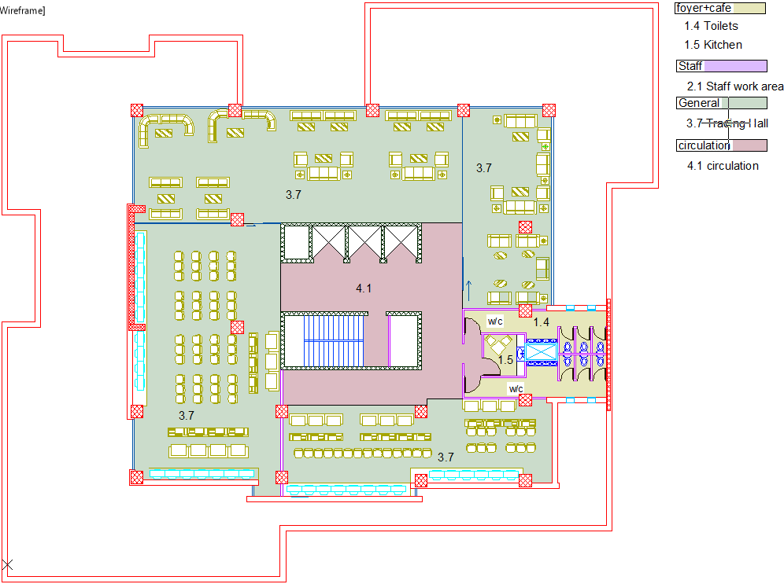
Architectural design:
Second floor: area 619 square meter

Slide 11
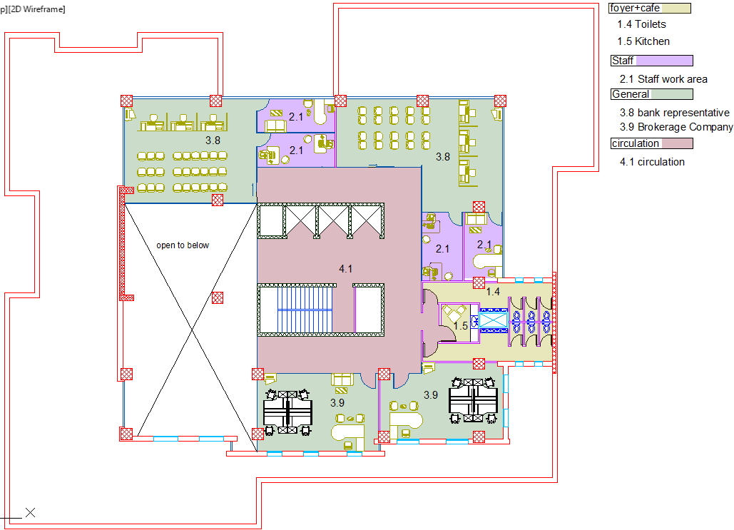
Architectural design:
Third floor: area 474 square meter

Slide 12
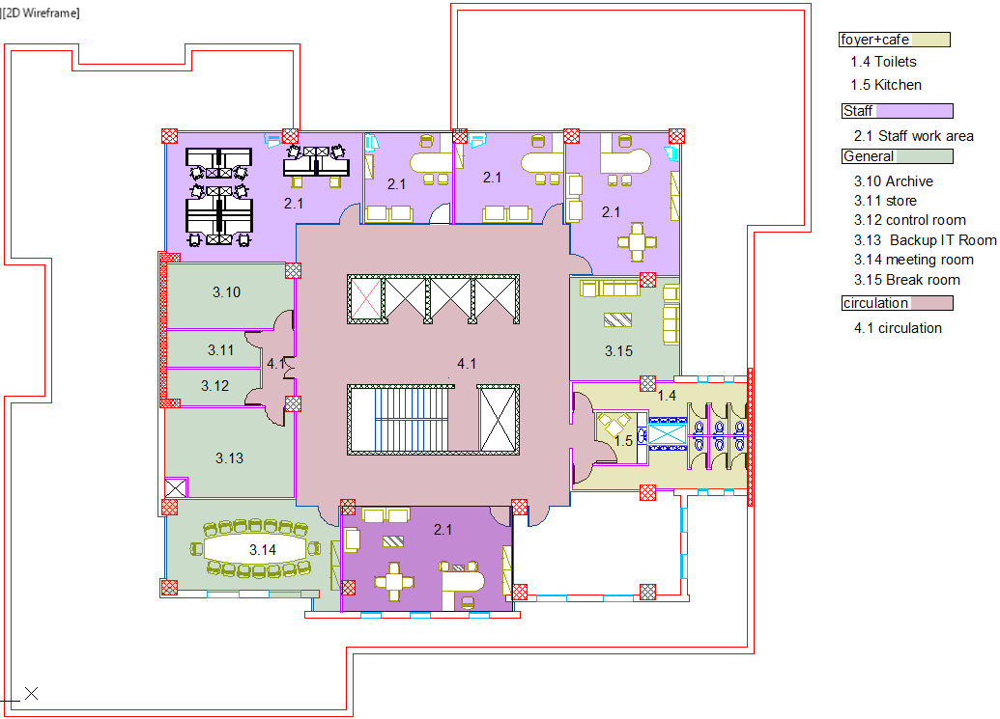
Architectural design:
Fourth floor: area 619 square meter

Slide 13
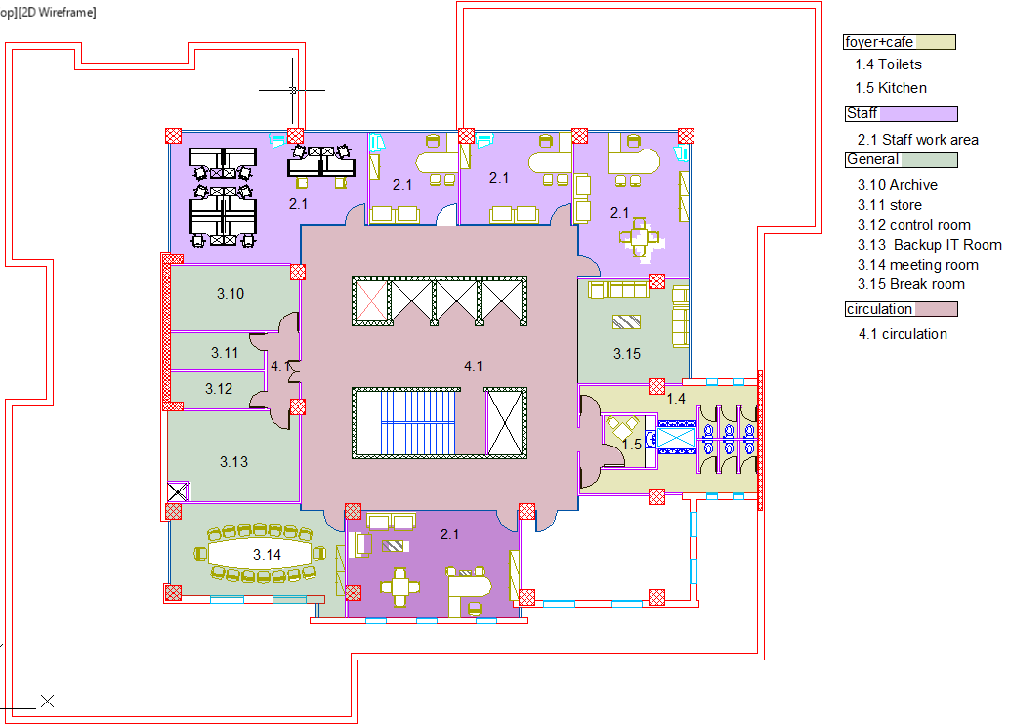
Architectural design:
Fifth floor: area 619 square meter

Slide 14
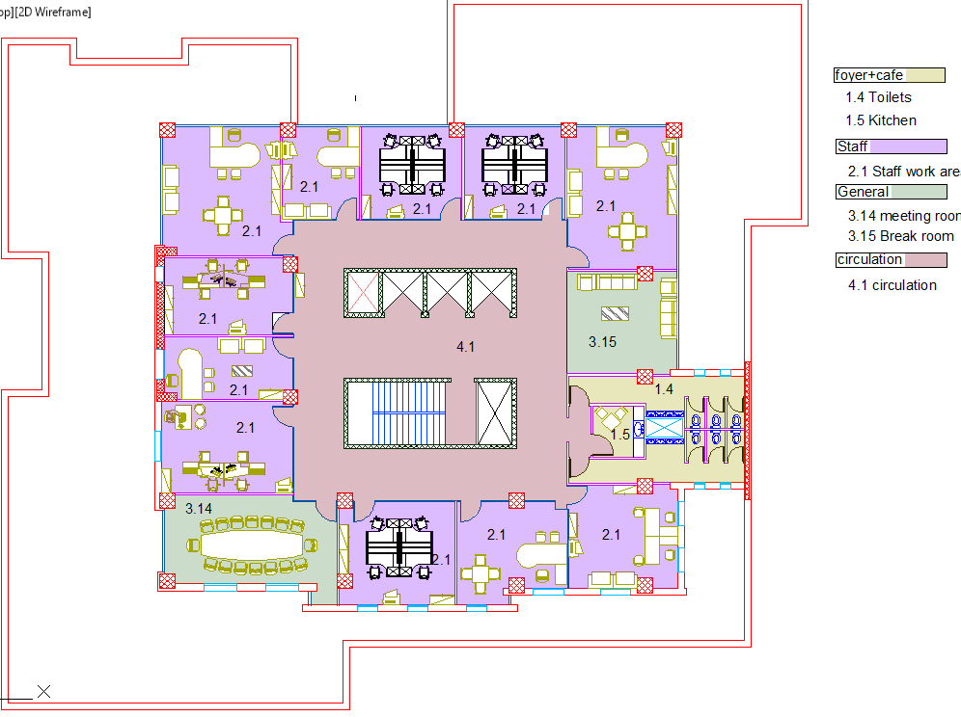
Architectural design:
Sixth floor: area 619 square meter

Slide 15
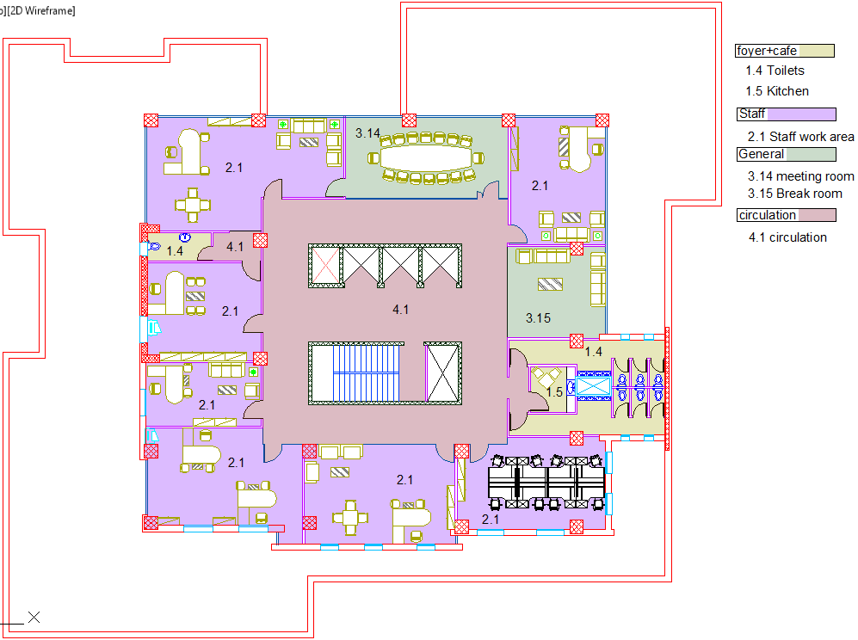
Architectural design:
Seventh floor: area 619 square meter

Slide 16
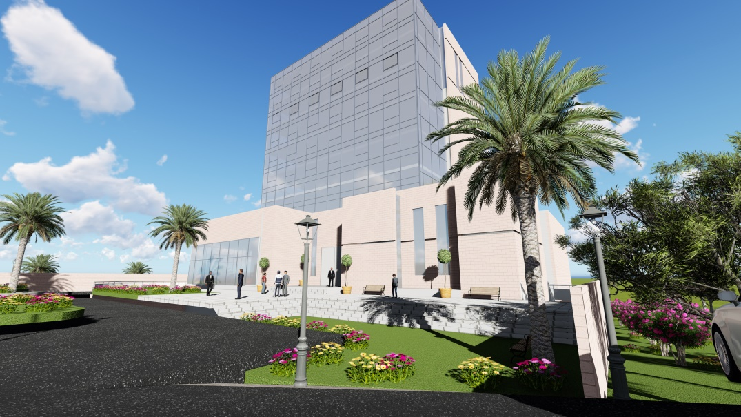
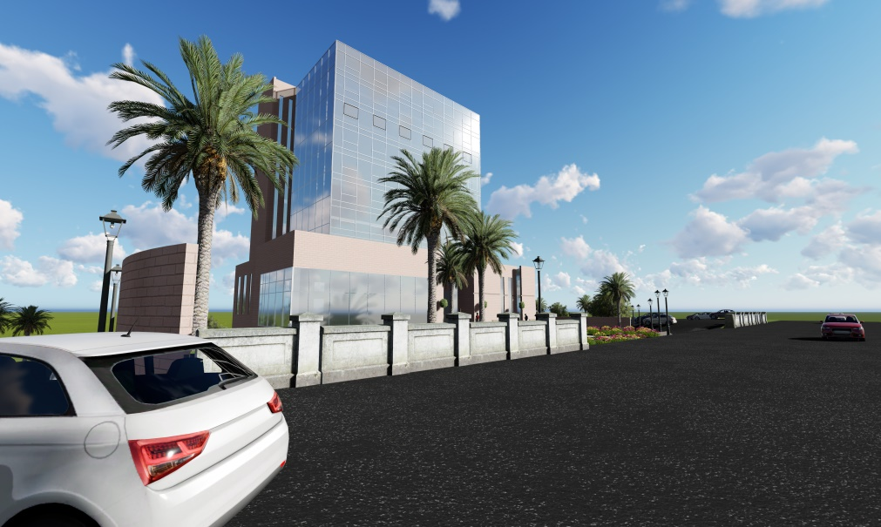
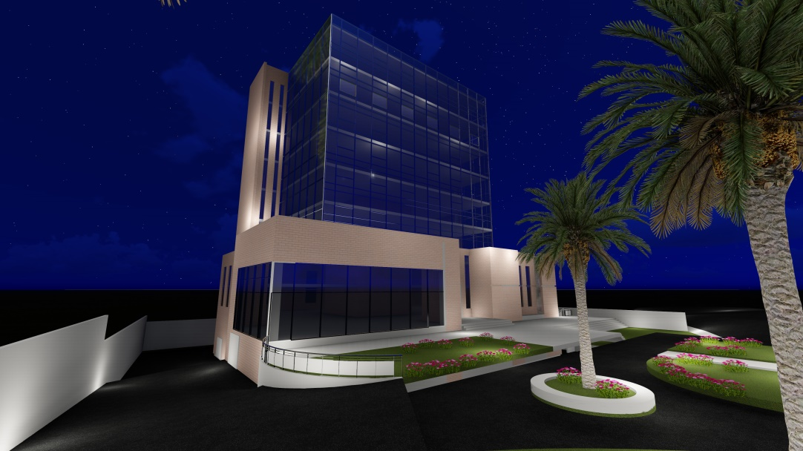
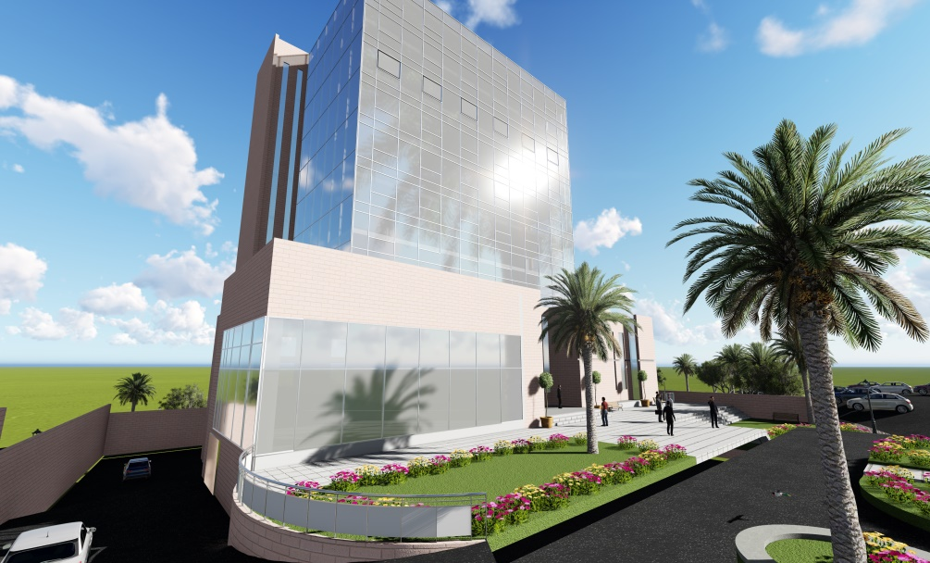
Architectural design:
Rendering

Slide 17
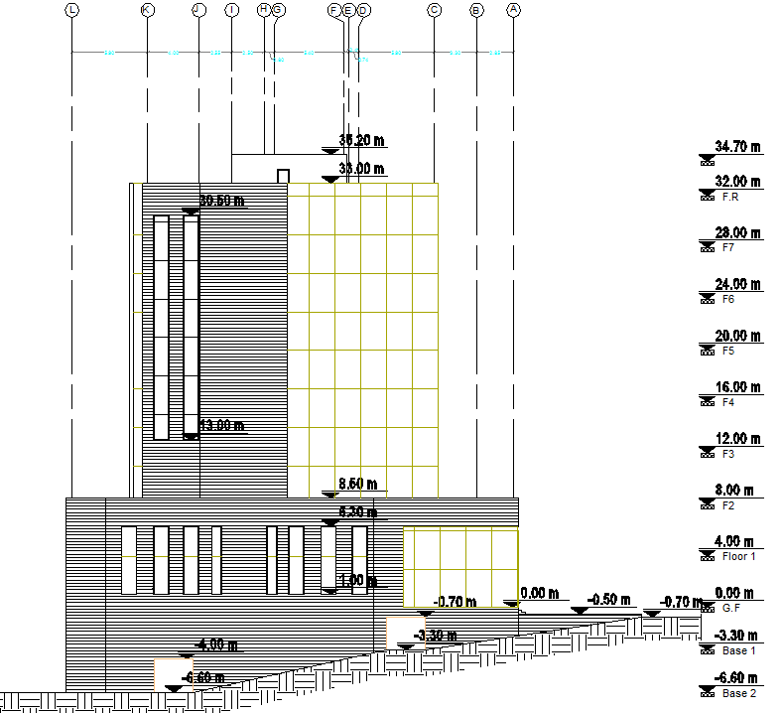
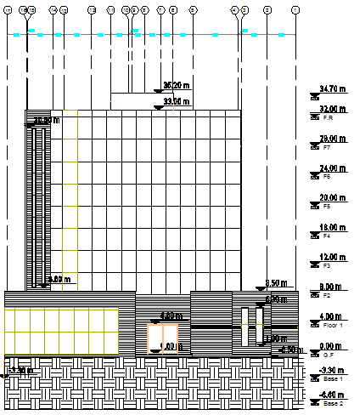
Architectural design:
Elevations
East elev.
North elev.

Slide 18
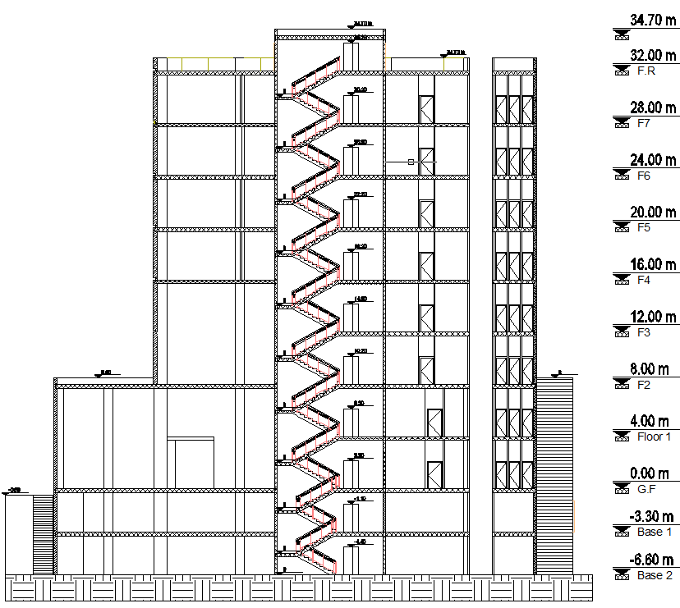
Architectural design: section

Slide 19
Environmental design.

Slide 20
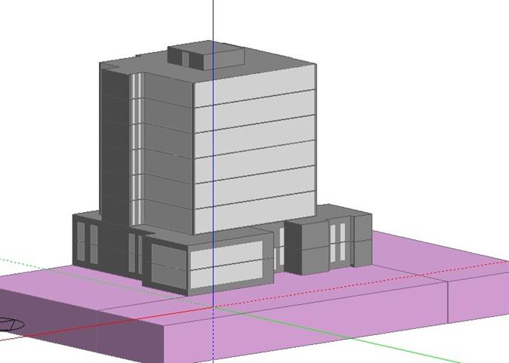
Environmental design:
Simulation analysis via DesignBuilder:

Slide 21
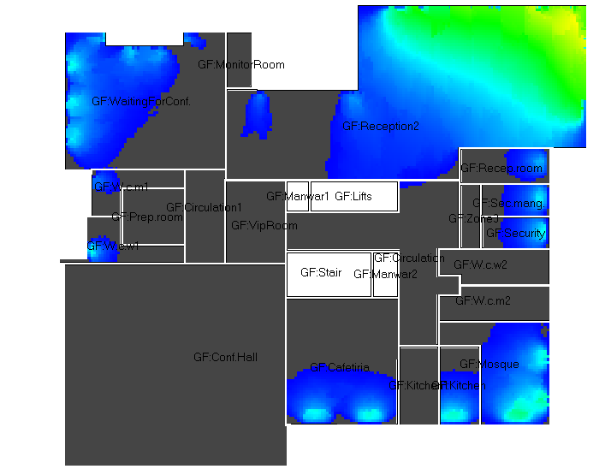
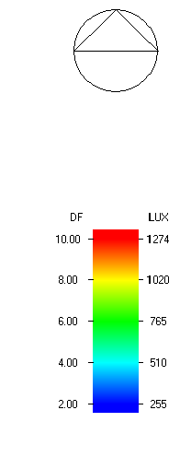
Environmental design:
Daylight factor: Ground floor

Slide 22
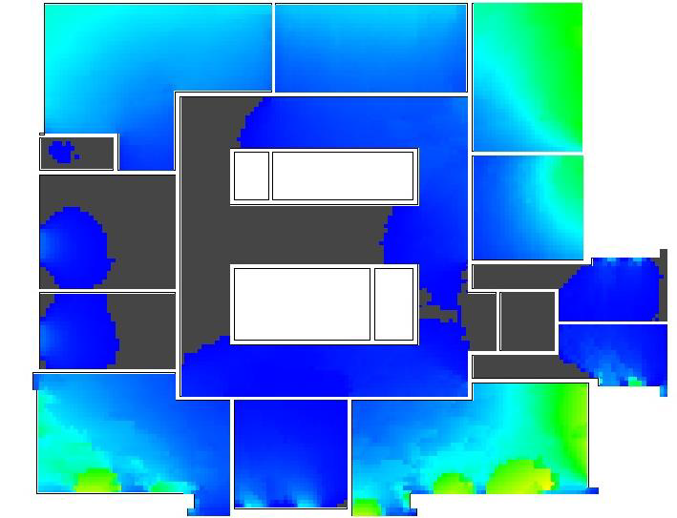
Environmental design:
Daylight factor: Seventh floor

Slide 23
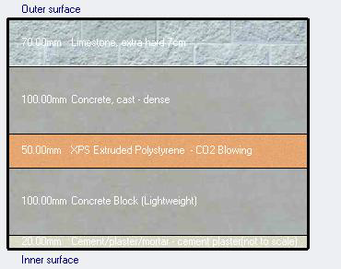
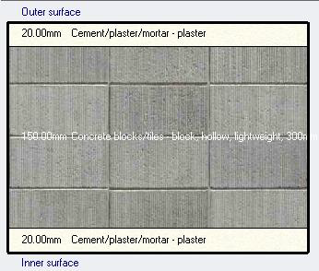
Environmental design:
Thermal analysis:
Definition of materials:
External walls: partitions walls: Glassing Wall:
double low/E Clr:
6mm/13mm argon
U-value:0.438(Kw/m2) U-value:1.961(Kw/m2) U-value:1.493(Kw/m2)

Slide 24
Environmental design:
Thermal analysis:
Cooling and heating loads for different spaces of Ground floor
Zone | Heating load (KW) | Cooling load (KW)
Reception hall | 21.42 | 25.31
Reception room | 0.910 | 1.520
Circulation | 2.660 | 3.750
Security | 0.620 | 1.200
Monitor room | 0.540 | 0.640
Security manager room | 0.590 | 1.230
Mosque | 1.980 | 4.250
Kitchen | 1.460 | 3.700
Cafeteria | 3.750 | 5.640
Preparation room | 0.790 | 1.020
Conference hall | 15.04 | 25.74
VIP. room | 1.160 | 1.440
Waiting for conf. | 5.640 | 9.690
w.c. women 1 | 0.570 | 0.950
w.c. men 1 | 0.590 | 0.980
w.c. women 2 | 0.690 | 1.030
w.c. men 2 | 0.680 | 1.020

Slide 25
Environmental design:
Thermal analysis:
Cooling and heating loads for different spaces of Seventh floor
Total cooling load = 428 KW
Total heating load = 194 KW
Zone | Heating load (KW) | Cooling load (KW)
Circulation | 4.84 | 6.19
Stock exchange manger | 3.55 | 8.14
Secretary | 1.28 | 2.44
Stock exchange vice manger | 2.30 | 6.46
Legal assistant | 0.93 | 1.92
Administration head | 1.19 | 2.07
Finance administration department | 2.88 | 6.63
Financial department | 2.59 | 6.94
Meeting room | 1.92 | 3.35
Rest area | 1.22 | 5.00
Kitchen | 0.27 | 0.79
w.c. women 1 | 0.94 | 1.40
w.c. men 1 | 0.93 | 1.30

Slide 26
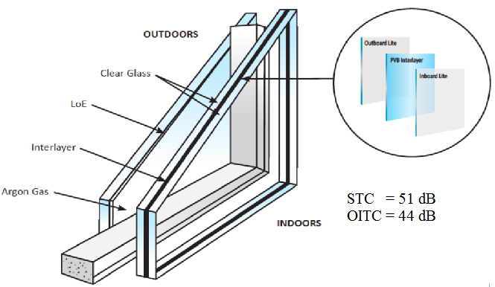
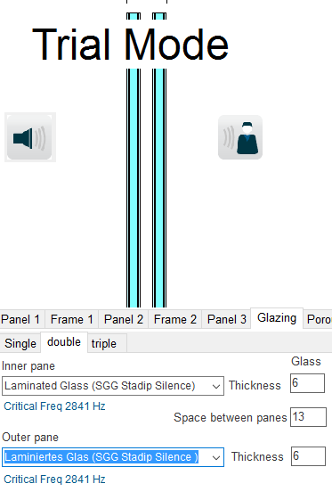
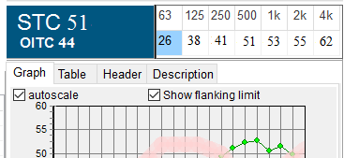
Environmental design:
Acoustical design: recommended STC Value:
External wall: not less than 50dB
Glass wall:

Slide 27
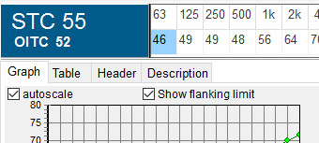
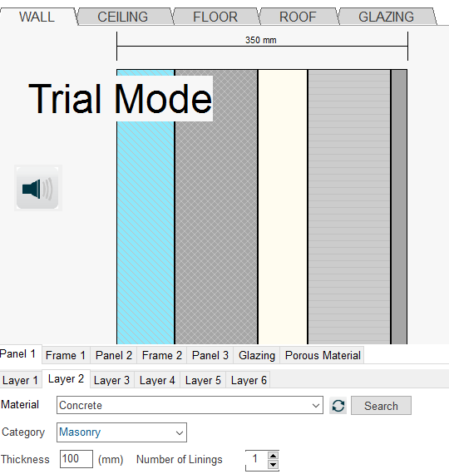
Environmental design:
Acoustical design: recommended STC Value :
External wall: not less than 50dB
Masonry wall:

Slide 28
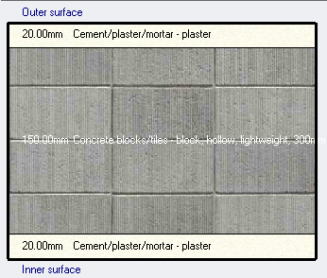
Environmental design:
Acoustical design: recommended STC Value :
Internal wall: 52dB
Layers | STC (dB)
15cm hollow block | +43
Plaster via resilient one sides | +10
Total | 53

Slide 29
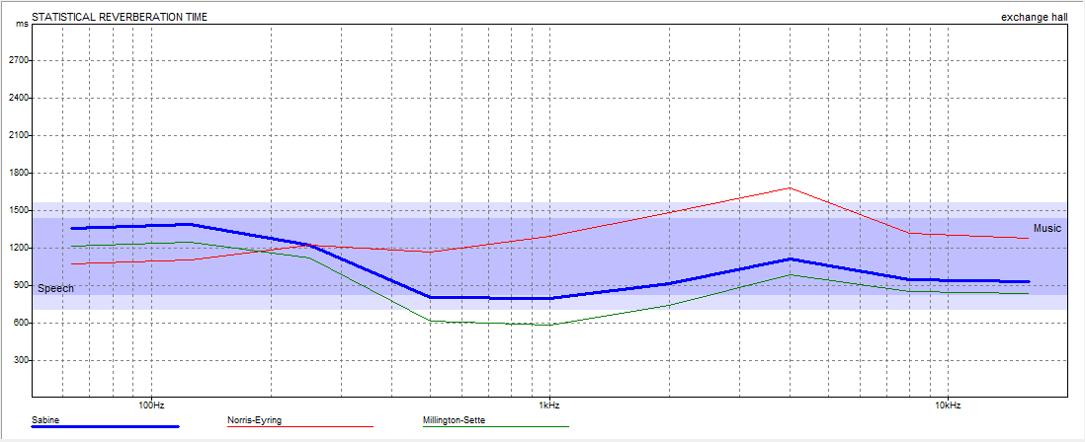
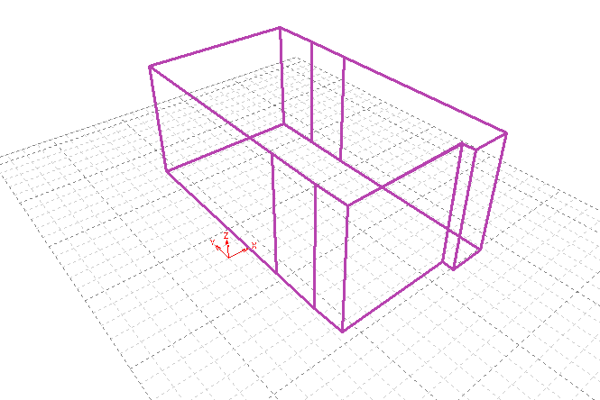
Environmental design:
Acoustical design: recommended RT60 For Trading hall : 0.7 to 1.1 sec
RT60 curve for full occupancy (70person).
Result:
FREQ. ABSPT. RT(60)
63Hz: 127.948 1.36
125Hz: 124.078 1.39
250Hz: 126.469 1.23
500Hz: 204.292 0.80
1kHz: 206.240 0.79
2kHz: 164.448 0.92
4kHz: 117.905 1.11
8kHz: 118.768 0.94
16kHz: 119.836 0.93

Slide 30
Structural design.

Slide 31
Structural design:
Design Codes
•ACI 318-09: American Concrete Institute provisions for reinforced concrete structural design.
•UBC-97 Code.

Slide 32
Structural design:
Steps for design
Step one: Materials.
A- Concrete:
For slabs, beams, stairs and footings =28MPa.
For shear walls and columns =32MPa.
The unit weight of the reinforced concrete is 25 KN/ m3
B- Steel:
grade-60: yield strength fy is 420 MPa

Slide 33
Structural design:
Steps for design
Step two: structural system.
A- Floor system:
Solid slab for Parking floor.
Two way Ribbed slab.

Slide 34
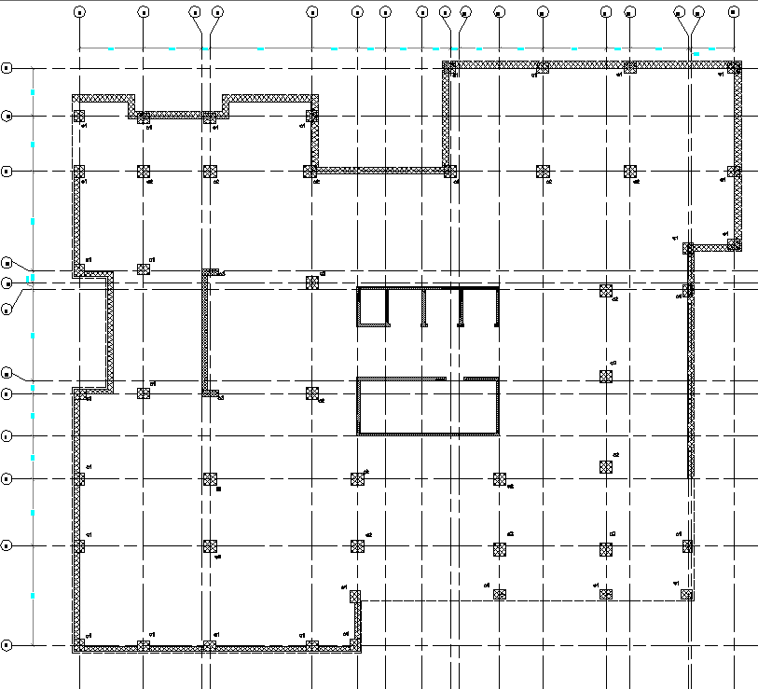
Structural design:
Steps for design
B- Column grid and orientation:

Slide 35
Structural design:
Steps for design
Step three: Loads.
Dead loads: The own weight of the structural elements
Super imposed dead loads: 5 KN/m2
Live load: according to UBC 97 code
Earthquake Load: Dynamic analysis:
Occupancy | Uniform live load (kN/m²)
Garages | 4.79
Offices | 2.40
Exit facilities (corridors) | 4.79
Libraries | 6
Lobbies | 4.79

Slide 36
Structural design:
Steps for design
Primary Design: before step 4.
Beams dimensions: 700mm*500mm
Columns:
Column (75*75) cm
Column (60*70) cm
Column (40*100) cm

Slide 37
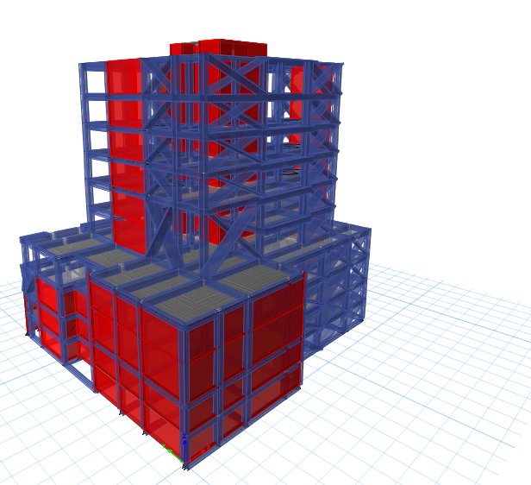
Structural design:
Steps for design
Step four: modeling and analysis by ETABS.

Slide 38
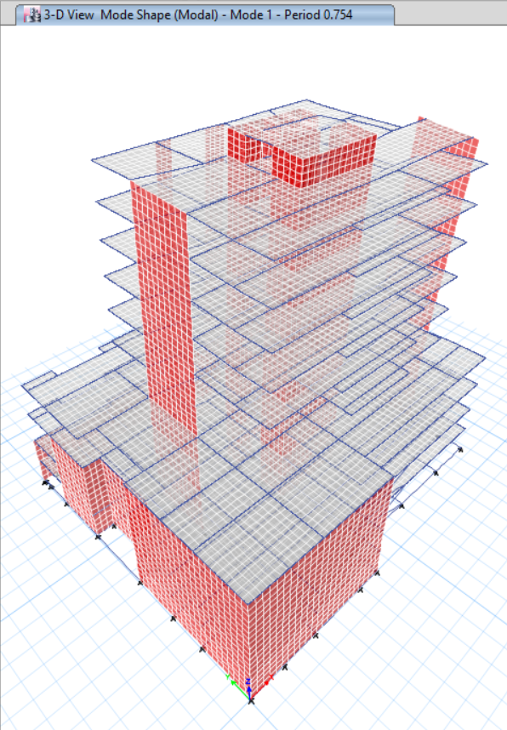
Structural design:
Model checks:
Compatibility

Slide 39

Structural design:
Model checks:
Equilibrium:
Dead Load (Hand Calculation) = 108897 KN.
Dead Load (ETABS 2016):
% of difference=0.53%<5%…………(OK)

Slide 40

Structural design:
Model checks:
Equilibrium:
Live Load (Hand Calculation) = 26386 KN
Live Load (ETABS 2016)
% of difference=3.32%<5%…………(OK)

Slide 41

Structural design:
Model checks:
Internal Stress Check:
M_{(live)} =$\frac{Wl^{2}}{8}$ = 20.8KN.m
M_{(live)} (ETABS)= 20.56 KN.m
$\% of difference=1.15\%<10\%…………\left(OK\right)$

Slide 42
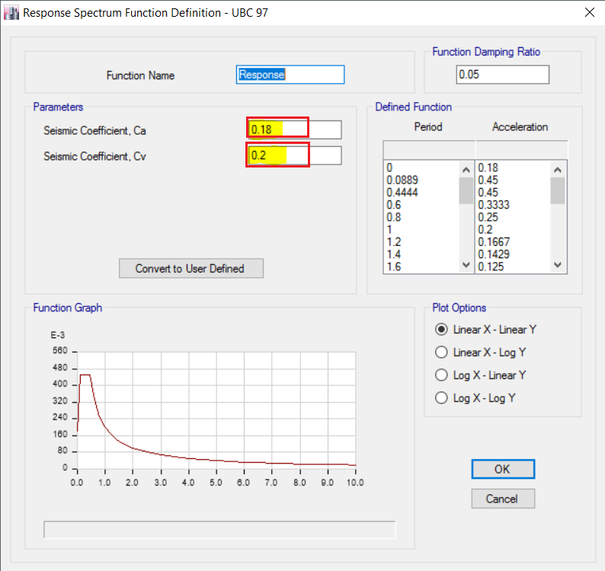
Structural design:
Dynamic Analysis: Using response spectrum to determine the design base shear
W = 185916 KN.
Soil profile type is assumed to be SD
Z = 0.2
I = 1
R = 5.5
Cv = 0.2
Ca = 0.18

Slide 43
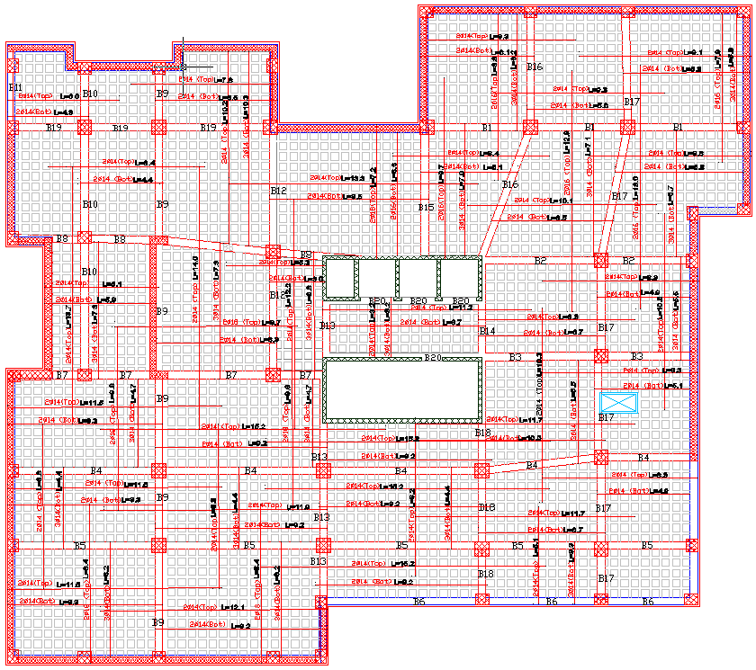
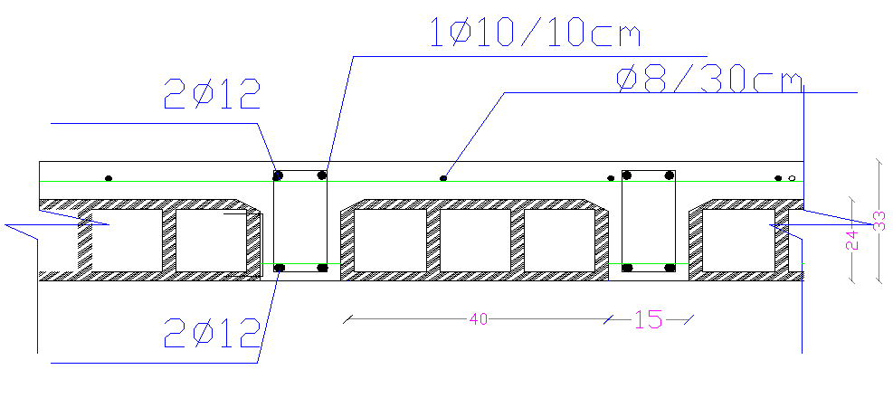
Structural design:
Steps for design
Step five: Design and draw detailing
Slab reinforcement details :

Slide 44
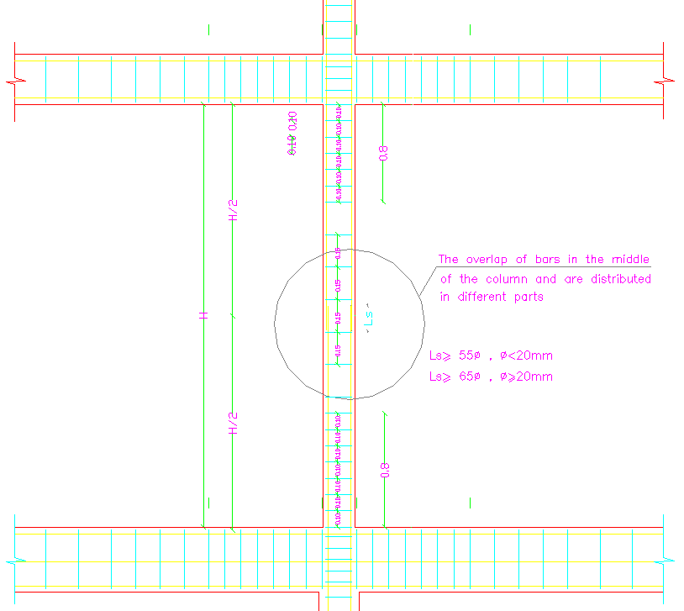
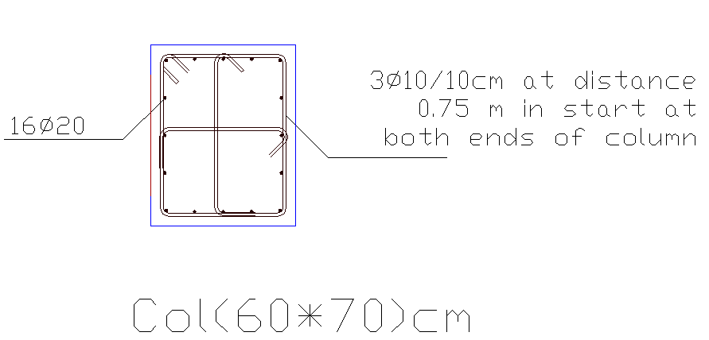
Structural design:
Step five: Design and draw detailing
Column reinforcement details:

Slide 45
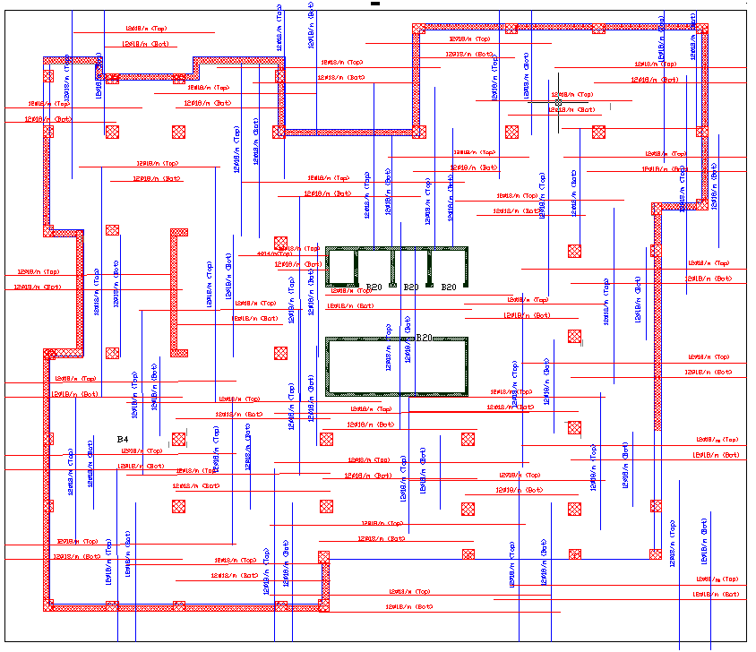
Structural design:
Step five: Design and draw detailing
Mat found. Reinforcement detail :
Thickness 1.6m

Slide 46
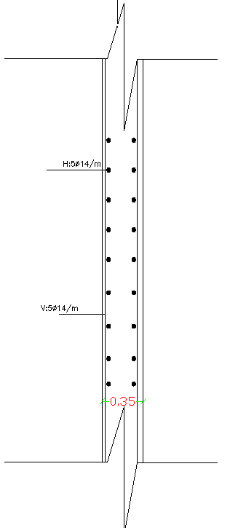
Structural design:
Step five: Design and draw detailing
Walls reinforcement details :

Slide 47
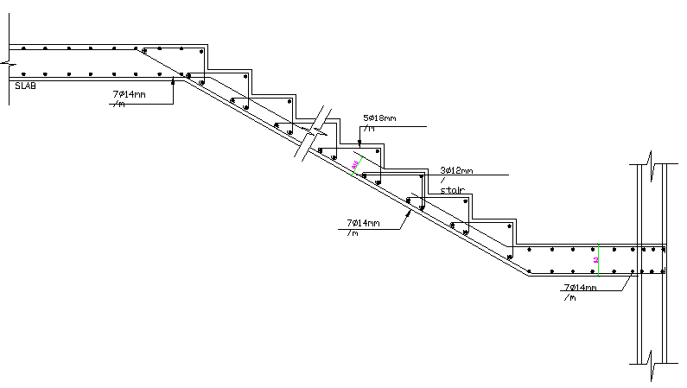
Structural design:
Step five: Design and draw detailing
Stair Reinforcement Details

Slide 48
Electrical design.

Slide 49
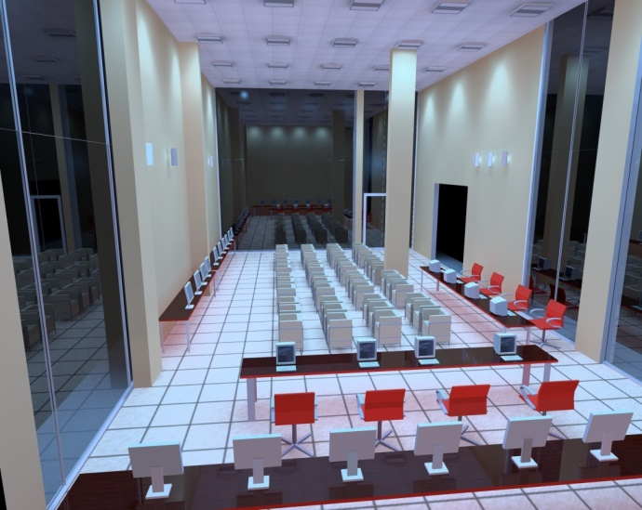
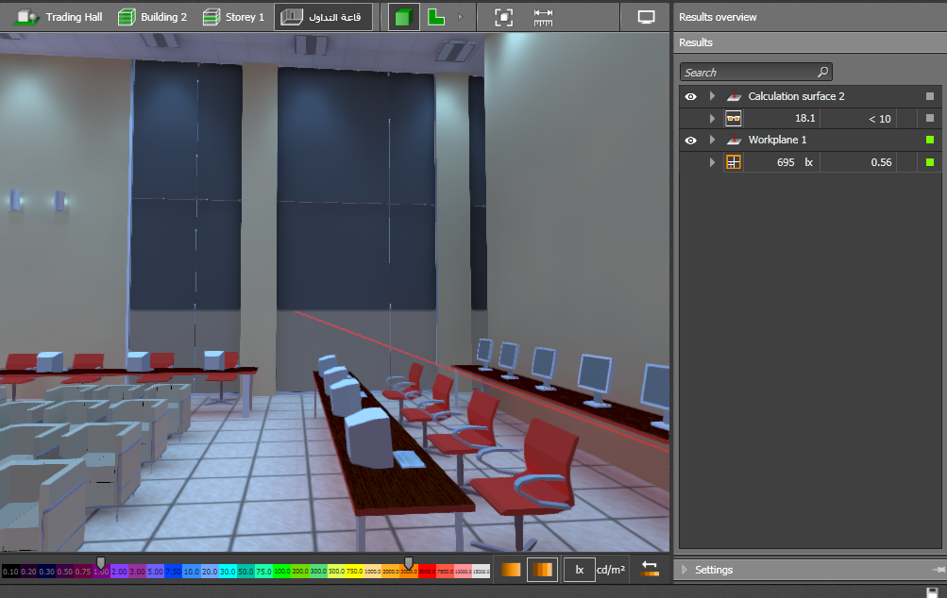
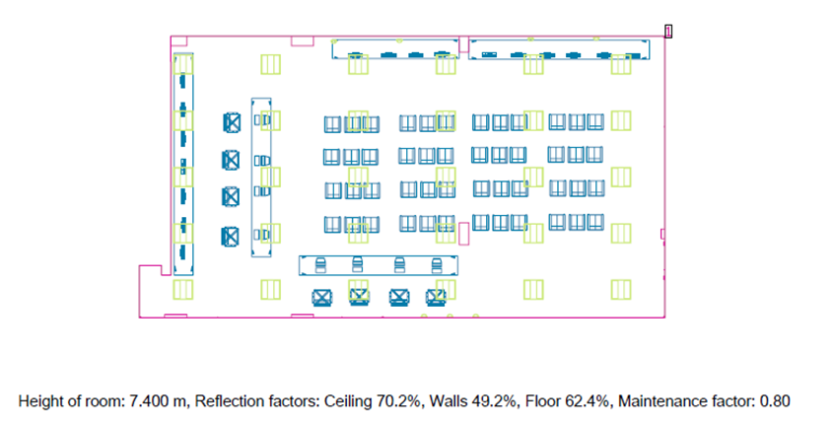
Environmental design:
Artificial design:
Trading hall design:
Result:

Slide 50
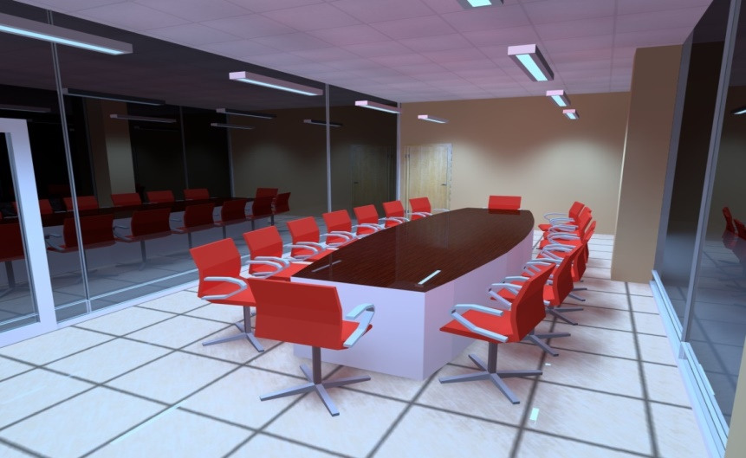
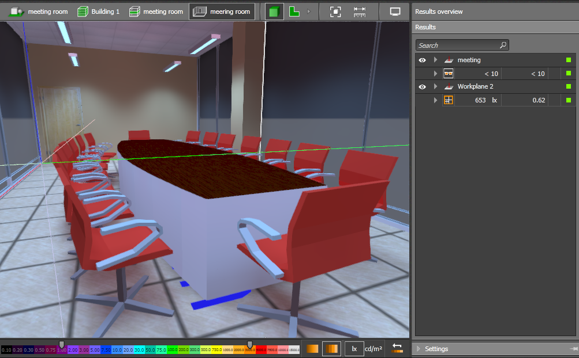
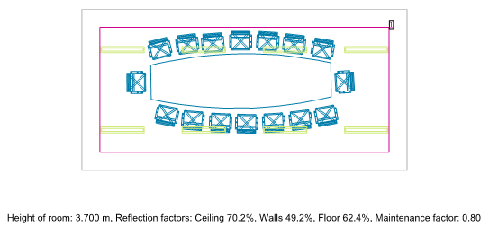

Environmental design:
Artificial design:
Meeting room design:
Result:

Slide 51
Mechanical design.

Slide 52
Mechanical design:
General:
Mechanical design of a building involves many aspects including:
1. HVAC system design.
2. Water supply system.
3. Drainage design system.
4. Vertical transportation.

Slide 53


Mechanical design:
HVAC system design:
    VRF system for seventh
    floor:
    Cooling load = 53 kw

Slide 54


Mechanical design:
HVAC system design:
    VRF system for conference hall

Slide 55
Mechanical design:
HVAC system design:
    VRF system for conference hall
Duct | Diameter (m) | Rectangular(m)
X-A | 0.580 | 1.40*0.250
A-1 | 0.168 | 0.20*0.125
A-B | 0.238 | 0.40*0.125
B-1 | 0.168 | 0.20*0.125
B-2 | 0.168 | 0.20*0.125
A-C | 0.500 | 1.20*0.225
C-1 | 0.168 | 0.20*0.125
C-D | 0.475 | 1.00*0.225
D-1 | 0.168 | 0.20*0.125
D-E | 0.238 | 0.40*0.125
E-1 | 0.168 | 0.20*0.125
E-2 | 0.168 | 0.20*0.125
D-F | 0.376 | 0.80*0.175
F-1 | 0.168 | 0.20*0.125
F-G | 0.336 | 0.70*0.150
G-1 | 0.168 | 0.20*0.125
G-2 | 0.168 | 0.20*0.125
G-H | 0.238 | 0.40*0.125
H-1 | 0.168 | 0.20*0.125
H-2 | 0.168 | 0.20*0.125

Slide 56

Mechanical design: water supply system:

Slide 57

Mechanical design:
Drainage system:

Slide 58

Mechanical design:
Rain Drainage system :

Slide 59
Mechanical design:
Vertical transportation system:
The required elevators for the stock exchange after making the calculation.
Three elevators:
Capacity= 2500 lb. 13 person .
Speed=400 ft/min

Slide 60
Safety design

Slide 61

Safety design:
Ground floor movement escape

Slide 62

Safety design: fire extinguisher

Slide 63

Safety design:
Ground floor sprinklers distribution

Slide 64

Safety design:
Ground floor All distribution

Slide 65

Safety design:
IT room.

Slide 66
Estimated Cost

Slide 67
Estimated Cost:
The total cost of the Building is about 6.8 million NIS.
The total cost per meter square for the building is about 1500 NIS.

Slide 68
Thank You

