Slide 1
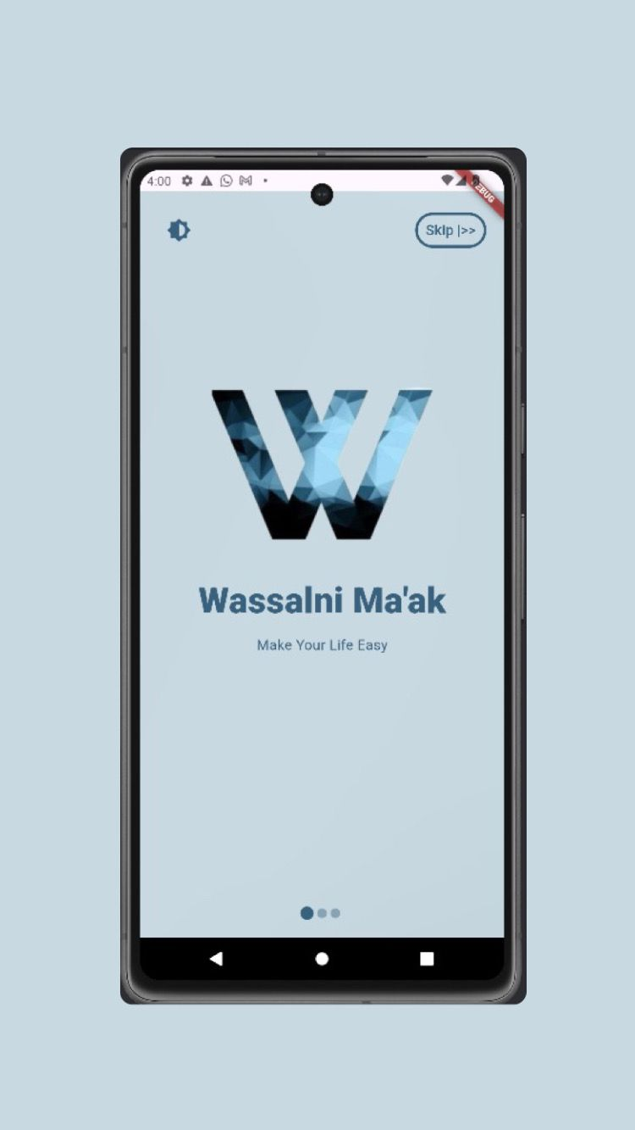

An-Najah National University
Faculty of Engineering and Information Technology
Computer Engineering Department
Software Graduation Project
Wassalni Ma’ak
Supervised by: Dr. Anas Toma
Malak Jawabreh
Aya Awwad

Slide 2

Table of constants
Feature
Future work
Introduction
1
2
3
4
5
Project Execution
Constraints

Slide 3

The Problem
Limited public transportation, especially during peak hours or in underserved areas, makes commuting difficult.
Traffic congestion and high commuting costs create daily challenges for students, employees, and long-distance travelers.
Objectives
Provides a reliable transportation alternative when public transit is unavailable.
Offers a user-friendly platform for easy trip coordination and booking
Lowers commuting costs for both drivers and passengers.

Slide 4

Wassalni Ma’ak | وصلني معك
"Wassalni Ma’ak" is an innovative app that allows people to share their rides with others heading to the same destination.

Slide 5




Technologies used
BACK END :
Node.js
FRONT END:
Flutter
DATA BASE:
MongoDB , Firebase

Slide 6
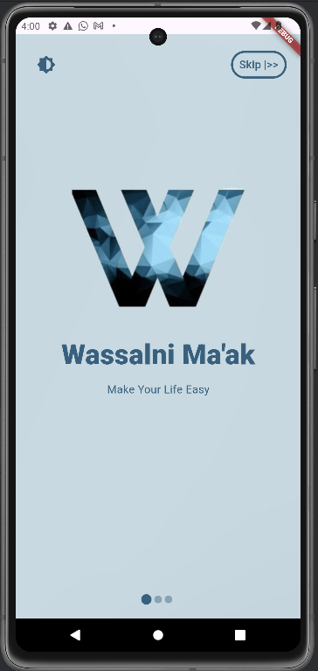
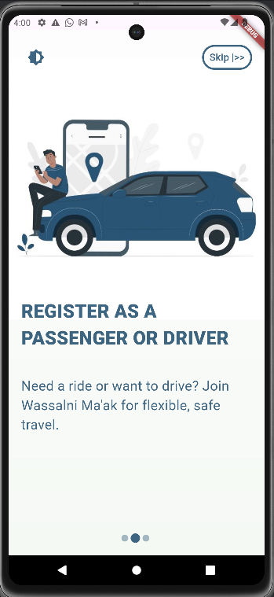
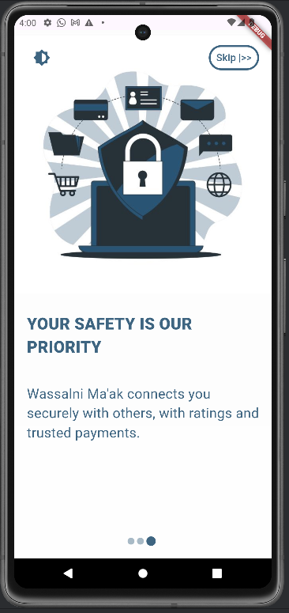
Welcome Pages

Slide 7
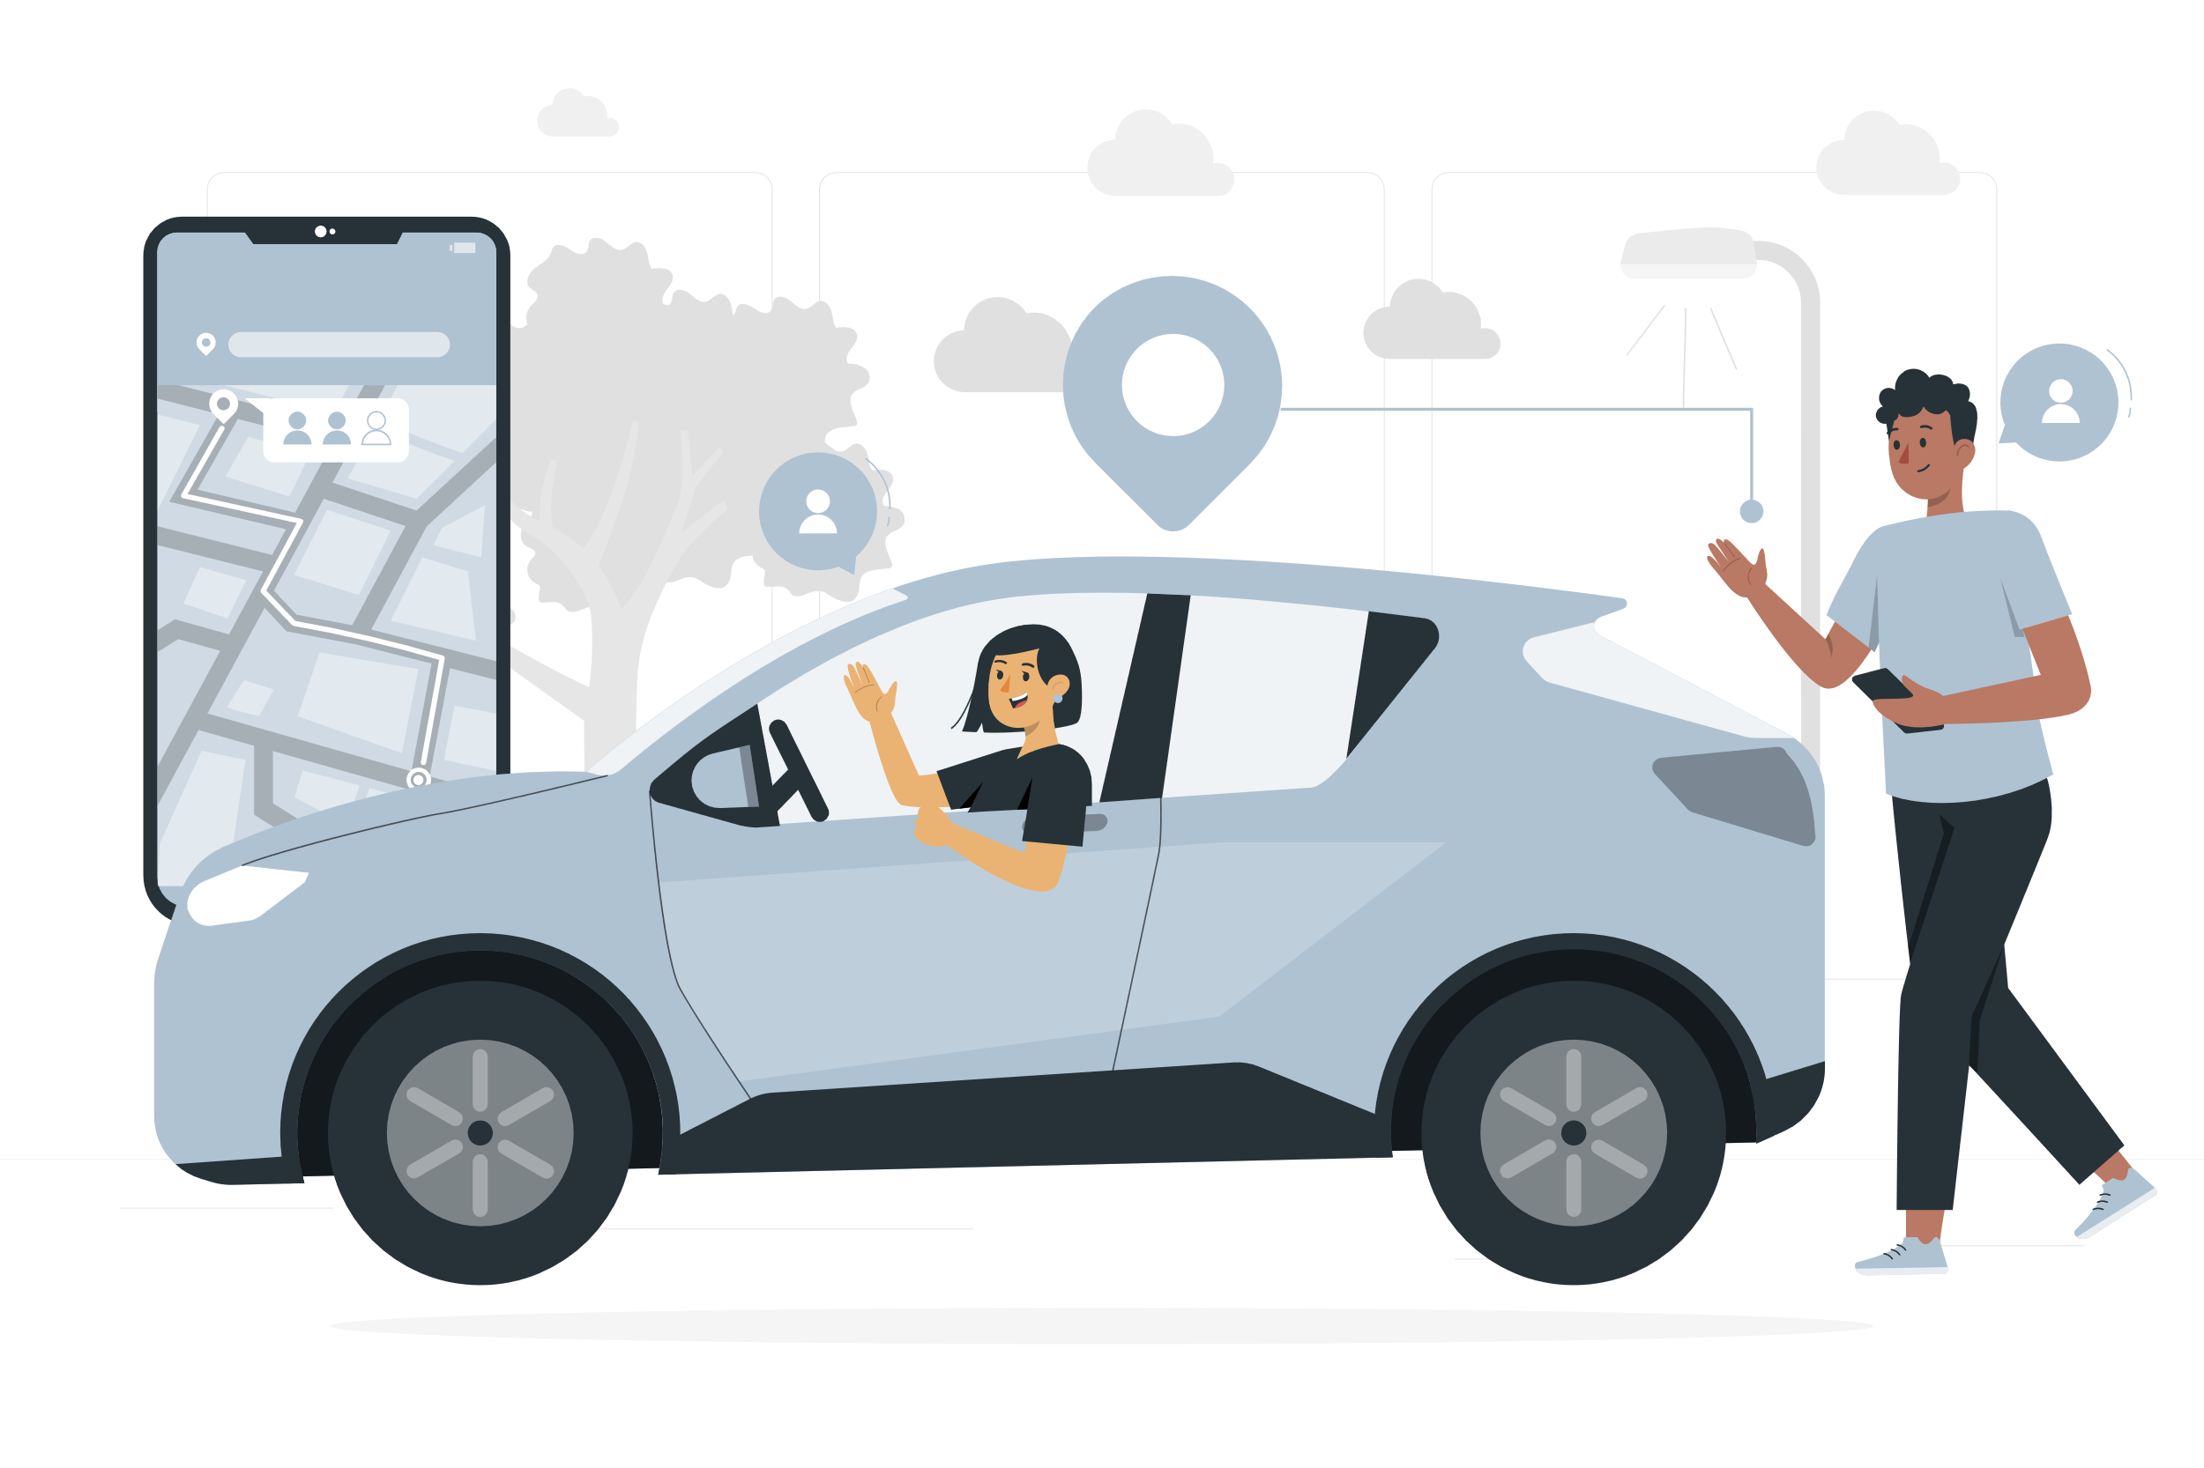
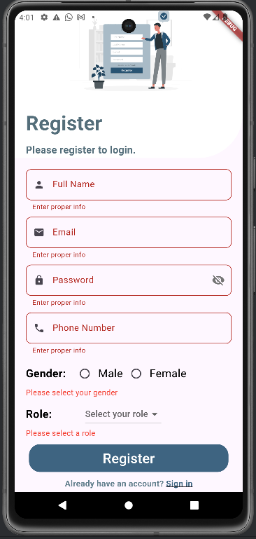
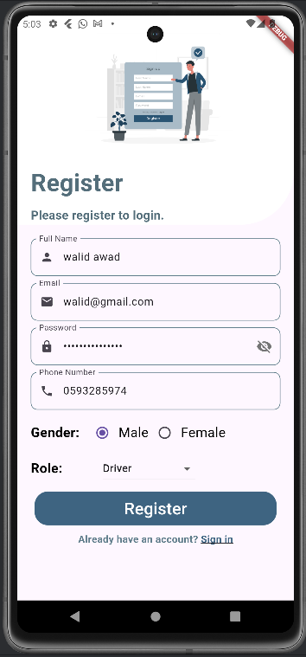
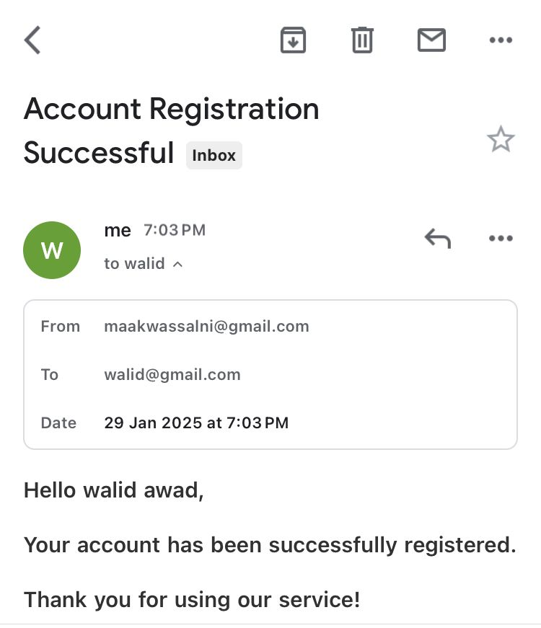
Registration

Slide 8
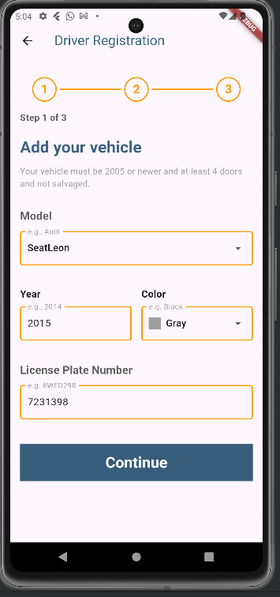
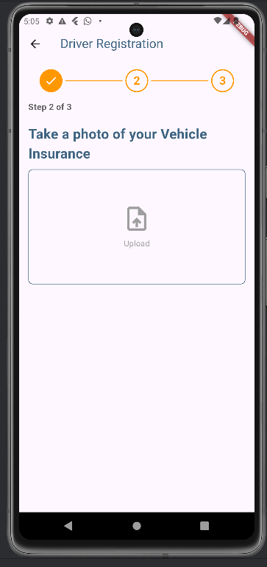
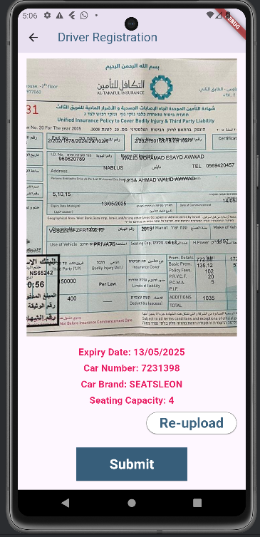
Registration As Driver

Slide 9
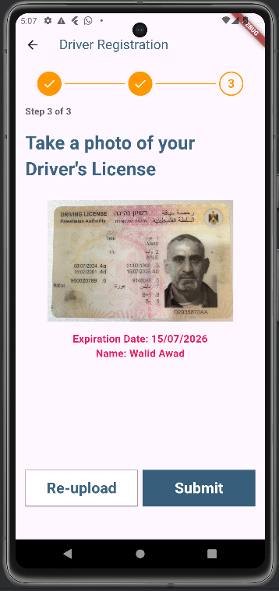
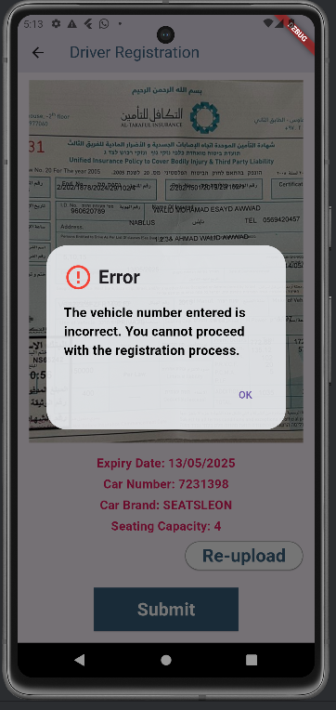
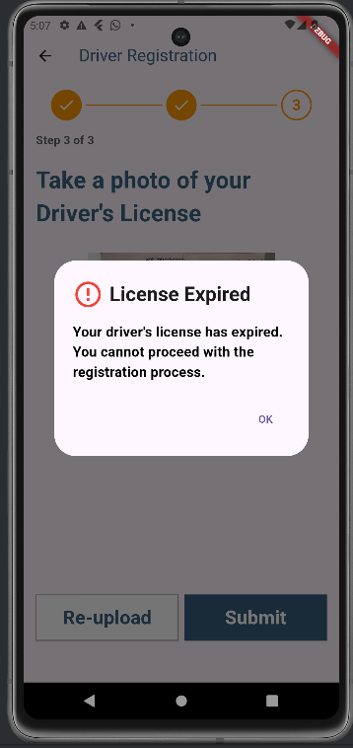
Registration As Driver

Slide 10
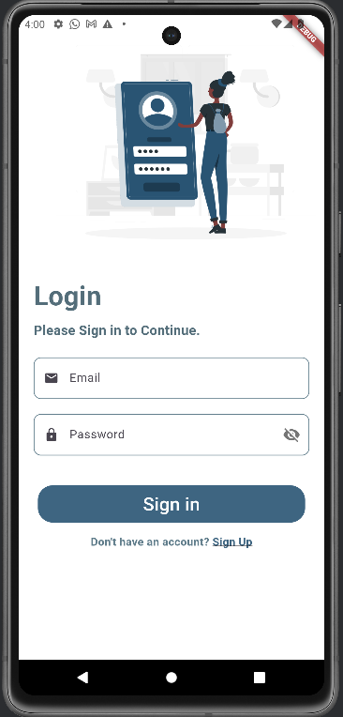
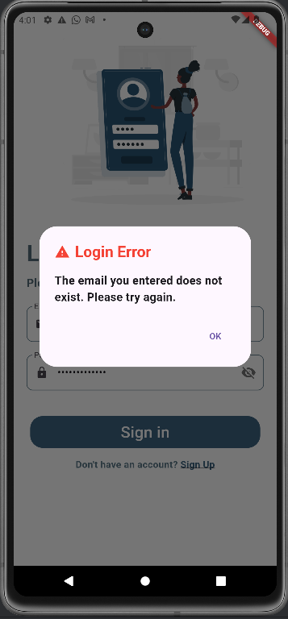
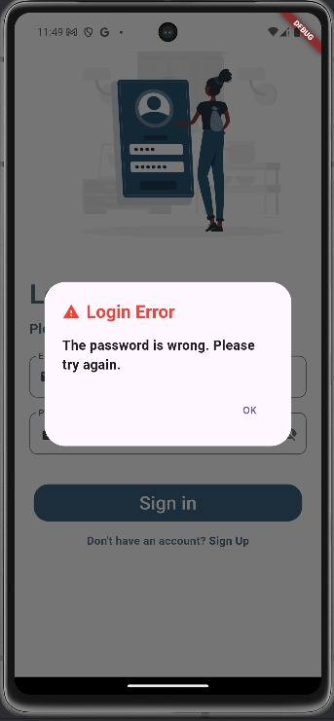
Login Page

Slide 11
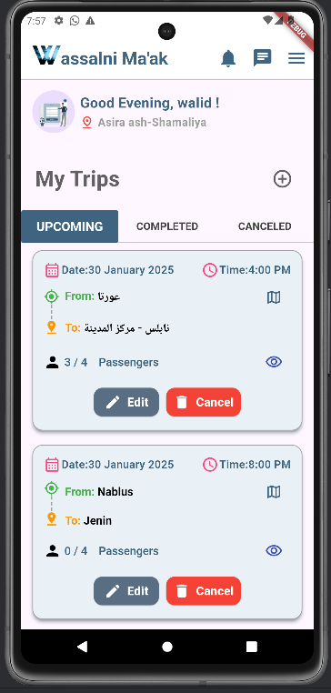
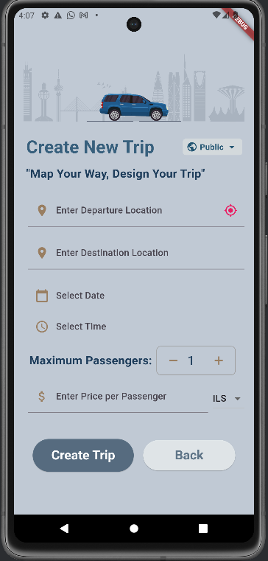
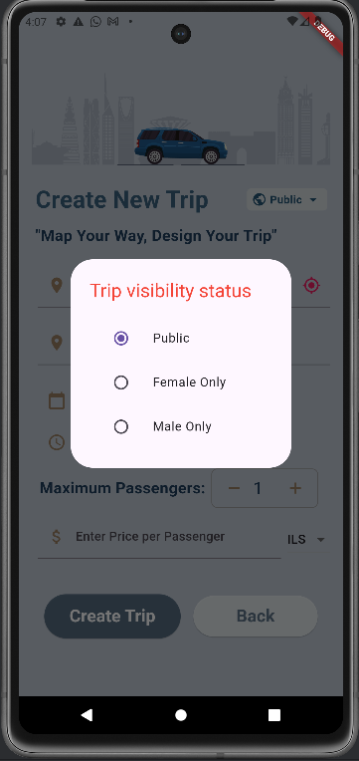
Features
Driver Dashboard (( الصفحة الرئيسية للسائق

Slide 12
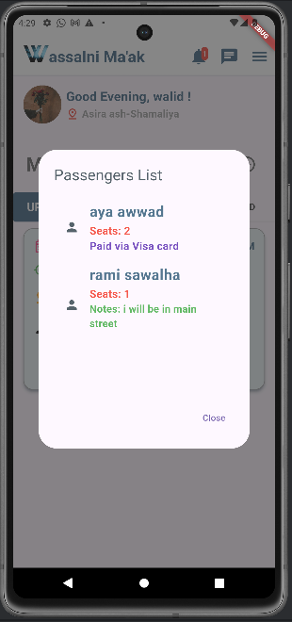
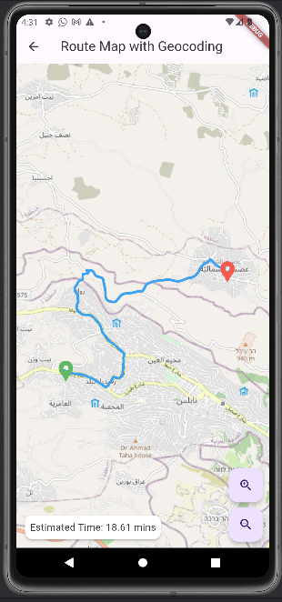
Driver Dashboard (( الصفحة الرئيسية للسائق

Slide 13
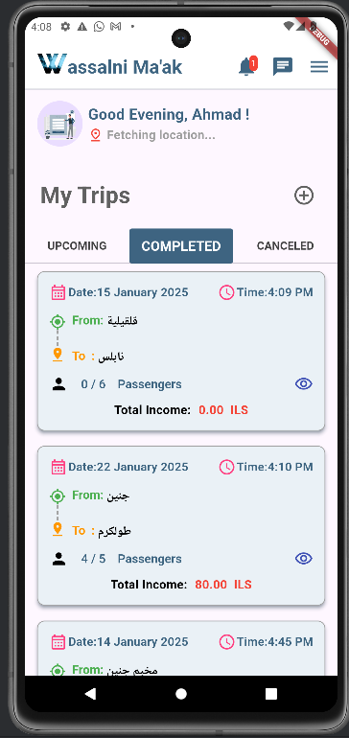
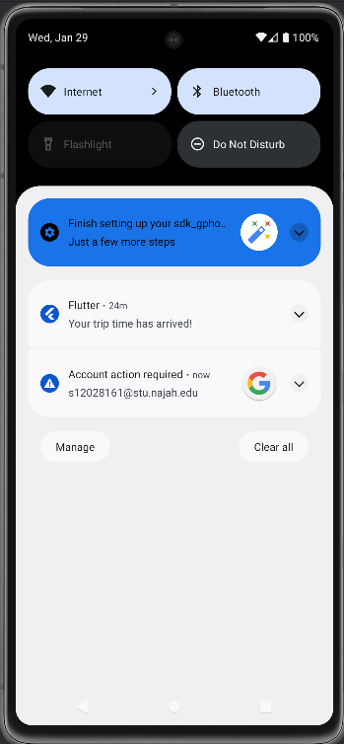
Driver Dashboard

Slide 14
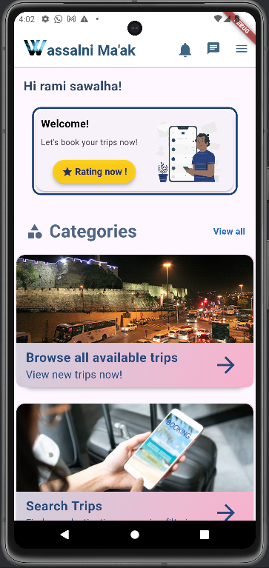
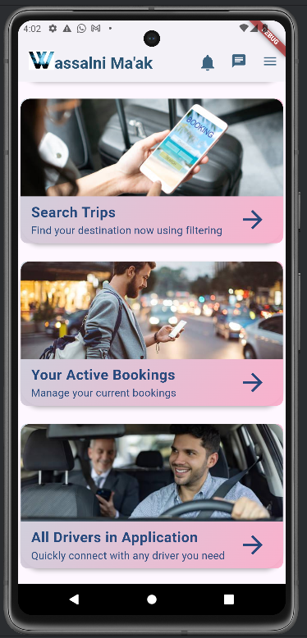
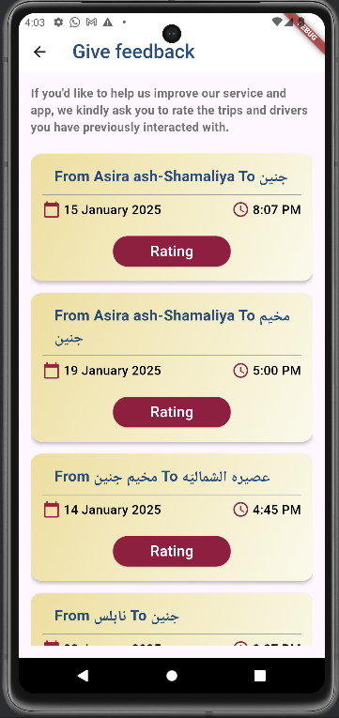
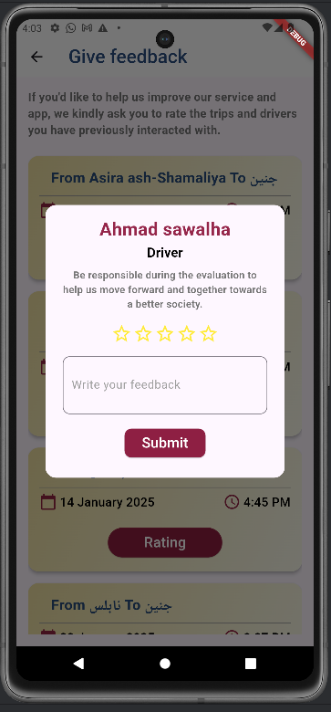
Passenger Dashboard ( الصفحة الرئيسية للراكب )

Slide 15
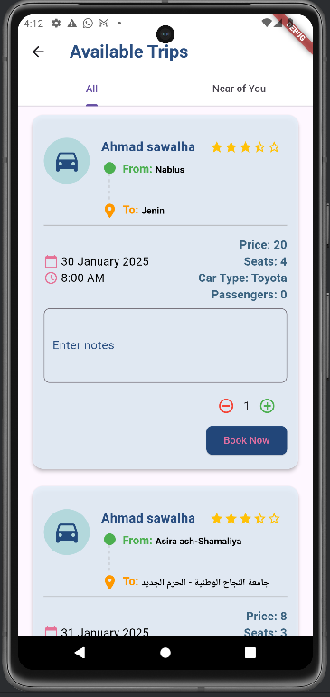
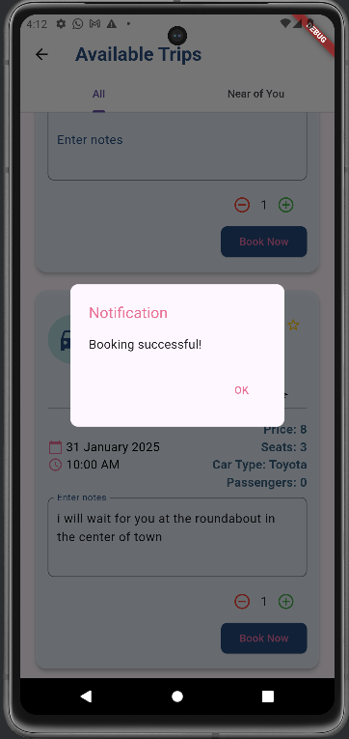
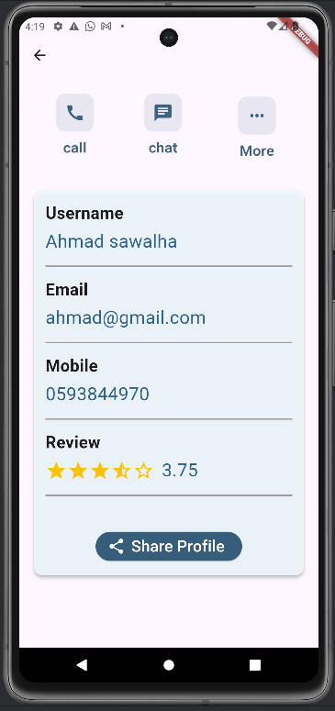
Passenger ( Booking Trip )

Slide 16
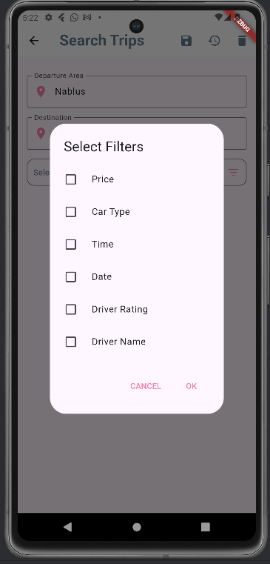
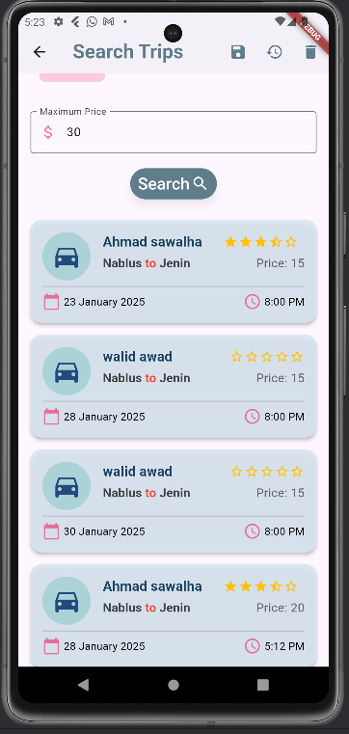
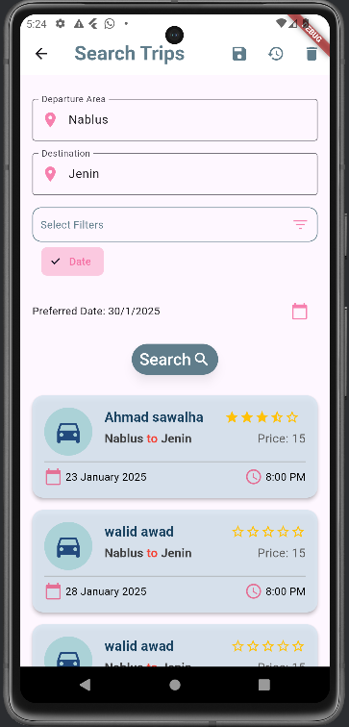
Passenger (Search and filter trips )

Slide 17
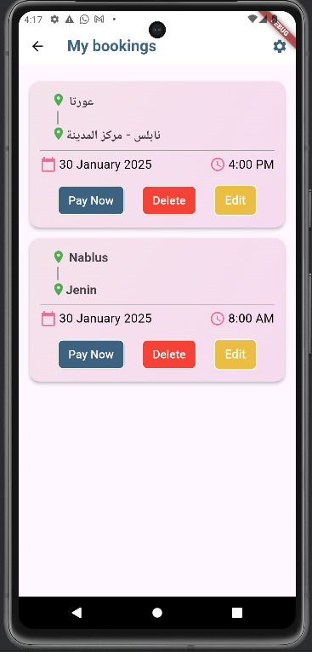
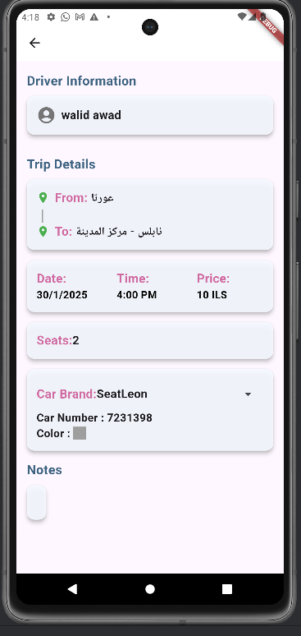
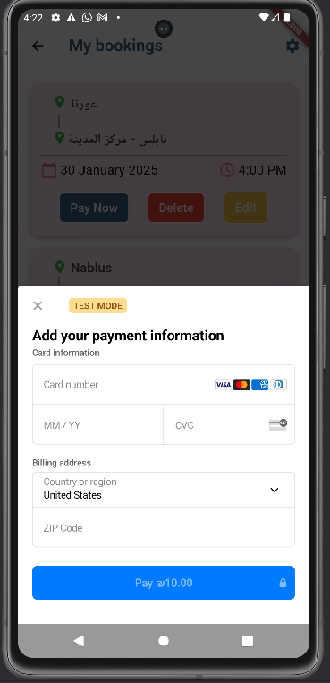
Passenger (My Booking)

Slide 18
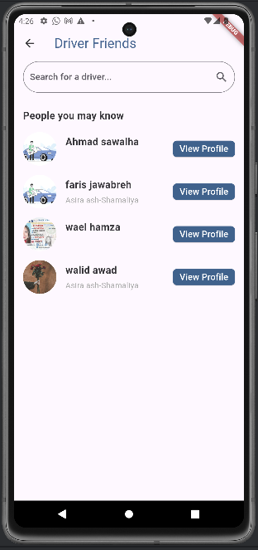
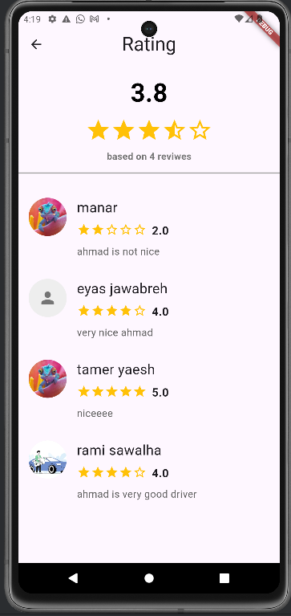
Passenger ( View All Driver )

Slide 19
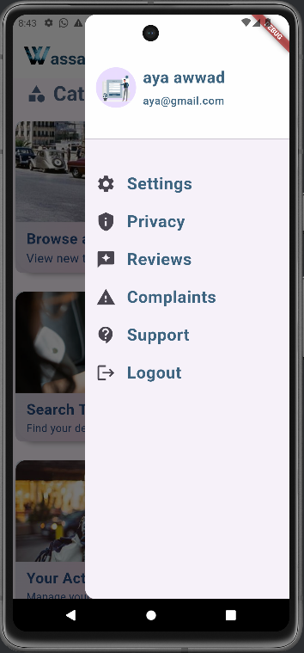
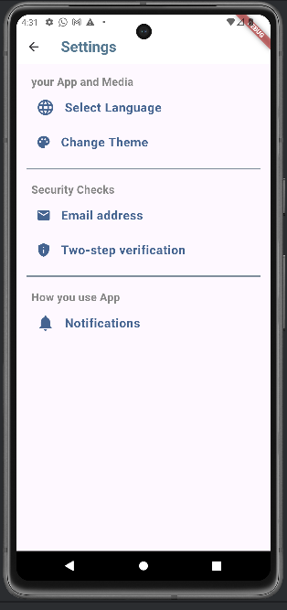
Navigation Drawer

Slide 20
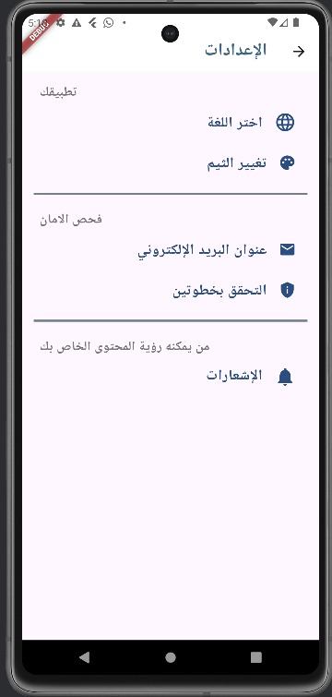
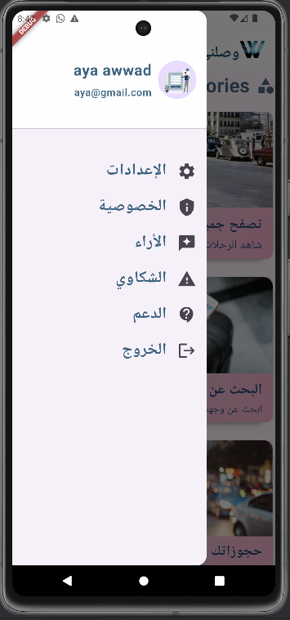
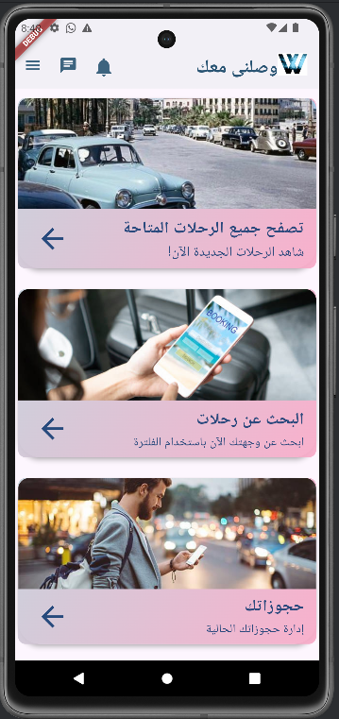
Navigation Drawer اعدادات اللغة

Slide 21
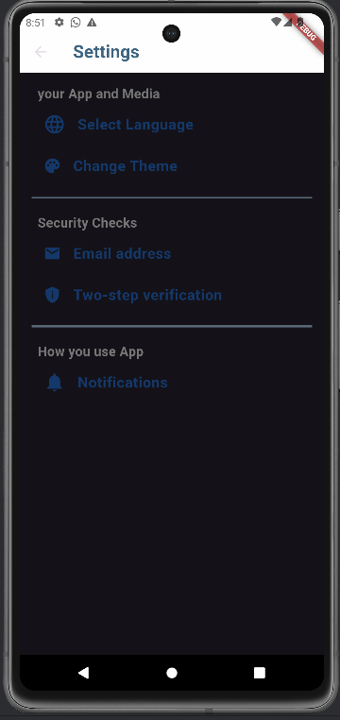
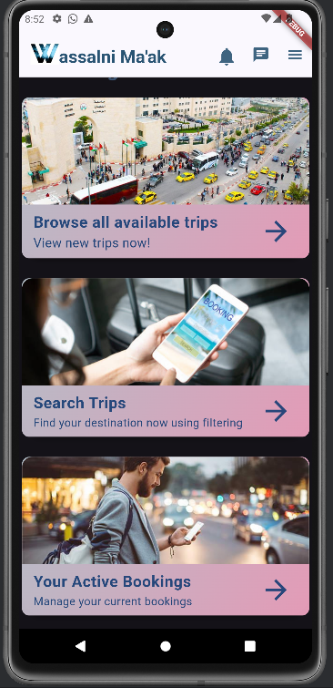
Navigation Drawer اعدادات الثيم

Slide 22
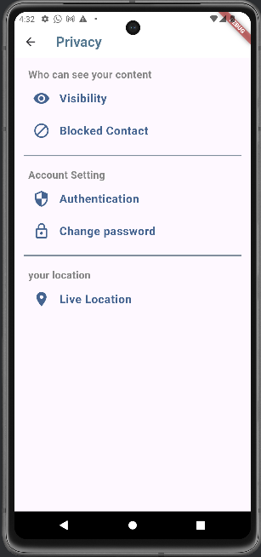
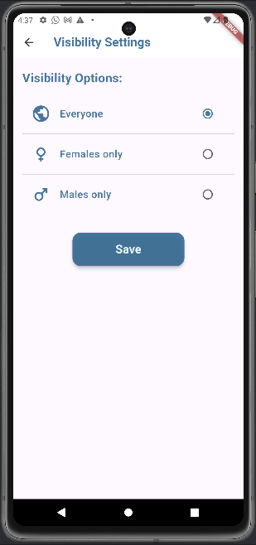
Navigation Drawer حالة الحساب

Slide 23




Security and Authentication
Use JWT to Authenticate accounts
Encrypt passwords and admin code
Hide the password

Slide 24
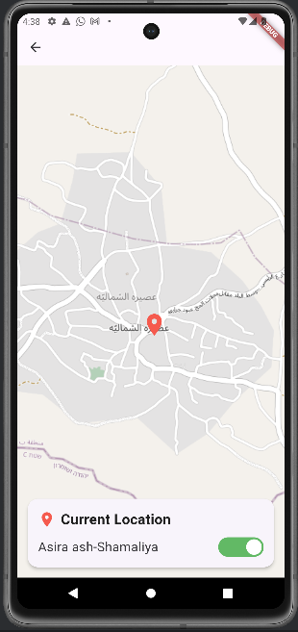
Navigation Drawer الموقع الحالي

Slide 25
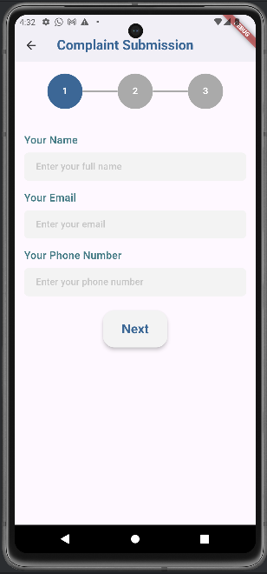


Navigation Drawer الشكاوي

Slide 26


Navigation Drawer الدعم

Slide 27



Personal Page المعلومات الشخصية

Slide 28

Personal Page سجلّ الدخل

Slide 29



Chatting
Chat List
Chat Page – User 1
Chat Page – User 2

Slide 30


Notifications اشعار حجز في رحلة

Slide 31

Website – Welcome Page

Slide 32

Website Admin

Slide 33

Admin
ادارة المستخدمين

Slide 34

جميع المستخدمين

Slide 35


البحث عن أي مستخدم
using name or phone

Slide 36



عرض معلومات اي مستخدم

Slide 37

Admin
ادارة الرحلات

Slide 38

Admin
ادارة الحجوزات

Slide 39


Search -البحث عن الحجوزات

Slide 40


Add – اضافة حجز جديد

Slide 41


Add – اضافة حجز جديد
عرض الرحلات لسائق معين

Slide 42

Admin
ادارة الشكاوي

Slide 43

Admin Management

Slide 44

Admin
اضافة ادمن جديد

Slide 45

Admin
حذف ادمن

Slide 46

Admin Chatting

Slide 47

CONSTRAINTS:
1
Updates in Flutter.
2
The Many Languages We Learned In Short Time.

Slide 48
FUTURE WORK :
2
To add the ability to track the car when it sets off to the intended
destination.
3
To add the feature of tracking road conditions so that the driver and
passenger can see the status of barriers and take the best route.
4
Organize trips through the application to tourist places.

Slide 49
THANK YOU !
Do you have any question ?

