Slide 1
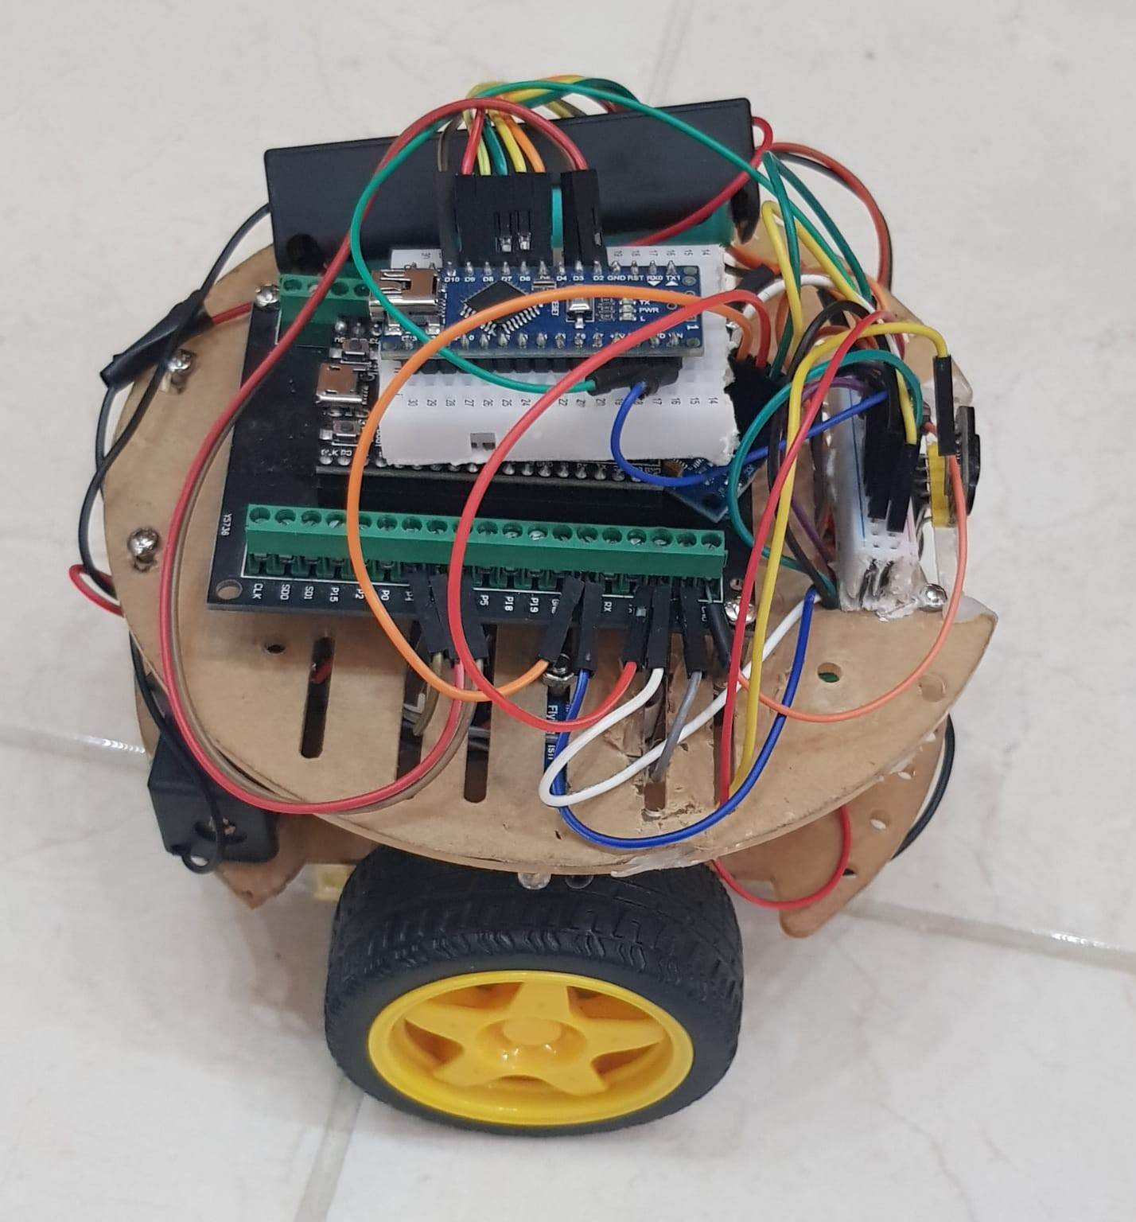
MAZESOLVER: ROBOT SOLVES A MAZE
AN-NAJAH NATIONAL UNIVERSITY
COMPUTER ENGINEERING DEPARTMENT
SUPERVISOR: DR. MUHANNAD AL-JABI
BY: MOTAZ QARMASH, ABDALRAHMAN MASRI

Slide 2
TABLE OF CONTENTS
Introduction
Flood Fill overview
Hardware Implementation
Main features
Challenges
Result and Analysis
Conclusions
Future work

Slide 3
TABLE OF CONTENTS
Introduction
Flood Fill overview
Hardware Implementation
Main features
Challenges
Result and Analysis
Conclusions
Future work

Slide 4
🚀 INTRODUCTION
Motivation: Automating maze-solving tasks to address the need for adaptive navigation in dynamic environments.
Problem: Navigating unpredictable settings requires solutions that can adjust in real-time.
Goal: Develop a cost-effective, efficient robot to solve a 4x4 maze using the Flood Fill algorithm.

Slide 5
🛠️ SOFTWARE IMPLEMENTATION

Slide 6
🌀 FLOOD FILL OVERVIEW
The Flood Fill algorithm in our project is implemented to help the MazeSolver robot navigate a 4x4 maze toward a specified goal. Here’s a summary of how it works in points:
Initializes a distance array with a maximum value for all cells, setting the goal cell’s distance to 0.
Uses a queue to process cells, starting from the goal, and calculates the shortest distance to each reachable cell.
Updates distances by exploring adjacent cells (north, south, east, west) if no walls block the path.
Assigns each cell a distance value based on the minimum path length from the goal.
Guides the robot to move toward the cell with the smallest distance in the next step, adjusting orientation and position accordingly.
Recomputes distances dynamically after each wall

Slide 7
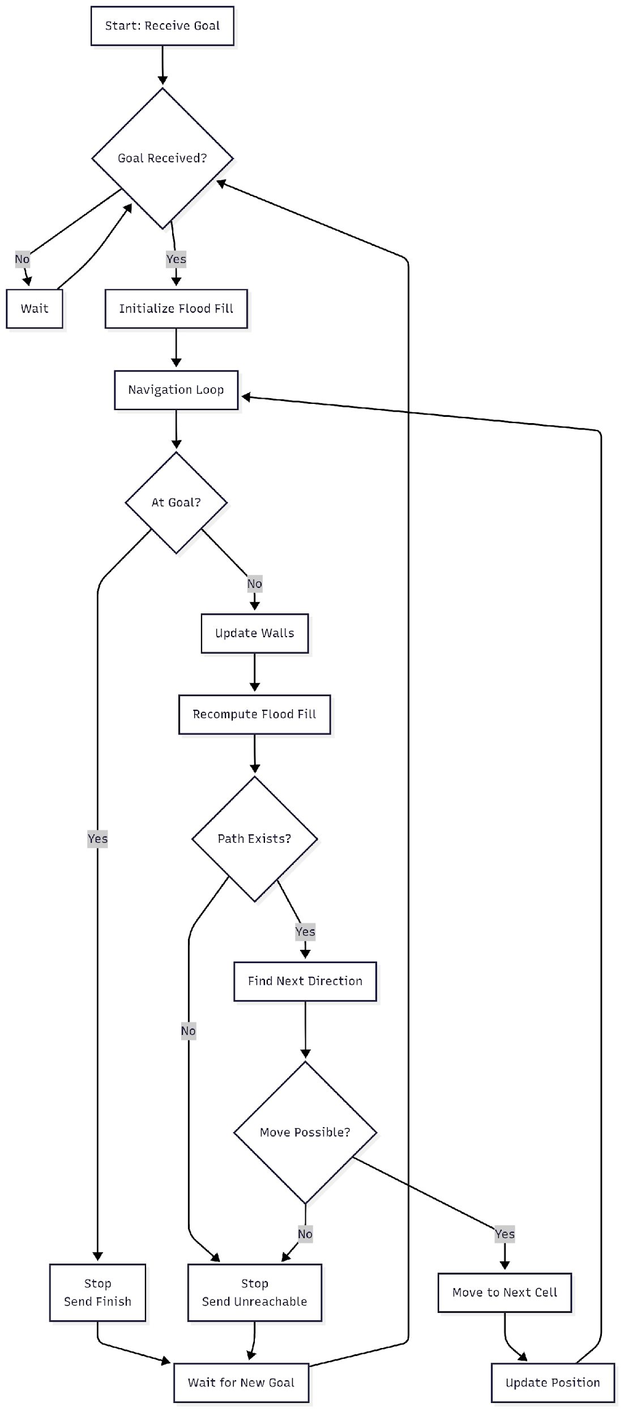
📊 FLOOD FILL NAVIGATION FLOWCHART
Overview: The flowchart illustrates the robot's decision-making in floodFillNavigate(): Receive goal → Map maze → Navigate until goal or unreachable.
Key Steps:
Receive Goal & Initialize: Robot waits for goal (row, col) from remote. Navigation Loop: Check if at goal. If yes, stop and send "Finish". If no, sense walls (IR/LiDAR) and update map.
Recompute Flood Fill: Reset distances, run BFS from goal through open paths. If current position = 16, goal is unreachable – stop and send "Unreachable".
Find & Move: Select lowest-distance neighbor. If blocked, backtrack to visited cell. Move to next cell.

Slide 8
🛠️ HARDWARE IMPLEMENTATION

Slide 9
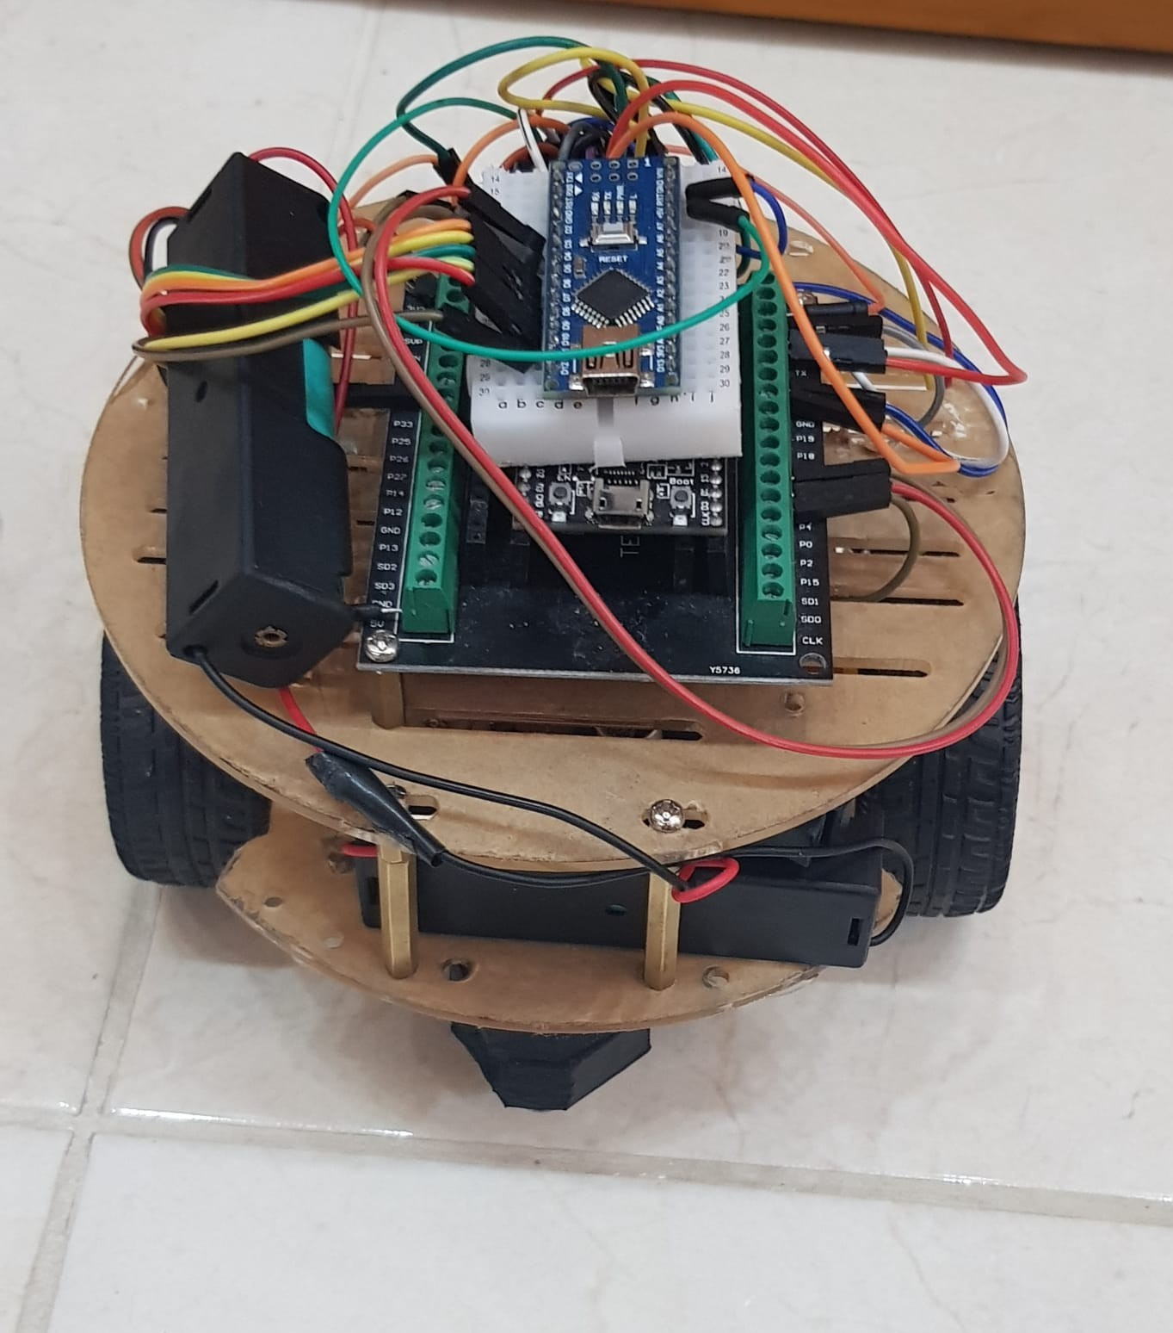
Robot COMPONENTS

Slide 10
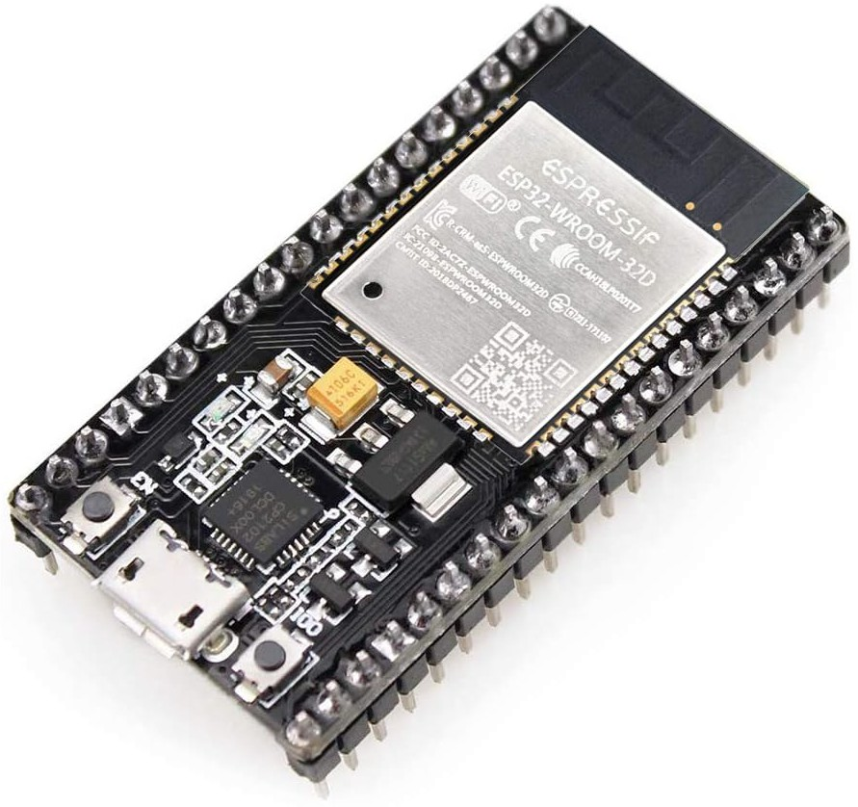
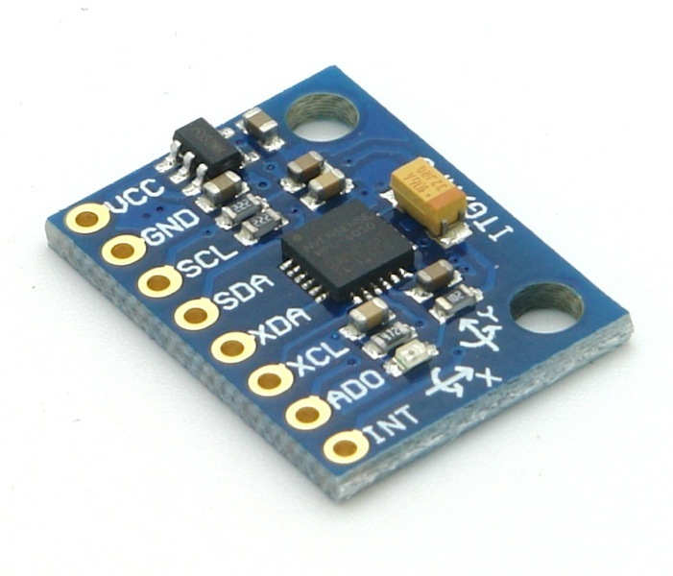
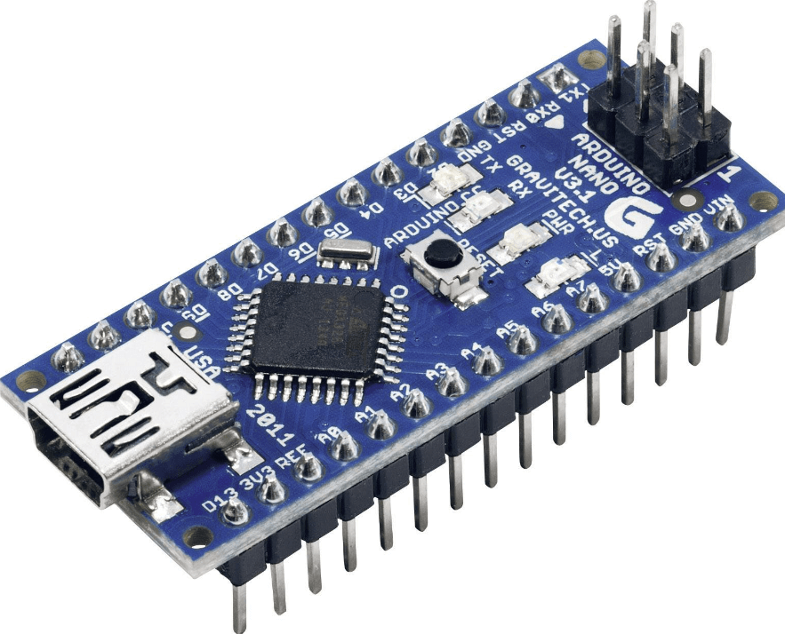
Robot COMPONENTS
Esp32-Wroom
MPU6050
Arduino-Nano
Ran control loop, algorithm, ESP-NOW communication with the remote, and controlling servo motors. | Ensured accurate turns with gyroscopic orientation data. | controls robot by processing sensor data and driving motors.

Slide 11
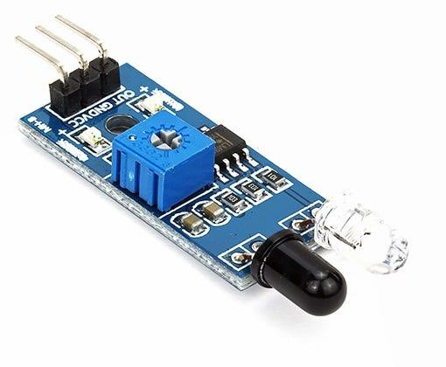
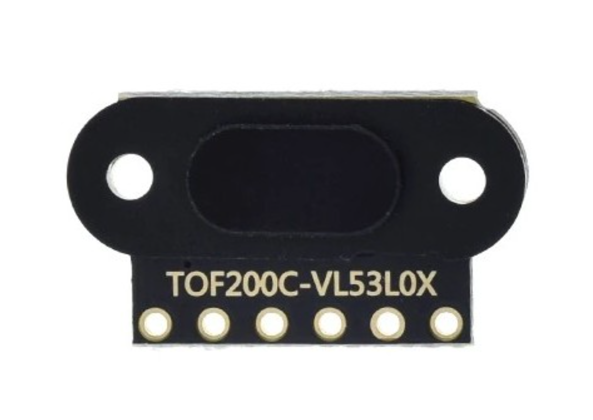
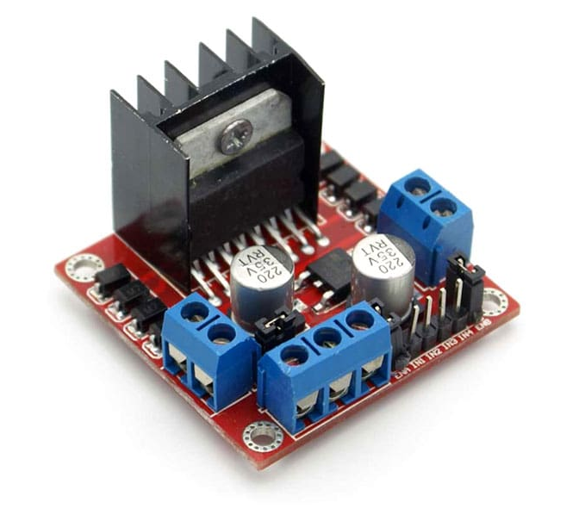
Robot COMPONENTS
IR sensor
VL530X Lidar
L298N
Detected left/right walls for maze mapping in the Flood Fill algorithm. | Measured distances for centering and precise obstacle detection. | Drove DC motors with PWM for precise movement.

Slide 12
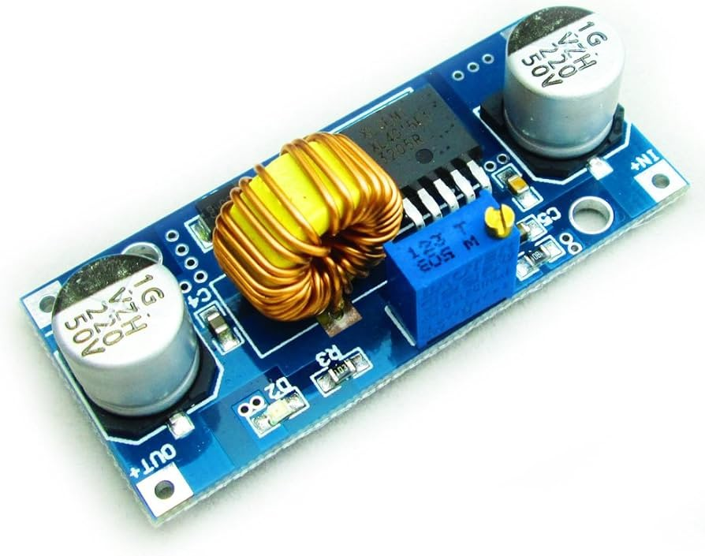
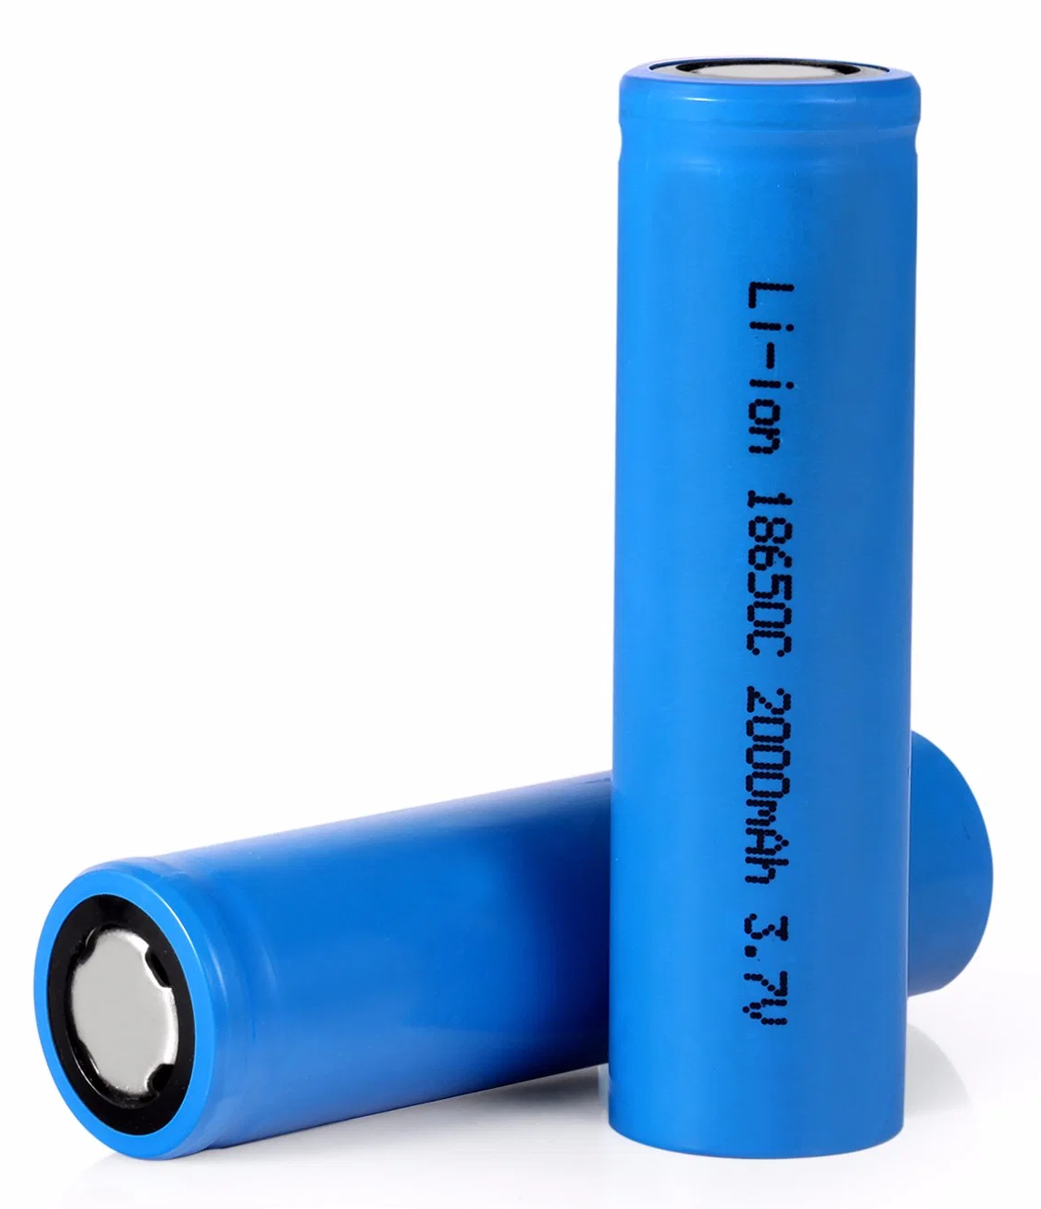
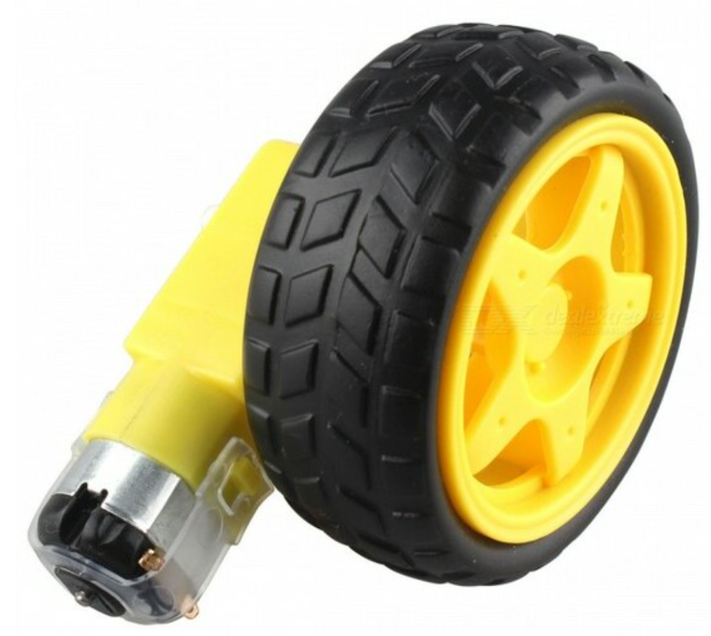
Robot COMPONENTS
XL4015
2xLithium Battery
2xDc Motors with encoder
Converts 7.4V→5V to safely power ESP32, Arduino, sensors, and L298N logic. | power and control all robot components (motors, microcontrollers, sensor). | controls wheel speed for smooth, accurate movement and uses encoder feedback for basic odometry to track distance.

Slide 13
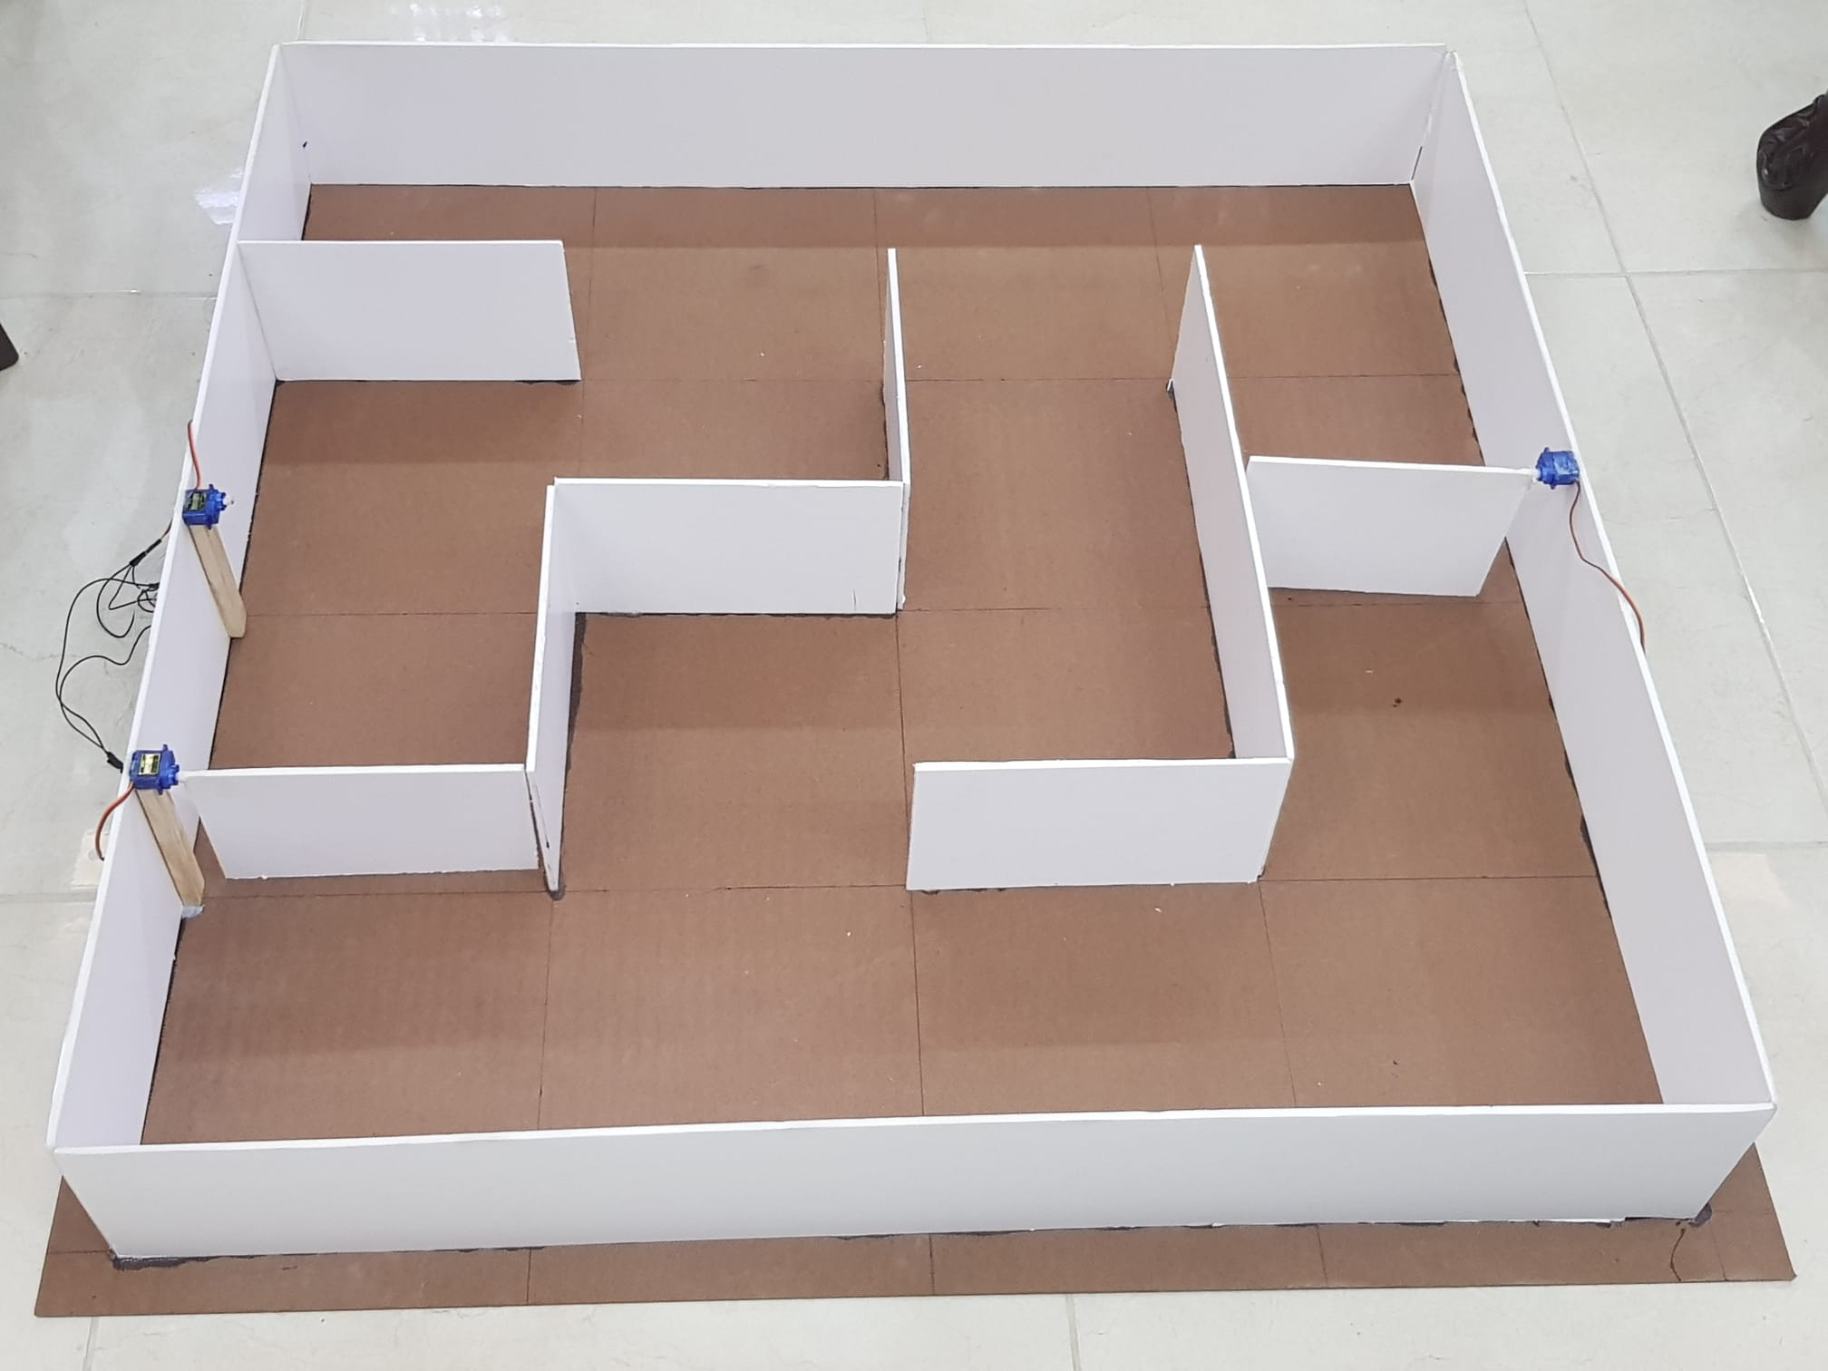
Maze Design

Slide 14
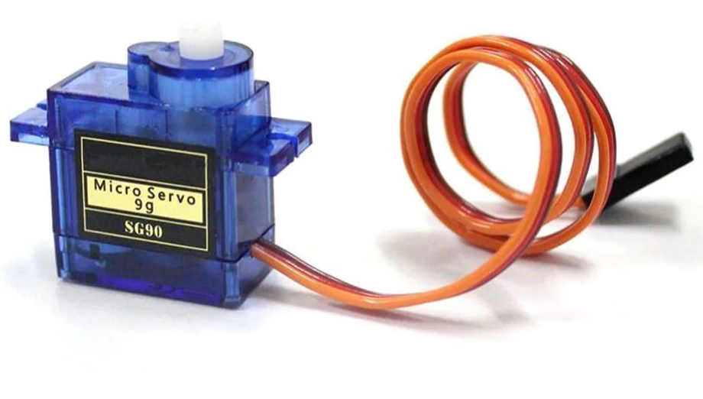
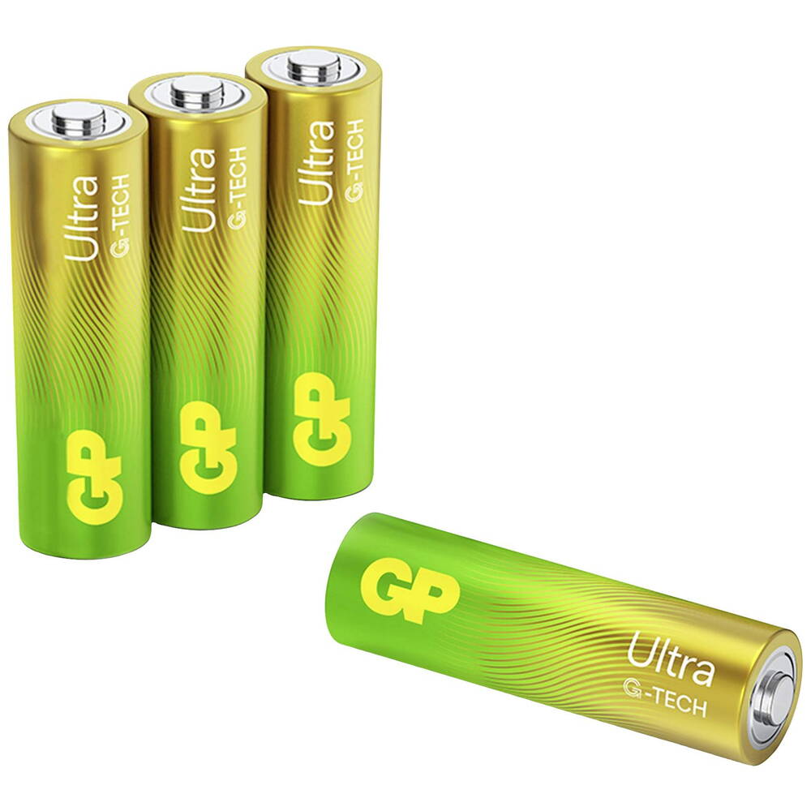
Maze COMPONENTS
Servo Motors
4xGP batteries
Esp32-Wroom
Controlled three maze walls , opening/closing. | power the ESP32 and the servo motors. | controls the servo motors to open or close walls based on commands from the remote unit.

Slide 15
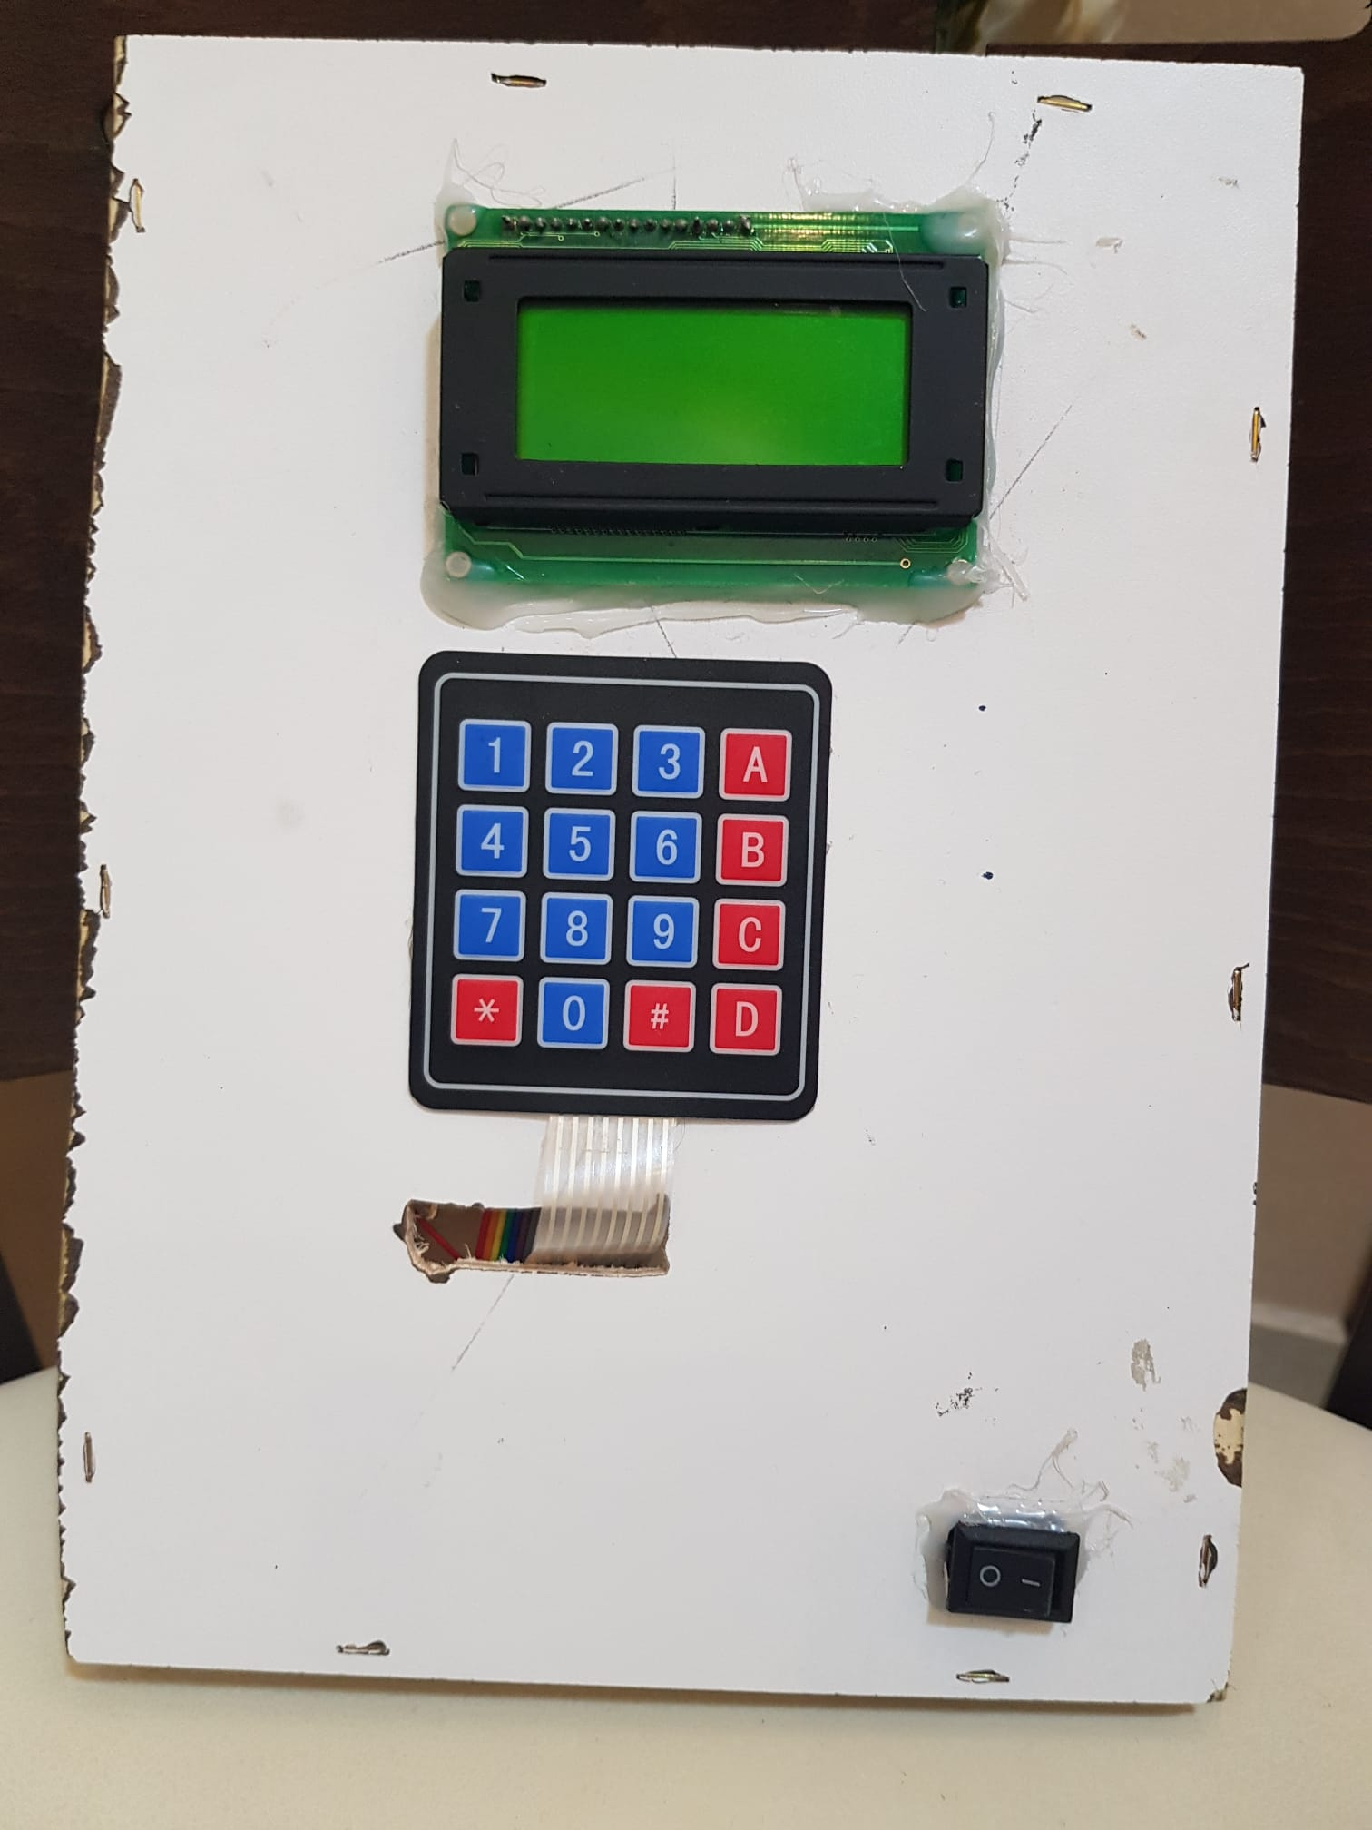
Remote Control

Slide 16
Remote Control COMPONENTS
4xGP 1.5Vbatteries
Esp32-Wroom
Power for the remote control | The ESP32 is used in the Remote Control to manage components like the LCD and keypad

Slide 17
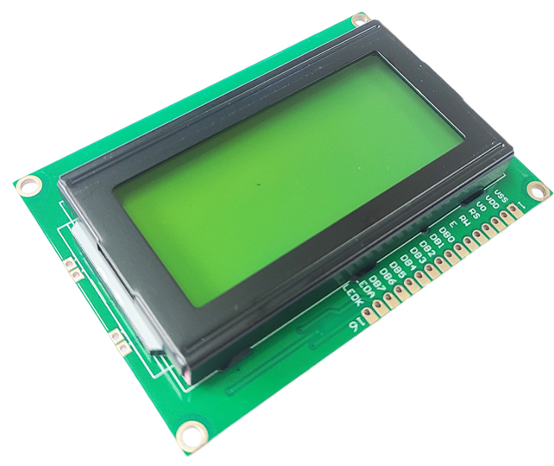
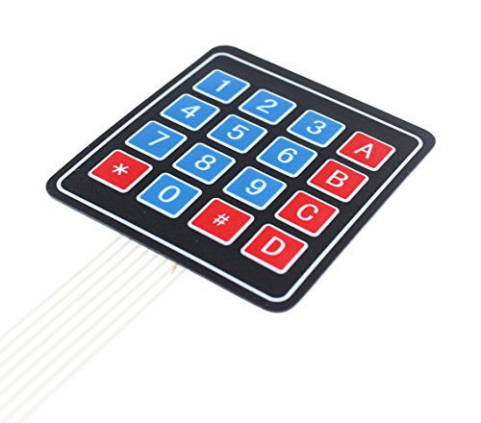
Remote Control COMPONENTS
LCD 16*4
Keypad 4*4
Displayed robot status and prompts on the remote. | remote control for goal coordinates, control servo motors for dynamic walls.

Slide 18
Keypad Button Functions
Button | Function
0–3 | Input the row or column coordinate for the goal point.
A | Resets the system and sends a stop command to the robot, clearing the current goal.
* | Saves the entered row or column value for the goal coordinates.
# | Clears the currently entered row or column value.
B | Toggles the first servo motor between 0 and 180 degrees to open or close a maze wall (via ESP-NOW to maze ESP32).
C | Toggles the second servo motor between 0 and 180 degrees to open or close a maze wall (via ESP-NOW to maze ESP32).
D | Toggles the third servo motor between 0 and 180 degrees to open or close a maze wall (via ESP-NOW to maze ESP32).
4–9 | Not used.

Slide 19
✨ MAIN FEATURES

Slide 20
MAIN FEATURES
Autonomous navigation using the Flood Fill algorithm.
Real-time path planning and dynamic wall adaptation with servo-controlled maze.
Remote control via ESP-NOW protocol with keypad and LCD.
Precise movement with L298N motor driver and DC motors with single encoder.
Loop detection and unreachable goal handling for robust navigation.

Slide 21
⚡ CHALLENGES

Slide 22
CHALLENGES
Motor and Driver Limitations: DC motors are prone to voltage drops, and the L298N driver overheats during prolonged use, potentially reducing performance without cooling or upgrades.
Power Supply Limitations: it was difficult to determine the exact voltage and current requirements for my project.
Sensor Constraints: IR sensors are affected by light and reflectivity.
Development Time: The project timeline constrained testing and advanced features like full PID control or machine learning integration.
Terrain Assumptions: The design assumes flat surfaces, making it unsuitable for uneven terrain without significant modifications

Slide 23
📈 RESULT AND ANALYSIS

Slide 24
📈 RESULT AND ANALYSIS
Maze Solving and Pathfinding: Robot navigated from start to user-defined endpoint using Flood Fill, mapping walls initially and taking the shortest path in later runs .
Wall Configuration Adaptation: Successfully navigated maze with pre-set servo-controlled walls, adapting via Flood Fill to different configurations.
Remote Control and Communication: ESP-NOW provided reliable, low-latency link for goal setting and real-time position updates on LCD.

Slide 25
🎯 Conclusion

Slide 26
🎯 Conclusion
Effective Algorithmic Control
Robust Hardware Integration
Seamless Communication Network
Validation of Design
Robust Error Handling
Efficient Power Management

Slide 27
🔮 FUTURE WORK

Slide 28
🔮 FUTURE WORK
Implement Full PID control.
Enhance the User Interface.
Expand Dynamic Maze Capabilities
Incorporate RFID Localization.

Slide 29
🙏 THANK YOU

