Slide 1

An-Najah National University
Faculty of Engineering & Information Technology
Mechanical Engineering Department
Graduation Project II
CFD Simulation of Water Distribution Network
Prepared By:
Yahya Mohammad Bani Matar
Khaled Omar
Loai Abu Shomar
Supervisor
Dr. Mahmoud Assad

Slide 2
Outline
Fluid
Pipe Fittings
Pipe network problems
CFD
Geometry
Mesh
Results
Pressure drop
Conclusion
Future work

Slide 3

Fluid mechanics
Fluid mechanics is the study of the behavior of liquids and gases, and particularly the forces that they produce.

Slide 4
Fluid mechanics is involved in many scientific disciplines
Meteorologists
Physics
Engineering

Slide 5
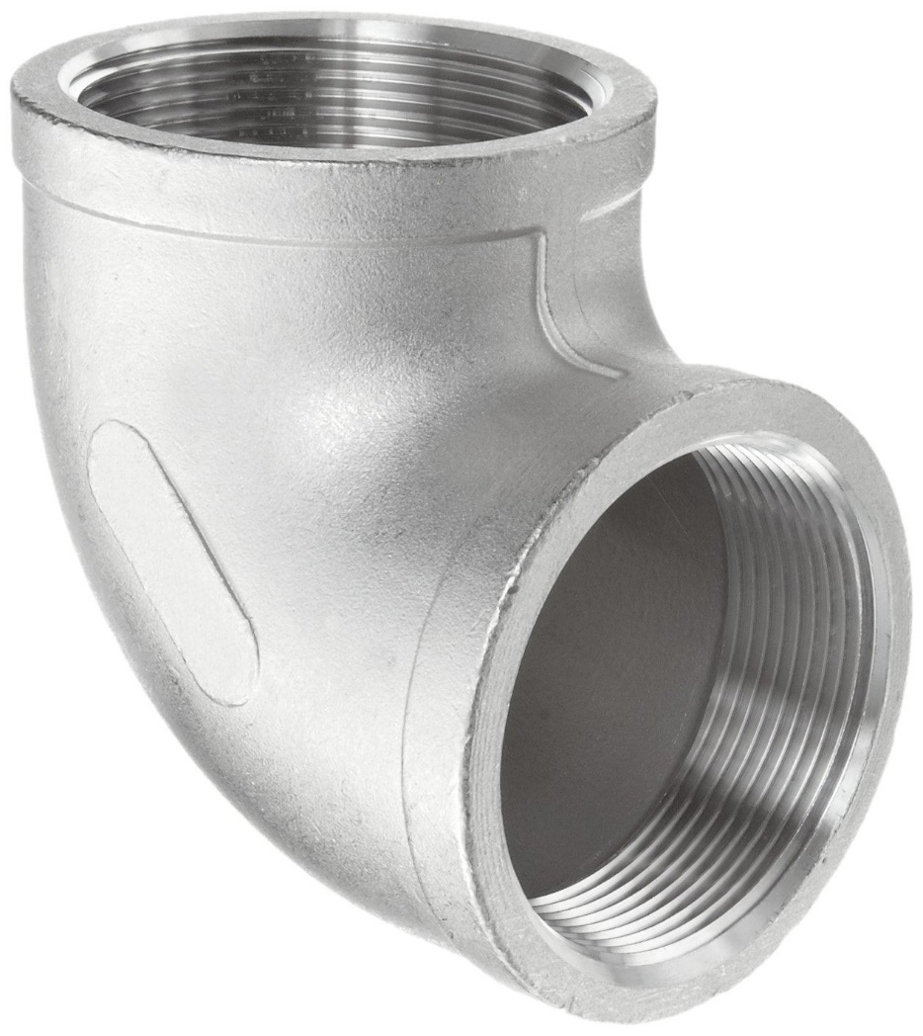
Pipe Fittings
What are the pipe fittings?

Slide 6
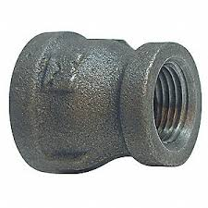
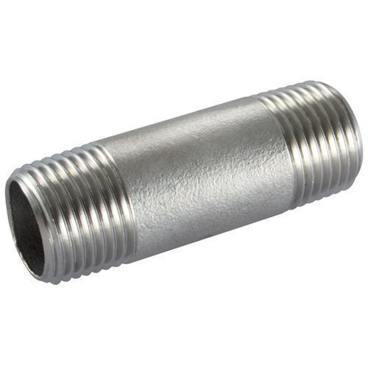
Types of pipe fittings
Elbow
Tee
Nipple
Reducer

Slide 7
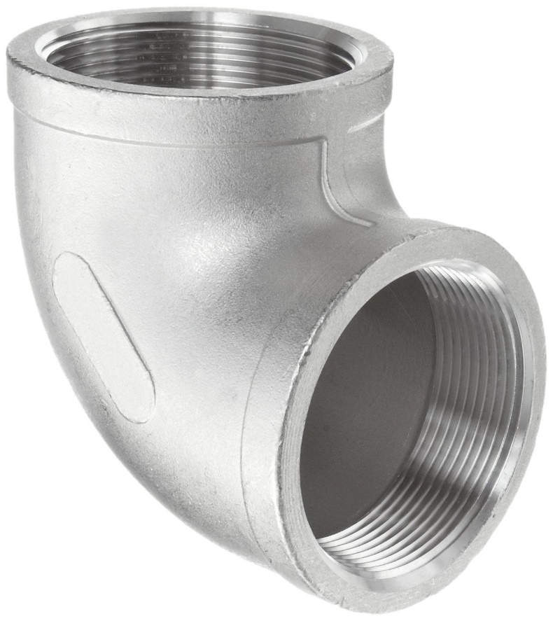
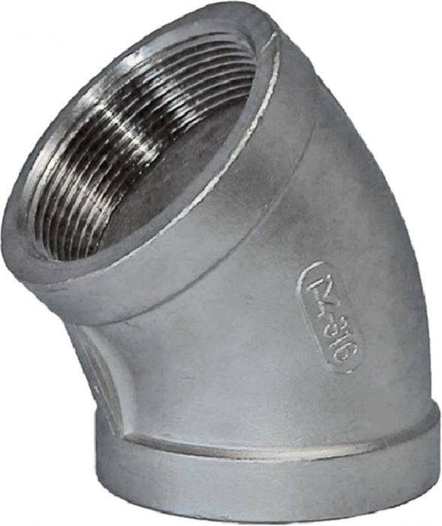
Elbows
90-degree elbow
45-degree elbow

Slide 8
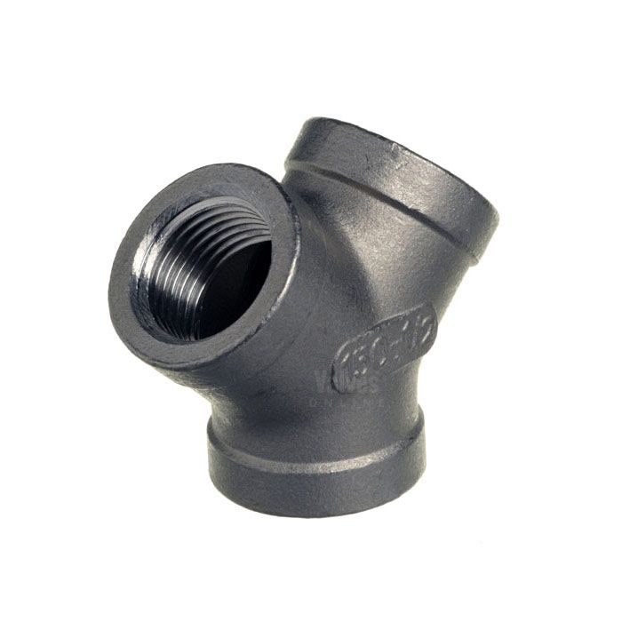
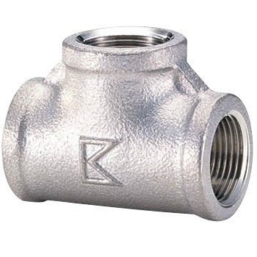
Tees
Tee-Joint
Y-Joint

Slide 9
Applications of pipe fittings
The transfer of extremely hazardous materials.
Protection of sensitive equipment from high pressures.
Protection from corrosion.
Resistance to household and industrial chemicals.

Slide 10
Industries in which pipe fittings enter
Chemical / Petrochemical
Municipal
Oil and Gas
Power
Process Instrumentation
Marine & dredging
Sanitation
Residential
Road & highway construction
Ventilation etc.

Slide 11
Pipe network problem
Unreasonable design
Poor pipe network quality
Incorrect selection of insulation thickness

Slide 12
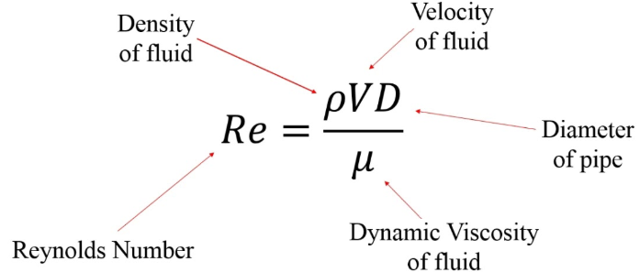
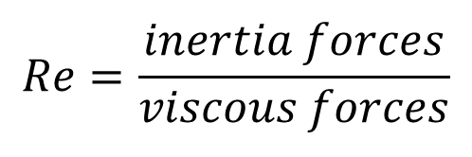
Reynolds Number
$$Re=\frac{inertia forces}{viscous forces}$$

Slide 13
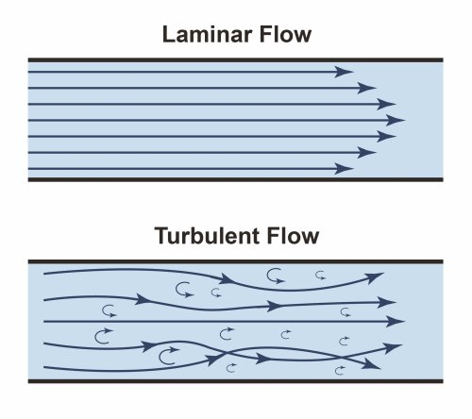
Laminar and Turbulent

Slide 14
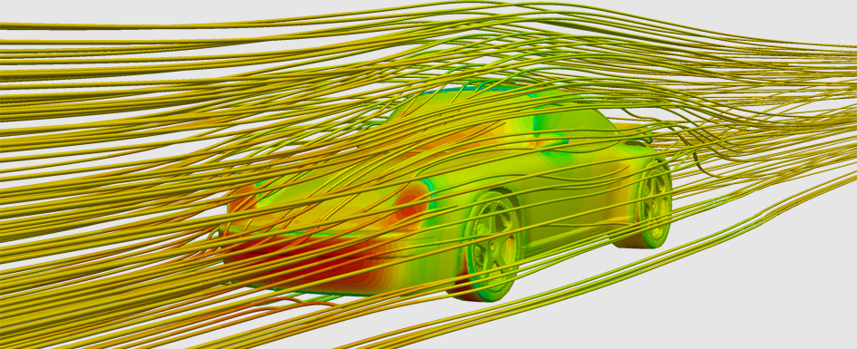
CFD
What is the CFD?

Slide 15
Applications of CFD
Aerodynamics
HVAC
Heat transfer
Pipes and valves

Slide 16
Advantages of CFD
Provides a detailed understanding of flow
Cost saving
Speed
Simulate real conditions

Slide 17
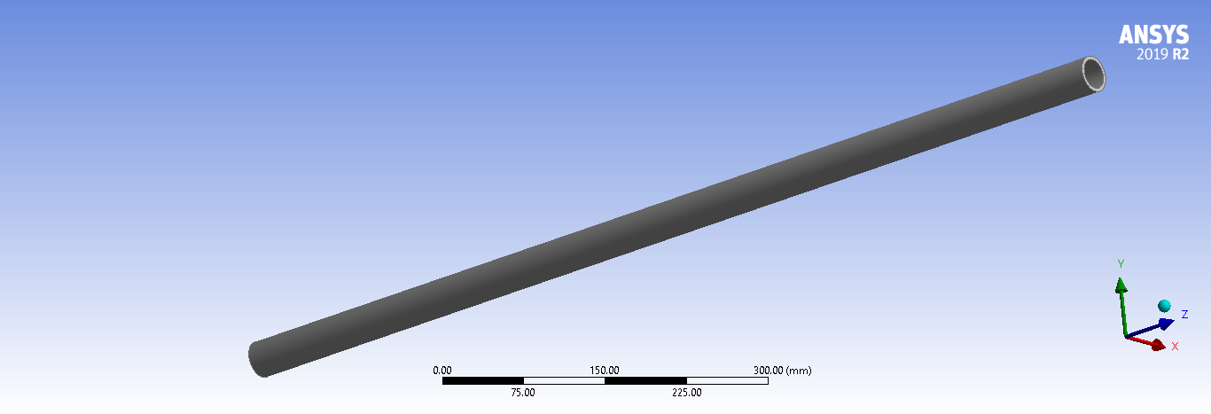
Geometry
Pipe

Slide 18
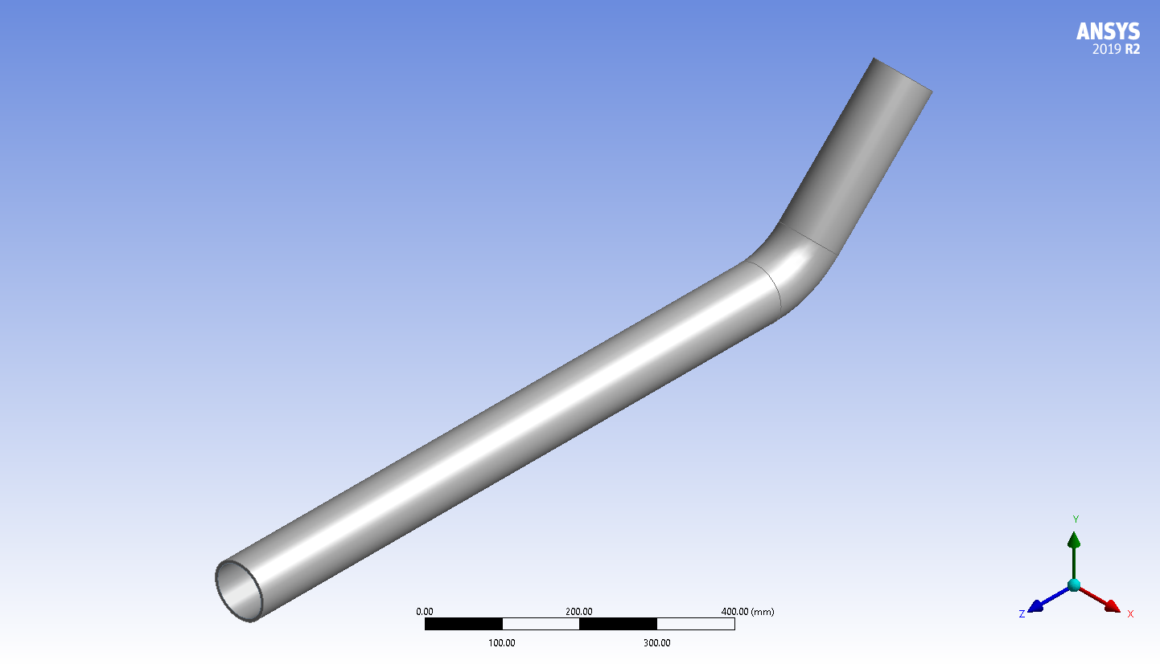
Geometry
Elbow 45º

Slide 19
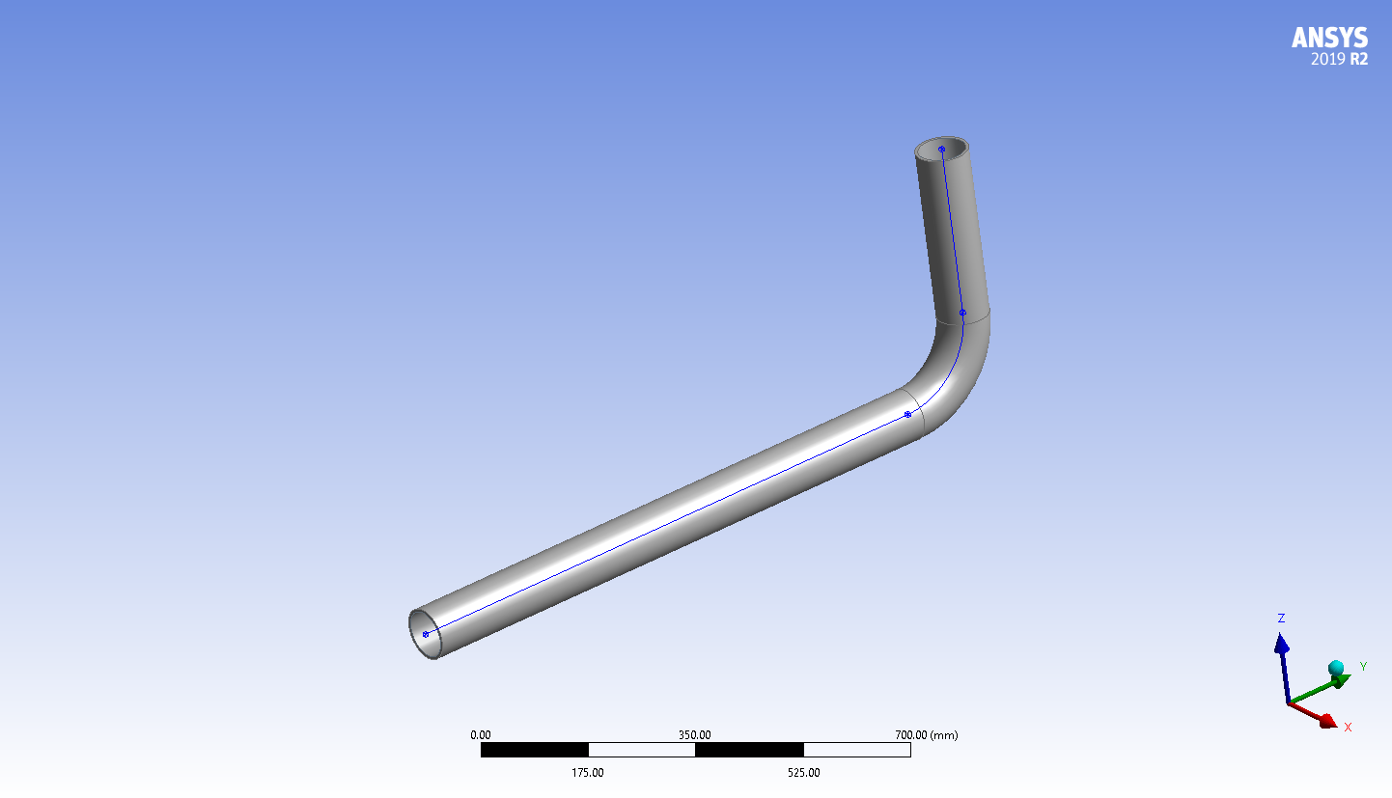
Geometry
Elbow 90º

Slide 20
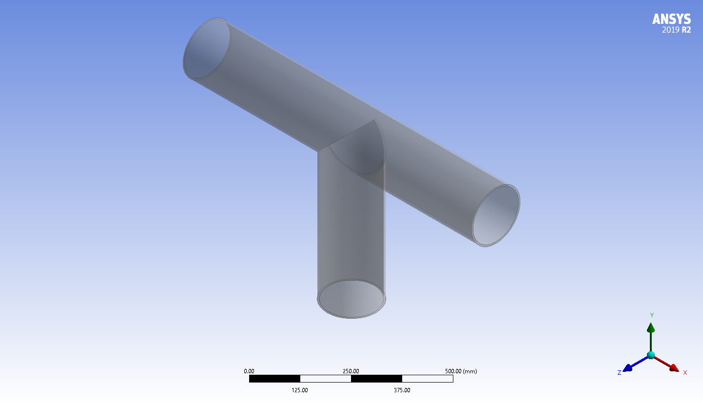
Geometry
T-junction

Slide 21
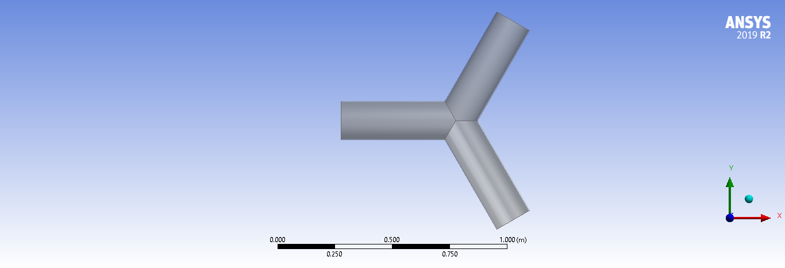
Geometry
Compact wye

Slide 22
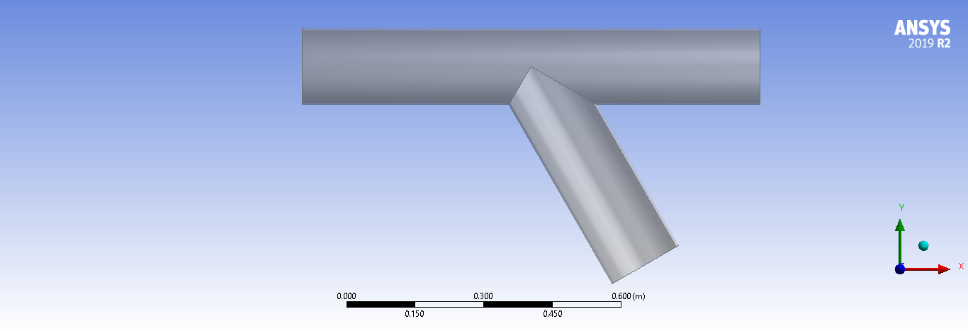
Geometry
Standard wye

Slide 23
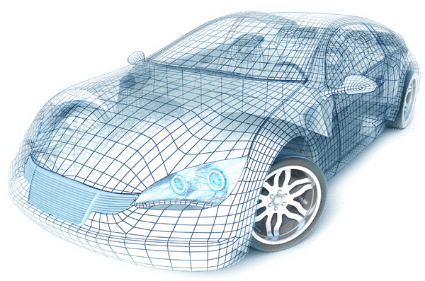
Mesh

Slide 24
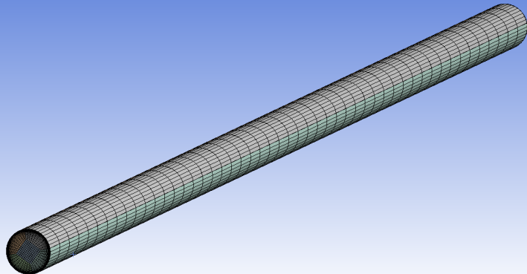
Mesh
Pipe

Slide 25
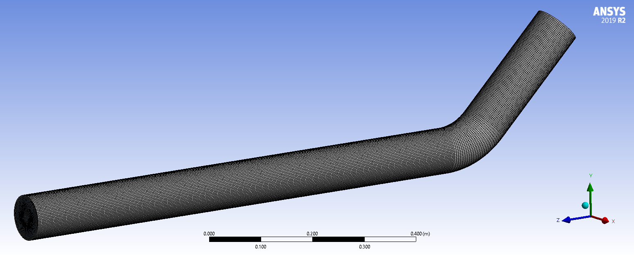
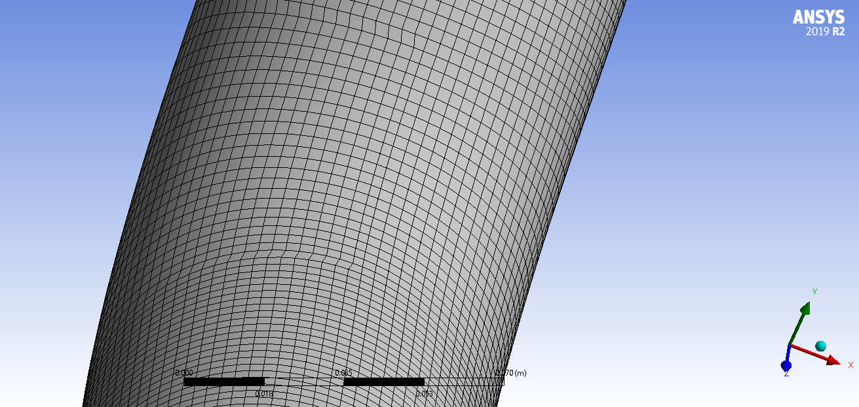
Mesh
Elbow 45º

Slide 26
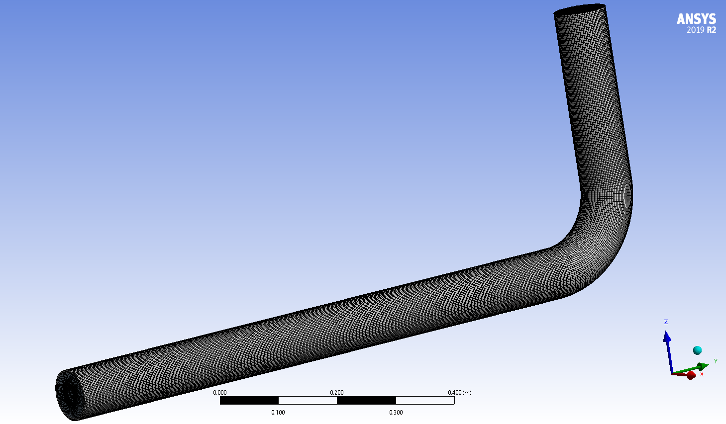
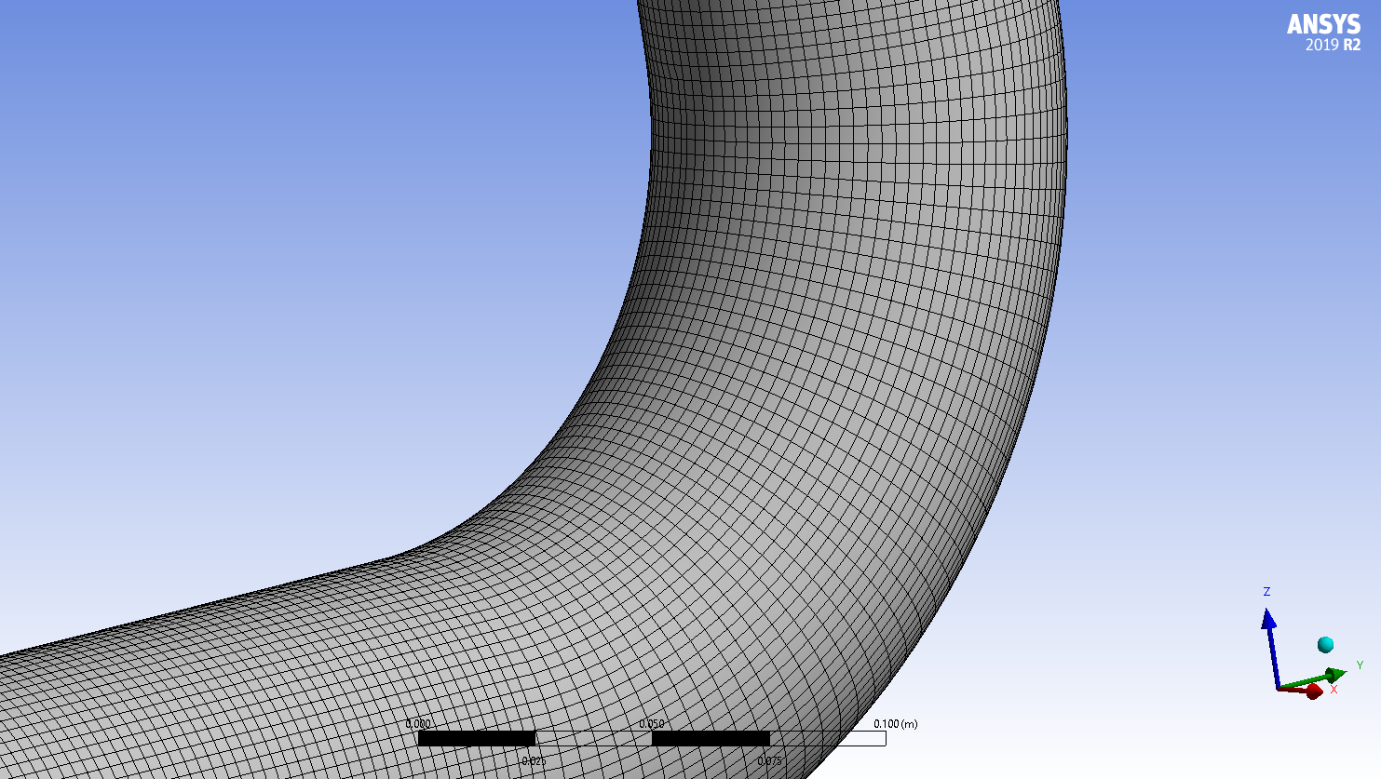
Mesh
Elbow 90º

Slide 27
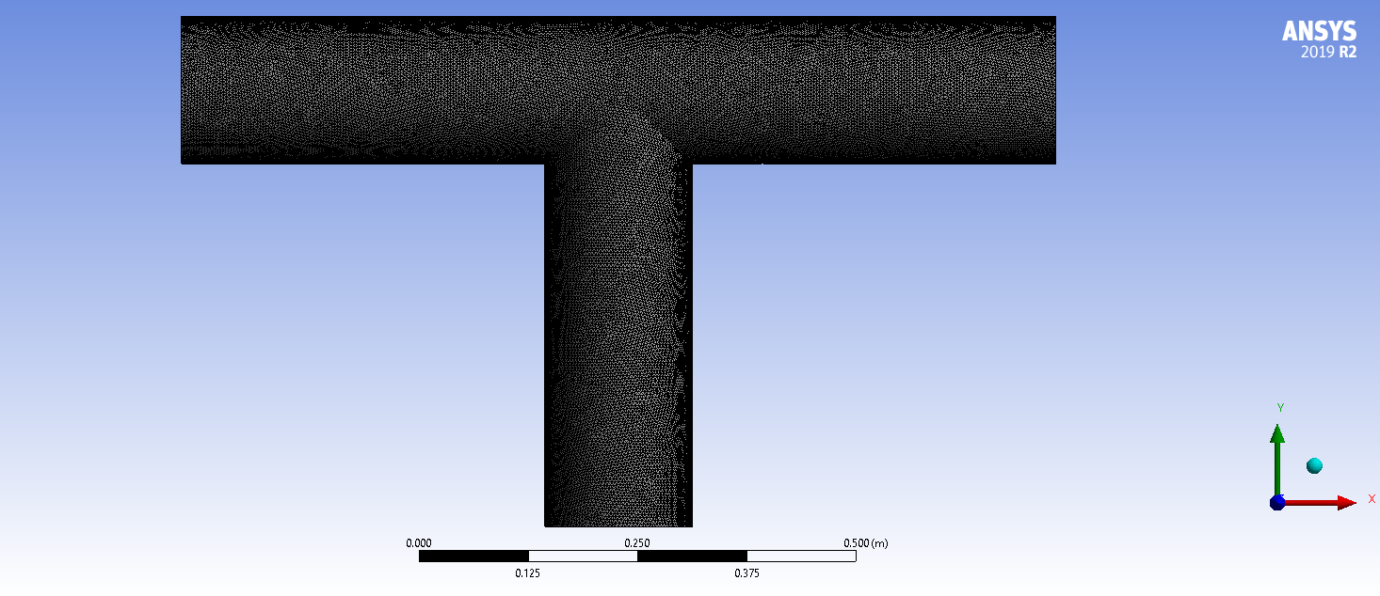
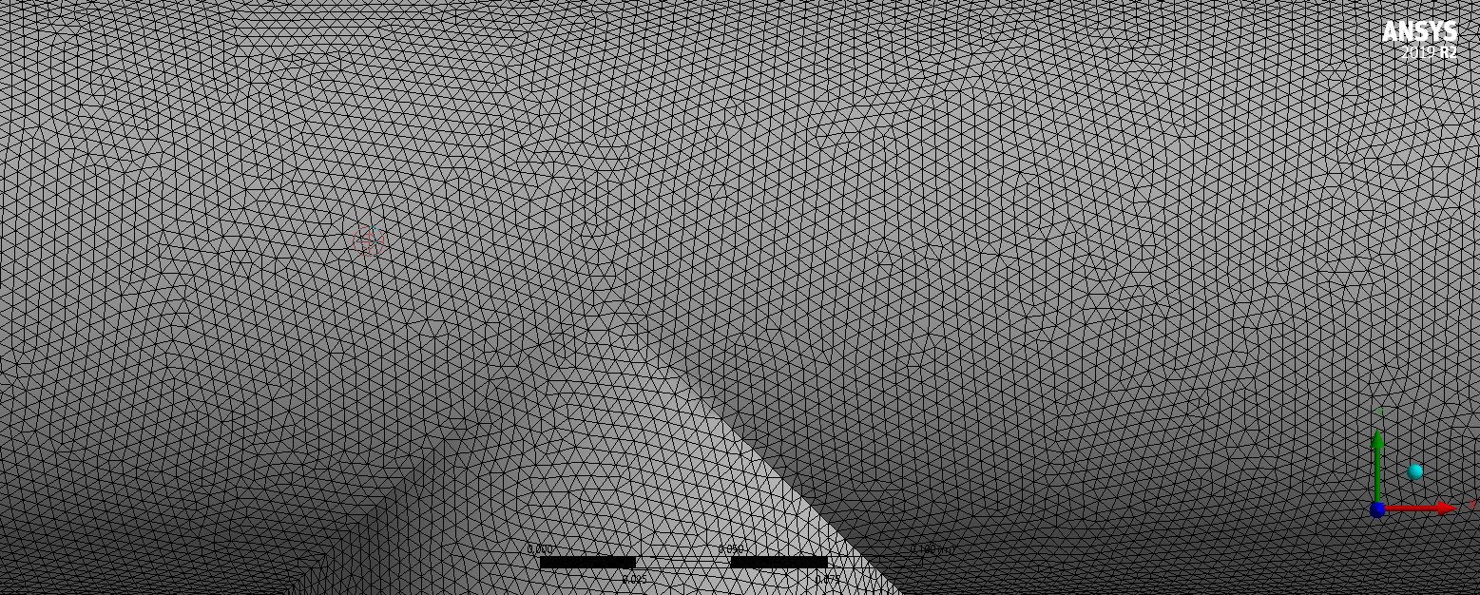
Mesh
T-junction

Slide 28
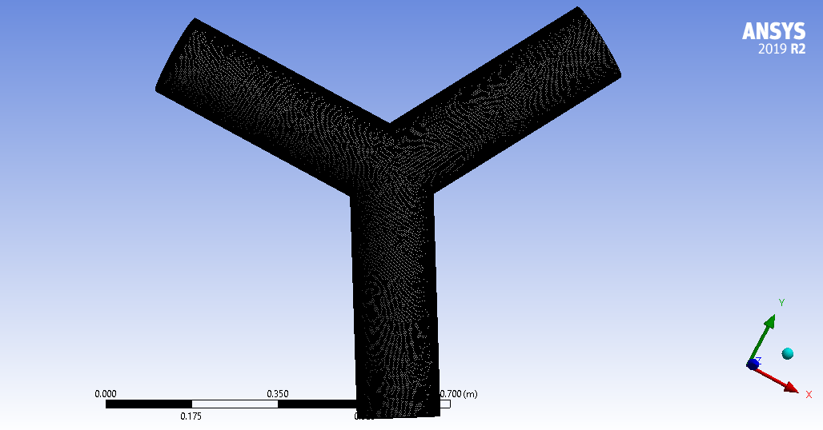
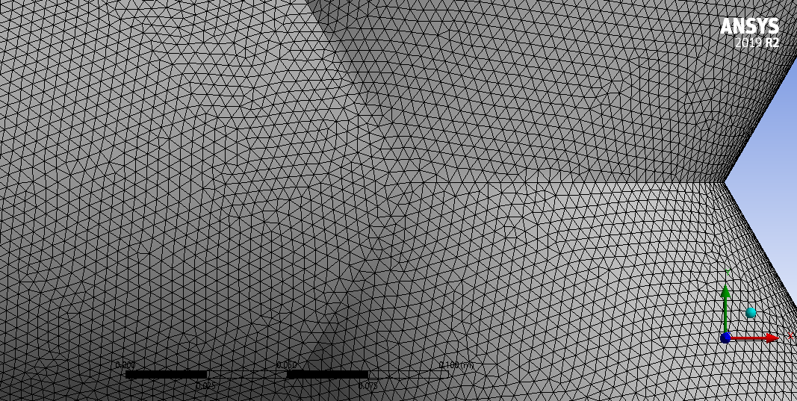
Mesh
Compact wye

Slide 29
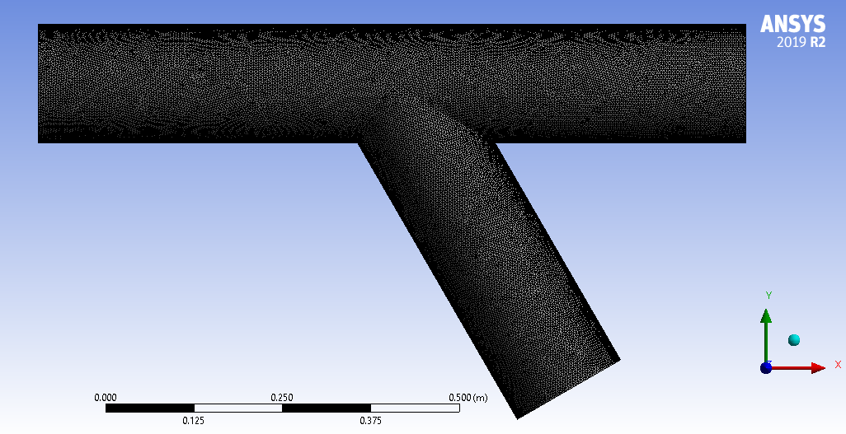
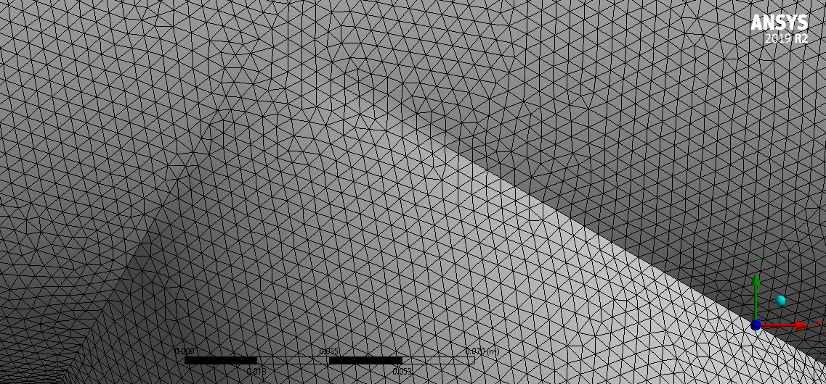
Mesh
Standard wye

Slide 30
Results
Pipe

Slide 31
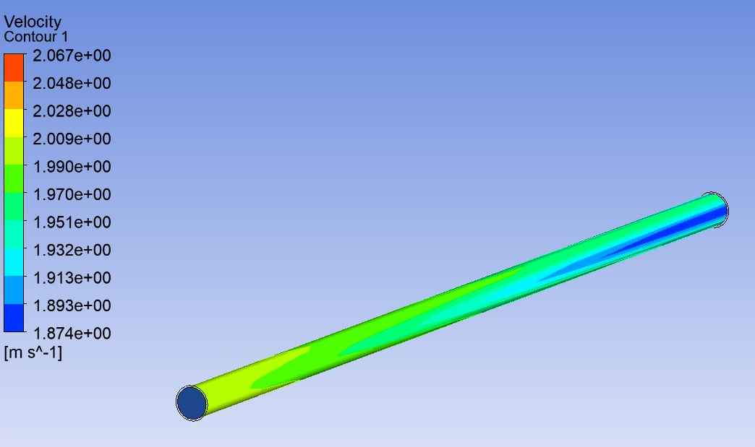

Slide 32
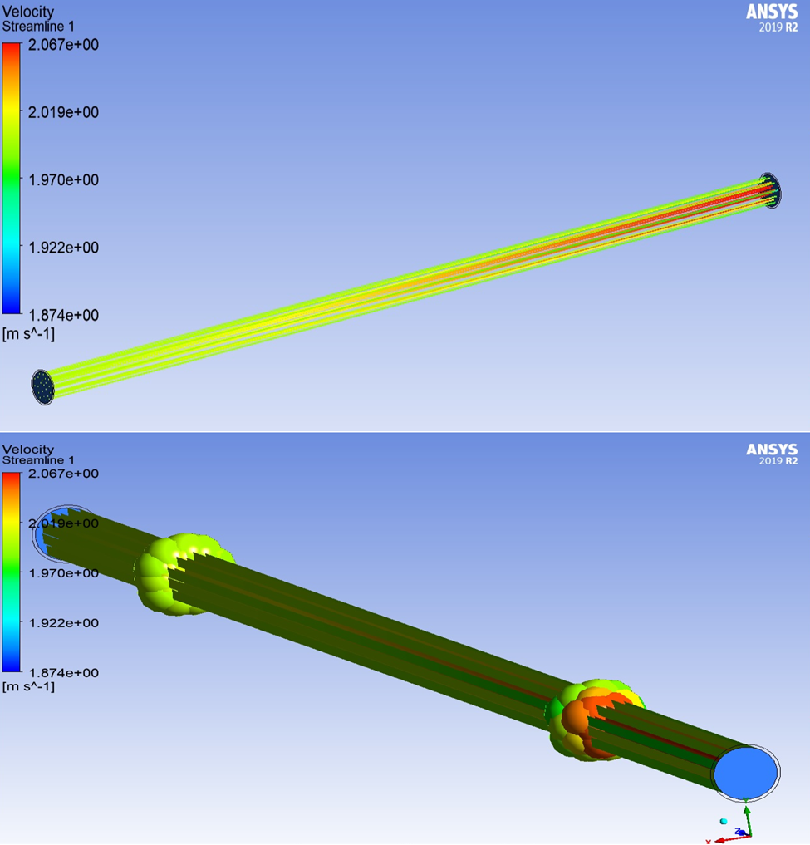

Slide 33
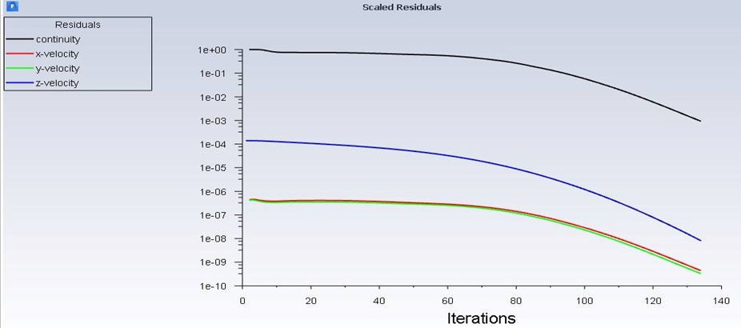

Slide 34
Results
Elbow 45º

Slide 35
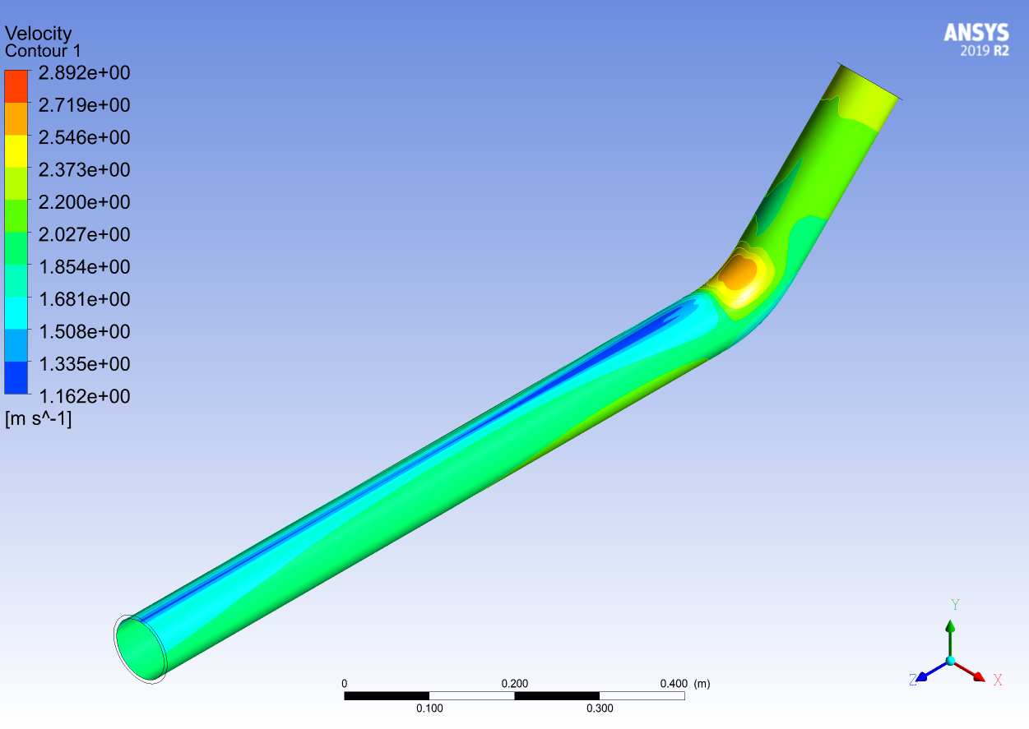

Slide 36
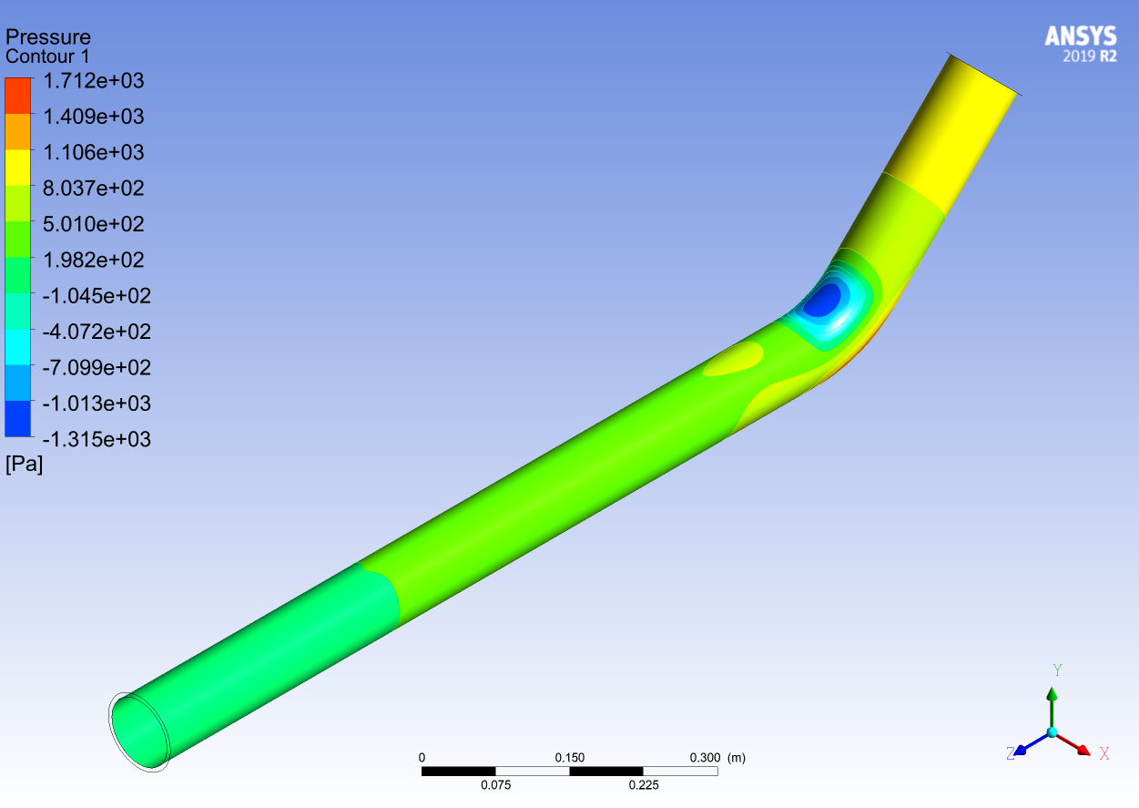
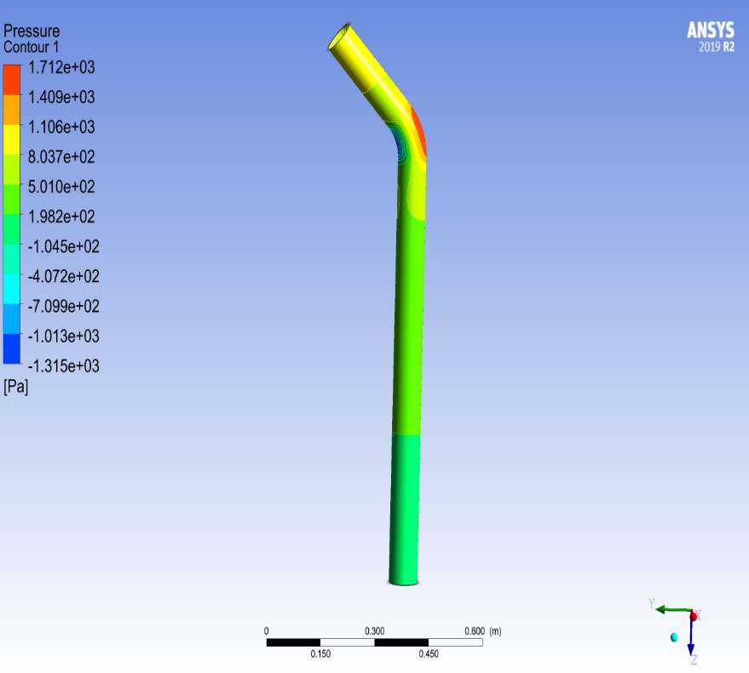

Slide 37
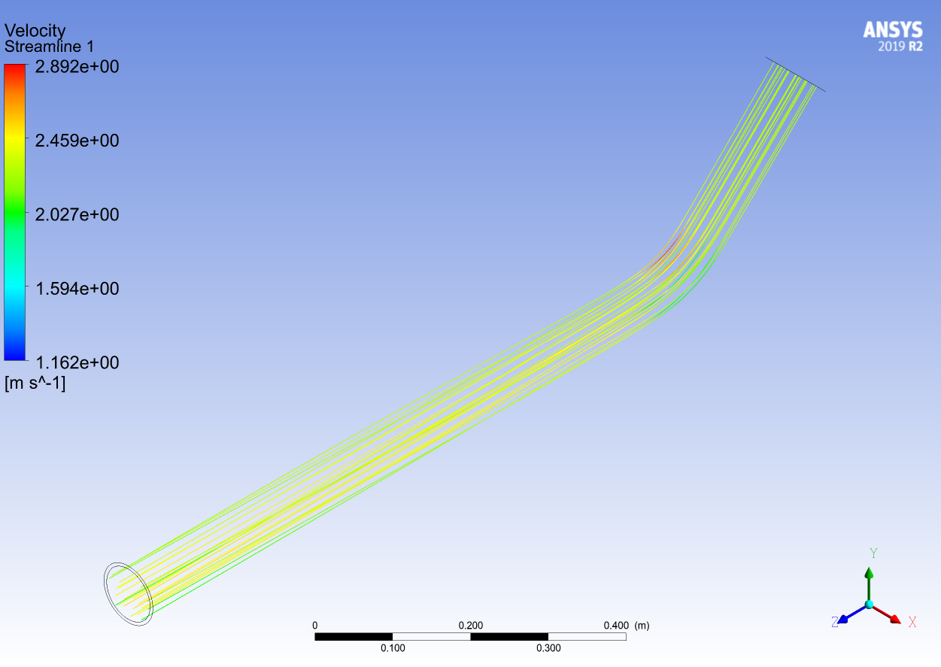

Slide 38
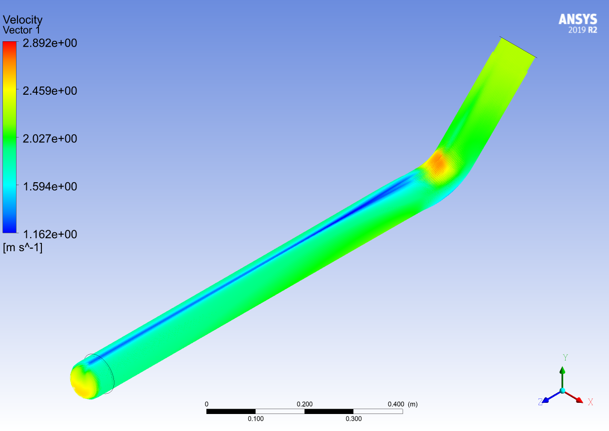

Slide 39
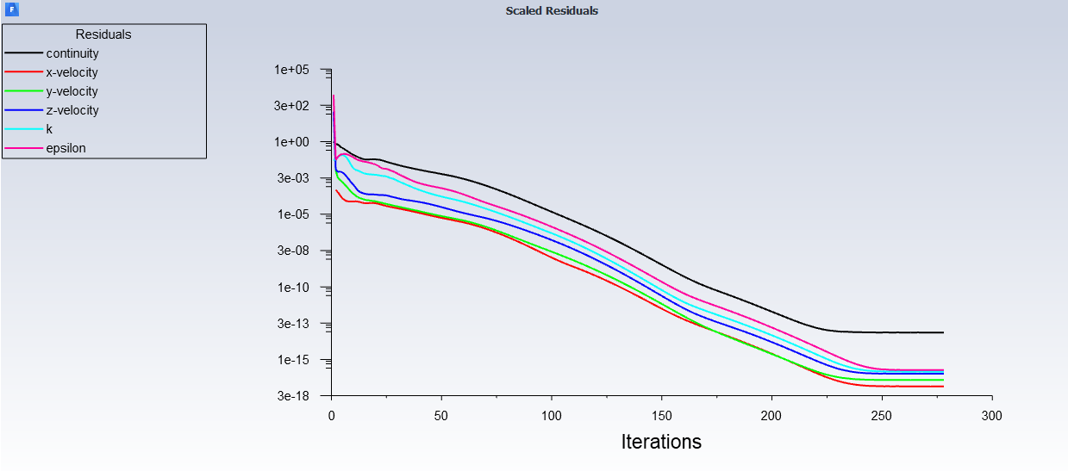

Slide 40
Results
Elbow 90º

Slide 41
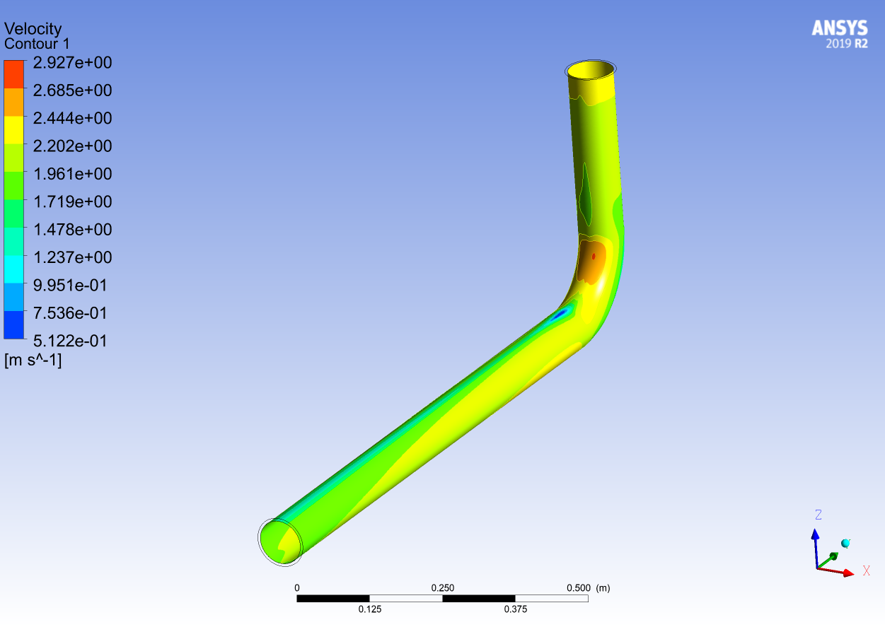

Slide 42
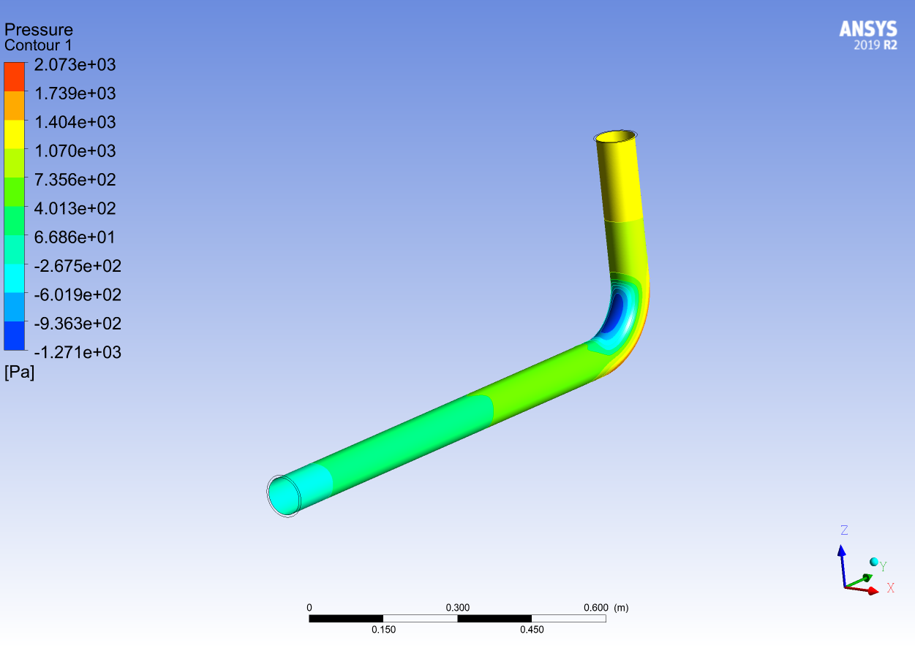
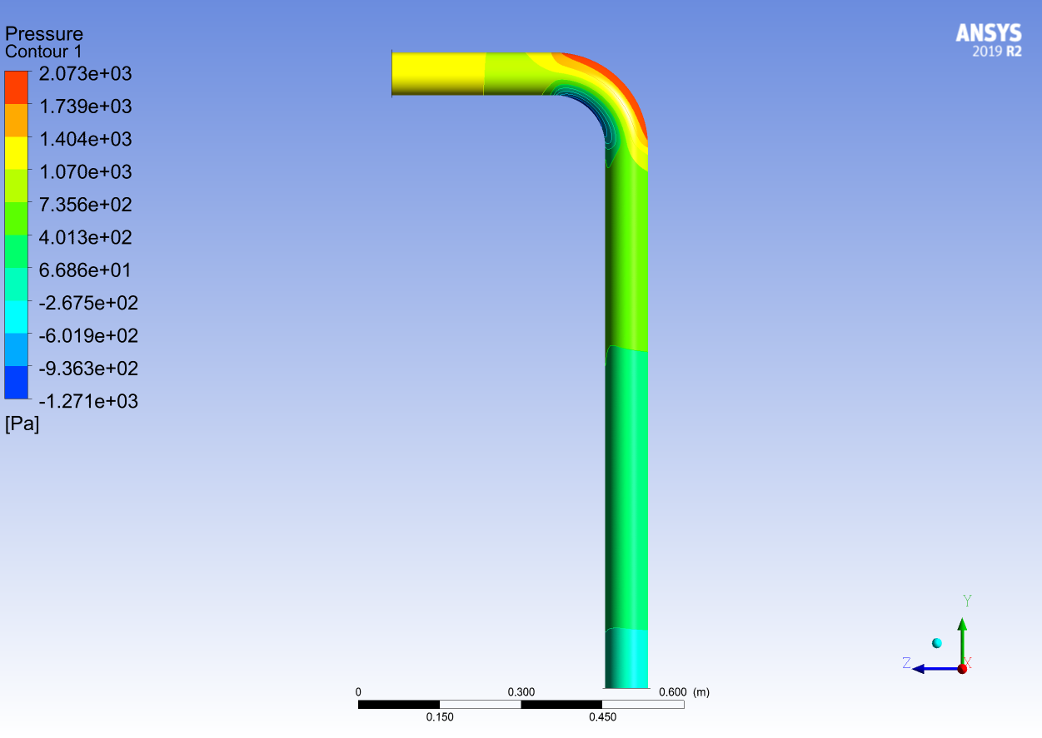

Slide 43
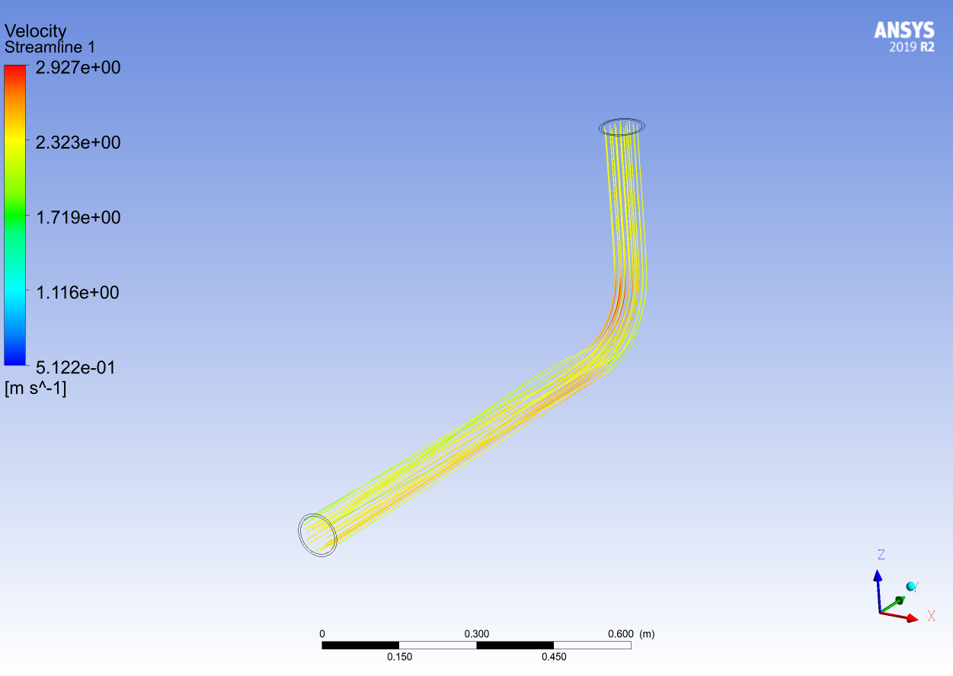

Slide 44
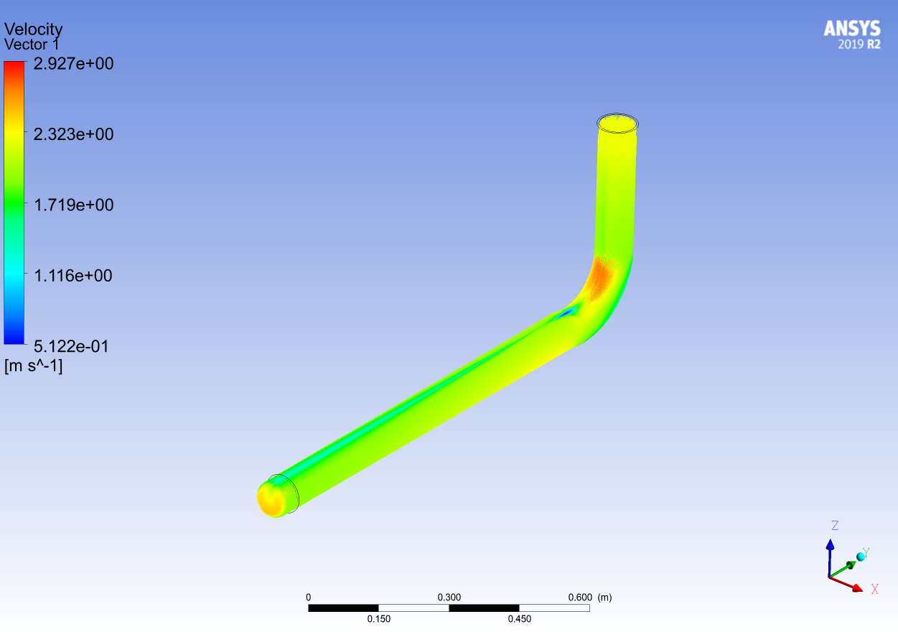

Slide 45
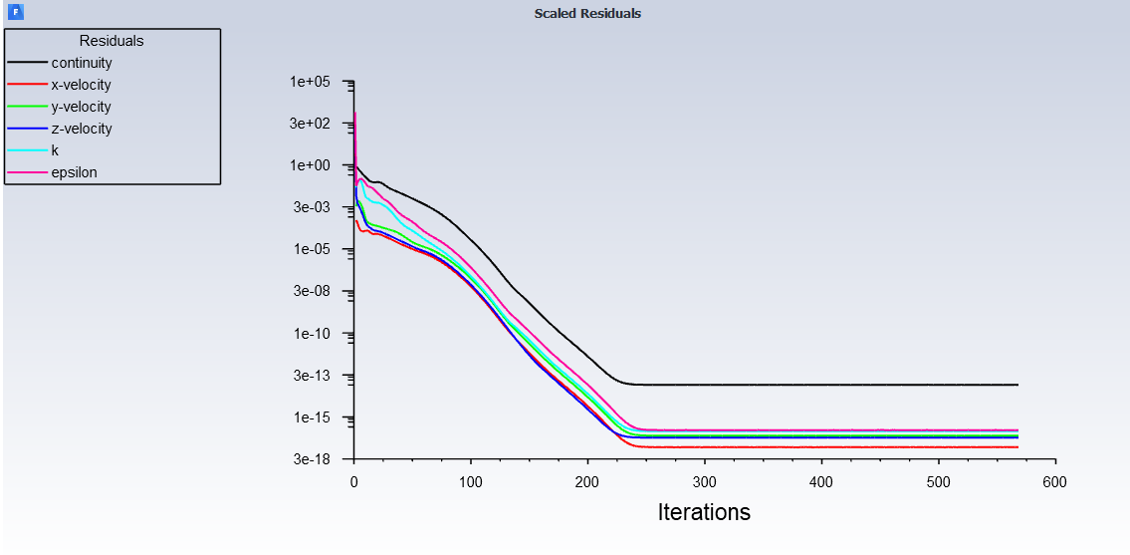

Slide 46
Results
T-junction

Slide 47
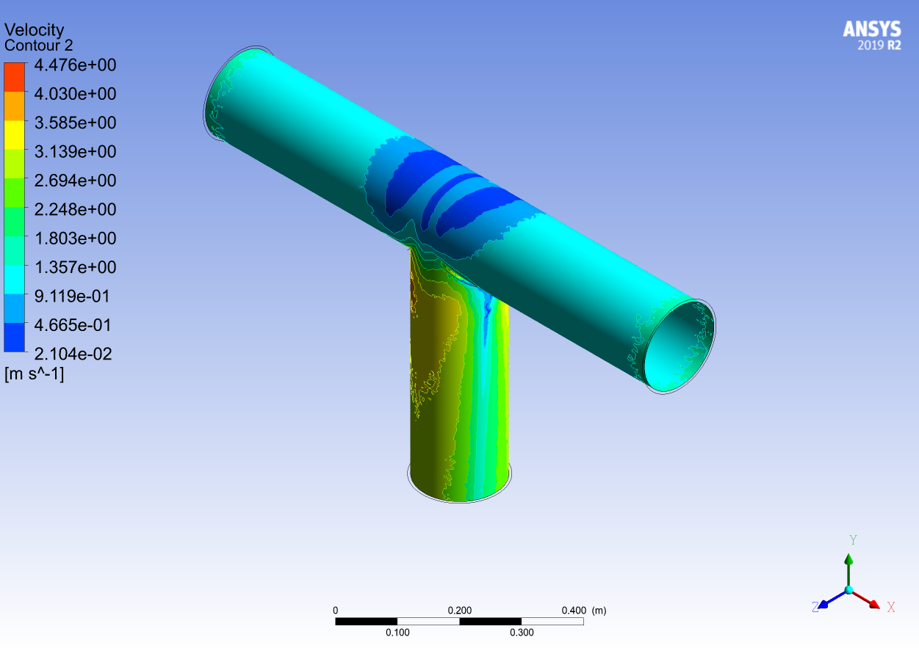

Slide 48
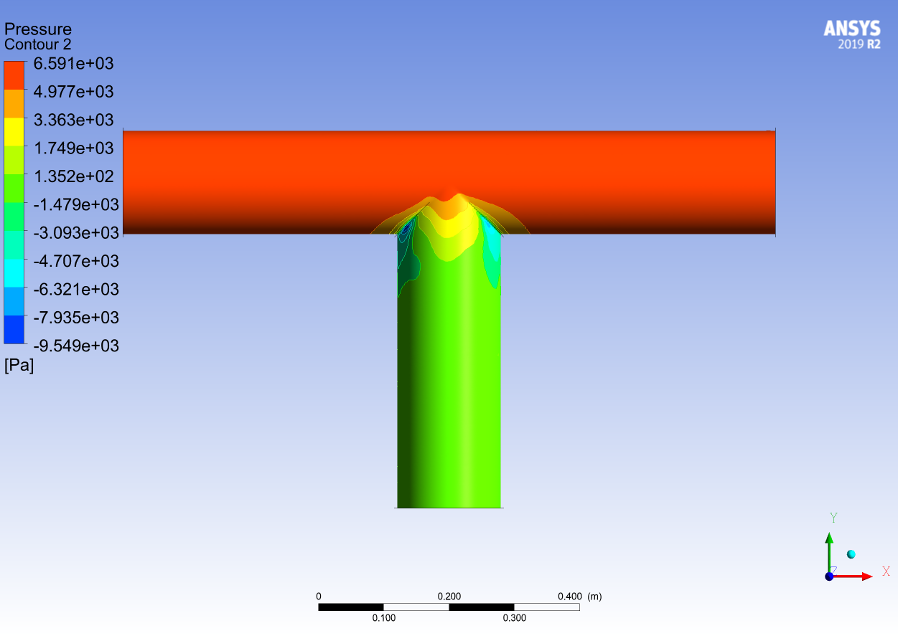

Slide 49
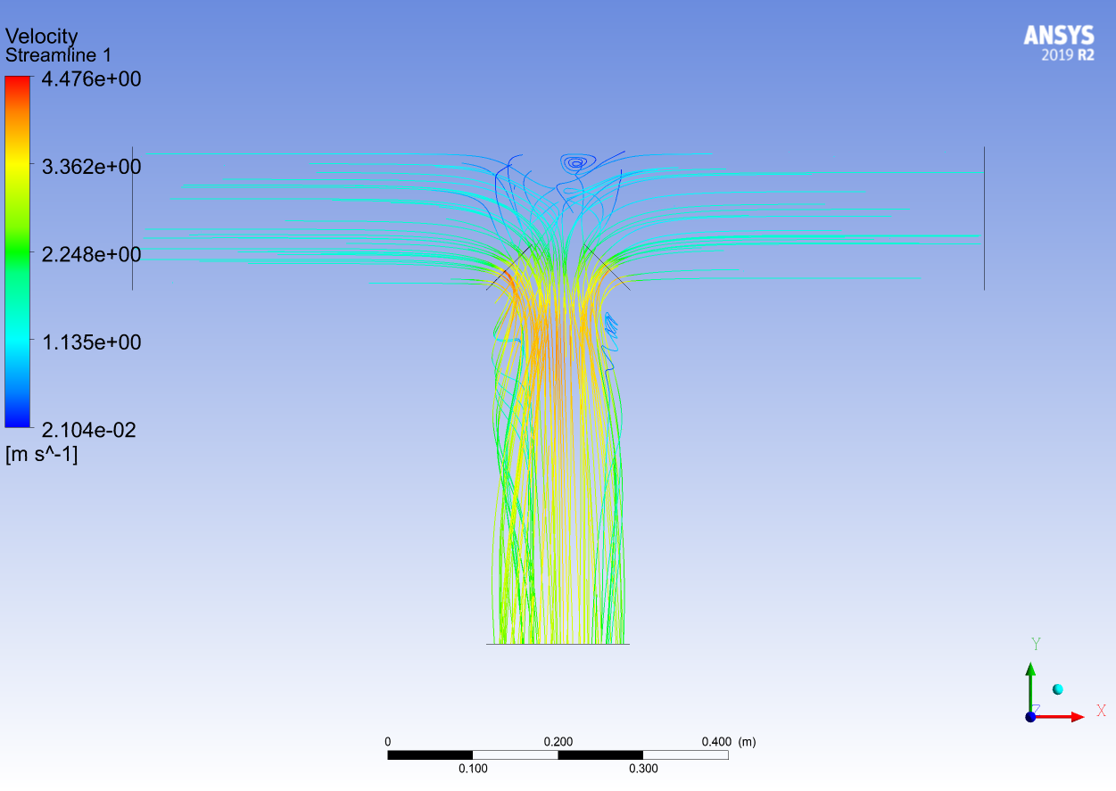

Slide 50
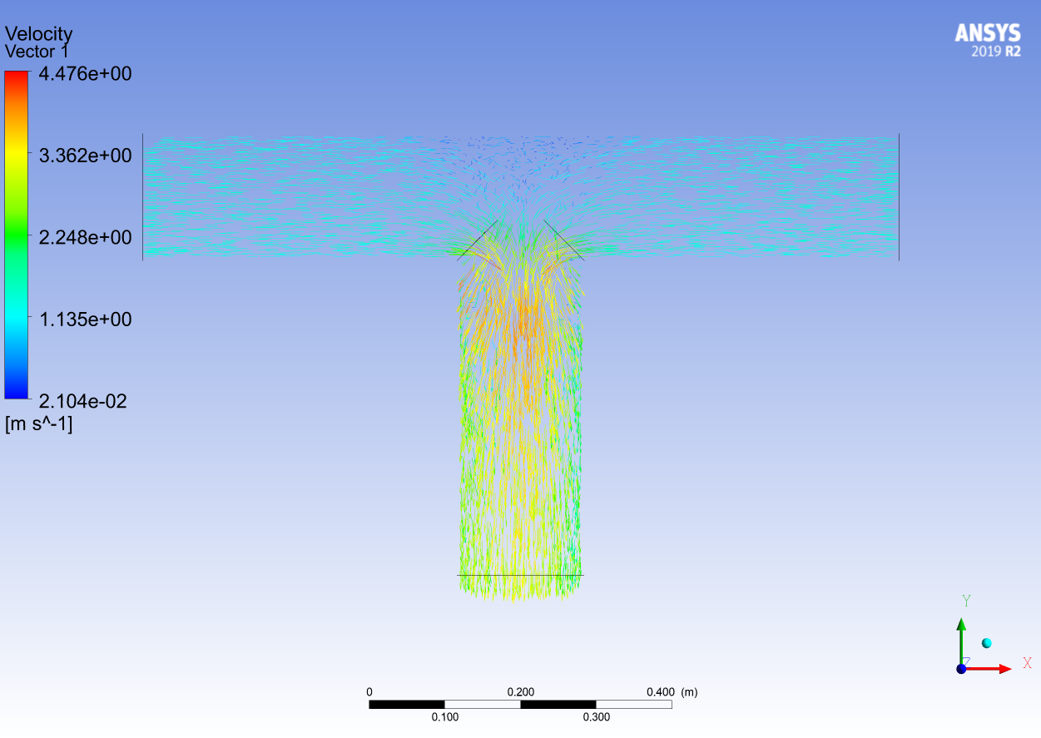

Slide 51
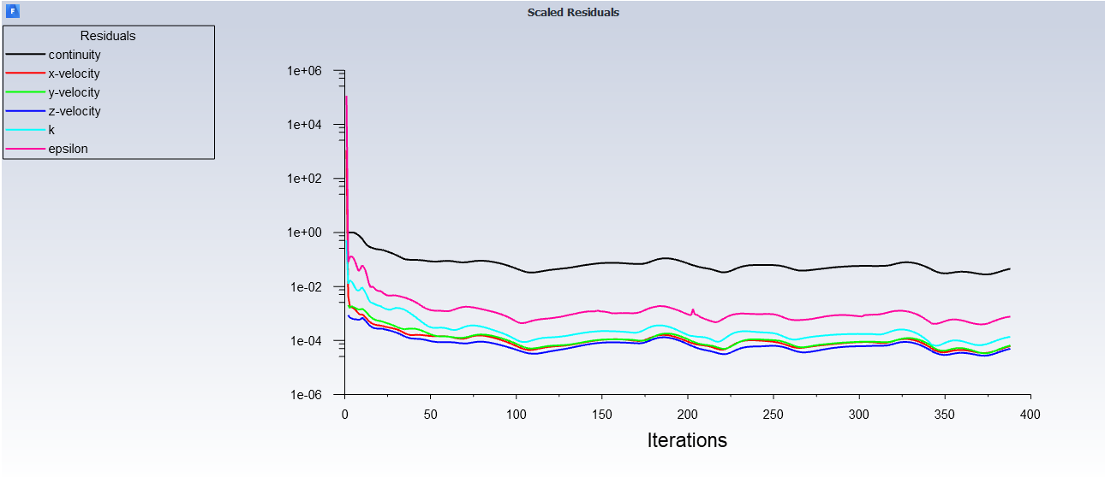

Slide 52
Results
Compact wye

Slide 53
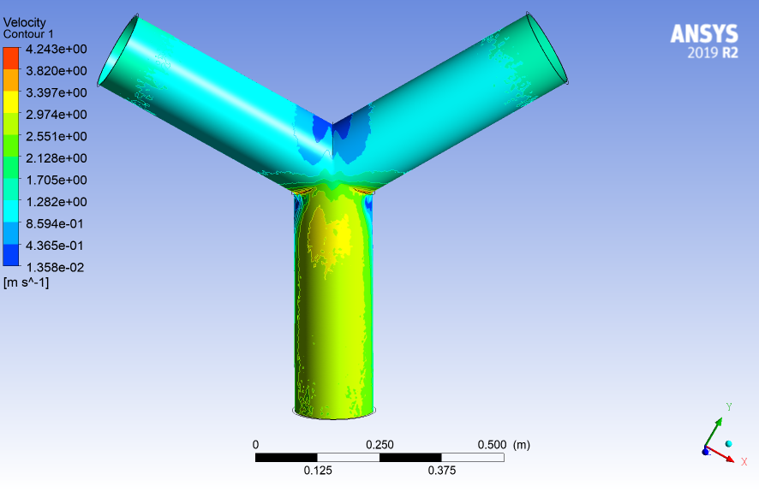

Slide 54


Slide 55


Slide 56


Slide 57


Slide 58
Results
Standard wye

Slide 59


Slide 60


Slide 61


Slide 62


Slide 63


Slide 64

Pressure drop

Slide 65
Pressure drop

Slide 66
Pressure drop

Slide 67


Slide 68
Future work
Another pipe fittings
Simple network
Investigate the effect of turbulence modelling in the description the flow regions

Slide 69
Thank you

