Slide 1
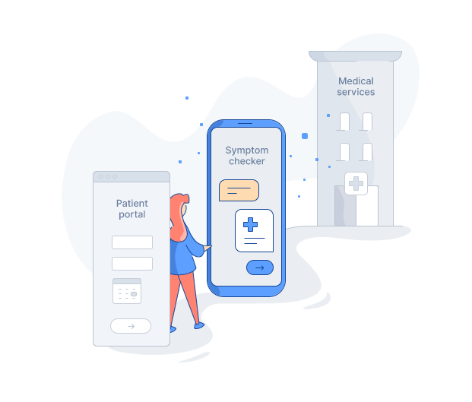
Check-Up Disease

Slide 2
Table of Contents
Acknowledgement
Introduction
Problem specification
Project scope
Goals and objective
Literature and methodology
System analysis and design
Conclusion
Future work

Slide 3
supervisor:Dr. Emmad Saadeh
Dr. Mutasem Abuzant
Dr Ahmad Awad
Dr Baker abd-Alhaq
Acknowledgement

Slide 4
With the development of technology and the means of modern technology, our vision was to combine the medical and technological aspects for a quick and accurate diagnosis of emergencies and other diseases.
A check-up disease application can give you all this, from the symptoms of your illness to how to deal with emergencies to consulting a specialist doctor to receive the appropriate instructions.
Introduction

Slide 5
We are always exposed to an emergency health condition, or a person feels sudden symptoms whose cause is unknown, in addition to that he may be in a place far from reaching a hospital or obtaining the necessary prompt medical care in a timely manner, so it was necessary to solve this dilemma.
Problem specification

Slide 6
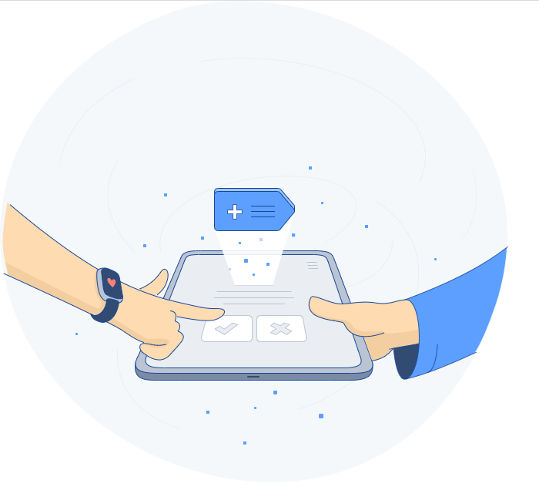
Check-up disease is a mobile application that we created from scratch to help people with various health aspects by entering the symptoms of the patient and based on these symptoms, the disease will diagnose and suggest to the appropriate doctor.
The system is secure, user-friendly, and easy to use, which helps prevent common errors.
Project scope

Slide 7
Goals and Objectives
We have 3 goals:
1. Make healthcare accessible, convenient, and affordable for everyone.
2. Receive the right care at the right time.
3. Make medical care decisions within everyone's reach.

Slide 8
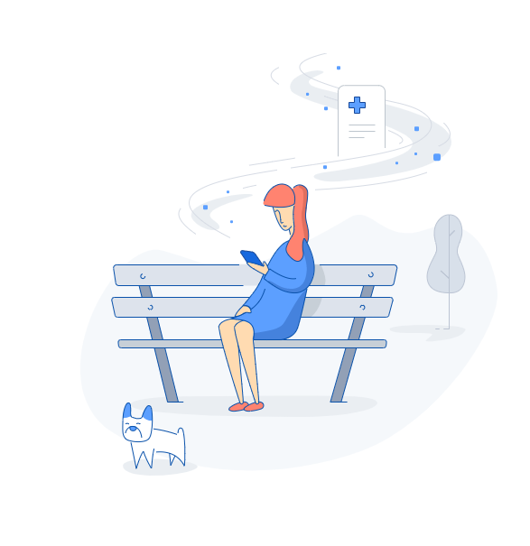
Disadvantages of the current system:
Literature and methodology
1. The patient doesn't get medical health care at the appropriate moment.
2. Access to health care is limited.
3. Most people lack first aid instructions knowledge

Slide 9
Proposed System
The advantages of the proposed mobile application are:
1- User friendly.
2- Easy to access health resources quickly under emergencies, As they say, we gain golden hours for patients.
3- Maintainable.
4- Affordable.
5- Easiest way to get a diagnosis, is just by sitting in front of a smart device.
The application still faces many problems, for example:
1. Electricity dependency.
2. Network dependency.
3. It required the user to know how to deal with the technology.
However, there is no new technology without needs and no limitation for these needs.

Slide 10
Methodology
we conducted a literature review by searching the database on current systems related to our project and their advantages and disadvantages.

Slide 11
System analysis and design

Slide 12
Requirements discovery
2. Requirement Collection

Slide 13
3. Interview Outline
4. Prototype

Slide 14
patient:
5. Functional Requirements
1. He can change the password.
2. He can log in.
3. He chooses symptoms from the list to check the disease.
4. He contacts the Drs.
5. He sends feedback.
6. He searches for emergency cases.

Slide 15
Functional Requirements ( continued )
Doctor:
1. He checks patients' medical files.
2. He gives consultations.
3. He gives feedback to admins about symptoms and disease.
4. He can change the password.
5. He can log in.
6. He suggests adding symptoms and diseases to admin
Administrator:
1. He receives the patient’s feedback.
2. He adds doctors to the system.
3. He views all added symptoms and diseases.
4. He added symptoms and diseases to the system.
5. He sends reports to the maintenance team.

Slide 16
Functional Requirements ( continued )
Maintenance Team:
Its main job is to perform routine checks on all machines once and while making some repairs if necessary
They send notifications when a bug is fixed.
They updated the mobile application.
they contact admins.
They receive maintenance requests.

Slide 17
6. Non-Functional Requirements:
Usability
Reliability
Dependability
Availability
Maintainability

Slide 18
Here are the main actors in the system:
Patient: is the main actor and the main user of the program
Administrator: Who controls the system, performs maintenance, and controls access.
Doctor: his main job is to give consultation to the patient when needed.
Maintenance Team: Its main job is to perform routine checks on all machines once and while making some repairs if needed.
7. Actors

Slide 19
Requirements classification and organization
Admin page:
The admin receives customer feedback.
admin is able to see all added symptoms and disease.
admin is able to add doctors to the system.
able to add new symptoms to the system.
B. Patient page:
Patients are able to send feedback through mobile applications.
Can choose symptoms from the list to check for disease.
contact the doctor.
can log in to the application and change his password.
able to use the application with all its sections (deep diagnosis, quick diagnosis, and first aid instructions)

Slide 20
Requirements classification and organization (Continued )
C. Doctor:
can check patients' medical files.
able to give consultations.
able to send feedback to admins about symptoms and disease.
can log in.
He suggests adding symptoms and diseases to the system.

Slide 21
System design

Slide 22
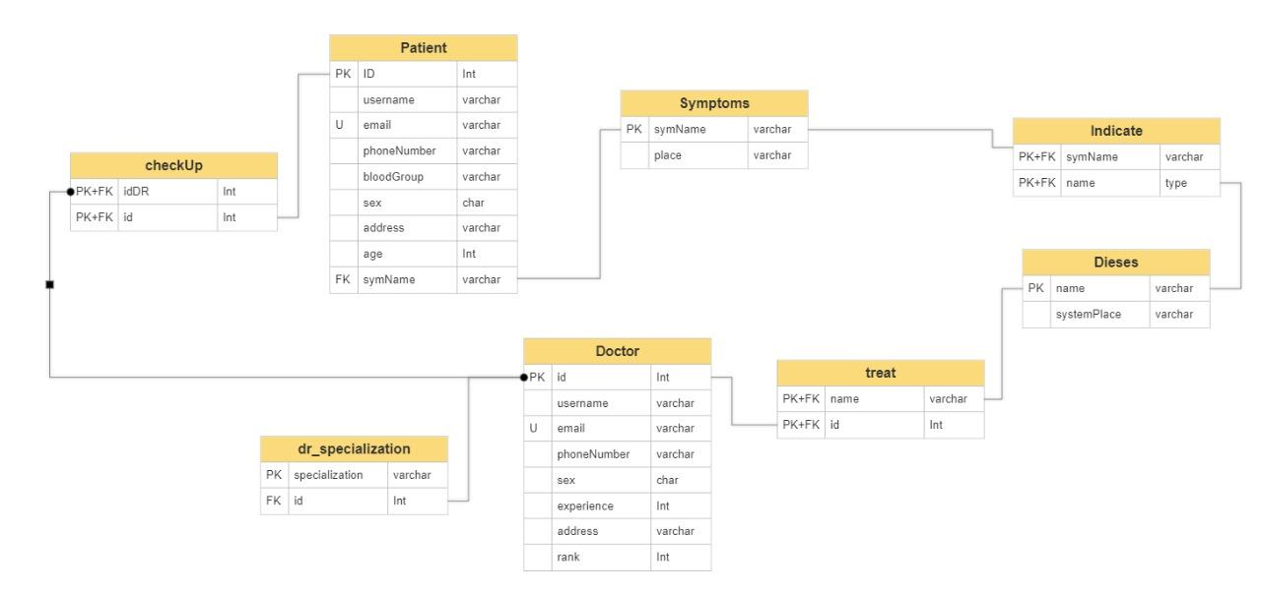
1. Class Diagram:

Slide 23
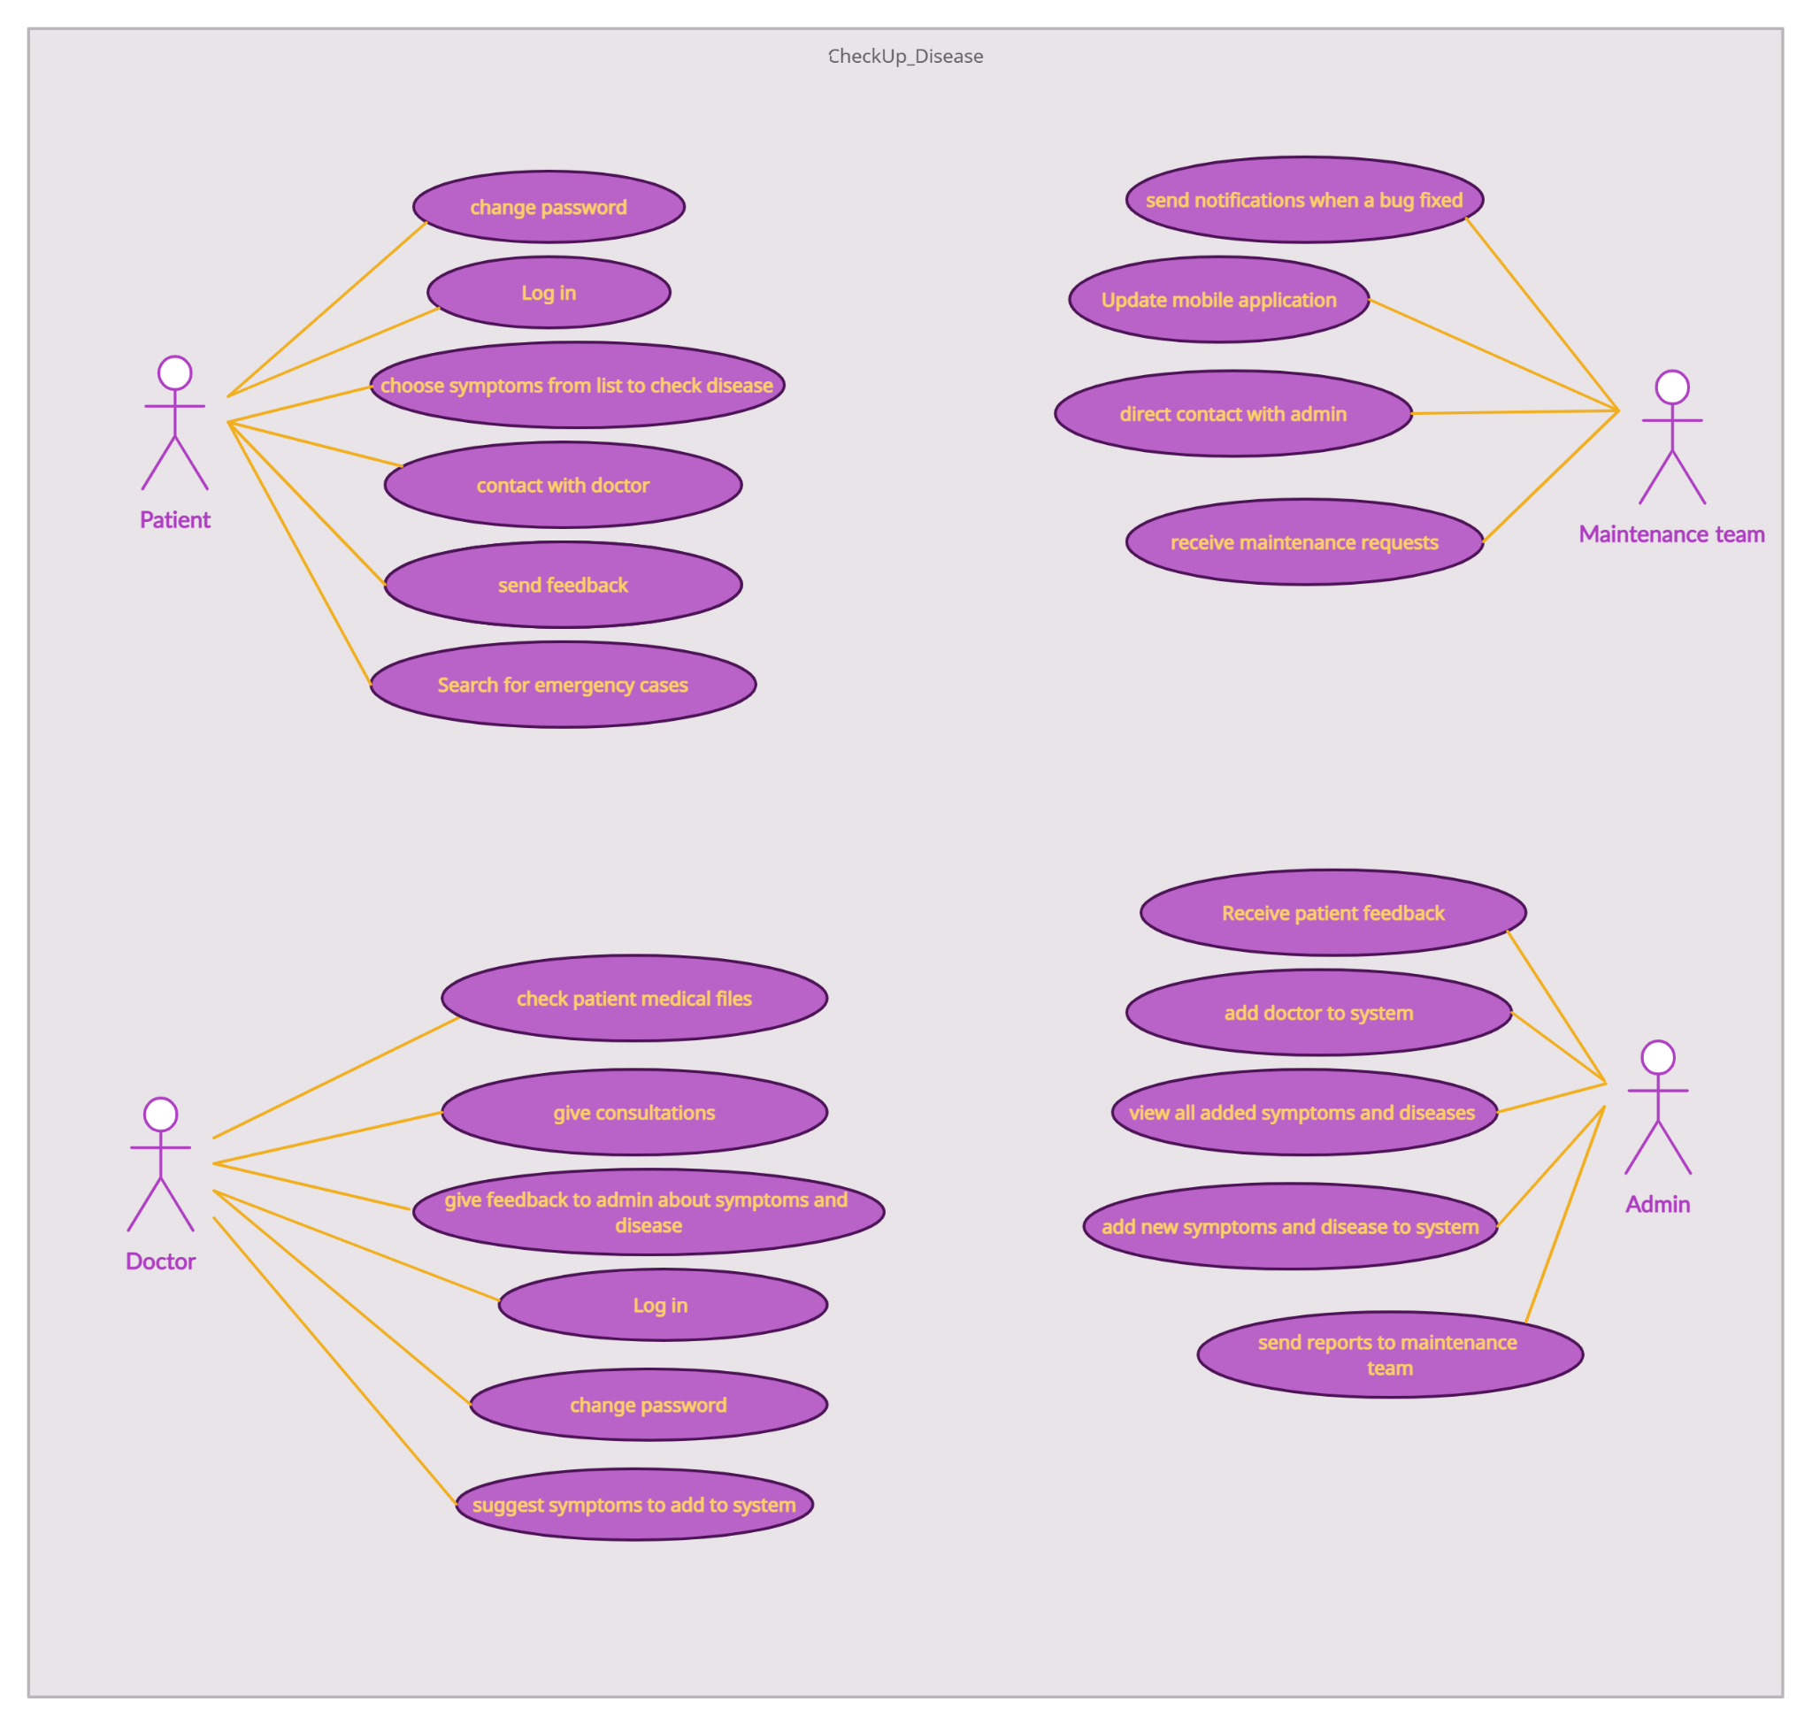
2. Use Case Diagram:

Slide 24
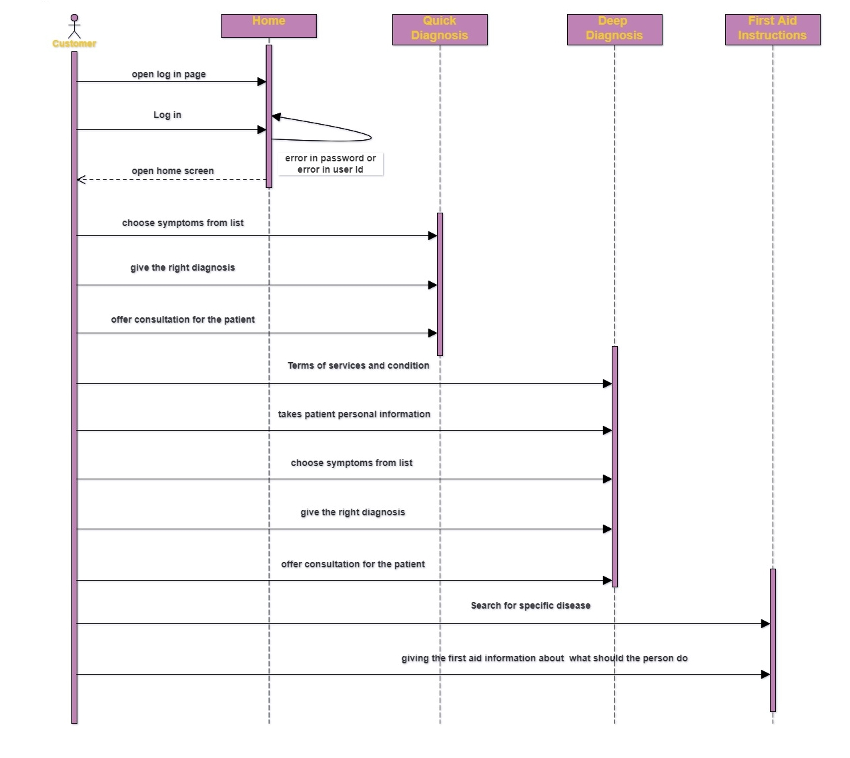
3. Sequence Diagram:

Slide 25
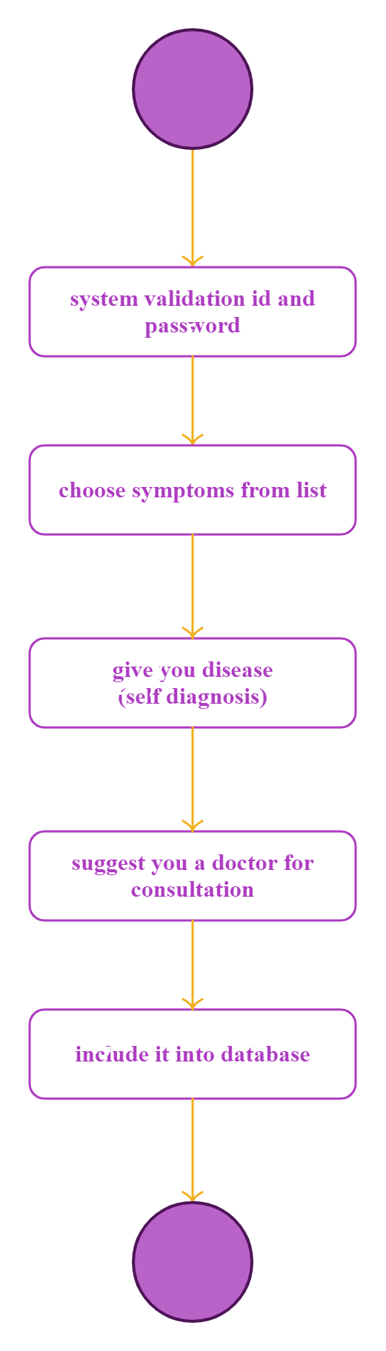
4. State Diagram:

Slide 26
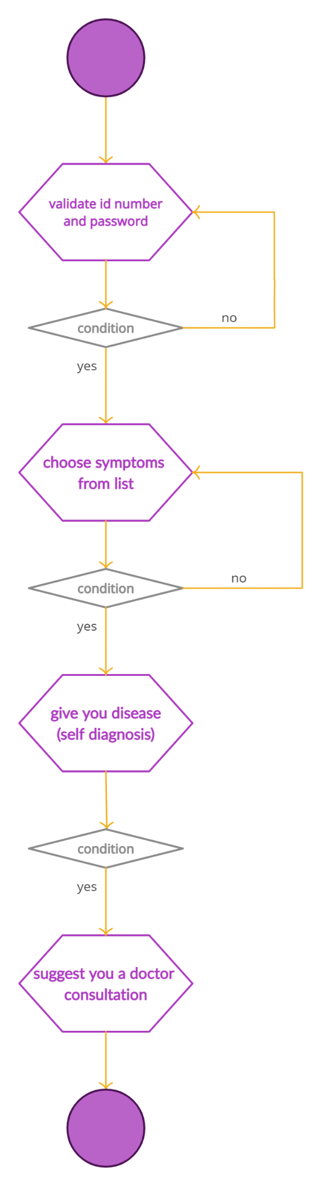
5. Activity Diagram:

Slide 27
Nowadays, some people face an urgent emergency situation, maybe they are in a place far from reaching a hospital, and they have lack knowledge in first aid instructions, so we create a mobile application called check-up disease that gives the patients their diagnosis and can also afford a consultation for them and it can give them information on what should they do on emergency situations like giving them first aid instruction but because of the lack of time there still many works left for the future like expanding the database and other things we provided in the future work section
Conclusion

Slide 28
support the first aid interface with pictures and videos that explain how to properly deal with an emergency situation.
Expanding the database to include more diseases.
Add translation features for more than one language.
Make a file for each patient containing the medical history.
After the patient knows his diagnosis, the application will give him instructions about health care in terms of food, amount of sugar, and simple exercises.
Future work

