Slide 1
Applying active learning approach in engineering labs assessment and methodology development
Supervisor : Dr. Hussam Arman
Walaa Al-Johari Hala Abu Shaqam
Sajeda Shtya Abeer Khaled

Slide 2
Outline :
Comparison between passive and active learning
Approaches of learning
Projects goals and motivations
Sample size & Questionnaire
Safety lab
Groups of the project
New Techniques
Evaluation of the project
Feed back
Recommendation

Slide 3
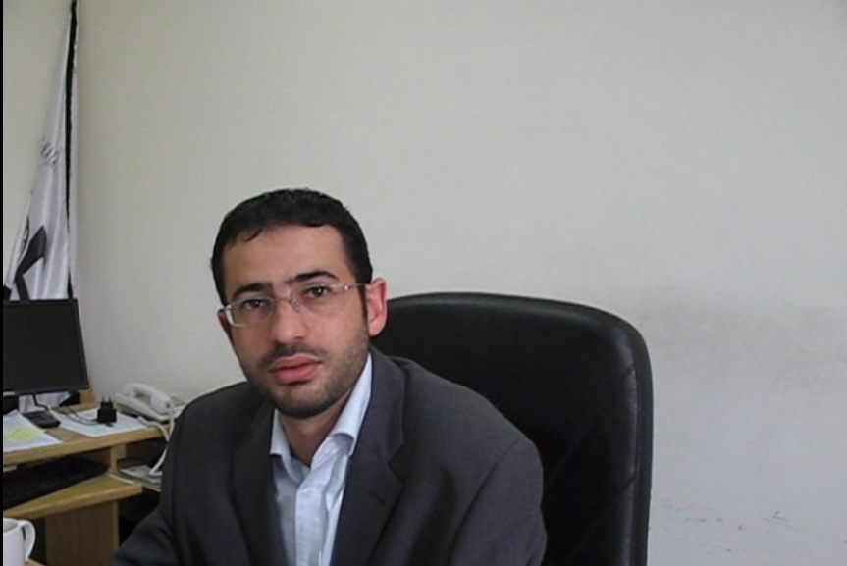
Dr. hussam

Slide 4

Teaching vs. learning

Slide 5
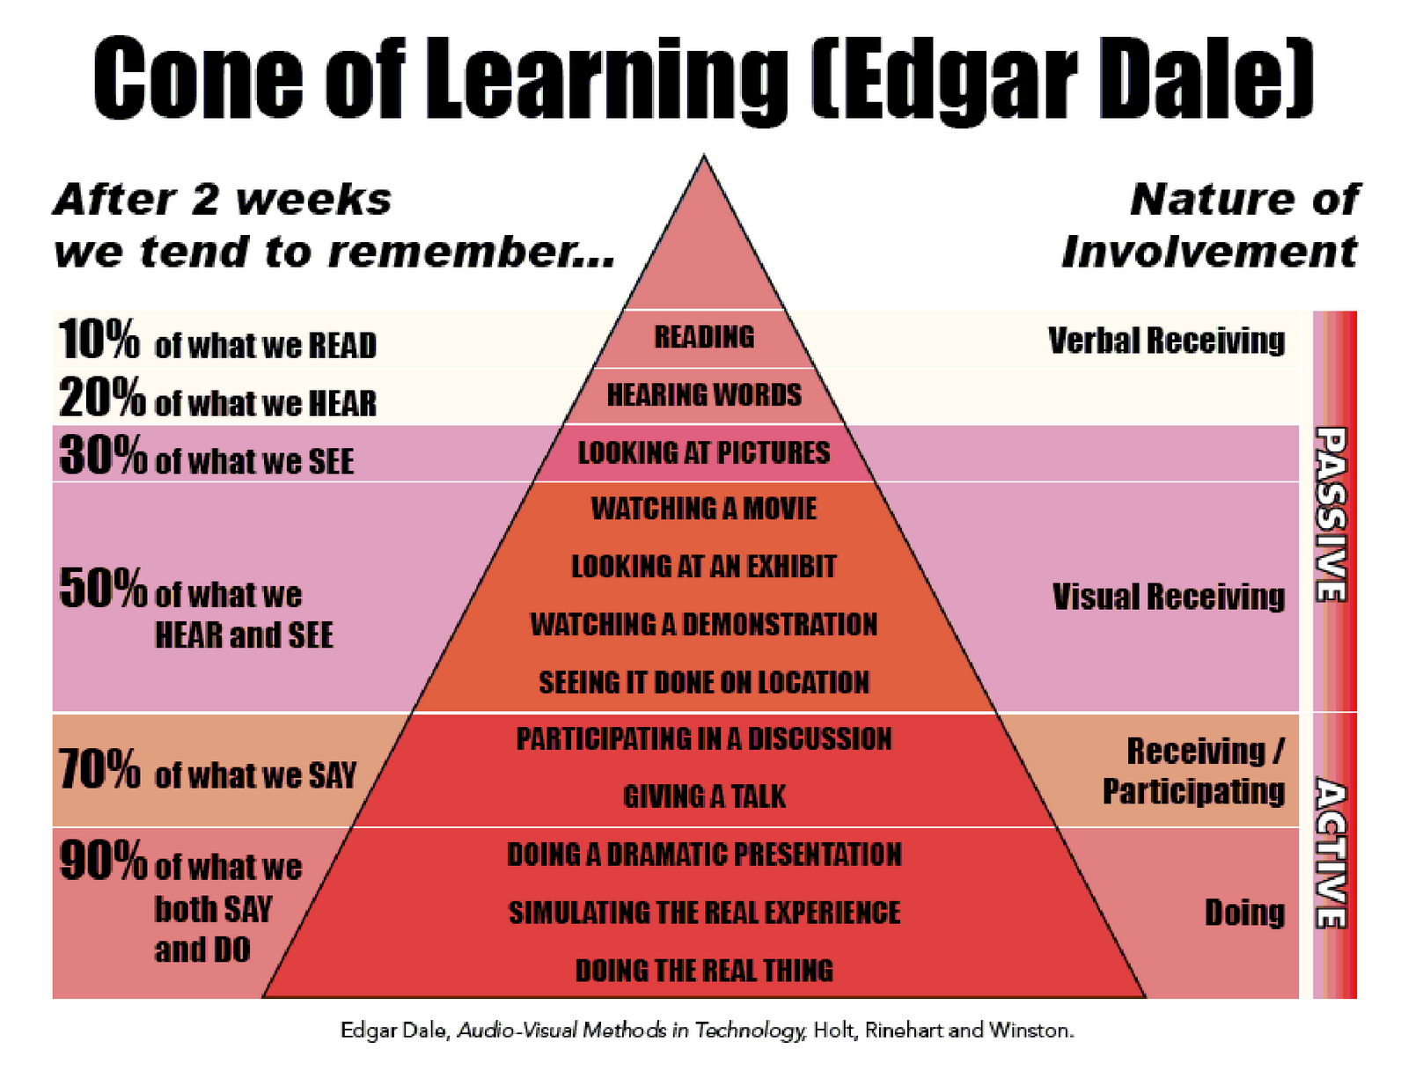
Comparison between passive and active learning

Slide 6
Face to face learning
Self based learning
Online Collaborative Learning

Slide 7
Approaches of learning
Constructivism approach
Self learning approach
Problem based learning

Slide 8
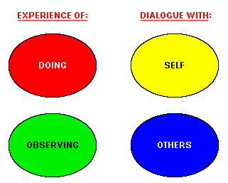
Problem based learning

Slide 9
Self learning approach
Self learning approach
Corporative learning
Games
Quizzes

Slide 10
Projects goals and motivations
Assessment survey
Sample size calculation
Questionnaire modeling
Questionnaire analyses

Slide 11
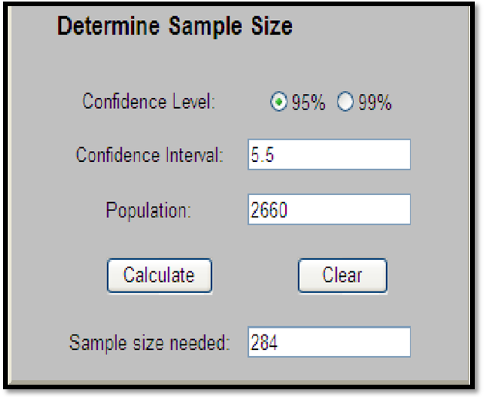
Sample size calculation

Slide 12
106 | 107 | 108 | 109 | Department/year
14 | 26 | 24 | 27 | Civil
4 | 5 | 5 | 5 | Architectural
6 | 10 | 6 | 4 | Electrical
4 | 6 | 4 | 4 | Chemical
6 | 7 | 6 | 5 | Industrial
5 | 5 | 5 | 5 | Computer
6 | 11 | 7 | 7 | Mechanic
0 | 2 | 6 | 5 | Mechatronics
7 | 10 | 9 | 8 | Building
0 | 0 | 4 | 4 | Communication

Slide 13
Questionnaire modeling
-What things we want to assess.
General satisfaction
Lab readability
Course material
Lab hours
Problems
-Questionnaire and sample type.

Slide 14
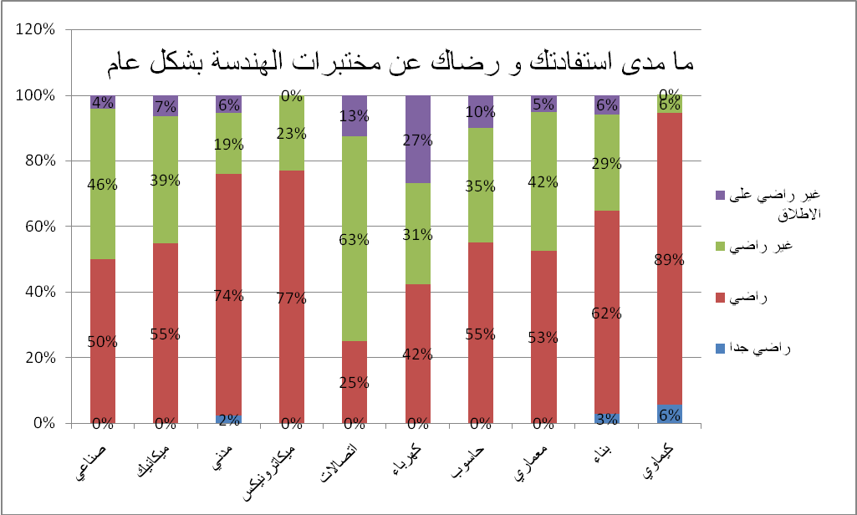
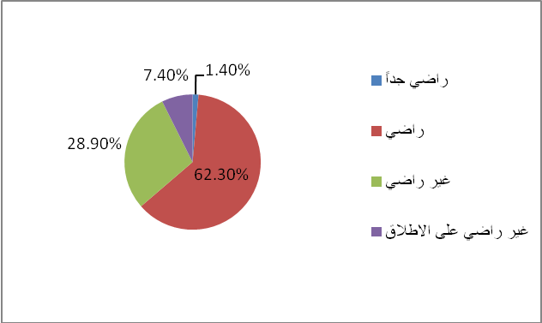
Questionnaire analyses

Slide 15
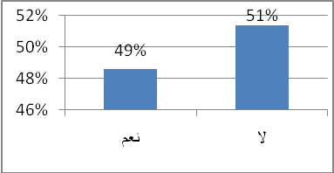
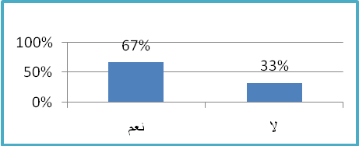
Methods of teaching
Teaching hour satisfaction

Slide 16
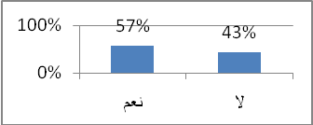
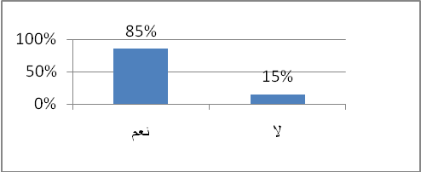
Comprehension and connects theoretical with practical
Needs for extra means

Slide 17
The comfort of labs conditions
باعتقادك ادوات المختبرات وبيئة العمل وظروفه مناسبة ومريحة
القسم الذي ينتمي اليه الطالب | نعم دائماً |  | نعم في بعض المختبرات |  | لا
 | العدد | النسبة | العدد | النسبة | العدد | النسبة
صناعي | 1 | 4% | 19 | 79% | 4 | 17%
ميكانيك | 4 | 13% | 24 | 77% | 3 | 10%
مدني | 9 | 10% | 69 | 76% | 13 | 14%
ميكاترونيكس | 1 | 8% | 12 | 92% | - | -
اتصالات | - | - | 7 | 88% | 1 | 13%
كهرباء | - | - | 18 | 69% | 8 | 31%
حاسوب | 1 | 5% | 16 | 80% | 3 | 15%
معماري |  | - | 14 | 74% | 5 | 26%
بناء | 1 | 3% | 27 | 79% | 6 | 18%
كيماوي | 3 | 17% | 12 | 67% | 3 | 17%

Slide 18

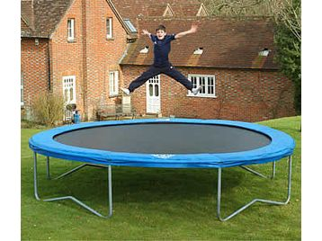
Safety lab (case study)
Why?
Collective decision
Good condition

Slide 19

2 groups (criteria)
2 equivalent groups number
age, gender and average GPA
Students
Control group
Classic group

Slide 20
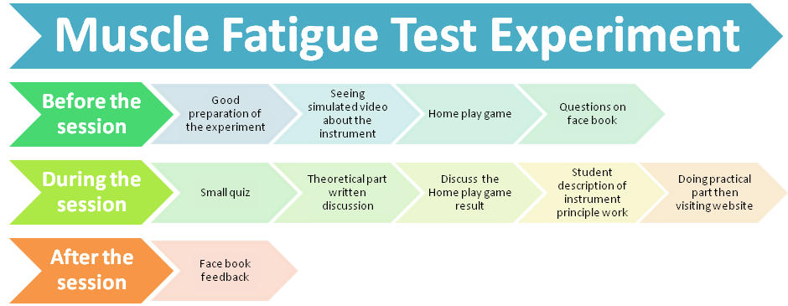
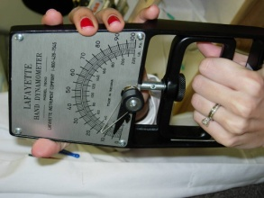
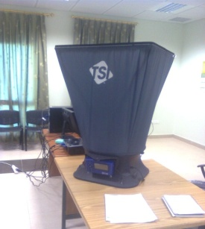
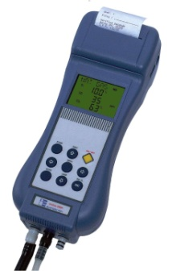
Experiment Selection
Muscle Fatigue Test.
Flue Gas Analysis.
Air Quality assessment.

Slide 21
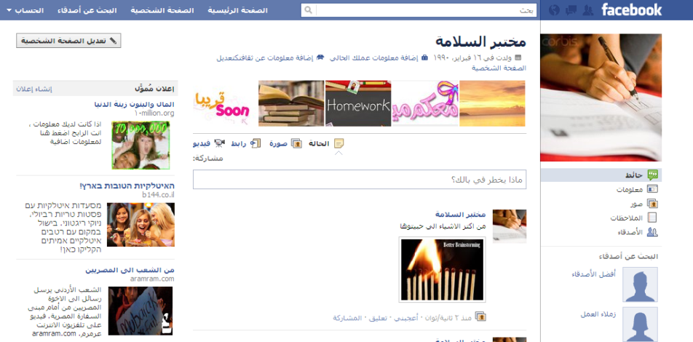



New Techniques Preparation
1- Facebook account and email
2- Multimedia
3- Full Arabic description.
4- Quizzes
5- Sheet for Theoretical and practical Information
6- Websites
7-Home ,class Activities
8- Competing questions

Slide 22
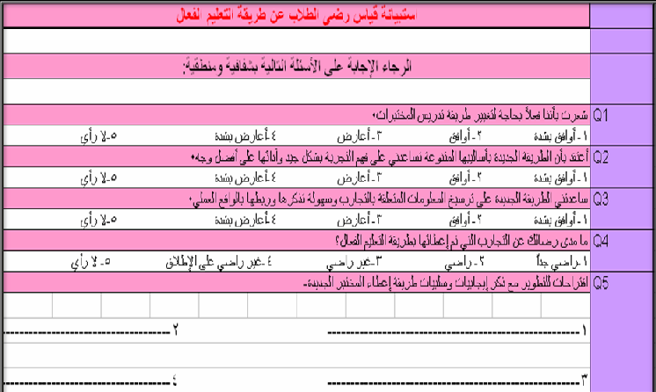
Methods that follows to evaluate Control group:
1)Questioner

Slide 23
Methods that follows to evaluate Control group (cont):
2) Mid term exam.

Slide 24
The comparison between marks of tow groups:

Slide 25
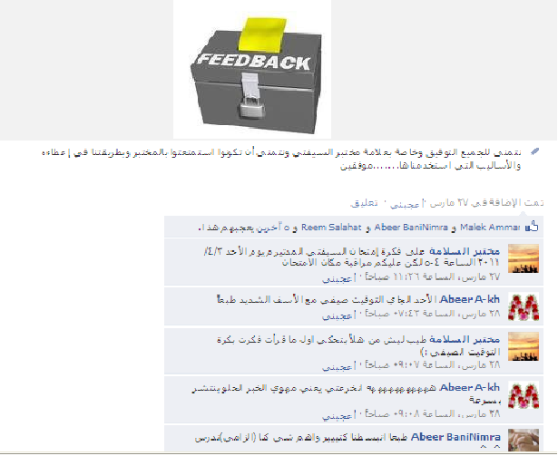



The feed back for control group taken by:
Questioner.
Mid term exam.
Face book.
The students of control group themselves.

Slide 26
Recommendations
Promote students learning and encourage dialogue with self .
Take students Psychological factors .
Make use of internet and website.
Connected the theoretical part with the practical.
Enhance the relations between students and their teachers.
Utilization of friends grouping policy in the class.

Slide 27


