Slide 1
Sentiment Analysis for Arabic Comment (Build Arabic Lexicon Using Madamira and Rapidminer Tool)
Prepared by :
Doa’a Dwaikat
Reem Ismail
Razan Eid

Slide 2
Main Points:
Introduction
What is sentiment analysis
Sentiment Analysis Techniques
How to get data Data acquisition?
Preparing Data
Altova Map Force
Using Madamira tools
Building Training Data
Rapidminer process

Slide 3
INTRODUCTION :
Now days on web the number of reviews, suggestions, feedbacks are increasing in enormously manner.
Reviews play vital role in helping and suggesting other person in their decision making.
But on the other hand it becomes difficult to read all reviews and make decision as per. Thus, mining this data, identifying the user opinions this is done by performing detailed sentiment analysis on the data.

Slide 4

What Is Sentiment Analysis?
Sentiment analysis is the interpretation and classification of emotions (positive, negative and neutral) within text data using text analysis techniques.
Opinion mining is a sub part of web content mining which is also called as sentiment analysis.

Slide 5
Sentiment Analysis Techniques
Un-Supervised Learning
Supervised Learning : In Supervised Learning, model learn by examples. The machine learning uses its algorithms on labeled data, based on a feature set, to train and teach how to predict the polarity of new unlabeled data. There are many machine algorithms that are used in the sentiment classification, such as Naive Bayes (NB), KNN and Support Vector Machine(SVM) are most common algorithms used to classify opinions

Slide 6



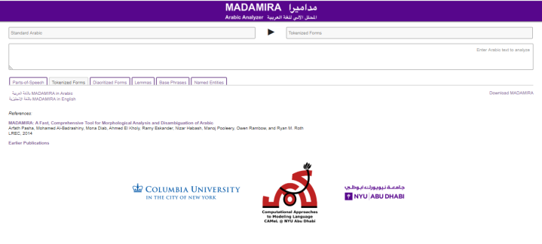

All the tools used:
Facepager
Microsoft Excel
Madamira Morphological Analysis tools for Arabic

Slide 7
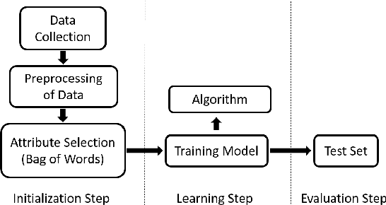
Sentiment analysis steps

Slide 8
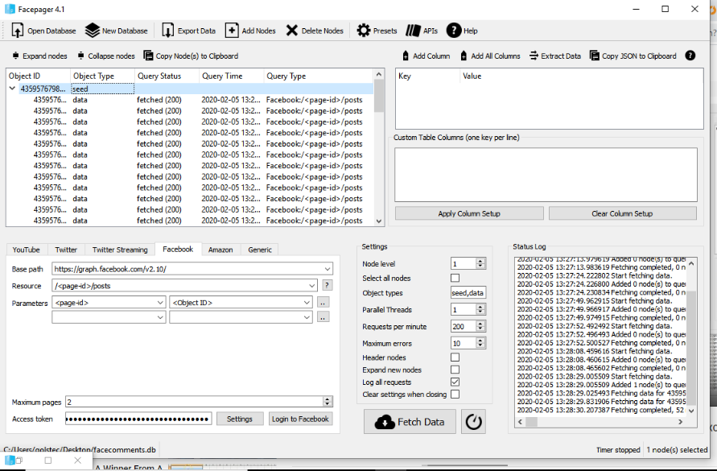
Data acquisition
The first step is to get comments from the Facebook page by linking Facepager with the account and fetch comments

Slide 9
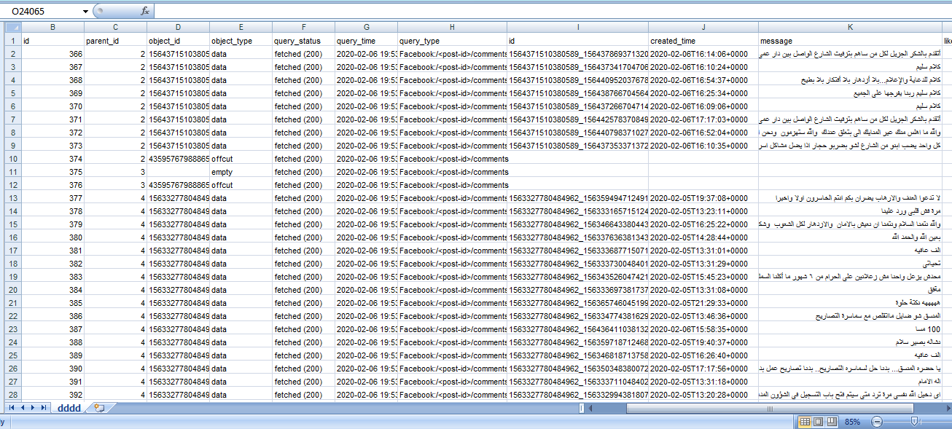
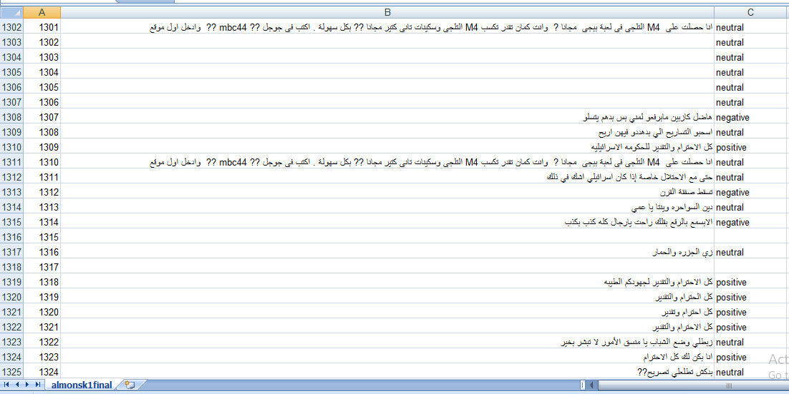
Preparing data
Data from Facepager
Data before cleaning

Slide 10
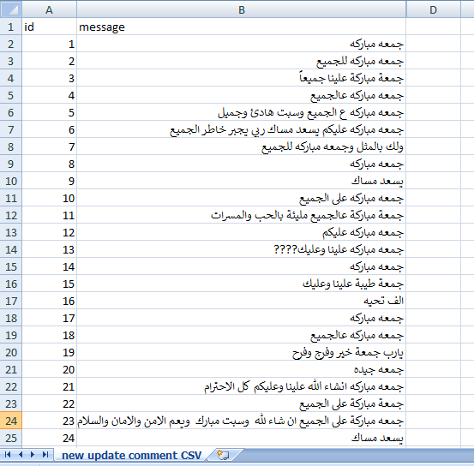
Data after filtering

Slide 11
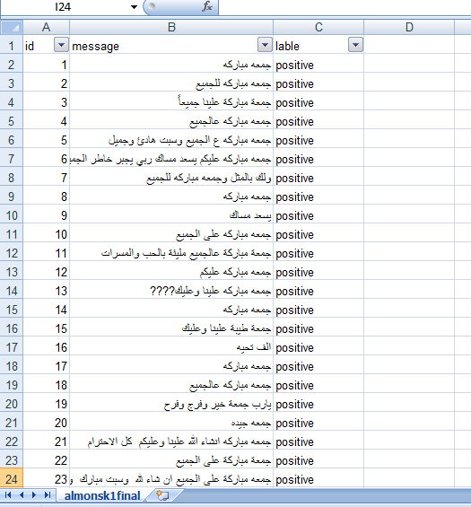
Because we used supervised learning the data should be labelling, we make this manually and build a two text file of word (negative, positive) .

Slide 12
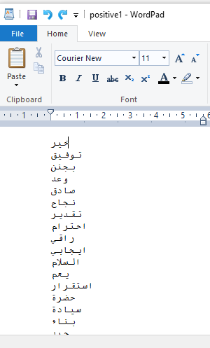
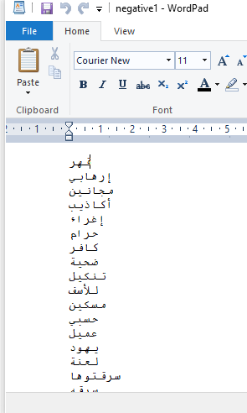
Positive and negative file

Slide 13
What is madamira?
MADAMIRA, a system for morphological analysis and disambiguation of Arabic that combines some of the best aspects of two previously commonly used systems for Arabic processing, MADA and AMIRA .
MADAMIRA improves upon the two systems with a more streamlined Java implementation .

Slide 14
Madamira
Tokenize
Lemma
Stem
Part of speech tag

Slide 15
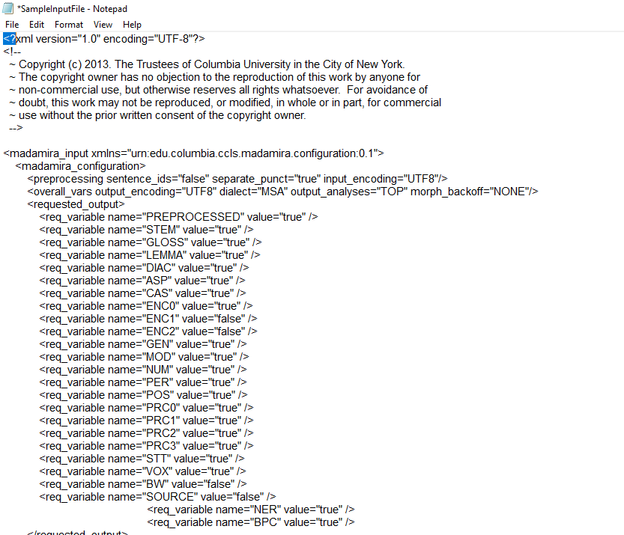
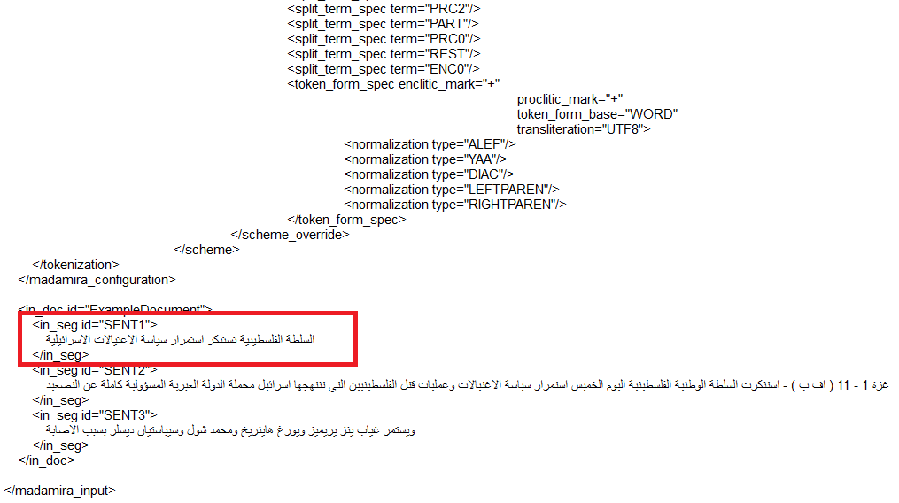
Madamira
The default method of data passing and receiving results in XML.
We have data in excel file and need to convert it as madamira input file as below:

Slide 16
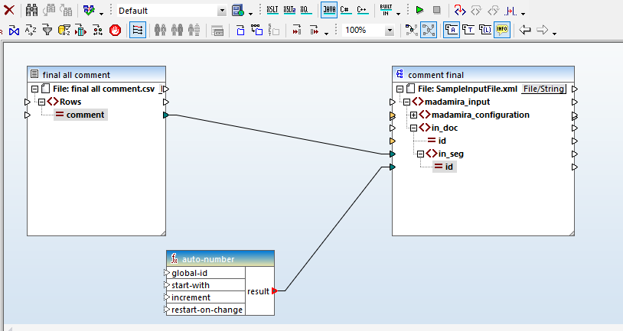
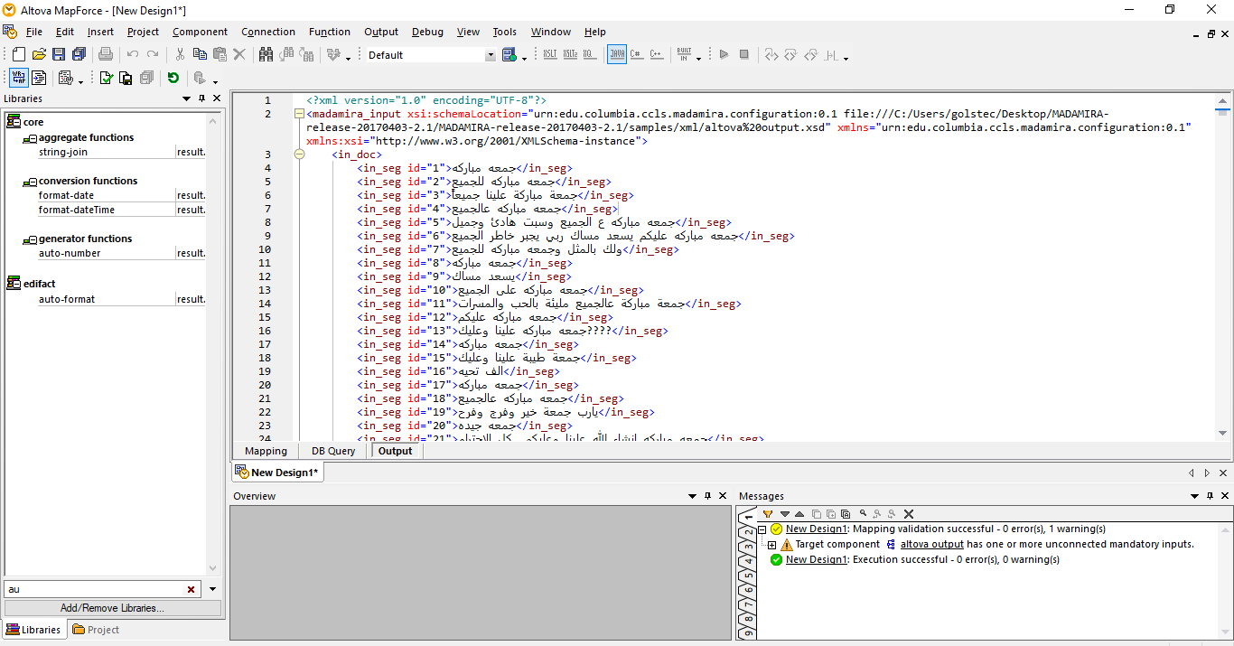
What is Altova MapForce?
Altova MapForce : a data mapping tool enables you to transform data from one format to another, or from one schema to another, by means of a visual, "drag-and-drop" -style graphical user interface.
we convert xls data file to csv file to use it in altova mapforce to convert it to xml.

Slide 17
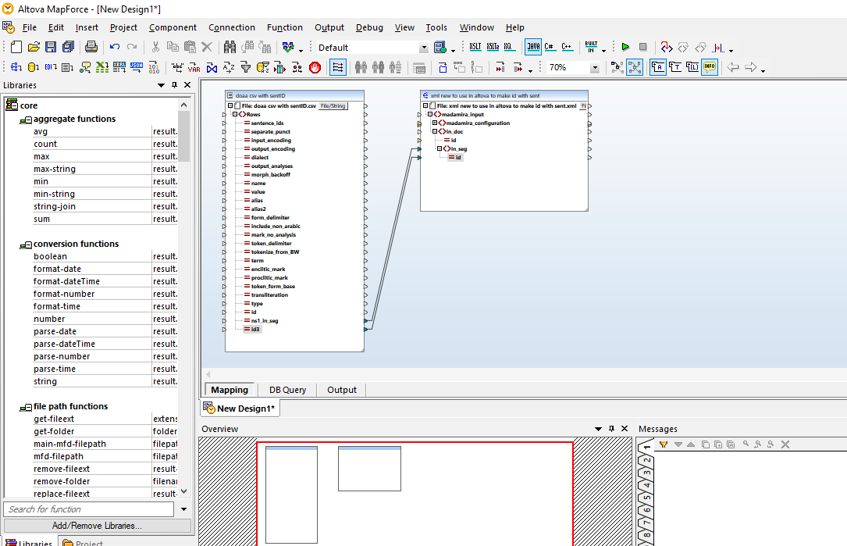
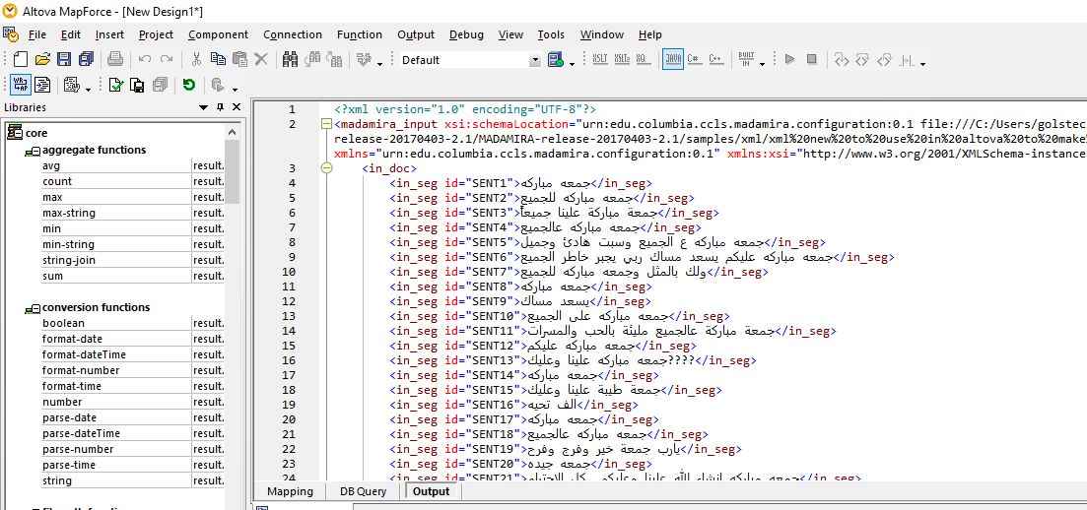

Slide 18
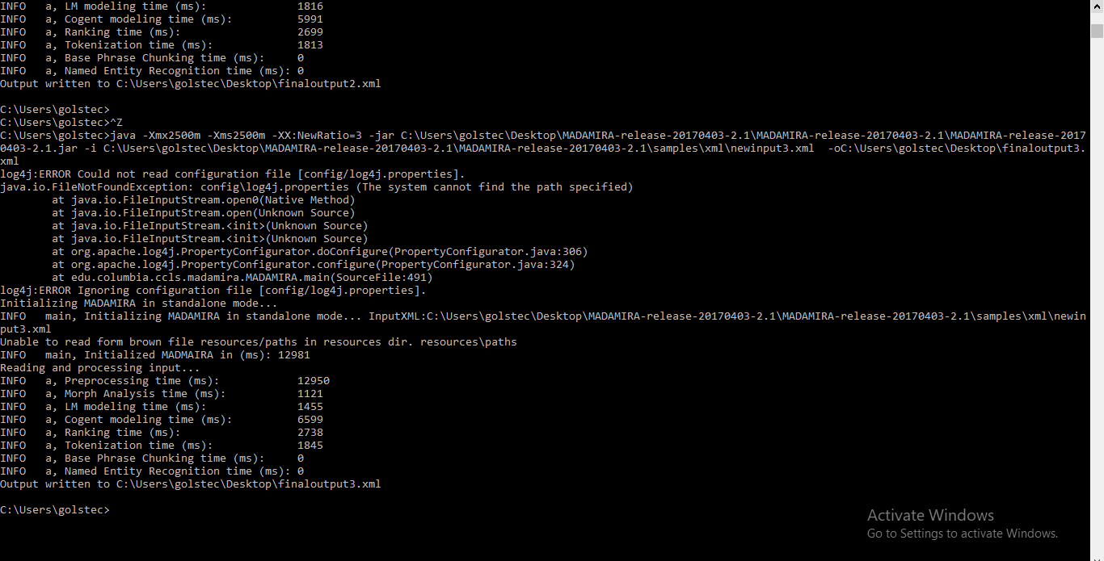
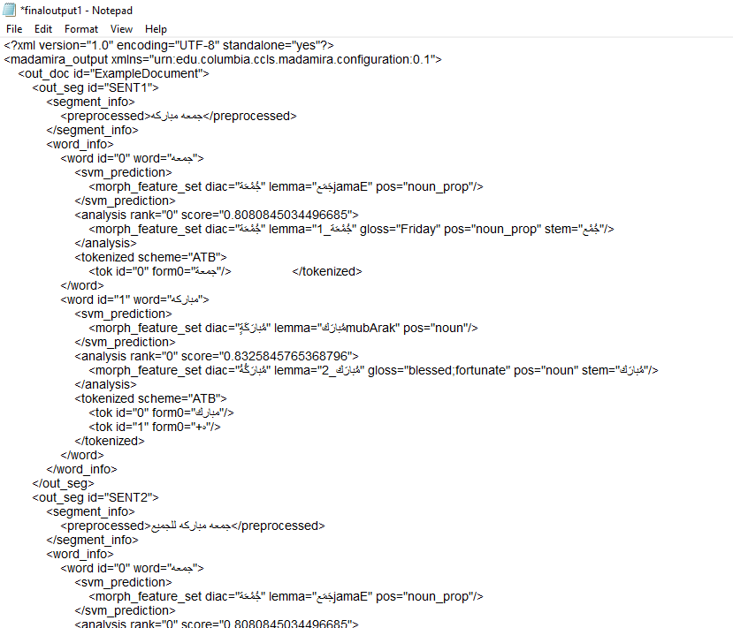
After preparing the xml file processing with madamira
command in cmd for processing
xml file output from madamira

Slide 19
Building Training DataSet
After processing the comments ,list of positive and negative word using madamira .
Every comment have ID
Madamira tokenize each word in comment ,
We use the (Ablebits Add-ins) function in excel to add all words of the same comment .

Slide 20
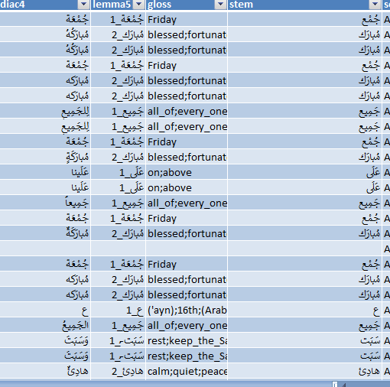
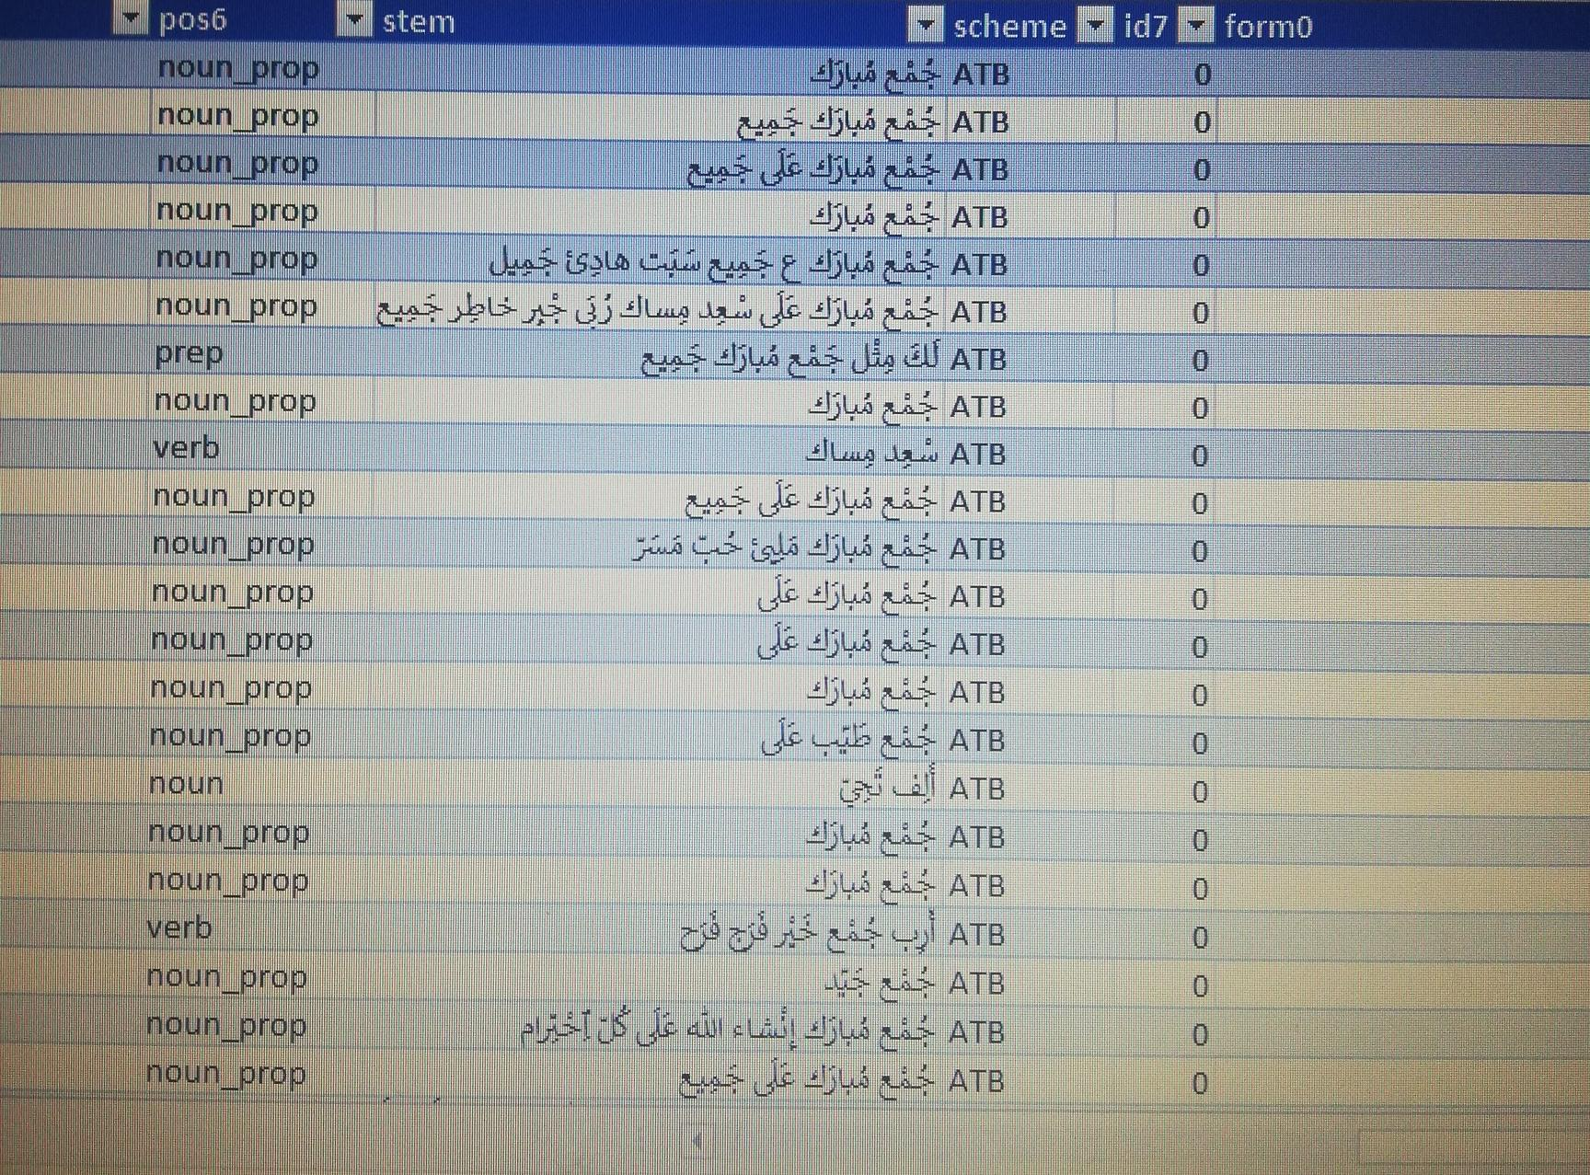

Slide 21
Using Excel to build training data set table (word vector)
The first row contain (massage,all positive and negative word from the file,label).
The first column contain the comments.
Word Embeddings or Word vectorization is a methodology in NLP to map words or phrases from vocabulary to a corresponding vector of real numbers which used to find word predictions, word similarities/semantics.

Slide 22
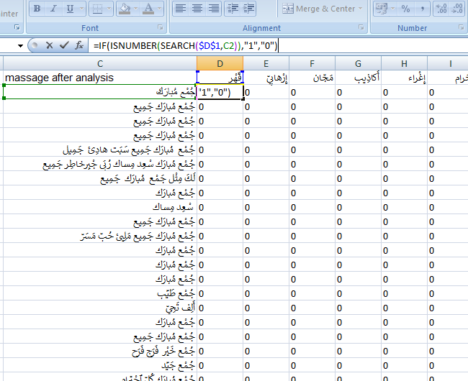
Word Vector:Binary Term Occurrence
Binary term occurrence : One of the methods used to create word vector ,If the word is present, it is represented by 1 and if it is not 0 .
We use this function in excel Searches if the word is in the comment, if it exists it places 1, and if it does not exist it places 0.
=IF(ISNUMBER(SEARCH($D$1,C2)),"1","0")

Slide 23
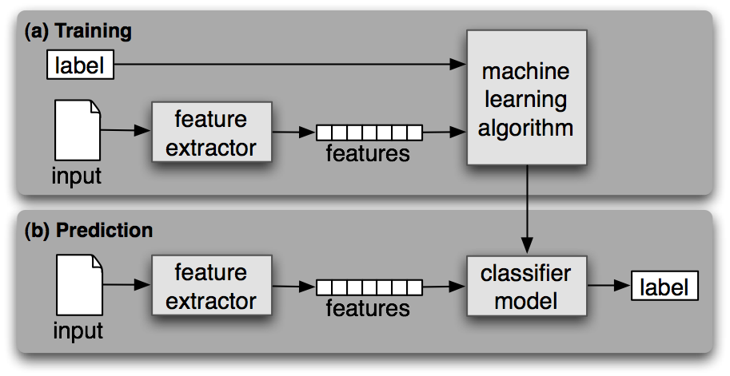
Training model-Rapidminer
Supervised Training Process

Slide 24
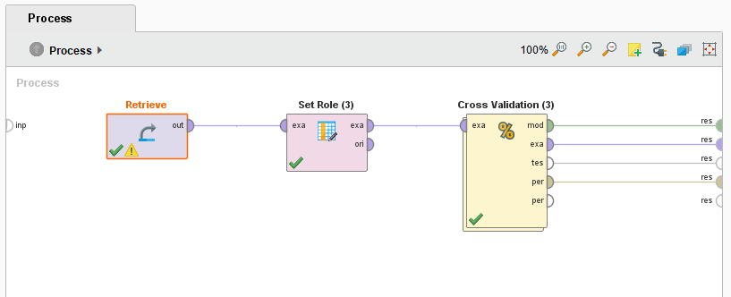
Training model-Rapidminer
Rapidminer Training and Testing Process

Slide 25
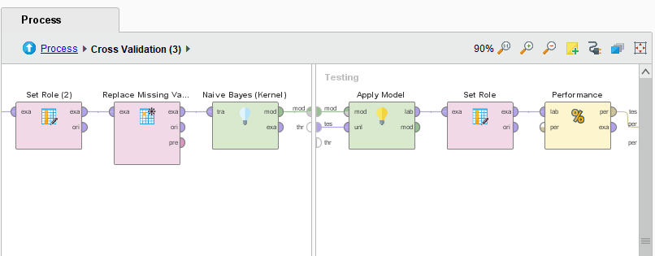

Slide 26
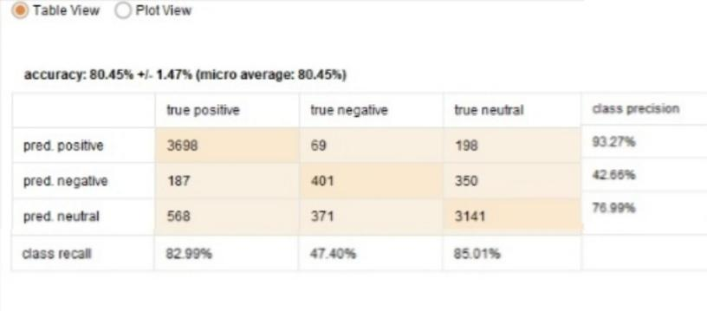
classification confusion matrix

Slide 27
