Slide 1
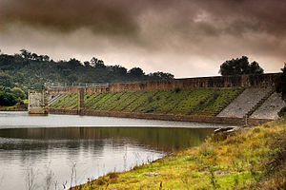
An-Najah National University
Faculty Of Engineering
Department Of Civil Engineering
HYDROLOGICAL Study for DESIGN AL MALEH DAM
Prepared By:
MUHAMMAD SAADEH
OSAMA ABU MUTAW’
AHMAD ABU KHADRAH
UNDER THE SUPERVISION OF
DR. NUMAN MIZYD

Slide 2
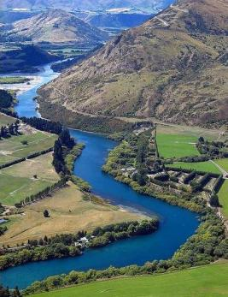
Introduction
{أَنزَلَ مِنَ السَّمَاء مَاء فَسَالَتْ أَوْدِيَةٌ بِقَدَرِهَا فَاحْتَمَلَ السَّيْلُ زَبَدًا رَّابِيًا } (17) سورة الرعد
Important of water.

Slide 3
Objectives
Study the characteristics of the study area.
Conduct a yield analysis for the watershed.
Establish a hydrological model using computer software to estimate the design flood flow.
Design the dam embankment.

Slide 4
Methodology
Project
Define Objective
Data collections
Watershed Delineation
Watershed Characteristics
Yield Analysis
Statistical Analysis
Hydrological Model
Embankment Design
Spillway, outlet and stilling basin Design
Results
Recommendations

Slide 5
Data Collections
previous studies
Ministry of Agriculture
Tubas Municipality
Meteorological Department

Slide 6
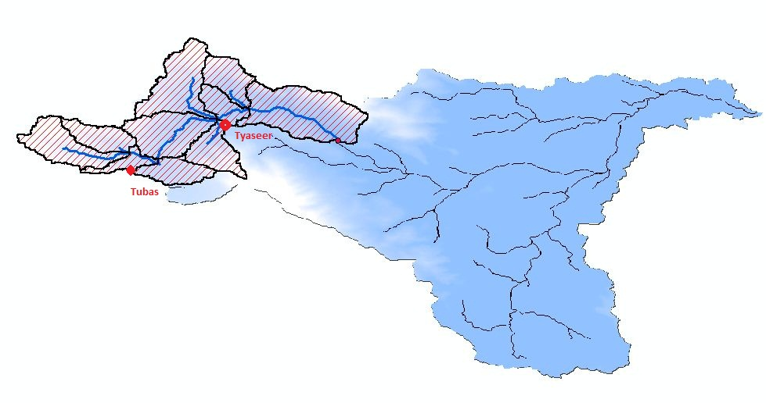
Study Area

Slide 7

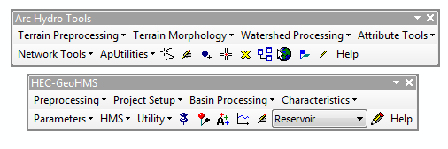
WATERSHED DELINEATION
DEM data.
GIS Software
Arc Hydro toolbar.
HEC-Geo HMS toolbar.

Slide 8
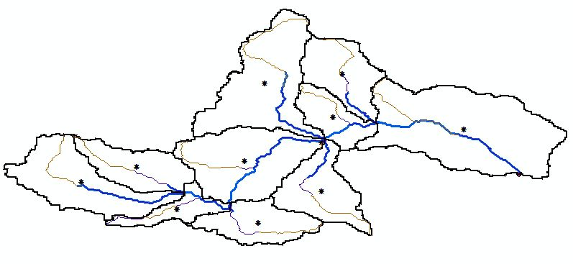
WATERSHED DELINEATION

Slide 9
Watershed Characteristics
sub basin | Area (km²) | Stream Length (m) | stream slope % | Distance from centroid to outlet (m) | Longest flow path (m) | CN
1 | 4.15 | 2490 | 4.86 | 1800 | 5500 | 77.15
2 | 2.08 | 1113 | 4.49 | 1300 | 3060 | 70.42
3 | 6.8 | 3742 | 1.68 | 1566 | 4500 | 72.45
4 | 1.37 | 1320 | 1.97 | 977 | 2400 | 70.16
6 | 3.65 | 3264 | 2.30 | 1846 | 4350 | 71.9
7 | 2.18 | 1223 | 4.82 | 1194 | 3770 | 71.04
8 | 1.88 | 425 | 3.76 | 1180 | 3000 | 77.06
9 | 3.29 | 2613 | 3.75 | 2290 | 4400 | 78.06
10 | 0.95 | 1317 | 1.97 | 1160 | 3250 | 79.11
11 | 1.85 | 224 | 0.89 | 790 | 2820 | 81.6

Slide 10
Yield Analysis
Year | Average annual rainfall (mm) | Runoff volume (m3)
1990 | 316 | 800000
1991 | 939.5 | 4750000
1992 | 465.5 | 1580000
1993 | 333.5 | 98000
1994 | 444.5 | 126000
1995 | 378.5 | 527000
1996 | 521.5 | 700000
1997 | 514 | 610000
1998 | 184.5 | 64000
1999 | 385.7 | 800000
2000 | 266.1 | 11000
2001 | 501.5 | 660000
2002 | 639.5 | 1400000
2003 | 322.5 | 15000
2004 | 436 | 1000000
2005 | 454 | 425000
2006 | 372 | 51000
2007 | 325 | 385000
2008 | 393 | 865000
2009 | 440 | 450000

Slide 11
STATISTICAL ANALYSIS

Slide 12
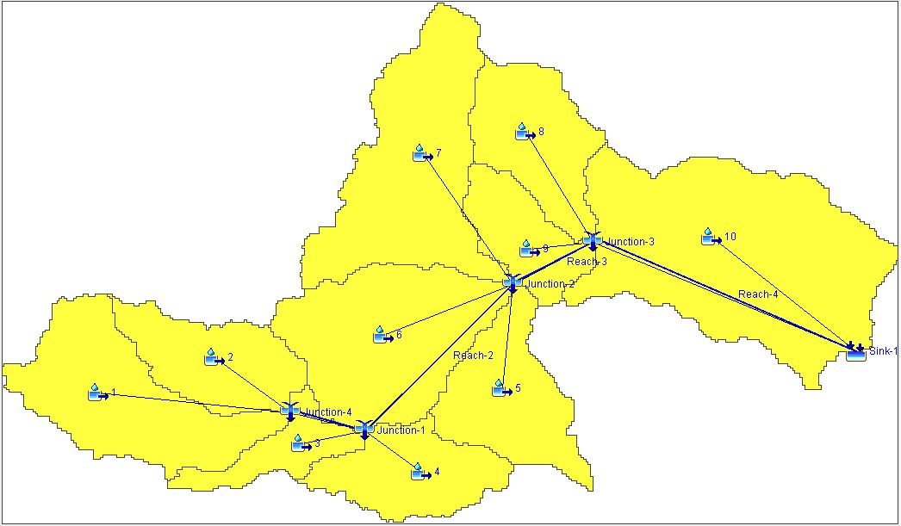
Hydrological analysis

Slide 13
Hydrological analysis
Model Parameter
Sub basin
Junctions
Reach
Outlet (Sink)

Slide 14
Hydrological analysis

Slide 15
IDF Curve (100- Year)

Slide 16
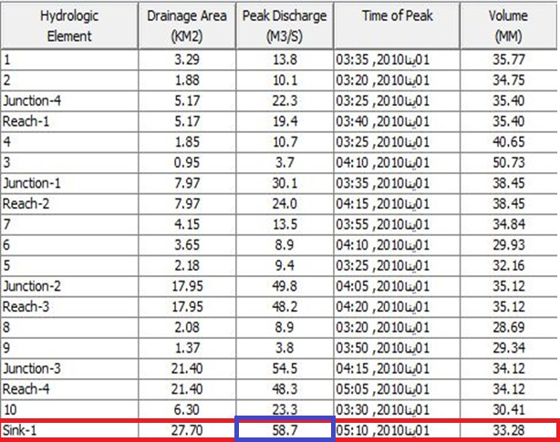
Design Flood Flow

Slide 17
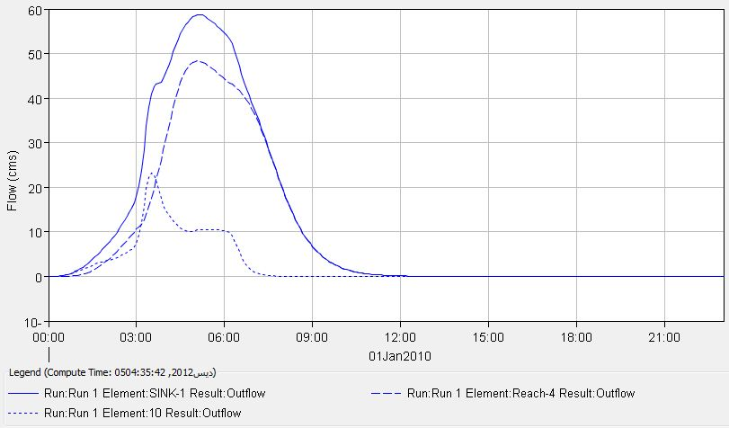
Resulted Hydrograph at Outlet

Slide 18
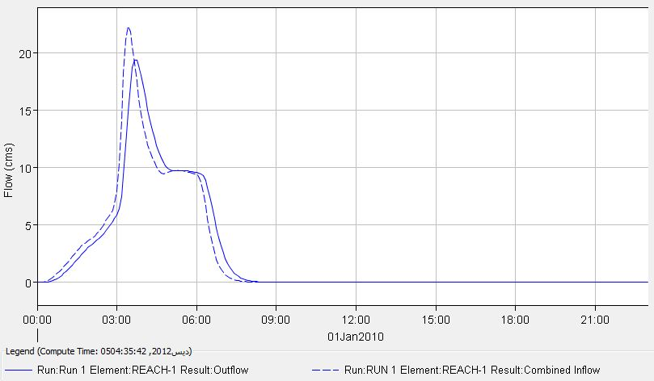
Flood Routing for Reach 1

Slide 19
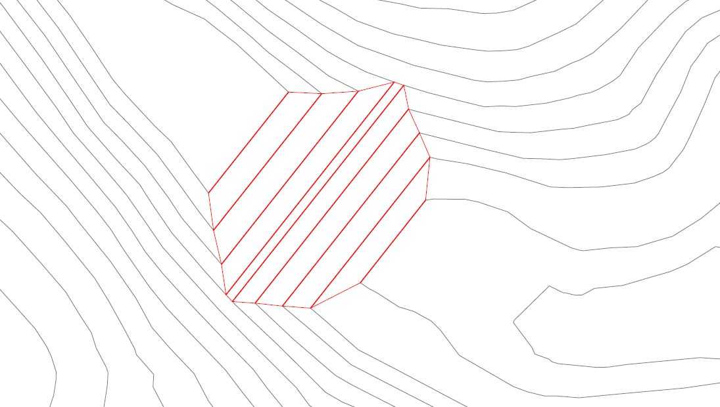
Embankment Design

Slide 20
Dam Dimensions
Dam storage volume is 600000 CM.
Max. length for the dam is 170m.
Max. width of the dam is 103m.
Max. height of the dam is 15m.
Crest width is 6m.
Side slope for upstream is 3.5:1
Side slope for Downstream is 3:1

Slide 21
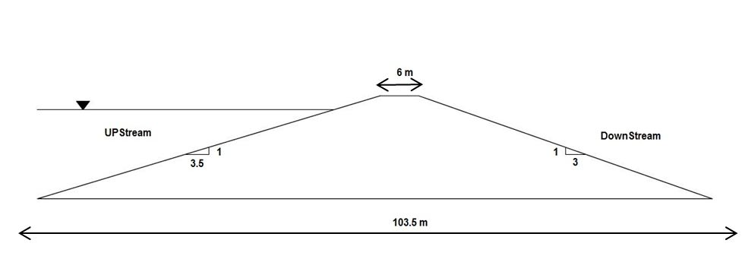
Dam Dimensions

Slide 24
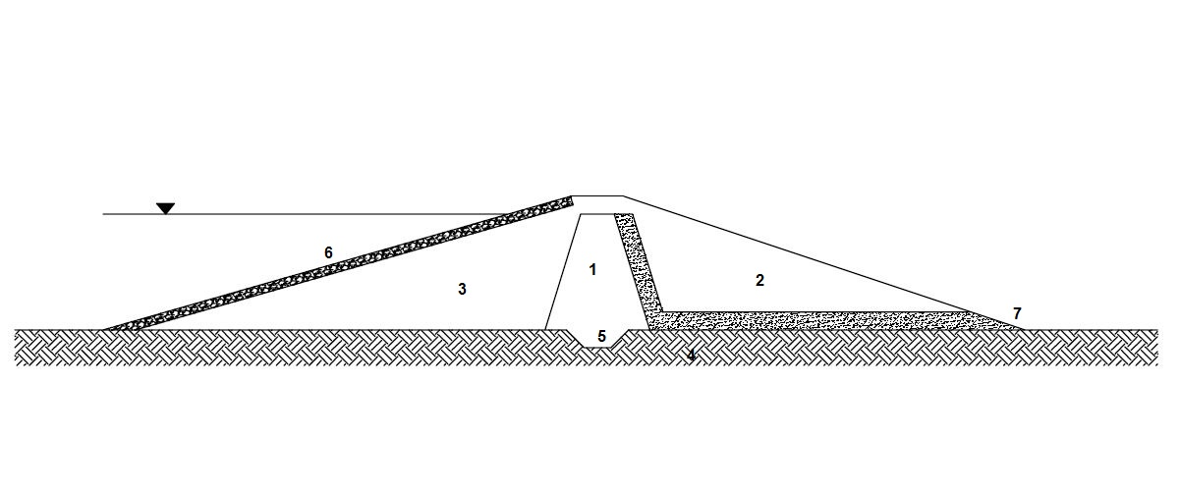
Dam Layers
1 | Central Core ( impervious , compacted clay )
2 | Downstream ( pervious material )
3 | Upstream ( pervious material )
4 | Foundation ( impervious rock foundation )
5 | Cutoff trench ( 3m width , 1:1 side slope )
6 | Gravel layer ( 0.5 m )
7 | Sand drain filter ( 2 m )

Slide 25
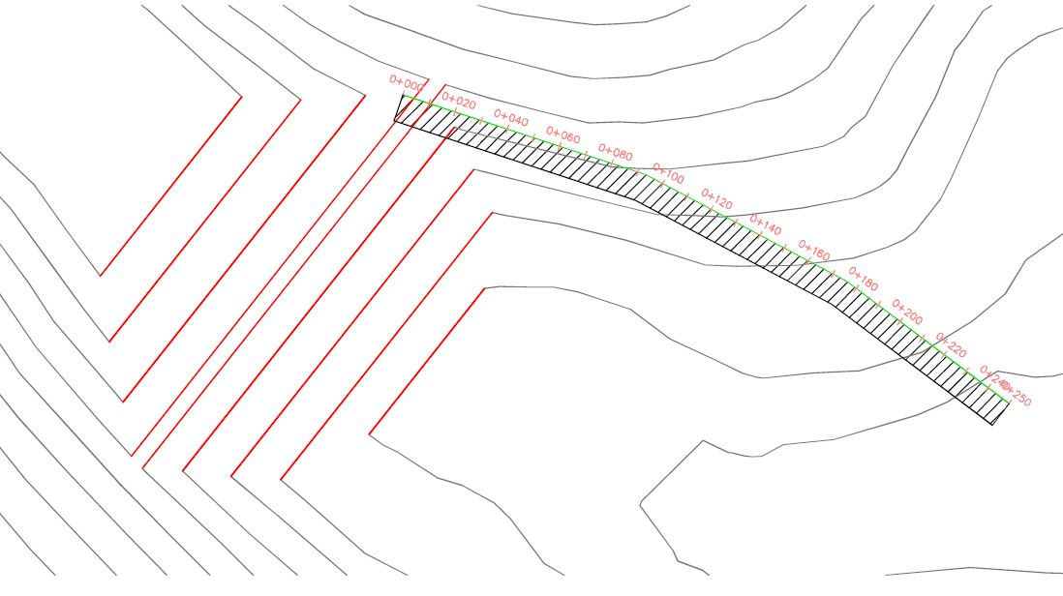
Spillway Design
(spillway layout)

Slide 26
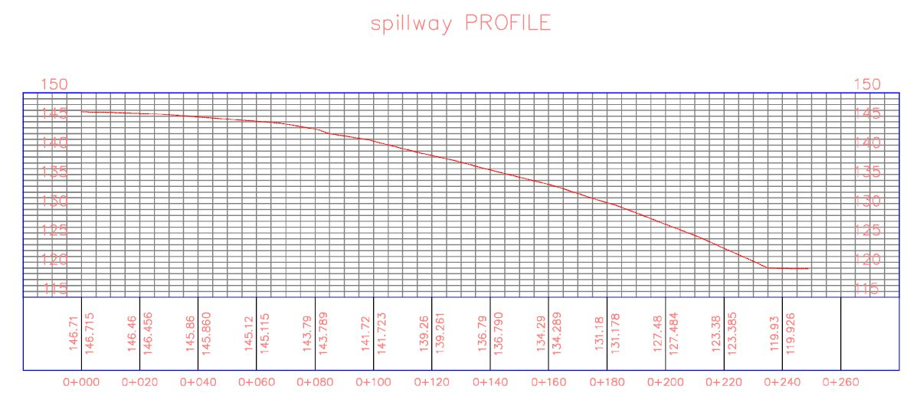
Spillway Profile

Slide 27
Spillway Geometry
Q = 1.7 B H^{1.5}
C (discharge coefficient) is 1.7
B (width of spillway) is 10m
H (design head) is 2.4m
The length of spillway is 250m
Elevation Difference is 30m

Slide 28
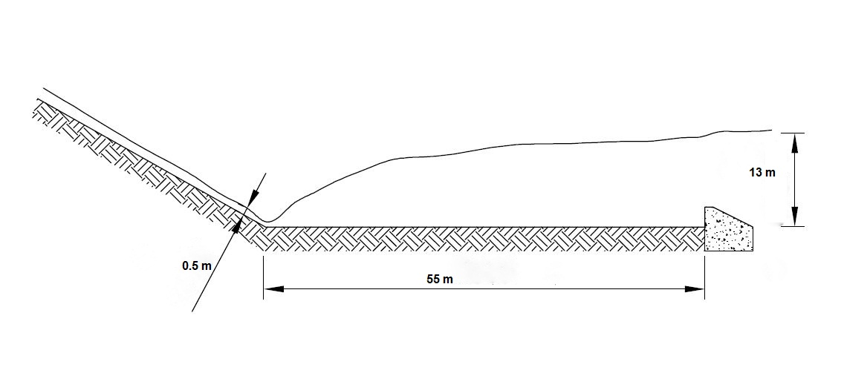
Stilling basin Design
Stilling basin length is 55m
Water depth before stilling is 0.5m
Water depth after hydraulic jump is 13m

Slide 29
Outlet Design
Pipe diameter is 12inch.
Pipe slope is 2%.
Pipe capacity is 0.58 m3 / s.

Slide 30
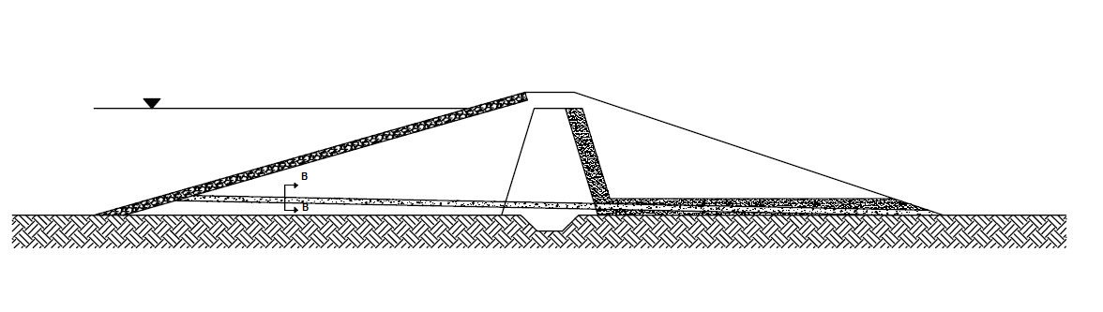
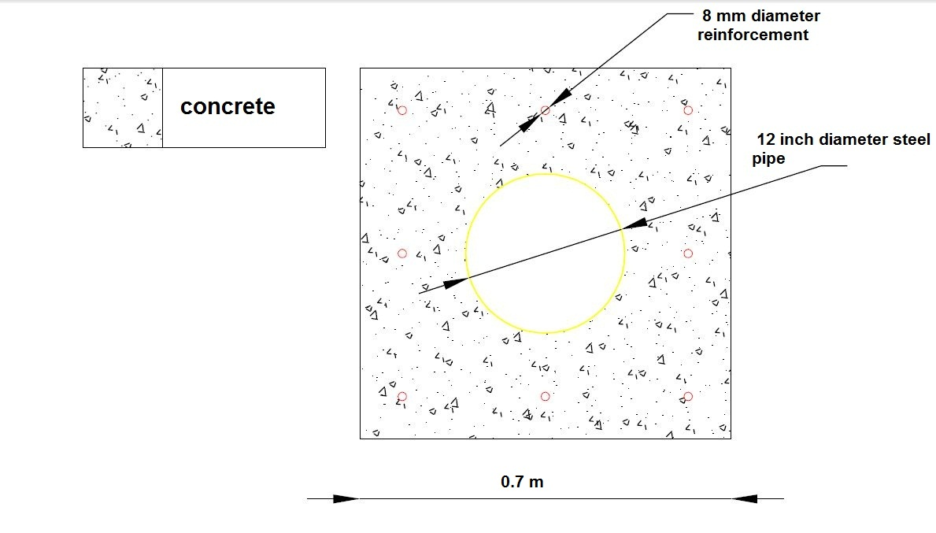
Outlet Design

Slide 31

Recommendations
Geotechnical study
Geophysical survey
Environmental study
Cost analysis study
Water quality studies

Slide 32

For Your Attention

