Slide 1
An Najah National Uni
"Sports Arena "
Prepared By:
Khaled M. Hamadneh
Rafat Hassiba
Omar Abu Shamma
Supervisor:
Dr. Shaker Bitar

Slide 2
Table Of content :
Introduction.
Design of Slab.
Design of Beam.
Steel Design .
Column.
Footing.
Shear Wall.
Stairs.

Slide 3
  Project Description
Our project is design and analysis of Sports Arena located in Nablus city .
Area of Project 5 donom.
The project consists of two parts:
Part A (Main Hall) .
Part B ( Basement ).

Slide 4
  Materials
Concrete structure :
f`c = 28 Mpa.
The yield strength of steel is equal to 420MPa.
Steel Structure :
G50 steel material (Fy=344Mpa) .

Slide 5
Unit weight, γ ( Kn/m³ ) | material
25 | Reinforced concrete
23 | Plain concrete
28 | Tiles
27 | Stone
12 | Concrete blocks

Slide 6
Loads
Dead loads includes:
The own weight=6.25 KN/m.
Superimposed dead load = 4KN/m2.
Live load :
MAIN HALL the live load is recommended to be 5 KN
BASEMENT buildings the live load is recommended to be 3 KN .

Slide 7
3D - Structural Analysis and Design

Slide 8
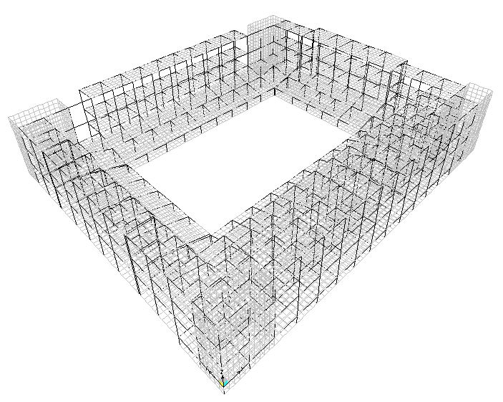

Slide 9
Design of Slab:
Ultimate load on Slab:
For MAIN HALL
Wu = 1.2 DL+ 1.6 LL
= 1.2 (6.25+4 ) + 1.6 *5
=20.3 KN
For BASEMENT
Wu = 1.2 DL+ 1.6 LL
= 1.2 (6.25+4 ) + 1.6 *3
= 17.1 KN

Slide 10
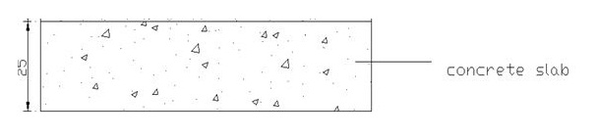
Slab thickness
Thickess For BASEMENT h1=5.8 /28 = 0.21 , h2=4.8/24 =2.1,Use h=25cm
Thickess For MIAN HALL is h = 5.8/24 = 24.1 cm = 25 cm
Figure : The Own Of The Slab Section

Slide 11
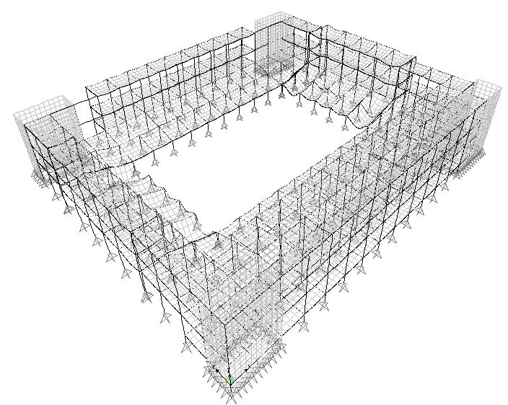
Compatibility

Slide 12

Equilibrium
      Live Load:
From Manual:
ΣF_{z} = ( 429.21*3 ) + ( 448.7 *5 )
=3531.48 KN
From Sap:
ΣF_{z} = 3378.73 KN
Error = ( 3378.73-3531.48 ) / 3378.73 = 4.5 %. OK

Slide 13

Super Imposed Dead Load:
From Manual:
ΣF_{z} = total area * SDl = 877.8 *4
= 3511.2 KN
From SAP:
ΣF_{z} = 3334.504 KN
Error = ( 3334.504 - 3511.2 ) / 3334.504 = 5.28 %. OK

Slide 14
Dead load:
From Manual:
ΣF_{z} = 8772.9 KN
From SAP:
ΣF_{z} = 9207.823 KN
Error = (9207.823 - 8772.9 ) / 9207.823 = 4.72 %. OK

Slide 15
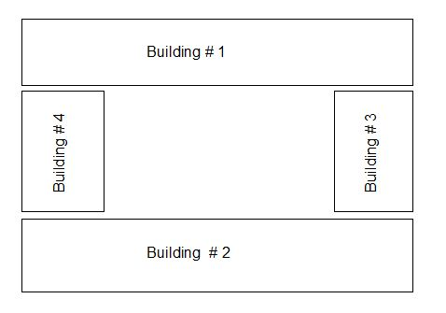

Slide 16
Calcalate Area Of Steel for slabs
Moment from SAP :
For BASEMANT
Mu+ (For Building 1) =34 KN.m
b= 1000mm , d= 200mm
ρ =0.0022 …….. OK
As =0.0022 *1000 * 200 =440 mm2
440/113 = 4
Used 4ø12

Slide 17
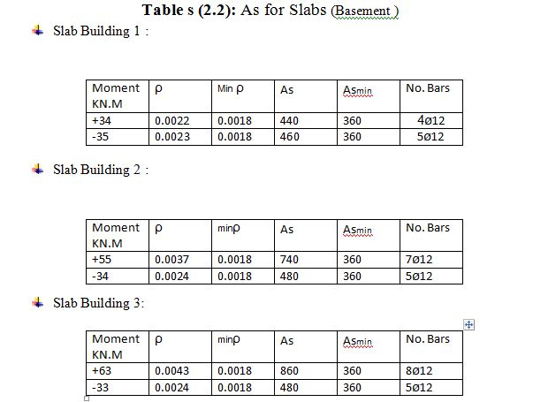

Slide 18
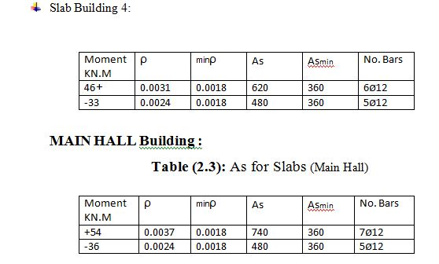

Slide 19
Design Of Beams :
For Basment ( BeamA)
Loads On Beam:
Wu = (4.8 * 17.1) =82.08
Wu = 82.08
For Main hall (Beam1)
Loads on beam:
Wu = (4.8 * 20.3 ) =97.44
Wu = 97.44 KN/m

Slide 20
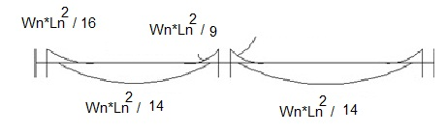
Thickness Of Beam ( Basement )
Figure : Moment On Beam
For Mu (negative) = ( Wu * L)/9
=(82.08 * 4.8 ) /9
= 160.8KN.m
Assume b= 400mm and d= 550 mm

Slide 21
Thickness of beam (mainhall)
Figure : Moment On Beam
For Mu (negative) = ( Wu * Ln)/9
=(97.44* 4.8 ) /9
= 190.98 KN.m
Assume b= 400mm and d= 600 mm

Slide 22
Check
For BASEMENT :
For interior span:
From SAP :
Mu = (143 + 132)/2 + 101 = 238.5 KN.m2
= 238.5 / 4.85 = 49.1 KN.m
From Manual:
Mu = Wu * L² /8
Mu = 17.1* 4.85² /8 = 50.2 KN.m
Error% = (Mu_{sap} –Mu_{manual})/ Mu_{sap}
= (50.2 – 49.1)/ 50.2 = 2.3 % Acceptable Error.

Slide 23
For MAIN HALL
For interior span:
From SAP :
Mu = ( 227 + 107 ) /2 + 132
= 299 KN.m2
= 299 /5 = 59.8 KN.m
From Manual:
Mu = Wu * L² /8
Mu = 20.3 * 5² /8
= 63.4 KN.m
Error% = (Mu_{sap} –Mu_{manual})/ Mu_{sap}
= (59.8 – 63.4 )/ 59.8 = 6.0% Acceptable Error.

Slide 24
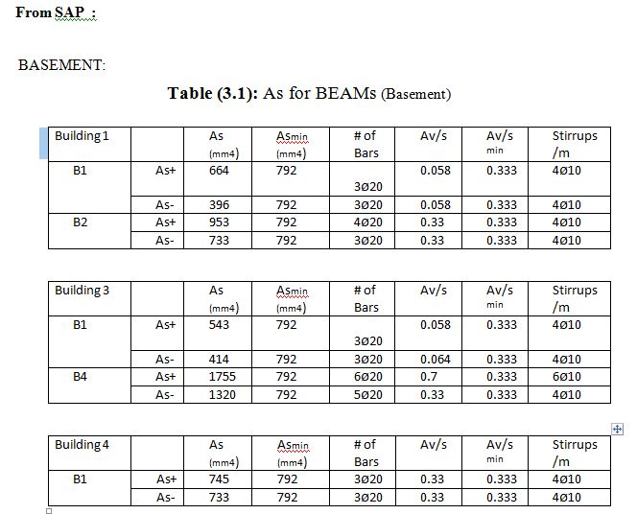
  Calcalate Area Of Steel for Beam's

Slide 25
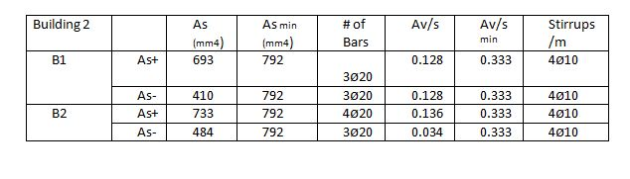
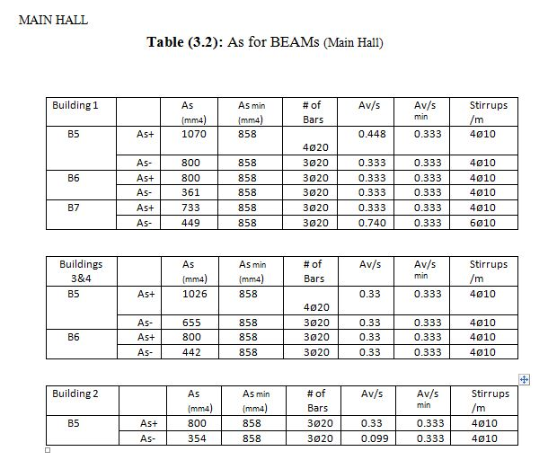

Slide 26
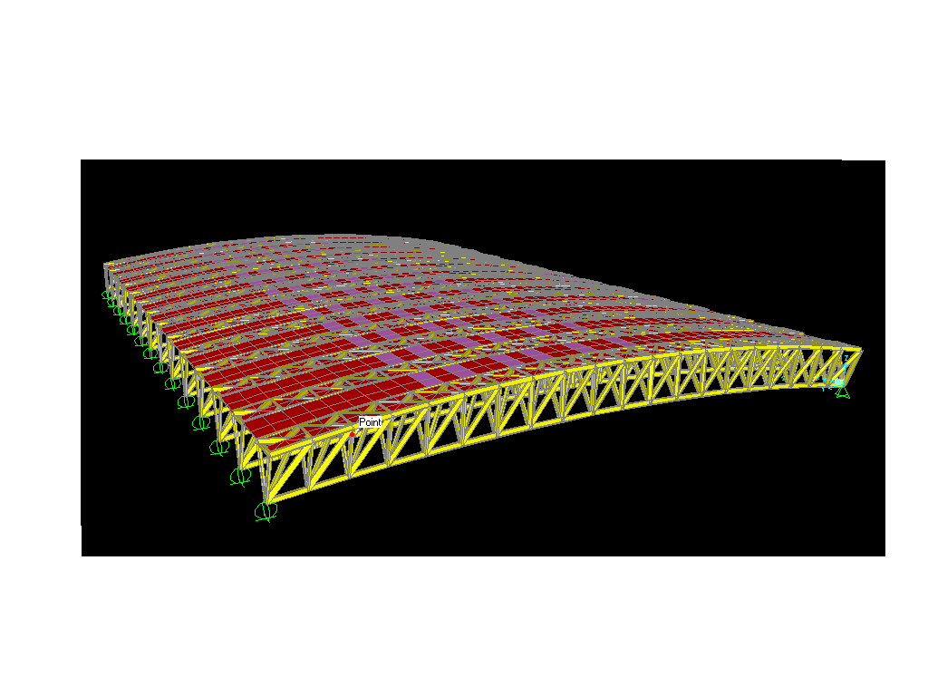
DESIGN OF STEEL

Slide 27
DESIGN OF STEEL
We used G50 steel material (Fy=344Mpa) and the following constants were used:
Kz=0.7 I=1(importance factor)
V= 100km/h qz= pressure velocity.
G: 0.85(guest factor). Kzt=1(topographic)
Kd=0.85(directionally factor).
Cp: external pressure factor. (-0.7 for sloped roof)
Total area = 2808m²

Slide 28
ANALYSIS :
For Roof:
P = qz * Cp * G
q_{z} = 0.613 K_{z} K_{zt}K_{d} V² I
q_{z} = 0.334 KN/m²
p= (.85)*(-0.7)*0.334= -0.199 KN/m²
p _{min} =( 500/1.3)(-0.7)= 0.269
p < p _{min} so we use
p = 0.293 KN/m² (suction)

Slide 29
Loads:
Live Load = 1 KN/m²
our put the super imposed as slab above steel (cover )
the material used for cover is Polyethylene ( unit weight=12 KN/m³ )
and the thickens of cover =0.1m.
Wind Load (P_{w}) = 0.293 KN/m²

Slide 30
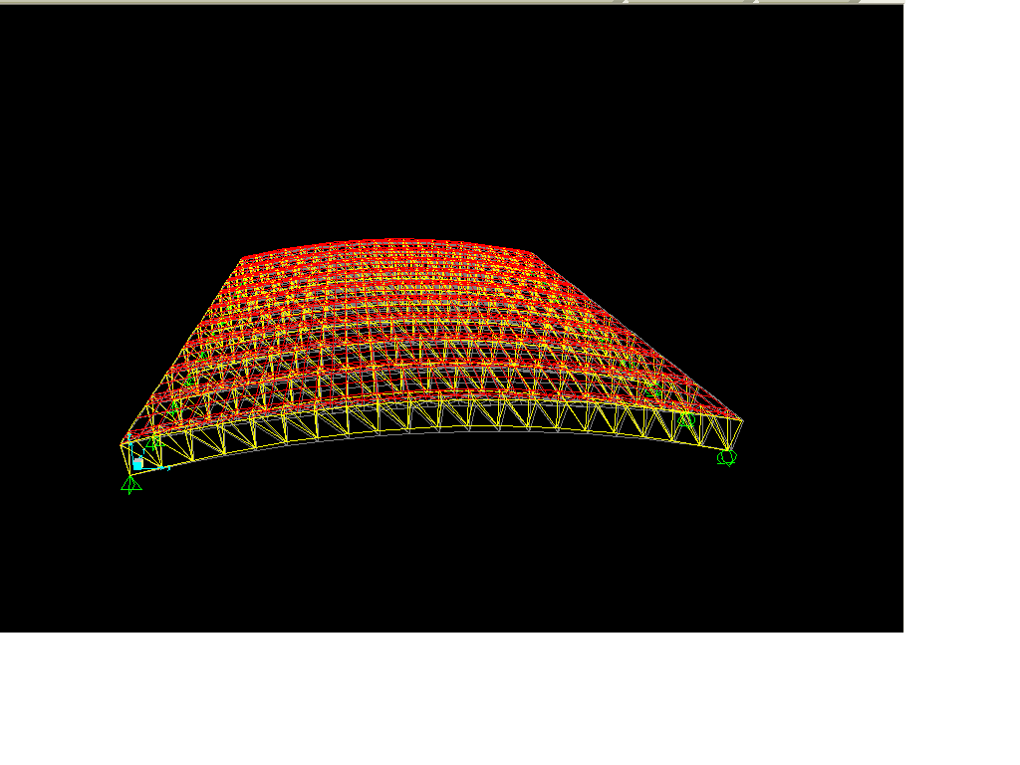
Check SAP Results :
1- compatibility

Slide 31

2- Equilibrium :
From dead load :
Manual :
The sum of dead loads = 1*12*0.1*3280+76.9*3.174*0.06*0.05 *3122= 6222KN
From SAP :
% error = (6222-6217)/6217=0.0008% ok

Slide 32
From live loads:
Manual :
The sum of live loads = 1*21*14=294KN
From SAP :
% error = 0% ok

Slide 33
From wind loads :
Manual :
The sum of wind loads = 0.293*21*14 = -86.142 KN
From SAP :
% error = (86.142-85.456)/85.456=0.8% ok

Slide 34
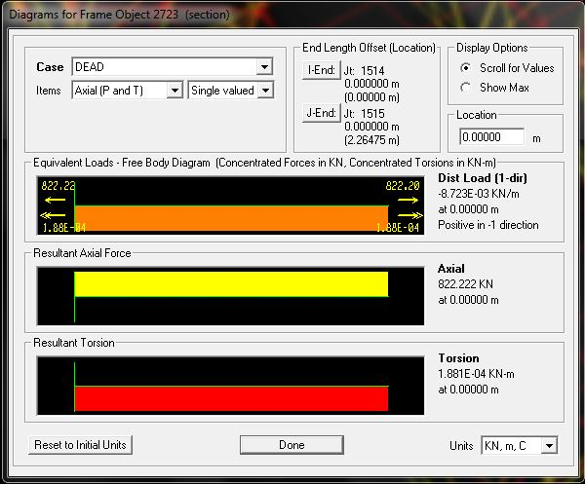
3- Stress strain relationship:
From Super Imposed Dead Loads :
Manual :
w=6217 KN/2.247= 2766.8 KN/m
M= wl²/8 = 2766 *(2.247)² /8 = 1745.6 KN.m
From SAP:
Td= 822.22*2.1 = 1726.62 KN.m
% error = (1745.6 -1726.62)/ 1726.62 =1.09% <5% ok

Slide 35
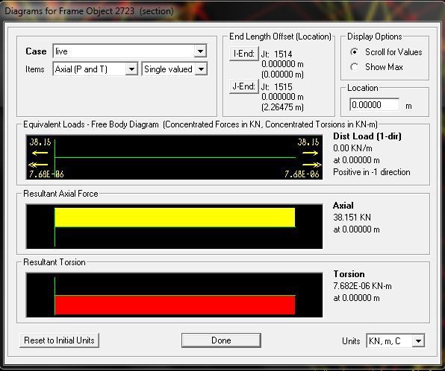
From live loads
Manual :
W = 294/2.264 =130KN/m
M= wl²/8 = 130*(2.264)² /8 = 83.1KN.m
From SAP:
Td= 38.428*2.1 = 80.6 KN.m
% error = (83.1-80.6) / 80.6 = 3.1 % <5% ok

Slide 36
4 DESIGN DETAILS:
From Compression:
Pu = -156.58 KN , k =1 , r = .035 , L=4.194 m , Ag= 0.002m²
KL/r = (1)*(4.194) / .035 = 119.82 so Ǿfcr = 108 N/m²
ǾPn= .9 (108)*(0.002)*10³ = 194.4 KN > 156.58 KN ok
From Tension :
Pu =49.3 KN , Ag= 8.9*10^-4 m² ,
ǾPn yielding =.9 * Ag * Fy = 0.9 * (8.9*10^-4) *344* 10³ = 275.5 > 49.3 KN ok
ǾPn fracture = .75 (8.9*10^-4) *(455*10³) = 303.7 KN

Slide 37
Check With SAP Results :
  From Compression
Manual: ǾPn= 194.4KN
From SAP: ǾPn= 183.047 KN
Error % = (194-183.047)/183.047 = 5.98% < 10% ok
  From tension:
Manual: ǾPn yielding = 275.5 KN
From SAP: ǾPn = 54.78KN
Error %= (275.5-54.78)/54.75= 4.031% <10% ok

Slide 38
Design member:
Compression:
Pu = -156.58 KN
Assume KL/r = 140 , ǾFCR =79 MPA
Ag =(156.58/79) = 1.98 *10^3 mm^2
Try with HSS5*2-1/2*1/4 Ag = 2.03*10^3 mm^2
ry = 25.4 , rx=43.9
KL/r= (4194/43.9)= 95.53 , Ǿ FCR =158.5MPA
ǾPn = Ag * ǾFCR = 0.002 * 158.5 *10³ = 317 > 156.58 ok
The section is HSS5*2-1/2*1/4

Slide 39
Tension Member :
Pu=49.3 KN , G50 steel is used (Fy=340 Mpa , Fu=450 Mpa)
Welded , L = 3.996m
Ag=Pu * 10³ / 0.9* Fy = 161 mm² Yielding.
Ag=Pu * 10³ / 0.6 * Fy = 241.6 mm² Fracture welded.
Try HSS4*4*3 / 16 (Ag = 166mm² , r = 39.4mm)
Yielding: Ø Pn= 50.79 > 49.3 OK.
Fracture: Ø Pn = 56> 49.3 OK.
Check slenderness:
L/rmin ≤ 300
3.996 / 39.4 ≤300
101 ≤ 300 OK.

Slide 40
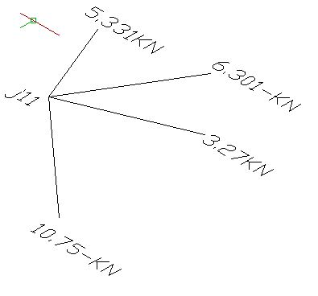
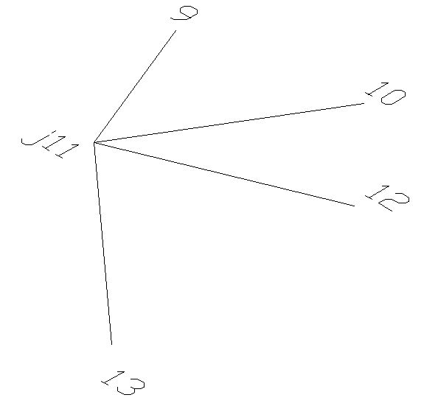
CONNECTIONS DESIGN:

Slide 41
member (12) = tw ( thickness of tube ) = 3.6 mm
TUBO 60*30*3.6
So the perimeter of the pipe :
Lw = perimeter of tube = 30*2+60*2=180mm
Assume E70xx weld type is used :
Pu= Ǿ (0.707 * a * 0. 6* Fu * L) . Ǿ =0.75 Fu= 480MPa
3.27 =0.75*0.707*a*0.6*480*180/1000
a = 0.1189 mm
a=0.1189 mm < a_{min} so we use a_{min} = 3 mm

Slide 42
Design of Columns
Used interaction digram if :
1-
2-
Ф Pn = Ф λ (0.85 fc (Ag-As) + As fy)
Assume the minimum steel ratio (ρ =1%)
Pn(max) = 0.65* 0.8 [0.85*fc*( Ag – As ) + As*Fy]
Assume
Ag = 250000mm^2
As = 2500 mm2
Pn(max) = 0.65*0.8*[0.85*fc*( Ag – As ) + As*Fy]
=3827.9 KN

Slide 43
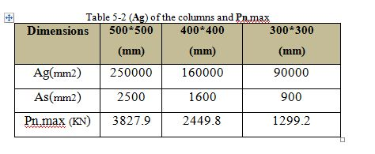

Slide 44
Check of load in column C1 using tributary area:
Live load = 46.56 KN.
Superimposed = 34.92 KN
Dead load:
Own weight = 6.25 KN/m²
Dead load = (6.25*11.64 ) + (0.65-0.25)*25*4.8*0.4 +(0.65-0.25)*25*(4.85/2)*0.4 =
Dead = 101.7 KN.
Ultimate load= 1.2*[101.7+34.92] + 1.6*[46.56] Ultimate load=238.4 KN
From sap = 237.24 KN error = 0.5 %

Slide 45
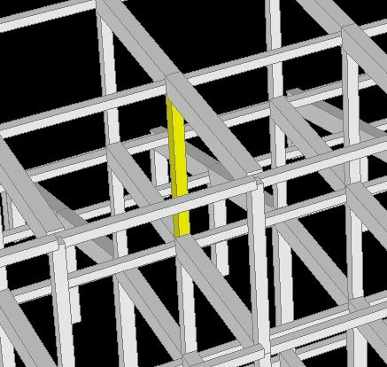
Check slenderness ratio
In order to determine whether the columns is short or long:
If
K*L /r ≤ 22 the column is considered short

Slide 46

In X direction
ψA = = 0.104
ψB = = 0.045
K= 1.04 ,K*L /r = 54.77 >22
In Y direction
ψA = = 0.223 ,ψB = 0.097
K=1.08
K * L /r = 57 >22
The column is long
All column in the sport's Arena are Long column .

Slide 47
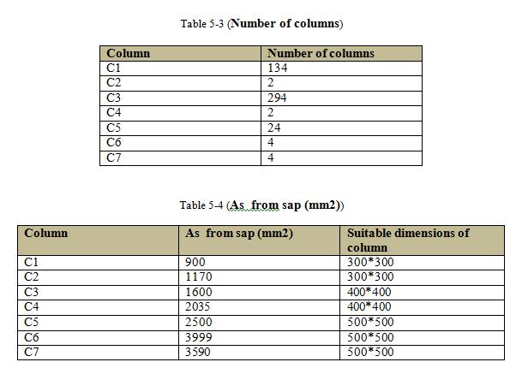

Slide 48
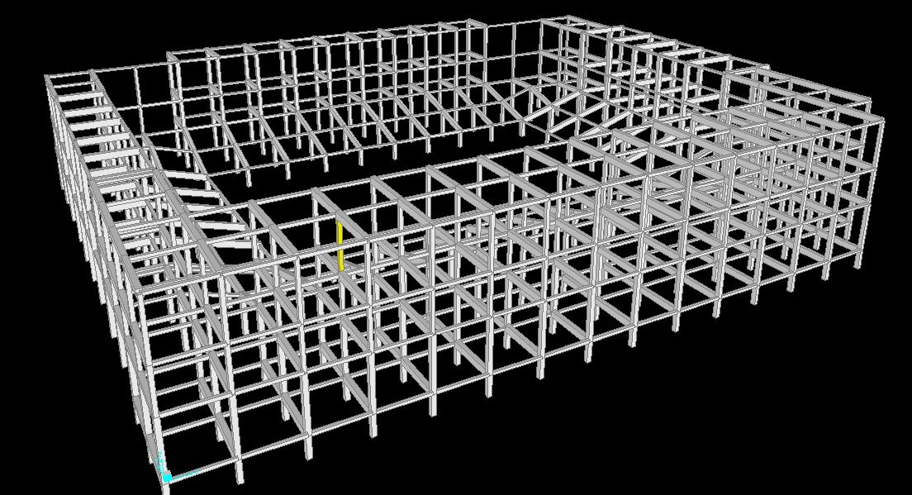
Design of columns in group C1:

Slide 49
Pu =504.058 kN
Mu =6.7147 KN.m
Used interaction digram if :
1-
2-
Pu =504.058 kN > 0.1*28 *0.3 * 0.3 = 0.252
Mu =6.7147 KN.m < 504 *(0.015 +0.03*0.3)=12
We can't use interaction diagram
Pn(max) = 0.65*0.8*[0.85*fc*( Ag – As ) + As*Fy]
= 1299 KN >504.058
Use
As= Ag *0.01 =90000*0.01 = 900 mm2
As From SAP =900 mm2

Slide 50
Use 8 Ф 12
300 – 2*cover =300 -130 =170
170 / 2 =85 mm
Spacing between bars = 85 mm ok
Design for ties:
Using Ф 10 mm ties
According to the ACT Code spacing between ties shouldn’t be more than the least of the following:
16*db = 16*12 = 192 mm
48*ds = 48*10 = 480 mm
400 mm
Use S = 190 mm
Therefore use Ф 10 mm /190 mm

Slide 51



Design of columns in group C6:
Pu =392.8 kN
Mu =312 KN.m
Pu =392.8 kN > 0.1*28 *0.5 * 0.5 = 0.7
Mu =312KN.m > 392.8 *(0.015 +0.03*0.5)=11.78
We use interaction diagram
=1.57 ,1.57 /6.9 = 0.22
=2.49 , 2.49/6.9 = 0.36
Fc = 28/ 7 =4 Ksi
Fy = 420 /7 =60 Ksi
= 0.75 ,
From fig A-9b ,
As =0.0155 *b*h =3875 mm2 , As from Sap =3954mm2

Slide 52
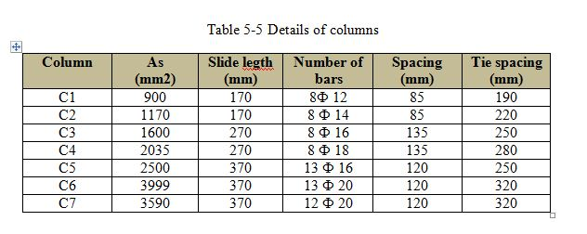

Slide 53
DESIGN OF FOOTING
from the results the soil have cavitations , so we used mat foundation in our project Sports Arena building,
bearing capacity of Soil = 280 KN/m²

Slide 54
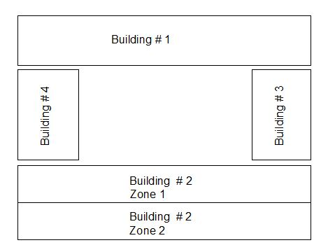

Slide 55
Determine depth of footing:
Qall=280 KN /m²
Cover =100 mm
Mat For Building Number 1
Q = 33676.1 KN
A = 71.7*14.45=724.17m²
I x = (b)(h)³/12 = (71.7)(14.45)³ /12= 18027.75m .
I y = (h)(b)³ /12= (14.45)(71.7)³ /12 = 443858m .
X = (1108587/ 33676) =32.9 m .
Y = (273460/ 33676) =8.12 m.
e( x ) = Y - yg = 0.98
e( y )= X - xg = -2.95
M x = Q * e( y ) = 29971.7KN.m
M y = Q * e( x ) = 99344.5KN.m

Slide 56
q(A) = -(Q/A) - ( Mx * y / I (x))- ( My * x / I (y))
= -52.5 KN/ m²
q(B) = -(Q/A) + ( Mx * y/ I (x)) + ( My * x / I (y))
=-12.46 KN/ m²
52.5 KN /m² < 280 KN /m²
Check wide beam shear :
Assume d =500mm
Vu = qu*(L/2)
= 52.5 *1.4*(4.8/2) = 176.5 KN/m
Ǿ Vc = 0.75* * b*d /6000
= 0.75* * 1000*500 /6000 = 308 KN/ m
Ǿ Vc > Vu ……….ok

Slide 57
Check bunching shear :
Take the largest load on the column or the bad column (edge )
Vu = 956.2 KN
Ǿ Vc = 0.75* * b*d /3000
= 0.75* * 2500*500 /3000 = 1653 KN
Ǿ Vc > Vu ……….ok
d =500mm
h=600mm

Slide 58
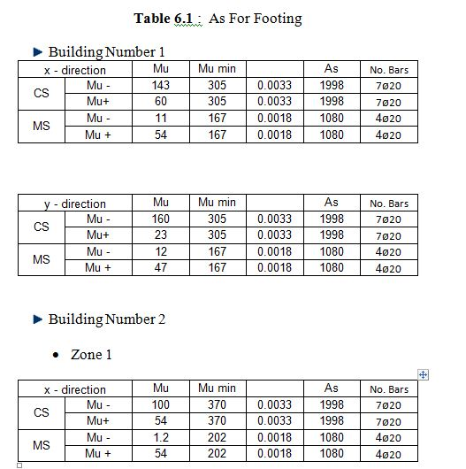

Slide 59
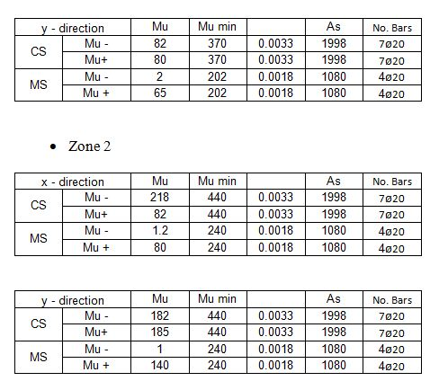

Slide 60
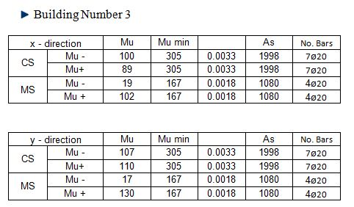
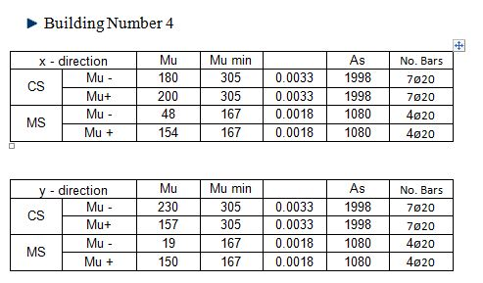

Slide 61
DESIGN THE SHEAR WALL
For Building # 1
Max axial load = 492.171 KN
Assume wall thickness = 250 mm
ρ = 0.0025
Ag = 250 *1000 = 250000 mm²
As = 0.0025 * 250 * 1000 = 625 mm²
P_{U} = Ø λ [0.85 f_{C} (Ag – A_{S}) + F_{y} A_{S}]
= 3222.76 KN >> 492.171 → ok
As = 0.0025 *250*1000 = 625 mm²/m → Use 612 mm/m .
Other direction (horizontal):
As = As,min = 0.0018 *b*h
= 0.0018 * 250 * 1000 = 450 mm²/m → Use 4 12 mm/m .

Slide 62
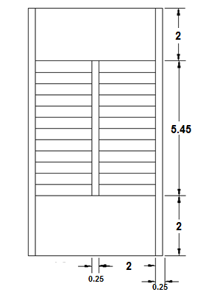
DESIGN OF STAIRS
The thickness of the flight and landing can be calculated as follows:
Flight span = 5.0 m
Hmin = 5/20 = 0.25 m
Use H =0.3 m , D = 0.25 m

Slide 63
Loads on stairs:
Live load = 4 KN/m²
Dead load = 0.3 * 25 = 7.5 KN/m²
Super imposed dead load = 5 KN/m²
Wu = 1.2 (5 + 6.25) + 1.6 * 4 = 21.4 KN/m²
Mu = Wu * L² /8 = 21.4 * 5² /8 = 66.87 KN.m/m for stair.
For Mu = 66.87 KN.m/m
ρ = 0.00341 > ρ_{min}
As = 0.00341 * 1000 * 250 = 853 mm²/m
Use 5 Ф12 mm/m

Slide 64
Load on landing = landing direct loads + loads form flight
= 21.4 + 21.4 * (5/2) =74.9 KN/m
Assume this load is resisted by 1m wide of landing, then:
Mu = 74.9 * (4.35)² / 8 = 177.1 KN.m
ρ = 0.00805
As = 0.00805 * 1000 * 250 = 2014 mm²
Use 8 Ф14 mm/m.
Check of shear in landing:
Vu = 74.9 * 4.35 / 2 = 162.9 KN
ФVc = 0.75 *(1/6) * (28)^{1/2} *1000 *250 /1000 = 165.3 KN > Vu OK.

Slide 65
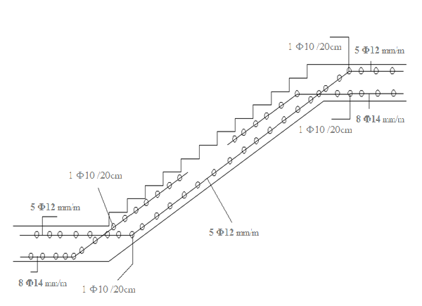

Slide 66


