Slide 1



An– Najah National University
Design of Water Distribution and Sewage Collection
Network for Attil
Prepared By:
Hakam Awwad Tameem Badawi
Ibrahim Sarsour
Khalid Armoush
Supervisor: Dr. Numan Mizyad

Slide 2
Project I (Review) :
(WDN)
Our project divided into two major parts:
1. Design of water distribution network to Attil town using “Water CAD”
2. Design of wastewater collection network to the same town using “Sewer CAD”
In the WDN we concentrate on adjusting the velocities in the pipes and the pressure in the junction. (pressurized).

Slide 3
Project I (Review) :
(WDN)
We conducted the design of water net work by using a software program is (Water CAD) . Through which we can conduct design and analyze water distribution net work with maintaining of specification and standard tabulated in data base of this program. In our project we use this software to design net work taking in to account the Palestinian standard and specification.

Slide 4
Project I (Review) :
(WDN)
Per capita per day considered in the WDN =120 L/day
Future Demand = 120L/C.d * 23000* C = 2760m³/d .
Pipe material: Hazen-Williams =130(ductile iron ).
*We will show how we calculated this number.

Slide 5
Project I (Review) :
(WDN)
* Pumping :
the pumping system adds a head by a pump have characteristics about 120 m with a flow of about 5700m³/day
Another important input shape files :
contour map
Roads
Houses
reservoir

Slide 6
Project I (Review) :
(WDN)
* General comments :
Pressure ranges from 2.7 bars to 10.2 bars on the Junctions
Minimum diameter used is 2 inches in the network
Multiplication factor used 2 in beak consumption hours for example at (7.00 AM)
Velocity ranges from .1 to 2m/sec in the pips

Slide 7
Introduction

Slide 8
The importance of Sewage Network
(in general)
There is many advantages from having a wastewater Collection system …….. Conservation of environment, reduce pollution of groundwater.
Attil town dose not have infrastructure for the wastewater ………….. They get rid the wastewater by using cesspits in houses.
The solution is construction of wastewater collection network accompanied with wastewater treatment plant

Slide 9
Sewage collection network :
The Sewage network should be capable of:
    Meeting all loads from consumption.
    Satisfactory all constraints and Specifications .
Sources of sanitary sewage:
1) Dwellings.
2) Commercial.
3) Industrial.
4) Institutions.

Slide 10
design of Sewage network:
The design of Sewage network involves the following:
    Determination of conduits diameters.
    Selection of pipe material.

Slide 11

Objectives

Slide 12
The Objectives of the Project:
The main objectives of this project are to:
Studying and analysis the existing of Attil town.
Design of Sewage collection network .

Slide 13

Study Area
Study Area

Slide 14
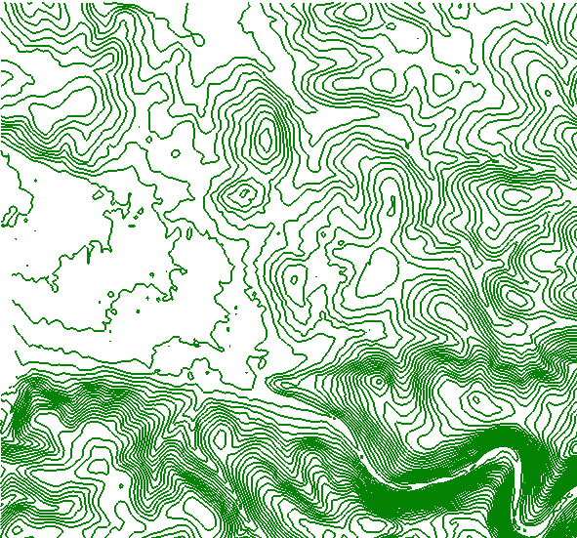
Topography

Slide 15
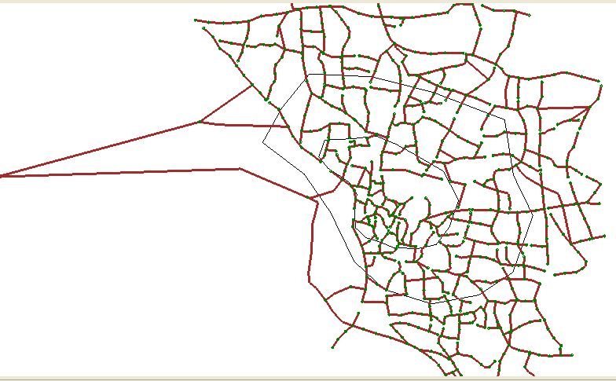
Network Layout

Slide 16
Assumption and constraints

Slide 17
Population
The main side in water and sewer collection networks design is expected number of people that network will Serve.
P_{n} =P₀ (1+r)^{n}
P_{n} = 12000(1+0.02655)²⁵
→P_{n} = 23000 capita
From these data we note that the population after 25 years is 23000 capita

Slide 18
Award of population
south
West
North

Slide 19
Assumptions
* As the Palestinian standards recommend using are turn factor ranging between (75-85)% from the water incomes the WDN we took a factor of 0.85
* The Palestinian standards recommend the hourly peak factor to range from (2 -4) typical =3and the daily peak factor ranges from (1.5-3) typical =1.8 we choose a hourly peak factor with a value of 3 .
* For the distribution network, we divided the town into three zones depending on the consumption of water. In the result, from these zones we expected produced different loads on the manholes from zone to another zone.

Slide 20
Density
Population

Slide 21
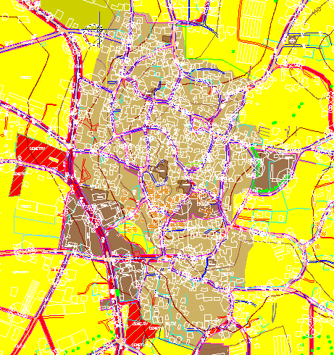
Saturation Zone
Saturated zone
Population | 7000 Capita
Area | 173.1 donum
Density | 40.44 C/ donum
(Load/manhole) :
(7000*120*3*.85)/(126*24)=0.71m³/hr.

Slide 22
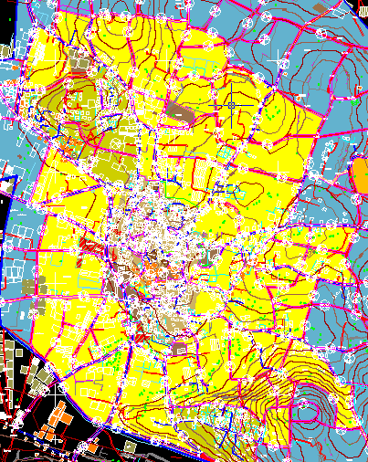
Moderate Saturation Zone
Moderate zone
Population | 7000 Capita
Area | 2200.4 donum
Density | 3.18 C/donum
(Load/manhole) :
(9000*120*3*.85)/(499*24)=0.23m³/hr.

Slide 23
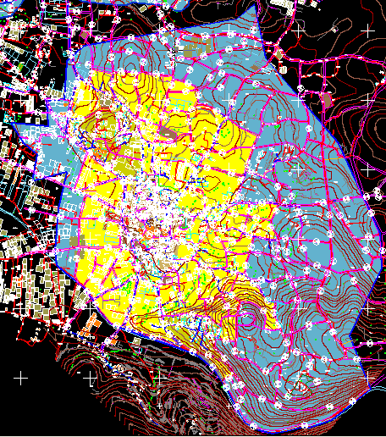
Unsaturation Zone
Unsaturated zone
Population | 9000 Capita
Area | 2834.4 donum
Density | 3.18 C/donum
(Load/manhole) :
=(7000*120*3*.85)/(185*24)
=0.5m³/hr.

Slide 24
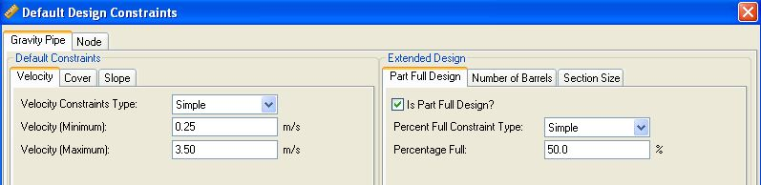
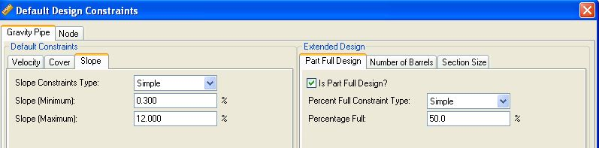
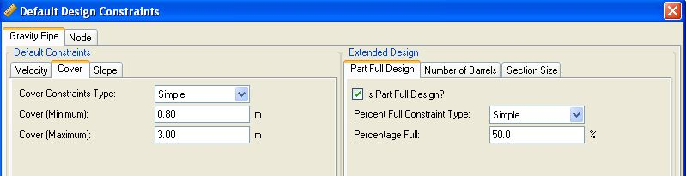
Constraints

Slide 25
Design of Sewage Collection network

Slide 26

About Sewer CAD
Sewer CAD is a software program, which we can use to design and analyze waste water collection network with maintaining of specification and standard tabulated in data base of this program. In our project we use this software to design network taking in to account the Palestinian standard and specification.

Slide 27
Preparing for Sewer CAD
The first basic thing prepared for input data to software is contour map. After that we transfer this file to many shape files such as roads to imagine how can we lay the conduit of network to receive houses and institutions , houses to gain an indicate about density of people.

Slide 28
Important term in design
Conduit : There are some conditions to be met in the pipe :
1 - High durability to resist external and internal pressures.
2 - High resistance to corrosion
3 - The ability to bear different temperatures
Manholes : designed from brick or plain or reinforced concrete, and the goal of these openings is to enable maintenance equipment or maintenance workers to work in order to remove sediments in the sewer lines.
Plant treatment.

Slide 29
Results
(Out Put of Sewer CAD)

Slide 30
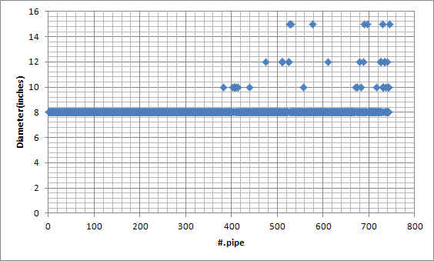
Variation in the Diameters of pipe
This relationship between diameters and number of pipes.

Slide 31
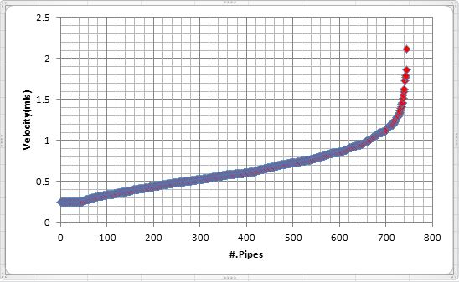
Variation in the velocity of pipe
This figure show the relationship between Velocity cover and number of pipes.

Slide 32
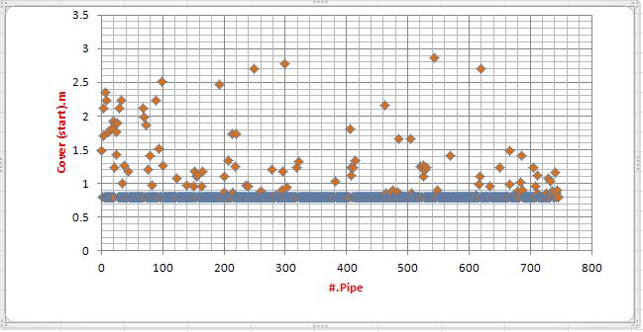
Variation in the cover and Pipes
This figure show the relationship between start cover and number of pipes.

Slide 33
Elements of Network.
To facilitate the vision, will summarize the most important elements of the network in the following table:
Element | Diameter(inches) | Length(Km) | Number
Conduit | 8 | 58.1386 | 709
Conduit | 10 | 1.4713 | 30
Conduit | 12 | 4.5786 | 12
Conduit | 15 | 5.7017 | 6
Manhols | 39.4 | ـــــــــــــ | 746

Slide 34
Conclusion

Slide 35
General comment
* In the first iteration we faced many problem corresponding with cover, we found the cover about 50m!in many conduit, after that, we change many items in the design mainly the diameter of conduit to meet the standard that the minimum cover equal .3m and the maximum cover equal 3m.
* Minimum diameter used is 8 inches and this diameter according the Palestinian standards and specification, the diameter closest the outfall reach about 15,12inches.
* When we designed the network we consider three different(Load/manhole)in the three zones we divided the town, first zone is the saturation equal0.71 m³/hr the second zone is moderate saturation zone equal0.5 m³/hr , the third zone is the unsaturated zone equal 0.23 m³/hr.

Slide 36
General comment
* In our network we noted that, the velocity in the conduit ranges from .25 to 3.43m/sec as maximum velocity and this value in few conduit in the network and these range nearly meet the Palestinian standard and specification.
* In the software we found many pipes exceeds the maximum distance between manholes to which we can work to run the network.

Slide 37
References
1. Palestinian Central Bureau of Statistics.
2. Engineering Department in Attil municipality.
3. http://www.pmd.ps
4. http://www.pcbs.gov.ps/

Slide 38

THE END
THANKS FOR YOUR ATTENTION

