Slide 1

Cereal
Vendor Machine

Slide 2
Introduction

Slide 3

Table of contents
01
04
Introduction
Mobile App & LCD & Keypad
02
05
Implementation
Constraints
03
06
Hardware Components
Future Work

Slide 4

Problem
The conventional breakfast routine poses challenges for modern consumers. Many skip breakfast or choose unhealthy options, leading to decreased productivity, energy levels, and well-being. The lack of accessible, nutritious breakfast solutions exacerbates this problem, particularly in workplaces, schools, or transportation hubs where time and convenience are critical factors.

Slide 5
Project Objectives
Enhance Convenience
Support Customization
Offer a quick and easy breakfast solution for individuals with busy schedules.
Offer a range of cereals and fruits for a customized breakfast experience.
Promote Healthy Eating
Improve Accessibility
Provide nutritious, high-quality cereals and fruit add-ons to support a balanced diet.
Provide healthy breakfast options in multiple locations for everyone's well-being.

Slide 6

Implementation

Slide 7

FEATURES

Slide 8
FEATURES
Heater
Fruit & Nuts
Water heater to have hot milk with the cereal.
You can choose either nuts or fruit to add to the cereal, or both.
water
Heat the water and pump it to the second bowl, mix it with the milk, then pump it into the cereal cup.
Mixer
Mix the hot water with the milk powder.
Cereals
You can choose the type of cereal you want.
Cup Drop
Drop the cup that will contain the ingredients

Slide 9

Hardware Components

Slide 10
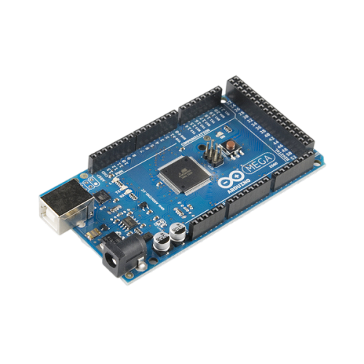
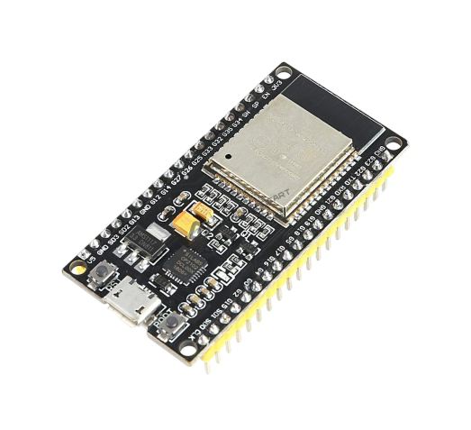
Microcontrollers
Arduino Mega 2560
ESP32

Slide 11
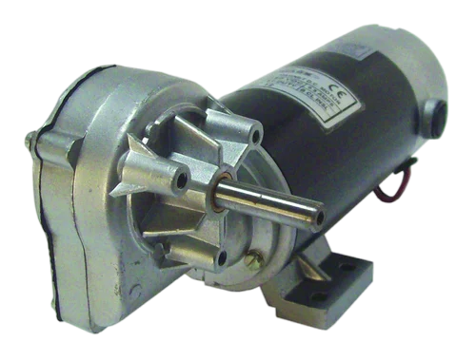
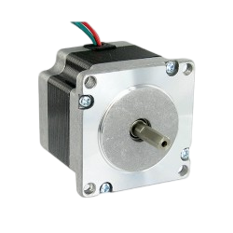
Motors and Drivers
DC Motor
Stepper motor NEMA17

Slide 12
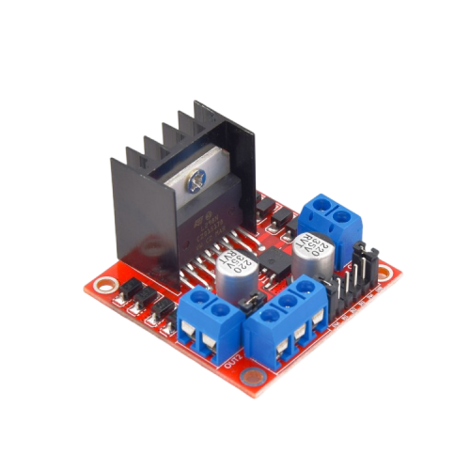
Motors and Drivers
H-bridge L298N

Slide 13
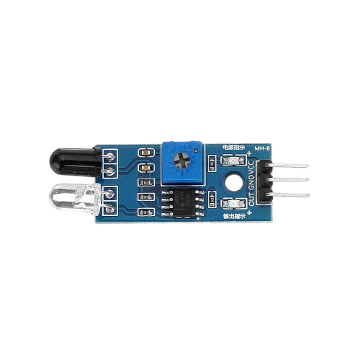
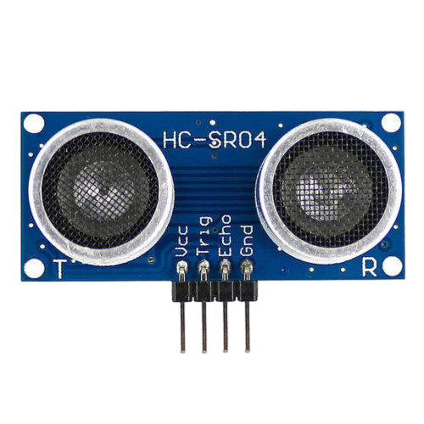
Sensors
Ultrasonic Sensor
IR Sensor

Slide 14
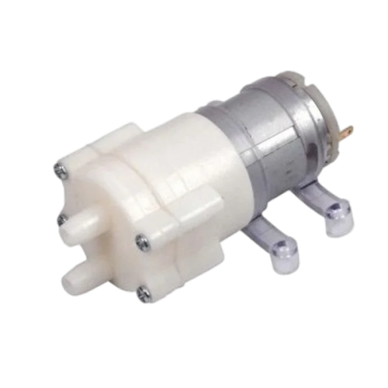
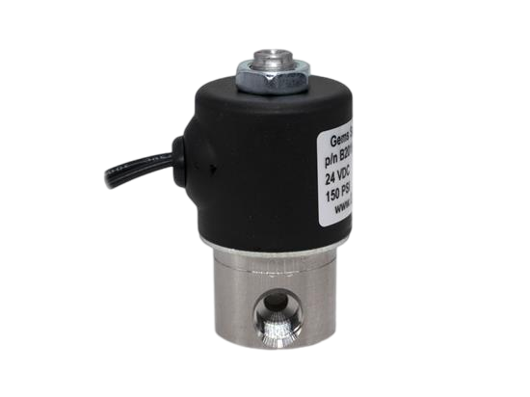
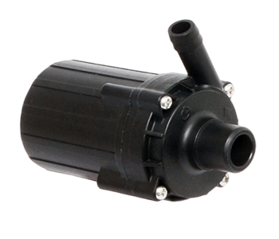
Water Pump
DC-12V Water Pump Motor Pneumatic Diaphragm Water Pump R365
12 Volt Water Pump
12 Volt Water Valve

Slide 15
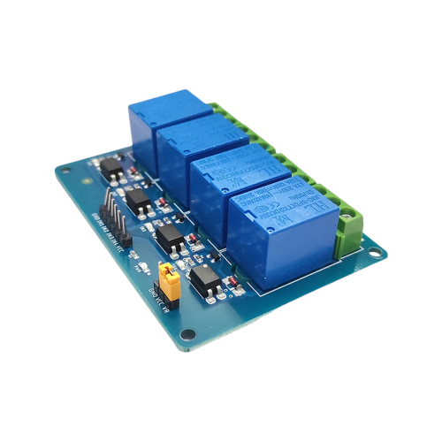
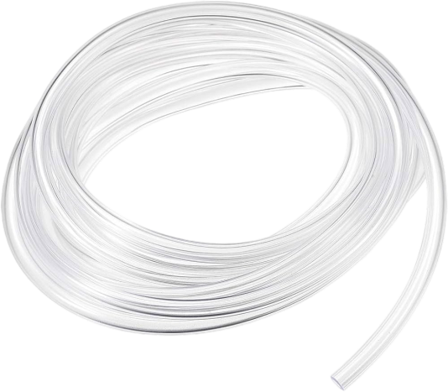
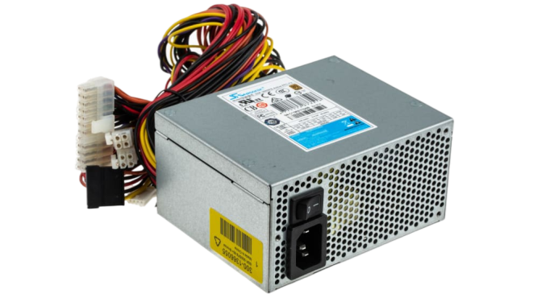
Other Components
Tubes
Relay
Power Supply

Slide 16
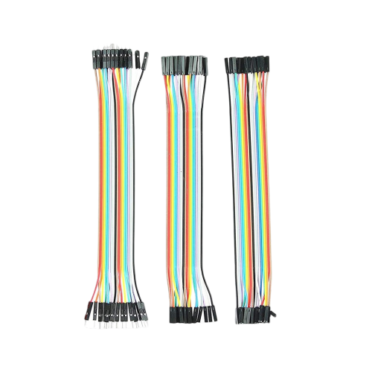
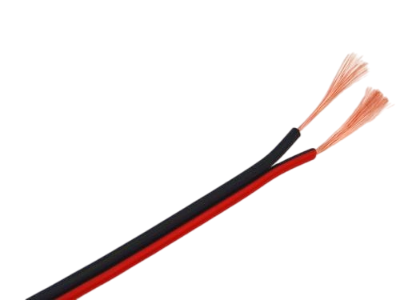
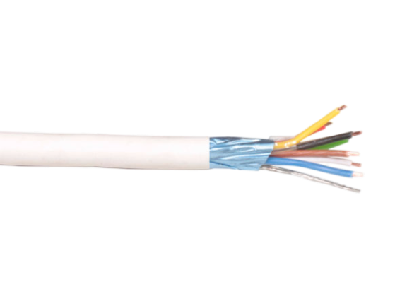
Other Components
Wires
Intercom Wires
Radio Wires

Slide 17
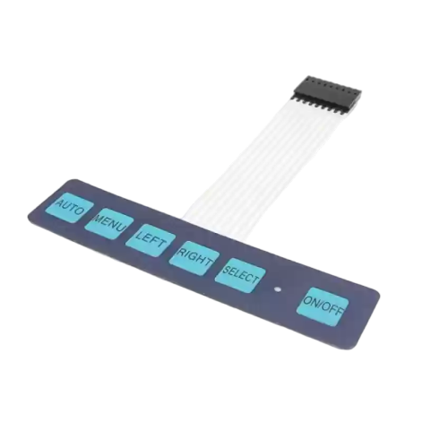
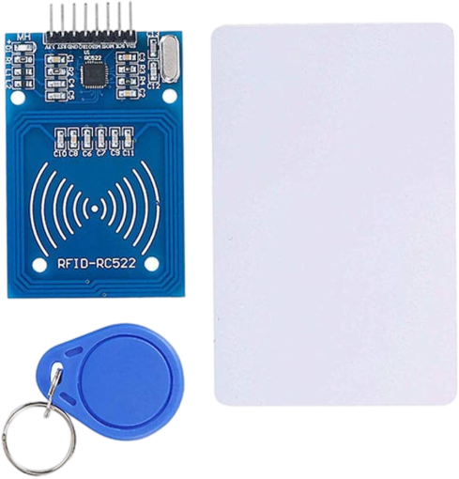
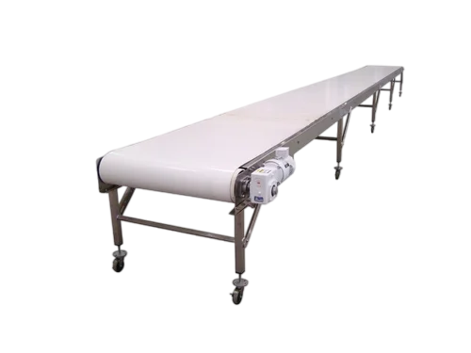
Other Components
Belt
Keypad
RFID

Slide 18

MOBILE APP & LCD & Keypad

Slide 19
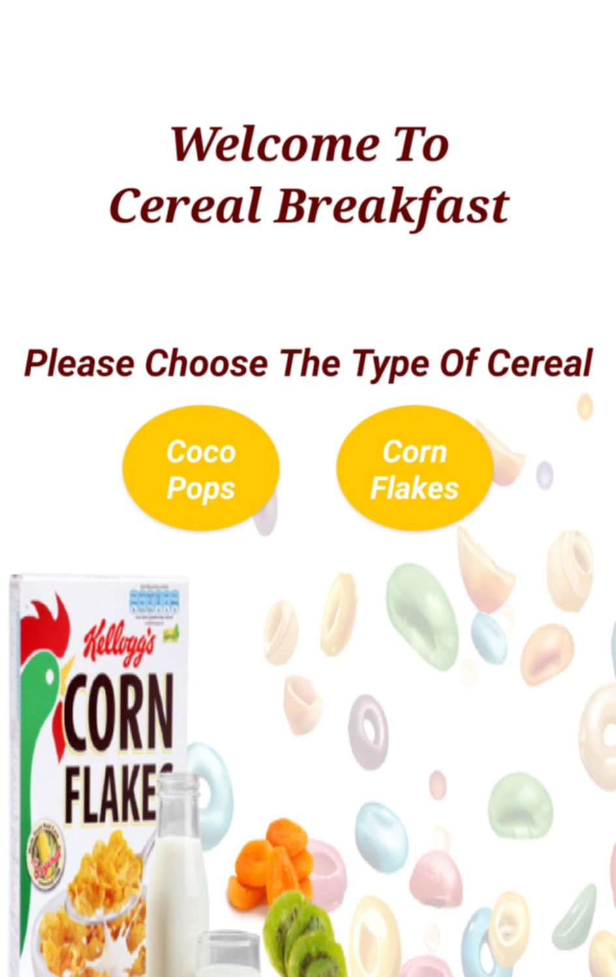
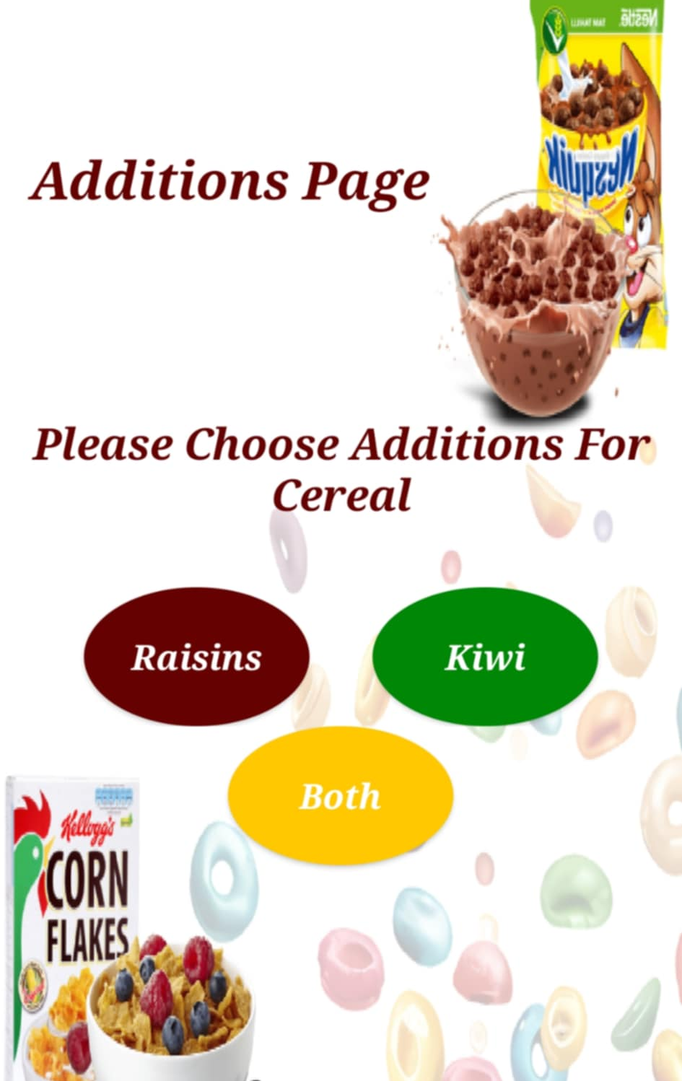
MOBILE PAGES

Slide 20

CONSTRAINTS

Slide 21
CONSTRAINTS
Water
IR Sensor
Dealing with Water & Water Pump
Dealing with light sensitivity and illumination
Mechanical problems
The design
Outside design
Dropping cereals and nuts from the can by a certain amount

Slide 22
Future Work
Container clean
Spoon
Use a timer to clean the container in which we mix water and milk powder
Drop spoon to the cereal cup
Types
Cup size
Add more types of cereals, fruit and nuts
Add additional sizes of cereal cups

Slide 23
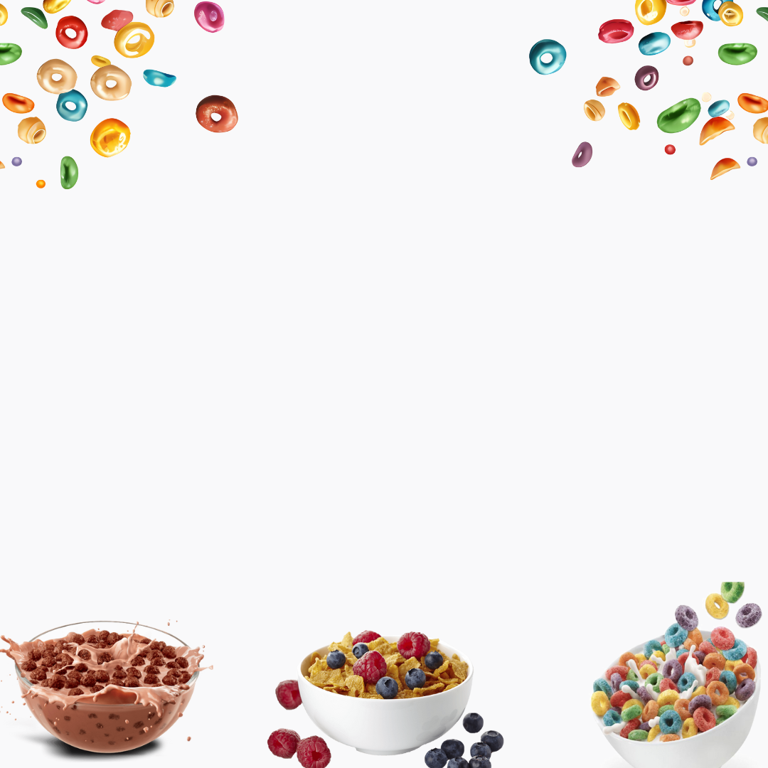
Thanks!
Please Ask Questions

