Slide 1

Secure
E-learning
Graduation
project

Slide 2

Work team:
Hadeel Odeh
Sarah Salameh
Raghad Jehad
Supervisor:
Dr. Fadi Draidi

Slide 3

Introduction
Problem statement
Objective and benefit
Methodology
Software Requirements
System Implementation
System Algorithm
Results
Video
Challenges
Future work
Contents:
Introduction
Software Requirements
Problem
statement
System Implementation
Objectives
Challenges
Methodology
Conclusion

Slide 4

Introduction

Slide 5

Problem
statement

Slide 6

Objectives
Increasing confidence between the student and the teacher.
Reducing cases of cheating in exams
Confirm the student's attendance and attention during exams.
Giving the student the grades he deserves without embezzlement.

Slide 7


Target
Audiences:
Universities
Schools
Teachers
Students

Slide 8






1
Requirements.
Methodology
2
Design.
3
Implementation.
4
Testing.
5
Deployment.
6
Maintenance.

Slide 9

Software Requirements
Flask Python
HTML
CSS
PHP
MyAdmin
Haar
Cascade
OpenCV

Slide 10


System Implementation
1
2
First Part:
Second Part:
Training
and
Prediction
Data Collection

Slide 11

Data
Collection
Steps
1
2
3
4
Defining Path
Face extraction
Multi
Scaling
Cropping Image
Resizing and saving the Output
Releasing and Destroying the windows
Reading
Wait Key
5
6
7
8

Slide 12


Training and predicting the Data.
based on the training your model will predict (based on confidence)
train the model on the data that we have collected.

Slide 13

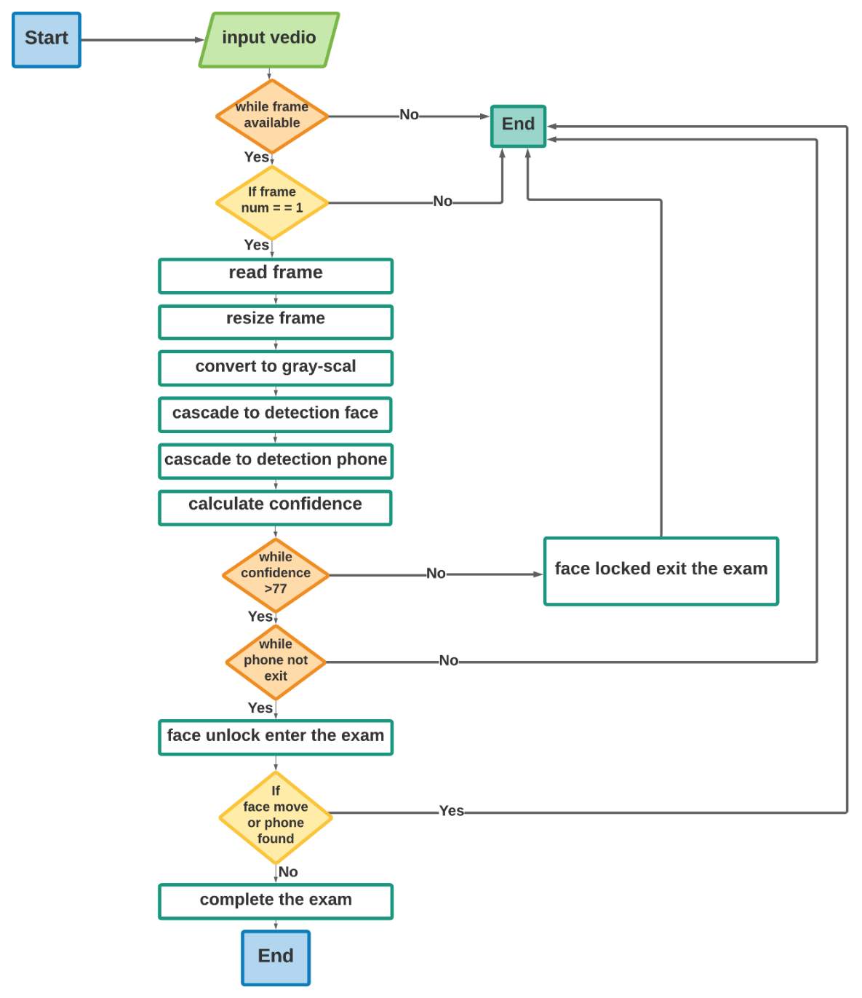

System
Algorithm

Slide 14

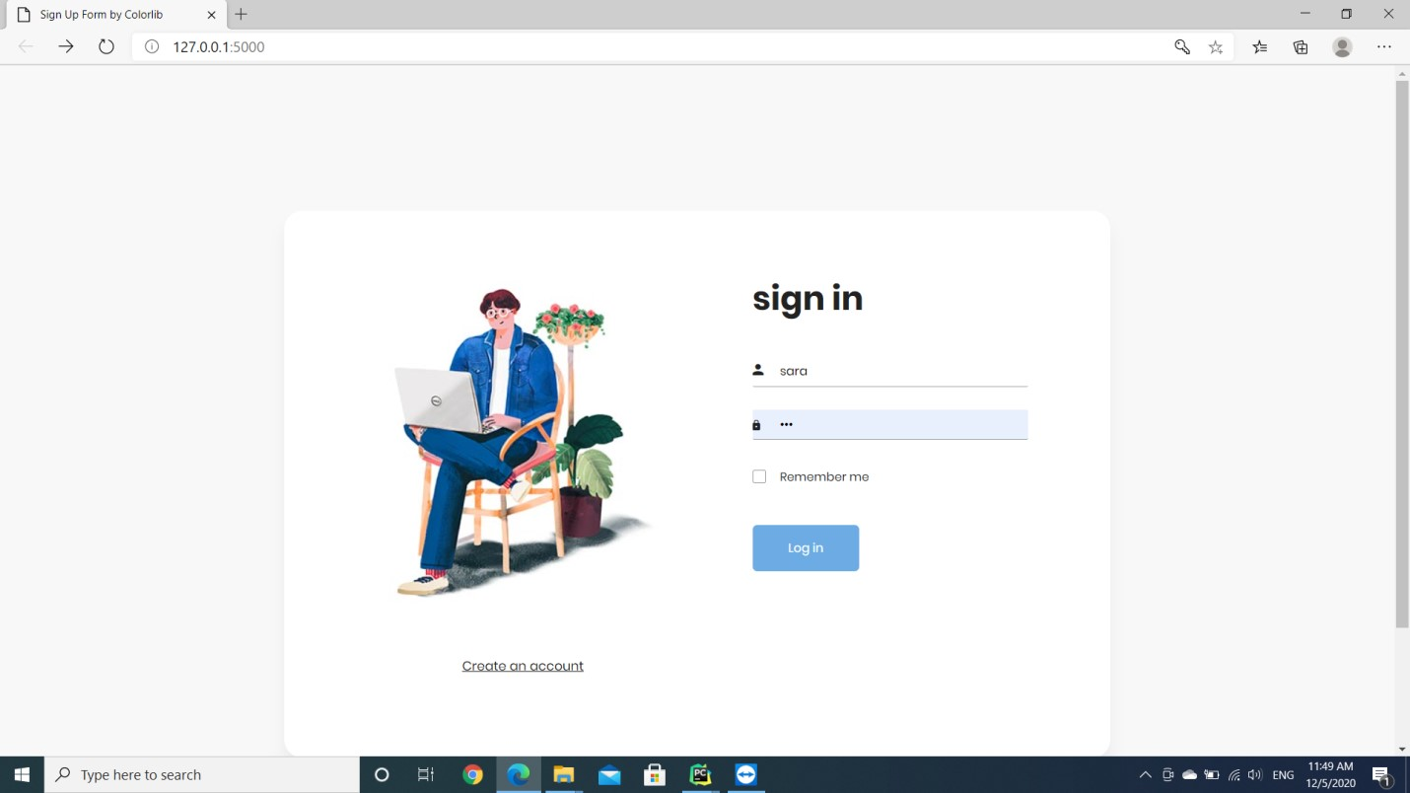
Results:
Login
Interface

Slide 15
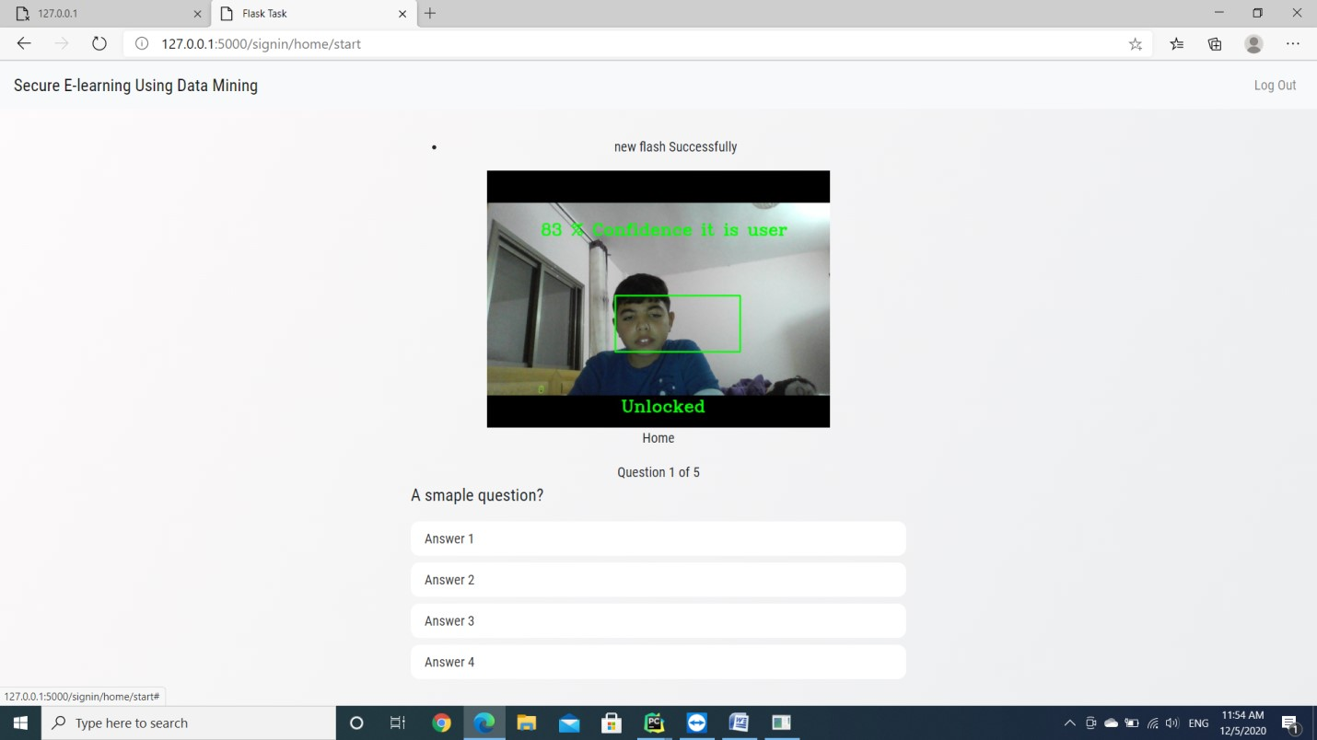
Exam
Interface

Slide 16
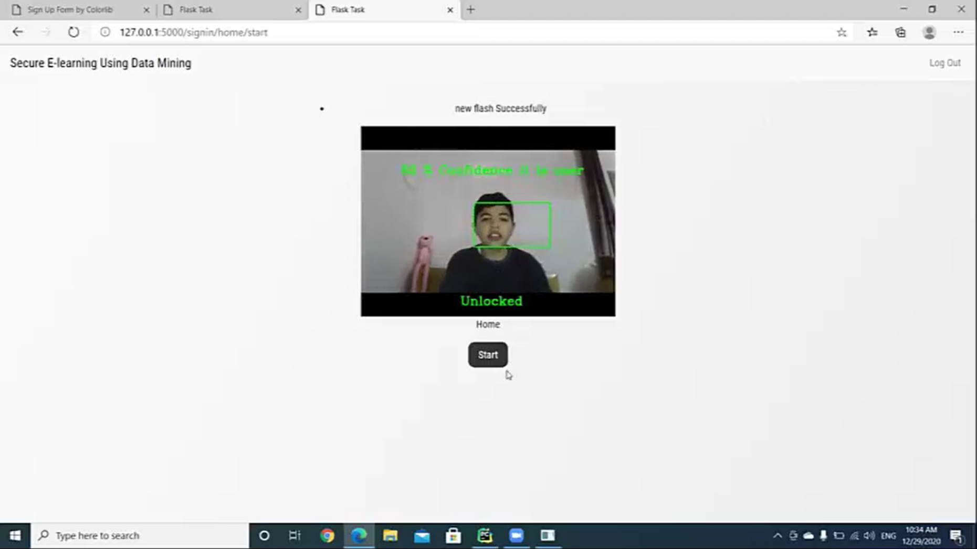
ONE
Person
Unlocked

Slide 17
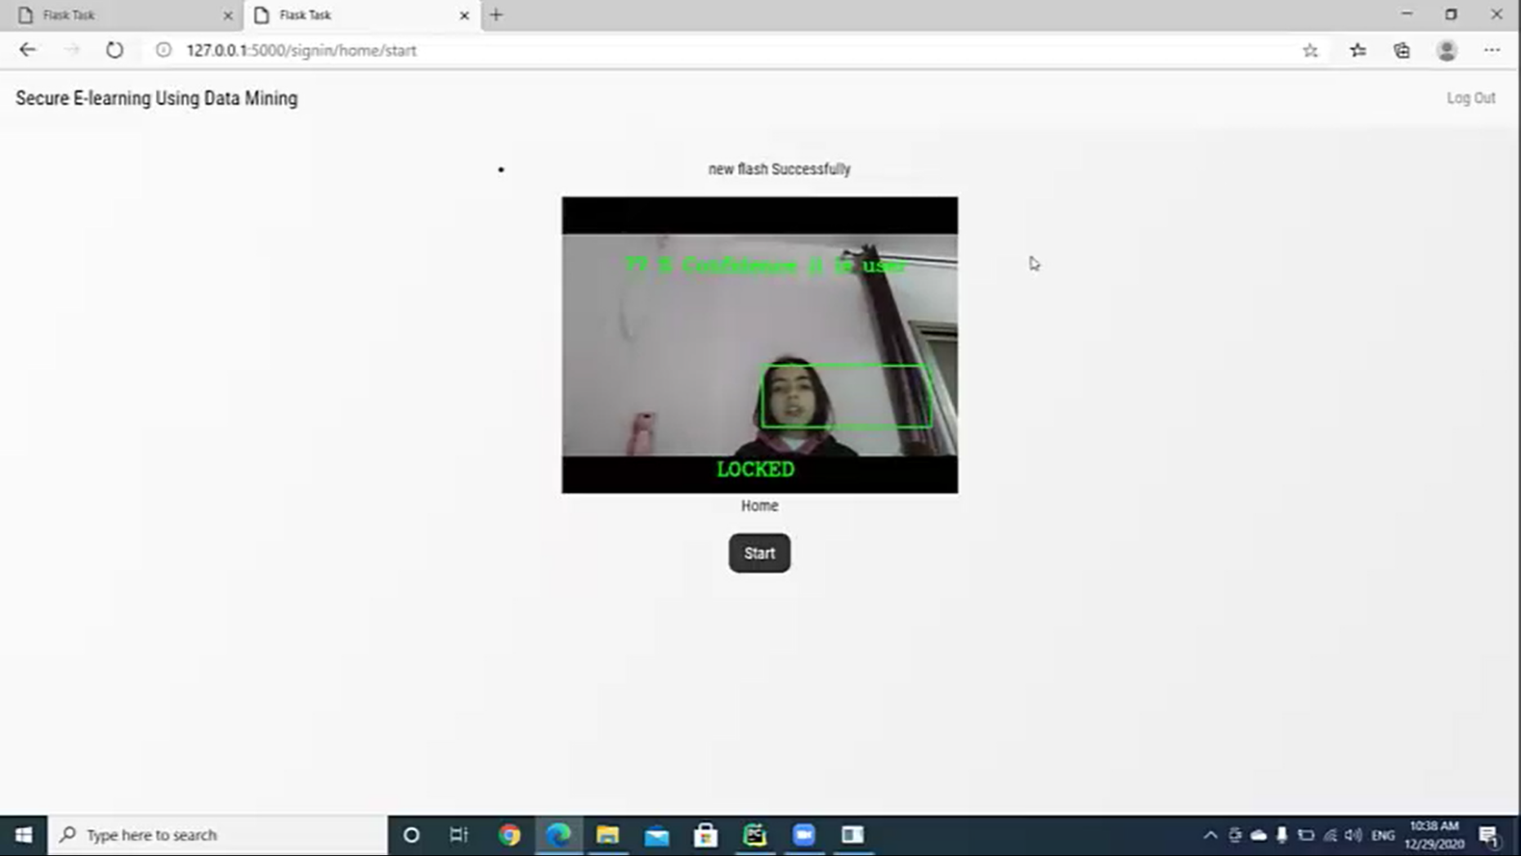
ONE
Person
Locked

Slide 18
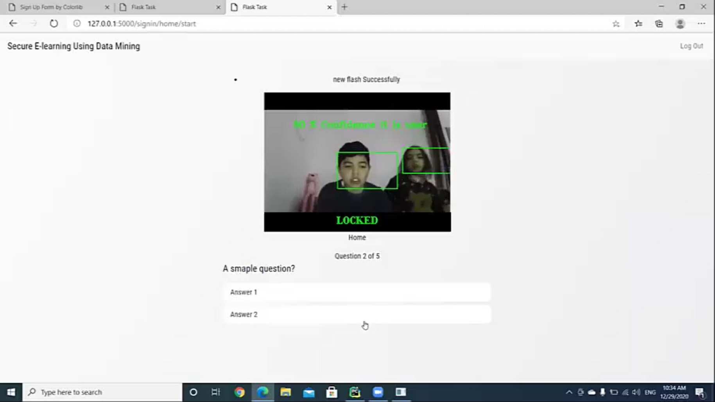
TWO
Person
Locked

Slide 19
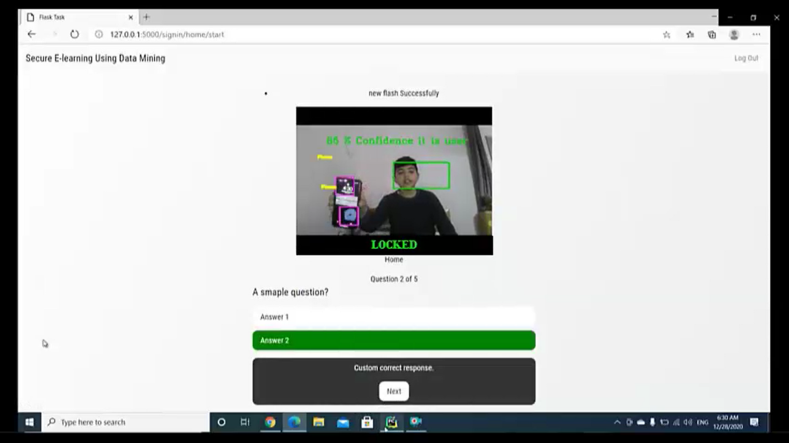
Phone
Locked

Slide 20




Challenges
learn a new programming language.
Mobile Detection took more time than
Required.
It tooks a lot of photos for training the face.

Slide 21

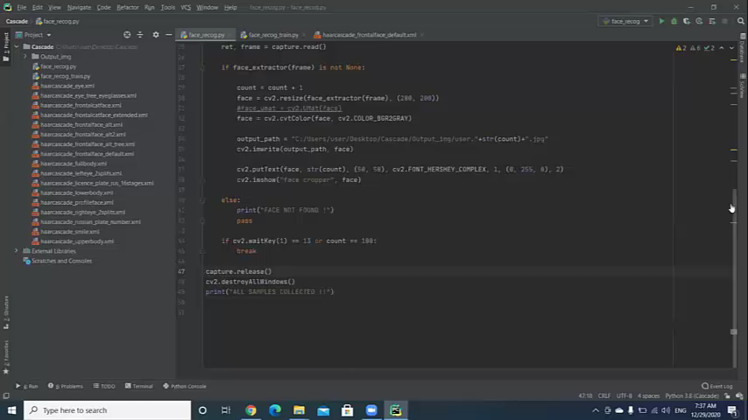
Project
Video

Slide 22



Future work
1
produce an extensive website and app.
2
create discussion room between students and teachers.
3
work on microphone to detect voices if this is user voice or another one.
4
prevent copying and pasting of exams.

Slide 23



Any Questions?

