Slide 1
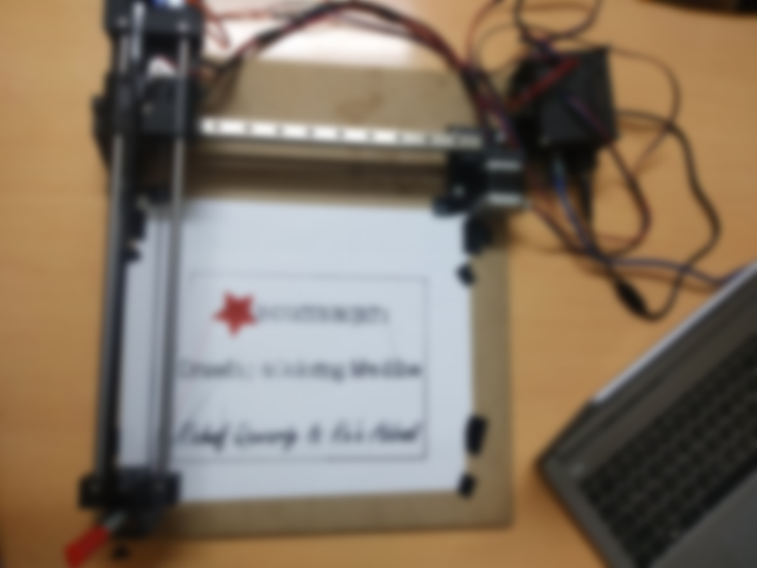
An-Najah National University
Faculty of Engineering
Computer Engineering Department
Graduation Project 2
Color Drawing machine
Presented by:
Rahaf qawariq & Ru’a abbadi
Supervisor: ENG. asmaa afifi.

Slide 2
OUTLINE:
Main features.
Tools and Project structure.
Project software.
Constraints and problems.
Conclusion and future work.

Slide 3
MAIN FEATURES:
Our project is a CNC drawing machine. The Main Feature is to scale and draw black or colorful drawings or texts on almost anything flat.

Slide 4
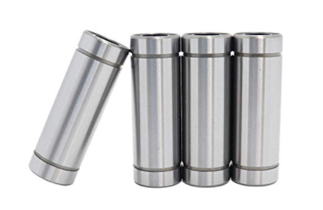
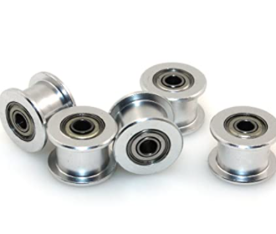
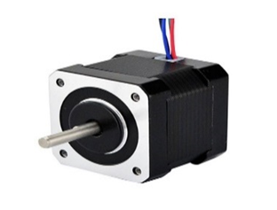
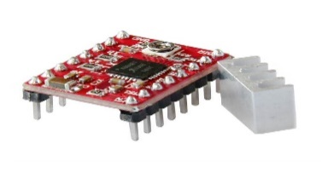
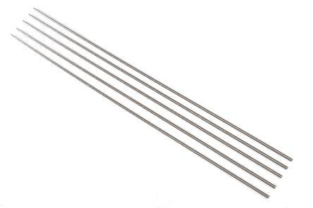
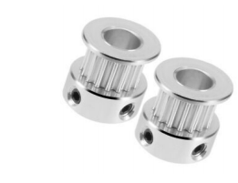
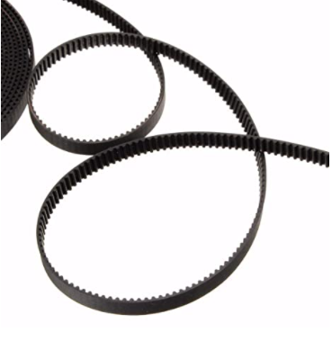
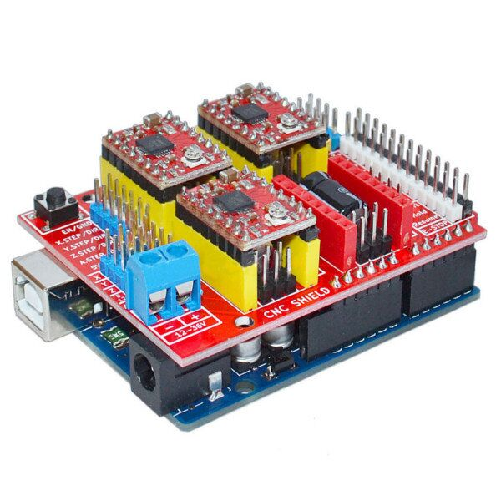
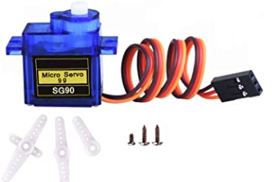
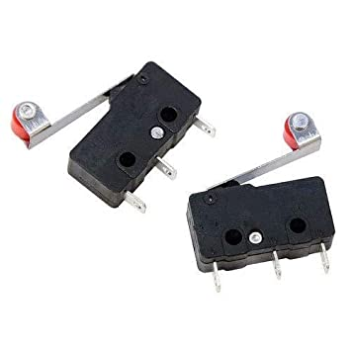
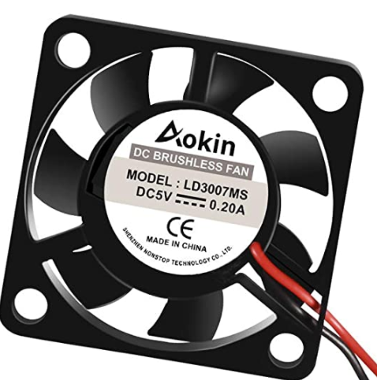
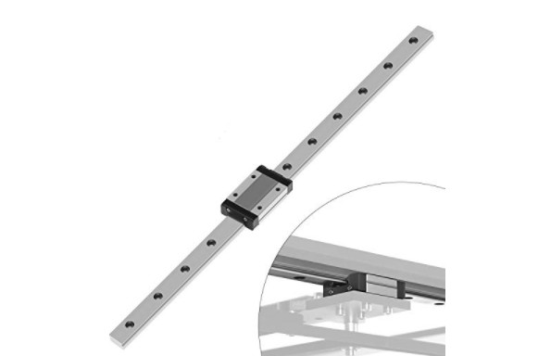
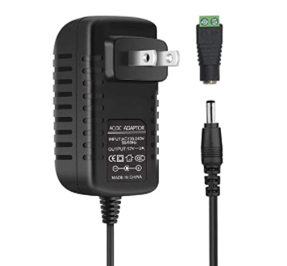
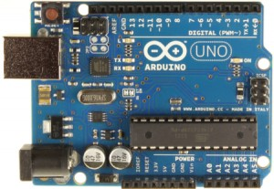
Tools
Stepper Motor
Stepper Driver
Linear Motion Rods
Linear Bearings
Idler Wheel
Toothed Pulley
GT2 Timing belt
Arduino CNC Shield
Micro Servo
linear rail with block
Contact switch
Fan
Power Supply
Arduino Uno

Slide 5

Project Structure

Slide 6

Project software
⚫ We used GRBL firmware.
⚫ we used an open source called Universal G-code Sender (UGS).
⚫ In order to get a g-code file we used an open source program called Inkscape.

Slide 7
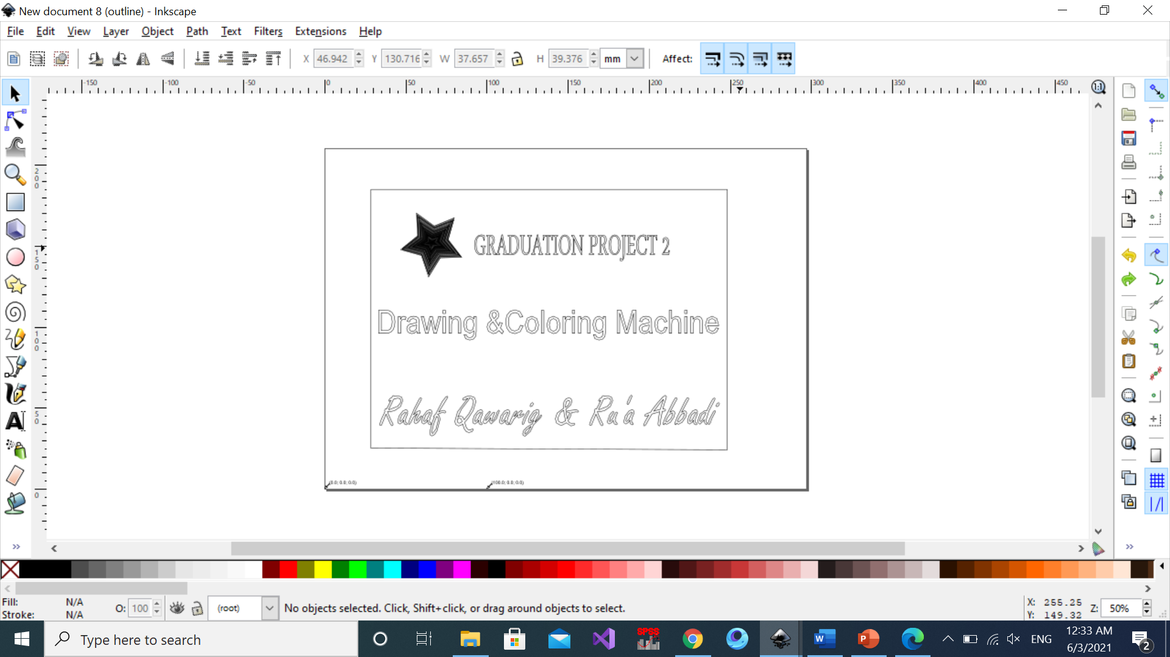
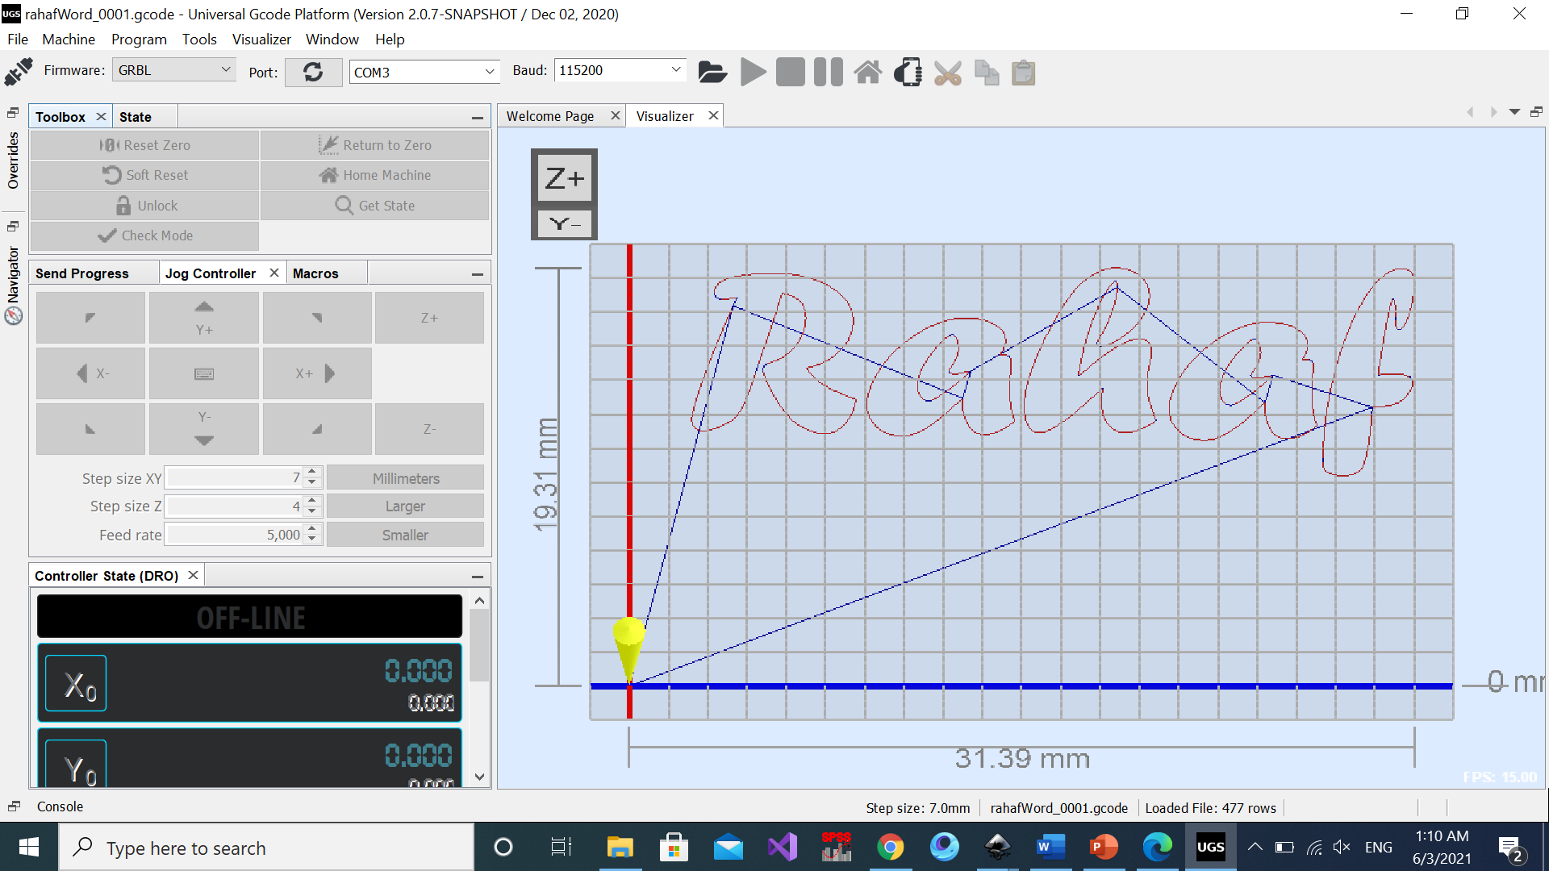
1
2

Slide 8
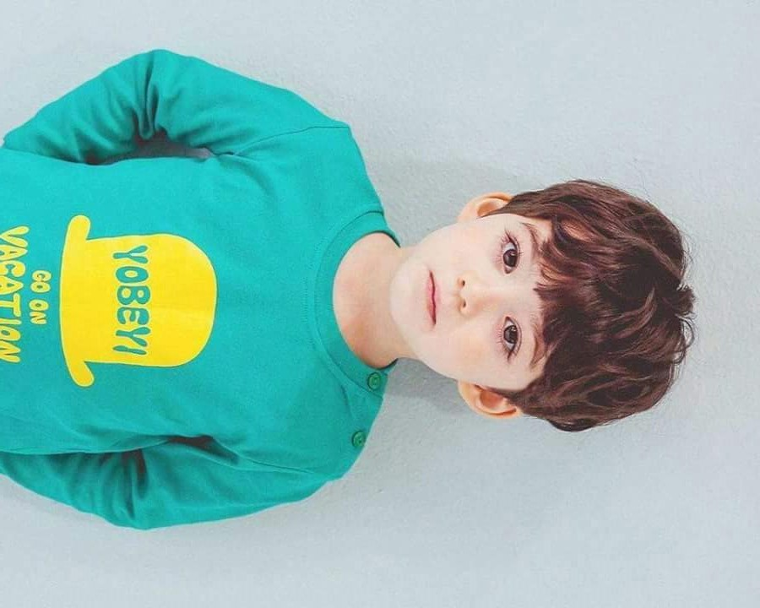
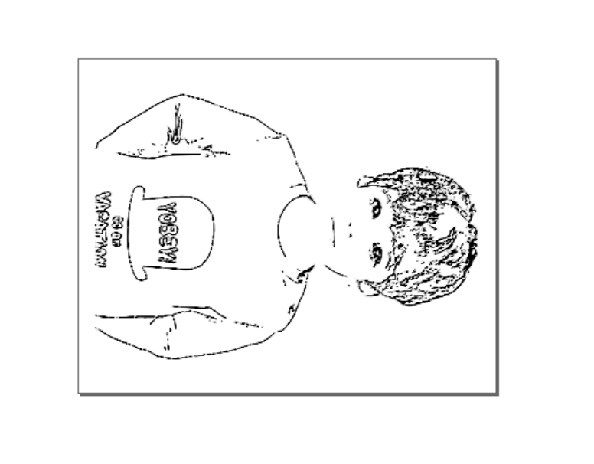
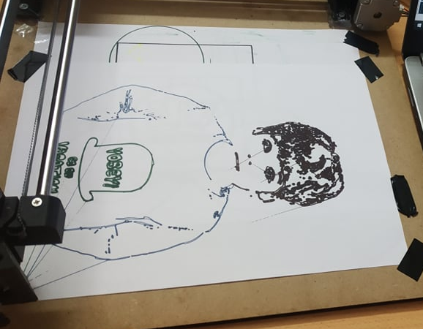
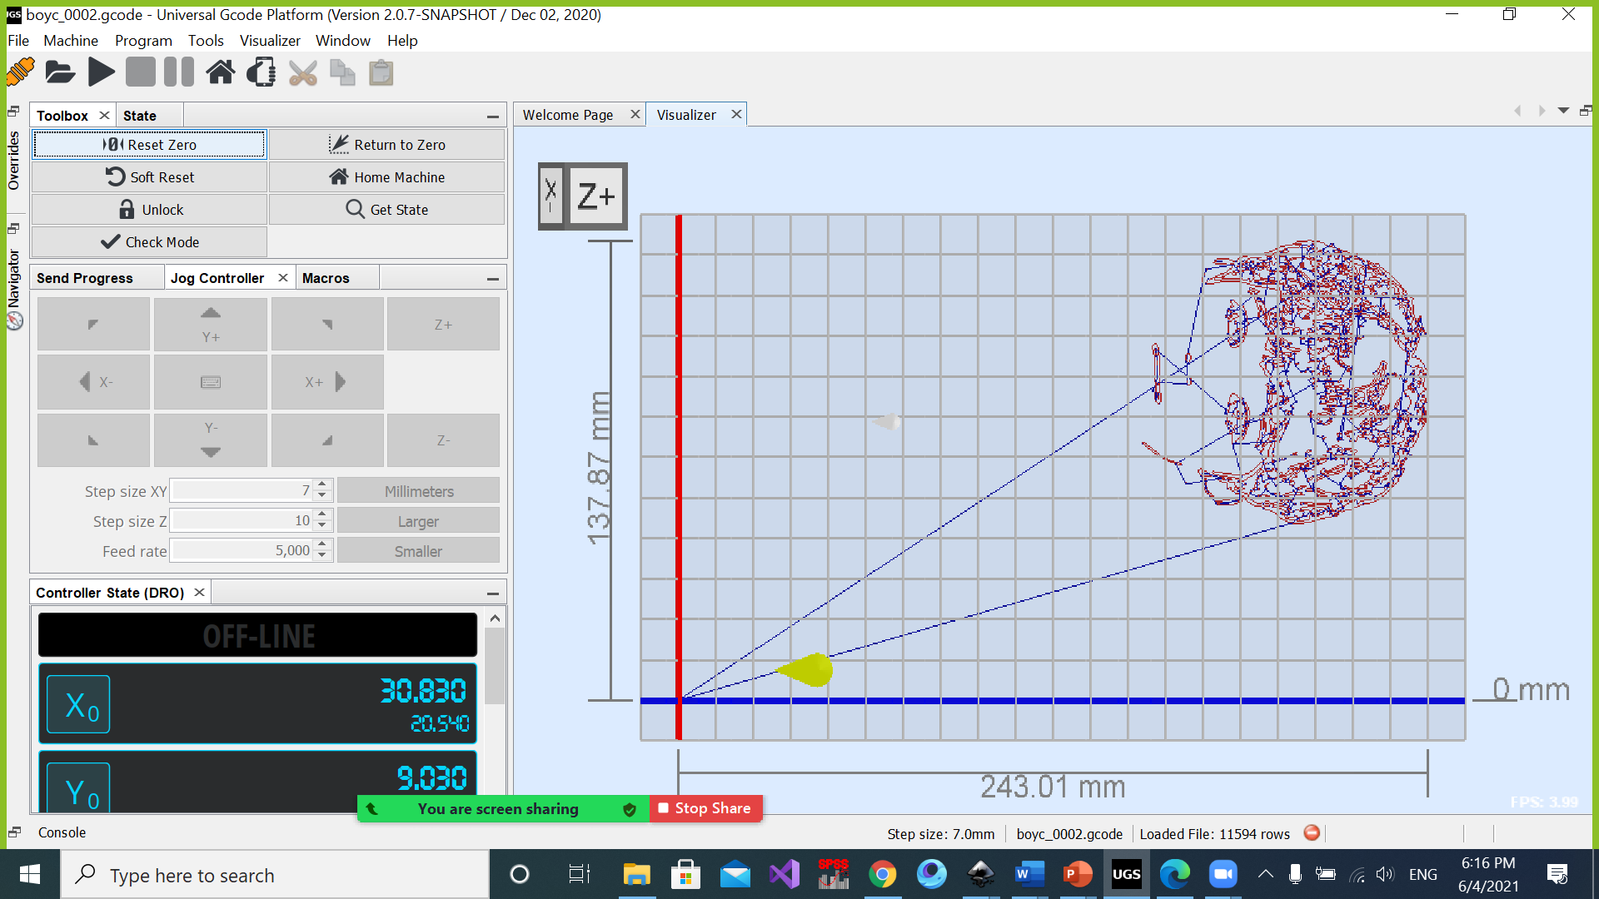
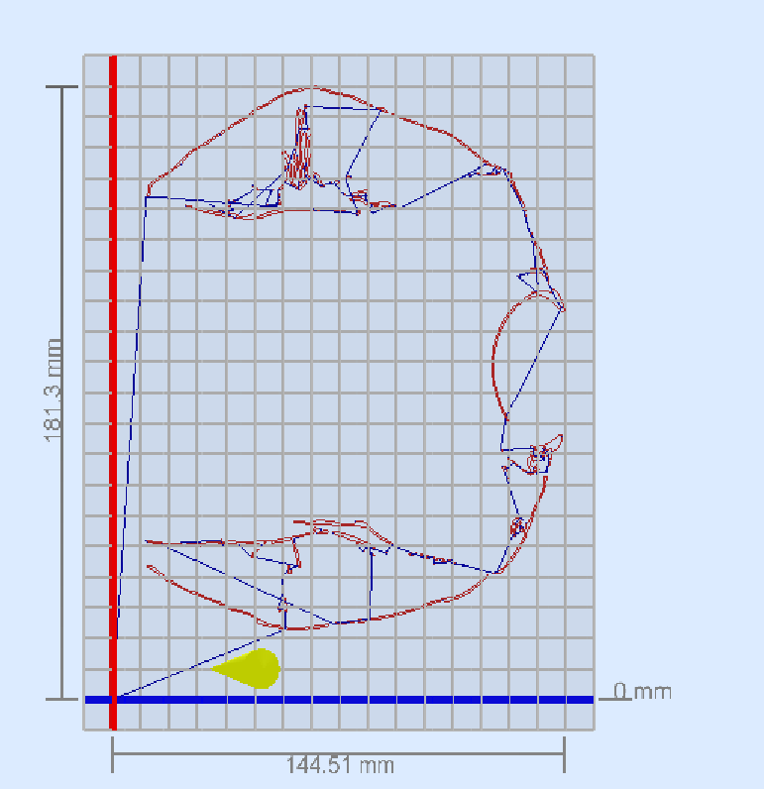
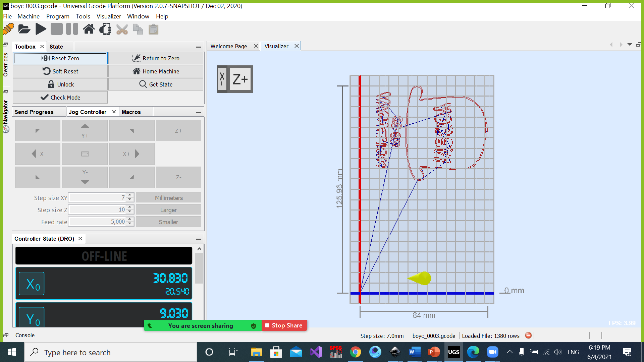

Slide 9
Constraints and problems
1. We do not have sufficient working knowledge about mechanical matters in terms of installation and use of equipment.
2. The late arrival of Linear rail with block with the required length (30 cm).
3. One of the 3D printed pieces has broken.
4. Difficulties to meet with partner.

Slide 10
Conclusion and future work
We learned a lot from our project, our project is CNC drawing machine, this kind of project aims to facilitate human life and reduce the effort on people by creating a tool that saves time and effort.
We hope to develop in the future more features and some ideas we thought about,
⚫ One of these ideas is to make something to hold many pens and switch between them,
⚫ Make some changes in the machine design to make it draw pictures sent through the internet.

Slide 11
Thank you for listening

