Slide 1

Detection Type Font
Presented by: Donya Hamadneh
Ansam Shtaiwi
Supervisor: Dr.Samer Arandi

Slide 2
Over View
What is detection type font .
Motivations
Technologies
About Techniques
Analysis and Results
Constrains
Future Work and conclusion

Slide 3
What is Detection Type Font ?
Detection Type is an Android application that helps users in general, and Arabic teachers in particular, in order to distinguish the types of 9 Arabic language fonts .

Slide 4
Motivations
The presence of most applications that work to distinguish the type of font in the English language significantly and to other languages in general, but there are no Android applications that work to distinguish the type of font for the Arabic language
motivated users to become more familiar with the types of Arabic language fonts and to become familiar with them
The presence of many types of fonts and thus easy to distinguish between them

Slide 5
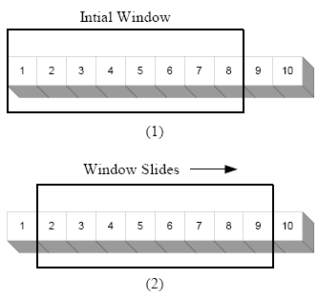




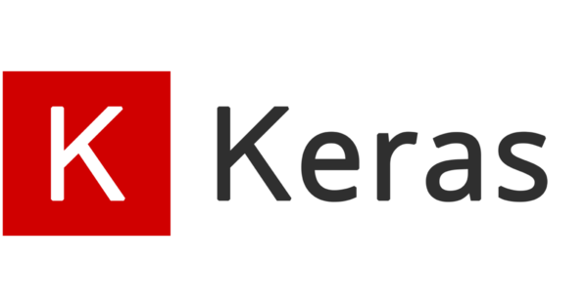
Technologies

Slide 6
About Techniques
TensorFlow: It is open source and is also used in machine learning applications such as neural networks.
CNN: is a class of deep neural network, most commonly applied to analyzing visual imagery
Sliding Window: It is a rectangle that works on the movement from right to left through all parts of the image and is used to cut the image into several equal parts

Slide 7
Methodology
How to create a data set.
The training process.
batch size.
data set distribution.
model creation.
model saving.
sliding window step.
Testing process.

Slide 8
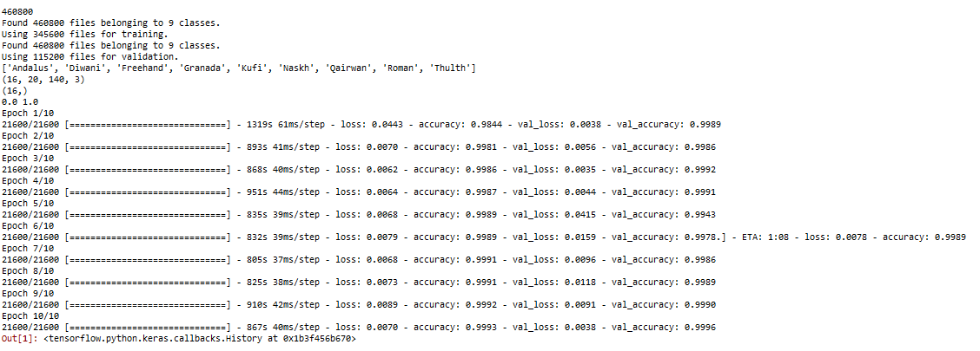
Analysis
This is results of epochs for training level

Slide 9
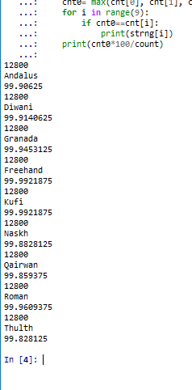
Cont. Analysis
This results of testing ( Percentage) :

Slide 10
constrains
The size of our device memory, where we needed a large memory size in order to accommodate our data base
We needed a high net speed in order to download the data base
The problem of many updates to the Python language, where we had difficulty downloading the necessary Libraries in an appropriate way with the modern version

Slide 11
Future Work and conclusion
In our application this we mainly aim to facilitate the user to distinguish between the lines of the Arabic language and will aim in the future to distinguish the Arabic font from other fonts, as well as convert the image into text and also add a larger number of Arabic fonts.

