Slide 1

College Of Education Science Centers Building
Prepared By :
Reem Abdat
Rasha yasin
Submitted to :
D.Imad Al-Qasem

Slide 2

College Of Education Science Centers Building

Slide 3

Introduction

Slide 4
Project Description
The project is located in An-Najah National University in Nablus (new campus)
The project consists of 1 blocks
The project consists of 2 basement floors , ground floor and top three floors .
Total Area = 5852m²

Slide 5
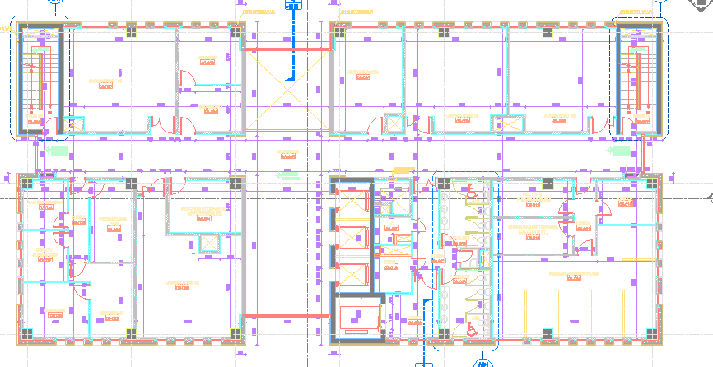
Project Site Plan

Slide 6
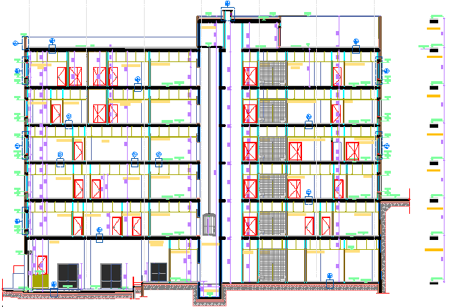
Elevation

Slide 7
Objectives of Graduation Project (1)
To make a preliminary design for the structural members.
To build a 3D model using SAP2000 for the project with the verification of the analysis.

Slide 8
Objectives of Graduation Project (2)
Seismic design of structures
Drawing details of all members structures

Slide 9
  project description
Floor | Area(m²) | Height(m)
Basement 1 | 1359.52 | 5.55
Basement 2 | 957.03 | 4.5
Ground floor | 952.93 | 4.5
First | 860.82 | 4.5
Second | 860.82 | 4.5
Third | 860.82 | 4.5
Total | 5852 | 28.05

Slide 10
Materials
Property | Value
Compressive strength of concrete (f’c) | 25Mpa
Compressive strength of concrete (f’c) ( column) | 30 Mpa
Yield strength(fy) | 420 Mpa

Slide 11
Unit weights of the materials
Material | Ɣ(KN/m³)
Block | 12
tiles | 26
Plastering | 23
Masonry stone | 26
Aggregate | 18
Concrete mortar | 23

Slide 12
Soil Properties
Bearing capacity of the soil =350KN/m
Codes and Standers
ACI 318-11 (American Concrete Institute ): building code requirements of structural concrete and commentary .
UBC-97(uniform building code )

Slide 13
Live Load
Floor | Live load(KN/m^2)
Basement 1 | 4.8
Basement 2 | 4.8
Ground floor | 4.8
First | 4.8
Second | 4.8
Third | 4.8
roof | 10

Slide 14
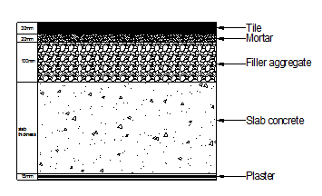
Superimposed load
WSD= W fill +W mortar + W plastering + W partitions
= 1.8+.46+.345+1.6=4.2KN/m²
the material and their thickness in a slab section

Slide 15
load combination
U=1.4D
U=1.2D+1.6L
U=1.4D U= 1.2D+1.6L+0.5(Lr or S or R)
U =1.2D+ 1.6 (Lr or S or R)+(1.0L or 0.5W)
U =1.2D +1.0W+1.0L+0.5(Lr or S or R)
U=1.2D+1.0E +1.0L+0.2S
U= 0.9D +1.0W U= 0.9D +1.0 E
Where:
D = Dead load L = Live load
E = Earthquake load Lr = Roof Live floor
S = Snow load W = Wind load
R= Rain load

Slide 16

PRELIMINARY DESIGN

Slide 17
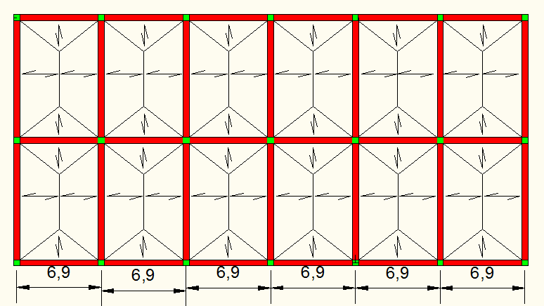
Two Way Solid Slab

Slide 18
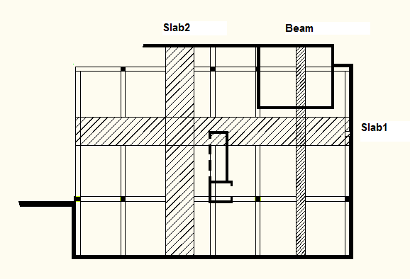
The slab strip and the sample beam for each floor and roof

Slide 19
Slab design In each floors
Thickness of slab:
All columns 0.8*0.8 m
h=Ln(0.8+fy/1400)/(36+9B)
Where :
Ln=10-0.8 =9.2m
B= (10-0.8)/(6.9-0.8)=1.5
h=9.2*(0.8+420/1400)/(36+9*1.5)= 0.21m
h= 0.21m , try h=250mm, take d=210mm

Slide 20
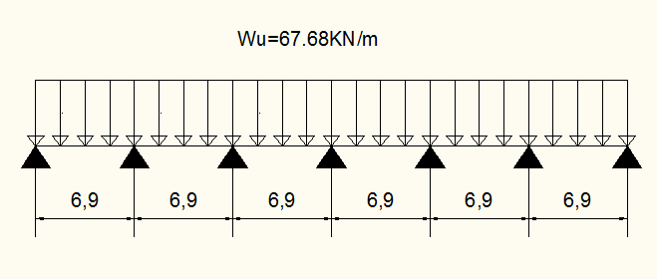
Loads
column strip width =2*min of {0.25*10=2.5
0.25*6.9=1.725 }
Column strip width =3.45m
W_{SD}=4.2 KN/m² , W_{L}=4.8 KN/m²
Live and superimposed dead, ultimate loads on a 3.45 meter width of the slab in each floor are shown in figure
Wu=1.2D+1.6L ={{1.2*(4.2+25*0.25)}+{1.6*4.8}}*3.45
=19.62 KN/m²*3.45=67.68 KN/m Wu

Slide 21
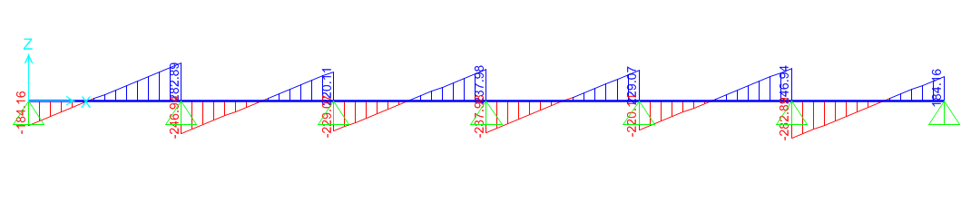
Strip( 1)
Check for shear :
Span length =6.9m
ØVc=0.75× × b×d×10^-3
Shear force on a 3.45m width strip of the slab in strip 1

Slide 22
ØVc=453>Vu=268.6→no need for shear reinforcement
Since the critical position was chosen to check , all other position are okay .

Slide 23
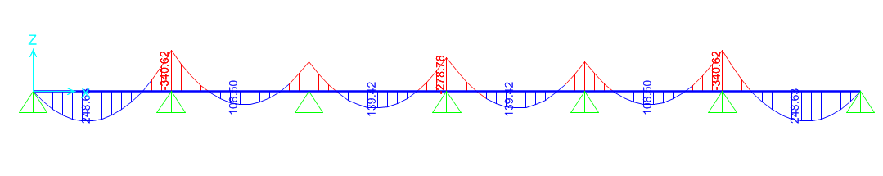
Flexure design
Moment diagram for slab

Slide 24



Positive moment :
Mu1=248.63KN
A_{S=}𝜌pd=0.0045*3450*210=3260.25mm².
A_{S} min=0.0018 b h =1552.5mm².
Use A_{S}=3260.25 mm² →5 φ16 mm/m
Negative moment :
Mu2=340.6.6KN
A_{S=}𝜌pd=0.0063*3450*210=4564mm².
A_{S} min=0.0018 b h =1552.5mm².
Use A_{S}=4564 mm² →5 φ20mm/m

Slide 25

Strip(2)
Check for shear
ØVc=453>Vu=408.78→no need for shear reinforcement
Since the critical position was chosen to check , all other position are okay .

Slide 26
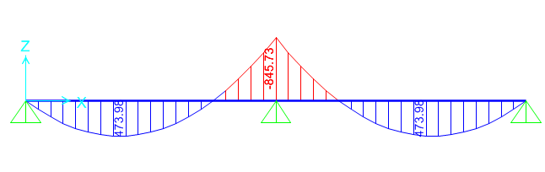
Flexure design
Positive moment
A_{S}= 6520.5mm² →6 φ20 mm/m
Negative moment
A_{S}=11592 mm² →7 φ25 mm/m

Slide 27
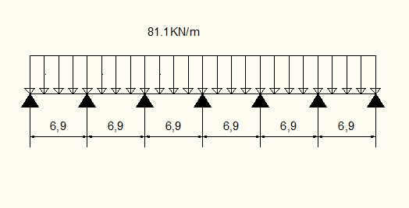
Slab design In the roof
Thickness of slab:
h= 0.21m , try h=250mm, take d=230mm.
Column strip width =3.45m
W_{L}=10 KN/m²
Wu=1.2D+1.6L ={{1.2*(25*0.25)}+{1.6*10}}*3.45=23.5KN/m2*3.45=81.1KN/m

Slide 28
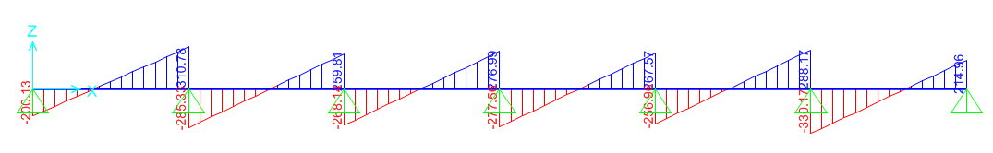
Strip (1)
Check for shear
.
Span length =6.9m
ØVc=496>Vu=309.7 →no need for shear reinforcement
Since the critical position was chosen to check , all other position are okay

Slide 29
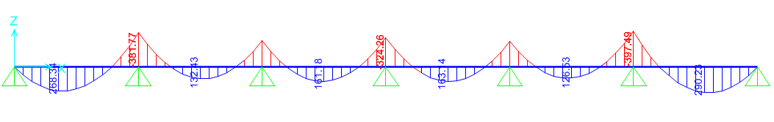
Flexure design
positive moment
A_{S}=3492 mm² →5 φ16 mm/m
Negative moment
A_{S}=4840 mm² →7 φ16 mm/m

Slide 30
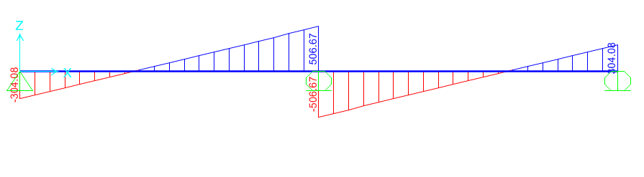
Strip(2)
Check for shear
ØVc=496>Vu=488 →no need for shear reinforcement
Since the critical position was chosen to check , all other position are okay .

Slide 31
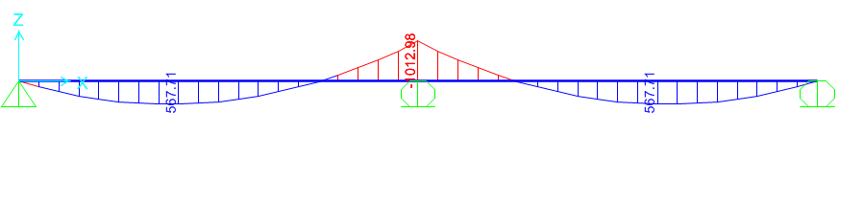
Flexure design
positive moment
A_{S}= 7141.5mm² →5 φ25 mm/m
Negative moment
A_{S}= 12696mm² →8φ25 mm/m

Slide 32
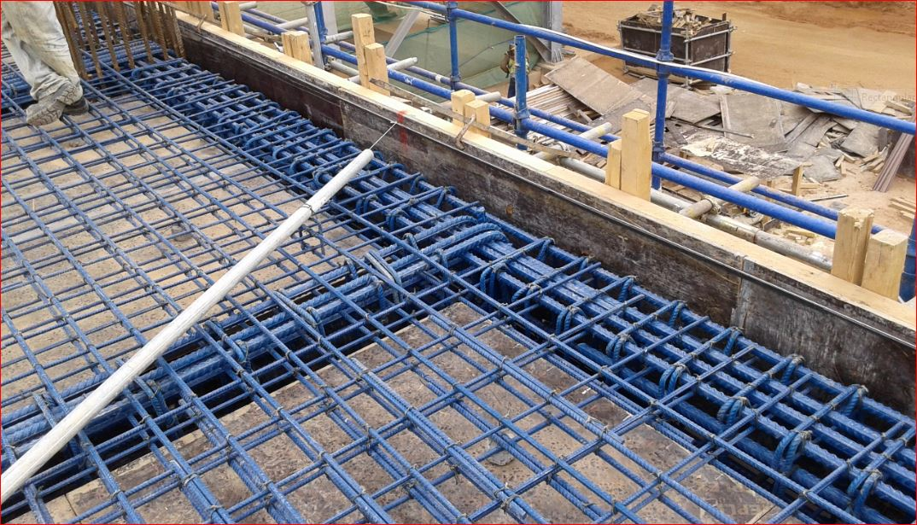
Beams
beam in each floor

Slide 33
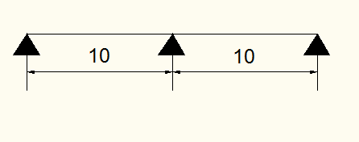
Beams Dimensions
Beams dimensions divided into depth and width. Depth of beams was found according to ACI-318-08.
h=L/ 18.5 =10/18.5 =.54
try h=800mm
After trying different dimensions, the preliminary dimension are (h:800mm,w:500mm)

Slide 34
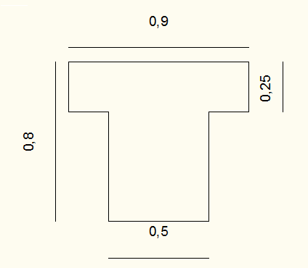
Section in the beam

Slide 35
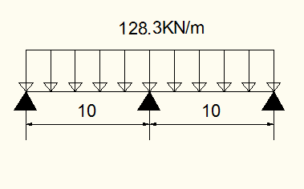
Loads
WL=4.8KN/m2 =29.28 KN /m
WSD= 4.2KN /m2=25.62
W_{own weight} =0.3*0.55*25=4.125 KN /m
W_{u}={1.2(4.2+25*0.25)+1.6*4.8}(6.1)+1.2*4.125=128.3 KN /m

Slide 36
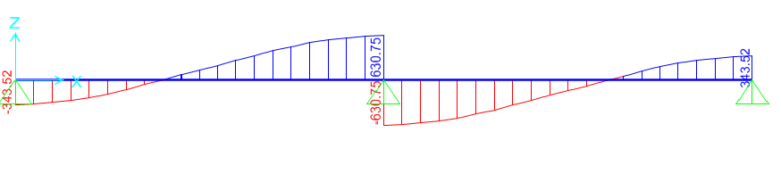
Shear design
Shear force diagram for beam
Use →1 φ 12 /20 cm

Slide 37
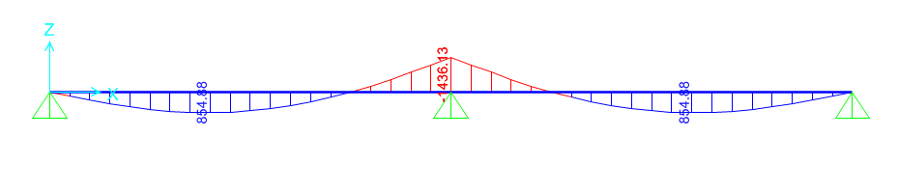
Design for flexure
Moment diagram for beam

Slide 38
For positive moment
Mu1=855KN
b=900mm , d=740mm
use As=3197 mm² , 6 φ25mm
For negative moment
b=500mm , d=740mm
Use,As=3330 mm²,7 φ25mm

Slide 39
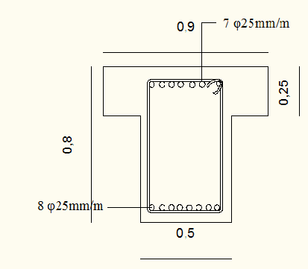
Section in the beam with reinforcement

Slide 40
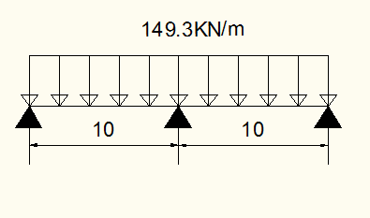
Beams in roof
(h:800mm,w:500mm)
Ultimate load on beam

Slide 41
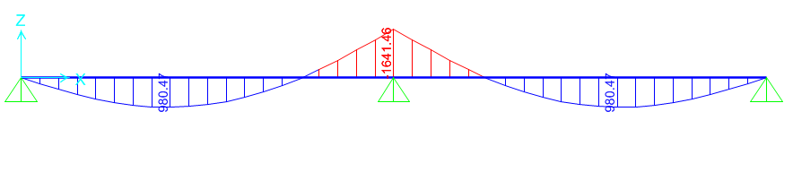
Design for flexure and Shear
Moment diagram for beam

Slide 42
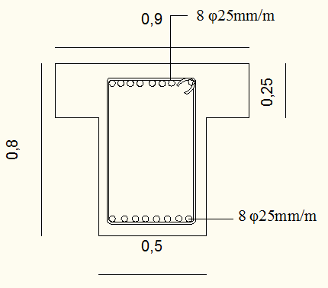
Section in the beam with reinforcement
Use →1 φ 12 /10 cm

Slide 43
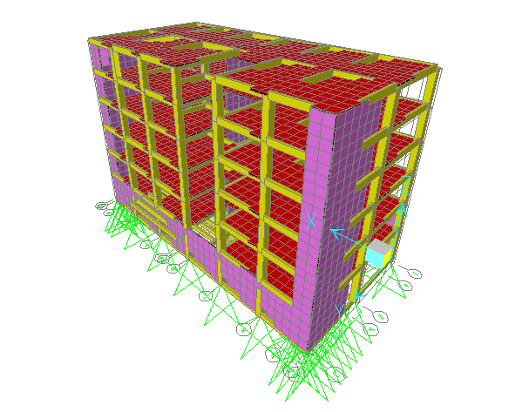
THREE DIMENSIONAL STRUCTURAL ANALYSIS AND DESIGN

Slide 44
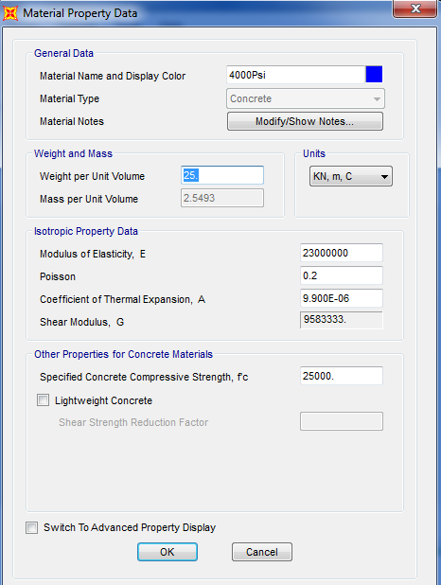
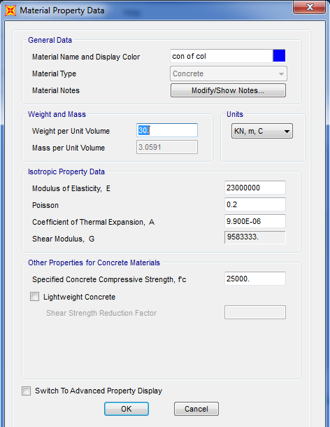
Material
Material that used in this project is reinforced concrete f′𝑐= 25MPa for slab and beam ,and
𝑓′𝑐= 30MPa for columns and the definition on sap is shown in figure 3.2 and 3.3 .
Figure 3.2 Material definition for slab and beam
Figure 3.3 Material definition of column

Slide 45
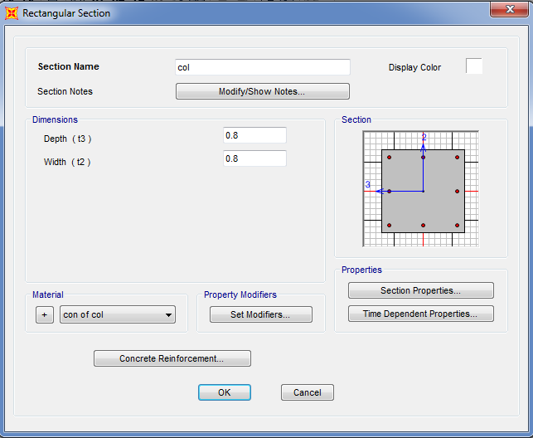
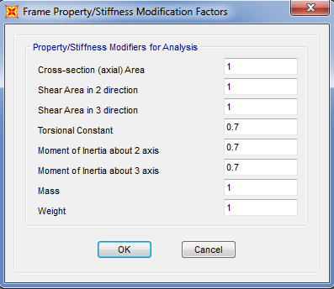
Section on sap
Columns definition on sap
In this project , there are one section (800*800) square section. The definition of (800*800) column is shown in figure 3.4 .In addition , the modifiers for column section are shown in figure 3.5.
Figure 3.4 Columns definition
Figure 3.5 Modifiers of columns

Slide 46
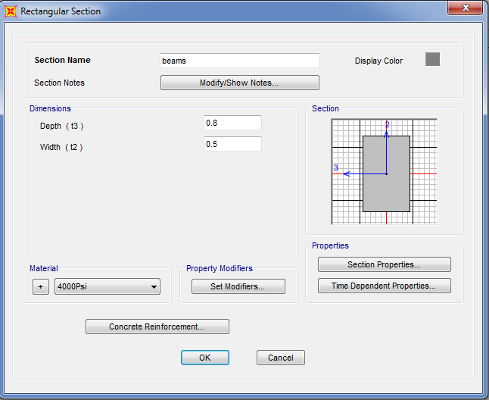
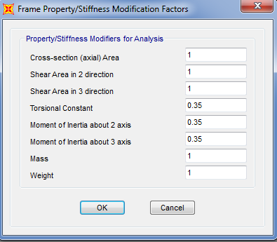
Beams definition on sap
There are one type of beam in the project with cross sections (800*500) , the definition of beam is shown in figure 3.6.Modifiers for beams are shown in figure 3.7.
Figure 3.6 Definition of beam
Figure 3.7Modifiers of beams

Slide 47
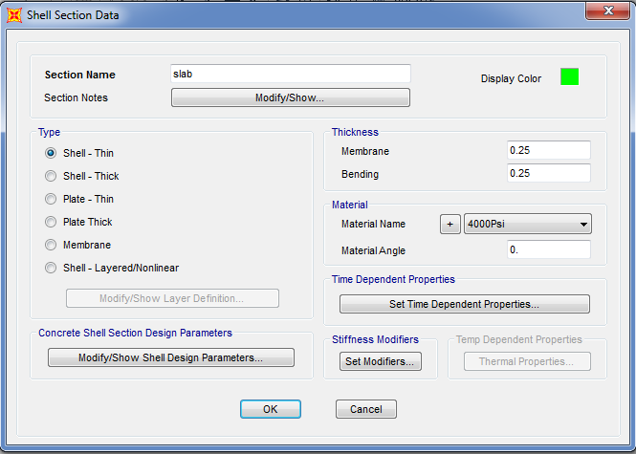
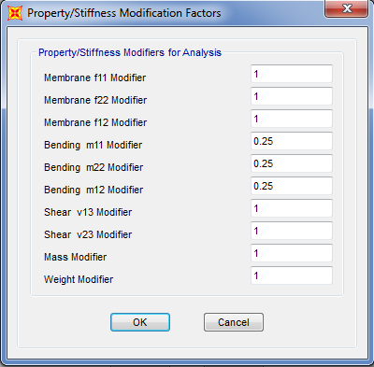
slab definition on sap
In the project , there is one thickness of slab(250mm) for each floor and roof . The definition of 250mm thickness slab is shown in figure 3.8 . Modifiers for slab is shown in figure 3.9 .
Figure 3.8 The definition of the 250mm thickness of slab
Figure 3.9 Slab modifier

Slide 48
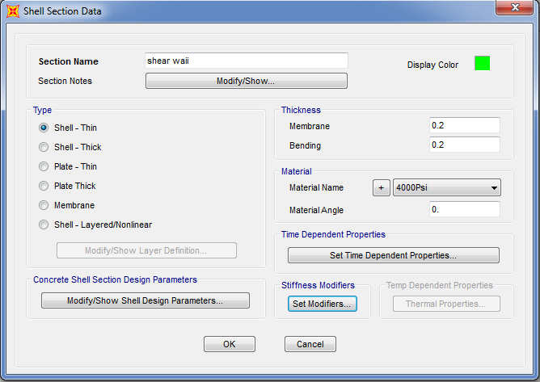
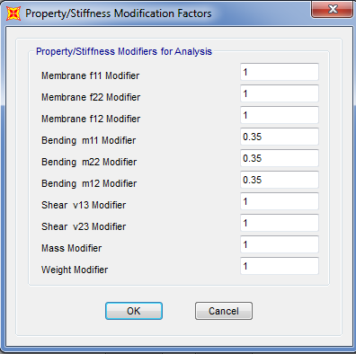
Shear wall definition on sap
The project is surrounded and contains shear wall with 200 mm thickness . The 200mm shear wall is shown in figure 3.10 .The modifiers for shear wall is shown in figure 3.11.
Figure 3.10 shear wall definition
Figure 3.11 Shear wall modifiers

Slide 49
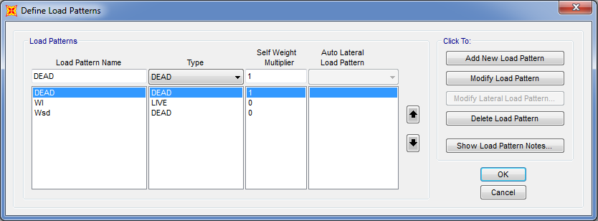
Load on sap
load cases and load combination are added automatically on sap based on ACI-318-02 code.
Load pattern
There are both gravity load on the structure ( live , superimposed , dead ). Load pattern is shown in figure 3.12.
Figure 3.12 Load pattern

Slide 50
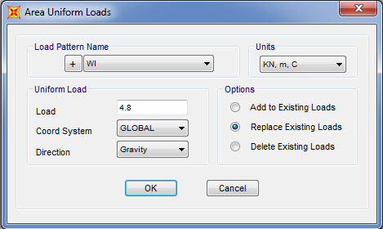
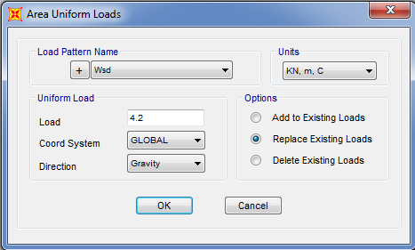
Live load
Live load on each floor is 4.8 KN/m² and on roof is equal 10KN/m² .live load on each floor is
shown in figure 3.13.
**Superimposed dead load :
Superimposed dead load on each floor is 4.2KN/m² which shown in figure 3.14.
Figure 3.14 Superimposed load on each floor
figure 3.14 live load figure 3.14 superimposed load

Slide 51
verifications of structure analysis
1)compatibility of structural model
2) Equilibrium
allowable difference not more than 5%. Calculation of load are based on that in chapter two .
W dead=w slab+ w beam +w column +w shear wall
W dead= 33919.375+10613.625+9155.52+12914.95=66603.455KN
W live=26360.2KN
W SD=16281.3KN
Result from sap are shown in figure 4.16 and comparison between hand calculation and sap results is shown in table (3.1)

Slide 52
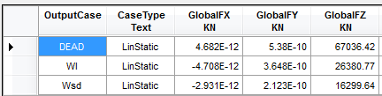
Figure 3.16 Dead ,live ,and superimposed loads from sap
Differences % | SAP results KN | Hand results KN | Load type
.0.65% | 67036.42 | 66603.5 | Dead
0.11% | 16299.64 | 16281.3 | SD
.078%. | 26380.77 | 26360.2 | Live
The difference between hand results and SAP results is very small and less than 5%, so equilibrium check for loads is OK

Slide 53
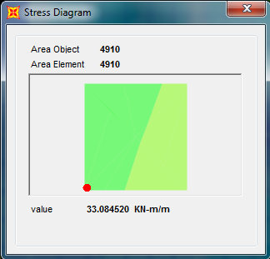
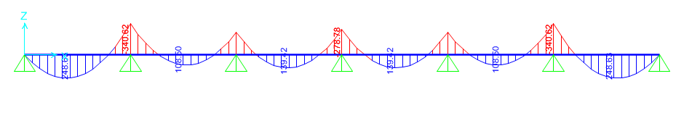

3) Stress strain relationship
M22 value will be read at the middle of the second span .Figure 4.17 shows positive moment at the middle of the second span.
From 1D model for the slab ,M22 value will be read at the middle of the second span. Figure 4.18 shows positive moment at the middle of the span .
Figure 3.17 Positive moment at the middle of the span
Moment in 1m span =108.45/3.45=31.45
% error =
*100%=5.18%
The differences percentage is 5.18% ,which is less than 10% ,OK .

Slide 54
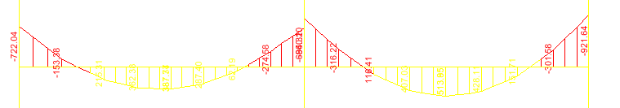
Beam moments
Figure 3.19 shows the moment distribution on the beam (that was chosen as a sample in preliminary design ) using 3D.
=722.04+382.37+860.19+511.89+
921.64=3398.13KN/m
Figure 3.19 Moment distribution on the beam using 3D
Figure 3.20 shows the moments on the beam using 1D analyze
=854.88+1436.13+854.88=
3145.89KN/m
Figure 3.20 Moments on the beam using 1D analyze
=% error
% error =7.4%
The difference percentage is 7.4% , which is less than 10% , OK .

Slide 55
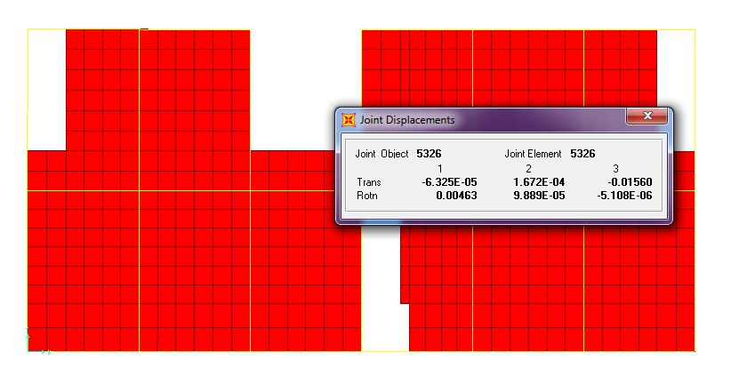
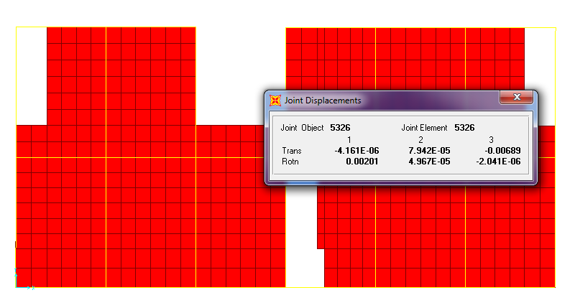
Check slab for deflection (serviceability check )
Deflection from total dead load is shown in figure 3.21and from live load is shown in figure 3.22
Figure 3.21 Deflection from total dead load
Δ long term= 41.5mm
Length of span of slab =10m
The allowable deflection for all sustained load =L/240=10000/240=41.66
41.66>41.5 ,OK
Figure 3.22 Deflection from live load

Slide 56
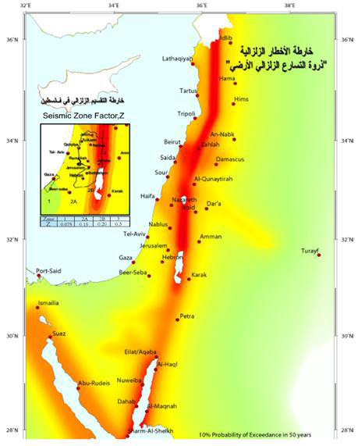
SEISMIC LOADS

Slide 57
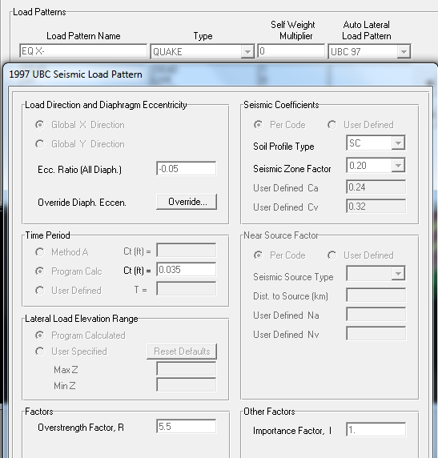
Load patterns
Seismic Load in X-direction

Slide 58
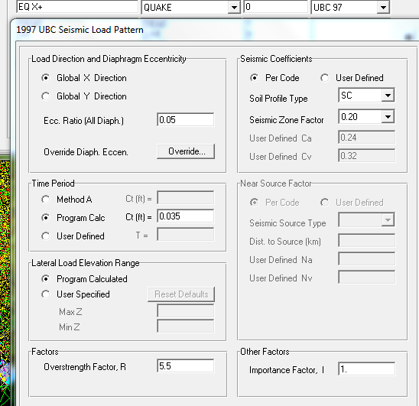
Seismic Load in X+ direction

Slide 59
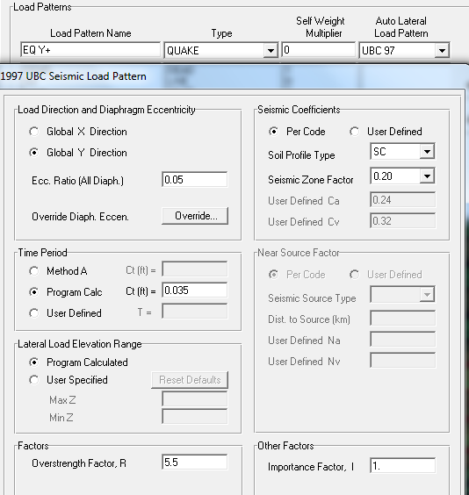
Seismic Load in Y+ direction

Slide 60
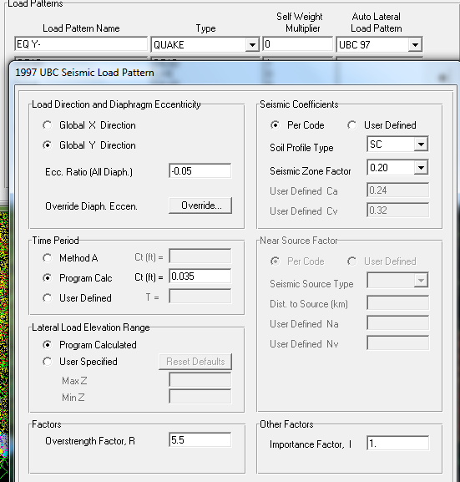
Seismic Load in Y-direction

Slide 61
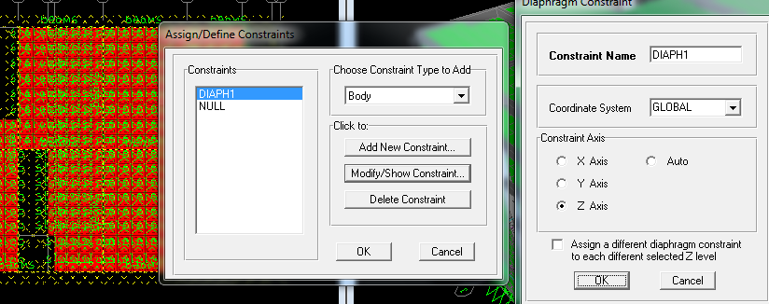
Joint constraints

Slide 62

Mass source

Slide 63

Chapter4: Design of Columns

Slide 64


Columns Grouping:
dimensions and design values for each column

Slide 65


section in column for group 1
section in column for group 2

Slide 66

sap results
The interaction diagram of column (10) was drawn ( taking the values of M33 vs Pu from sap ) to determine if the maximum axial load and moment exceeded the capacity of the column. Figures (4.3 and 4.4) show the interaction diagrams from M33 vs Pu and M22 vs Pu respectively . Moment and axial load on the column are 116.4KN.m and8757KN respectively .
As the point in the figure are inside the diagram ,moment and axial on column are less than the capacity and column is safe

Slide 67

Chapter5: Design of Footing

Slide 68
Isolated footing
The column 17 and column 10 are the more critical columns in their group – it has the largest loads
Column 10 :
Service load equal to 6760 KN.
Ultimate load is equal to 8900 KN.
Column 17 :
Service load equal to 3560 KN.
Ultimate load is equal to 4680 KN

Slide 69

Hand calculation
Footing Dimension
σmax ≤ q all
(P/A), ≤ q all
6760/𝐴 = 350, Then A = 19.3 m2
But we can guess L:
L = √𝑝/𝑞 = √6760/350 = 4.4 => Try L =4.4 m,
B = 𝐴𝐿 = 19.34.4 = 4.4 => Try B = 4.4 m.
Then the footing dimension:-
L =4.40 m, B= 4.4m.
Footing Thickness
The thickness of isolated
footing Is depending on the
Wide beam Shear:-

Slide 70

Check punching sheer:
Flexure Reinforcement:-
The cantilever length at long direction, L = 1.8 m.
Mu = (qu∗L^2)/2 =(459.7∗18^2)/2 = 744.7 KN.m./m
With b= 1000 mm, d= 900 mm, Mu = 744.7 KN.m/m, then: -
ρ = 2.43* 10^-3
As = ρ*b*d = 2.43* 10-3 * 1000 * 900 = 2187 mm2/m.

Slide 71



SAP CALCULATION( for column 17)
deflection :At First we need to check the deflection to be less than 10 mm
Bearing capacity :
Qu must be less than 350KN/m2 .maximum reaction
.

Slide 72

wide beam shear
Effective depth (d ) will be assumed as in hand calculation .9 m then check
the value of wide beam shear .
.
Vu=1448 KN
d = 500-80= 4200 mm
∅ Vc = 0.75*( 1/6)*√fc` b*d =0.75*(1/6)*√25 *1000*900 /1000] = 562 KN
Vu>∅ Vc there is a need to increase the depth
Tack h=1.1 d=1.02m

Slide 73

shear at distance d after increasing h
Vu=405.4KN
And after increasing the depth ∅ Vc will be as follows:
∅ Vc=0.75*(1/6)*√25 *1000*1020 /1000 = 637.5KN
∅ Vc>Vu
Wide beam shear is ok

Slide 74

check punching shear
∅ Vcp =∅0.33√fc` bo*d
∅ Vc =0.75*0.33*√25 *1000*1020 /1000∅ =1262.3 KN/m
punching shear at d/2 distance from the face of the column
As ∅ Vcp>Vu𝑝 , punching shear is ok

Slide 75

Flexural design
Moment value is shown in figure that was read at the face of the column.

Slide 76

Bottom steel
MU=903.6 KN.m
𝜌=0.00235
As=2397mm2
As min=0.0018bh=1980mm2
Use As=2397mm2
Use 1∅ 20/130mm
Number of bars in 3.2m=3.20/.13=24 bar
Top steel
Use half the shrinkage steel in each direction 80
As = 1980*0.5=990mm2
Use 1∅ 12/100mm in each direction
Check development length :
Ld=(3.2−0.4)/2 - side cover (0.05)=1.4-0.05=1350mm
Ldt=576mm
Ld>Ldt
No need to have hook

Slide 77


