Slide 1

Energy Engineering and Environment Department
and Chemical Engineering Department
Environmental Impact Assessment of Scrap Tires in the West Bank
Prepared by:
Fadwa Wa’el and Raid Zaghlool
Supervisor:
Dr. Amjad El-Qanni
DEC 24, 2018

Slide 2
Outline
Introduction
Objective of project
Timeline
Land selection
the geological and hydrographic of the region
Technology selection
Methodology
Capacity
Leopold matrix
Mitigation and mentoring plan
Conclusion

Slide 3
Introduction
Scrap tires is an inevitable product of society, and one of the greatest challenges for future generations is to understand how to manage large quantities of scrap tires in a sustainable way. Scrap tiers is a big problem in Palestine.it is facing the problem of scrap tires like any country in the world due to increase of population, the lack of appropriate places for the scrap tires and shortage of sanitary landfills.
The main objective of this report is to assess the potential environmental impacts of gas producing from pyrolysis on environment (ground water, air quality, soil, noise and health). It also aims to make recommendations for the mitigation of the potential negative impacts and increase of the positive ones.

Slide 4
Objective
Ensure environmental considerations are explicitly addressed and incorporated into the development decision-making process.
Anticipate, avoid, and minimize the adverse significant biophysical, social, and other relevant effects of development proposals.
Protect the productivity and capacity of natural systems and the ecological processes which maintain their functions.
Promote development that is sustainable and optimize resource use as well as management opportunities.

Slide 5
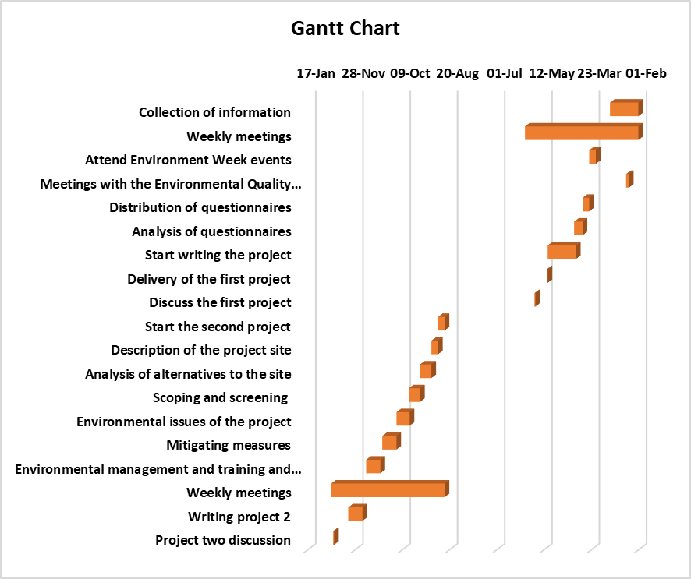
Timeline

Slide 6
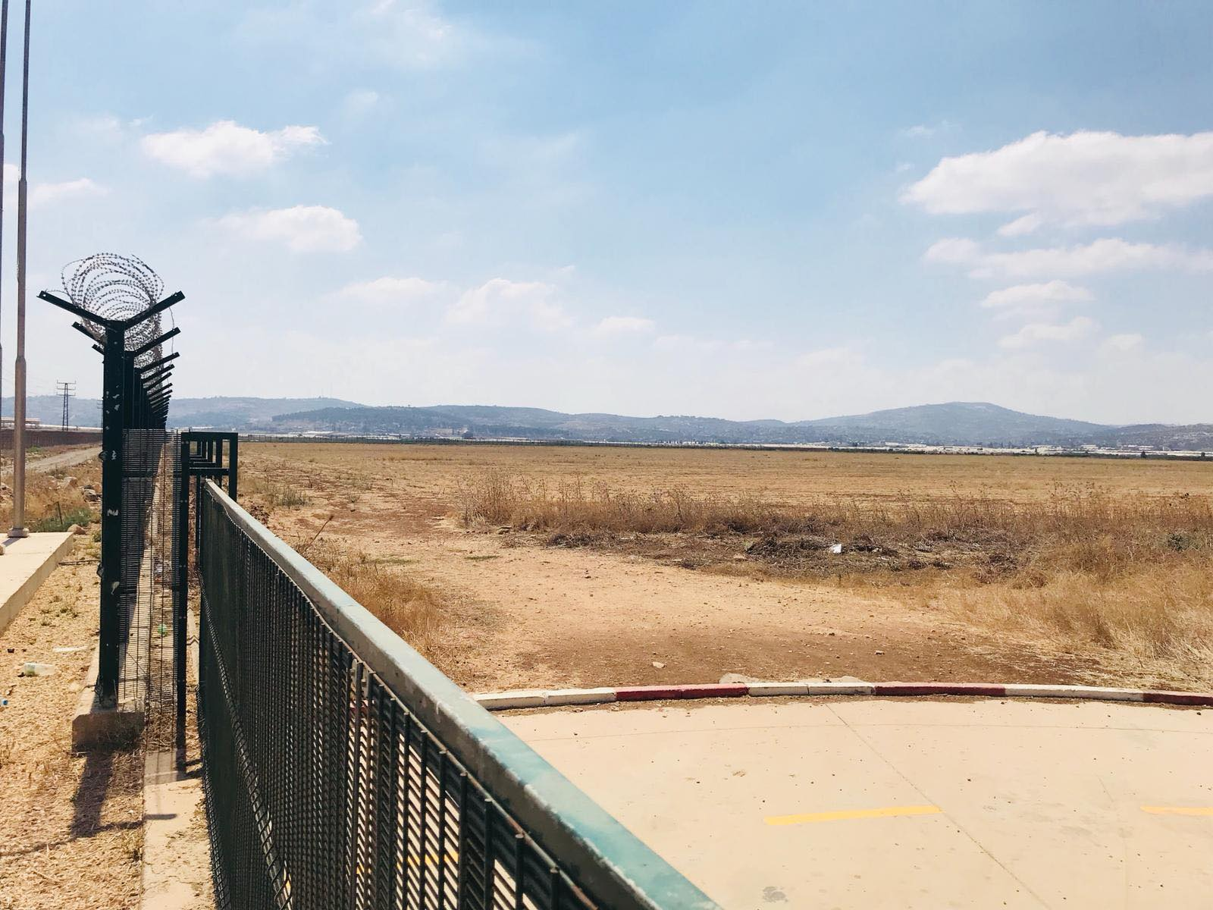
Land selection
Location of project
Nature of land use
Topographic location
Soil location and its properties

Slide 7
The geological and hydrographic of the region
Climate
Temperature distribution
Humidity
Rainfall
Winds
Water evaporation

Slide 8
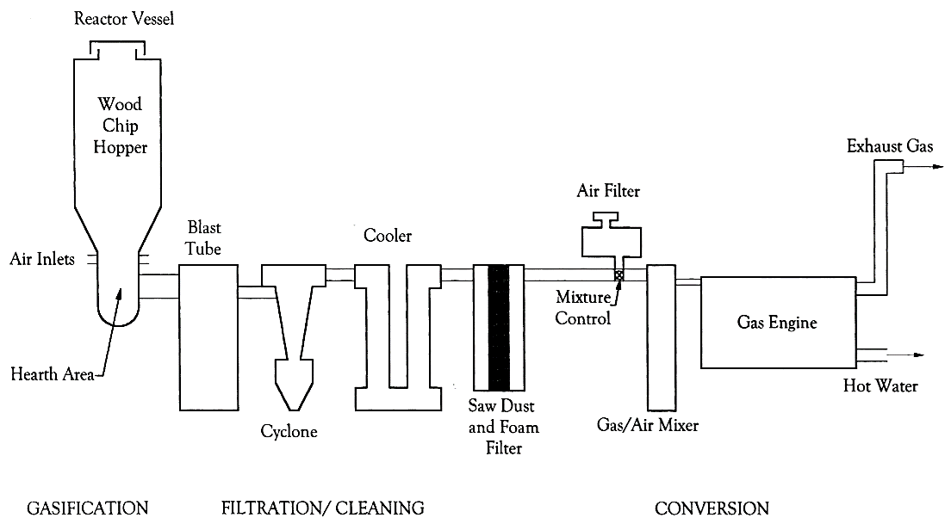
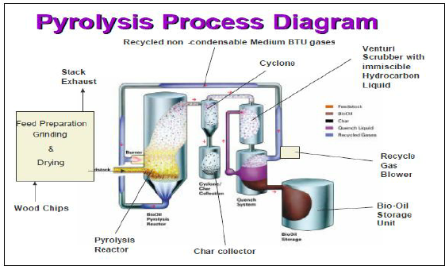
Technology selection
Quench system
Tires in

Slide 9
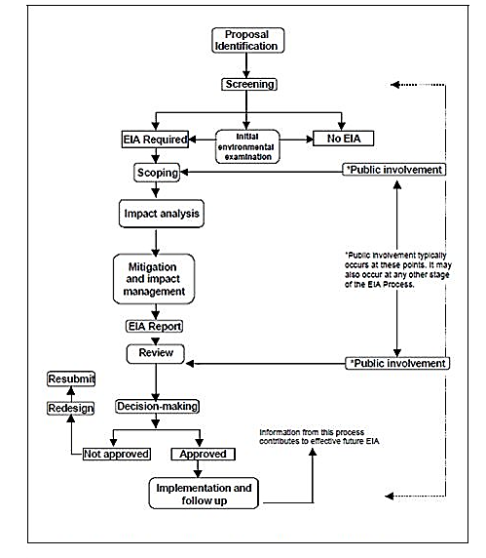
Methodology

Slide 10
Capacity
# of cars | 400,000 cars
# of tires per car | 4 tiers
Life time of tires | 1.5 year
Total # of tires | 2,400,000
Average tire weight | 8 kg
Capacity | 12800 ton per year
# of working days per year | 260 day per year
Pyrolizer capacity | 4 tons per hour
# of treated tires per day | 40 tons

Slide 11
Leoplod matrix
Operation |  |  |  |  |  | Construction |  |  |  | Pre-construction |  | Activities
Gases emissions | Waste disposal | Pyrolysis process | Using water | Operation machines | Collection trucks | casting | Excavation | Water using | Construction trucks | Survey | land acquisition | Environmental items
-10 12 | -2 12 | -7 12 | 0 12 | 0 12 | -5 12 | 0 12 | -6 12 | 0 12 | -3 12 | 0 12 | 0 12 | Air quality | physical
0 10 | -5 10 | -8 10 | -10 10 | 0 10 | 0 10 | 0 10 | 0 10 | -1 10 | 0 10 | 0 10 | 0 10 | Water quality
0 3 | 0 3 | -1 3 | -2 3 | 0 3 | 0 3 | -7 3 | 0 3 | -5 3 | 0 3 | 0 3 | 2 3 | Water source

Slide 12
-3 2 | 0 2 | -2 2 | 0 2 | -10 2 | 0 2 | 0 2 | -5 2 | 0 2 | 0 2 | 0 2 | 0 2 | Noise
-3 1 | 0 1 | 0 1 | 0 1 | 0 1 | 0 1 | -5 1 | -5 1 | 0 1 | 0 1 | 0 1 | 0 1 | Visual scene
0 9 | -5 9 | -5 9 | 0 9 | 0 9 | 0 9 | -2 9 | -4 9 | 0 9 | 0 9 | 0 9 | 2 9 | Soil
-10 7 | -8 7 | 0 7 | 0 7 | 0 7 | -4 7 | -4 7 | -8 7 | 0 7 | -2 7 | 0 7 | 2 7 | Wild life | biological
-8 8 | -7 8 | 0 8 | 0 8 | 0 8 | -4 8 | -5 8 | -7 8 | 0 8 | -2 8 | 0 8 | 0 8 | Biodiversity

Slide 13
0 5 | 0 5 | 4 5 | 0 5 | 8 5 | 8 5 | 3 5 | 3 5 | 0 5 | 3 5 | 0 5 | 0 5 | employment | Socio-economic
-9 11 | -7 11 | -3 11 | -3 11 | 0 11 | 0 11 | 0 11 | 0 11 | 0 11 | 0 11 | 0 11 | 0 11 | Health
0 4 | 0 4 | 0 4 | 0 4 | 0 4 | -5 4 | -4 4 | -5 4 | 0 4 | -3 4 | 0 4 | 0 4 | Traffic
0 6 | 0 6 | 5 6 | 0 6 | 8 6 | 7 6 | 3 6 | 3 6 | 0 6 | 3 6 | 0 6 | 0 6 | Economy

Slide 14
Mitigation and mentoring plan
Potential impacts | Monitoring mechanism | Person in charge | Monitoring/reporting frequency | Elements during construction
Due to drilling. | Moisturizing the ground with water during dredging to minimize the impact of this dusting. | Workers and Engineers. | Weekly or on receipt of any complaint (monthly monitoring of dust in the villages interviewed). Once a week during drilling and production testing. | Air quality
Due to drilling. | Regular maintenance of trucks, conveyors, drilling mechanisms and commitment to work during normal working hours. | Workers and Engineers. | Measuring noise through the use of instruments based on international standards and standards (use of sound meters) once a week during the production test and every hour during drilling operations. | Noise
Due to the leakage of waste. | Buffer stock coverage and continuous monitoring of drifting soil. | Workers. | Daily routine monitoring by the Contractor and weekly observation by the Environment Officer if necessary. | Soil
Due to construction material trucks, drilling, transport, and collection waste tires. | Place warning and guidance signals. | Workers | Monthly monitoring of drivers' driving certificates Monthly monitoring of all operating vehicles | Traffic hazards

Slide 15
Potential impacts | Monitoring mechanism | Person in charge | monitoring/reporting frequency | Elements during operation
Due to harmful gases emissions. | Regular maintenance of chimney outlets and add filters and Installation of a detector for all types of gases emitted in case of leakage. | Workers and Engineers | Monitoring changes in the concentration of gases emitted into ambient air. Gas emissions are calculated from measured concentrations in gas and condensate. Twice a year | Air quality
Due to the leakage of waste | Plant trees to reduce soil erosion. | Workers | Periodically during the transport of waste | Soil
Human, industrial and medical uses. | Provide a container for the placement of solid waste resulting from use. | Workers | Solids - monthly monitoring of solid human waste storage areas and their transfer to designated areas when needed. Periodic weekly monitoring of solid industrial waste storage areas and their transfer to designated landfills as needed. | Solid waste
Due to the operation of machines. | Continuous maintenance of machines which are the main source of the noise. | Workers | Measurement of noise level through the use of instruments based on international standards and standards (use of sound meters) once every three months during operation (monitoring every 24 hours). | Noise
Due to community water resource uses | Designing a sewage system | Workers and engineers and EQA | Chemical analysis of its components monthly. Weekly monitoring of storage and evaporation areas when needed. Rainwater - Maintenance of rain drainage network annually before the rainy season. Continuous monitoring of discharge during rain storms. | Water resources and quality
The unexpected presence of rare animals in the construction area or there are government nature reserves. | Plantation of forest trees during operation to beautify the area. | workers | No need | wildlife

Slide 16
Conclusion
The establishment of the scrap tires recycling plant is considered necessary for the preservation of the environment by limiting the dumping of such waste in Palestine.
Since pyrolysis process has been proposed as a solution of this environmental problem, the main concern of such a process is the by-product gas emissions.
Installation of detectors for all gases emitted from chimneys and inside the factory and connected to the alarms.
Emphasis on the need to reduce the noise range within the global specifications.
Emphasis on the need to adhere the proposed management and control plans during the establishment and operation.
Continued monitoring of all the outputs of the plant on a continuous basis.
Emphasis on the general safety conditions inside and outside the plant to ensure that they remain within the global and local standards.
Holding a special symposium for the local community to present the project in all its aspects and formulate their views regarding the development of the region to become an industrial and direct impact on them and focus on local employment and training and development of appropriate cadres.

Slide 17
Thank you for listening
Welcome to receive questions

