Slide 1

Al-Najah National University
Faculty of Engineering
Building engineering department
Graduation project 2
DESIGN Assessment and REDESIGN OF A BANK BUILDING .
Under the supervision of :Dr. Luay Dwaikat
Prepared By: worood Alhawah, Mohammad Daragmh& Rahaf Ali

Slide 2
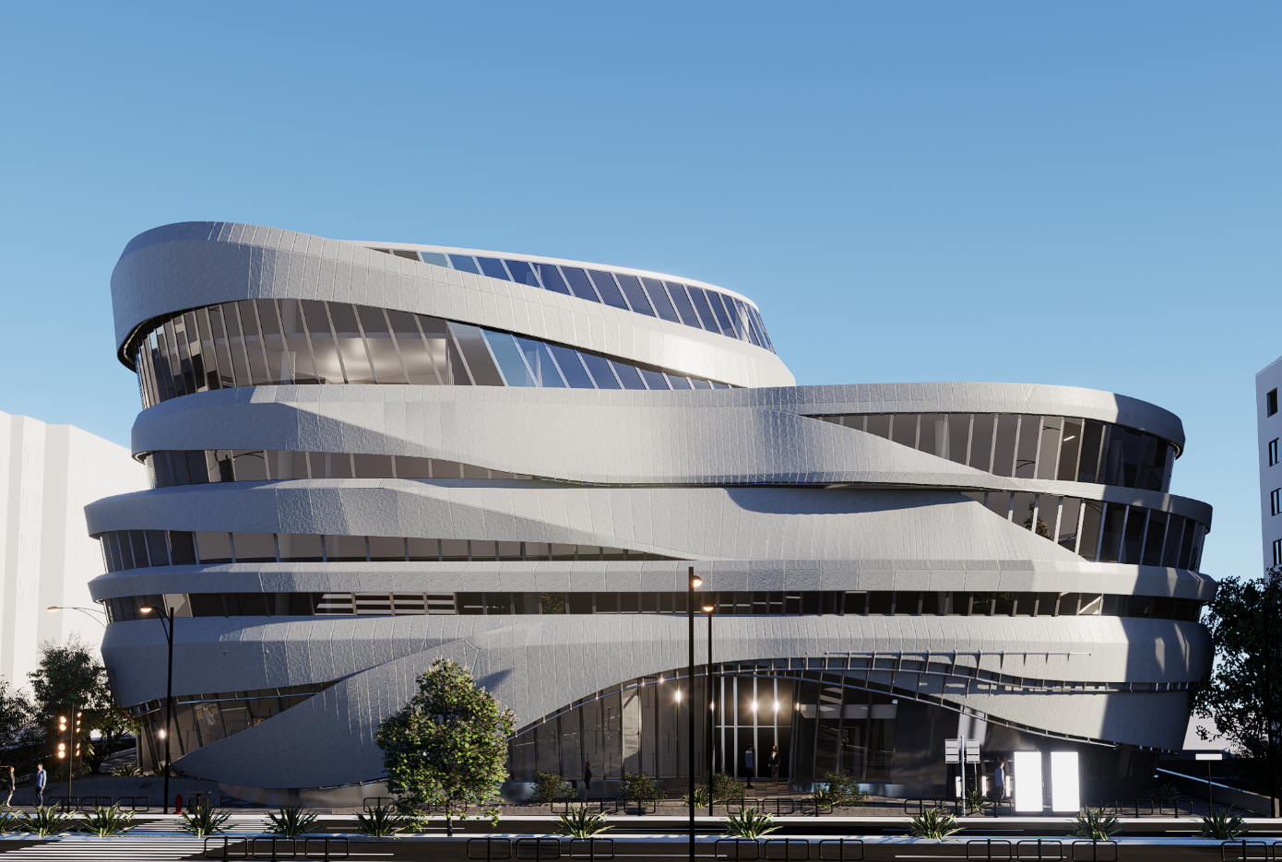
Introduction:
This project represents an integrated design for an administration building in Nablus. Its strategic location to serve all categories of the city's population and its accessibility and improve the level was administrative, architectural, and urban planning of the country. The main design criteria is to follow the environmental design concepts.
The total area of the building is 10150 m2 .
It has 7 stories and 2 basements.

Slide 3
Architectural- Environmental aspect:

Slide 4
Architectural
Site location
Architectural plans

Slide 5
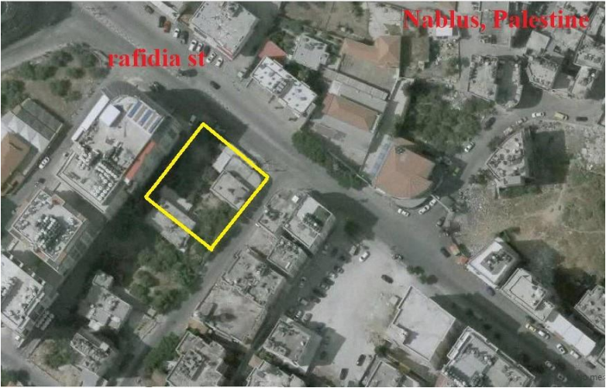
Site location

Slide 6
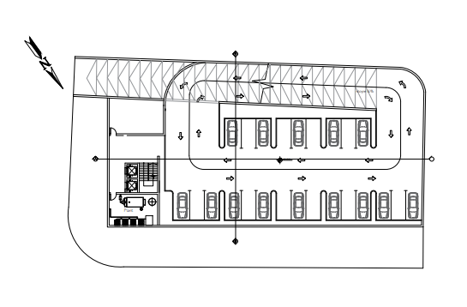
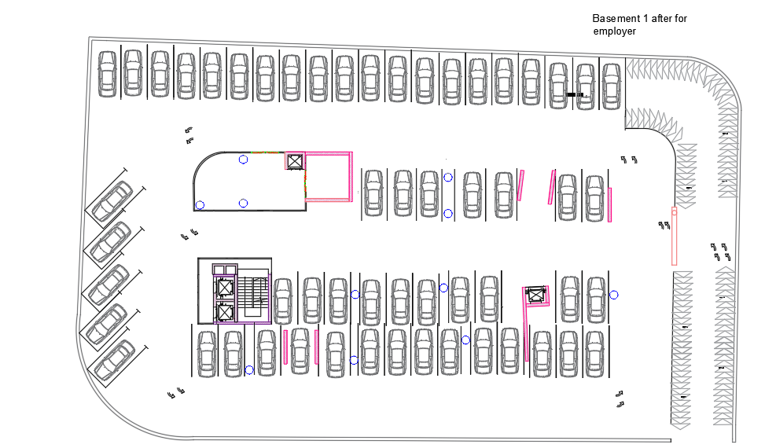
Architectural plans
Basement 1
Before modification
After modification

Slide 7
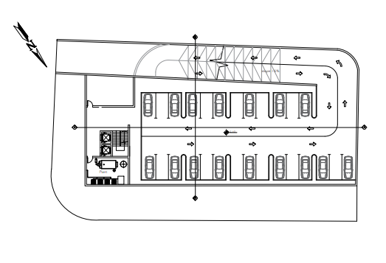
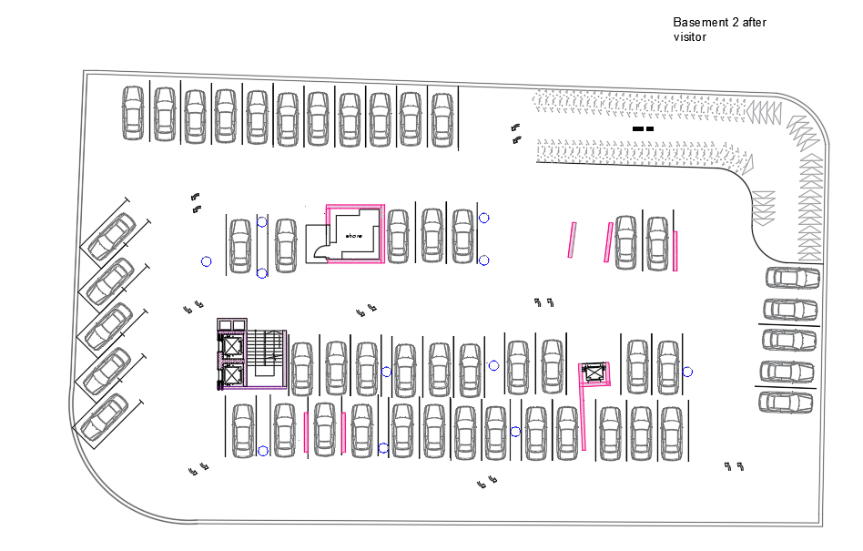
Basement 2
Before modification
After modification

Slide 8
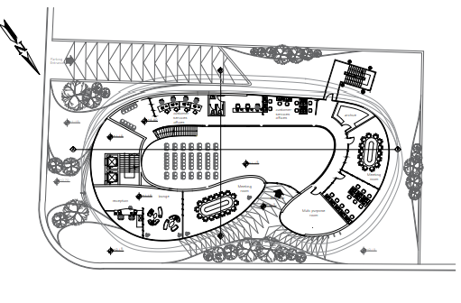
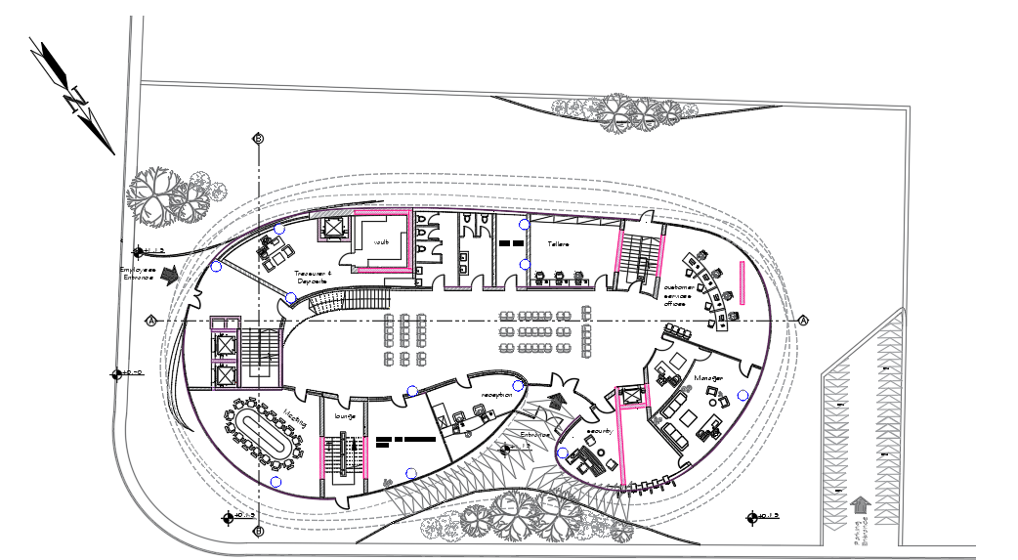
Ground floor
Before modification
After modification

Slide 9
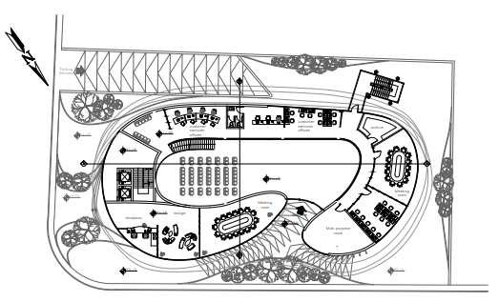
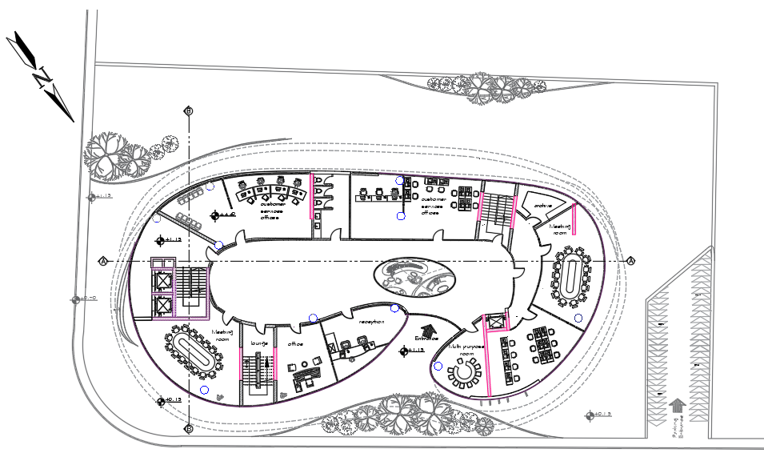
First floor
Before modification
After modification

Slide 10
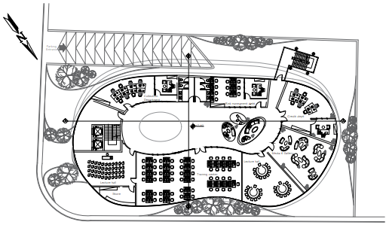
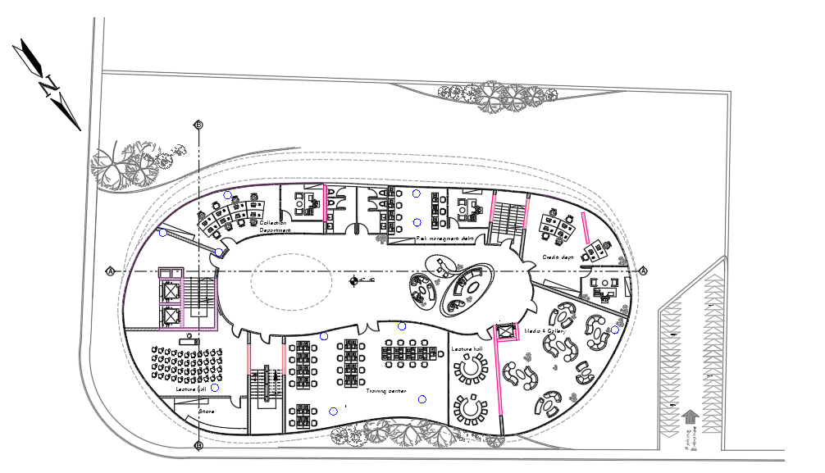
Second floor
Before modification
After modification

Slide 11
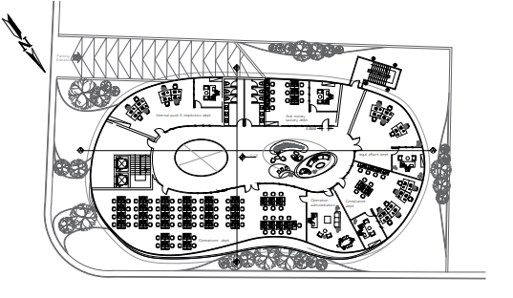
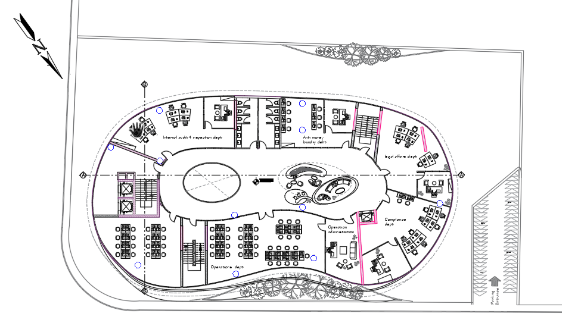
Third floor
Before modification
After modification

Slide 12
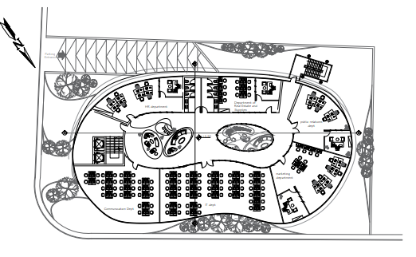
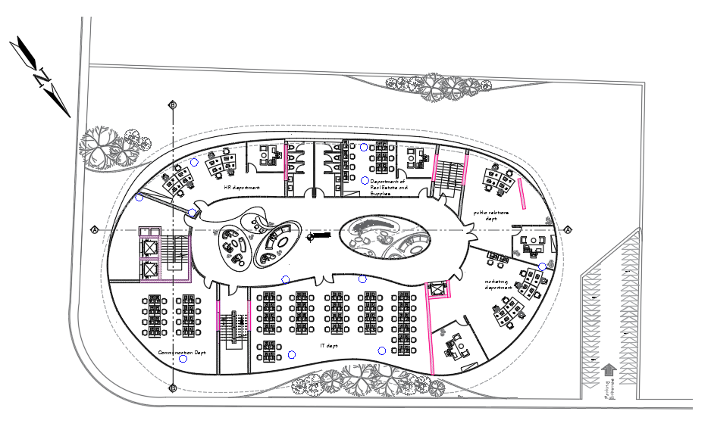
Fourth floor
Before modification
After modification

Slide 13
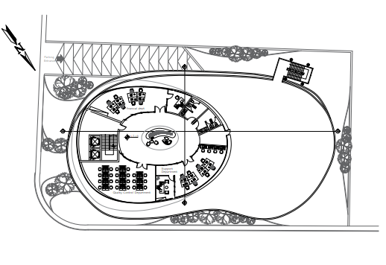
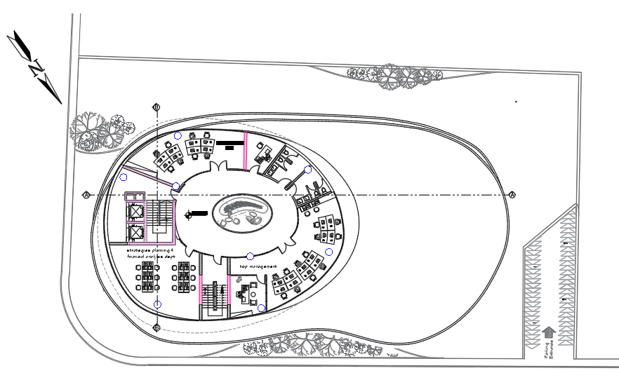
Fifth floor
Before modification
After modification

Slide 14
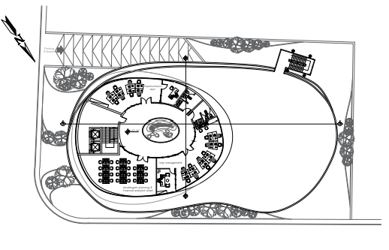
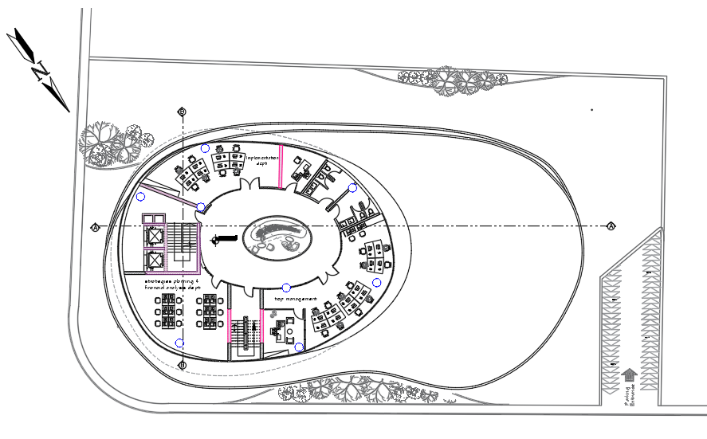
Sixth floor
Before modification
After modification

Slide 15
Environmental
Proposals
Environmental Analysis
Thermal
Analysis
Energy conservation

Slide 16
Environmental design program:
Type glass(Double glass 12 mm) with 60% lighting,26% solar, good insulation.
Put insulation in roof.
Put inside shutters.
Note:The working hours in the building are from 8:00 am-3:00pm.
Photovoltaics.

Slide 17

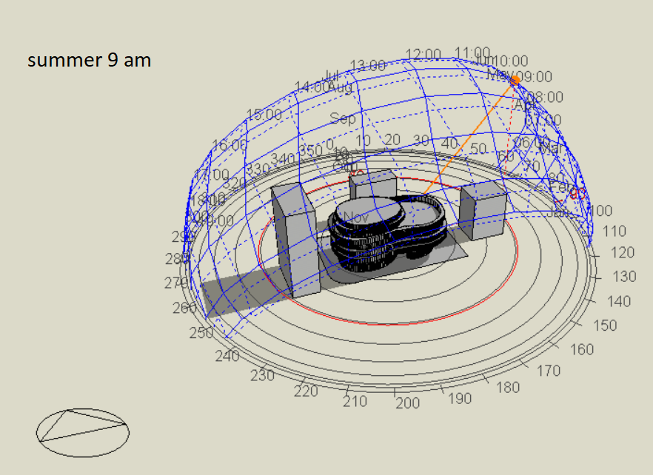
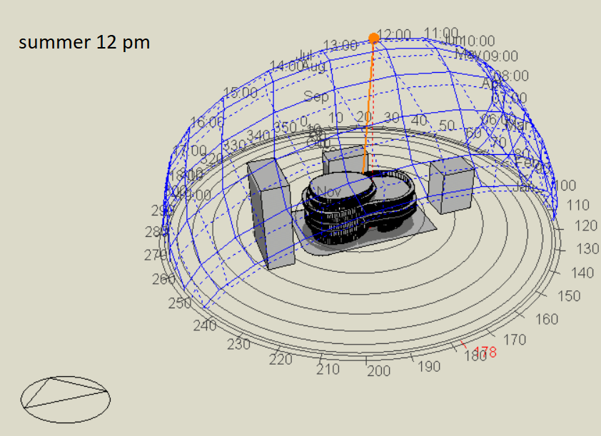
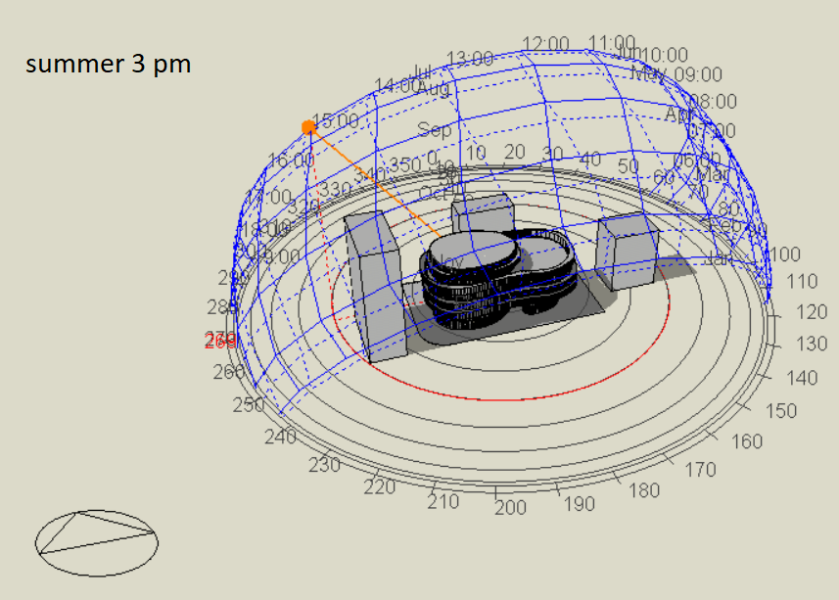
Overshadowing and shading:

Slide 18
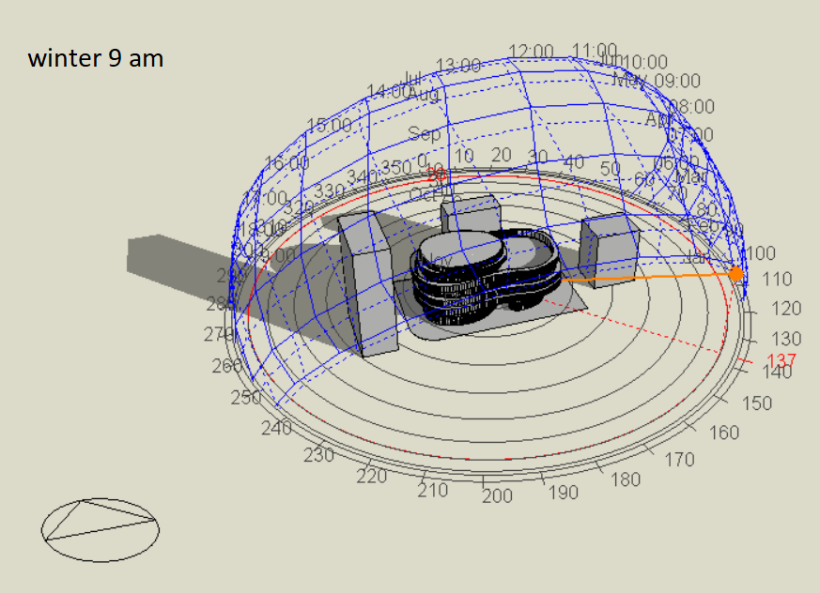
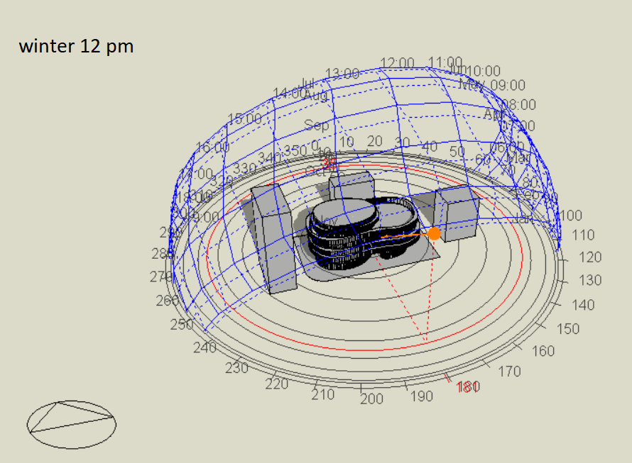
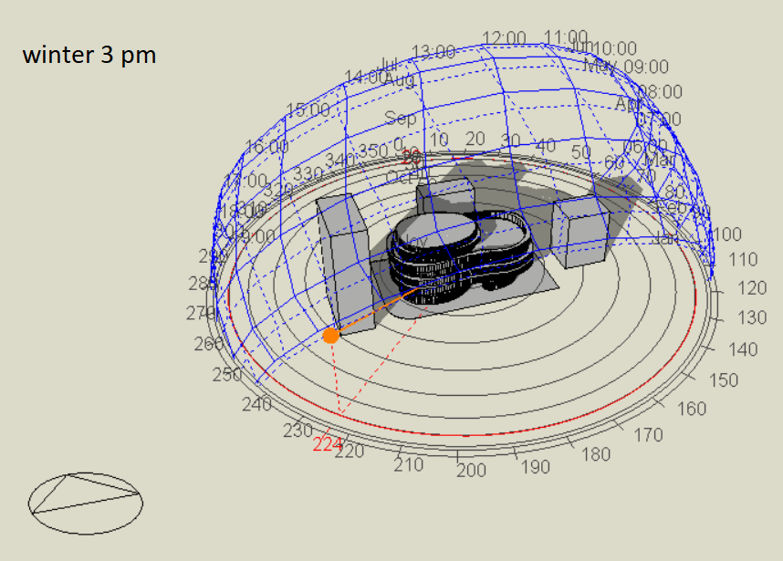
Overshadowing and shading:

Slide 19
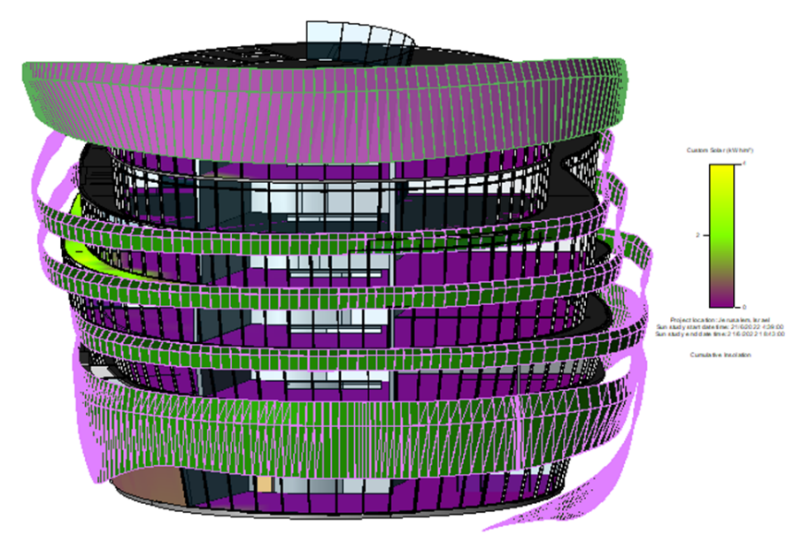
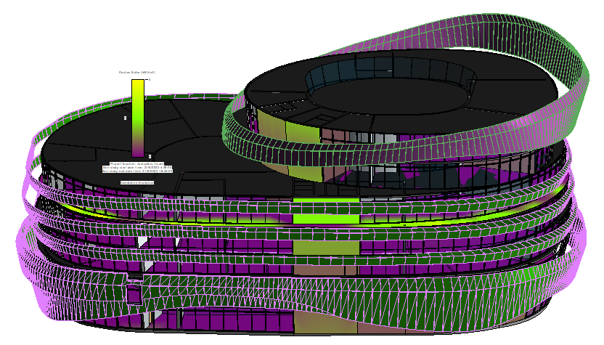
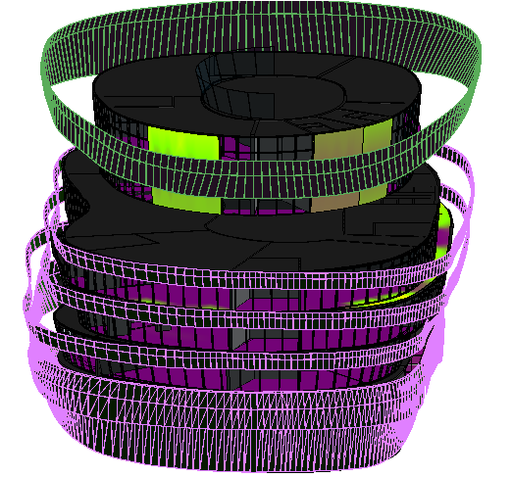
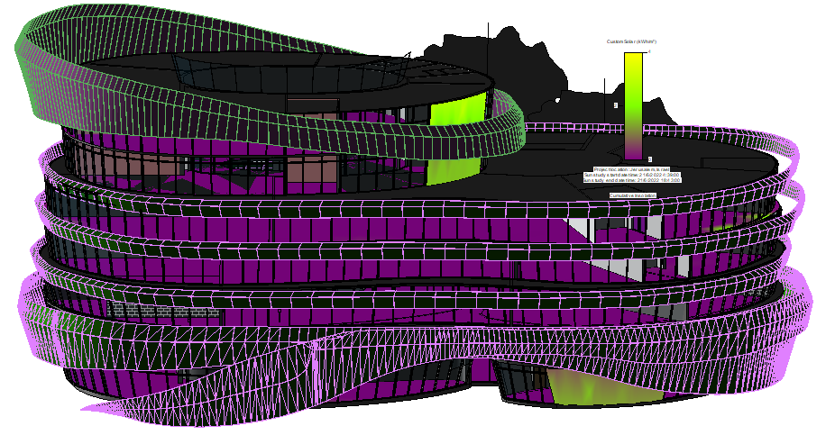
Solar radiation
Solar radiation in summer for elevation:
west elevation
south elevation
East elevation
North elevation

Slide 20
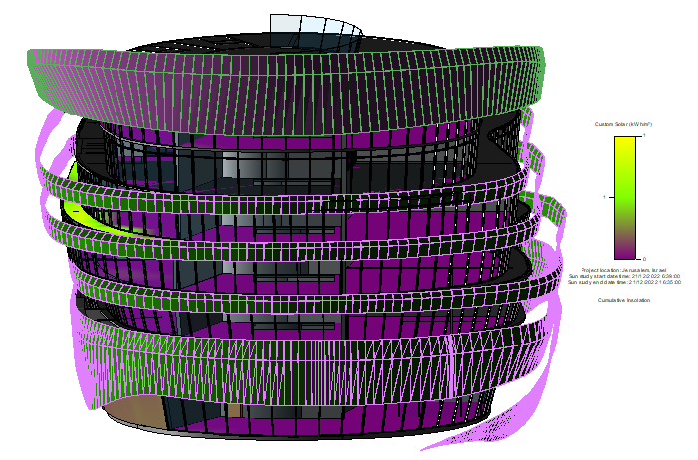
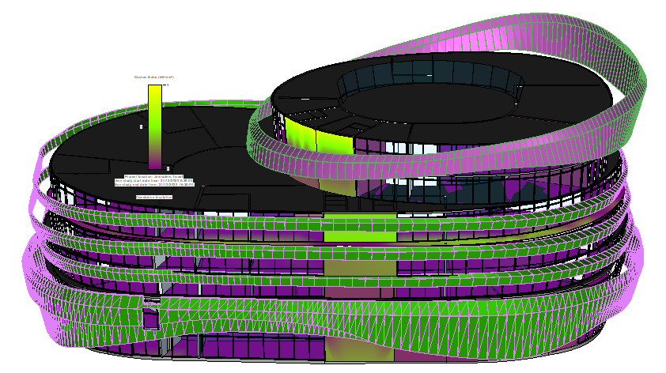
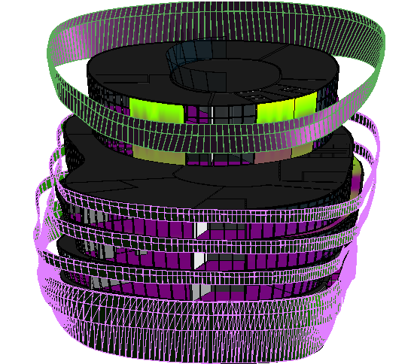
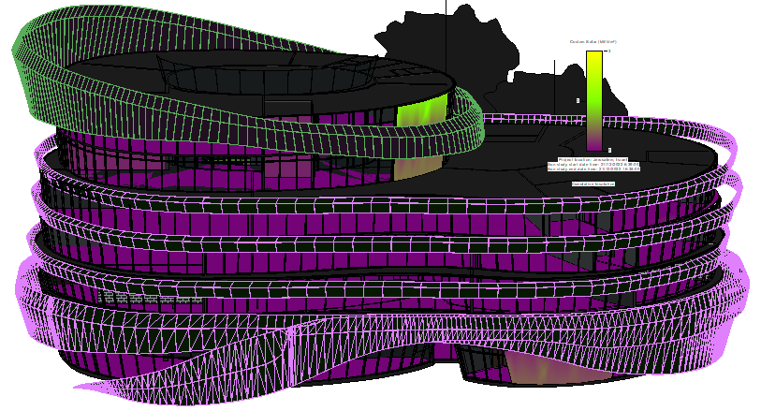
Solar radiation in winter for elevation:
south elevation
west elevation
North elevation
East elevation

Slide 21
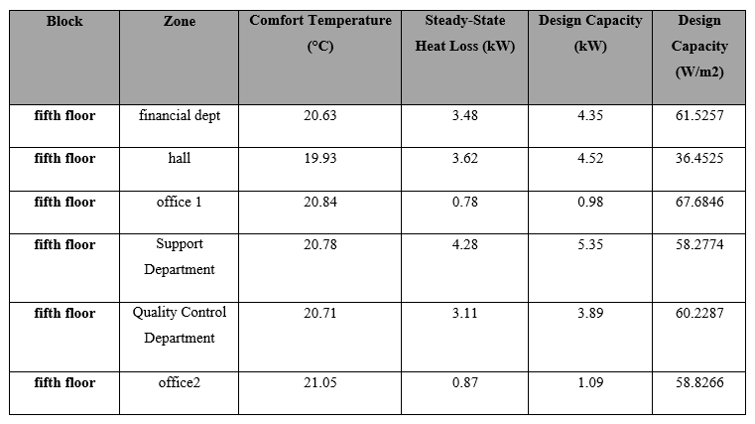
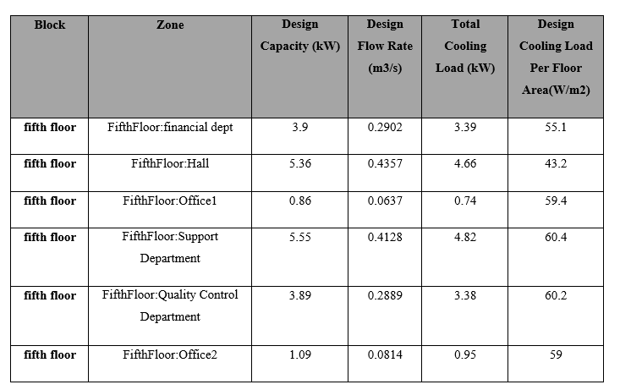
Heating and cooling load
Heating load: (total load =266.35 Kw) (76.361 Ton)
Cooling load: (total load = 267.88 Kw)(76.800 Ton)

Slide 22
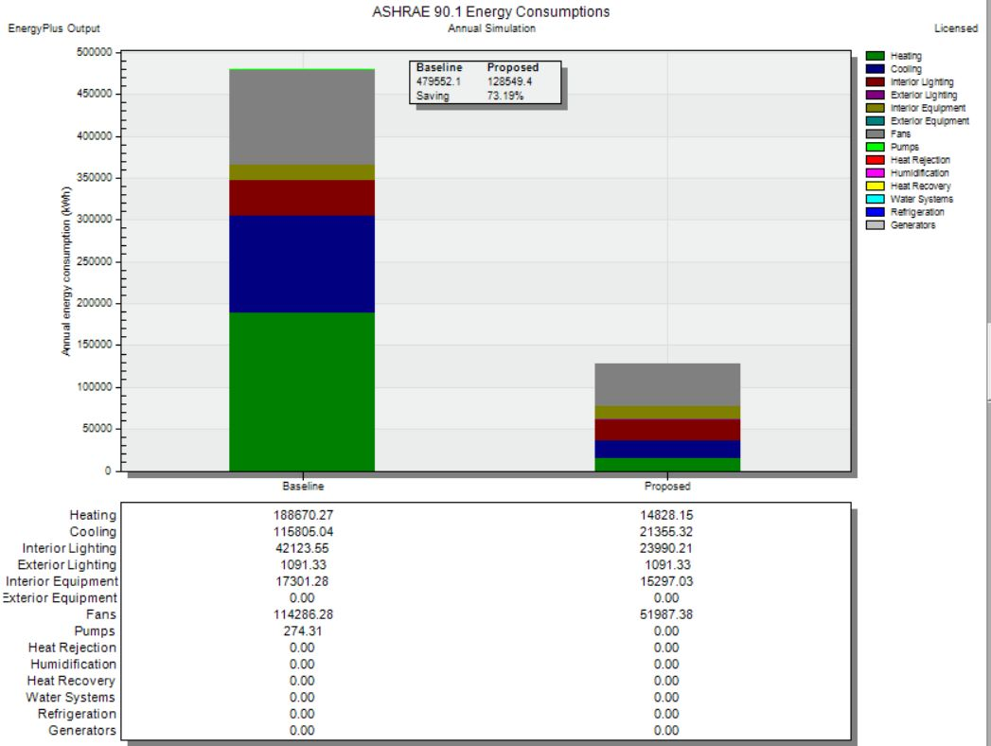
• Baseline energy building analysis:

Slide 23
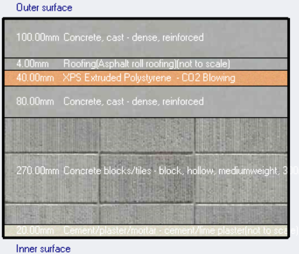
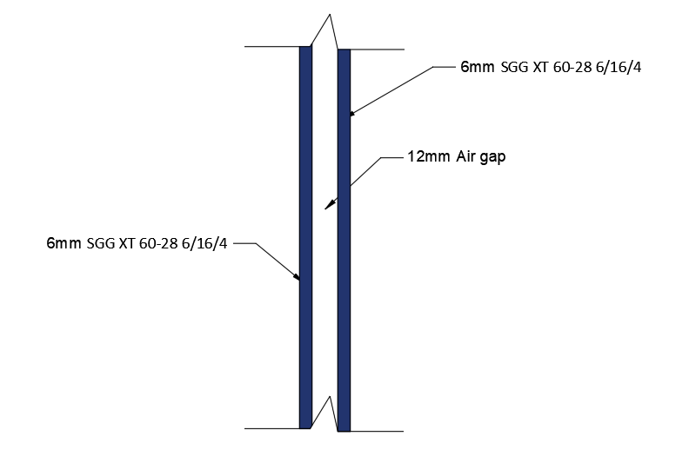
Thermal analysis:
External Wall
Roof
U=1.289 (w/m^2.k)
U=0.453 (w/m^2.k).

Slide 24
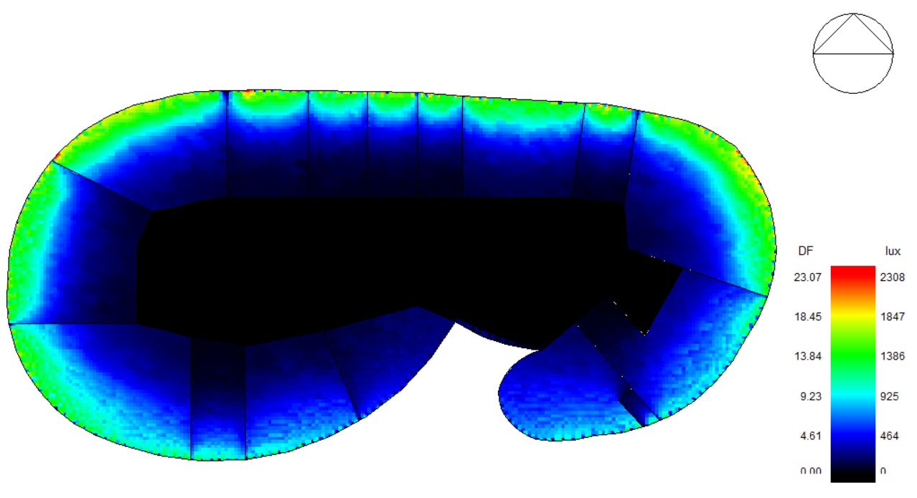
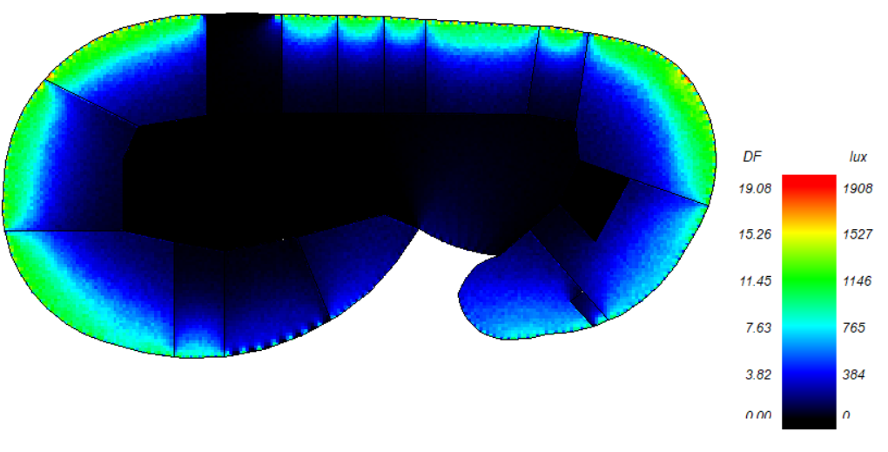
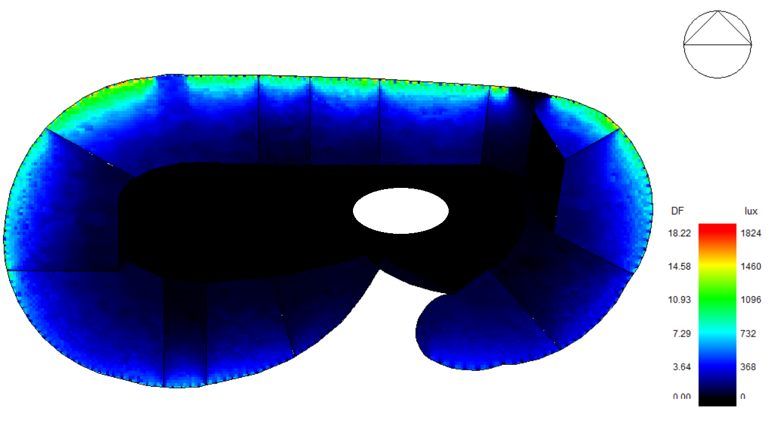
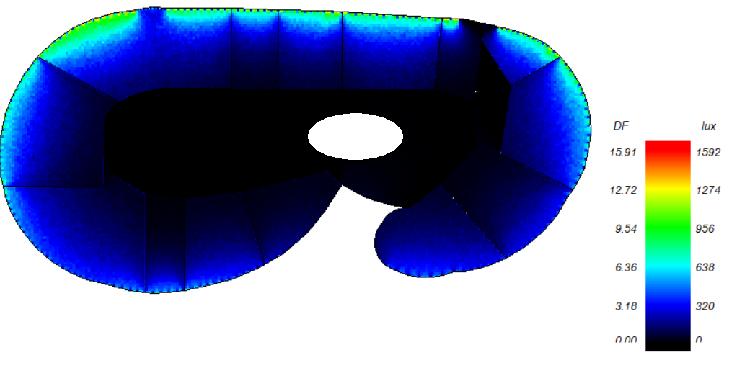
Daylight factor:
Ground (before)
Ground (after)
First floor (before)
First floor (after)

Slide 25
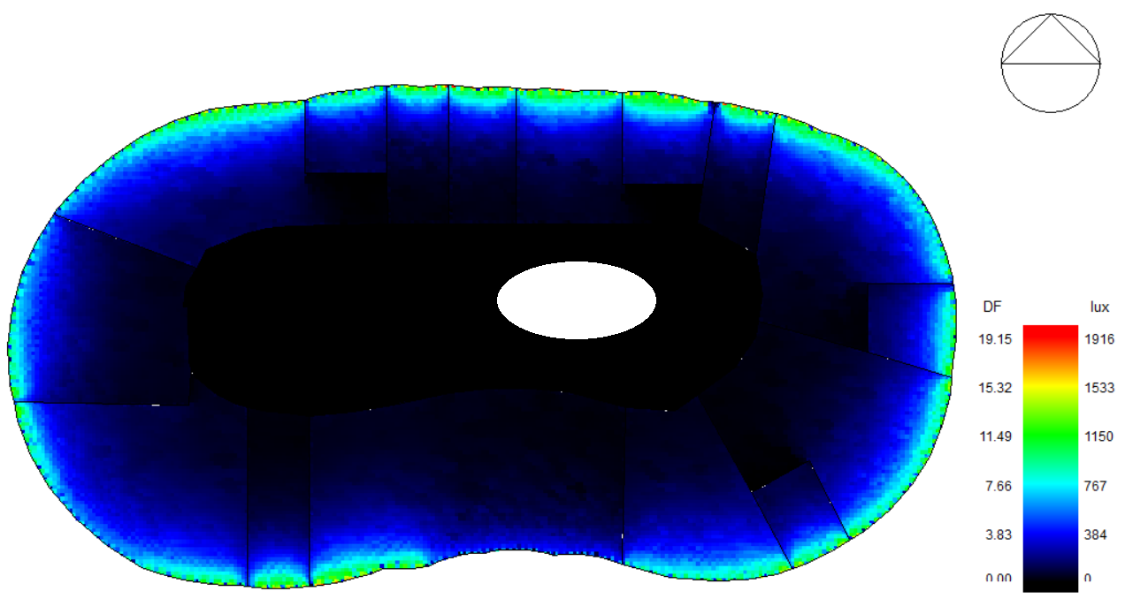
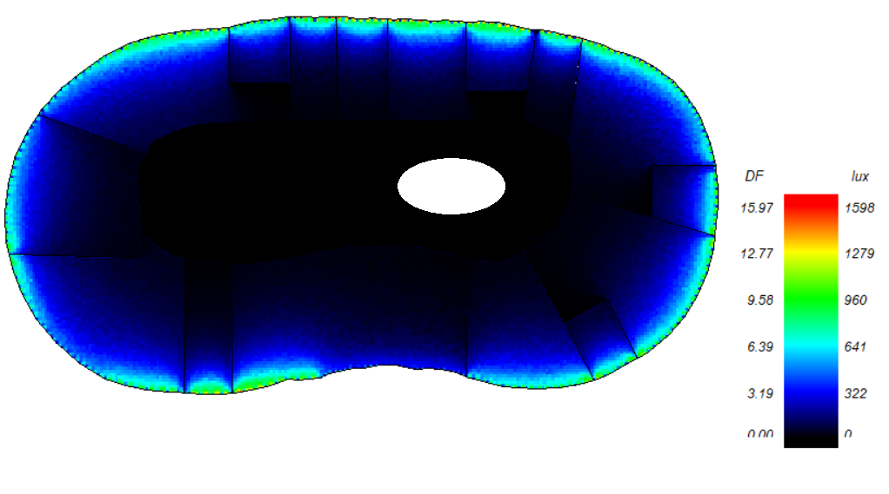
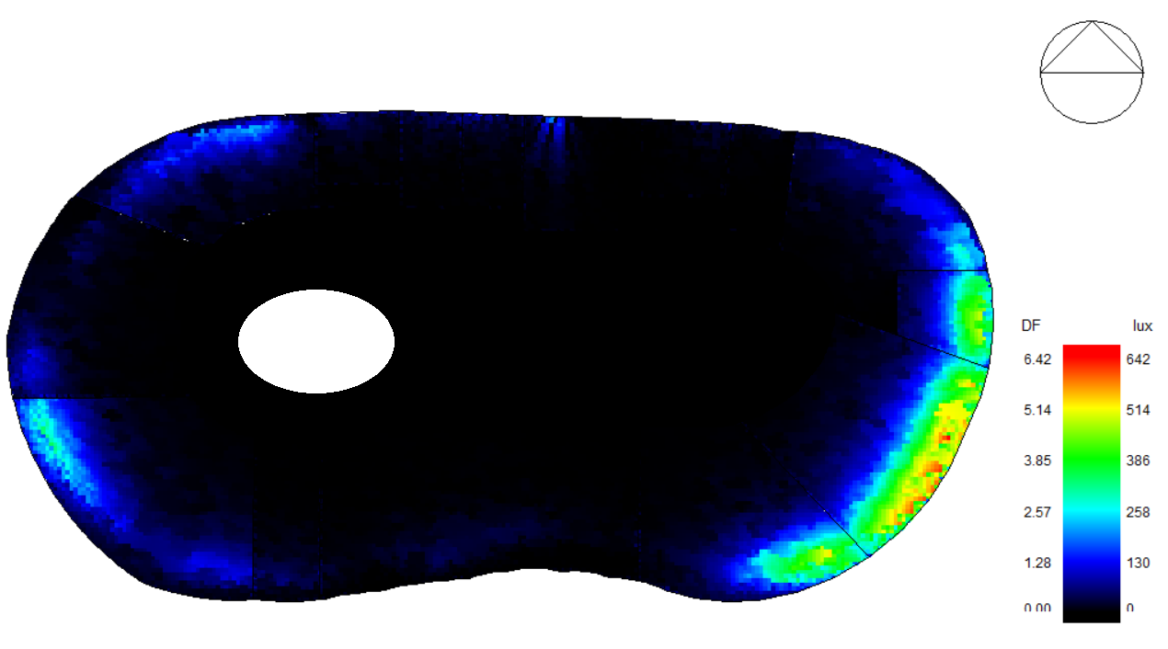
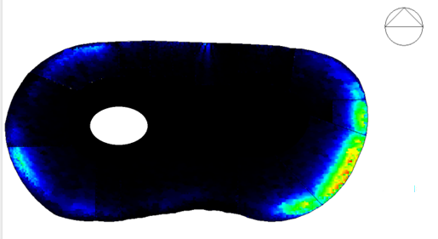

Daylight factor:
second floor (before)
second floor (after)
third floor (before)
third floor (after)

Slide 26
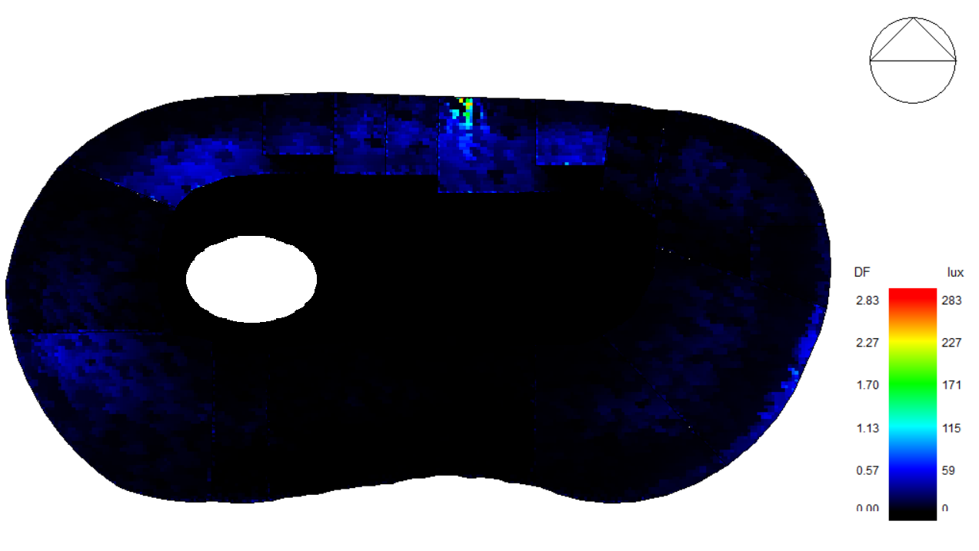
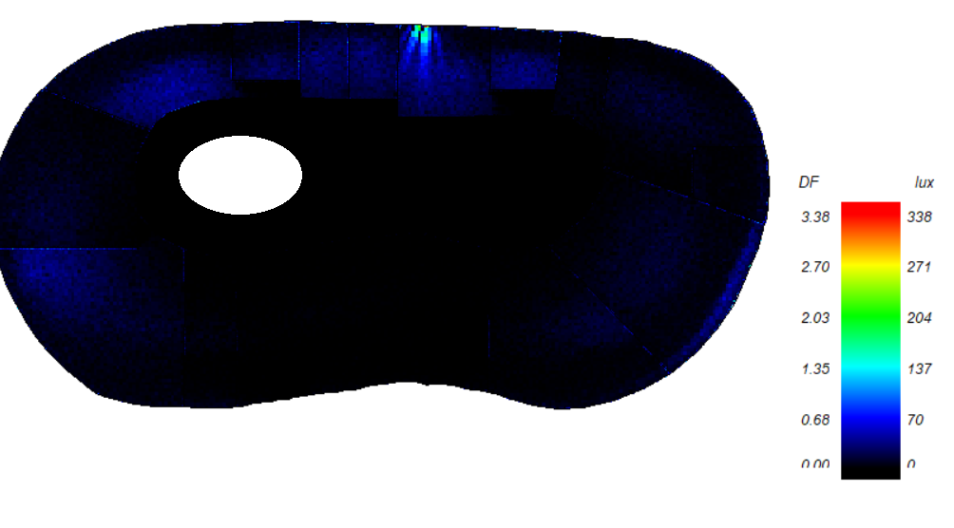
Daylight factor:
fourth floor (before)
fourth floor (after)

Slide 27
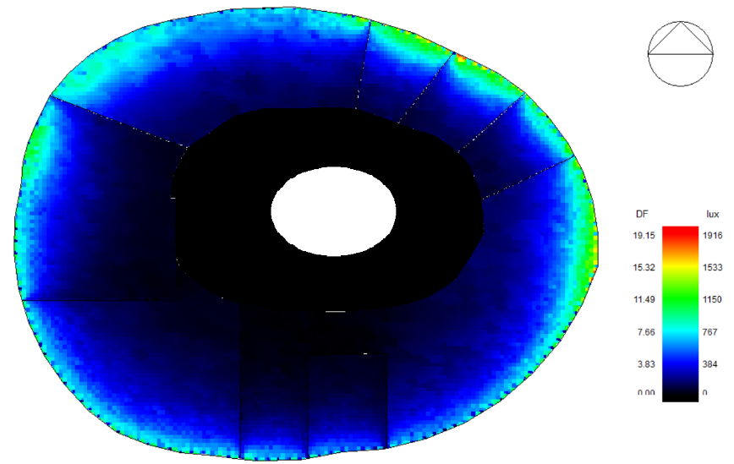



Daylight factor:
fifrth floor (before)
fifth floor (after)
sixth floor (before)
sixth floor (after)

Slide 28


Thermal comfort:
High PMV between (-0.7 to 0.7)
Number the of hours of discomfort is equivalent to 807.83

Slide 29
Structure aspects

Slide 30
Structure
Assumption
Structure system
Details
Martials Properties
ETABS check
Manual calculation
Seismic checks

Slide 31
Assumption:
loads:
Seismic load:
Live load =4.79 Kn/m²
seismic zone 2B(Z=0.2),
Live load of parking =6 Kn/m2
Soil profile: Sc
Superimposed load =2 Kn/m2
Ca=0.24
Wall load =18 Kn/m2
Cv=0.32
Wall load =3 Kn/m2
Important factor =1.00
Capacity load =220 Kn/m2
Vv=(0.175*Dead load)
R=5.5

Slide 32
Materials characteristics:
Fy=420 MPa
F⸍c=28 Mpa
Fcu=35 Mpa
Manual calculation:
Tow way ribbid thickness =350mm
Dead load =7.54 Kn/m2
Solid slab thickness =300mm

Slide 33



Structure System:

Slide 34


ETABS check
Compatibility check
Equilibrium check

Slide 35

Stress-strain check:
Columns:

Slide 36

Frame and beams :
Two-way slab:(Beam1):

Slide 37


Use ultimate load 1.2dead and 1.6 Live load: shown in the
Moment of slab with the beam for the frame area

Slide 38

Shear check:
Max shear from ETABS=73Kn/m
ØVc = .75/6 𝒙 √(f`c ) 𝒙 bw𝒙 d 𝒙1.1
ØVc = .75/6 𝒙 √(28 ) 𝒙200x320/1000 𝒙1.1 = 46.56 KN/rib → ØVc = 77.6 KN/m

Slide 39

Seismic checks:
Period check
Drift Check:
All ∆m in X, Y direction less than (∆story), so check is OK

Slide 40

Seismic checks:
modal participation mass ratio
Base shear check
Vx and Vy from ETABS greater than V manual calculated, so check its ok

Slide 41


Details
Columns:

Slide 42

Columns:
A check from Detailing the slanted column taken from the ETABS

Slide 43


Beam:

Slide 44


Shear wall:
cros _ section in SW 2
long section in SW 2 A-A

Slide 45
Slab:

Slide 46


Foundation
Raft footing

Slide 47

Sheet pile
Sheet pile

Slide 48


Stair

Slide 49



Ramp

Slide 50


Water tank :

Slide 51


alucobond

Slide 52
Electro-mechanical aspects:

Slide 53
Electro-mechanical aspects
Water supply
Drainage Design
Firefighting system
Artificial lighting
HVAC design
Acoustic
Electrical design

Slide 54
Acoustical
two component we should to take into consideration :
spaces we design by using insul and ease programs:
Architectural side
Electro- acoustic side
Meeting room
Component we was studied:
lobby
Reverpration time(RT60)
Sound transmission loss
Sound pressure level
Sound transmission class(STC)
Speech transmission index (STI)

Slide 55


Architectural side:
Reverberation time (RT60):
Lobby meeting room
The result is between 0.5-1
(within the standard so ok).
The result is between 0.4-0.6
(within the standard so ok).

Slide 56



External wall:
39 dB > 38 dB (standard), so it is ok.

Slide 57


Impact Insulation Class (IIC):
Internal wall:
45 dB > 38 dB (standard), so it is ok.
IIC (64)>52(standard), so it is ok.

Slide 58


Electro acoustic side (Load speaker design):
      Sound pressure level (SPL) :
Meeting room:
lobby:

Slide 59


lobby:
Meeting room:
All the value are more than 70 so its ok.

Slide 60


lobby:
Meeting room:
in this space the value approximately 0.6 so its status was good
In this space the value approximately 0.75 so its status was excellent

Slide 61



Water supply

Slide 62
Diameter design for pipes and calculation loss for each story
Dim | 1.5 | 1.25 | 1 | 0.75 | 0.5
loss/100" | 0.19 | 0.5 | 1.4 | 5.6 | 40
loss/eq. length | 0.057 | 0.15 | 0.42 | 1.68 | 12
Water tank design
60 liter /person needed in building
In building 370 person
There size of tank = 370*60 =22200 liter =22.2 m3
We used tank 2m3 Size.

Slide 63
Artificial lighting design :
Indoor lighting design:
Limitation:
All lighting element luminaires is LED with step control elements.
The daylight factor should be in between this ringing (1-5) present
Light Levels (Illuminance) for indoor area as levels of offices area standard.
The reflection percentage it’s for floor its 0.2, ceiling its 0.8 and wall its 0.7.

Slide 64



It debt :
The parameter for design this room is 500 lux min as standard.

Slide 65



Offices :
Reception
The parameter for design this room is 300 lux min as standard, uniformity =0.4

Slide 66




tellers
lobby:

Slide 67


lecture hall

Slide 68


-Lighting design for the basement

Slide 69



Firefighting system:
A sprinkler system was used in the lobby's and car parks, in addition to Fire hoses works on each floor and fire extinguishers inside the offices.
Automatic firefighting systems must be Connected with the automatic alarm system these systems work at the same time.

Slide 70

HVAC design
The system used for HVAC design is (VRF system)
Outdoor unit:
The Air stage company Catalog was used for
VRF .

Slide 71


Indoor unit :
Split unit:
Air stage company Catalog was used.
Cassette unit:
Air stage company Catalog was used.

Slide 72


Slide 73


Drainage

Slide 74


Rain water drainage

Slide 75

Water conservation
Number of days of storage = 4 days
The volume of water used for 4day= 8400 liter/ 1000 = 8.4 m3
The volume of rainwater collected in the tank = 200 m3

Slide 76

Electrical design
After designing wire for the worst case for each floor:

Slide 77

Electrical design

Slide 78



camera
low current

Slide 79

Photovoltaic design
Number of modules =189
System size =94500wp
94.5WP = 189708.75 KWH
The annual solar energy on the gross roof area is 189708.75 KWh/year, which mean that the coverage percentage equals 24%

Slide 80

2. Life cycle cost(discount):

Slide 81
Quantity surveying & Cost Estimate:
Base Model:

Slide 82




Lumion render:

Slide 83


Slide 84


