Slide 1


Smart Central Bus Station in Nablus
سماح طوباسي
ميسون عبدالقادر

Slide 2


OUTLINE
    Introduction
    Constraints
    Hardware Components
    Working of Station
    Working of Bus
    Future work

Slide 3
Introduction
Nablus Eastern Bus Station (NEBS).
Solving problems related to traffic congestion and the entry of unregistered cars or buses to the NEBS.
Knowing the number of passengers in each bus.
Enforcing the rules of the station
Passenger Application to get the information from station.

Slide 4
Constraints
Supplying power to the esp32, which has 2 types of voltages (3.3v and 5v).
The IR sensing distance.
The interference of IR sensors due to their presence next to each other.
Admin panel: there was no suitable physical interface that could be easily integrated into the project.

Slide 5
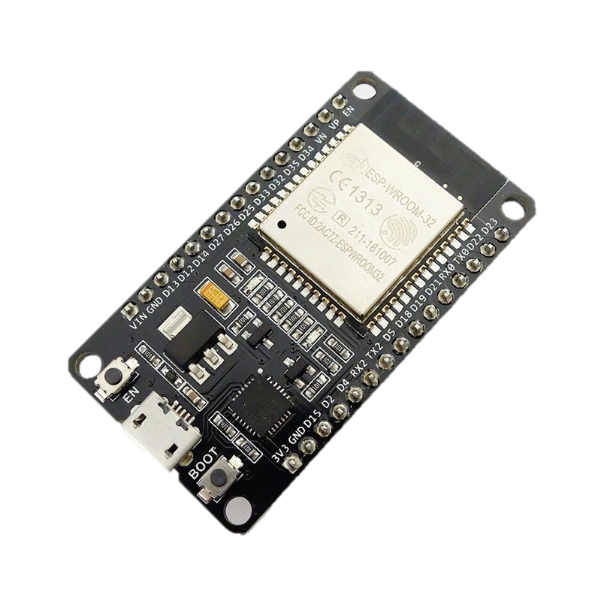
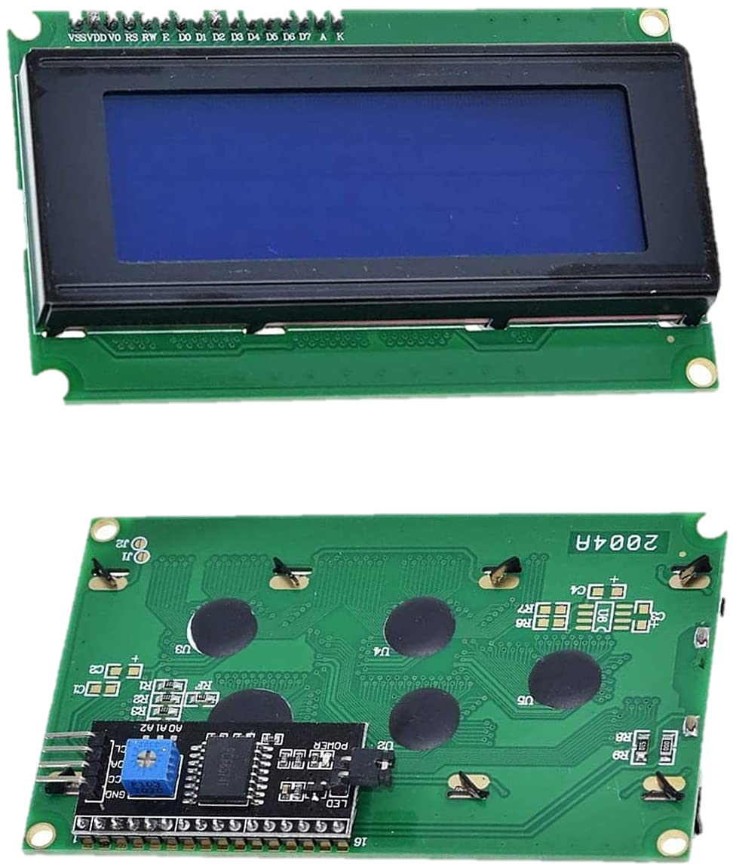
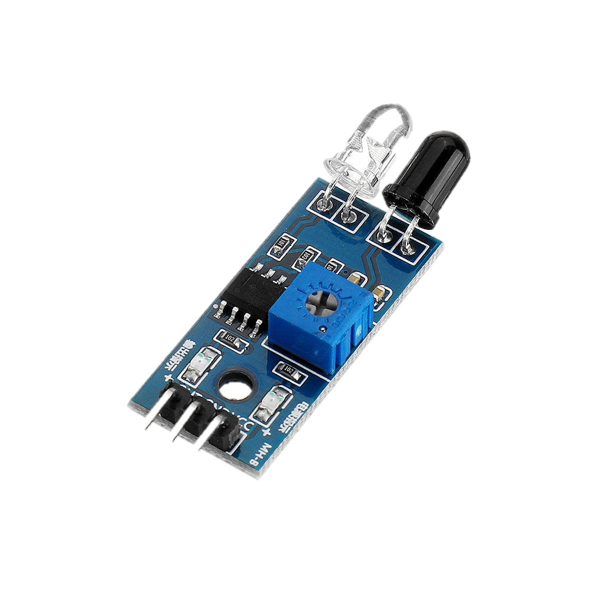
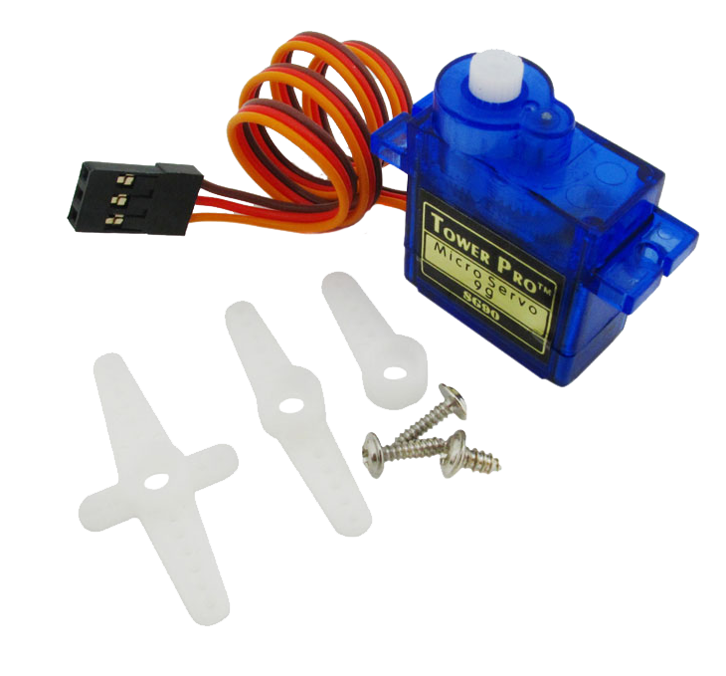
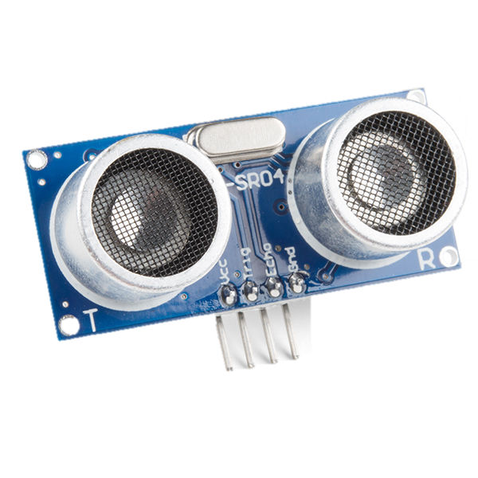
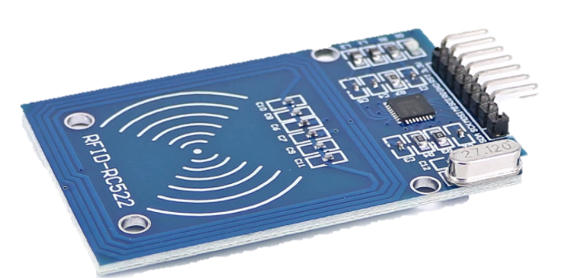
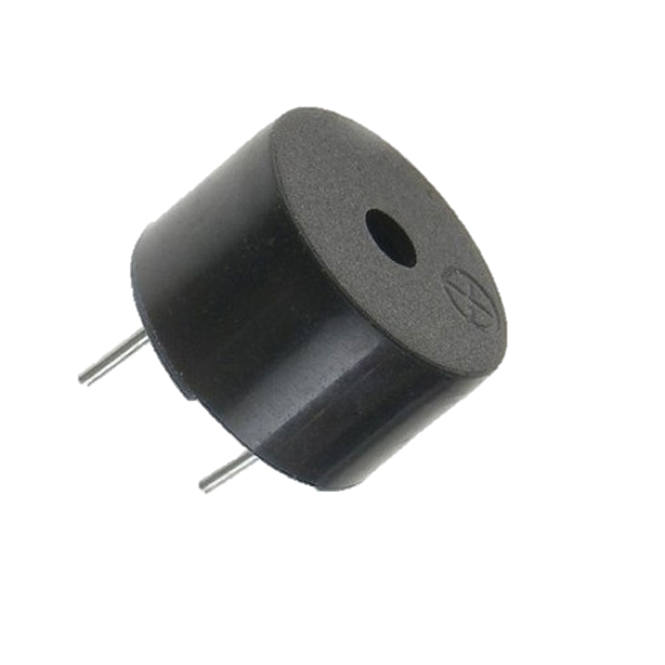
Hardware Components
ESP32
RC522 RFID reader
2 Servo Motor
2 IR Sensor
LCD 20X4 Display
Ultrasonic Distance Sensor
Mini Piezo Buzzer

Slide 6
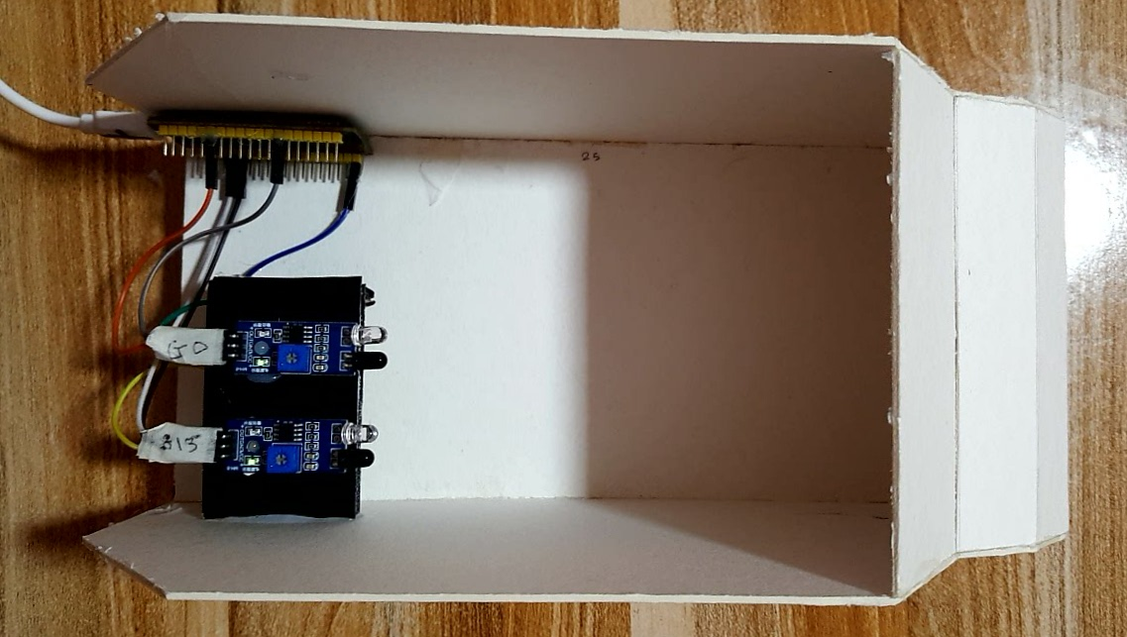
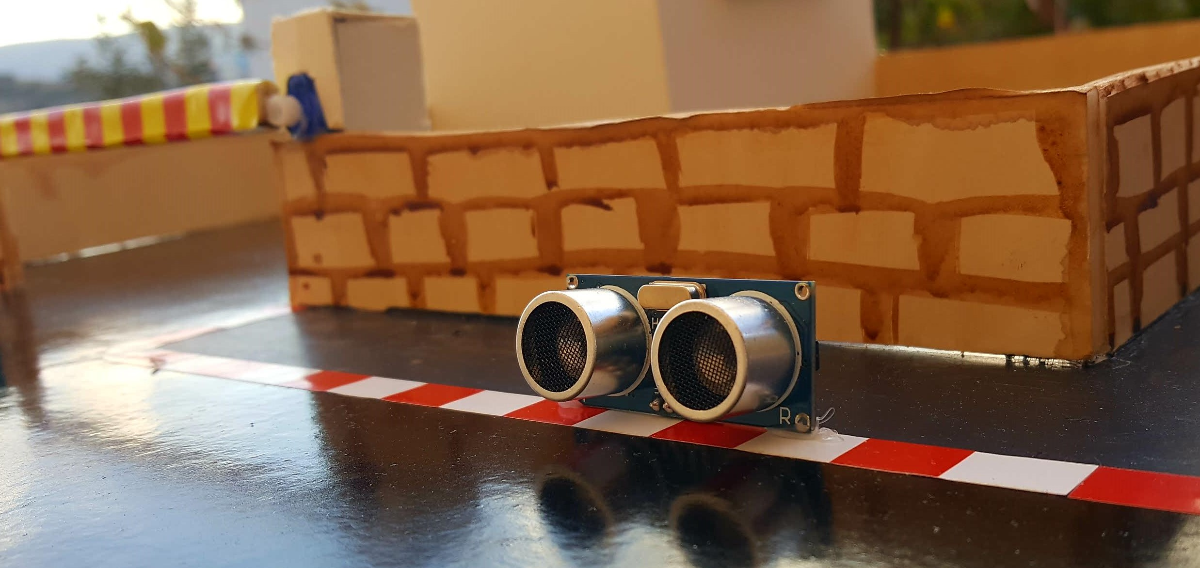
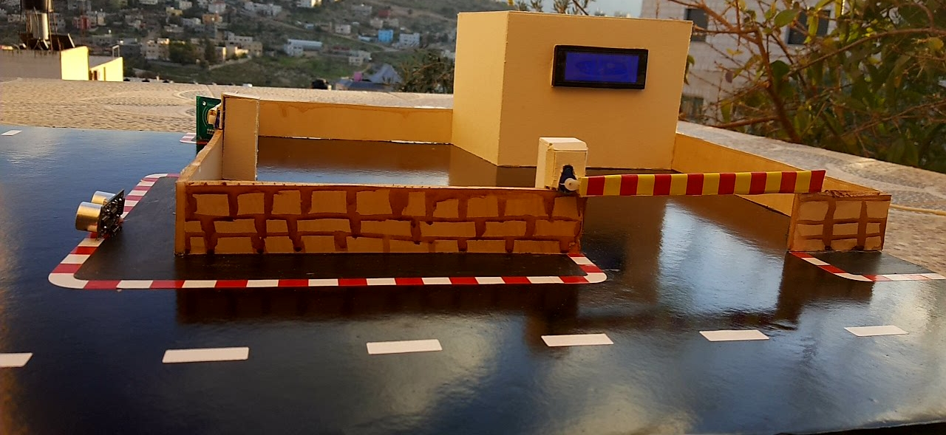
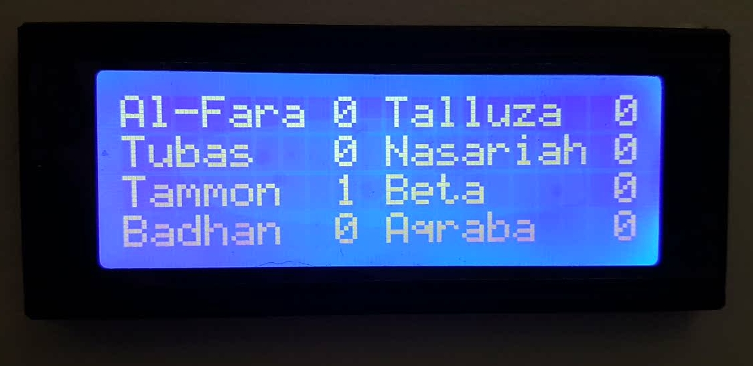

Slide 7
Working of the Station

Slide 8
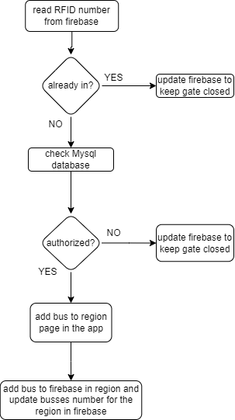
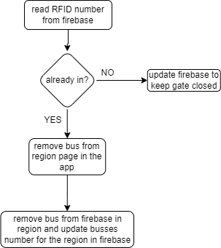
Working of the Entrance
Working of the Exit

Slide 9
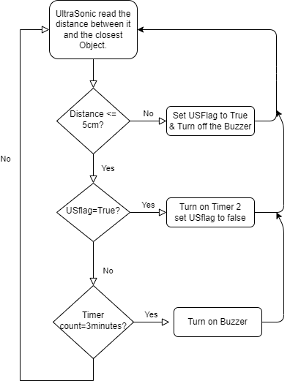
Working of the Ultrasonic

Slide 10
Working of the Bus

Slide 11
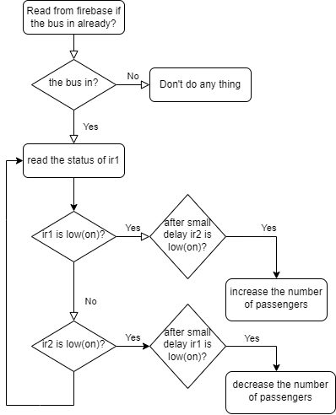

Slide 12
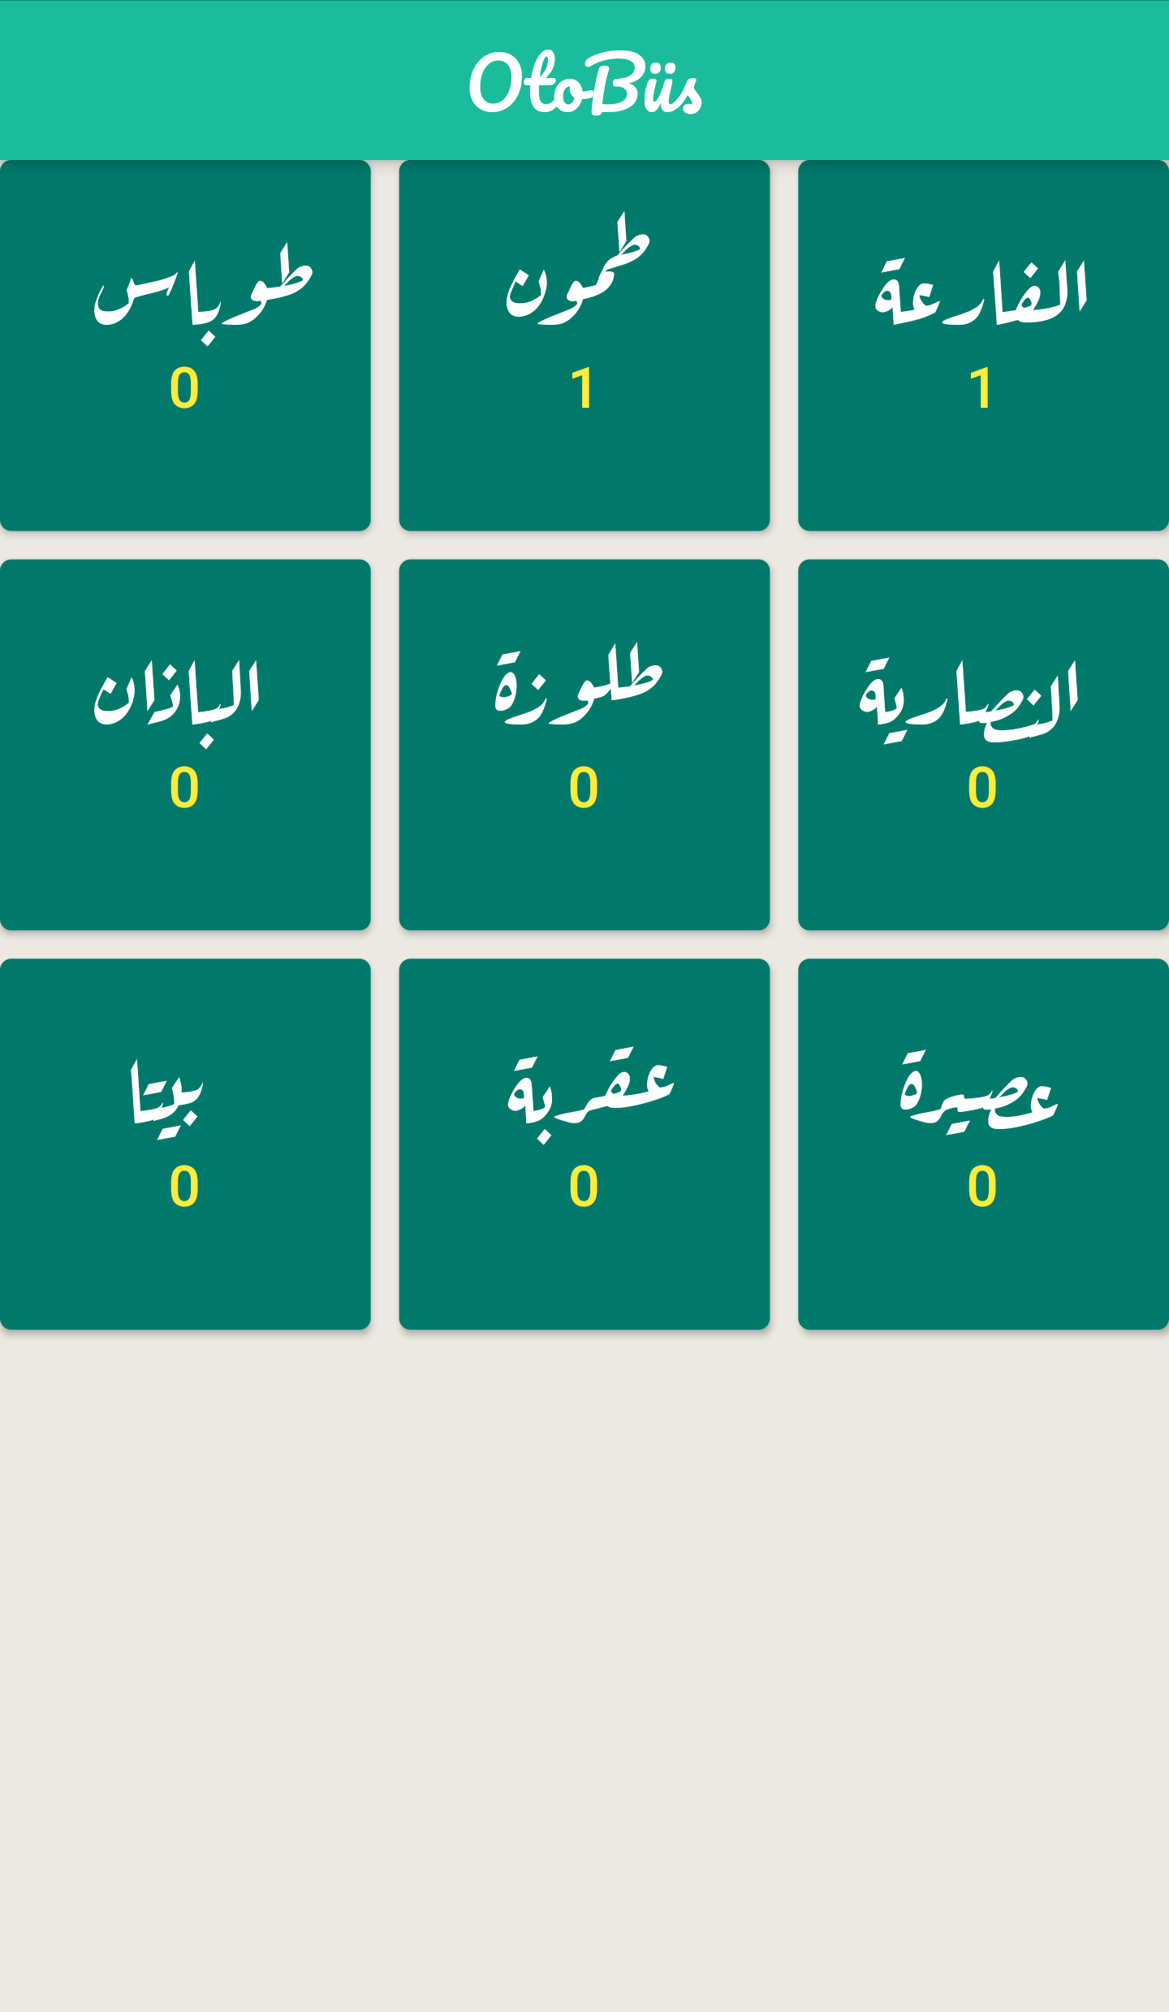

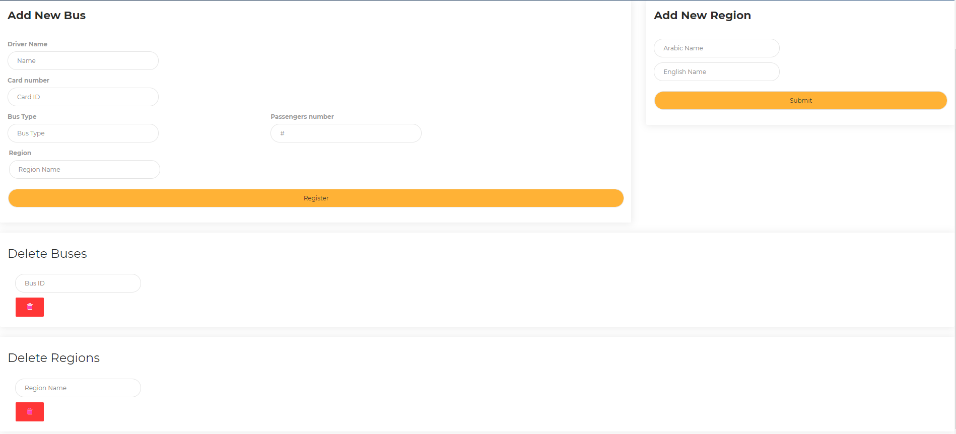
Passenger App
Admin website

Slide 13
Future work
Add umbrellas over stopping places that open if there is rain or a temperature rise above a certain value.
Add sensors at each stopping place of the station, if the bus that entered stops at a different stop from its region, a warning sound works and violates the driver.
Using camera and image processing to get the number of the bus and permission it to enter depending on it.

Slide 14
شكراً لحسن استماعكم

