Slide 1

An-Najah National University
Faculty of Engineering and Information Technology
جامعة النجاح الوطنية
كلية الهندسة
و تكنولوجيا المعلومات
Graduation Project Report II
Design Water Network for Qaryut Village and Cost Estimation
Prepared By:
Yousef Naser Braik- Reg. No: 11642545
Tasnim Jamal Odeh - Reg. No: 11541793
Leena Othman Ziadeh - Reg. No: 11612228
Mahmoud NaserBraik - Reg. No: 11642358
Under Supervision of:
Dr. Hamees Tubeileh

Slide 2
Contents
Introduction
Study Area
design of the water distribution network
cost estimate of the water distribution network
Discussion and Conclusion

Slide 3
Introduction
Water is one of the most important factors for life. Water covers about 70% of earth’s surface and the fresh water available is about 1.7% as surface and ground water sources.
One of civil engineering purpose is to transfer pure water from its resources to citizens .

Slide 4
Objective
Design Water Distribution Network (WDN) .
Quantity surveying and cost estimation .

Slide 5
Study Area
Location :
Qaryut village is located to the southeast of Nablus, 26 km to the northeast of the city of Ramallah and is surrounded by the villages of Talfit, Jaloud, Al-Sawiyah, Al-Laban Al-Sharqiya and Tirmus' Aya, in the middle of the West Bank .

Slide 6
Population
Total number of population in year 2017 is 2538
Water resources
Qaryat has two springs and private wells .

Slide 7
Climate
The mean annual maximum temperature is 24.4ºC . and mean annual minimum is 9.6ºC .

Slide 8
WDN Design

Slide 9

Population calculation

Slide 10
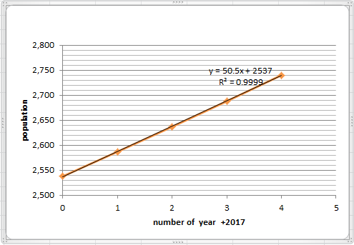
Population in each year
Population in 2035 = (50.5*18) + 2537
= 3446

Slide 11
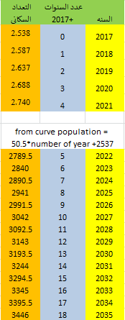
Population during 2017-2035

Slide 12
Design Parameters
The design period is 15 years until 2035
Maximum daily factor = 1.8
Minimum daily factor =0.27
Average daily Consumption =100L/C. d
Steel pipe with Hazen –Williams coefficient =140

Slide 13
Design constrains
Velocity = 0.3-3 m/s
Pressure = 20-100 m.H₂O
Minimum pipe diameter = 1 inch

Slide 14
Demand calculation
Demand = Consumption / (1-losses%)
Demand = 100/(1-0.15) = 117.64 L/C.d
Total demand = population * demand capita/day * daily factor *The period between each water infusion
3446 * 117.64 * 3 * 1.8 = 2190600 L/3day
= 2200 m³/3 day

Slide 15
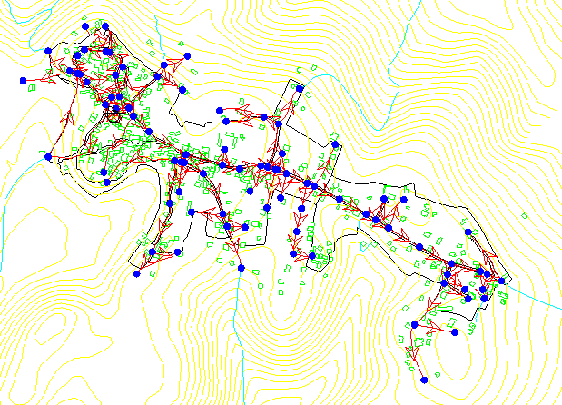
Network layout

Slide 16
RESULTS

Slide 17
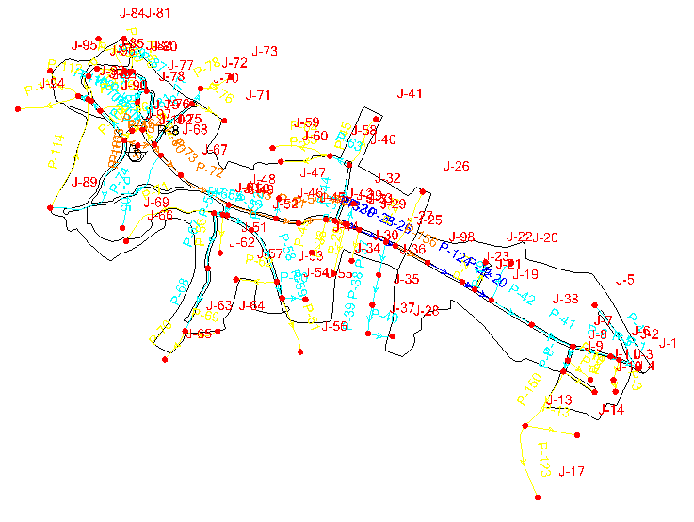
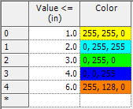
EPS Case Layout

Slide 18
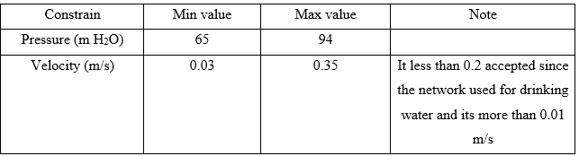
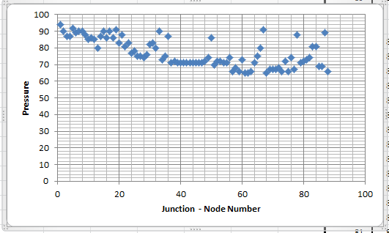
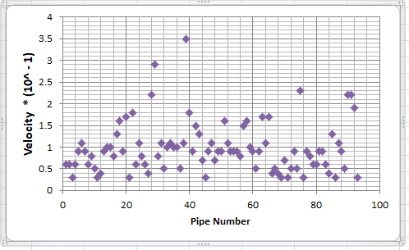
EPS ( 2 :00 AM )

Slide 19

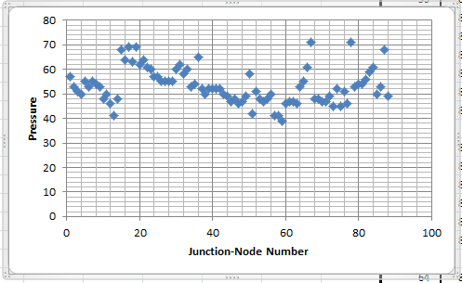
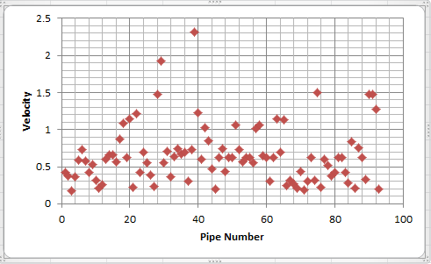
EPS ( 6:00 PM )

Slide 20
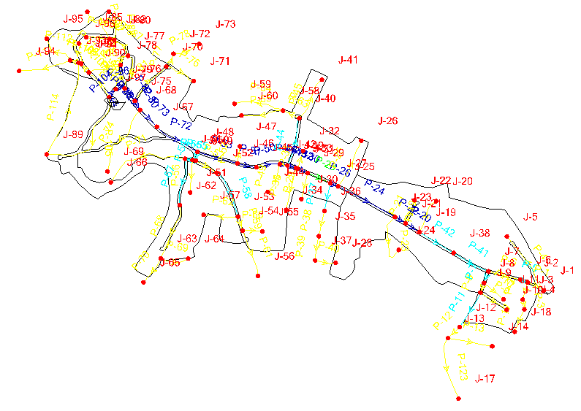
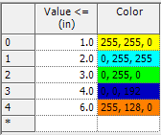
Steady Case Layout

Slide 21
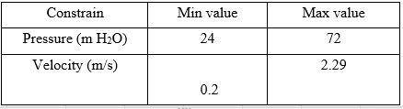
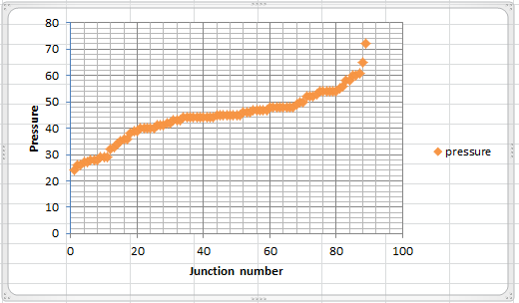
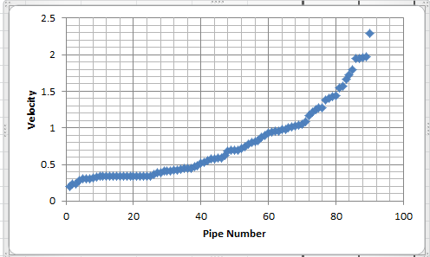
STEADY STATE

Slide 22

COST ESTIMATION

Slide 23
CUT
FILL
PIPES
RESERVOIR
TOTAL COST OF PROJECT

Slide 24
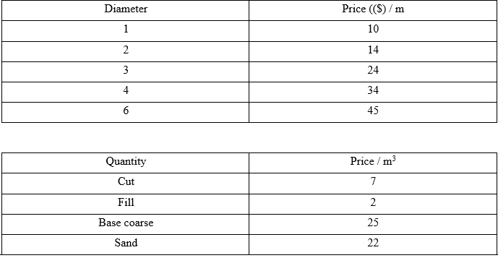
PRICES

Slide 25
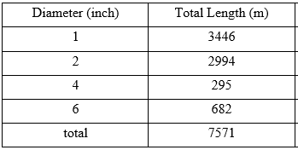
EPS

Slide 26
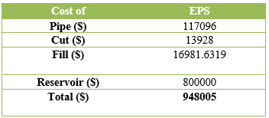
EPS CALCULATION

Slide 27
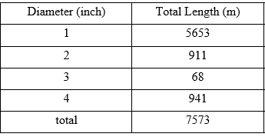
STEADY

Slide 28
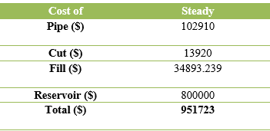
STEADY CALCULATION

Slide 29
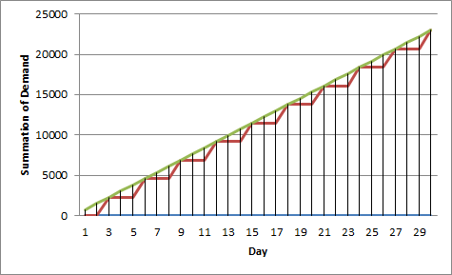
RESERVOIR
Reservoir is filled with water every two days and then emptied in the third day .
Demand in day 1 and 2 is Zero and the third day is 2300m³.

Slide 30
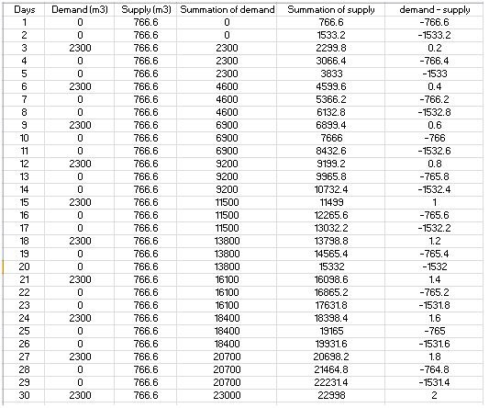
The maximum difference between demand and supply is 1531.6 m³ and this is the Reservoir size .
Reservoir Cost according to its size about 800000$

Slide 31
Discussion and Conclusion

Slide 32
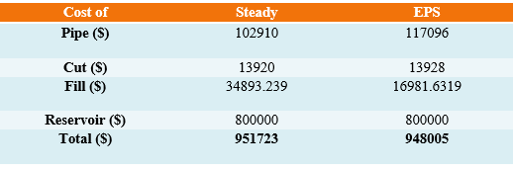
We designed the water distribution network in two cases , steady and EPS, where the number of junction is 97 and the number of pipes 126 .
The total cost of project after designing the network :

Slide 33


