Slide 1

The Potential of palm waste as a source of Renewable Energy:
A case study of Palestine
Supervisor Name: Dr. Adel Juaidi
Group Members: Anas Jarrar
Hamzah Nada
Hasan Totti

Slide 2

Presentation Content:
Introduction
Project Description
Methodology
Results And Analysis
Conclusion

Slide 3
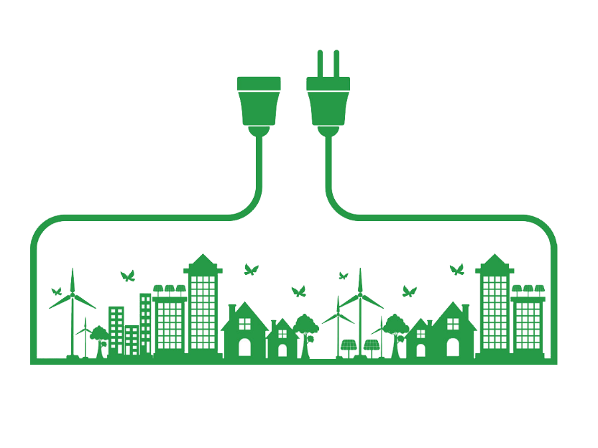
Introduction
Energy is defined as the ability to do work.
Energy Forms: electrical energy, thermal energy, chemical energy, nuclear energy, also potential and kinetic energies which are relative to each other.

Slide 4
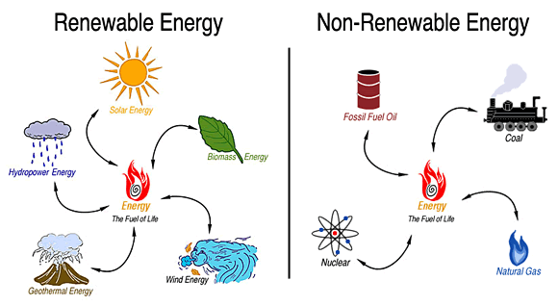
Renewable Energy & Non-Renewable Energy

Slide 5
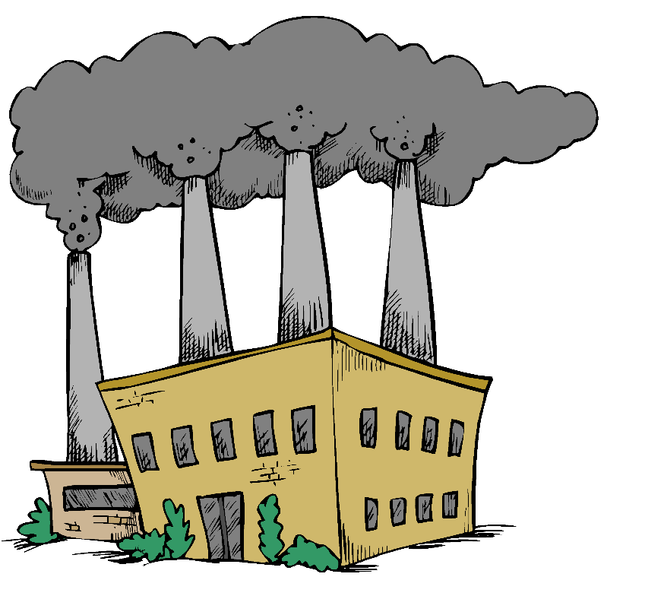

Energy in Palestine
Palestine is facing a huge demand on fossil fuel.
965,000 ton of oil consuming.
Enormous population growth.
Almost 5,277,193 of people.
Lack of fossil fuel sources.
Politic issues .

Slide 6
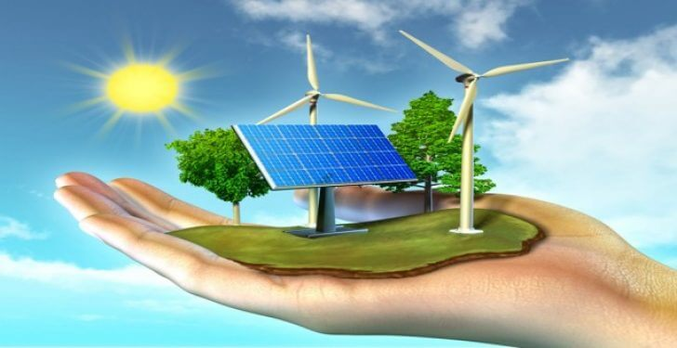
Renewable Energy in Palestine
11,187 TJ energy come from renewable sources .
Estimated as 11.7% of the total energy .
Solar energy supply is 120,000 MW .
Other green sources are very limited due to Israeli occupation .

Slide 7
Why palm waste specifically?!
Palm is considered Palestinian’s Gold.
It’s one of the pillars of the agricultural economy in Palestine.
Palm trees are widely planted in Palestine.
Almost 311,000 palm trees.
It’s waste biomass is an excellent source of energy.
It has a high content of volatile solids and a low percentage of moisture.

Slide 8
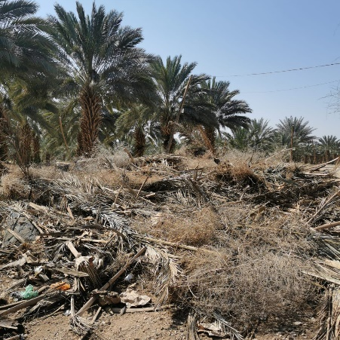
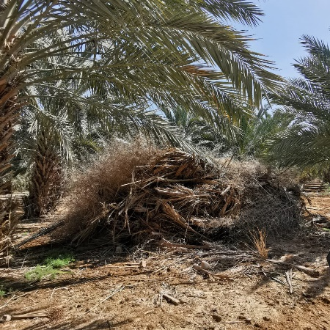
Why palm waste specifically?!
Every palm tree produce 15-20 kg of waste annually, 5,442,500 kg per year in total.
challenges and problems facing the Palestinian farmer in this cultivation.
source of energy from an economic and environmental point of view.

Slide 9
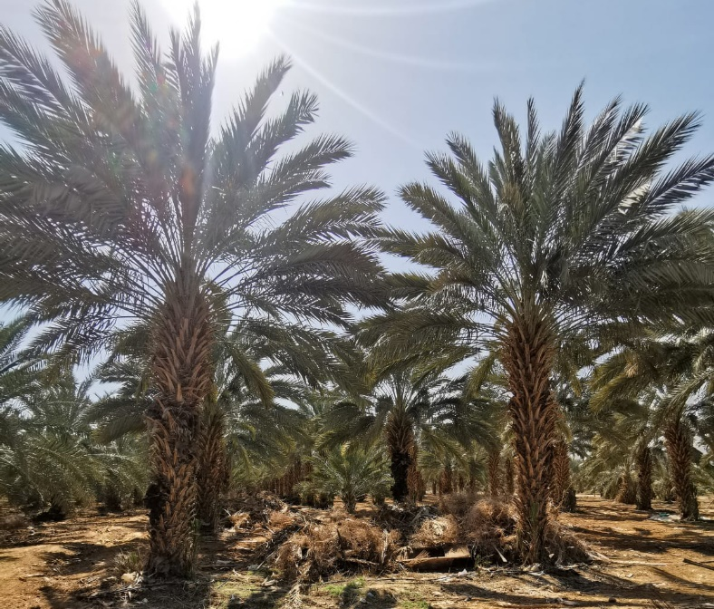
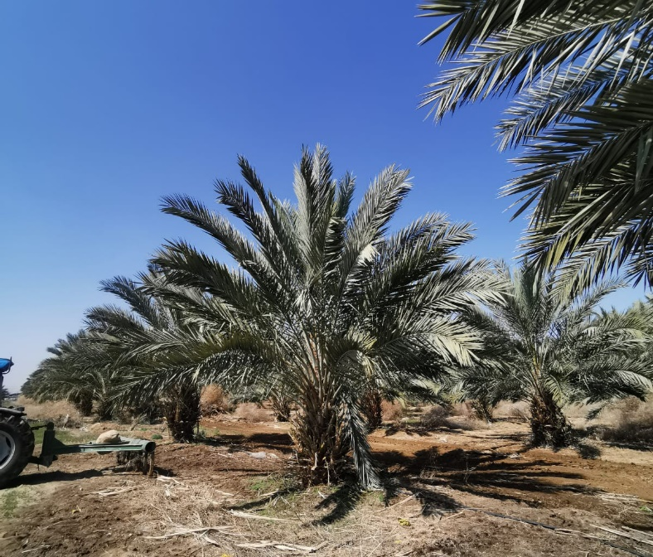
Project Description
The main objective of this project is to use the Palm Waste ( Bio-mass ) as a renewable energy source in Palestine.

Slide 10

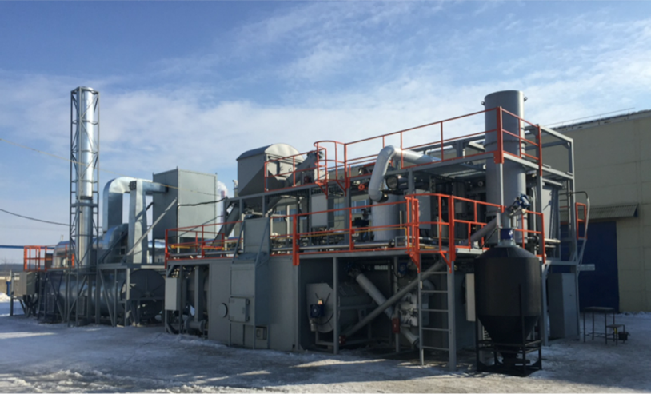
Converting Palm Waste To Energy
Fuel Types Of Palm Waste:
Palm waste can be converted into Bio-Fuel.
The resulting Bio-Fuel has three types, (Gas, Solid and liquid fuel).
Converting methods:
Pyrolysis
Gasification
Fermentation

Slide 11
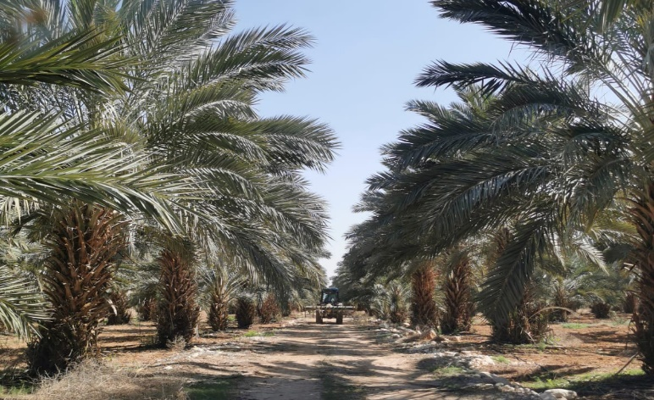
Methodology
Three visits to Jericho and the Jordan Valley have been done.
Palm trees farmers have been interviewed.
Questionnaire has been distributed to the farmers.

Slide 12
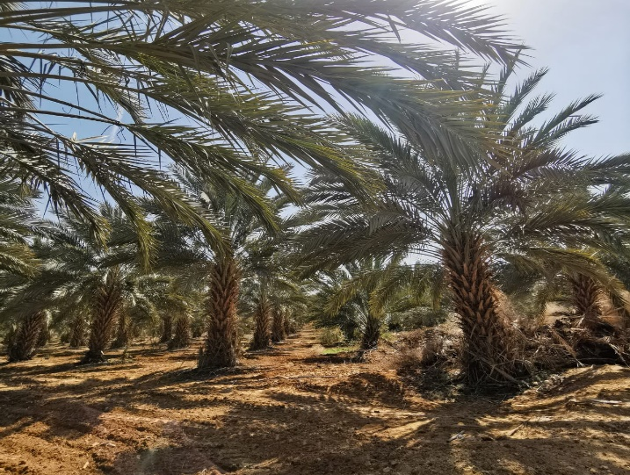
Methodology
General information was collected about palm trees, and the resulting palm wastes, in addition to the problems facing this cultivation.
The Questionnaire’s results have been studied and analyzed.

Slide 13
Results and analysis
After analyzing the questionnaire, the following results were obtained:
The number of trees in all the area covered by the questionnaire was 77,074 trees, equivalent to 24.78%.
There are three types of palm trees in the Jericho and Jordan Valley region are spread was as follows:
Majhool 95%
Barhi 2.5%
Alhayani 2.5%

Slide 14
Results and analysis
the water used for irrigation was distributed as follows:
fresh water 57.5%
salt water 42.5%
acidic water 0%
Type of waste generated from palm trees:
The fronds with their base and the kernel of dates 17.5%
Palm fronds 82.5%

Slide 15
Results and analysis
97.5% of the farmers confirmed that there are environmental damages resulting from the accumulation of this waste.
61.53% of the farmers use burning as the disposal method.
23.07% of the farmers throw the waste and accumulate them in areas close to crops.
15.3% farmers who use machines dedicated to shredding and cutting this waste and use it as animal feed.

Slide 16
Conclusion
Finding a new source of renewable energy in Palestine.
Solving the problems and challenges facing palm farmers.
Increase in the percentage of palm trees.
The pyrolysis technology produces 60-70% of liquid biofuels, 15-25% of coal and 10-20% of gases.
Contribute to solving these problems from an environmental point of view and not confining them to the economic side.

Slide 17
Any Questions?
THANKS!

