Slide 1
Blind Gadget Assistant
Ahmad Mansour
Mahdi Barham

Slide 2
Problem
Visual impairment is a common problem that plagues society. The number of visually impaired people is increasing every year.
While there is constant research to cure visual impairment. Solutions haven’t been implemented to solve it from the roots.

Slide 3
Objectives
Our goal is to make a system that can help the visually impaired detect nearby obstacles and help them get an idea of their general surroundings.
To do this we will have 2 separate components:
Handheld gadget
Checkpoint station

Slide 4
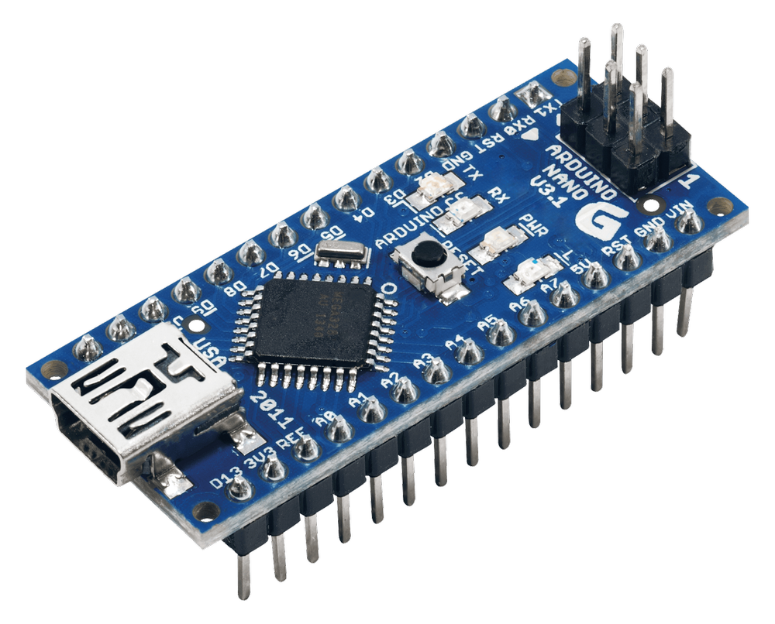
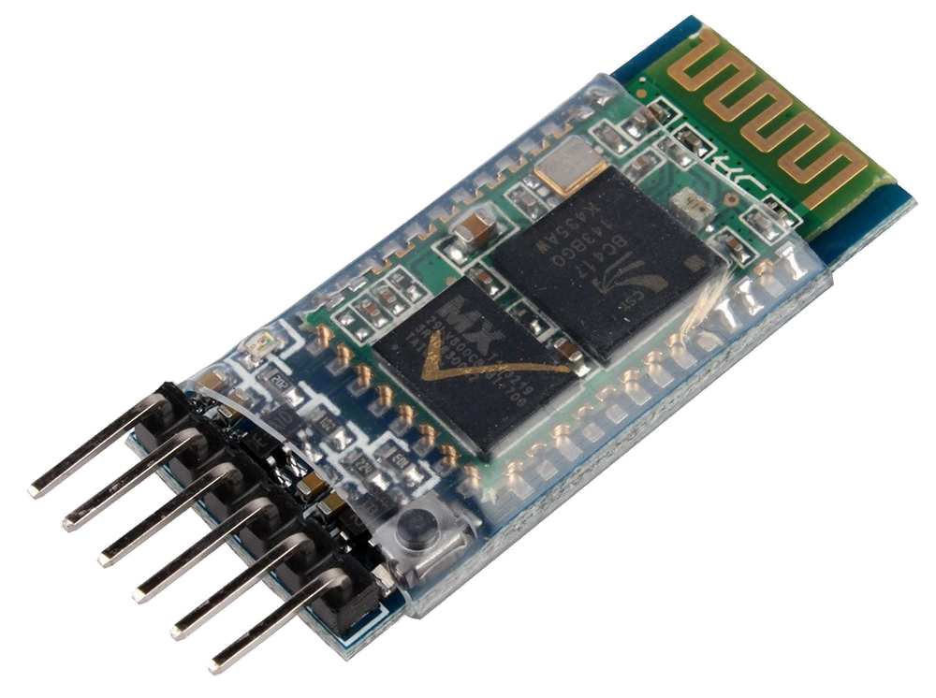
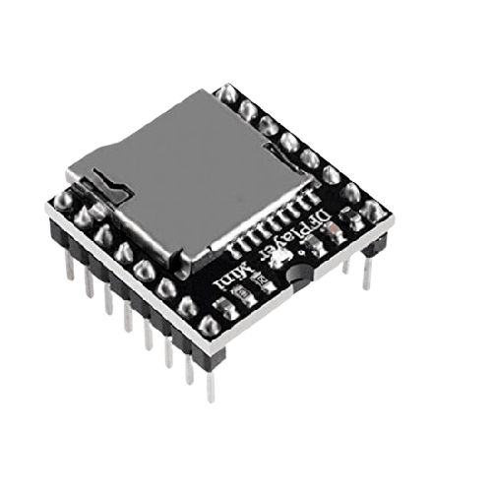
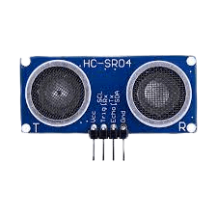
Handheld Gadget
The gadget consists of:
Arduino Nano
Ultrasonic sensor
Buzzer
Mp3 DF-Player
Speaker
Bluetooth module

Slide 5
Gadget Features
The gadget’s main features are:
Obstacle detection over short distances
Play Audio files

Slide 6
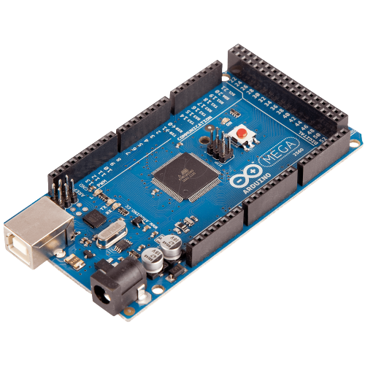
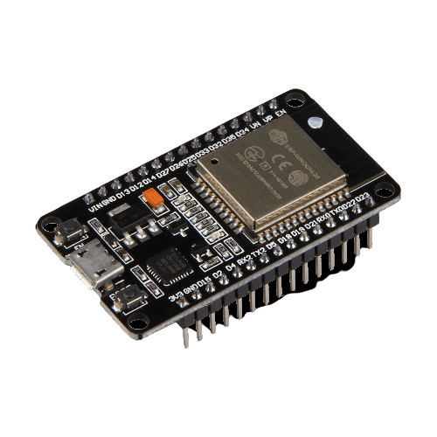
Checkpoint Station
Station components:
Arduino Mega
Bluetooth module
ESP32

Slide 7
Station features
The station’s main features are:
Send audio file name to gadget upon bluetooth connection.
Monitoring by sending logs using ESP32

Slide 8
Workflow
The workflow is as follows:
User uses the gadget for obstacle detection as he moves through stations.
Upon getting in-range of a station, the gadget connects with bluetooth.
Upon bluetooth connection, the station sends the audio file name to the gadget.
The gadget plays the corresponding audio file.

Slide 9
Thank You

