Slide 1
Protection and Simulation of 3ph induction motor in Matlab with Direct and Soft starting methods
By
Eng Mohanad Hamad
Eng Majdy Jadallah
Eng Oday Radwan
Supervisor
Dr.Falah Hasan

Slide 2
Overview
General overview about induction motor and existing problems .
Aims and Objectives.
3ph induction motor structure.
Power flow diagram.
Methods of starting induction motors
principle of operation.
Simulating and starting the 3ph induction motor in Matlab.
Hardware procedure
Results.
Comparison between results
Conclusions.

Slide 3
General overview about induction motor
Asynchronous machines are considered nowadays the most commonly used electrical machines, which are mainly used as electrical induction motors and sometimes as generators. This is mainly due to the simplicity of composition, low price, light weight, high reliability, easy to command and control performance and not containing parts that could easily breakdown compared with DC machines and synchronous machines.
Starting the induction motor is the most important and dangerous step, where the motor properties play a major role in the evaluation of all electrical motors, and these properties are defined by the following factors:

Slide 4
Starting torque
Starting current
Transient state
Smoothness of the starting
Simplicity and economics of starting

Slide 5
Existing problems
In this study, a couple of methods of starting three-phase motors will be discussed and compared through curves of currents, torque, speed, efficiency and power factor. These methods are Direct and Soft starting. The discussion will be based on a Matlab simulation of different loading cases of the induction motor. The induction motor model is created according to a group of standard equations (current, voltage, power, efficiency, speed and values developed and edited in the laboratory.

Slide 6
Aims and Objectives
. Mainly, this project aims to protect three phase induction motor by decreasing starting current through SCR or IGBT ,therefor we keep it from fault as possible.

Slide 7
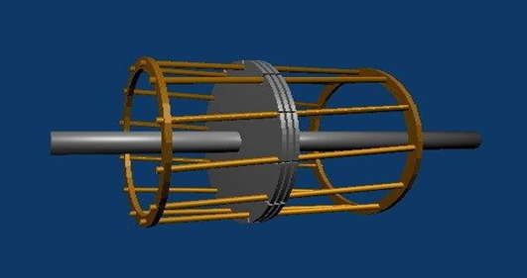
3ph induction motor structure.
A. Stator
B. Rotor
Rotors are sorted in terms of the type of its coils into two types:
B.1.Squirrel cage Rotor

Slide 8
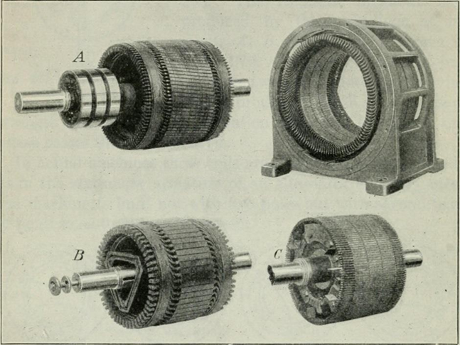
B.2.Slip Ring Rotor
C.Air-Gap

Slide 9
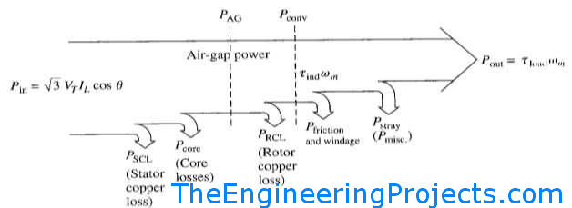
Power flow diagram

Slide 10
Methods of starting induction motors
Direct-On-Line (DOL) Starters
Soft starter by using SCR or mosfet
Starting Of Squirrel Cage Motors
By using primary resistors
Autotransformer
Star-delta switches

Slide 11
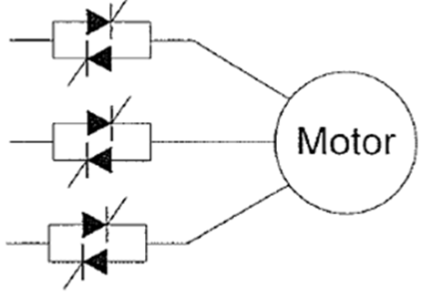
principle of operation.
In this project,we apply the soft starting by controlling the voltage applied in stator winding through using six back to back SCR through firing angle (alpha).

Slide 12
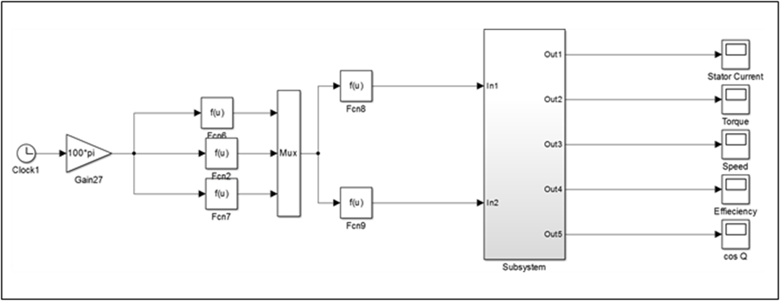
Simulating and starting the 3ph induction motor in Matlab.

Slide 13
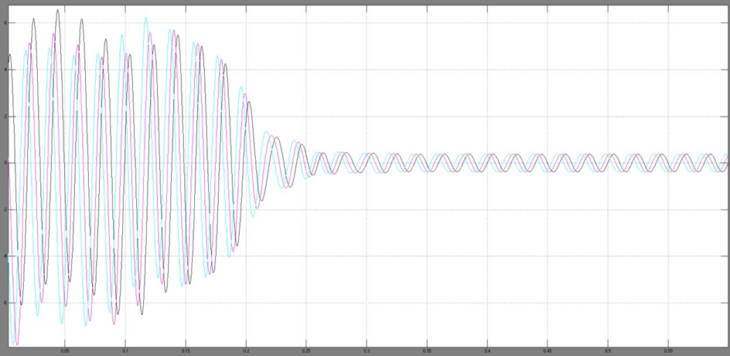
Direct starting method
Starting currents curves in the No-load case

Slide 14
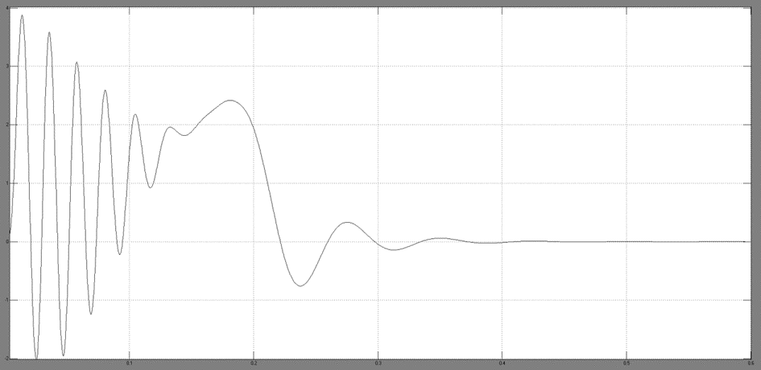
Starting torque curve in the No-load case

Slide 15
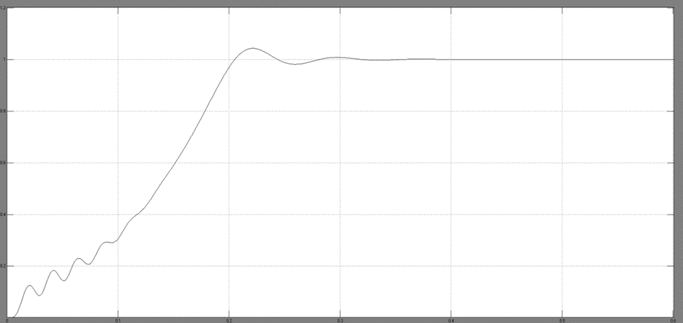
Starting speed curve in the No-load case

Slide 16
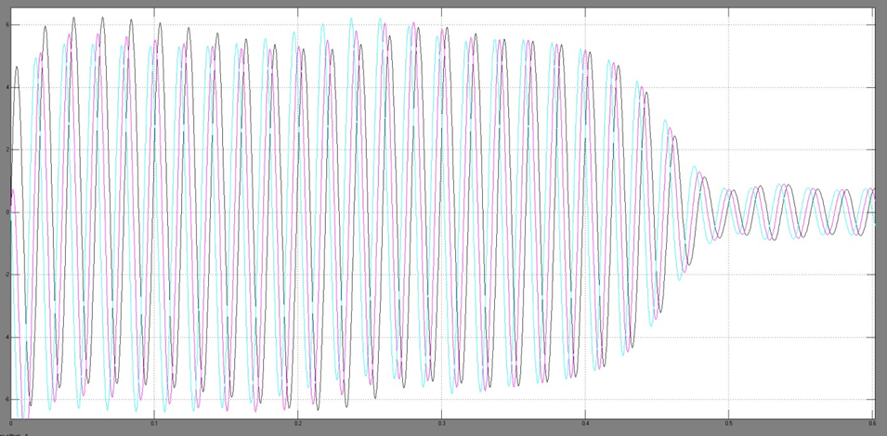
Direct starting curves in the 75% of nominal load case:
Starting currents curves in 75% of the nominal load case

Slide 17
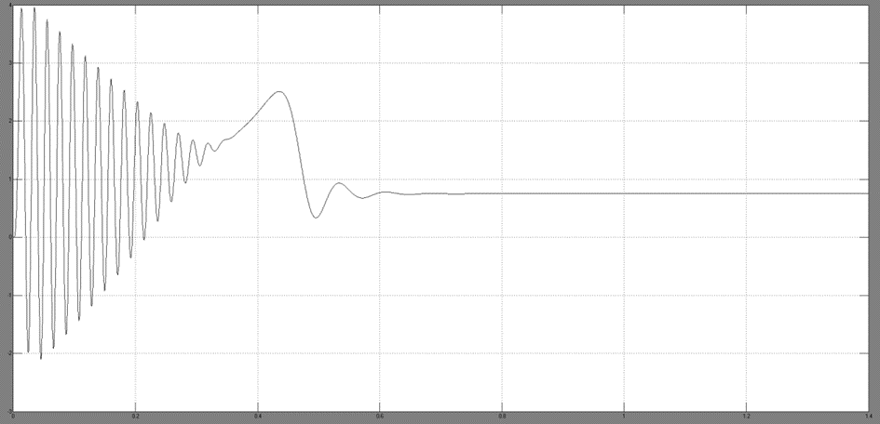
Starting torque curve in 75% of the nominal load case

Slide 18
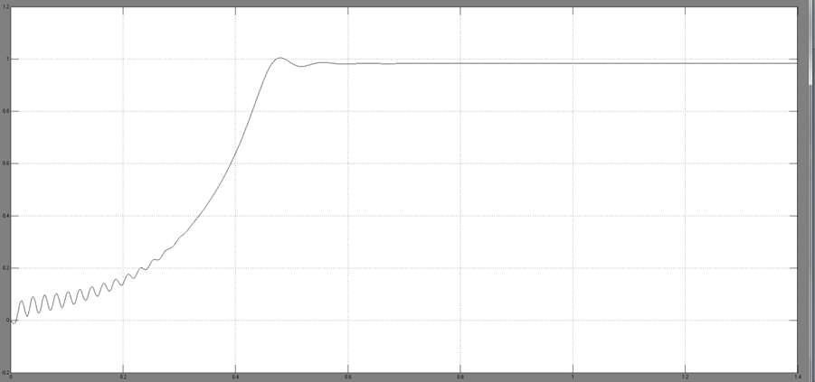
Speed curve in 75% of the nominal

Slide 19
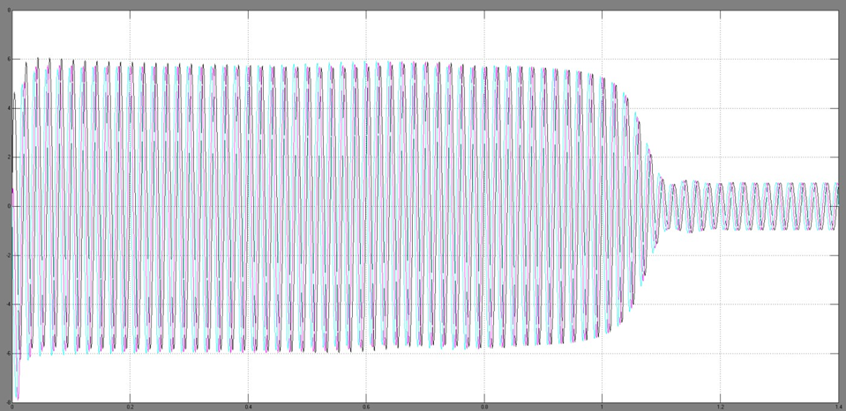
Direct starting curves in the nominal load case:
Starting currents curves in the nominal load case

Slide 20
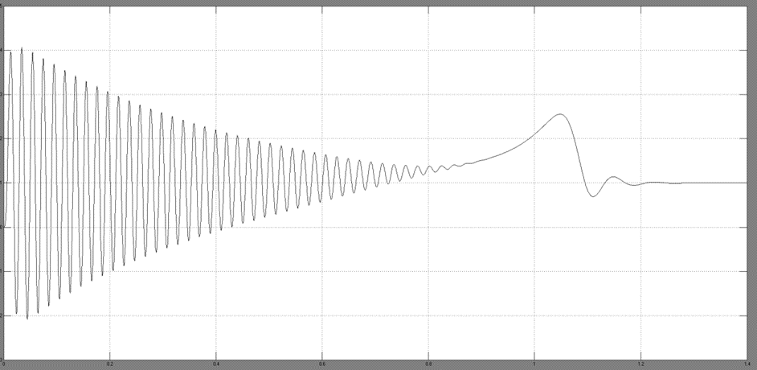
Starting torque curve in the nominal load case

Slide 21
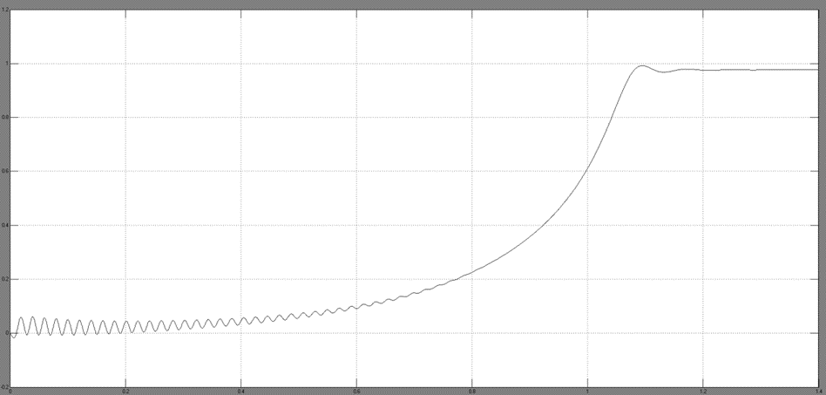
Speed curve in the nominal load case

Slide 22
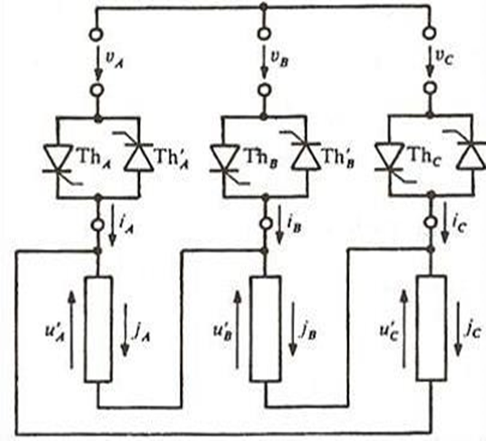
Soft staring method:

Slide 23
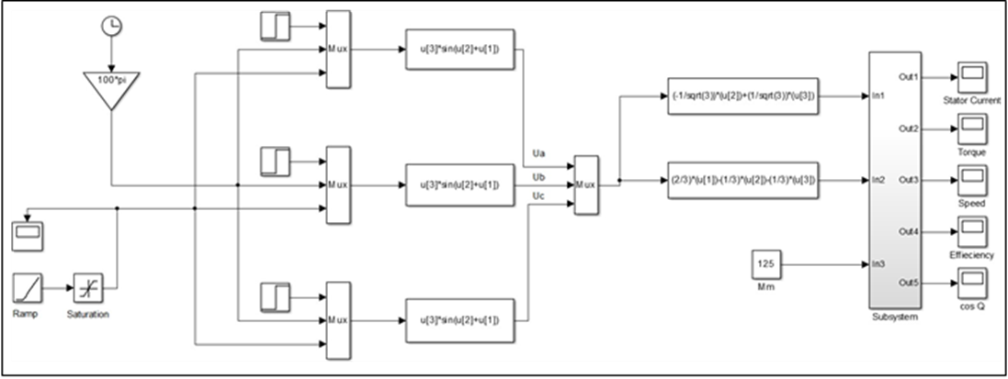
Block diagram for the induction motor model in the Soft starting case

Slide 24
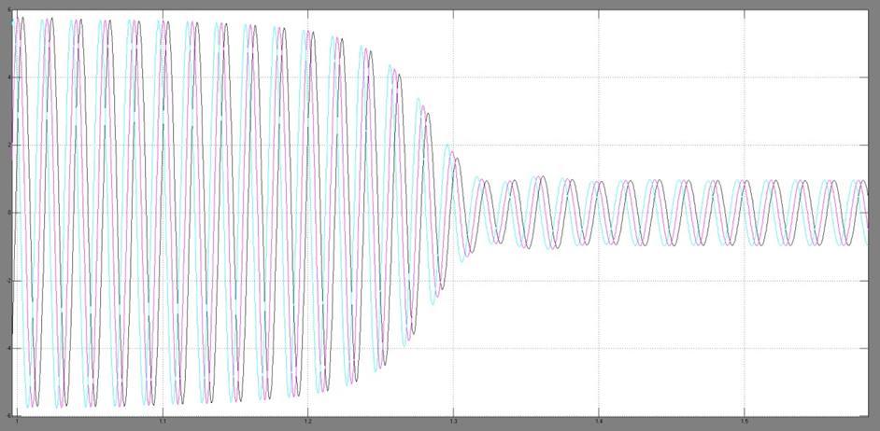
Soft starting curves in the nominal load case:
Starting currents curves in the Soft starting nominal load case

Slide 25
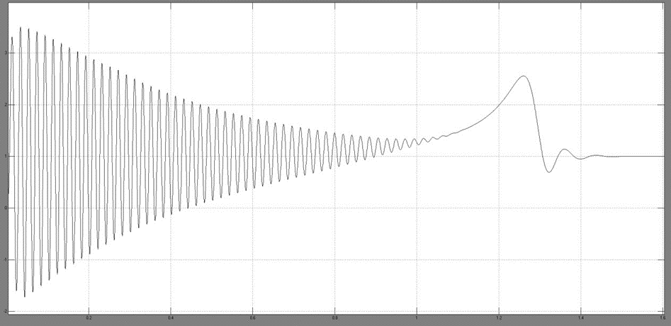
Torque curve in the Soft starting nominal load case

Slide 26
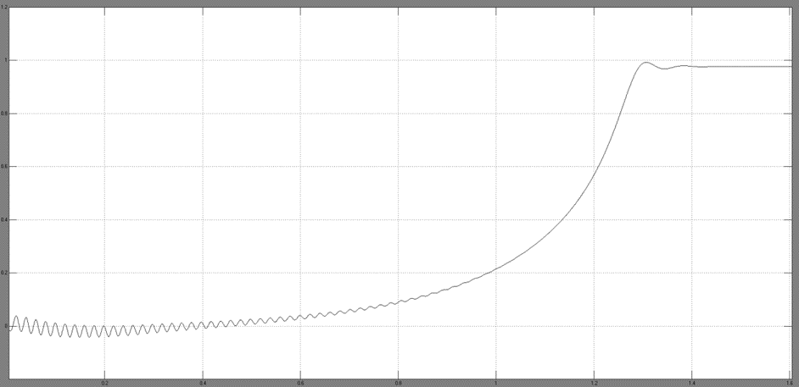
Speed curve in the Soft starting nominal load case

Slide 27
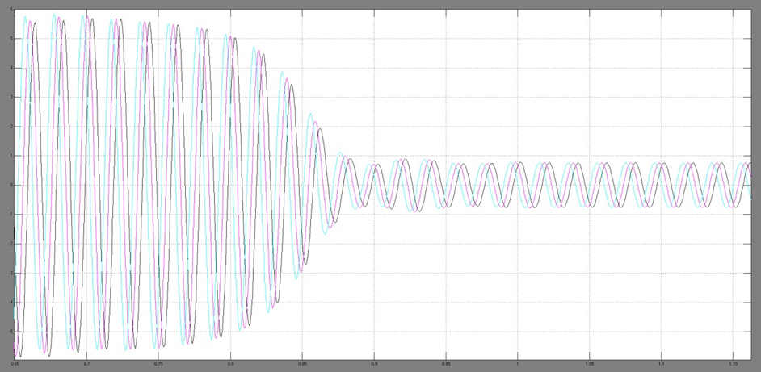
Soft starting curves in the 75% of nominal load case:
Starting currents curves in the Soft starting 75% nominal load case

Slide 28
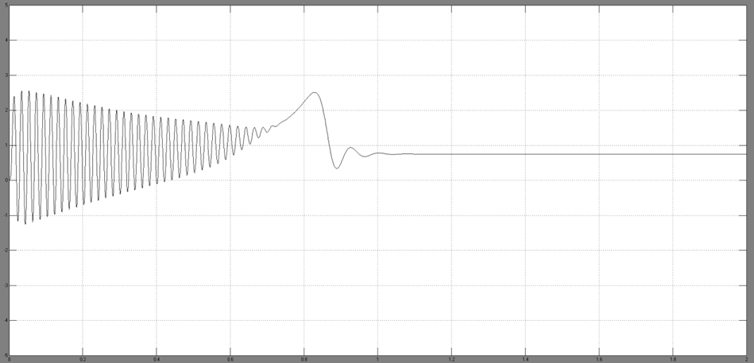
Torque curve in the Soft starting 75% nominal load case

Slide 29
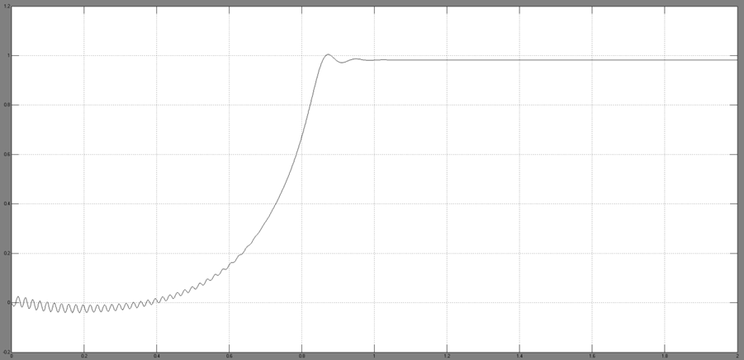
Speed curve in the Soft starting 75% nominal load case

Slide 30
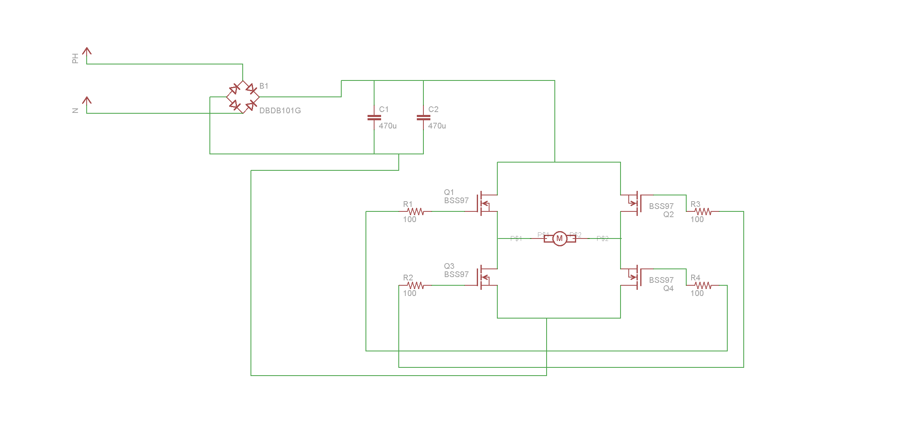
Hardware procedure
Circuit digrame:

Slide 31
-Componenets:
1-Rectifire bridge
2-Two capacitors (400volt,470microfarad)
3-Mosfet(20amp)
4-four resister (100ohm)
5-single phase induction motor (pump)(0.5hp)
6-Aurduino dueo with DAC

Slide 32
Code for generate sinusoidal wave:
static int sinTable[120]=
{
0x7ff, 0x86a, 0x8d5, 0x93f, 0x9a9, 0xa11, 0xa78, 0xadd, 0xb40, 0xba1,
0xbff, 0xc5a, 0xcb2, 0xd08, 0xd59, 0xda7, 0xdf1, 0xe36, 0xe77, 0xeb4,
0xeec, 0xf1f, 0xf4d, 0xf77, 0xf9a, 0xfb9, 0xfd2, 0xfe5, 0xff3, 0xffc,
0xfff, 0xffc, 0xff3, 0xfe5, 0xfd2, 0xfb9, 0xf9a, 0xf77, 0xf4d, 0xf1f,
0xeec, 0xeb4, 0xe77, 0xe36, 0xdf1, 0xda7, 0xd59, 0xd08, 0xcb2, 0xc5a,
0xbff, 0xba1, 0xb40, 0xadd, 0xa78, 0xa11, 0x9a9, 0x93f, 0x8d5, 0x86a,
0x7ff, 0x794, 0x729, 0x6bf, 0x655, 0x5ed, 0x586, 0x521, 0x4be, 0x45d,
0x3ff, 0x3a4, 0x34c, 0x2f6, 0x2a5, 0x257, 0x20d, 0x1c8, 0x187, 0x14a,
0x112, 0xdf, 0xb1, 0x87, 0x64, 0x45, 0x2c, 0x19, 0xb, 0x2,
0x0, 0x2, 0xb, 0x19, 0x2c, 0x45, 0x64, 0x87, 0xb1, 0xdf,
0x112, 0x14a, 0x187, 0x1c8, 0x20d, 0x257, 0x2a5, 0x2f6, 0x34c, 0x3a4,
0x3ff, 0x45d, 0x4be, 0x521, 0x586, 0x5ed, 0x655, 0x6bf, 0x729, 0x794
};
int i = 0;
int step1k=1; // 1 ms for 1000Hz
long nxt_time;

Slide 33
void setup()
{
analogWriteResolution(12); // set the analog output resolution to 12 bit (4096 levels)
}
void loop()
{
int AV = analogRead(A0);
step1k=AV;
analogWrite(DAC0, sinTable[i]);
analogWrite(DAC1, sinTable[i+60]);
i++;
if(i == 120)
i = 0;
while (micros()<nxt_time); // Hold the sample value for the sample time
nxt_time=micros()+step1k;
}

Slide 35
Results.
Direct starting method
No load case:
75% of nominal load case:
Ist (pu) | Tst) pu) | Transient (s)
6.3 | 3.8 | 0.4
Ist (pu) | Tst (pu) | Transient (s)
6.1 | 3.95 | 0.6

Slide 36
Direct starting method
Nominal load:
Ist (pu) | Tst (pu) | Transient (s)
6 | 4.1 | 1.2

Slide 37
Soft staring method:
nominal load case:
Soft starting 75% nominal load case
Ist (pu) | Tst (pu) | Transient (s)
3.55 | 3.45 | 1.45
Ist (pu) | Tst (pu) | Transient (s)
2.45 | 2.6 | 1.15

Slide 38
Comparison between results:
Nominal load | 75% of nominal load case | Case / load
6 | 6.1 | Direct starting (Ist)
3.55 | 2.45 | Soft starting (Ist)

Slide 40
Conclusions
The previous results showed that the Direct starting method requires a large starting current which causes a disturbance to voltages on the supply lines. In other words, the large starting current produces a severe voltage drop which affects the operation of other equipment. Other than that, it is a quite good method because it provides a large starting torque in a short transient state, without the need of external equipment to help starting the motor. The previous features make the Direct starting method the most common one to start a 3ph induction motor.

Slide 41
The Soft starting method requires a reasonable starting current to generate a small starting torque at a long transient state, not to mention the need of external thyristor voltage regulator which means extra costs. On the other hand, it provides a smooth startup without any jerks along with a controlled flawless acceleration. These features give the Soft starting method a reliable accuracy with less current needed at the expense of stationarity delay and external equipment charges.

Slide 42

ة1ة
ب 1ة ة1

