Slide 1

Water and Gas Leakage Detection Using Sensor
Presented by:
Dr. Falah Mohammed

Slide 2
Overview :
overview of gas and water leakage problem
Proposed System
Simulation and Results
Conclusions and Recommendations

Slide 3
overview of gas and water leakage problem
There can be no life on earth without water , The idea is the same for gas, it is very essential for people life, as it touch nearly every aspect of our life every single day.
The leakage is a major problem that faces underground water and gas distribution systems.
water leakage occurs for many reasons : technical and nontechnical leakage.
Gas leaks in the home are usually the result of poorly fitted, badly maintained or faulty appliances.

Slide 4
overview of gas and water leakage problem
there are various ways to detect gas leakage, one of them infrared thermal imaging the other one monitoring system and wireless gas sensor network.
There are many ways to detect water leaks using various leak detection techniques such as acoustic emission (AE) and test, pressure and infrared sensors, tracer gas detection, thermal imaging, Flow liquid meter sensor .
Benefits of Leak Detection and Repair
What are the dangers of gas leaks?

Slide 5

Methodology :
The idea of our project is to create a highly useful home application (Gas & Water Leakage Detector using Arduino and GSM Module with SMS Alert and Sound Alarm).
Our system contains water and gas sensors to detect leakage, Arduino Uno, GSM module and Sound Alarm.
Arduino Uno : The Arduino Uno might be a microcontroller board supported the ATmega328 (datasheet).

Slide 6
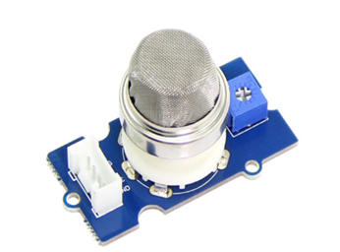
Methodology :
Gas Sensor :
Gas sensor Specifications
Item | Parameter | Min | Typical | Max | Unit
VCC | Working Voltage | 4.9 | 5 | 5.1 | V
PH | Heating consumption | 0.5 | - | 800 | mW
RL | Load resistance | - | Adjustable
RH | Heater resistance | - | 31±10% |  | Ω
Rs | Sensing Resistance | 10 |  | 60 | K Ω
Scope | Detecting Concentration | 200 |  | 10000 | ppm

Slide 7
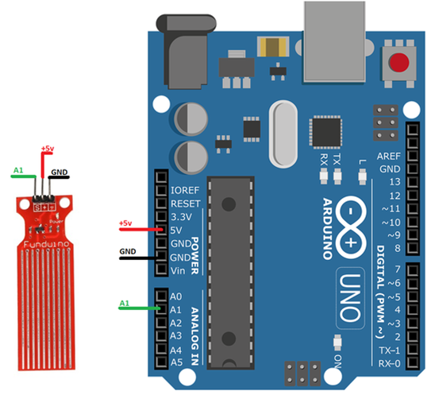
Methodology :
Water Sensor
Operating voltage: 5V
Operating current: less than 20mA
Sensor Type: Analog
Detection Area: 40mmx16mm
ProductDimensions:62mmx20mmx8mm
Working Temperature: 10℃-30℃

Slide 8
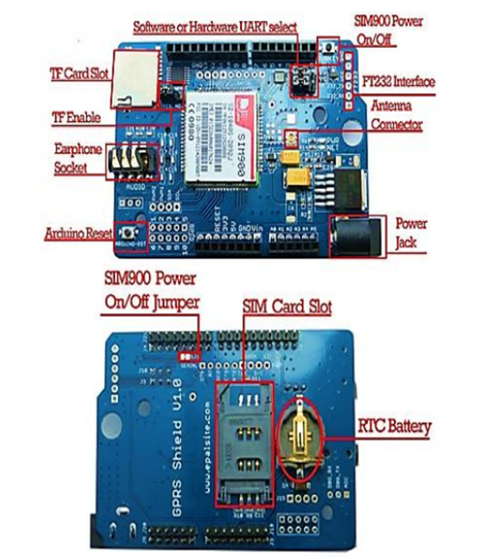
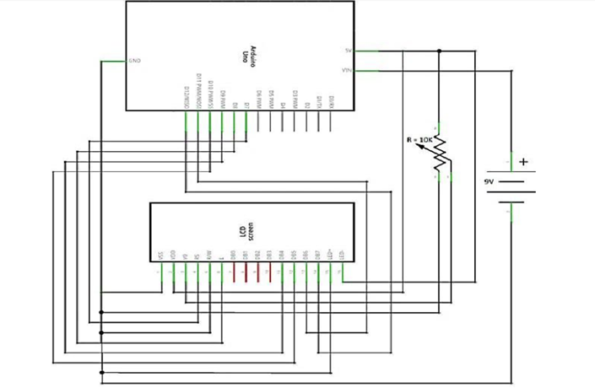
Methodology :
SIM900 – Arduino GSM Shield Unit
Liquid Crystal Display module

Slide 9
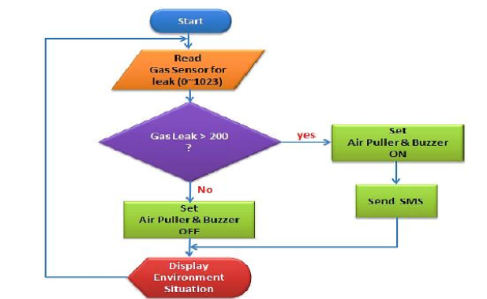
Simulation and Results
At this section we created a simulation example.We built a gas leakage detector circuit .
The Code as Flow Chart :-

Slide 10
Conclusions and Recommendations
The main advantage of this leakage detector is its simplicity and its ability to warn its stakeholders about the leakage of the system.
The water and gas are very important for all living beings, so we need to develop smart systems to avoid the leakage.
The other advantage this device offer is that even though if no one is there in the house and then leaks occurs an efficient wireless sensors is there and will gives alarm and then the GSM module send immediate messages to the stakeholders regarding the leak and thus will lower the intensity of accidents. 5.2 Recommend.

Slide 11
Conclusions and Recommendations
The initially stated overarching aim of this research was to detection Water and gas leakage using sensor.
This is the best ways to monitor the water and gas by use efficient wireless sensors and, if there's a leakage in the network it will send Short Message (SMS) to the owner and gives alarm.
In this part of our graduation project we have done this by simulation, but we will complete it in our graduation project 2 enshallah by simple hardware that represent how our project work , and the water and gas monitoring system of homes/offices research concept by using wireless sensor technology will be implemented.

