Slide 1


Slide 2




WHY SHOPMATE?
  Manual cart operation
  Long checkout queues
  Item loss and theft
  Difficult for elderly users

Slide 3
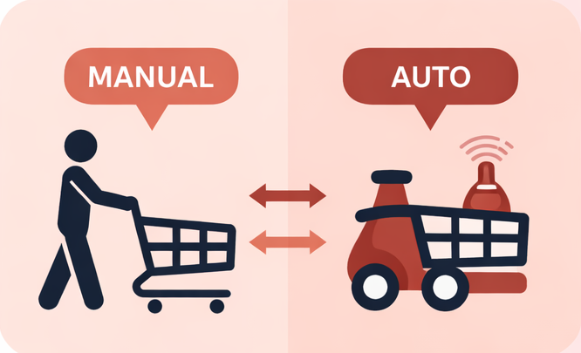

OBJECTIVES
  Manual & auto modes
  LiDAR navigation
  Secure item verification
  Queue-free payment
  Safe indoor operation

Slide 4
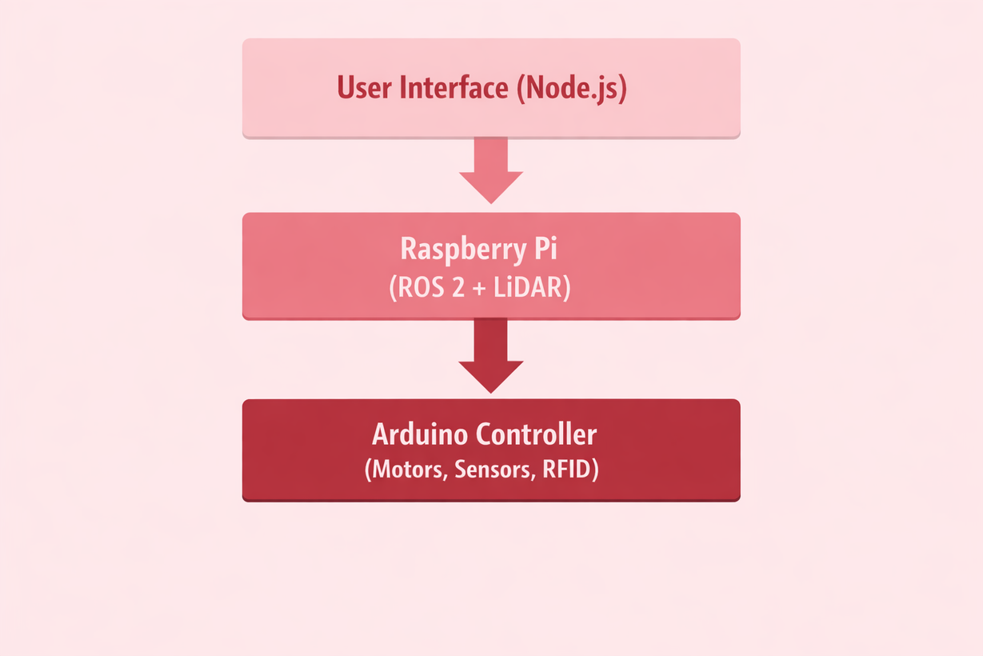
System
OVERVIEW
  Node.js UI
• User commands
  Raspberry Pi (ROS 2)
• Navigation logic
  Arduino
• Motors & sensors

Slide 5
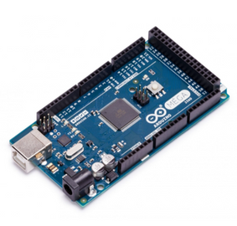
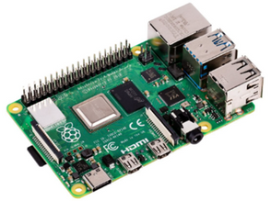
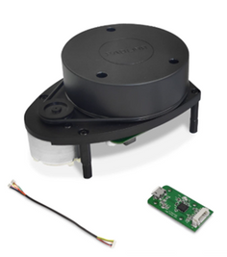
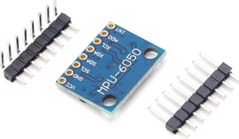

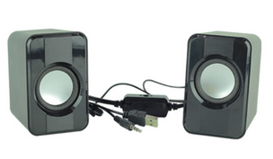
COMPONENTS
1
2
3
4
5
6

Slide 6
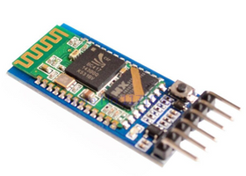
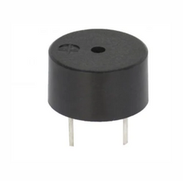
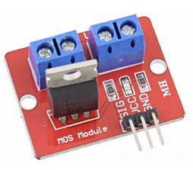
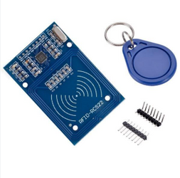
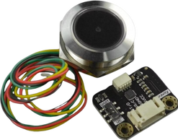
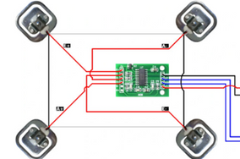
COMPONENTS
7
8
9
10
11
12

Slide 7
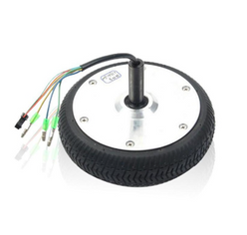
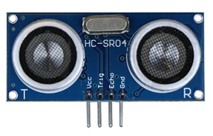
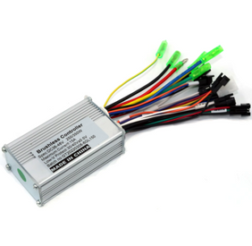
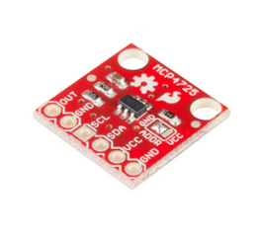
COMPONENTS
13
14
15
16

Slide 8
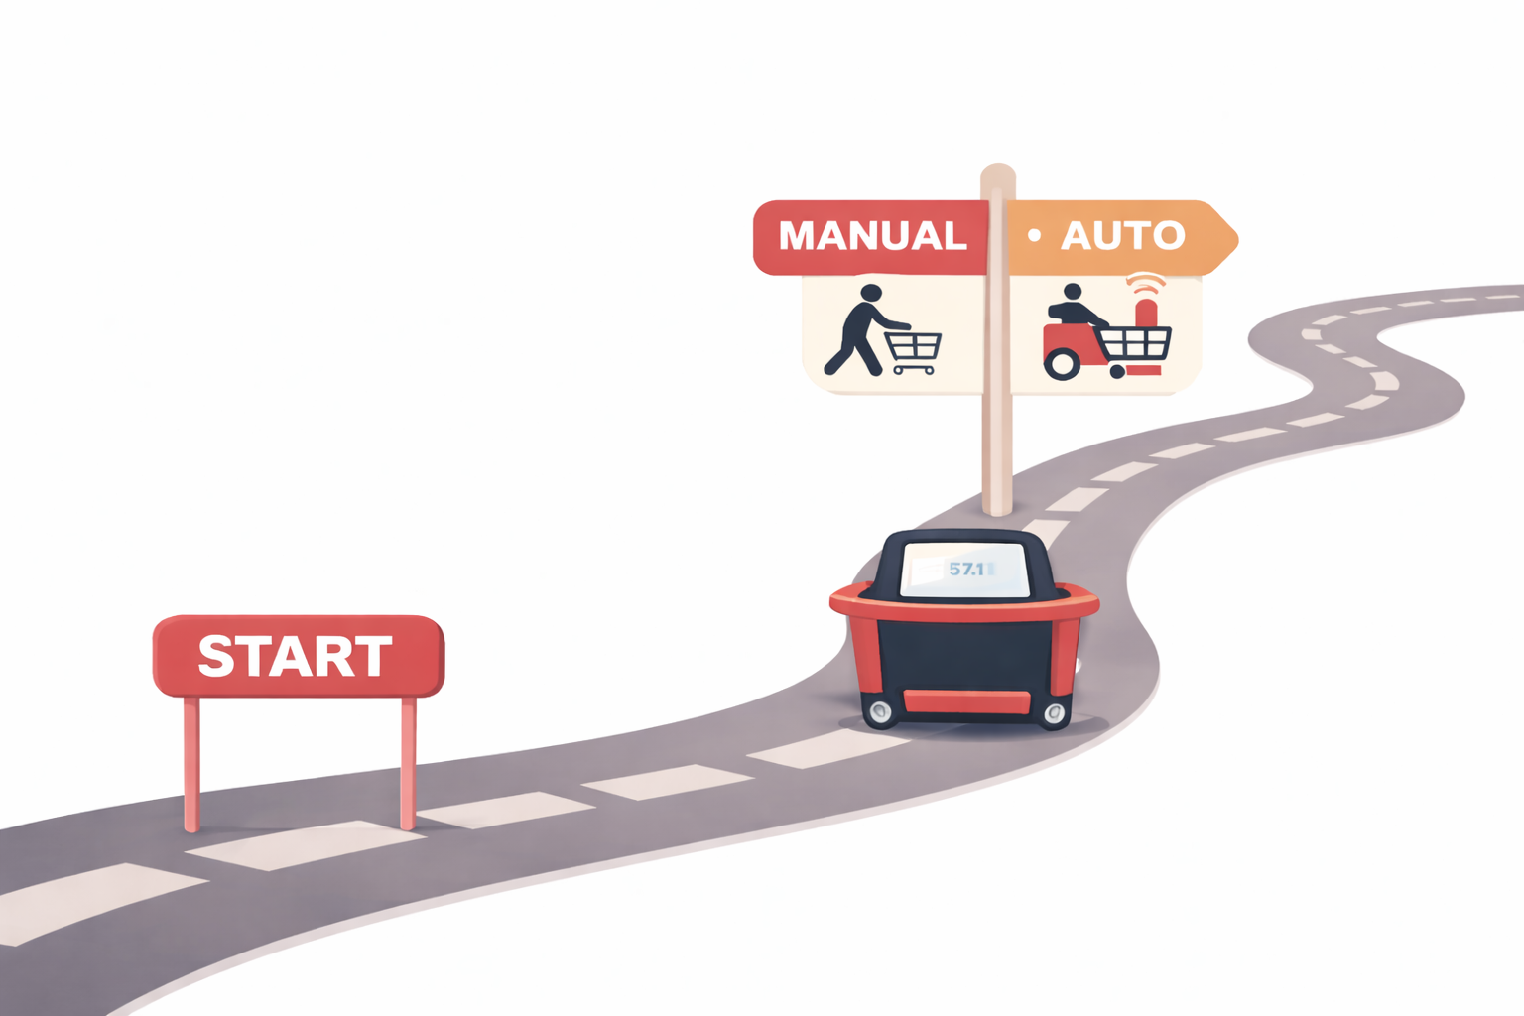
OPERATING MODES

Slide 9
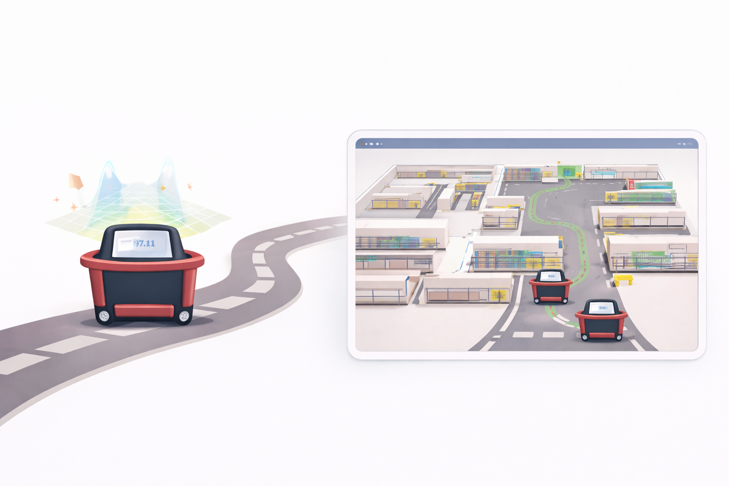
MAPPING & NAVIGATION

Slide 10
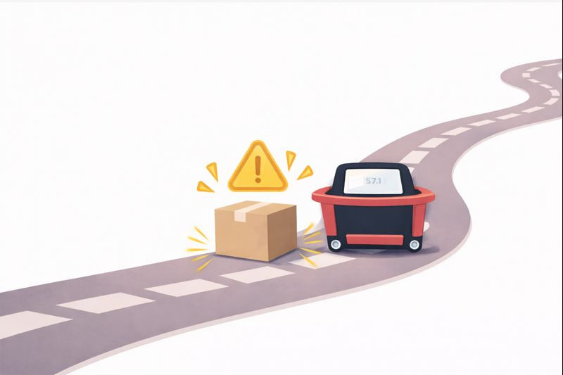
OBSTACLE HANDLING STRATEGY

Slide 11

SECURE SHOPPING WORKFLOW

Slide 12
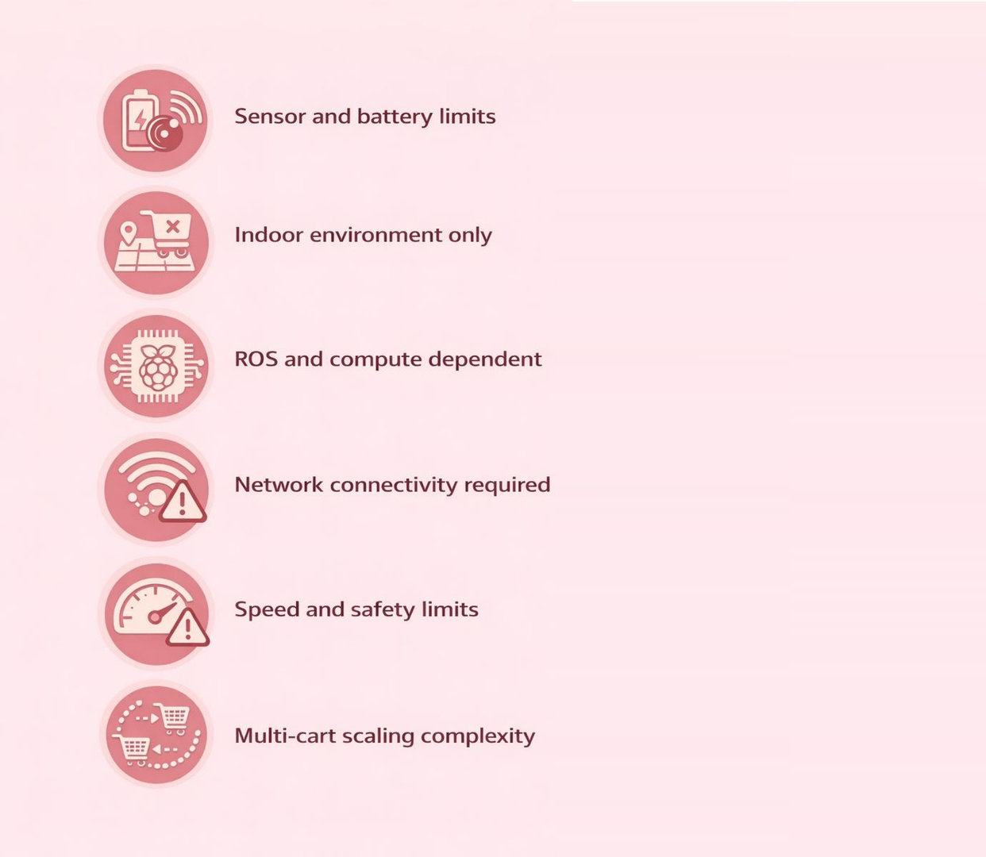

  Sensor and battery limits
  Indoor environment only
  ROS and compute dependent
Constraints:
  Network connectivity required
  Speed and safety limits
  Multi-cart scaling complexity

Slide 13
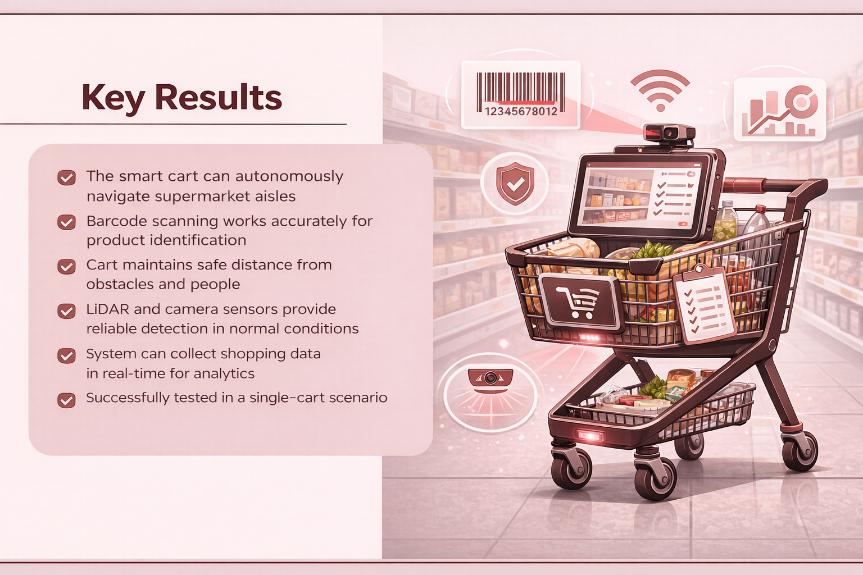
Key Results
  Autonomous aisle navigation
  Accurate barcode scanning
  Safe obstacle distance
  Reliable sensor detection
  Real-time data collection
  Single-cart validated

Slide 14

Future Work
  Multi-cart coordination
  Improved obstacle handling
  Faster navigation response
  Enhanced sensor fusion
  Cloud analytics integration
  Extended real-world testing

Slide 15
THANK YOU

