Slide 1
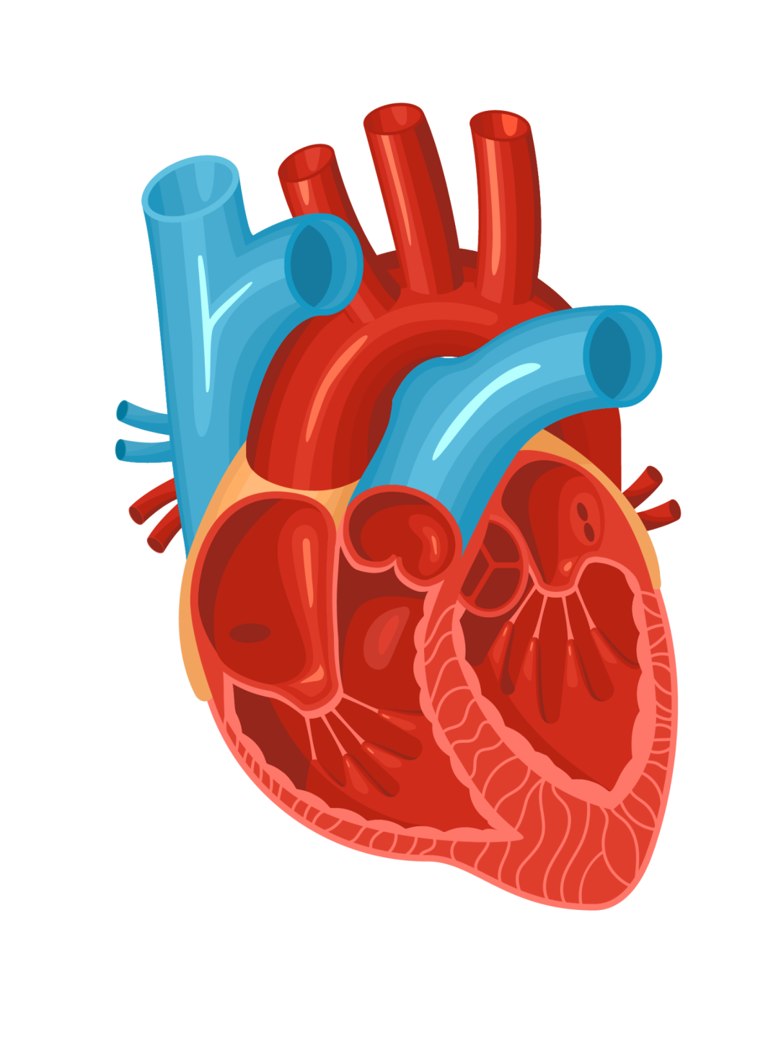

HEALTH MONITORING SYSTEM
For the elderly and heart patients
Supervised by: Dr. Raed Qadi

Slide 2
Our Team
Wa’ad Khalifa & Aseel Bustami

Slide 3
Outline
Introduction
Features
Hardware Components
Demo
Future work
Overall design

Slide 4

Introduction
Health Monitoring System is a system to monitor and measure the patient's vital signs remotely, which reduces costs for the patient, reduces pressure on the hospital, and protects the patient from injury as a result of a sudden fall.

Slide 5
Features
Pulse rate
Medicine reminder
Blood oximetry
Heartbeats(BPM)
Body temperature
Alert message
Electrodiagram

Slide 6
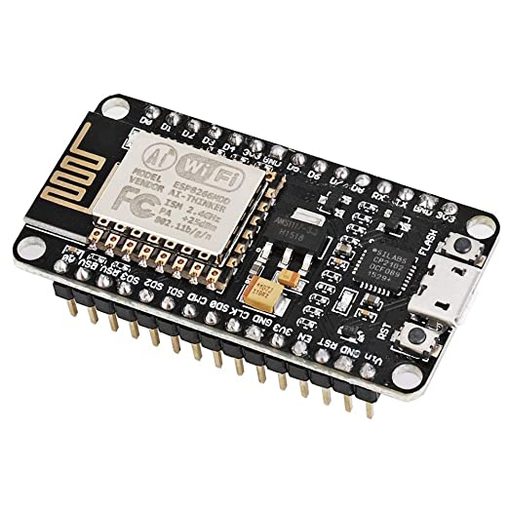
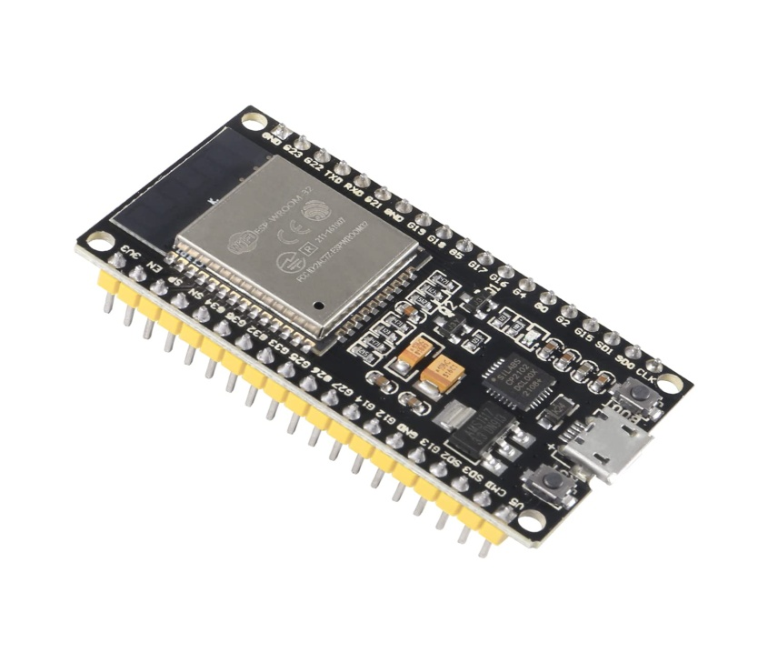
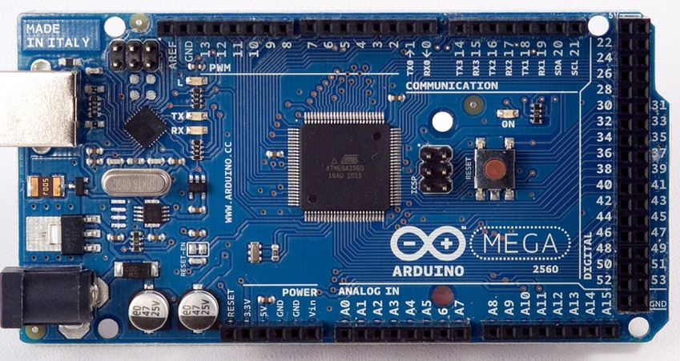
Microcontrollers
NodeMCU ESP2866
ESP32
ArduinoMega

Slide 7
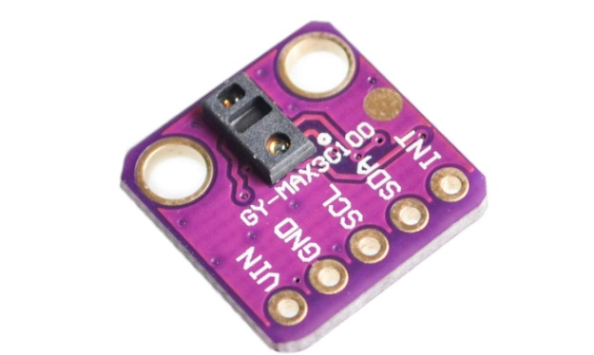
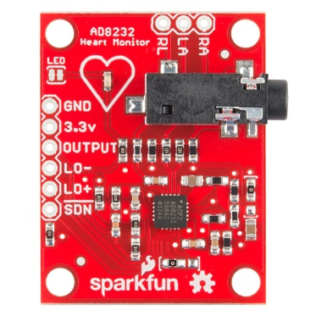
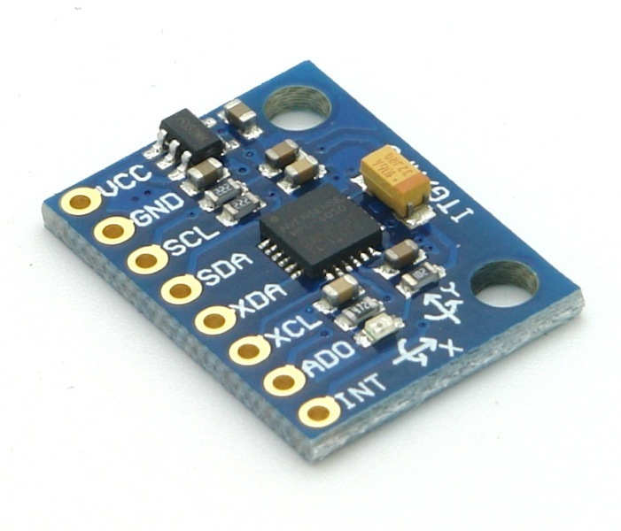
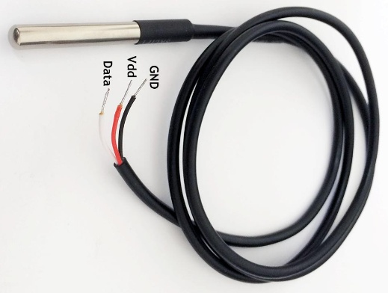
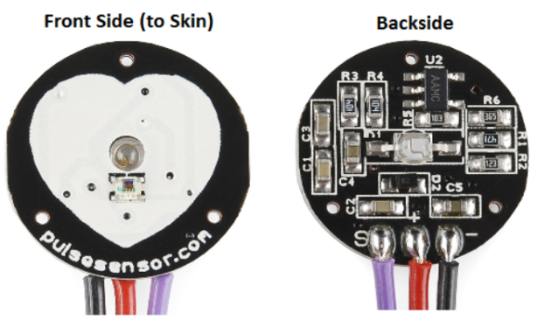
Sensors
MAX30100
AD8232
MPU6050
Pulse sensor
DS18B20

Slide 8
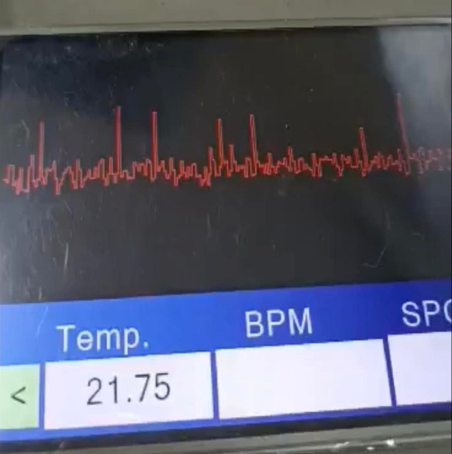
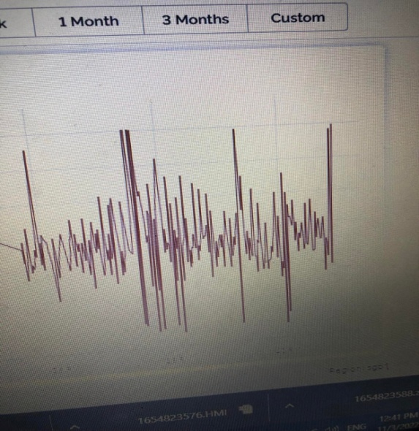
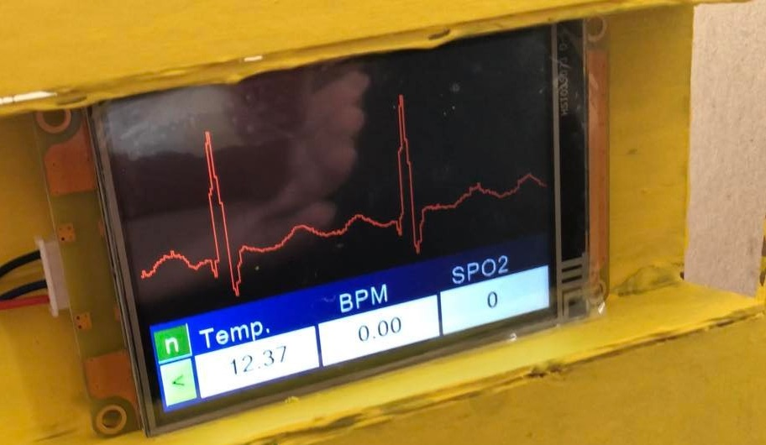
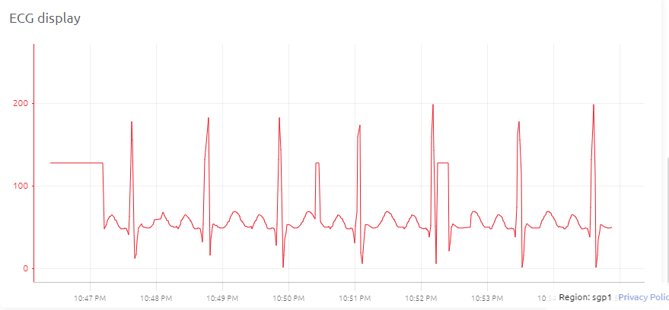
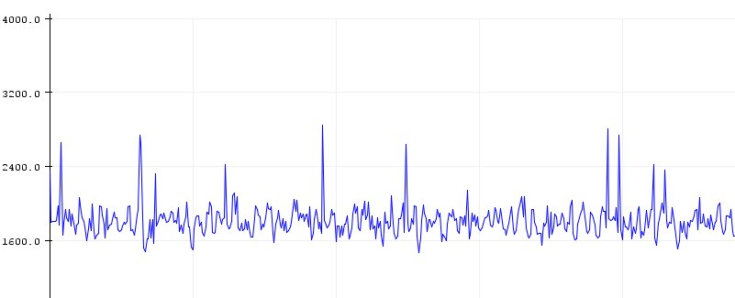
ECG
Before
After

Slide 9
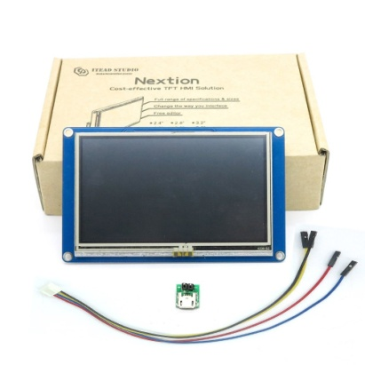
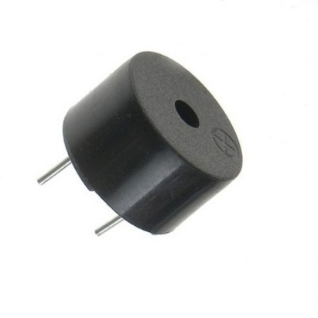
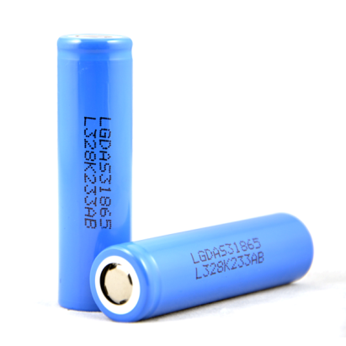
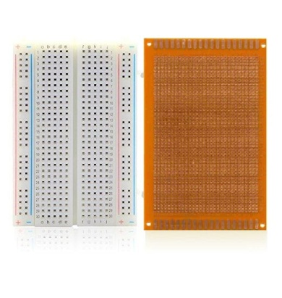
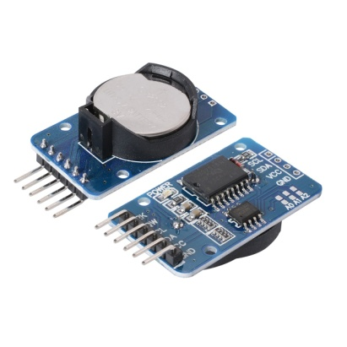
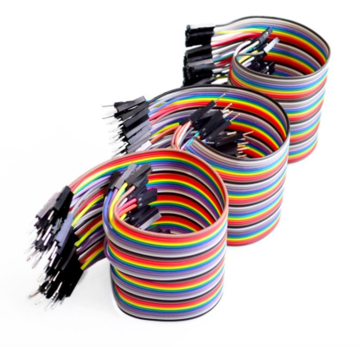
Other components
Nextion
display
Buzzer
Battery
Boards
RTC
Jumper
wires

Slide 10
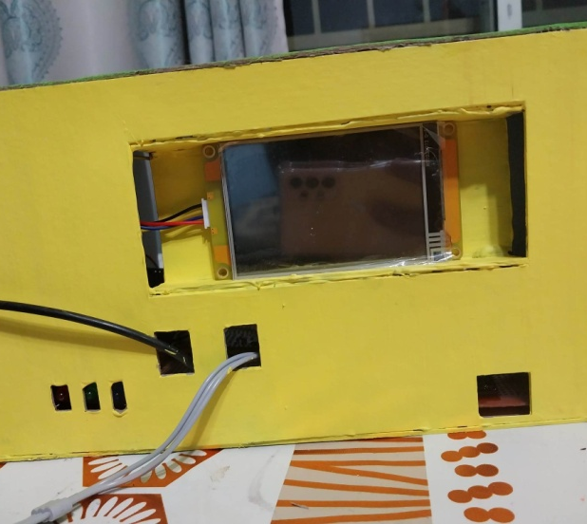
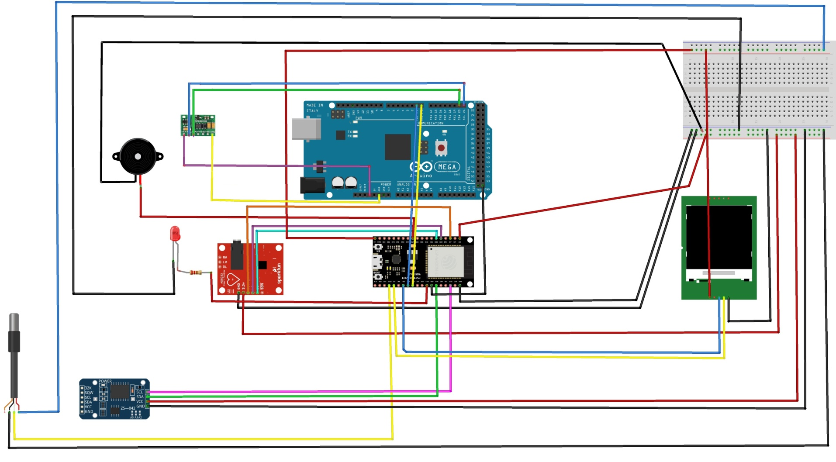
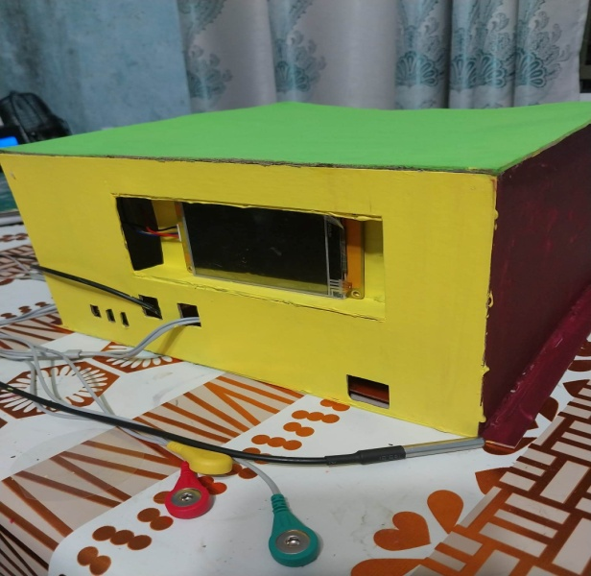
Health Monitoring System Device
Circuit & Overall design

Slide 11
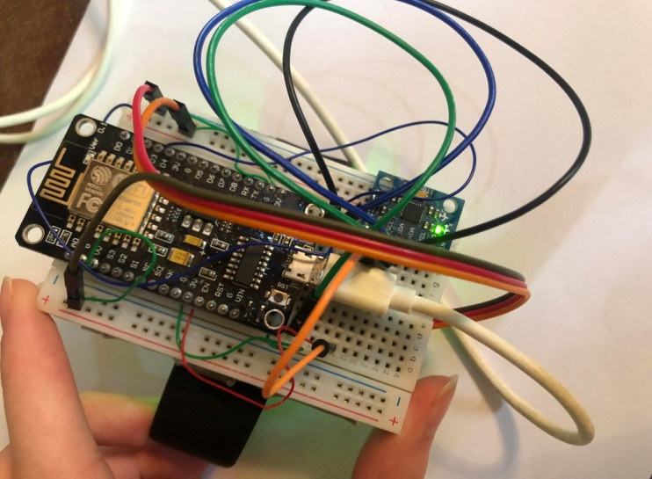
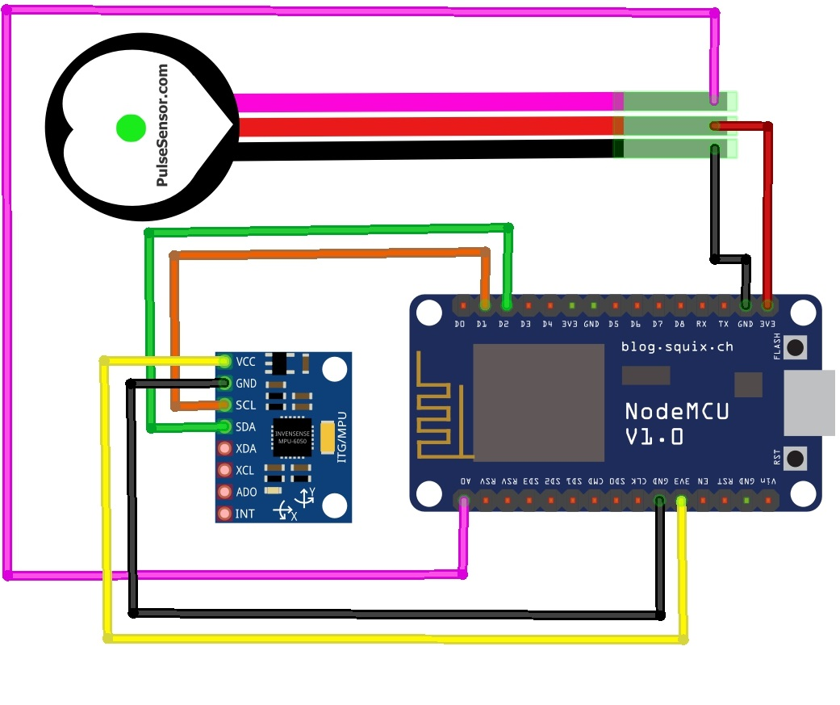
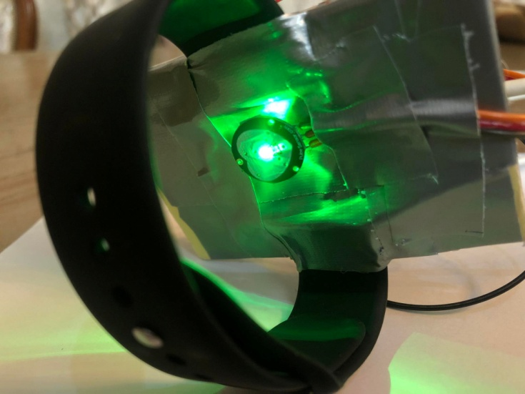
Electronic Bracelet
Circuit & Overall design

Slide 12
Problems
Components
Time Limit
Internet Connection

Slide 13
Future work
Blood pressure
Smart system
Bracelet measures
vital signs
Location
Accounts for patients
ESP32 with 3G by SIM5360

Slide 14
Project’s demo

Slide 15
Thank you

