Slide 1

Presented by: Supervisors:
Fuad Amira Dr. Raed Qadi
Reem Salous Dr. Samer Arandi
MY PATH KEEPER

Slide 2
Introduction:
Mobility issues for Visually impaired users.
Highly sophisticated mobile phones.
  New smart phones are equipped with different sensors and location services.
Exploit the features provided by smart phone to handle the mobility issues of VI users.
Notes:
As we all know, one of the major problems that VI people have in their life is the ability to manage their mobility and travel from one place to another,
VI people and non-impaired people, have some specific routes and paths that they use frequently in their daily life.
e.g going from home to workplace, or from home to a new friends house etc.
Nowadays, mobile phones are highly sophisticated and they are equipped with a wide range of accurate sensors.
In our project, we tried to utilize smart phones to provide the VI users with a tool that they can use to manage their mobility

Slide 3
General Idea:
A mobile application that records information about a specific trip.
Trips should be recorded with the help of an escort.
Notes:
Now I will give a general Idea about our project, our project is a mobile application that stores the GPS coordinates of a specific trip, in adition to some voice messages about the trip.
For the first time, the application must be used with the help of an escort, who can see the road and can mark the critical points of the trip.

Slide 4
General Idea:
The application will guide the VI user using voice messages and other features of the mobile phone.
Trips can be shared with other users .
Website for monitoring the VI user’s location.
Notes:
After having the information stored on the mobile’s database, the application will guide the VI user using voice commands and voice messages and it also makes use of different features provided by the mobile phone
Another feature we added to our project is the ability to share your trpis with other users, all the trips VI users creaded with their phones, will be uploaded to a server. So if the user can not get the help from people around him
In order to provide the family of the VI user with a tool for monitoring and coordinating, we designed a website that shows the trips created by the user and it also show his current location, only if he has an internet access

Slide 5
Two phases of the application:
Creating a trip
Navigating through a trip
Notes:
Now I will talk with a bit more details about the application, our applacation consists of two phases, one for creating a trip which is done either by downloading one, or asking an escort to help with recording it
The other phases deals with the issue of navigating through a specific trip

Slide 6
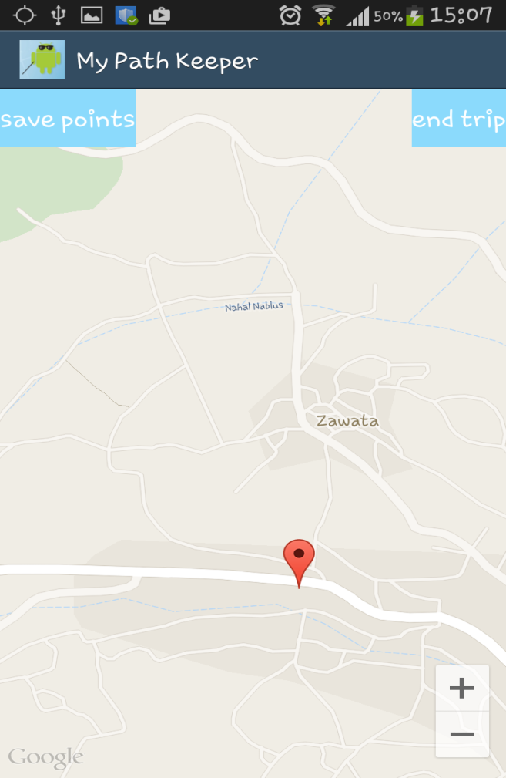
Phase1: Creating a trip.
Critical GPS coordinates
are stored by the escort.
The escort can also add
a descriptive voice message
for each node.
The recorded nodes will be
stored in SQLite database for later use.
Notes:
Phase 1 , creating a trip, lests imagine that the VI user wants to record a trip that starts at his house and ends at another friend’s house. As I mentioned earlier, for the first time, the user must get help from an escort who can actually see the road infront of him,
so we provided the escort with a simple interface that he can use to mark any critical point or node through the trip.
While marking any point, the escort will have the choice to record a voice message that gives information about that specific node, e.g, this street is dangerous, stick to the right side, or there is a traffic light infront of you etc.
When the escort is done with creating the trip, he can press the end trip button and the data will be stored in a local database

Slide 7
Phase 2: navigation.
The VI user is provided with a special interface to choose a specific recorded trip.
After choosing a certain trip, the application will provide the user with navigation commands.
Notes:
Now lets imagine that the VI user have created a trip befor and now he wants to use that trip.
We provided the user with a special interface so that he can easily choose that trip.
After choosing the trip, the program will start providing the user with voice commands and voice messages that describes the distance between his current location and the next node, and it will also give his the choice to listen to the choice to listen to the message that escort have recorded for him before

Slide 8
Identifying the correct direction:
We need to tell the VI user the correct direction.
We utilized the vibration property of the mobile phone
  Mobile vibrating→ wrong direction.
  Mobile stops vibrating → correct direction.
Notes:
One challenge for us was finding a way to tell the VI user the correct direction.
So we thought of utilizing the vibration feature that most of the smart phones provide
If the top of the phone is directed twards the worng direction, then the mobile will start vibrating
That means the user should start moving his phone in all directions.
Once the mobile stops vibrating then the top of the mobile is directed twards the correct direction.

Slide 9
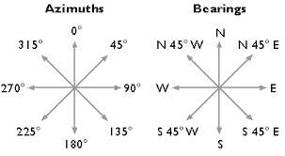
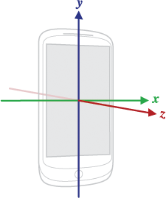
Direction calculations:
Bearing: the angle between two GPS coordinates and the magnetic north .
Azimuth: the angle between the y-axes of the mobile phone and the magnetic north
Notes:
We did that by matching the values of the azimuth and bearing,,
Bearing is the angle between the magnatic north of the earth, and line connecting between two gps coordinantes
While the azimuth is the angle between the y-axes of the phone and the magnatic north of the earth
so if the two gps coordinates are placed here and there, the phone must be directed in this direction so that the azimuth sensor will give nearly the same angle and stopp the vibration

Slide 10
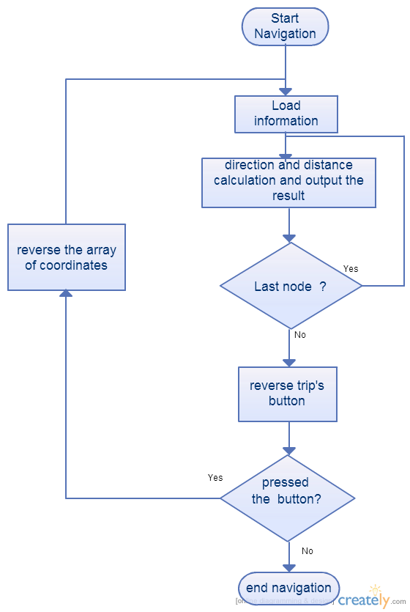
Flow chart:
Notes:
In this flow chart we illustrate the algorithim we used to navigate through a specific route
When the user starts the navigation process the system will load the array of nodes that descripe the trip
It starts by taking the first two nodes, then the distance and direction are calculated by the application and outputted to the user, when the user arrives the next node the app will check if it was the last point or not , if it wasn’t then the app will upload the next node of the array and it does that repeatedly until reaching the last node after arriving the last node the user will have the choice to reverse the trip, meaing that, he can flip between the sorace and destination, if we go back to our example, if the user went to his friend’s house and wants to go back home he can just press the button and the system will do the previouse procedre but reversed this time.

Slide 11
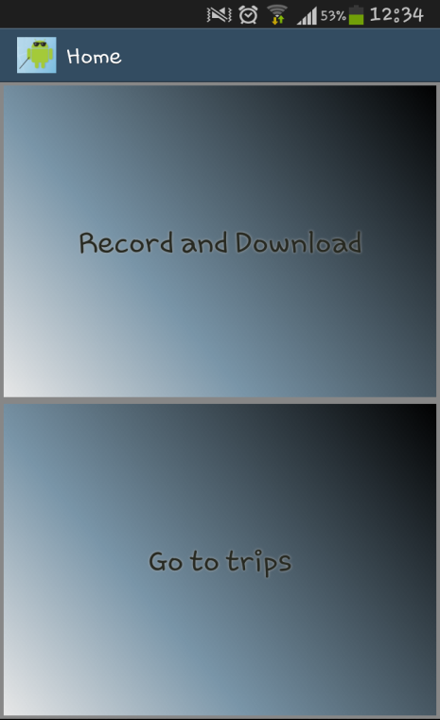
User interface:
Customized buttons:
Screen is divided into two
large areas.
Play back descriptive
voice command.
Notes:
Our user interface was specially designed for VI users, as you can see in the picture
The whole screen is divided into two major parts that form the buttons of the page
The user may start touching the screen, when he presses a button, the action will not be handled, instead, the the application will play a descriptive message that describes the functionality of the that button,
When the user is sure about his choice, then he can double click on the position of the screen in order to perform the functionality of that button

Slide 12
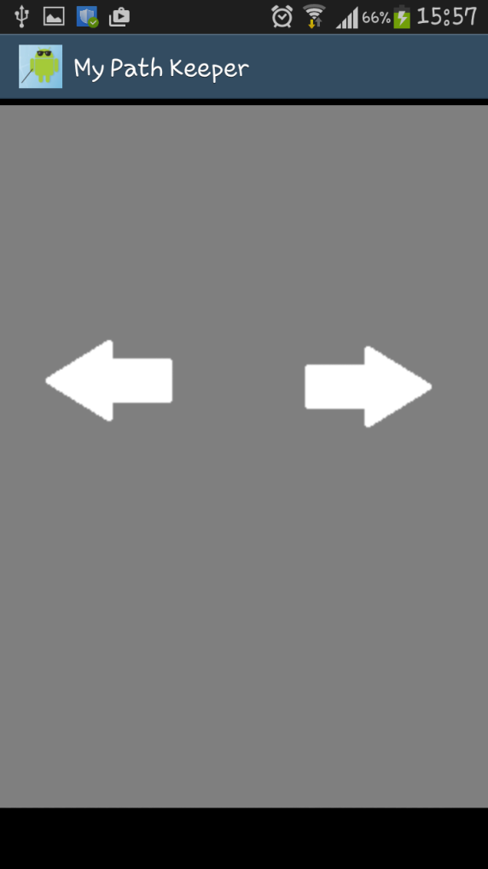
UI: select trip out of many
It is a challenge for
a VI user to choose a
trip from a list of trips.
Specially designed
list of trips.
Traverse through the
list by swiping left and write.
Notes:
Another problem that faces the VI user is how to choose an item of many in an item list,
The user will have a list of recorded trips that may not fit to the screen size
So we developed a new for visually impaired users.
The user can just swipe left or write to traverse through his item list
When swiping left or write, a voice message will be played and that message gives information about each item in the list

Slide 13
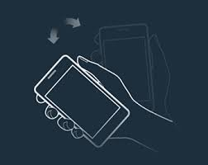
Shake for help
Each page in the application has a descriptive message that describes the layout of the page.
The user can shake his mobile to listen to the message
Notes:
When the user is moving from one page to another, he doesn’t actually know the layout of that page or the action that he must take,
so,, for each page, we added a descriptive voice message that descripes the items of that page and the functionalities that they handle
In order to listen to this message, the use can shake at any time and at any page, and listen to that message

Slide 14
Sharing trips:
The application will upload locally created trips to the server, so that it can be used by other users.
Synchronization adapter uploads the data automatically when the mobile phone has internet access.
Notes:
as we mentioned earlier, the local trips that each user have recorded can be shared to the server
We implemented a synchronization adapter that works in the background and uploads users trips automatically to the server
note that, while recording a trip, the escort can choose if the user wants to share that trip or keep it private

Slide 15
Downloading a trip from the server
Search mechanism designed for VI users.
the application sends current location to the server.
The server sends trips to the user sorted based on their distance to the user’s current location.
Notes:
Another problem we had to deal with is how to make the VI user able to download trips by himself
It’s a big challenge for a VI user to enter the search keywords
Soooooo, instead of entering search key words,
The application keeps the user’s location coordinates stored in a permenant variable,
When the user enters the search page , then the application will send the user’s current location to the server
And them, the server will order the trips he has based on their distance to the user’s current location
The closest trip comes first and so on

Slide 16
Downloading a trip from the server
user can swipe left and write and get the information about each trip as a voice message.
Double click on the screen in order to download the trip.
Notes:
When the array reaches the mobile phone, It will arrive as a list, so the user can just swipe left or write and listen to the message that
Gives information about each trip
When the user wants to download a specific trip, he can just double click on any place of the screen and the trip will be downloaded to his device

Slide 17
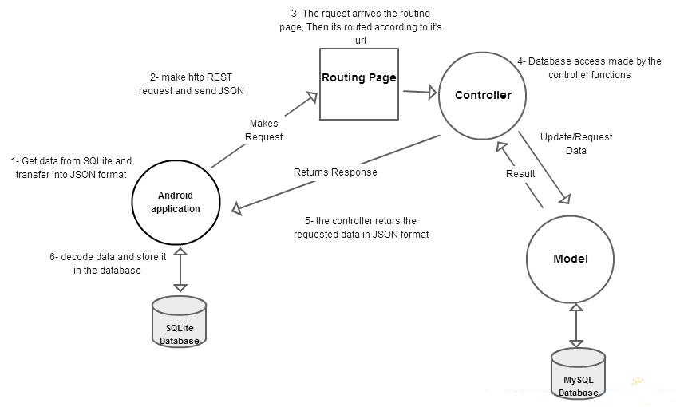
Application server interaction
Notes:
This photo illustrates the interaction process between the server and the application
We used MVC to manage the server, either for the application data or the website’s data
As you can see, the application makes a request to the server, when the request arrives at the server’s side, it routes each request to its handler according to the URL
The controller sends his requests for the model asking for the data from the data base and sneds the reply with that data to the application

Slide 18
Website:
A tool for monitoring and coordinating the user.
Shows all trips of the user and other users.
It also shows the current location of a specific user while connected to internet.
Notes:
Finally, to keep track of the VI users, we provided prople around him with a website through which they can see his recorded trips
And more importantly
They can see his location on the website’s map

Slide 19
Website demo
.

Slide 20
Thank you ya kbaar :D :D

