Slide 1

An-Najah National University
Faculty of Engineering and Information Technology
جامعة النجاح الوطنية
كلية الهندسة و تكنولوجيا المعلومات
II Graduation Project
Assessment and Process Recommendations of Anza WWTP
By
Helal Mansour – Reg. No:11610008
Alaa’ al-shaikh – Reg. No:11440780
Under supervision of: Dr. Sameer Shadeed

Slide 2
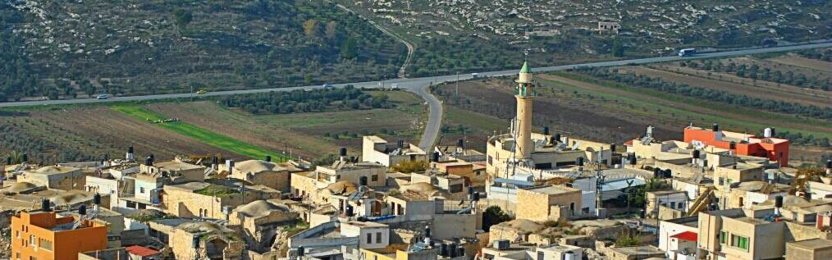
Assessment and Process Recommendations of Anza WWTP
Location: Anza is a Palestinian village which is located in Jenin Governorate.
Topography and land use : The village lies on two hills its lands are agricultural and residential, like most of the Palestinian lands, it’s covered with olive orchards.
Study area

Slide 3
Significance of the Work
Ensure the efficiency of the wastewater treatment process
propose considerable recommendations in future similar projects
Assessment and Process Recommendations of Anza WWTP

Slide 4
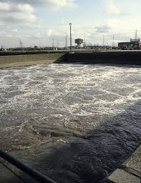
Anza Wastewater Treatment Method
Activated sludge system

Slide 5
Assessment and Process Recommendations of Anza WWTP
Anza Wastewater Flow Characteristics
Strong domestic wastewater

Slide 6
Assessment and Process Recommendations of Anza WWTP
Wastewater Generation
population
K: return fraction
2002 capita
(0.6 - 0.9)
02
04
01
03
05
design period
Water consumption
Growth rate
20 years
87 l/c.day
1.8%
Peak flow = (35 - 52) m³ / Hr. Peak flow = (35) m³ / Hr.

Slide 7
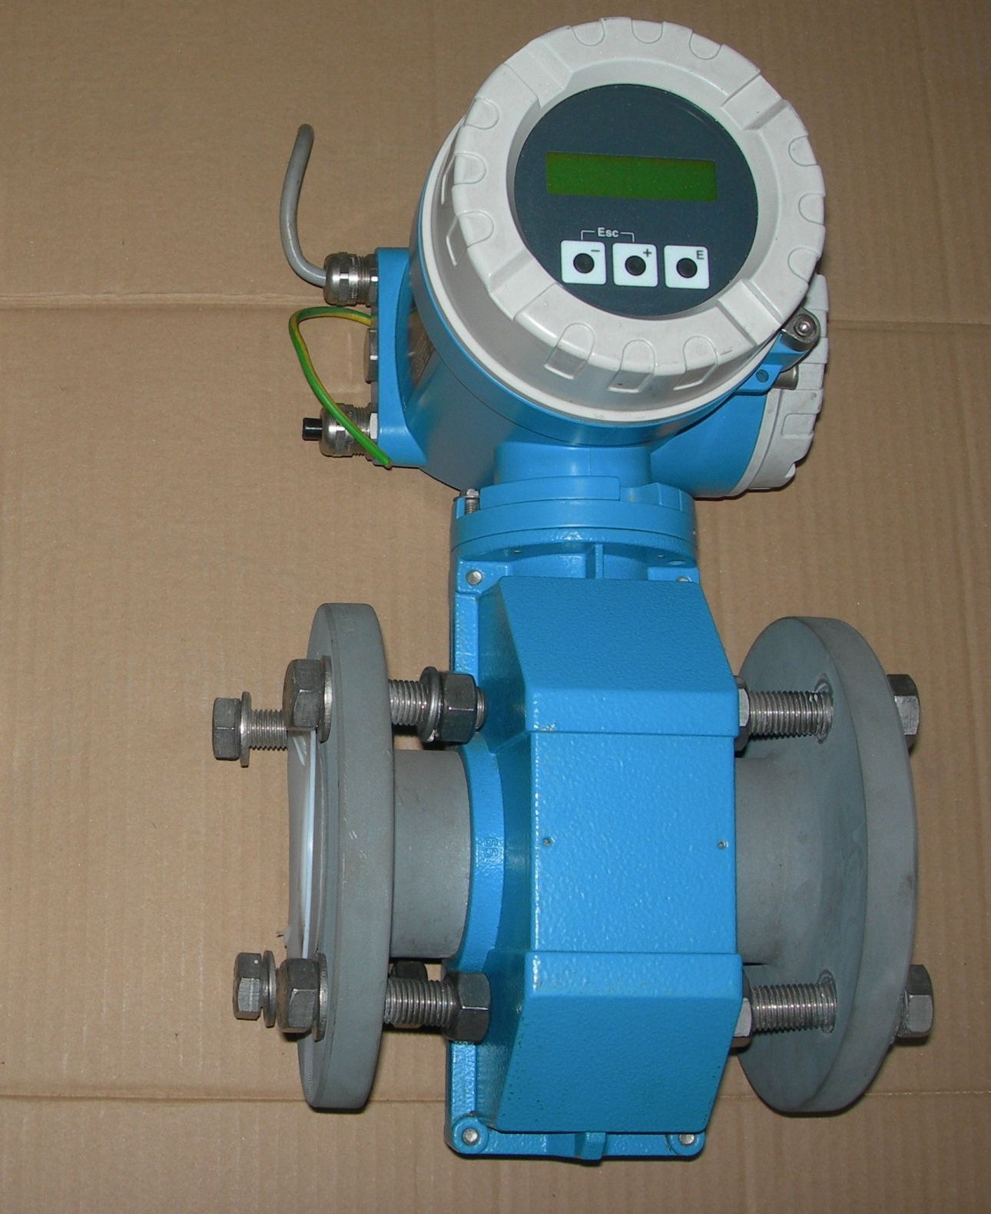
Flow meter
Flow from the pretreatment units is recorded by Endress and Hauser flow meter.
Flow = (80 – 100) m³
Assessment and Process Recommendations of Anza WWTP

Slide 8
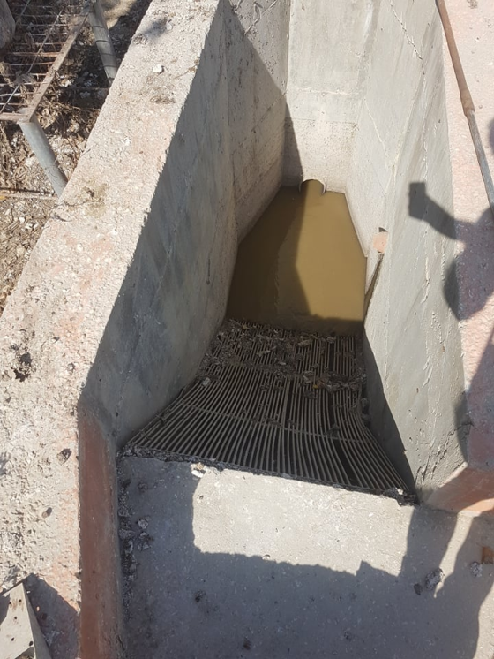
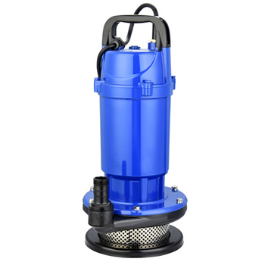
Screening and Pumping
Protect the pumps from large debris
The bar screen has capacity equal to design peak hour flows (35 m3/hr) with < 10 mm openings
To provide hydraulic head
Two submersible pumps (one standby)
Assessment and Process Recommendations of Anza WWTP

Slide 9
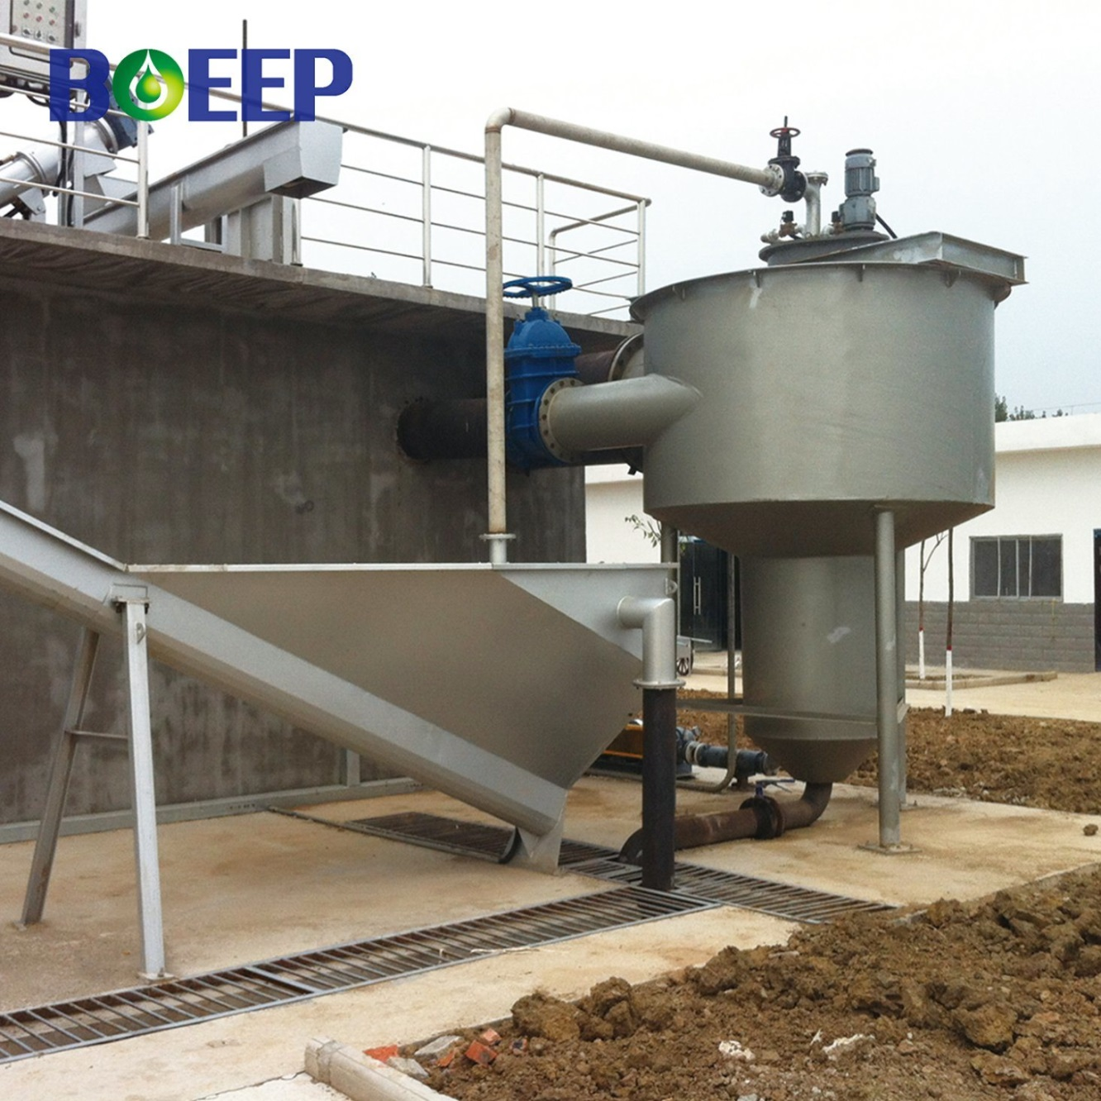
Grit and Grease Removal
vortex flow grit chambers
Assessment and Process Recommendations of Anza WWTP

Slide 10
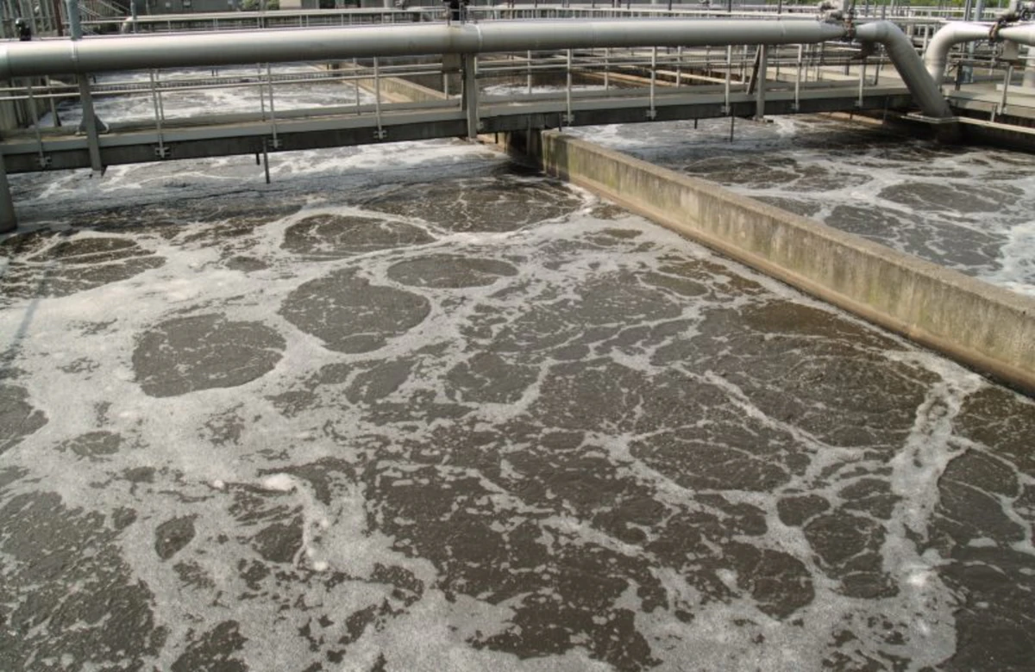
Activated Sludge Tank
Aeration zone: 80%
Anoxic zone: 20%
Assessment and Process Recommendations of Anza WWTP

Slide 11
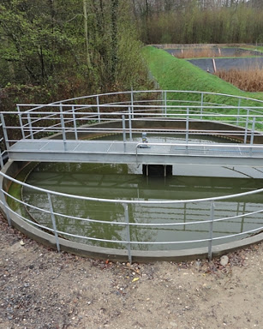
Secondary clarifier
To settle the suspended solid
RAS: 75%
WAS: 25%

Slide 12
Disinfection
chlorine disinfection method was used in the WWTP in order to kill the infective bacteria in the water

Slide 13
Filtration
Sand filter was used in order to remove the sand and small particles from the water

Slide 14

Design of Anza Treated Wastewater and Its Agricultural Water Distribution Network
Water Discharge
Storage tank: 500 m³
Winter: wadi discharge

Slide 15

Design of Anza Treated Wastewater and Its Agricultural Water Distribution Network
Sludge management
Sludge thickening and dewatering
Sludge disposing

Slide 16
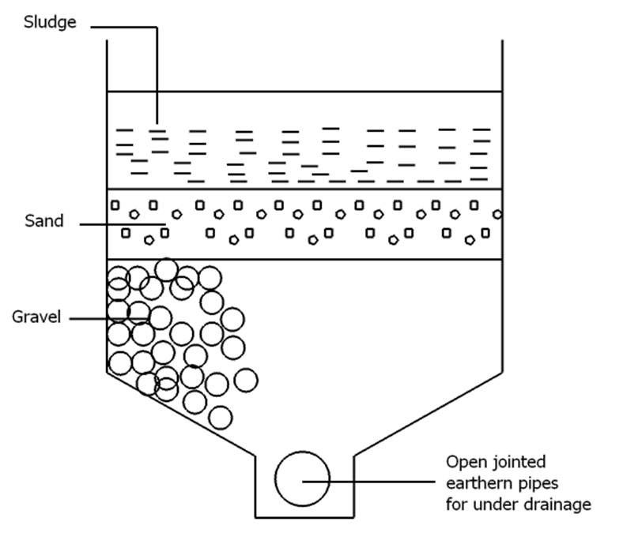
Sludge Thickening and Dewatering
Sludge drying bed (SDB)
أضف عنوان
هنا
Assessment and Process Recommendations of Anza WWTP

Slide 17
Sludge disposing
After the sludge is dewatered, it is charged and dumped in Zahret al Finjan

Slide 18
GPS-X Modelling
Assumption:
The model is starting with the secondary treatment stage.
Some influent characteristics are assumed as default values of strong domestic wastewater.
COD value equals two times the BOD₅ value in the influent characteristics.
Anoxic tank is assumed to be as a separate unit to represent the anoxic zones in the activated sludge tank.
أضف عنوان
هنا
Assessment and Process Recommendations of Anza WWTP

Slide 19
GPS-X Modelling
Flow rate simulation values:
449.8 m³/d which is the max monthly average and was suggested to the biological design flow rate.
346 m³/day which is the annual average flow rate.
100 m³/day which is the current average inflow rate.
Assessment and Process Recommendations of Anza WWTP

Slide 20
GPS-X Modelling
Biological-design flow characteristics
in order to acknowledge the values of BOD, TSS and TKN concentration values, some calculations were needed based on the following values that are linked to the design flow value (449.8 m3/h)
Assessment and Process Recommendations of Anza WWTP

Slide 21
GPS-X Modelling
Biological-design flow characteristics
Assessment and Process Recommendations of Anza WWTP

Slide 22
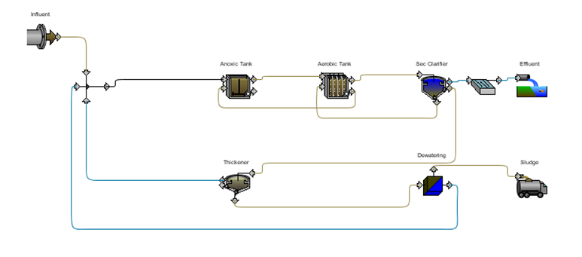
GPS-X Modelling
Model layout
أضف عنوان
هنا
Assessment and Process Recommendations of Anza WWTP

Slide 23
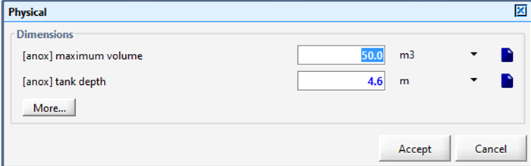
GPS-X Modelling
Anoxic Tank
Volume: 50 m³
Assessment and Process Recommendations of Anza WWTP

Slide 24
GPS-X Modelling
Aerobic Tank
Volume: 200 m³
Two reactors: each = 100 m³
Assessment and Process Recommendations of Anza WWTP

Slide 25
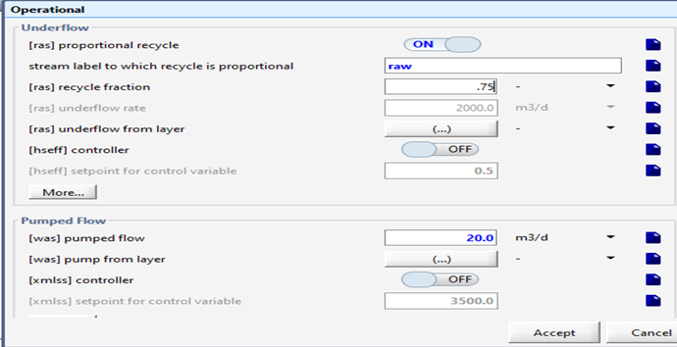
GPS-X Modelling
Secondary (final) Sedimentation Tank
Volume: 120 m³
(RAS = 75%)
(WAS = 25%).
Assessment and Process Recommendations of Anza WWTP

Slide 26
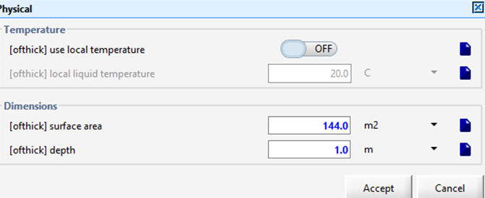
GPS-X Modelling
Thickeners
surface area: 144 m²
Assessment and Process Recommendations of Anza WWTP

Slide 27
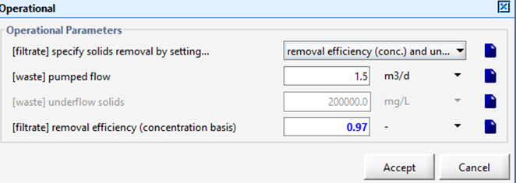
GPS-X Modelling
Dewatering
efficiency: 97%
Assessment and Process Recommendations of Anza WWTP

Slide 28
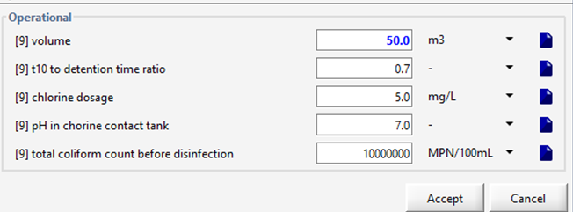
GPS-X Modelling
Chemical Disinfection
Volume: 50 m³
Assessment and Process Recommendations of Anza WWTP

Slide 29
GPS-X Modelling
Effluent desired characteristics
Assessment and Process Recommendations of Anza WWTP

Slide 30
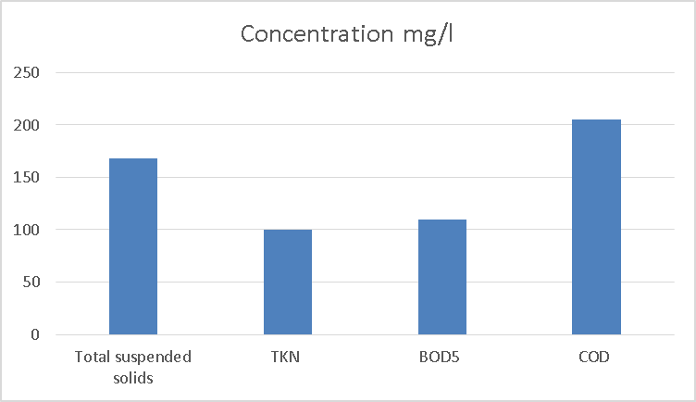
GPS-X Modelling
Simulation for 449.8 m³/day inflow.
Assessment and Process Recommendations of Anza WWTP

Slide 31
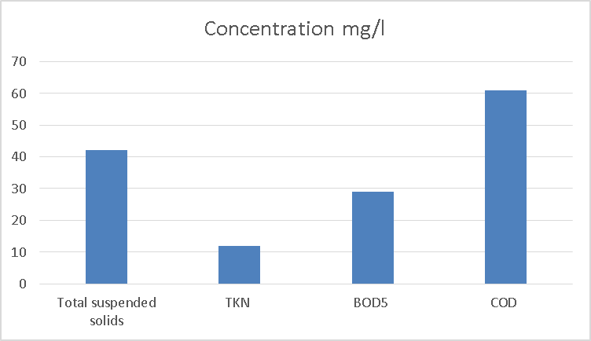
GPS-X Modelling
Simulation for 346 m³/day inflow.
Assessment and Process Recommendations of Anza WWTP

Slide 32
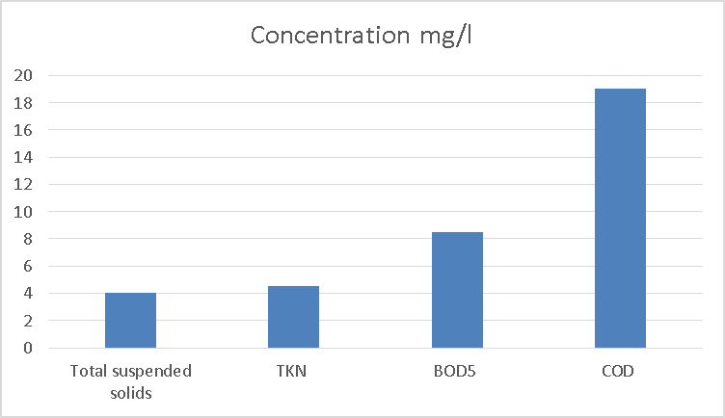
GPS-X Modelling
Simulation for 100 m³/day inflow.
Assessment and Process Recommendations of Anza WWTP

Slide 33



Assessment and Process Recommendations of Anza WWTP
CONCLUSION
449.8 m³/d
346 m³/day
100 m³/day

Slide 34
Assessment and Process Recommendations of Anza WWTP
Recommendations
Enlarge activated sludge tank
Sludge reuse
No industrial wastewater

Slide 35

شكرا لكم

