Slide 1


Faculty of Engineering & Information Technology
Department of Civil Engineer
Graduation Project I
Structural Analysis And Re-Design Of Modern English School
Prepared By:
Diab Samaneh
Adnan Ashqar
Saed Almaani
Raed Qadri
Under supervision of: Dr. Riyad Abdel-Karim

Slide 2
Chapter 1
Introduction

Slide 3
1.1: Project Description
The school consists of two basements and one ground floor.
each block were designed separately, there is an expansion joints between them.
Type of use | Height | Area | Floor
Classes, dressing room and a multi-use hall. | 3.75 | 1975.53 | Second basement. B2
Classes, library, labs, Praying room, and computers lab. | 3.75 | 1335.82 | First basement. B1
Classes, offices, and reception. | 3.75 | 1739.38 | Ground floor. G

Slide 4
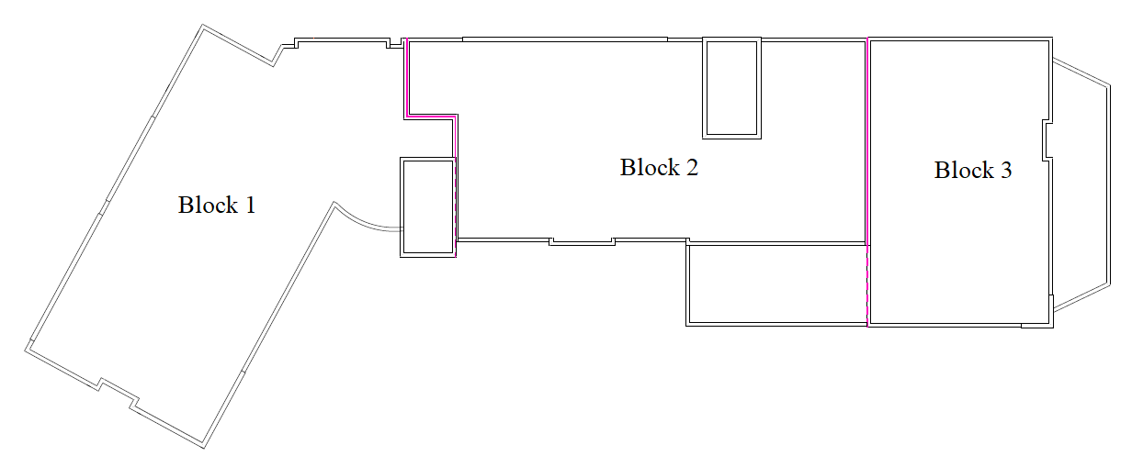

Slide 5
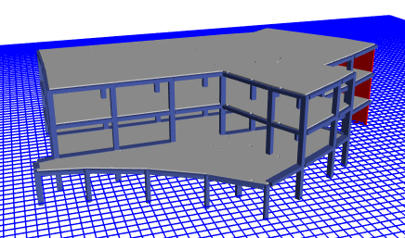
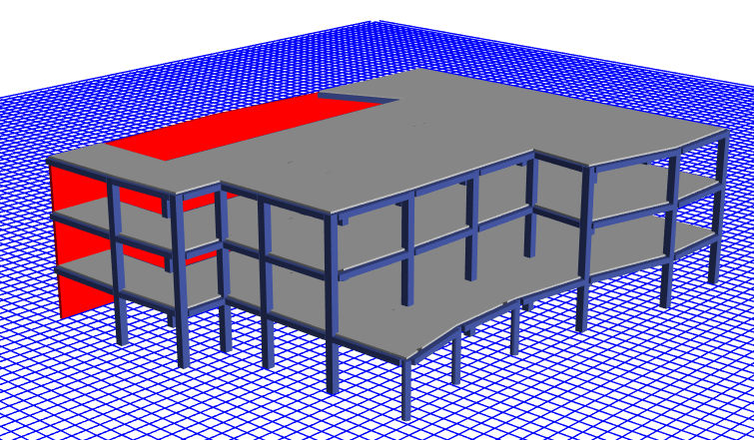
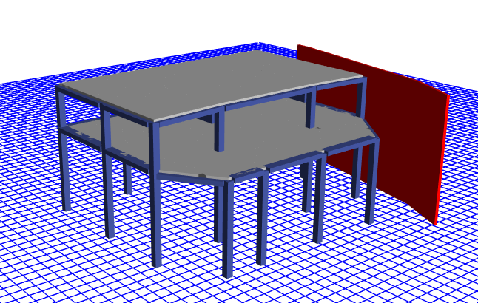

Slide 6

1.2: Codes & Materials
Codes:
ACI318-14
ASCE7-10
Materials:
Concrete $f^{′}c=28MPa (B350)$
Reinforcing Steel Fy = 420 MPa (Grade 60)
KN/m³ | Material
6 | Light weight blocks
26 | Tiles
23 | Plastering
26 | Masonry stone
18 | Aggregate
23 | Concrete mortar

Slide 7
1.3: Loads
1.3.1: Load Types
(1)Dead Load:
consist of the own weight of the structure.
Type | Block 1 | Block 2 | Block 3
Slab | 11230.51 KN | 11494.03 KN | 3422.14 KN
Beams | 6310.23 KN | 6280.55 KN | 3133.87 KN
Columns | 2925.03 KN | 2704.24 KN | 2032.50 KN
Shear Wall | 1092.56 KN | 2521.5 KN | 1606.44 KN
Total Weight | 21558.332 KN | 23000.32 KN | 10194.94 KN

Slide 8
1.3: Loads
1.3.1: Load Types
(2)Live Load:
The same for all blocks
Usage | Live Load (KN/m²)
Corridors and Emergency exits | 4.79
Classrooms | 1.92

Slide 9
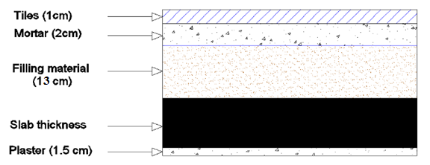
1.3: Loads
1.3.1: Load Types
(3)Superimposed Load:
come from the weight of all non-structural elements.
Item | Unit weight Ɣ (KN/m³) | Thickness (mm) | Calculations | Weight per m² (KN/m²)
Mortar | 23 | 20 | 0.02*23 | 0.46
Tiles | 26 | 10 | 0.01*26 | 0.26
Plastering | 23 | 15 | 0.015*23 | 0.345
Filling (Sand and gravel) | 18 | 130 | 0.13*18 | 2.34
Partitions |  |  |  | 1.015
Total Super Dead Load |  |  |  | 4.42

Slide 10
1.3: Loads
1.3.2: Load Combinations
Basic ultimate load combinations:
(A)Basic service load combinations:
D
D + L
D + (0.6W or 0.7E)
D + 0.75L + 0.75(0.7E) + 0.75S
0.6D + 0.7E
(B)Basic ultimate load combinations:
1.4D
1.2D + 1.6L + 0.5(L_{r} or S or R)
1.2D + 1.0E + L + 0.2S
0.9D + 1.0E

Slide 11
Chapter 2
Preliminary design

Slide 12
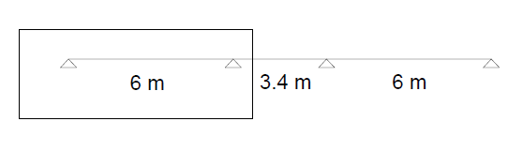
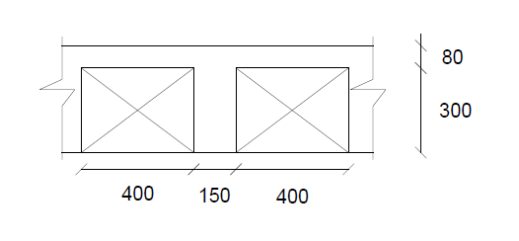
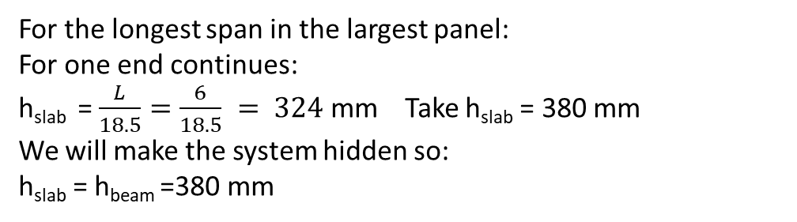
2.1: Preliminary slabs thickness
2.1.1: For block one
Slab dimensions:
For the longest span in the largest panel:
For one end continues:
h_{slab} = $\frac{L}{18.5}=\frac{6}{18.5} = 324$ mm Take h_{slab} = 380 mm
We will make the system hidden so:
h_{slab} = h_{beam} =380 mm

Slide 13
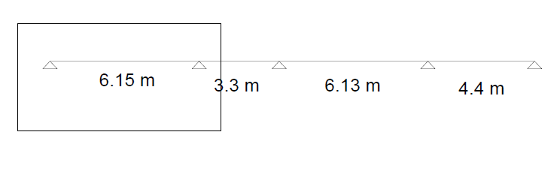
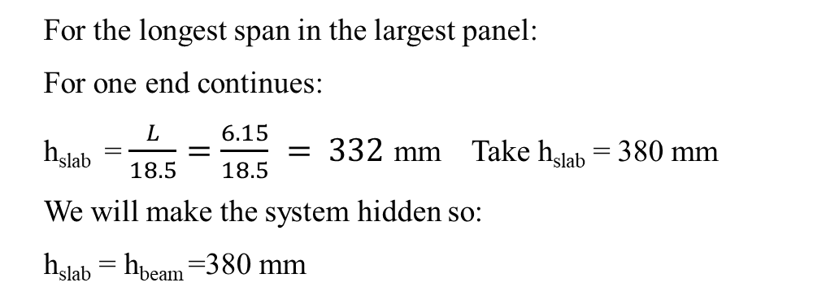
2.1.2: For block two
Slab dimensions:
For the longest span in the largest panel:
For one end continues:
h_{slab} = $\frac{L}{18.5}=\frac{6.15}{18.5} = 332$ mm Take h_{slab} = 380 mm
We will make the system hidden so:
h_{slab} = h_{beam} =380 mm

Slide 14
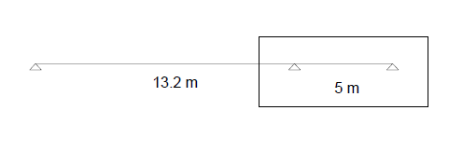
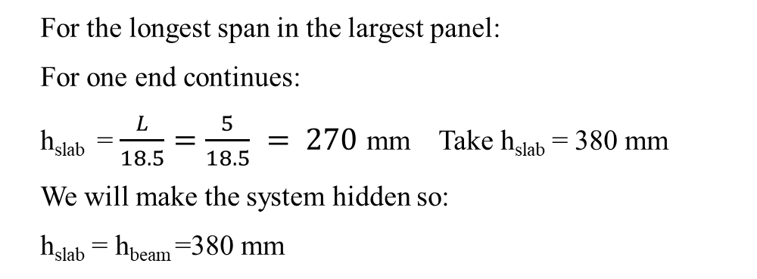
2.1.3: For block three
(1) For ribbed slab (Loads transfers in X-direction):
Slab dimensions:
For the longest span in the largest panel:
For one end continues:
h_{slab} = $\frac{L}{18.5}=\frac{5}{18.5} = 270$ mm Take h_{slab} = 380 mm
We will make the system hidden so:
h_{slab} = h_{beam} =380 mm

Slide 15
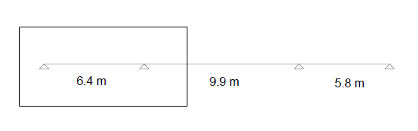
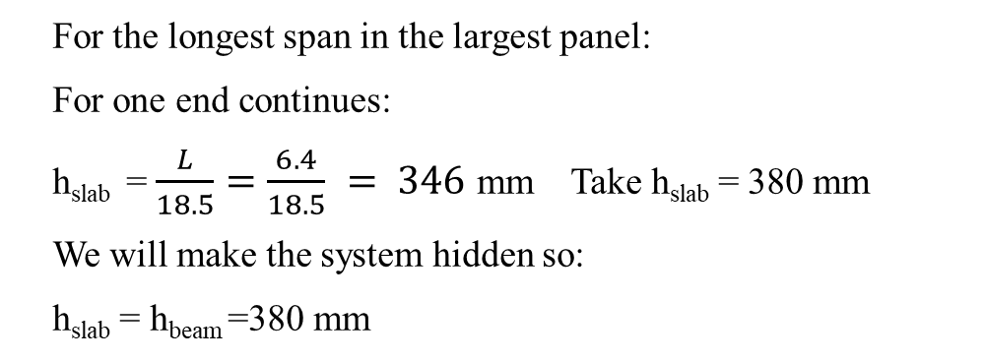
(2) For ribbed slab (Loads transfers in Y-direction):
Slab dimensions:
For the longest span in the largest panel:
For one end continues:
h_{slab} = $\frac{L}{18.5}=\frac{6.4}{18.5} = 346$ mm Take h_{slab} = 380 mm
We will make the system hidden so:
h_{slab} = h_{beam} =380 mm

Slide 16
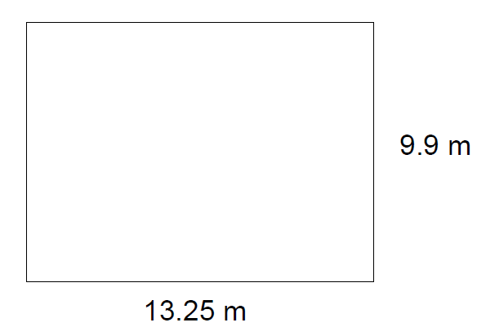
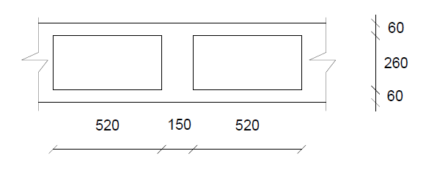
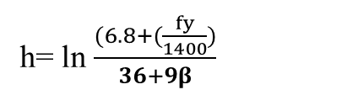
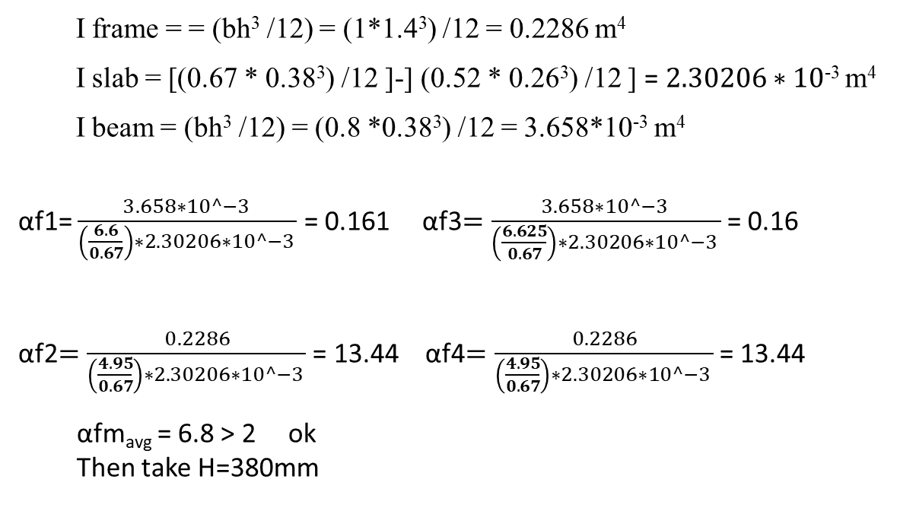
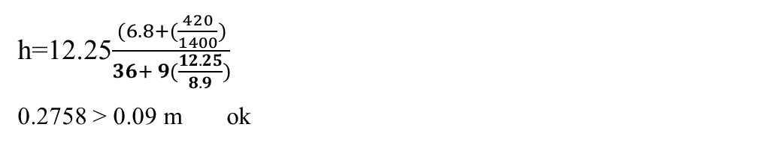
(3) For U-Boot :
h= ln $\frac{(6.8+(\frac{fy}{1400})}{36+9β}$
Assume αfm_{avg} > 2
h=12.25$\frac{(6.8+(\frac{420}{1400})}{36+ 9(\frac{12.25}{8.9})}$
0.2758 > 0.09 m ok
I frame = = (bh³ /12) = (1*1.4³) /12 = 0.2286 m⁴
I slab = [(0.67 * 0.38³) /12 [-] (0.52 * 0.26³) /12 [ = $2.30206∗10\text{−3} \text{m}\text{4}$
I beam = (bh³ /12) = (0.8 *0.38³) /12 = 3.658*10⁻³ m⁴
αf1= $\frac{3.658∗10^−3 }{\left(\frac{6.6}{0.67}\right)∗2.30206∗10^−3 }$ = 0.161 αf3$=\frac{3.658∗10^−3 }{\left(\frac{6.625}{0.67}\right)∗2.30206∗10^−3 }$ = 0.16
αf2$=\frac{0.2286}{\left(\frac{4.95}{0.67}\right)∗2.30206∗10^−3 }$ = 13.44 αf4$=\frac{0.2286}{\left(\frac{4.95}{0.67}\right)∗2.30206∗10^−3 }$ = 13.44
αfm_{avg} = 6.8 > 2 ok
Then take H=380mm
Slab dimensions:

Slide 17
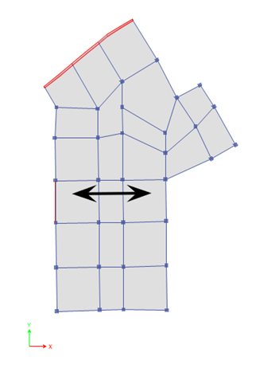
2.2: Preliminary beams thickness
2.2.1: For block one
Since we have two end continuous span then :
H beam = L / 21 = 6.2 / 21 = 0.3 m
Since h slab = 0.38 m then h beam is the same (h beam = 0.38 m)
B beam >= 200 mm
B beam >= L / 20 = 0.31 m (considered)
B beam >= 0.5 H = 0.19 m
Since we have hidden beams and the deflection is high then we increased the width of main beams
(B main beams = 800 mm)
For secondary beams: due to deflection we consider the width to be 600 mm and the depth = 380 mm

Slide 18
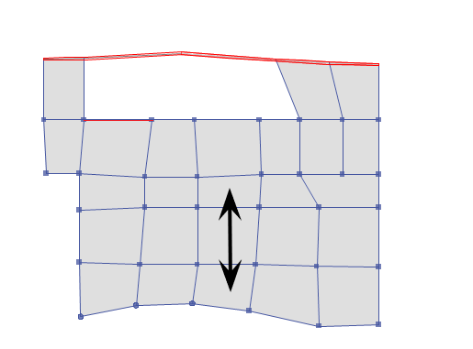
2.2.2: For block two
Since we have two end continuous span then :
H beam = L / 21 = 0.35 m
Since h slab = 0.38 m
B beam >= 200 mm
B beam >= L / 20 = 0.35 m (considered)
B beam >= 0.5 H = 0.19 m
B main beams = 800 mm
B secondary beams = 600 mm

Slide 19
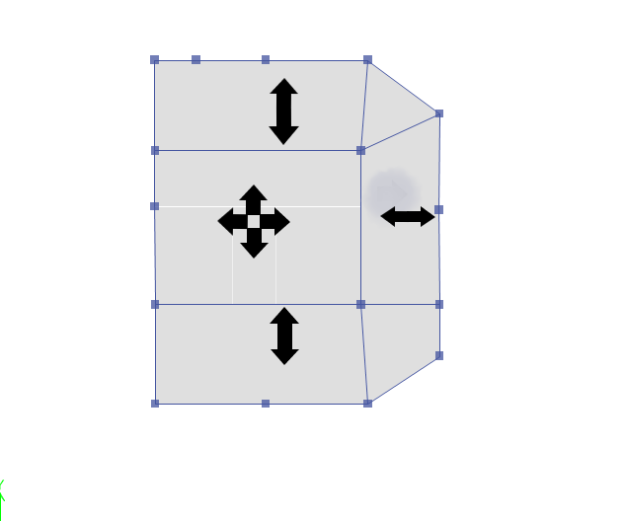
2.2.3: For block three
(1) For ribbed slab (Loads transfers in X-direction):
Since we have two end continuous span then :
H beam = L / 21 = 0.29 m
Since h slab = 0.38 m
B beam >= 200 mm
B beam >= L / 20 = 0.31 m (considered)
B beam >= 0.5 H = 0.19 m
B main beams = 800 mm
B secondary beams = 600 mm

Slide 20
(2) For ribbed slab (Loads transfers in Y-direction):
Since we have one end continuous span then :
H beam = L / 18.5 = 0.38 m
Since h slab = 0.38 m
B beam >= 200 mm
B beam >= L / 20 = 0.36 m (considered)
B beam>= 0.5 H = 0.19 m
B main beams = 800 mm
B secondary beams = 600 mm

Slide 21
(3) For U-Boot :
Since we have one end continuous span then :
H beam = L / 18.5 = 0.72 m
B beam >= 200 mm
B beam >= L / 20 = 0.66 m (considered)
B beam >= 0.5 H = 0.36 m
Since we have large deflection values we took H beam = 1.4 m and B beam = 1 m

Slide 22
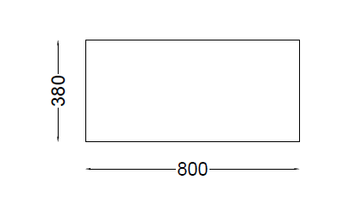
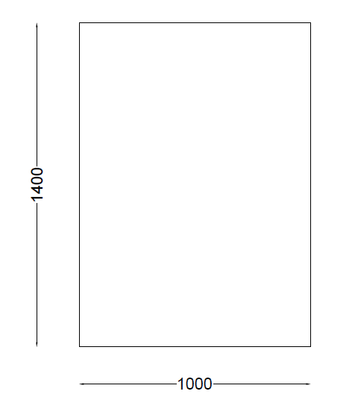
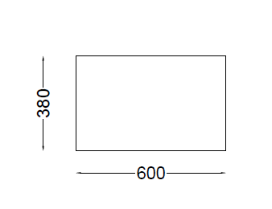
(1) Main beams section
(3) Frame beams section
(2) Secondary beams section

Slide 23
Chapter 3
Block 1 checks and design

Slide 24

3.1 : Compatibility Check
It is a check used to ensure that the structure is compatible, which means that the structural members works and moves as one mass and to ensure the connection between members as shown in pictures below:

Slide 25
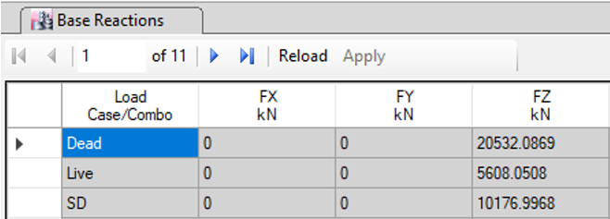
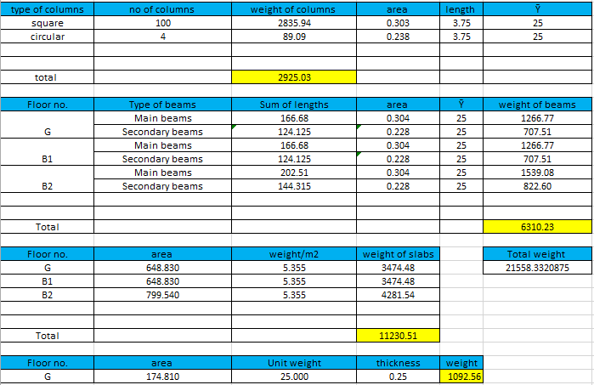
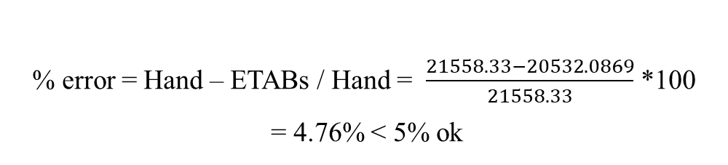
3.2: Equilibrium check
Dead load from ETABs:
Weight calculations (hand calculations):
Dead load: own weight of structural elements:
% error = Hand – ETABs / Hand = $\frac{21558.33−20532.0869}{21558.33}$ *100
= 4.76% < 5% ok

Slide 26
3.3: Stress strain check
From ETABs :
Moment at end one: 61.83 KN.m
Moment at end two: 74.29 KN.m
Moment at middle: 41 KN.m
Hand Calculations:
Mo = (Live load * L2 * Ln²) / 8 = (4.79 * (3 + 1.7) * (6.5-0.55)²) / 8 = 99.63 KN.m
By ETABs = middle + (end 1 + end 2) /2 = 41 + (74.29 + 61.83) / 2 = 109.06 KN.m
Error = 9.47 % < 10 % (OK)

Slide 27
3.4: Deflection check
a) Deflection for slab :
The deflection due to 2D+2SD+1L is equal to ( L /240 ) where L is the shortest direction in the largest panel which equals to ( 5.7 / 240 ) = 0.02375 m
The deflection of hand calculation = 0.02375 m and the deflection by the software = (0.040422/1.4) – ((0.00678+0.003859+0.005774+0.005437)/4) =0.02341 m so 0.0237 > 0.02341 which is safe.

Slide 28
3.4: Deflection check
b) Deflection for beams :
The deflection due to service live load = ( L / 360 ) where L is the length of beam that have the highest deflection which equals to (7.27 / 360 ) = 0.02 m
The deflection of hand calculation = 0.020 m and the deflection by the software = 0.00373 m so 0.02 > 0.00373 which is safe .

Slide 29
3.5: Reinforcement design for slab
We took the max positive moment and the max negative moment:
The maximum negative moment =107 KN.m
(ρ) = 0.0025
As =850 mm²/m < As (min) = 1132.2 mm²/m
Use As = 1132.2 mm²/m
As = 1132.2*0.55 = 622.71 mm²/550 mm
Use 2Φ20/550 mm (ribs)
The maximum positive moment = 77.17 KN.m
(ρ ) = 0.00179
As =609 mm²/m < As (min) = 1132 mm²/m
Use As = 1132.2 mm²/m
As = 1132.2*0.55 = 622.71 mm²/550 mm
Use 2Φ20/550 mm (ribs)

Slide 30
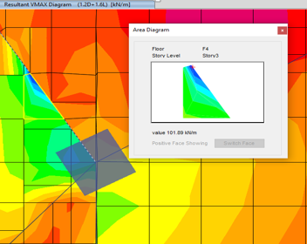
3.6: Shear check for slab
ØVc = 0.75*(1/6)*1 √28 * 1000*340/1000= 225 KN.
ØVc / 2 = 112.5 KN
Vu=102 KN
Vu < Ø Vc / 2 (No need for shear reinforcement)
We used minimum shear reinforcement.
(Av /s)min = 0.833
Assume 2 leg Ø 10
Av = 2*78.5 = 157 mm²
S = 157 / 0.833 = 188 mm
Smax = min [ 170 , 600 ]
Smax = 170 mm
Use 2 legs Ø 10 / 170mm

Slide 31
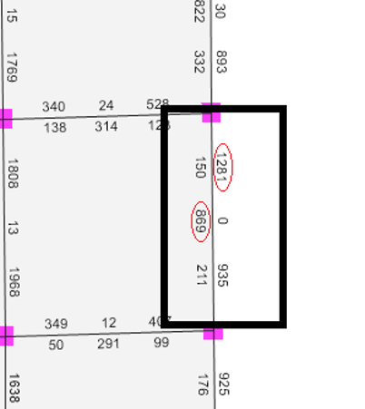
3.7: Design check and reinforcement for beams
Wu on slab =14.8 KN/m²
Wu on beam = (6/2)*14.8+ (1.2*3.3) +7.6*1.2 = 57.48 KN/m
Mu(Positive)=(57.48*(6.2-0.55)²)/16 = 114.68 KN.m
ρ=0.00338
As manual = ρ*b*d =918.36 mm²
As from Etabs =869mm²
Error 5.4% < 10% OK
Mu (negative) = (57.48*(6.2-0.55)²)/11 = 166.8 KN.m
ρ=0.004983
As manual = ρbd =1355.38 mm²
As from Etabs =1281mm²
Error 5.5% < 10% OK

Slide 32
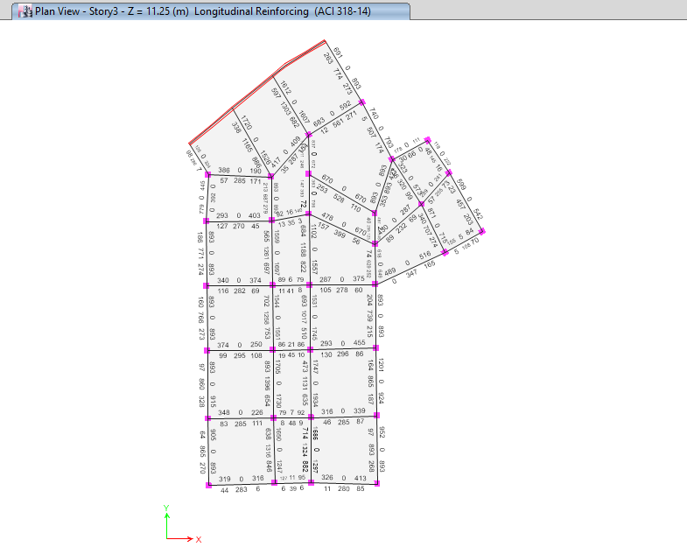
Notes:
For main beams that have As < As _{min =} 0.00333*800*340=905.76 mm use As=905.76 mm.
For secondary beams that have As < As _{min =} 0.00333*600*340=679.32 mm use As=679.32 mm.

Slide 33
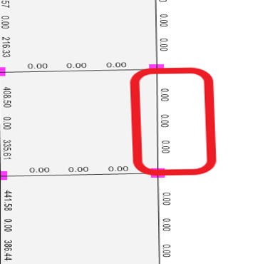
3.8: Design check and reinforcement for shear in beams
Wu on beam =57.48 KN/m
Vu = (57.48 * (6.2-0.55)) / 2 = 162.38 KN
Vu / Ø = 162.38/0.75 = 216.5 KN
Vc = (1/6) * √28 * 800 * 340 / 1000 = 239.88 KN
Vc / 2 = 119.94 KN
Vc / 2 < ( Vu / Ø ) < Vc Category 2 (Case 2)
Then we use minimum shear reinforcement.
(Av /s)min = 0.67
Assume 2 leg Ø 10
Av = 2*78.5 = 157 mm²
S = 157 / 0.67 = 234.33 mm
Smax = min [340/2=170, 600]
Smax = 170 mm
Use 2 legs Ø 10 / 170 mm

Slide 34
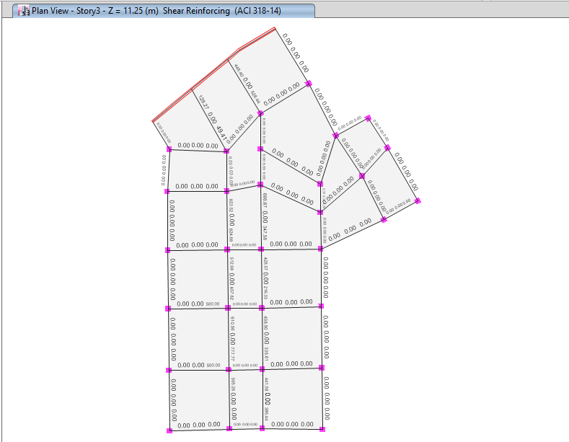
Notes:
For main beams that have ØVc / 2 < Vu < ØVc = 0.75*239.88 = 179.91 use minimum shear reinforcement
= 2 legs Ø 10 / 170 mm.
For secondary beams that have ØVc / 2 < Vu < ØVc = 0.75*179.91 = 134.93 use minimum shear reinforcement = 2 legs Ø 10 / 170 mm.

Slide 35
Chapter 4
Block 2 checks and design

Slide 36
4.1 : Compatibility Check
It is a check used to ensure that the structure is compatible, which means that the structural members works and moves as one mass and to ensure the connection between members as shown in pictures below:

Slide 37
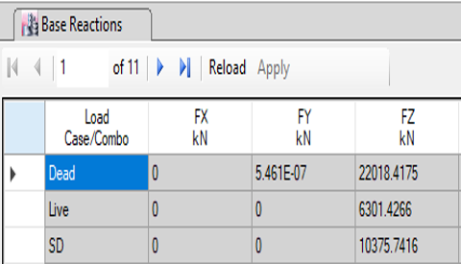
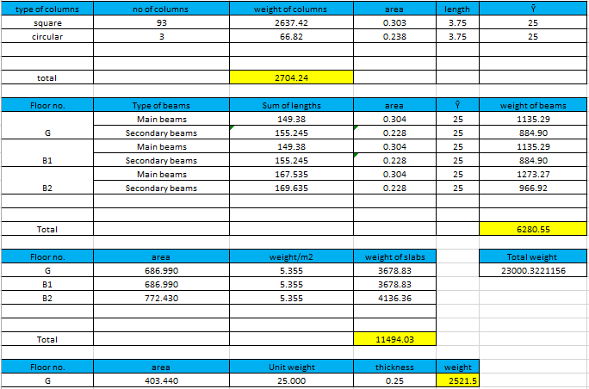
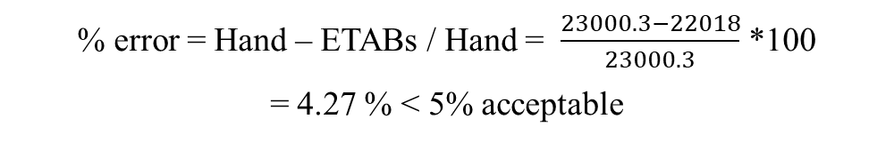
4.2: Equilibrium check
Dead load from ETABs:
Weight calculations (hand calculations):
Dead load: own weight of structural elements:
% error = Hand – ETABs / Hand = $\frac{23000.3−22018}{23000.3}$ *100
= 4.27 % < 5% acceptable

Slide 38
4.3: Stress strain check
From ETABs :
Moment at end one: 46.13 KN.m
Moment at end two: 47.03 KN.m
Moment at middle: 28.84 KN.m
Hand Calculations:
Mo = (superimposed dead load * L2 * Ln²) / 8 = (4.42 * (1.65+3.05) * (5.8-0.55)²) / 8 = 71.57 KN.m
By ETABs = middle + (end 1 + end 2) / 2 = 28.84 + (46.13+47.03) / 2 = 75.42 KN.m
Error = 5.38 % < 10 % (OK)

Slide 39
4.4: Deflection check
a) Deflection for slab :
The deflection due to 2D+2SD+1L is equal to ( L /240 ) where L is the shortest direction in the largest panel which equals to ( 5.7 / 240 ) = 0.02375 m
The deflection of hand calculation = 0.02375 m and the deflection by the software = (0.040422/1.4) – ((0.00678+0.003859+0.005774+0.005437)/4) =0.02341 m so 0.0237 > 0.02341 which is safe.

Slide 40
4.4: Deflection check
b) Deflection for beams :
The deflection due to service live load = ( L / 360 ) where L is the length of beam that have the highest deflection which equals to (7.27 / 360 ) = 0.02 m
The deflection of hand calculation = 0.020 m and the deflection by the software = 0.00373 m so 0.02 > 0.00373 which is safe .

Slide 41
4.5: Reinforcement design for slab
We took the max positive moment and the max negative moment:
The maximum negative moment = 65.366 KN.m
( ρ ) = 0.00151
As =514.63 mm²/m< As(min) = 1132.2 mm²/m
Use As = 1132.2 mm²/m
As = 1132.2*0.55 = 622.71 mm²/550 mm
Use 2Φ20/550 mm (ribs)
The maximum positive moment = 65.401 KN.m
( ρ ) = 0.00151
As =514.91 mm²/m < As(min) = 1132.2 mm²/m
Use As = 1132.2 mm²/m
As = 1132.2*0.55 = 622.71 mm²/550 mm
Use 2Φ20/550 mm (ribs)

Slide 42
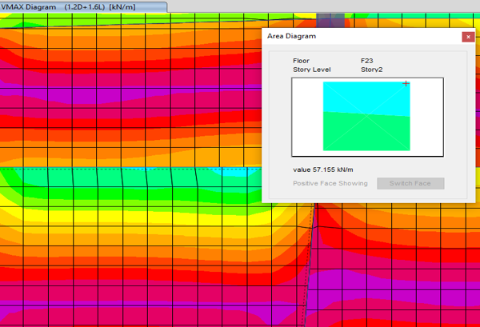
4.6: Shear check for slab
ØVc = 0.75*(1/6)*1 √28 * 1000*340/1000= 225 KN.
ØVc / 2 = 112.5 KN
Vu=57.15 KN
Vu < Ø Vc / 2 (No need for shear reinforcement)
We used minimum shear reinforcement.
(Av /s)min = 0.833
Assume 2 leg Ø 10
Av = 2*78.5 = 157 mm²
S = 157 / 0.833 = 188 mm
Smax = min [ 170 , 600 ]
Smax = 170 mm
Use 2 legs Ø 10 / 170mm

Slide 43
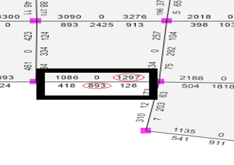
4.7: Design check and reinforcement for beams
Wu on slab =14.8 KN/m²
Wu on beam = (6.1/2)*14.8+ (1.2*3.3) +7.6*1.2 = 58.22 KN/m
Mu(Positive)=(58.22*(6.2-0.55)²)/16 =116.16 KN.m
ρ=0.00342
As manual = ρ*b*d =930.24 mm2
As from Etabs =893mm2
Error 4% < 10% OK
Mu (negative) = (58.22*(6.2-0.55)²)/11 =168.96 KN.m
ρ=0.00505
As manual = ρbd =1373.6 mm²
As from Etabs =1297 mm²
Error 5.58 % < 10% OK

Slide 44
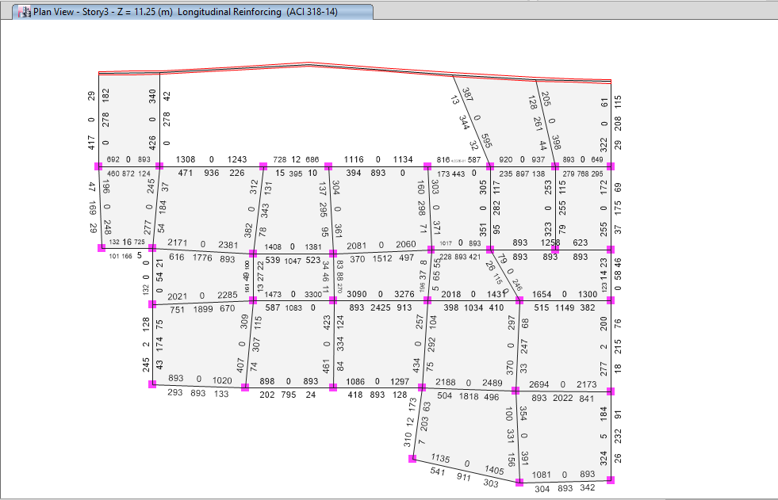
Notes:
For main beams that have As < As _{min =} 0.00333*800*340=905.76 mm use As=905.76 mm.
For secondary beams that have As < As _{min} = 0.00333*600*340=679.32 mm use As=679.32 mm.

Slide 45
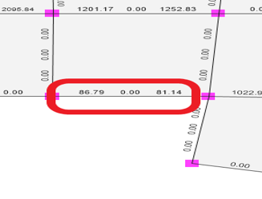
4.8: Design check and reinforcement for shear in beams
Wu on beam =57.48 KN/m
Vu = (58.22 * (6.2-0.55)) / 2 = 164.47 KN
Vu / Ø = 164.47/0.75 = 219.3 KN
Vc = (1/6) * √28 * 800 * 340 / 1000 = 239.88 KN
Vc / 2 = 119.94 KN
Vc / 2 < ( Vu / Ø ) < Vc Category 2 (Case 2)
Then we use minimum shear reinforcement.
(Av /s)min = 0.67
Assume 2 leg Ø 10
Av = 2*78.5 = 157 mm²
S = 157 / 0.67 = 234.33 mm
Smax = min [340/2=170, 600]
Smax = 170 mm
Use 2 legs Ø 10 / 170 mm

Slide 46
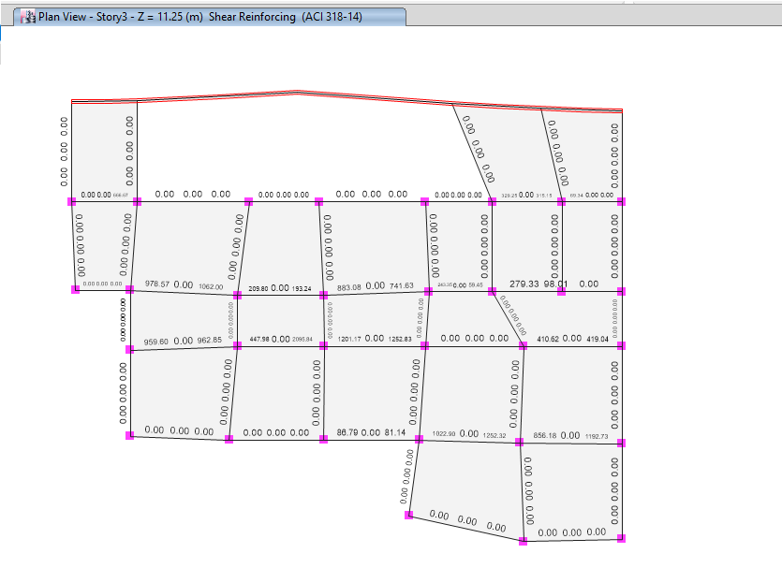
Notes:
For main beams that have ØVc / 2 < Vu < ØVc = 0.75*239.88 = 179.91 use minimum shear reinforcement
= 2 legs Ø 10 / 170 mm.
For secondary beams that have ØVc / 2 < Vu < ØVc = 0.75*179.91 = 134.93 use minimum shear reinforcement = 2 legs Ø 10 / 170 mm.

Slide 47
Chapter 5
Block 3 checks and design

Slide 48
5.1 : Compatibility Check
It is a check used to ensure that the structure is compatible, which means that the structural members works and moves as one mass and to ensure the connection between members as shown in pictures below:

Slide 49
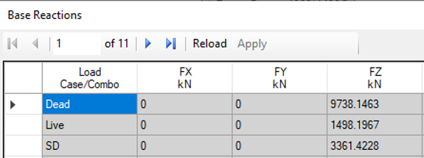
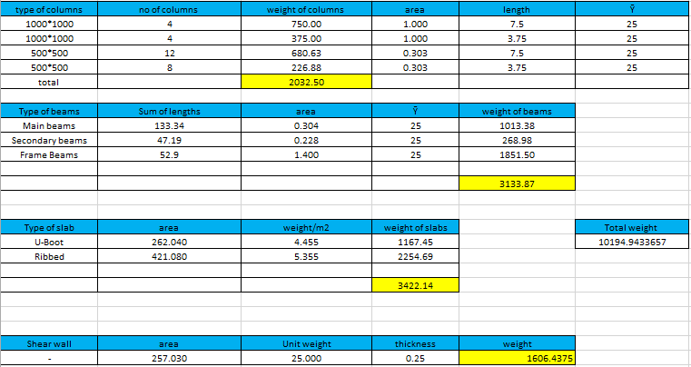
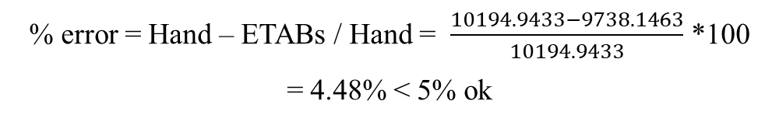
5.2: Equilibrium check
Dead load from ETABs:
Weight calculations (hand calculations):
Dead load: own weight of structural elements:
% error = Hand – ETABs / Hand = $\frac{10194.9433−9738.1463}{10194.9433}$ *100
= 4.48% < 5% ok

Slide 50
5.3: Stress strain check
From ETABs :
Moment at end one: 9.868 KN.m
Moment at end two: 8.7538 KN.m
Moment at middle: 7.6788 KN.m
Hand Calculations:
Mo = (Live load * L2 * Ln²) / 8 = (1.92) * (2.525) * (6.1-0.55)²) / 8 = 18.666 KN.m
By ETABs = middle + (end 1 + end 2) / 2 = 7.6788+ (9.868+ 8.7538) / 2 = 16.9897 KN.m
Error = 8.98 % < 10 % (OK)

Slide 51
5.4: Deflection check
a) Deflection for slab :
The deflection due to 2D+2SD+1L is equal to ( L /240 ) where L is the shortest direction in the largest panel which equals to ( 9.9 / 240 ) = 0.0412m
The deflection of hand calculation = 0.0247 m and the deflection by the software = (0.061148/1.4) – ((0.00515+0.003276+0.004168+0.005282)/4) =0.0392 m so 0.0412 > 0.0392 which is safe.

Slide 52
5.4: Deflection check
b) Deflection for beams :
The deflection due to service live load = ( L / 360 ) where L is the length of beam that have the highest deflection which equals to ( 13.25 / 360 ) = 0.0368 m
The deflection of hand calculation = 0.0368 m and the deflection by the software = 0.003258 m so 0.0368 > 0.003258 which is safe .

Slide 53
5.5: Reinforcement design for slab
For one-way Ribbed slab :
We took the max positive moment and the max negative moment from M11 and M22 :
The maximum negative moment = 158.119 KN.m
( ρ ) = 0.00374
As =1270.11 mm²/m > As(min) = 1132.2 mm²/m
Use As = 1270.11 mm²/m
As = 1270.11*0.55 = 698.56 mm²/550 mm
Use 2Φ22/550 mm (ribs)
The maximum positive moment = 47 KN.m
( ρ ) = 0.00108
As =368.62 mm²/m < As(min) = 1132.2 mm²/m
Use As = 1132.2 mm²/m
As = 1132.2*0.55 = 622.71 mm²/550 mm
Use 2Φ20/550 mm (ribs)

Slide 54
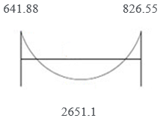
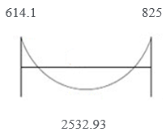
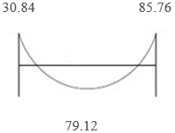
5.5: Reinforcement design for slab
For two-way U-Boot slab :
For X-Direction:
1) Moment values for Frame:
2) Moment values for Column strip:
3) Moment values for Column strip slab:

Slide 55
5.5: Reinforcement design for slab
For Column strip slab:
We took the max positive moment and the max negative moment from Column strip slab:
For the maximum negative moment = 85.76 KN.m
( ρ ) = 0.00199
As =678.1 mm²/m < As(min) = 1132.2 mm²/m
Use As = 1132.2 mm²/m
As = 1132.2*0.67 = 751.74 mm²/670 mm
Use 2Φ22/670 mm (ribs)
For the positive moment = 79.12 KN.m
( ρ ) = 0.00184
As =624.72 mm²/m < As(min) = 1132.2 mm²/m
Use As = 1132.2 mm²/m
As = 1132.2*0.67 = 758.754 mm²/670 mm
Use 2Φ22/670 mm (ribs)

Slide 56
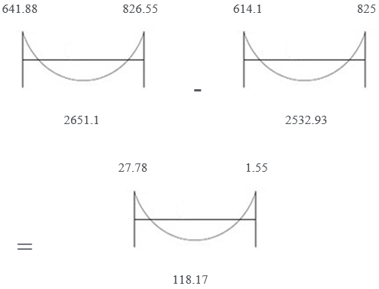
5.5: Reinforcement design for slab
4) Moment values for Middle strip slab:

Slide 57
5.5: Reinforcement design for slab
For Middle strip slab:
We took the max positive moment and the max negative moment from Middle strip slab:
For the maximum negative moment = 27.78 KN.m
( ρ ) = 0.00064
As =217.01 mm²/m < As(min) = 1132.2 mm²/m
Use As = 1132.2 mm²/m
As = 1132.2*0.67 = 758.574 mm²/670 mm
Use 2Φ22/670 mm (ribs)
For the positive moment = 118.17 KN.m
( ρ ) = 0.00277
As =940.9 mm²/m < As(min) = 1132.2 mm²/m
Use As = 1132.2 mm²/m
As = 1132.2*0.67 = 758.574 mm²/670 mm
Use 2Φ22/670 mm (ribs)

Slide 58
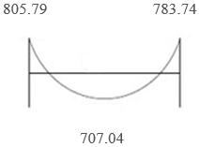


5.5: Reinforcement design for slab
For two-way U-Boot slab :
For Y-Direction:
1) Moment values for Frame:
2) Moment values for Column strip:
3) Moment values for Column strip slab:

Slide 59
5.5: Reinforcement design for slab
For Column strip slab:
We took the max positive moment and the max negative moment from Column strip slab:
For the maximum negative moment = 370.9 KN.m
( ρ ) = 0.00922
As =3136.381 mm²/m > As(min) = 1132.2 mm²/m
Use As = 3136.38 mm²/m
As = 3136.38*0.67 = 2101.375 mm²/670 mm
Use 2Φ38/670 mm (ribs)
For the positive moment = 309.2 KN.m
( ρ ) = 0.00757
As =2573.73 mm²/m > As(min) = 1132.2 mm²/m
Use As = 2573.73 mm²/m
As = 2573.73*0.67 = 1724.397 mm²/670 mm
Use 2Φ35/670 mm (ribs)

Slide 60

5.5: Reinforcement design for slab
4) Moment values for Middle strip slab:

Slide 61
5.5: Reinforcement design for slab
For Middle strip slab:
We took the max positive moment and the max negative moment from Middle strip slab:
For the maximum negative moment = 236.79 KN.m
( ρ ) = 0.0057
As =1936.69 mm²/m > As(min) = 1132.2 mm²/m
Use As = 1936.69 mm²/m
As = 1936.689*0.67 = 1297.582 mm²/670 mm
Use 2Φ32/670 mm (ribs)
For the positive moment = 254.14 KN.m
( ρ ) = 0.00614
As =2087.18 mm²/m > As(min) = 1132.2 mm²/m
Use As = 2087.18 mm²/m
As = 2087.18*0.67 = 1398.408 mm²/670 mm
Use 2Φ32/670 mm (ribs)

Slide 62

5.6: Shear check for slab
ØVc = 0.75*(1/6)*1 √28 * 1000*340/1000= 225 KN.
ØVc / 2 = 112.5 KN
Vu=100.326 KN
Vu < ØVc / 2 (No need for shear reinforcement)
We used minimum shear reinforcement.
(Av /s)min = 0.833
Assume 2 leg Ø 10
Av = 2*78.5 = 157 mm²
S = 157 / 0.833 = 188 mm
Smax = min [ 170 , 600 ]
Smax = 170 mm
Use 2 legs Ø 10 / 170mm

Slide 63

5.7: Design check and reinforcement for beams
Wu on slab =14.8 KN/m²
Wu on beam = (5.05/2)*14.8+ (1.2*3.3) +7.6*1.2 =50.45 KN/m
Mu (Positive)= (50.45*(6.1-0.55)²)/16 = 97.12 KN.m
ρ=0.002845ρ < ρmin
Take ρ=0.00333
As manual = ρ*b*d =905.76 mm²
As from Etabs =826 mm²
Error 8.81 % < 10% OK
Mu (negative) = (50.45*(6.1-0.55)²)/11= 141.27 KN.m
ρ=0.00419
As manual = ρbd =1139.49 mm²
As from Etabs =1177 mm²
Error 3.29 % < 10% OK

Slide 64

Notes:
For main beams that have As < As _{min =} 0.00333*800*340=905.76 mm use As=905.76 mm.
For secondary beams that have As < As _{min} = 0.00333*600*340=679.32 mm use As=679.32 mm.
For Frame beams that have As < As _{min} = 0.00333*1000*340=1132.2 mm use As=1132.2 mm.

Slide 65

5.8: Design check and reinforcement for shear in beams
Wu on beam =50.45 KN/m
Vu = (50.45 * (6.1-0.55)) / 2 = 140 KN
Vu / Ø = 140/0.75 = 186.67 KN
Vc = (1/6) * √28 * 800 * 340 / 1000 = 239.88 KN
Vc / 2 = 119.94 KN
Vc / 2 < ( Vu / Ø ) < Vc Category 2 (Case 2)
Then we use minimum shear reinforcement.
(Av /s)min = 0.67
Assume 2 leg Ø 10
Av = 2*78.5 = 157 mm²
S = 157 / 0.67 = 234.33 mm
Smax = min [340/2=170, 600]
Smax = 170 mm
Use 2 legs Ø 10 / 170 mm

Slide 66

Notes:
For main beams that have ØVc / 2 < Vu < ØVc = 0.75*239.88 = 179.91 use minimum shear reinforcement
= 2 legs Ø 10 / 170 mm.
For secondary beams that have ØVc / 2 < Vu < ØVc = 0.75*179.91 = 134.93 use minimum shear reinforcement
= 2 legs Ø 10 / 170 mm.
For frame beams that have ØVc / 2 < Vu < ØVc = 0.75*299.85 = 224.89 use minimum shear reinforcement
= 2 legs Ø 10 / 170 mm.

Slide 67
Thank You for Listening.

