Slide 1

An-N National University
Telecommunication Department
Enhanced Parking System
Submitted to: Dr.Naser Abu Zaid
Done by:
Ahlam Atout
Asma Alawneh
Diala Ashour

Slide 2
Outline
Introduction to our project .
algorithm ( flow chart ) .
image processing (algorithm)
explain neural network .
result of neural network .
raspberry pi .
recommendation .
conclusion

Slide 3
Introduction
Helping the citizen to save there time and money ,and facilitate the controlling operation of violation .uses an appropriate DIP combined with ANN algorithm

Slide 4
Significance
Automated
Economically
Effective remainder
Keep extra time
More parking spaces

Slide 5

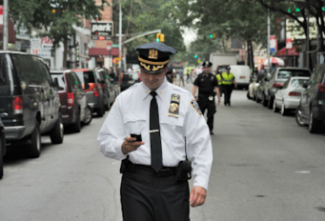
From government point of view
Economically
Automated

Slide 6

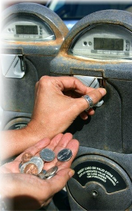
From user point of view
Effective remainder
Keep extra time

Slide 7
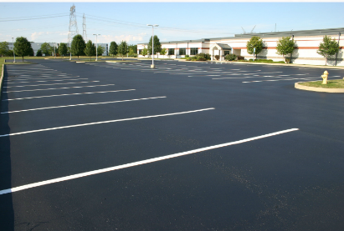
Keep extra time

Slide 8
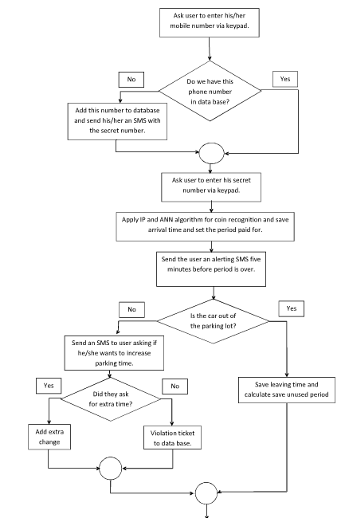
Flow Chart

Slide 9
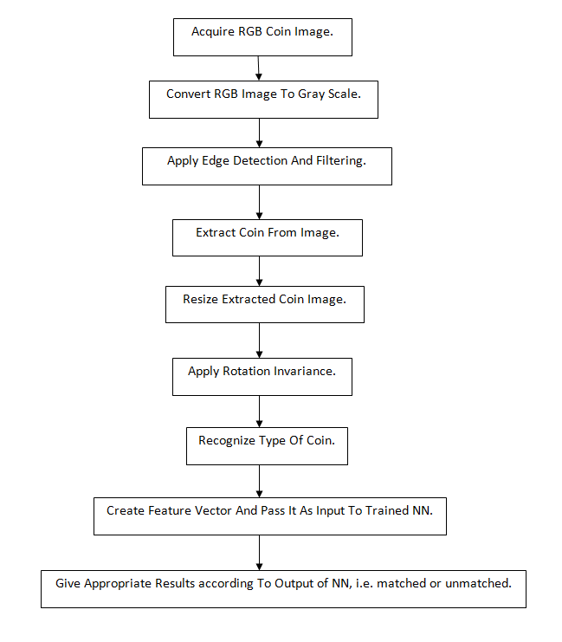
First part: image processing

Slide 10

Edge detection

Slide 11

Huff transform

Slide 12

ROI(creating mask) and cropping
The final stage, this image inter the ANN

Slide 13

Another example of image processing

Slide 14
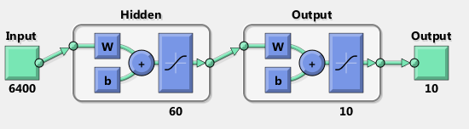
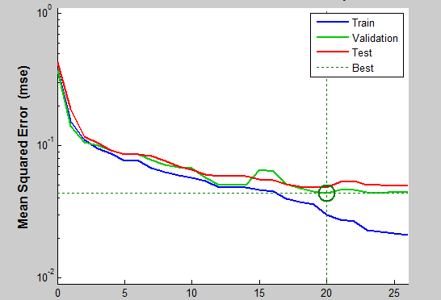
RESULTS OF ann
Two layer-network
Figure 1The architecture of one hidden-network.
Figure 2 The performance of one hidden-network

Slide 15
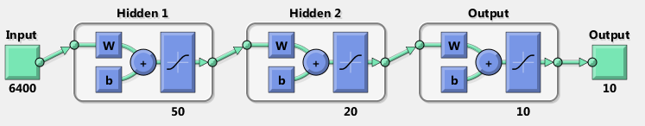
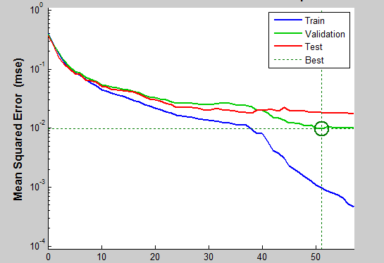
Three layer-network
Figure 3 The architecture of two hidden-network.
Figure 4 The performance of two hidden-network

Slide 16
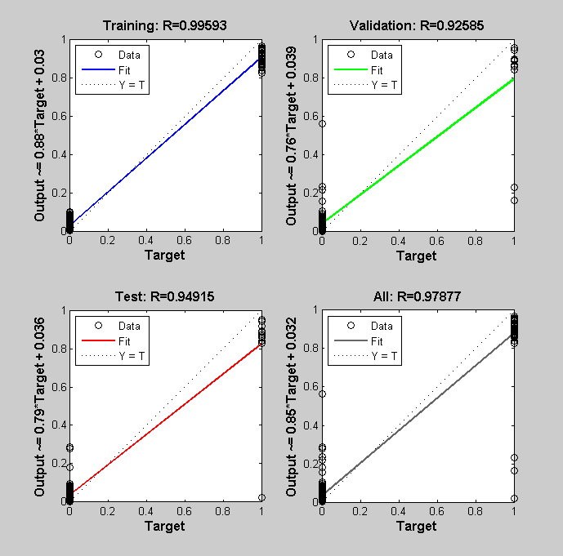
Figure 5 The regression plot of two hidden layer-network.

Slide 17
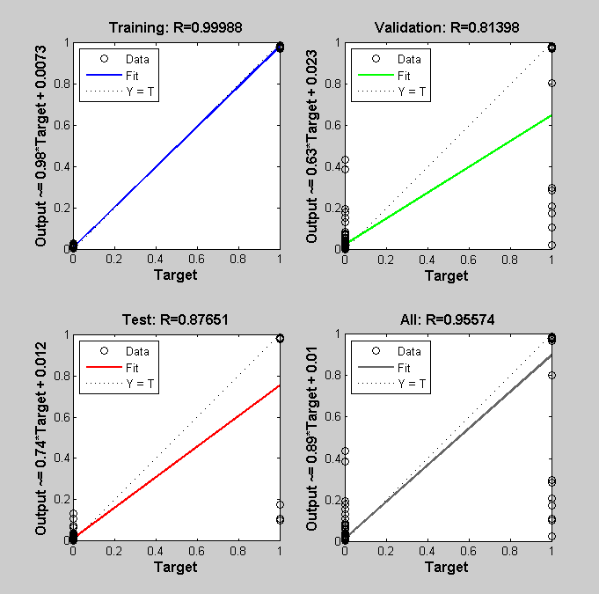
Figure 4 The regression plot of one hidden layer-network

Slide 18
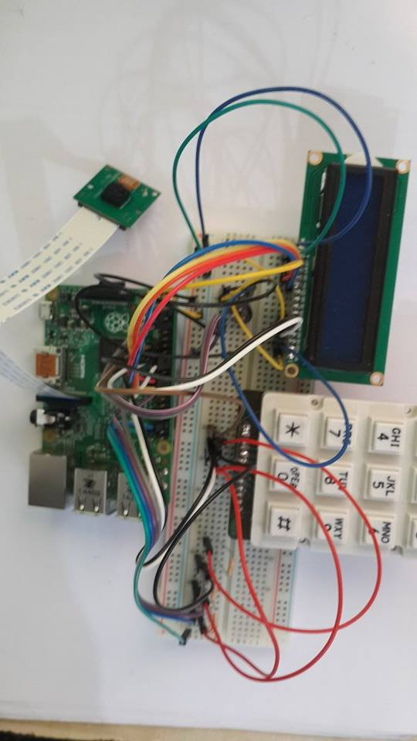
Interactive part with user

Slide 19
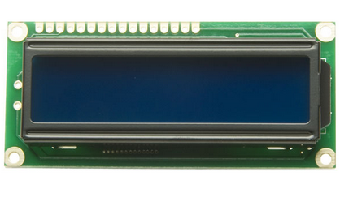
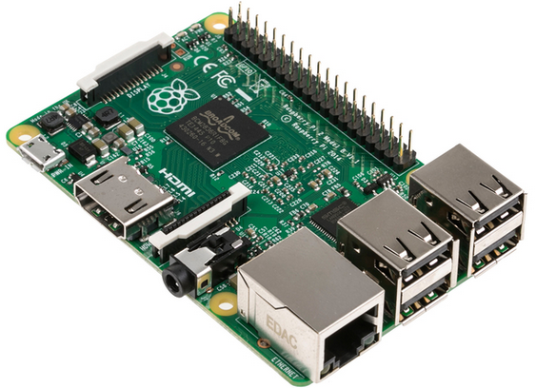
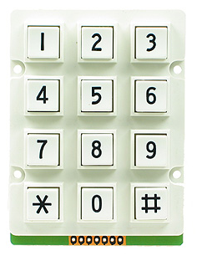
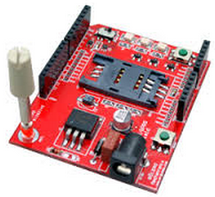
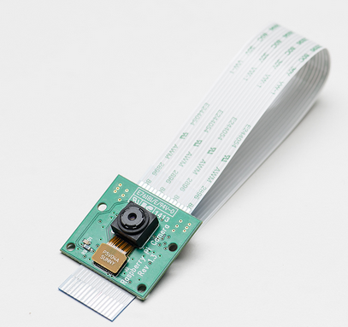
Interactive part with user
The whole system should consist of

Slide 20
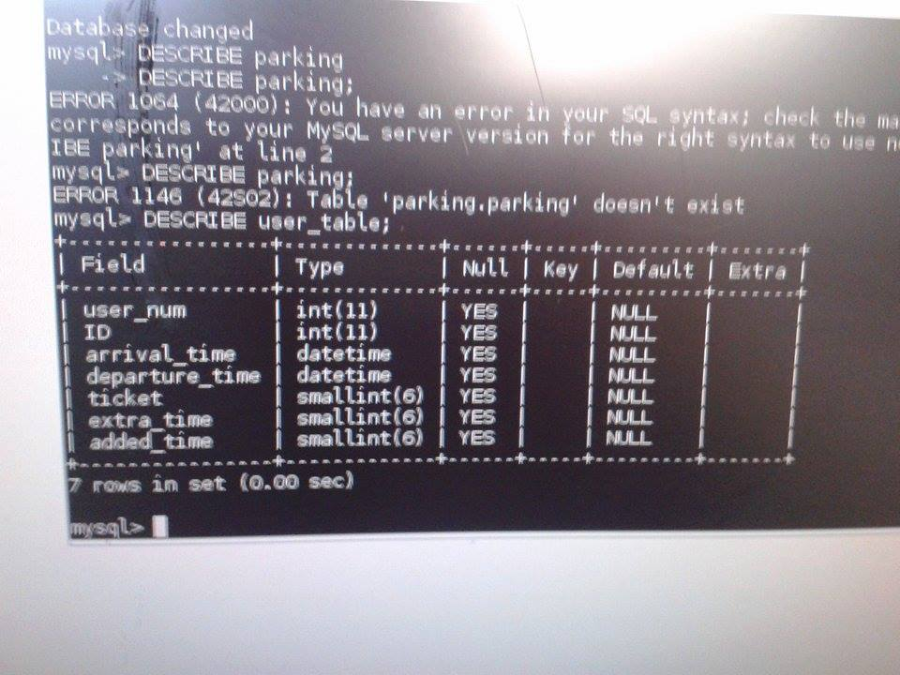
Our database using Mysql

Slide 21
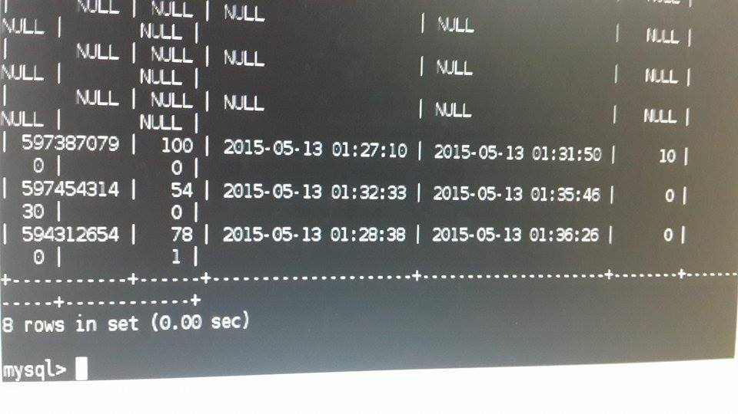
Example
Receive users data and add an account if not already there.
Check if user has a previous violation ticket, extra time or borrowed time.
start counter according to users decision.
Alert user 10 minutes before his time ends, giving optional added time, and update record accordingly.

Slide 22
conclusion
The first step in this project was coin recognition, by using a sensor connected to a control unit. After recognizing the coin a counter begin to count according to amount of money that the customer inserts. There is a data base contains mobile number and a secret code for each user and the amount of money he has in his account.

Slide 23
Further work
Building a larger data base on a central server .
Building the entire mechanical system where the coin falls and excites a sensor that would trigger the camera.
Converting our Matlab code for image processing and neural network into a code written in one of the softwares running on raspberry pi.

