Slide 1
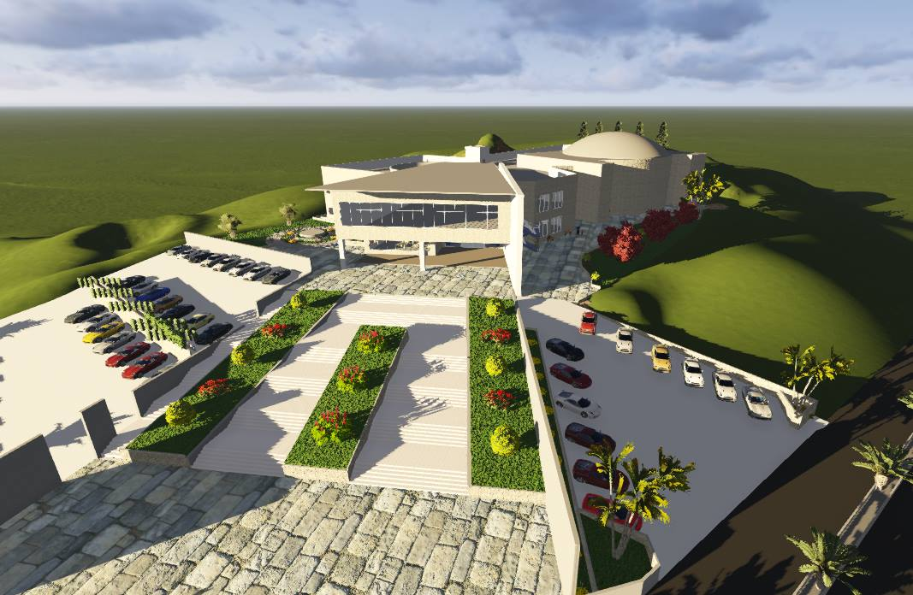
Culture Center
Prepared by:
Isra Draghmah
Sara AL-Khateeb
Riham Shakarnah
Supervisor :
Dr. Ahmad Saleh

Slide 2
Outline:
Introduction
Architectural Design
Structural Design
Mechanical Design
Safety Design
Environmental Design
Electrical Design
Quantity surveying and cost estimation

Slide 3
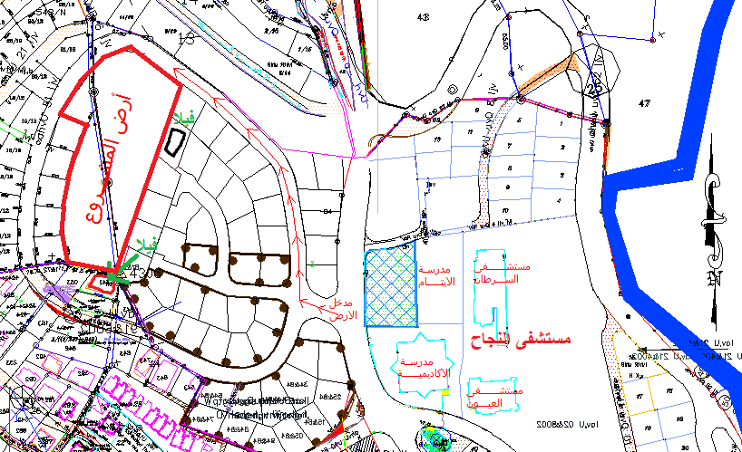
Introduction :
Location:
  -In Nablus near An-Najah Hospital, it is located to the north of Rafidya
  Street , and to the north- western of city center .
Total Area =
13368m^2
Notes:
Location of the project is in jamal abd alnaser park in nablus in yafa street , type of restaurant is fine dinning
The project is important because the municapility workiing to develop the park and theres no restaurants so it will be destination for the vsitors
Area =2000m^2

Slide 4
Architectural Design

Slide 5
Architectural Design:
1-Video .
2- Site plan and Accessibility
3- The plans
4- Sections
5- Elevations .
6-Requirements for Handicapped People

Slide 6
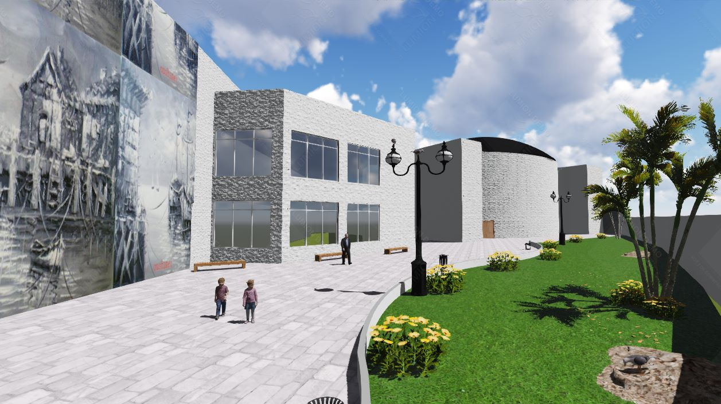
Architectural Design:

Slide 7
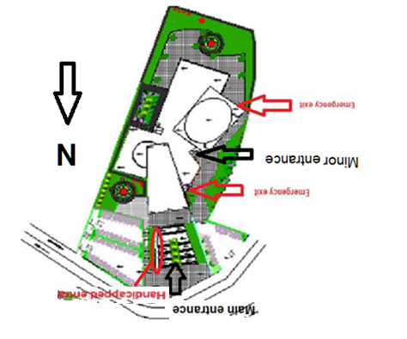
Site plan:
Notes:
The main entrance of the restaurant is from Jamal Abdel Nasser Park, the secondary entrance of parking, management, and services are from Yafa Street as shown in the figure below.
The site contains parking which the capacity of it about 36 car, and there are two ramps the first one for entrance, and the second one for exit

Slide 8
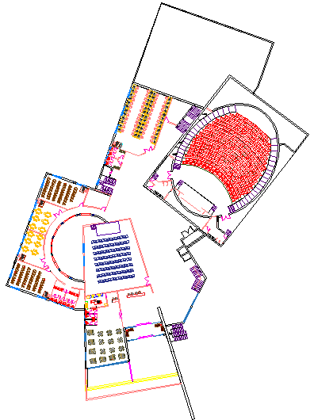
Ground Floor
Area=3256.3m^2
Notes:
The ground floor contains the reception and cashier, coat room, kitchen, dining area, mechanical and electrical rooms and storage

Slide 9
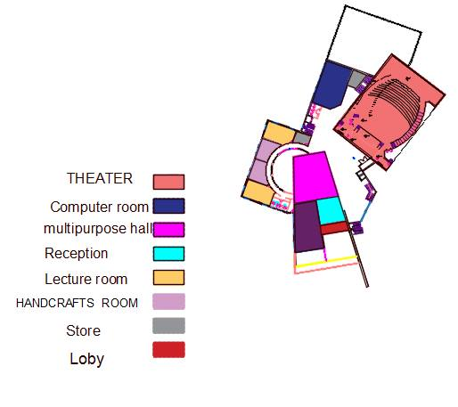

Slide 10
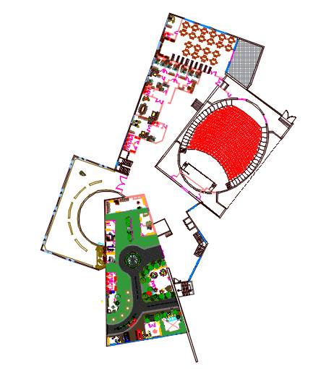
First Floor
Area=3864.83m^2

Slide 11
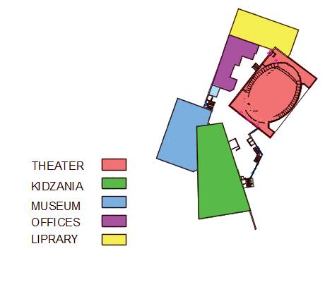

Slide 12
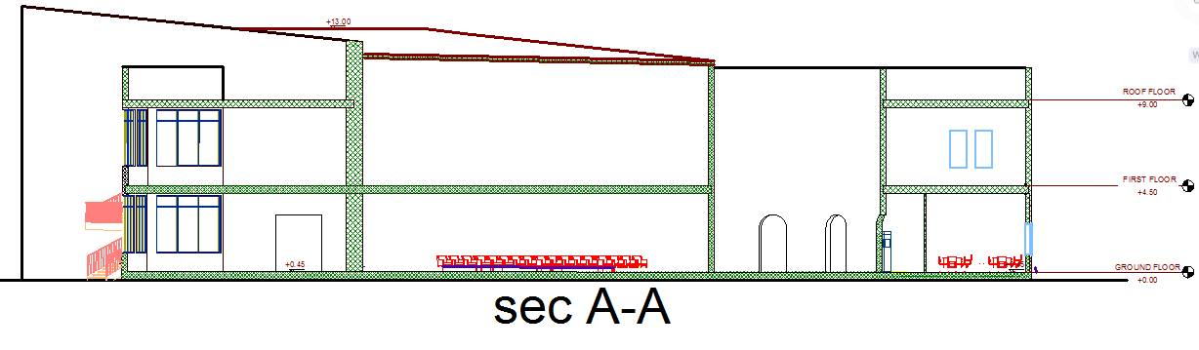
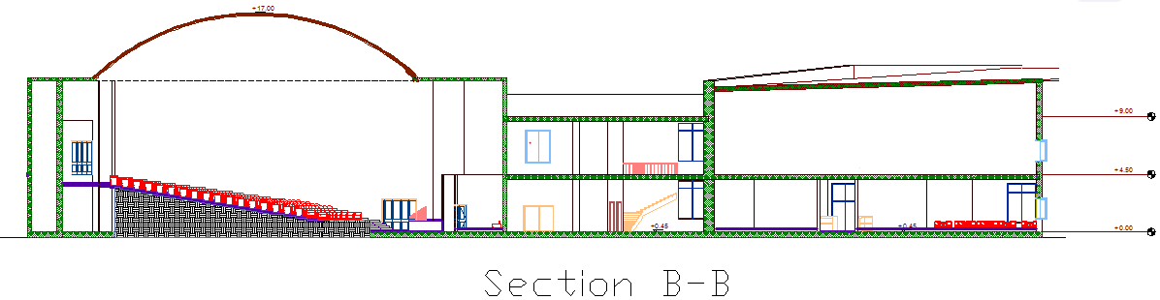
Sections

Slide 13
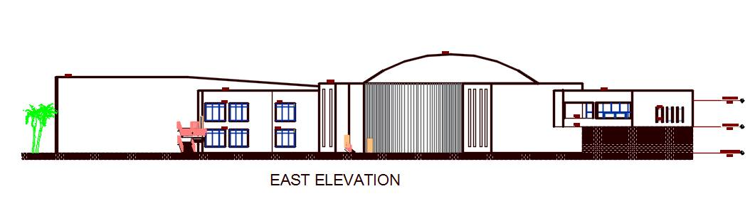
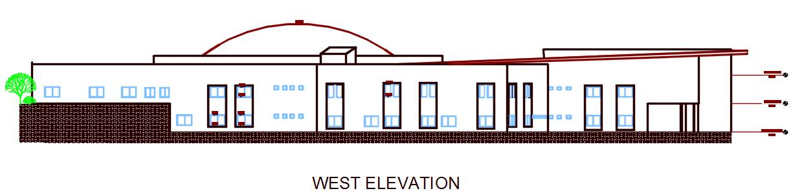
Elevations :

Slide 14
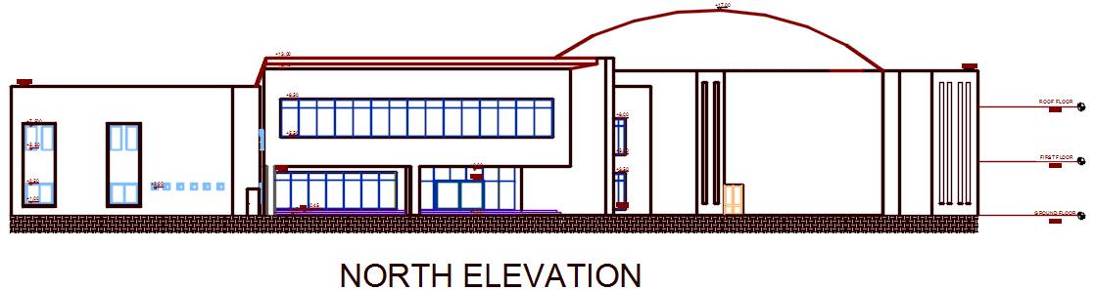
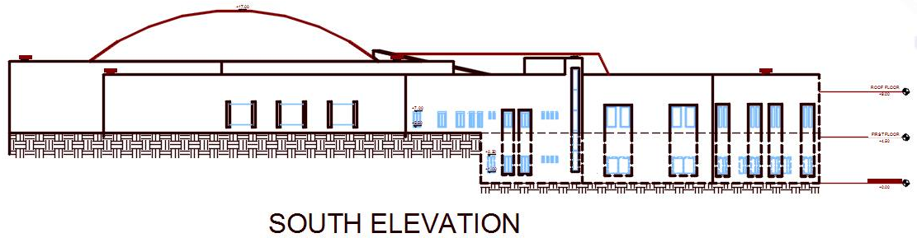

Slide 15
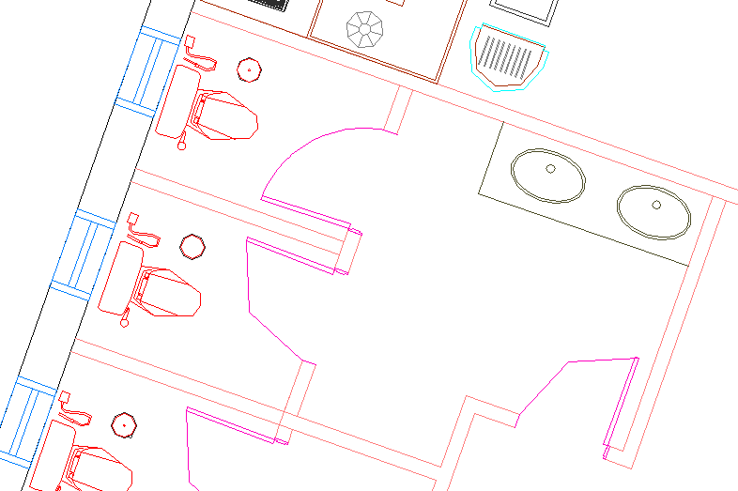
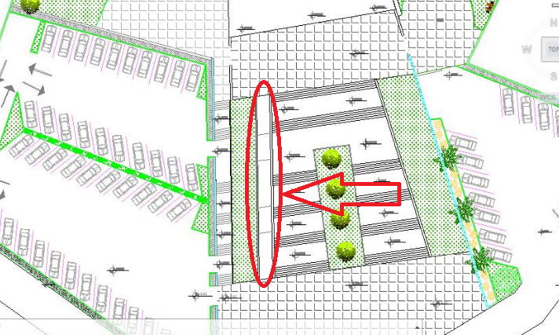
Requirements for Handicapped People
Special W.C
Ramps

Slide 16
Structural Design

Slide 17
Structural Design:
1- Design codes
2- Loads
3- Sap model and checks
4- Structural elements and detailing

Slide 18
Design Codes:
ACI-318-08 for reinforced concrete design .
UBC-97 for earthquake load computations .
ASCE for load computations

Slide 19
Loads:
Type of loads | Load (KN/m2)
Live load | 5KN/m²
Super imposed | 3KN/m²
Exterior walls | 21KN/m

Slide 20
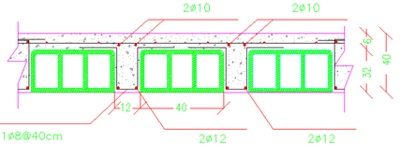
We have many slab system :
1- one way ribbed slab (40 cm thickness )
2- two way ribbed slab (40 cm and 50 cm thickness ) with Drop beams .
3- Shell structure ( 15 cm ) .
Section in one way ribbed slab

Slide 21
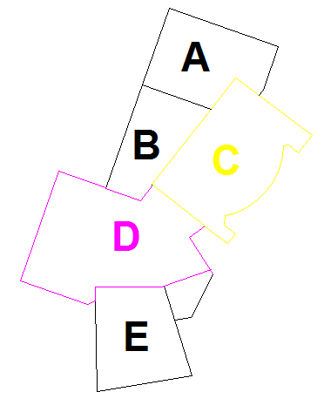
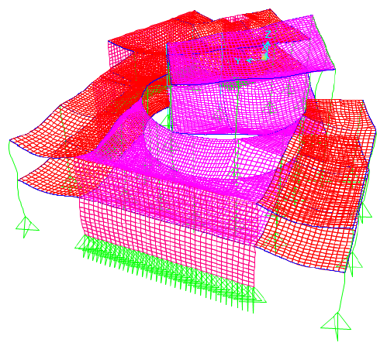
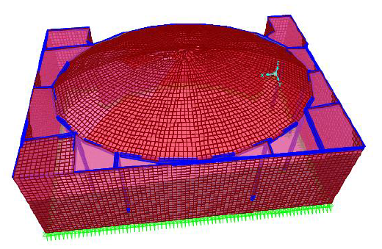
Sap model:

Slide 22
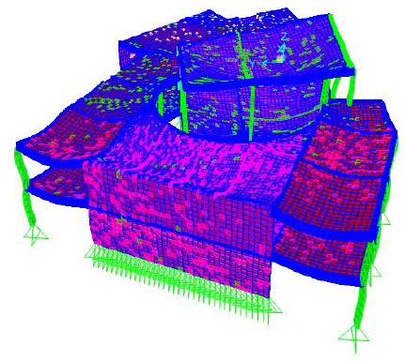
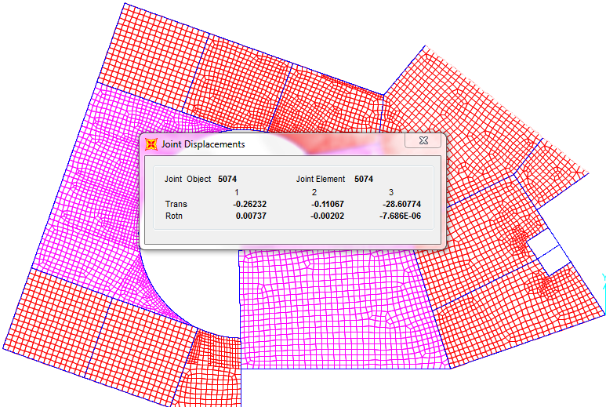
Checks for model :
1. Compatibility check:
Deflection check:
U from sap = 28.6mm < U max= 62mm
Notes:
compatibility had achieved as shown in the figure

Slide 23
2. Equilibrium check:
Load | Manual | Sap | Error
Dead load | 22159.26 KN | 22434.11KN | 1.24%
Live load | 13328.28KN | 12985.36KN | 2.57%
3. Internal Forces Check:
Load |  | Manual | Sap | Error
For Dead load | Slab | 127.31 KN.m | 148.206 KN.m | 16.4 %
Load |  | Manual | Sap | Error
For Dead load | Beam | 153.17 KN.m | 123.17 KN.m | 19.8%
Load |  | Manual | Sap | Error
For Dead load | Column | 580.23 KN.m | 393.07 KN.m | 32.25%

Slide 24
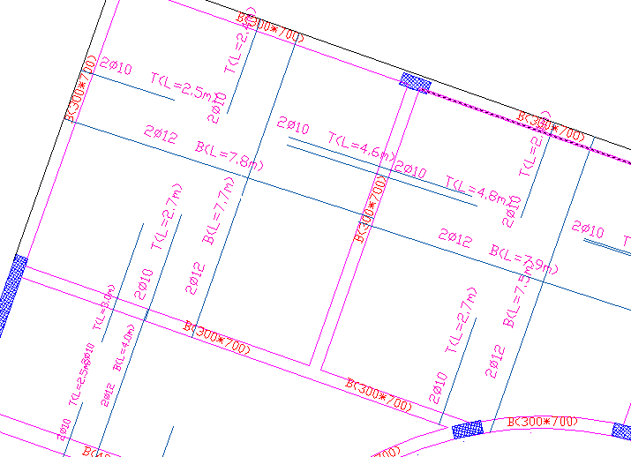
Design of Slab: Two-Way Ribbed Slab

Slide 25
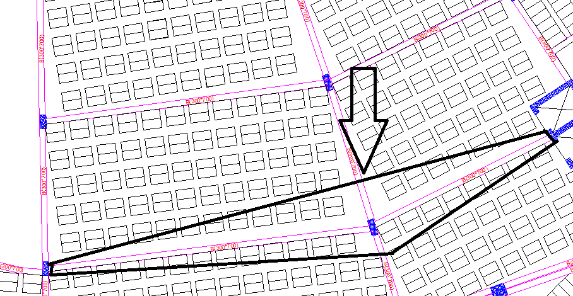
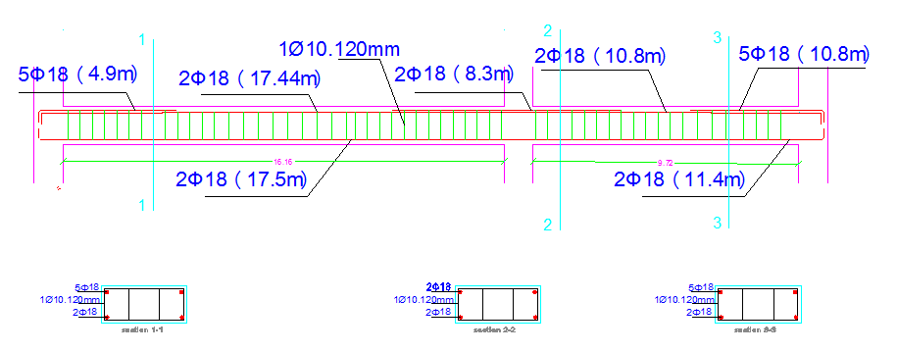
Beam Design:

Slide 26
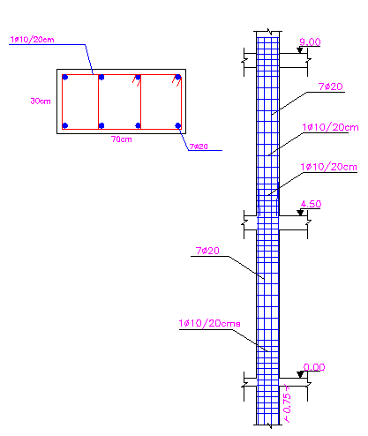
Column Design:

Slide 27
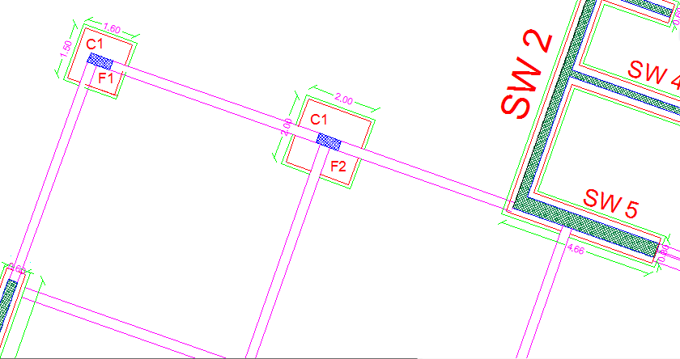
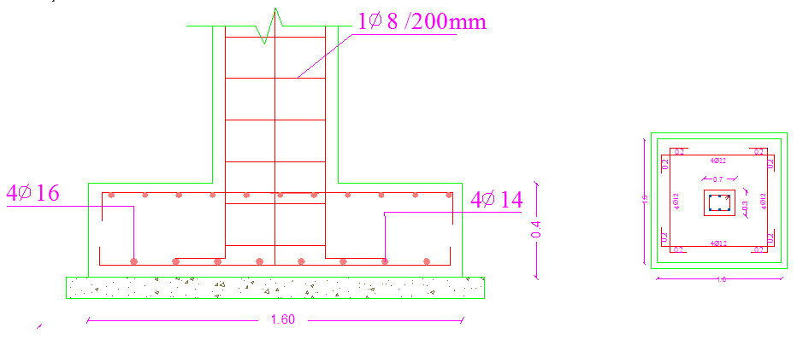
Footing Design:
F1

Slide 28
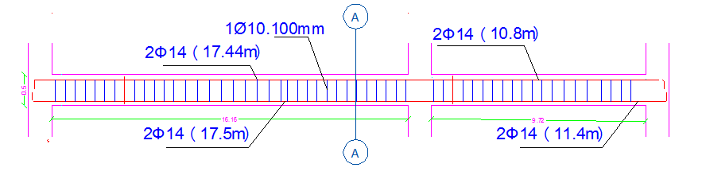
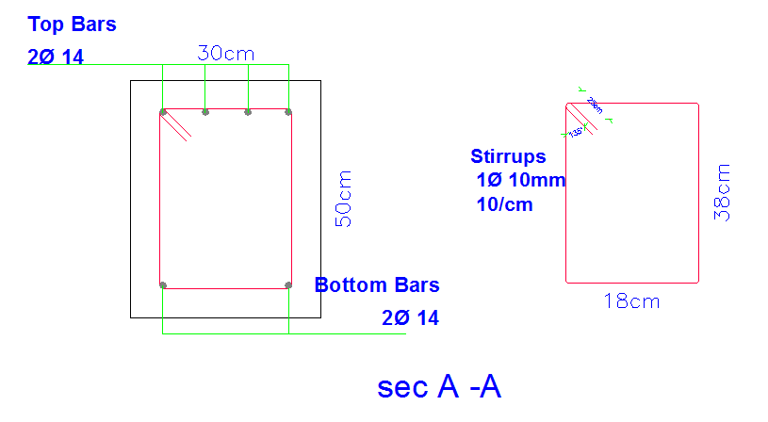
Tie Beam Design:

Slide 29
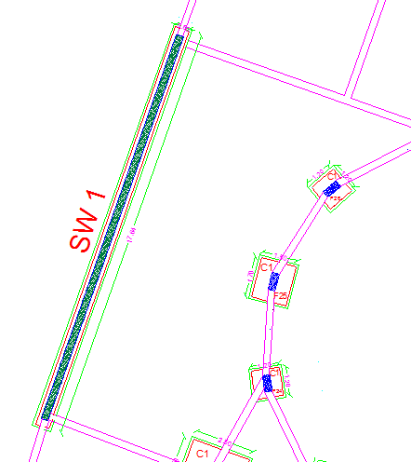
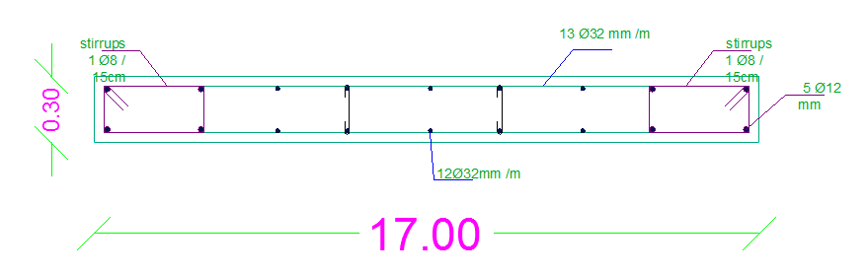
Shear Wall Design:

Slide 30
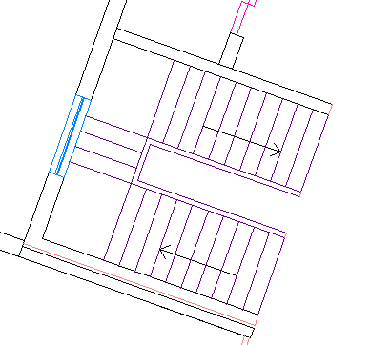
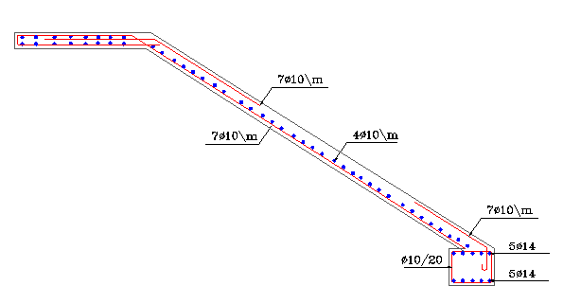
Stair Design:

Slide 31
Mechanical Design

Slide 32
Mechanical Design :
1- Water Supply .
2- Water Drainage
3- HVAC System .

Slide 33
Water supply system :
Tanks:
Individual demand in club building from water is 50 liter/person.
The size of the tank will be computed over four days.
30% of the tank size is for firefighting and cleaning.

Slide 34
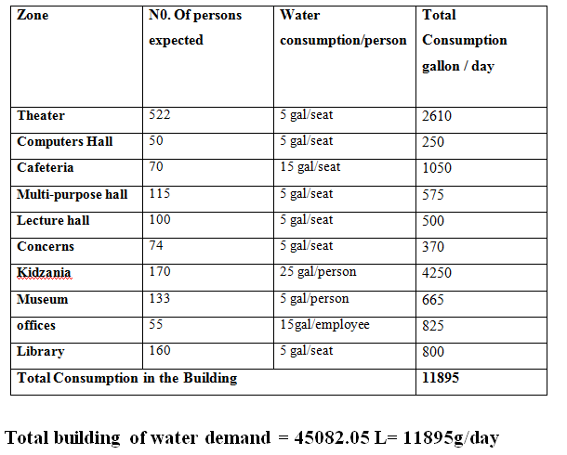
Water consumption

Slide 35
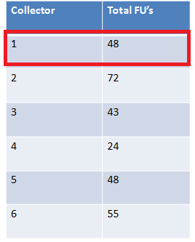
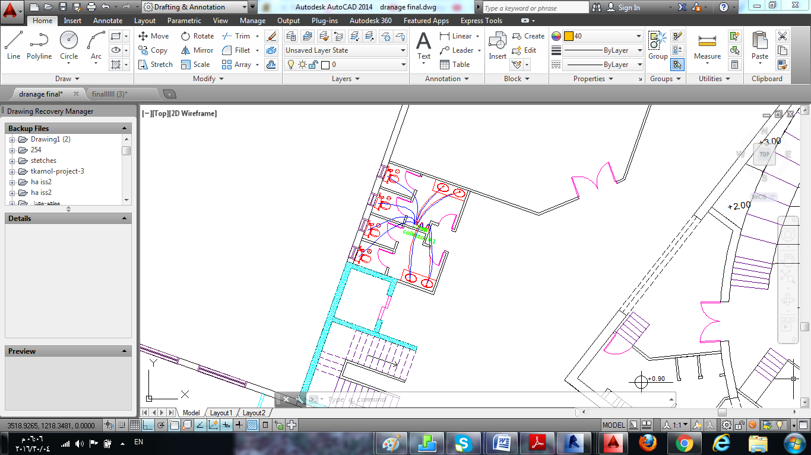
Water supply :
In ground &first floor :
meter : 3"
vertical : 2"
horizontal : 1.5"
branch: 1”

Slide 36
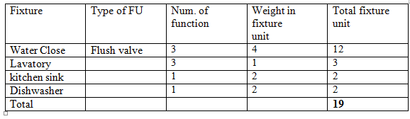
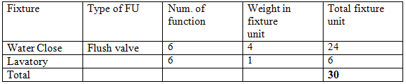
Water drainage:
Total Fixture units for cafeteria (Ground floor)
Total fixture units for Lecture hall - Ground floor

Slide 37
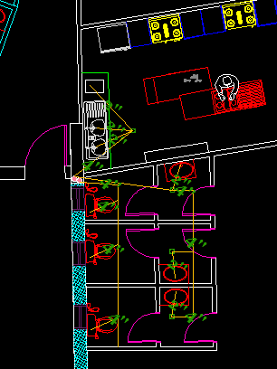
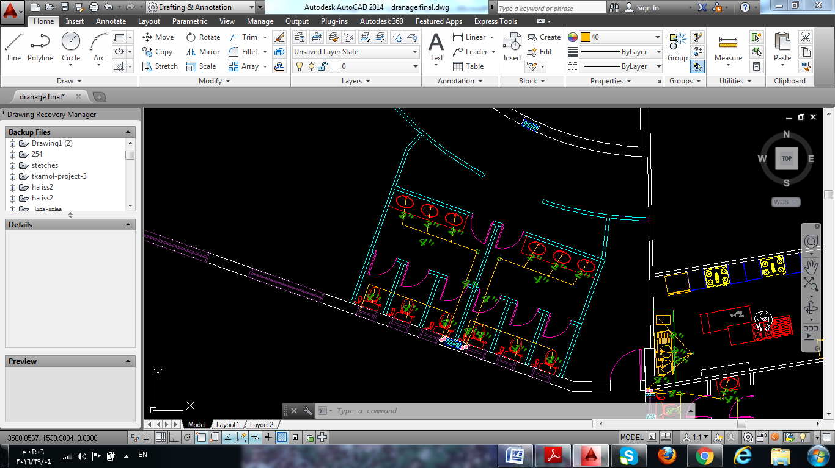
Water drainage :
Drainage system for educational zone
Drainage system for cafeteria

Slide 38
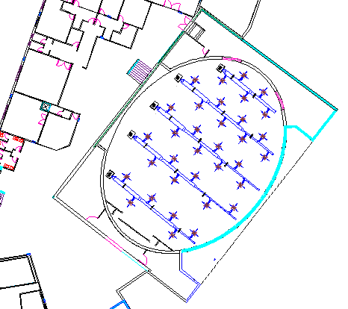
HVAC System :
Theater | Area :649 | Cooling load :45.3 | # of diffusers :34
Notes:
Irrigate grass

Slide 39
Safety Design

Slide 40
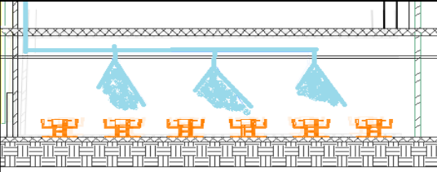
Fire system
In Cafeteria Ground floor
Sprinkler system

Slide 41
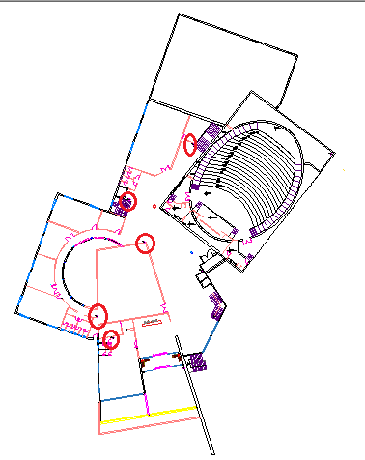
Fire system
Extinguisher system

Slide 42
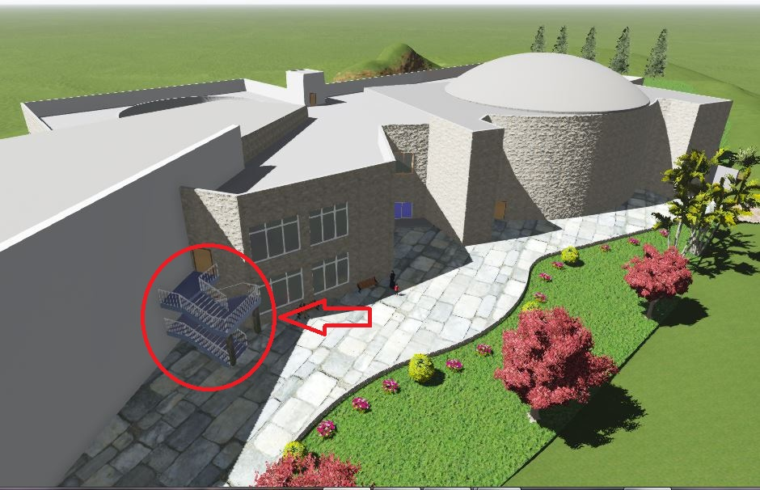
Emergency Exits

Slide 43
Environmental Design

Slide 44
Environmental Design:
1- The layers for the elements .
2- Thermal analysis .
3- Daylight factor .
4- shading design
5- Acoustical design .

Slide 45
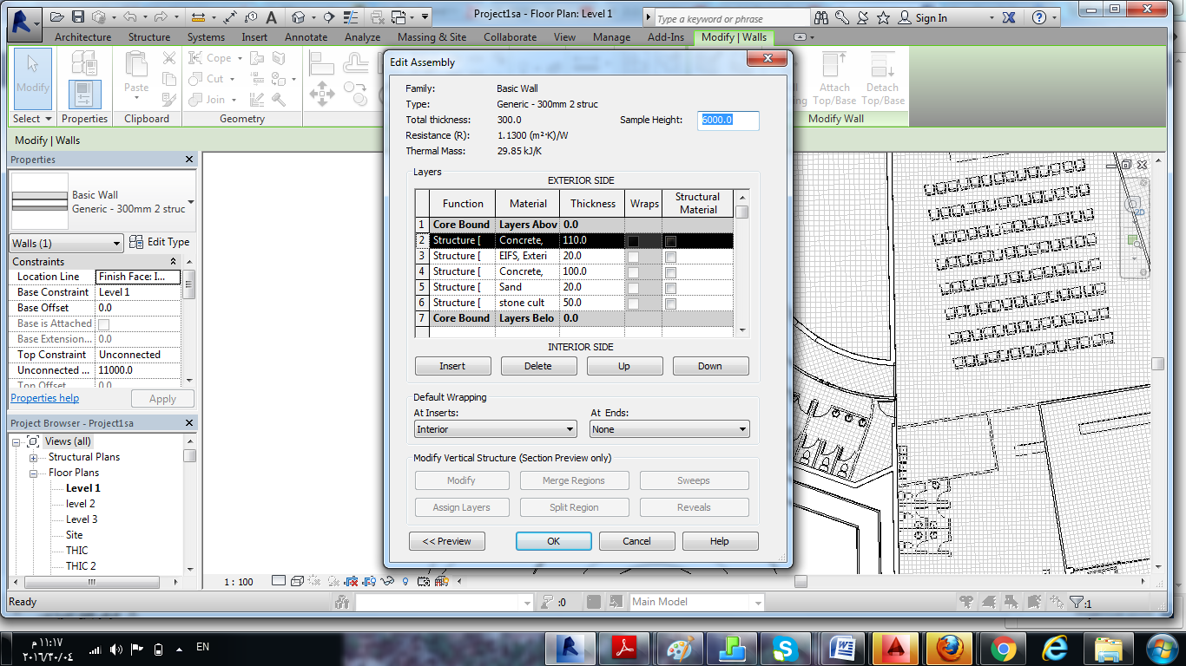
External Wall Material
U-Value:0.8108 (W/m².K)

Slide 46
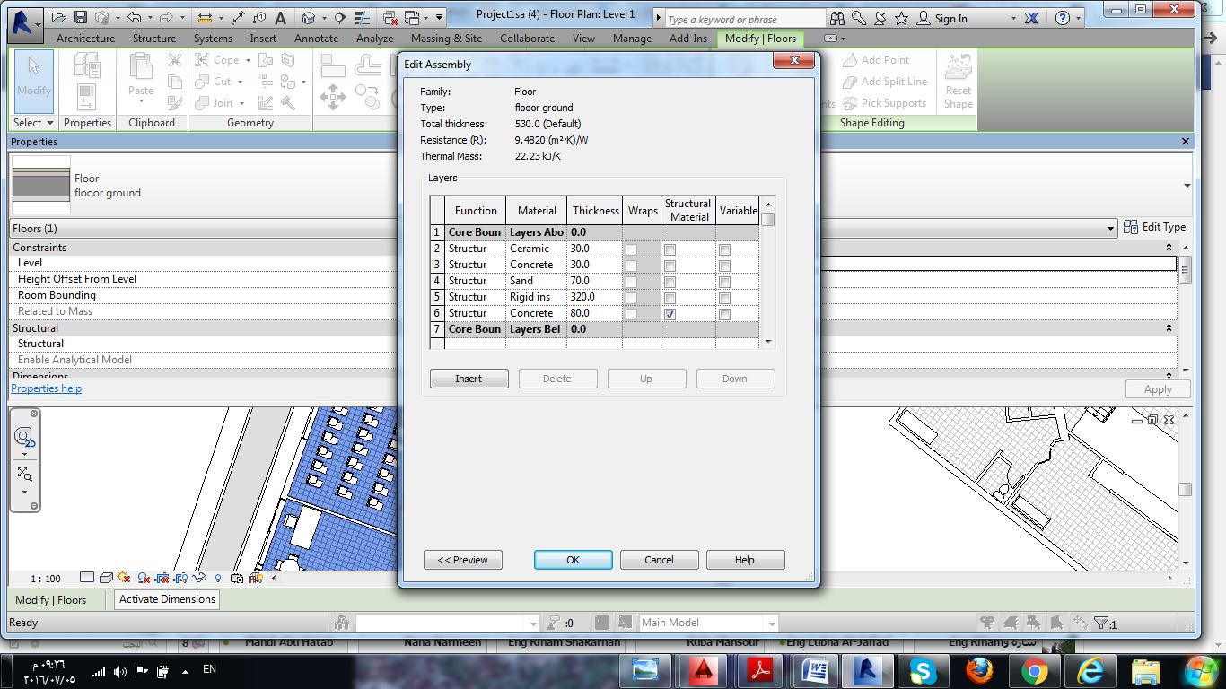
Partition Material
U-Value:1.4733 (W/m².K)

Slide 47
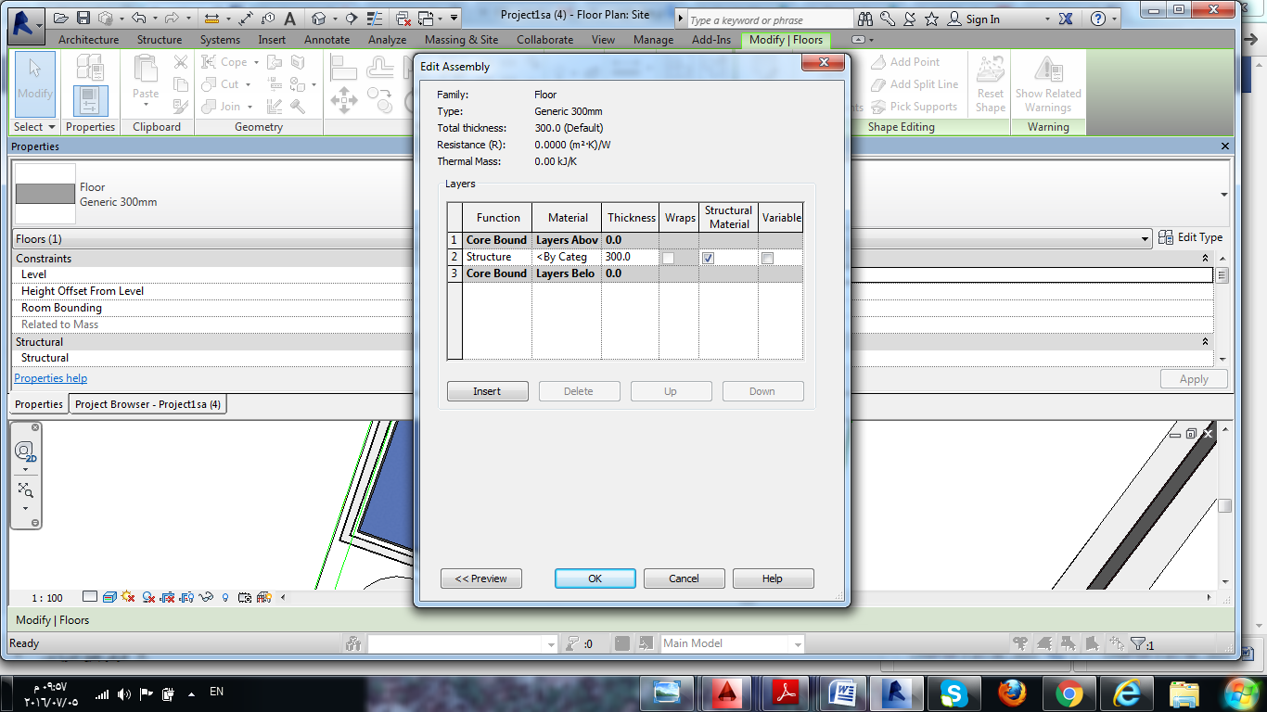
Roof Wall Material
U-Value:1.275(W/m².K)

Slide 48
Floor Material
U-Value:2.9582 (W/m².K)

Slide 49
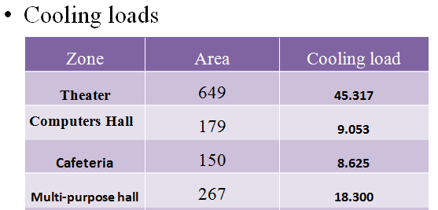

Slide 50
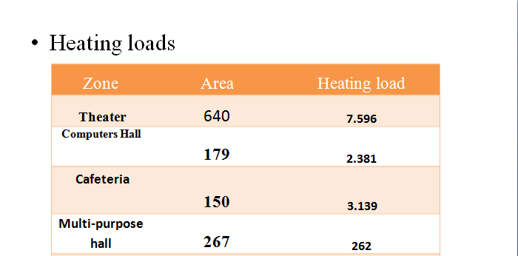

Slide 51

Peak cooling = 429.162 KW.
Peak heating = 61.926 KW.

Slide 52

Environmental Design
Double Tented Glass:
U-Value = 2.4
Solar Heat transmitted = 15%
Visible Light Transmitted =35%

Slide 53




Average Daylight Values
zone | Floor | Orientation | DF-Value | Picture
Cafetria | Ground floor | North-west | 5.85%
lecture hall one | Ground floor | East | 5.99%
Concerns one | Ground floor | East | 3.23%
Concerns two | Ground floor | East | 2.97%

Slide 54





lecture hall one | Ground floor | East | 4.76%
kidzania | 1st Floor | North-west | 5.53%
library | 1st Floor | South | 2.19%
Office one | 1st Floor | East | 3.18%
Office two | 1st Floor | East | 2.49%

Slide 55




Shading Design
the concept of vertical louvers in the east and west elevation
the concept of horizontal cantilevers in the south elevation

Slide 56

Acoustical Design

Slide 57


Museum volume = 1985.77 m³
Occupancy: 133
RT60 Empty Case
RT60 Full case
RT60 Values for Museum in F.F floor before modifications
Notes:
As it's shown in the standards, the reverberant time inside the Dining room does not match the specifications of restaurants that is ( 0.8 – 1.2 ) s

Slide 58


Used decorative sound absorption materials.
Acoustic panels.

Slide 59

RT60 Values for Musuem in F.F floor before modifications
RT60 Values for Musuem
in FF floor after
modifications
Notes:
All values lies in the range (0.8-1.2) Which is suitable for Dining rooms.

Slide 60

STC Calculations
For external walls
Required STC > 50
56

Slide 61

Impact Insulation Class :
STC and IIC for celling

Slide 62
Electrical Design

Slide 63
Artificial lighting :
The simulation analysis and design by “DIALux”
Function | Recommended Lux | Targeted Lux (avg.) | U_{o} | Reflection Factor
 |  |  |  | Ceiling | Wall | Floor
Theater | 300 | 382 | 0.455 | 70 | 82 | 30
Computer room | 500 | 515 | 0.61 | 73 | 29 | 30
Lecture Room | 500 | 530 | 0.674 | 70 | 75 | 30
Concerns | 500 | 631 | 0.611 | 70 | 82 | 30
Kitchen | 500 | 522 | 0.816 | 70 | 40 | 30
Library | 500 | 619 | 0.624 | 70 | 82 | 30
Reception | 300 | 317 | 0.663 | 70 | 50 | 20
multipurpose hall | 300 | 423 | 0.487 | 70 | 82 | 30
Library | 500 | 619 | 0.624 | 70 | 82 | 30
museum | 200
Office library | 500 | 705 | 0.606 | 70 | 82 | 30
Office staff | 500 | 657 | 0.617 | 70 | 82 | 30
Office director | 500 | 656 | 0.643 | 70 | 82 | 30
Conference room | 500 | 735 | 0.722 | 70 | 82 | 30
Notes:
Dialux program were used in our analysis to get a helpful and useful allocation of the artificial lighting, two different spaces were chosen to test and those were, manager ,dinning, kitchen, employee area and storage.
a targeted value of U (uniformity) and (unified glare rating) UGR shall be achieved for each space where U >0.6 and UGR should not exceed 19, so to get these values suitable paint, tile, color of furniture and appropriate type of lamp have to be applied.[25]

Slide 64



Artificial lighting for computer room
  Indoor Luminaire with Louver
Mounted Batten Commercial Indoor Luminaire with reflector

Slide 65




Artificial lighting for Theater
LAMP 9242660 KONIC OPAL
lighting Colored and moving head

Slide 66
Quantity surveying and cost estimation

Slide 67
Quantity surveying and cost estimation:
The total cost of the Culture design is about 14.76 million NIS
The total cost per meter square for the culture center is about 477 Denar/m².

Slide 68


