Slide 1


An-Najah National University
Faculty of Engineering and Information Technology
Industrial Engineering Department
Graduation Project 2
Feasibility Study to Establish a Cloud Kitchen in West Bank
Case Study in Nablus
Prepared By:
Aseel Mayaleh Rawan Yasser
Linda Othman We’am Moneer
Supervisor: Dr. Ahmad Ramahi

Slide 2

Outline
1
Introduction.
2
Problem Statement.
3
5
4
Market study
6
Technical study
  Financial study
  Recommendation
  Conclusion
7
  Difficulties & Challenges
8

Slide 3
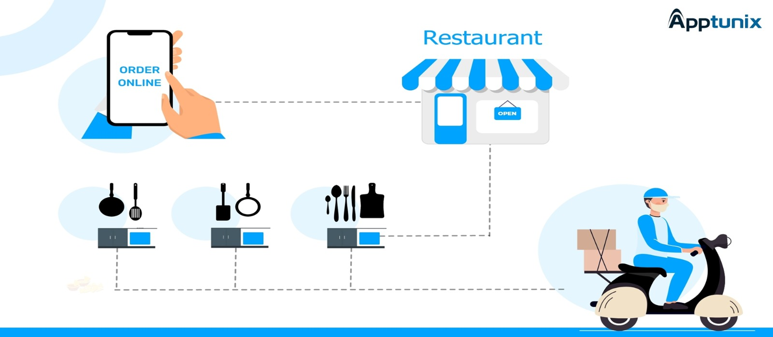
Definition of cloud kitchen

Slide 4
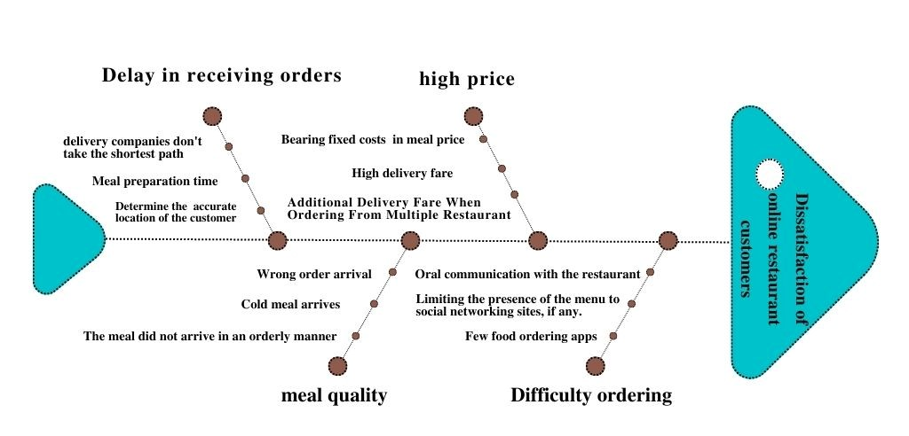
Problem statement
Reasons for customer dissatisfaction

Slide 5
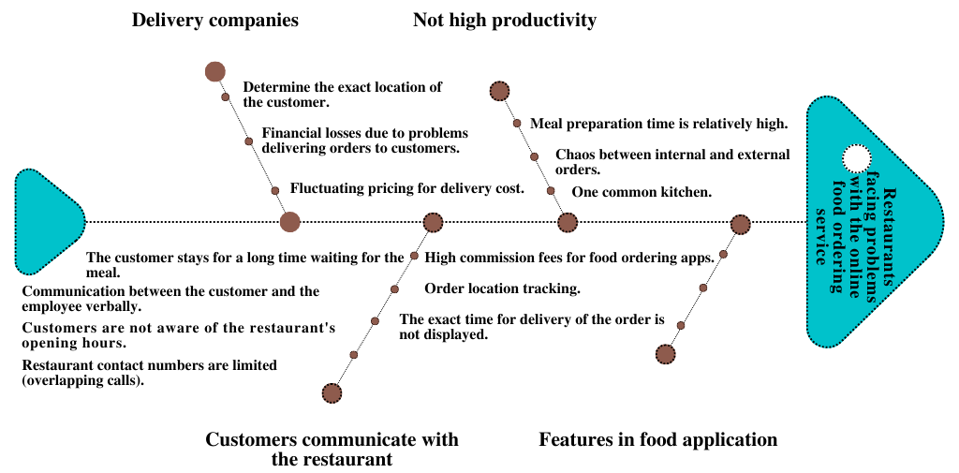
2. Problems facing restaurant owners in the delivery service

Slide 6


PROJECT

Slide 7


  Determining the target market
    2. The target city
Fast food restaurants
Customers of fast food
restaurants

Slide 8
Market Customer's Response to the
Cloud Kitchen Principles
92.9
92.8

Slide 9
    Reduce the price of the meal
50
90.2

Slide 11

Slide 1
Technical Study

Slide 12
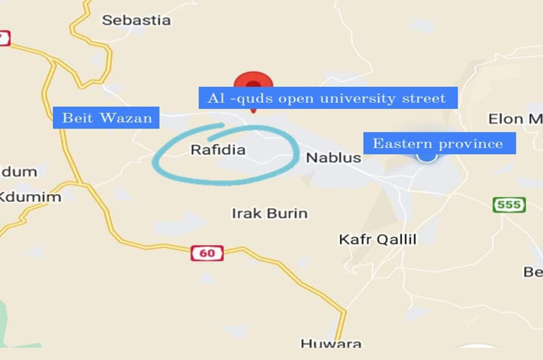
Central kitchen construction site
Alternatives to the land locations

Slide 13
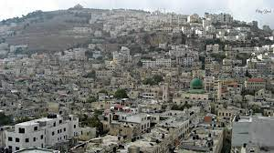
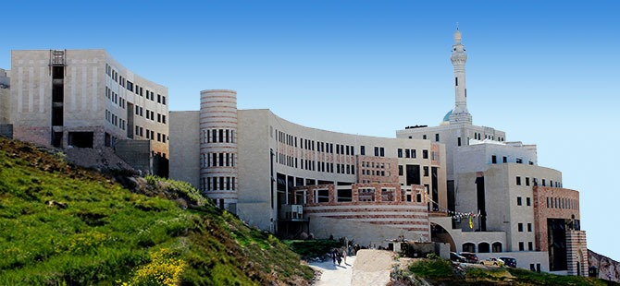
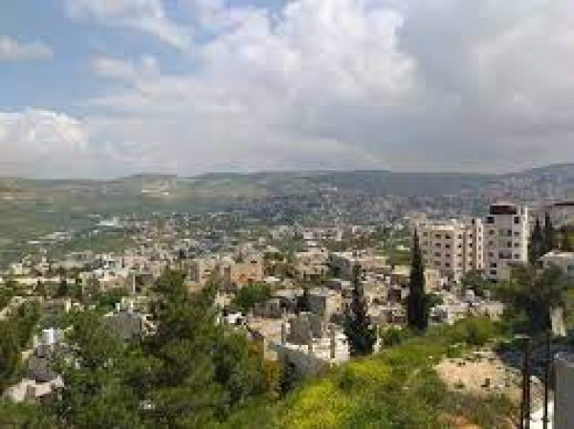
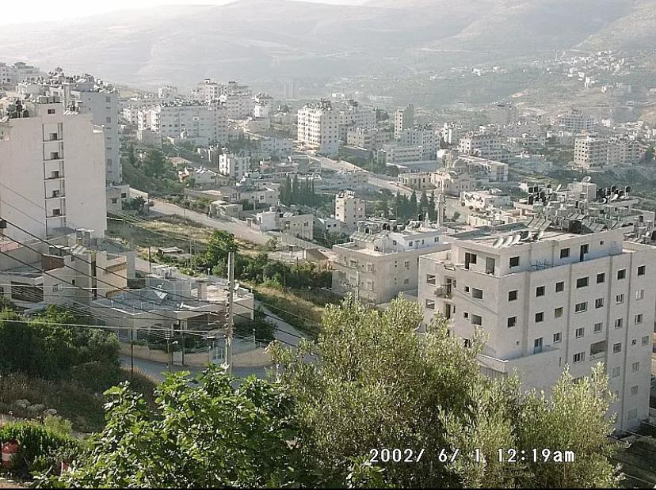
Eastern province
Al-Quds open university street
Beit Wazan
Rafidia

Slide 14
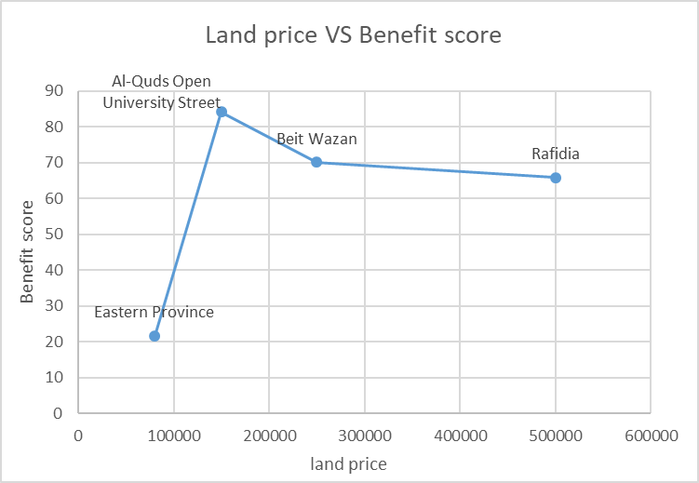
Attributes relevant to land selection
Cost
Benefits
Absence of a road crisis
Availability of services
Visibility
Closeness to customers

Slide 15
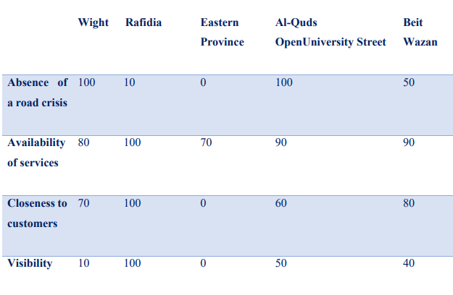
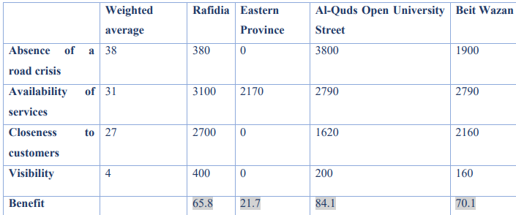
Values to measure the performance of the alternatives on that attribute and a weight for each attribute.

Slide 16

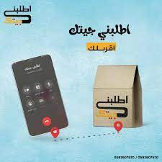



Business Model for Cloud Kitchen Delivery
Multiple delivery companies that are not owned by the cloud kitchen
Business model for Cloud Kitchen Delivery
The same owner of the cloud kitchen is the owner of the delivery company
A private company for each restaurant

Slide 17

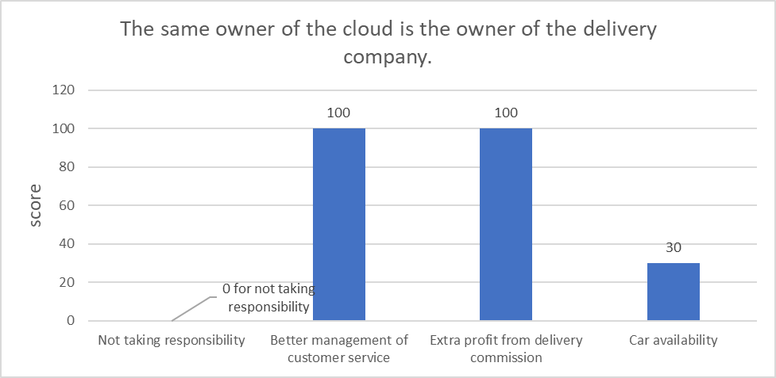
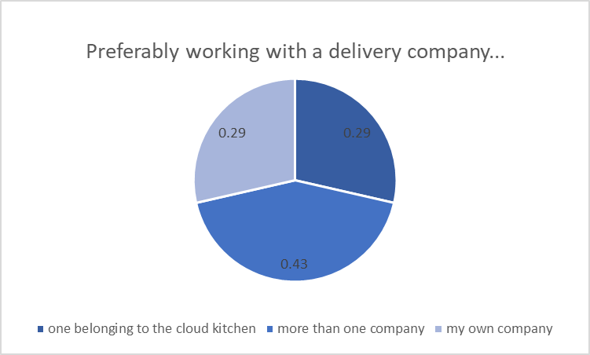
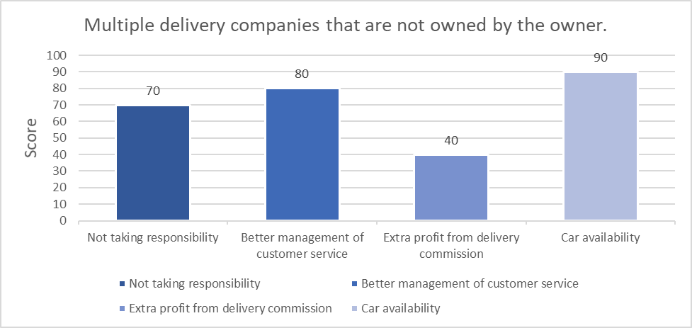
Direct customer (restaurants) preferred delivery model
    Determine the best delivery model for owner (Investor)

Slide 18
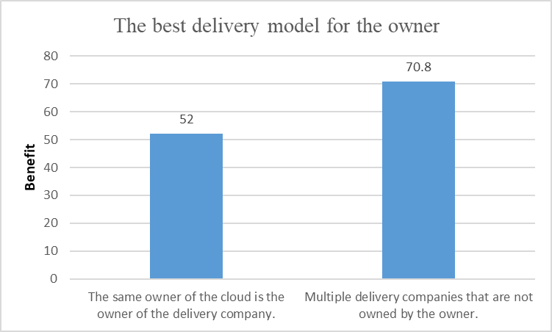
According to the Smart Technique method, the following result was reached

Slide 19








Manpower required to manage and operate the facility
Accountant
# 2
Cleaning staff
# 3
Security staff
# 1
Service staff
# 1
IT employee
# 1
Manager
# 1

Slide 20
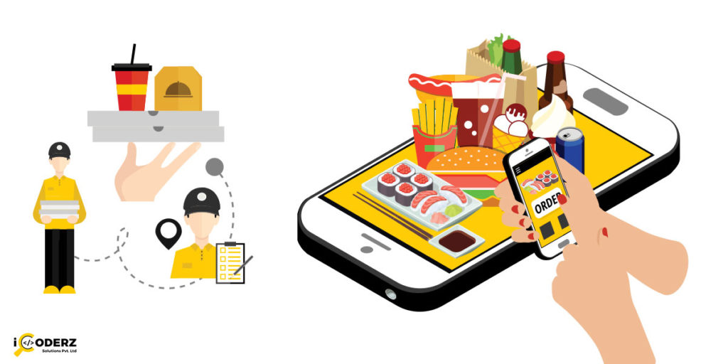
Slide 10
Mobile application

Slide 21
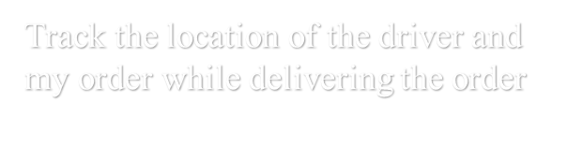
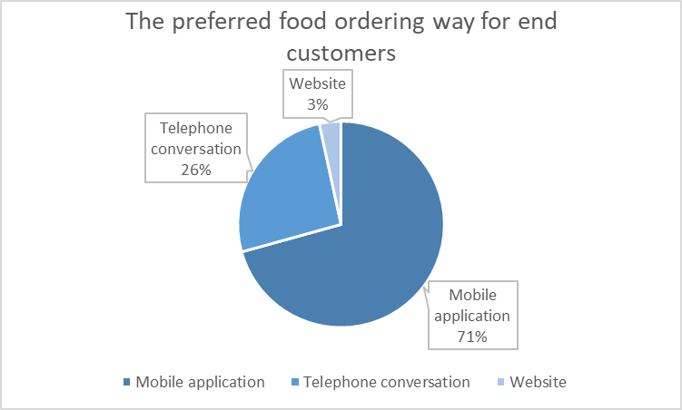
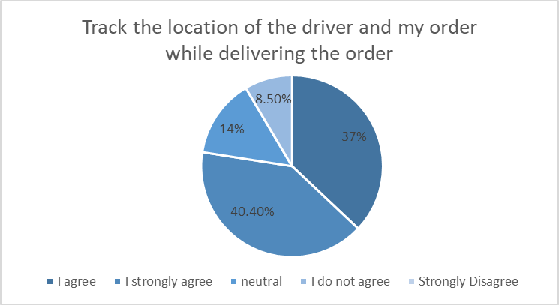
The preferred food ordering way for end customers

Slide 22
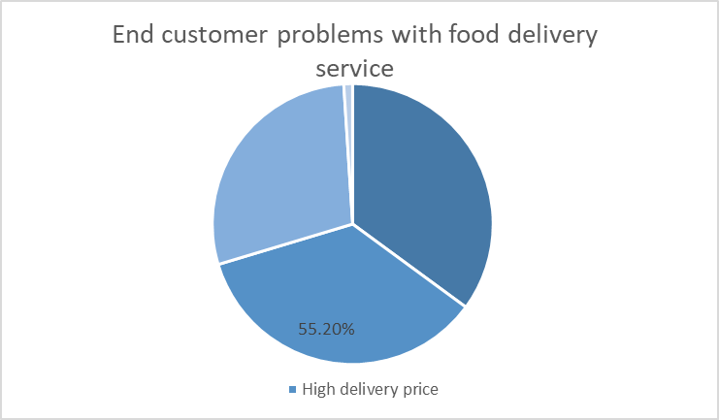
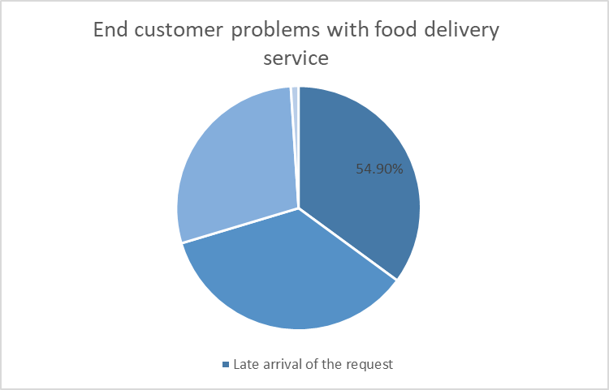

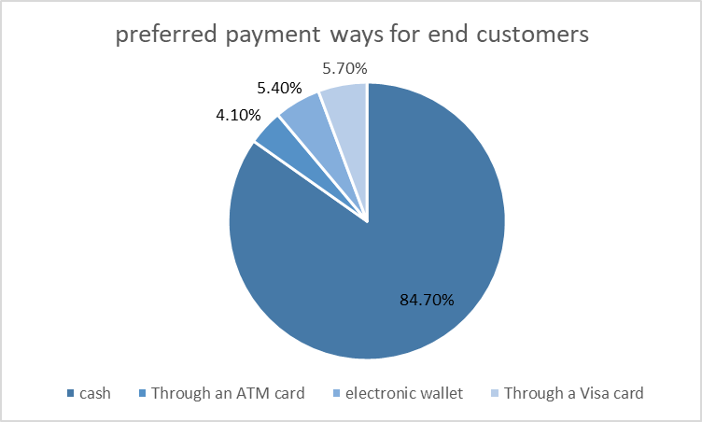

Slide 23
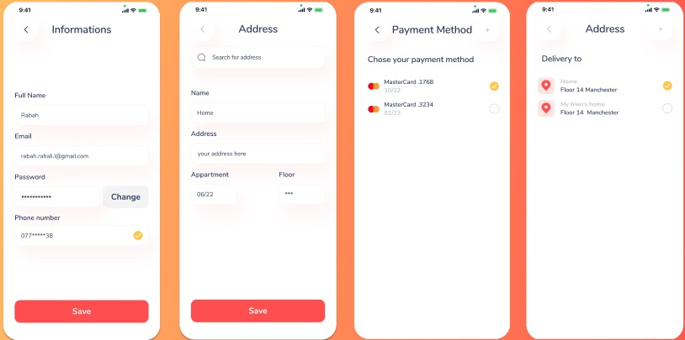
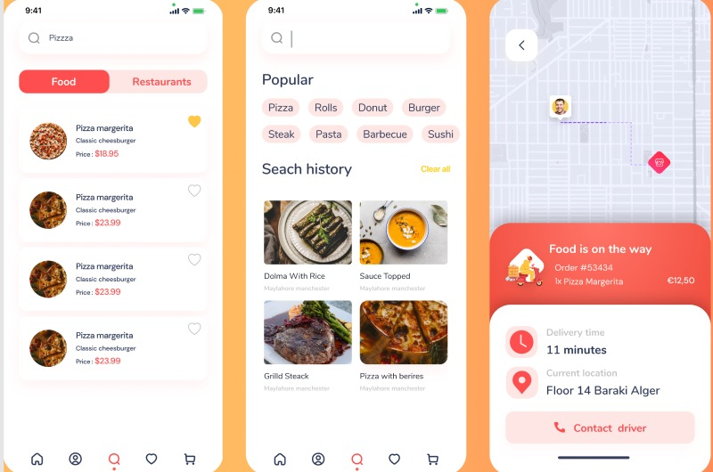
application interfaces

Slide 24
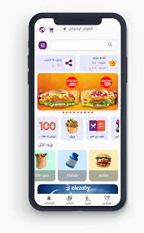
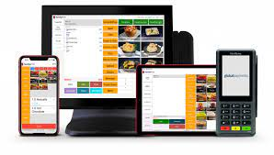

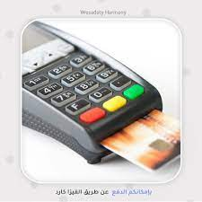
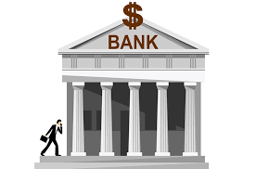
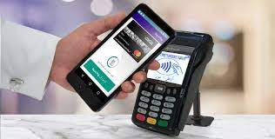

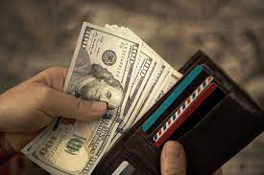


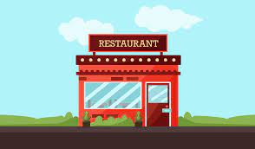
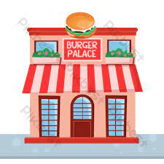
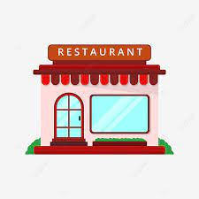
Managing financial matters
Mobile application
Accountant 2
Visa card
POS system
Jawwal Pay
Cash
Delivery upon delivery
Accountant 1
Owner of Cloud Kitchen
Rest 1
Rest 2
Rest 3

Slide 25

Finance study

Slide 26

Outline
Initial investment
      Annual cost
Revenue
Financial
Indicators
Net Cash Flow
Gross Profit
Sensitivity analysis

Slide 27
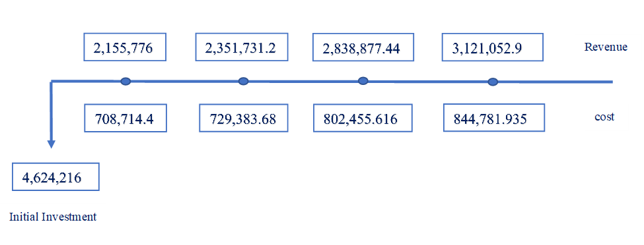

      Cash flow
      Revenue
      Annual cost
$$3,124,216$$
      Initial investment

Slide 28


      Initial investment
Type | Cost (NIS)
Land | 1,500,000
Building and constructions | 1,132,476
Equipment and machine | 355,740
Mobile application | 136,000
Total | 3,124,216

Slide 29
      Initial investment
Type | Cost (NIS)
Land | 1,500,000
Building and constructions | 1,132,476
Equipment and machine | 355,740
Mobile application | 136,000
The price of one dunum = 750,000 Nis
We need 2 dunum
Total | 3,124,216

Slide 30
      Initial investment
Type | Cost (NIS)
Land | 1,500,000
Building and constructions | 1,132,476
Equipment and machine | 355,740
Mobile application | 136,000
The price of one dunum = 750,000 Nis
We need 2 dunum
The Cost | Cost Price in (NIS)
Construction costs | 1000000
Electricity network | 100000
Water network | 17500
Factory license | 14976
Total | 3,124,216

Slide 31
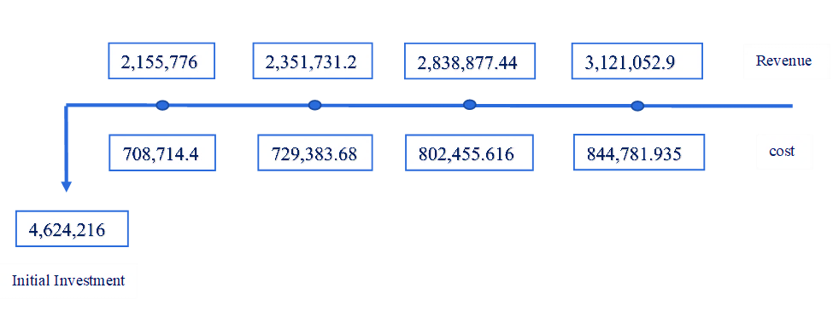

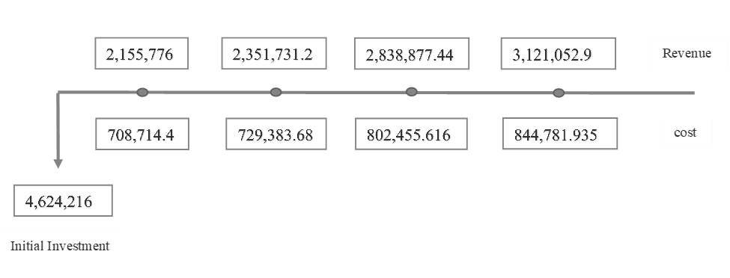

      Cash flow
      Revenue
      Annual cost
$$3,124,216$$
      Initial investment

Slide 32

Two Content Layout with SmartArt
      Annual cost
Group A
Ads for social media, celebrities and posters =17,648 NIS in the first year, 8,824 NIS in the 2nd , 3rd and 4th year.
Group B
The cost of water and electricity subscription, lighting, salaries and the POS system = 367,800 NIS.
Group C
Income tax rate = 15%

Slide 33
      Annual cost
The annual cost in first year :
Group A + Group B+(Group C)
Group A + Group B :367,800+17,648=385,448 NIS.
Group C: 2,155,776 rev.in 1st year * 0.15)= 323,366.4
So The annual cost in first year = 708,814.4 NIS/year.

Slide 34


      Cash flow
      Revenue
      Annual cost
$$3,124,216$$
      Initial investment

Slide 35



Revenue
The rent paid by restaurants to the system
Commission paid by delivery companies

Slide 36
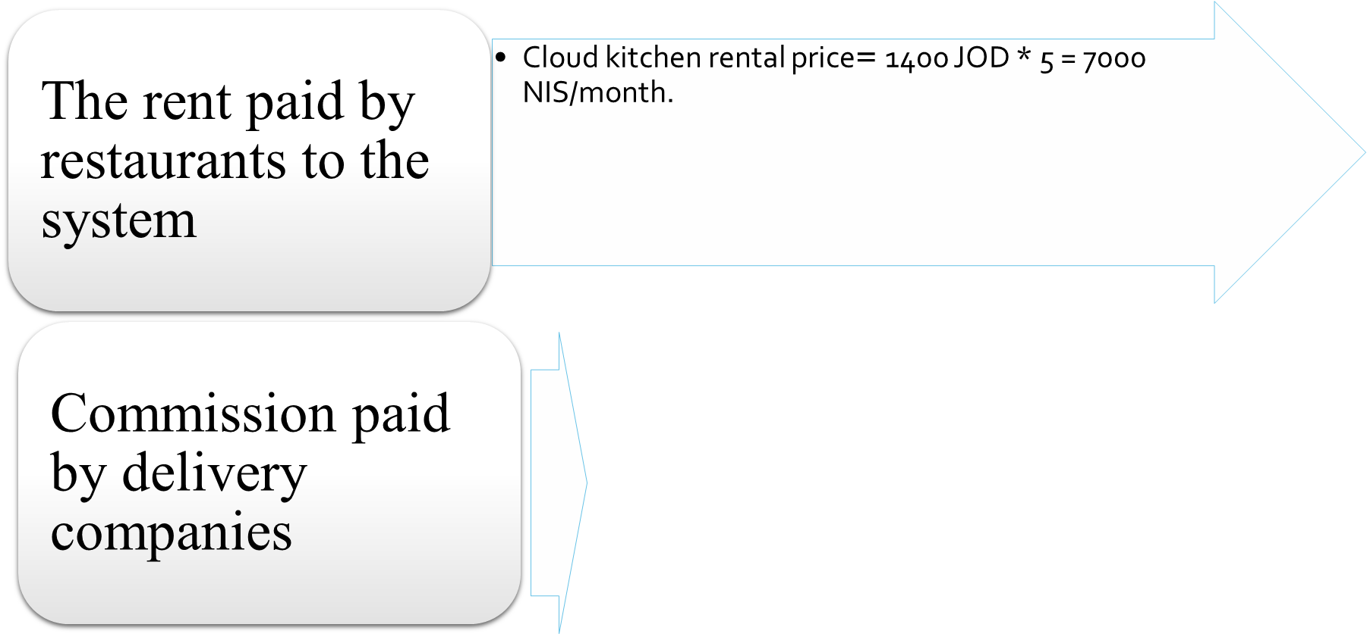
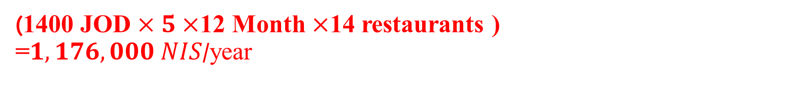
Revenue
Total revenue in 1st year
(1400 JOD $×5×$12 Month $×$14 restaurants )
=$1,176,000 NIS$/year

Slide 37
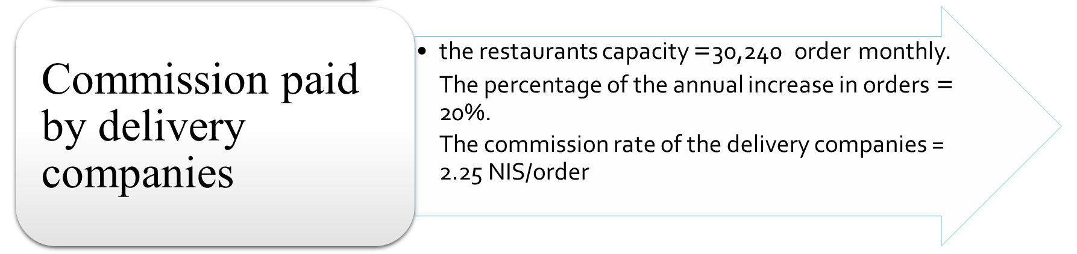
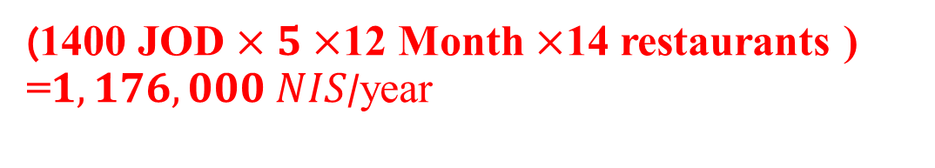
Revenue
Total revenue in 1st year
(1400 JOD $×5×$12 Month $×$14 restaurants )
=$1,176,000 NIS$/year

Slide 38
Revenue
Total revenue in 1st year
$\left(\left(30,240×0.20\right)+30,240 \right)=36,288 orders/mont$
$36,828×2.25 NIS×12 month=979,776\frac{NIS}{year} .$
Commission paid by delivery companies
The percentage of the annual increase in orders= 20%.
The commission rate of the delivery companies = 2.25 NIS/order
the restaurants capacity =30,240 order monthly.

Slide 39
Revenue
The rent paid by restaurants to the system
Commission paid by delivery companies
Total revenue = (Number of orders × commission rate for each order) + The total rental price for restaurant.
$$979,776+1,176,000=2,155,776 NIS revenue in first year$$

Slide 40
Revenue per year

Slide 41
      Cash flow
      Revenue
      Annual cost
$$3,124,216$$
      Initial investment

Slide 42
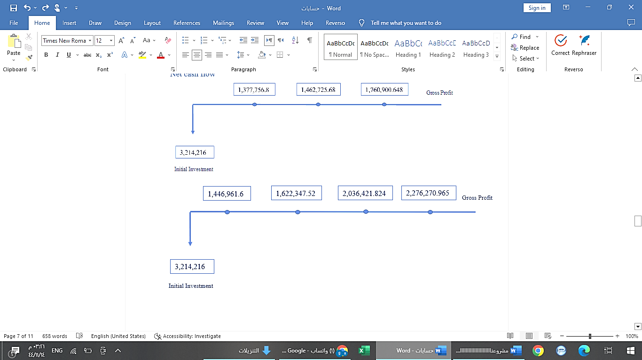
Net Cash flow

Slide 43


Profit
$Profit in the end of 4 years=total gross profit−initial investment$
$Profit in the end of 4 years=7,382,001.909−3,124,216 =4,257,785.91 NIS$.

Slide 44
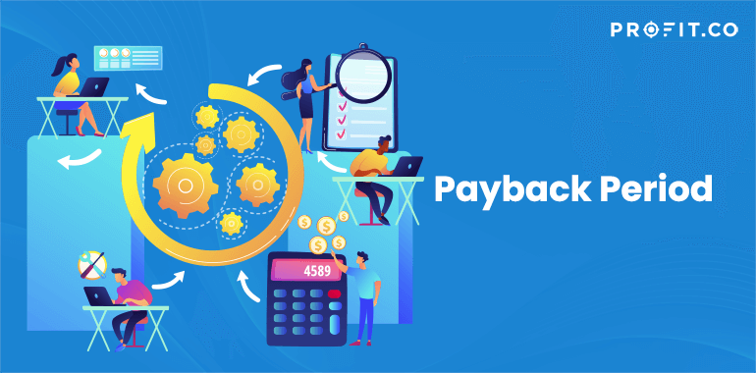

Payback Period (PBP)
$PBP=\frac{initial investment }{avareg gross profit}$
$PBP=\frac{3,124,216}{1,854,500.48}=1.68$
$≈2years$

Slide 45
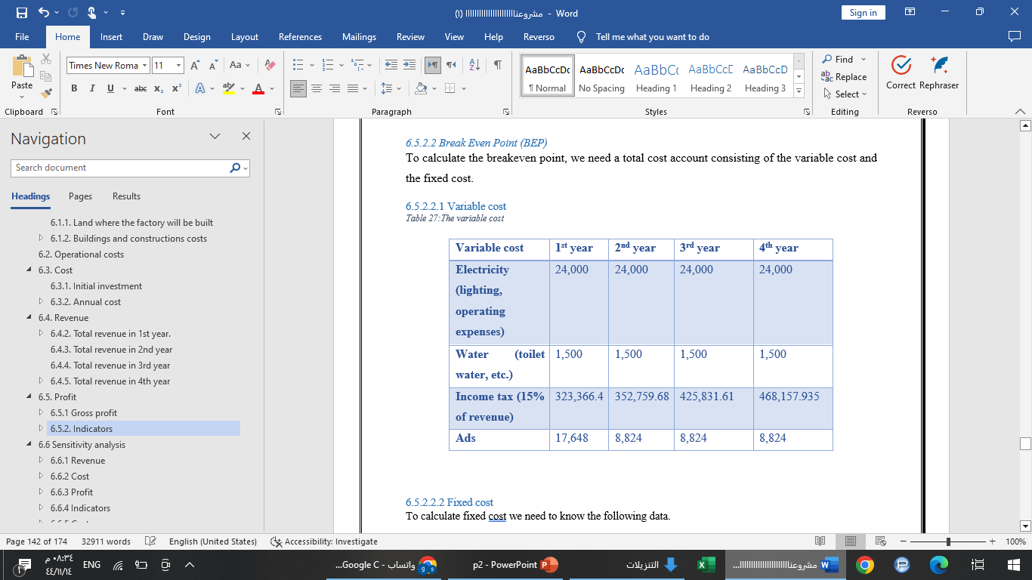
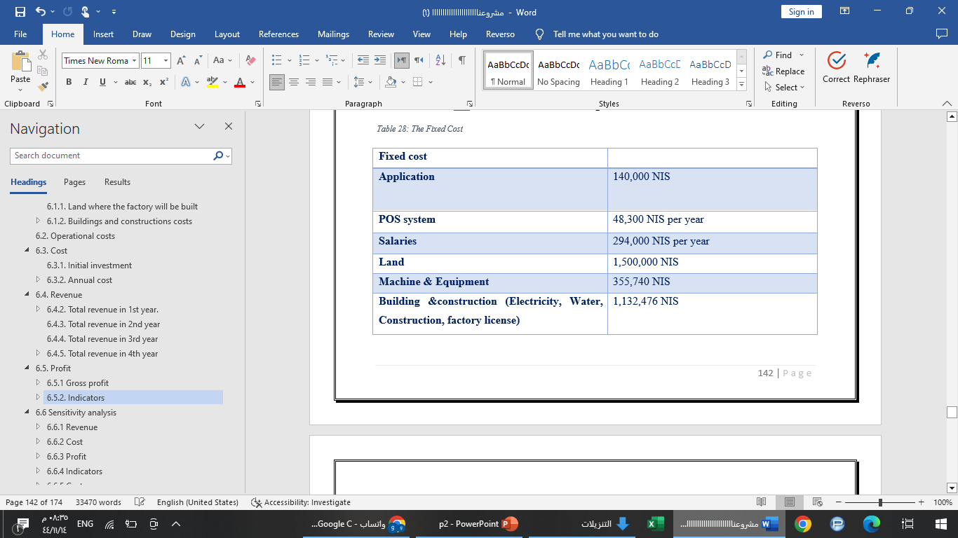
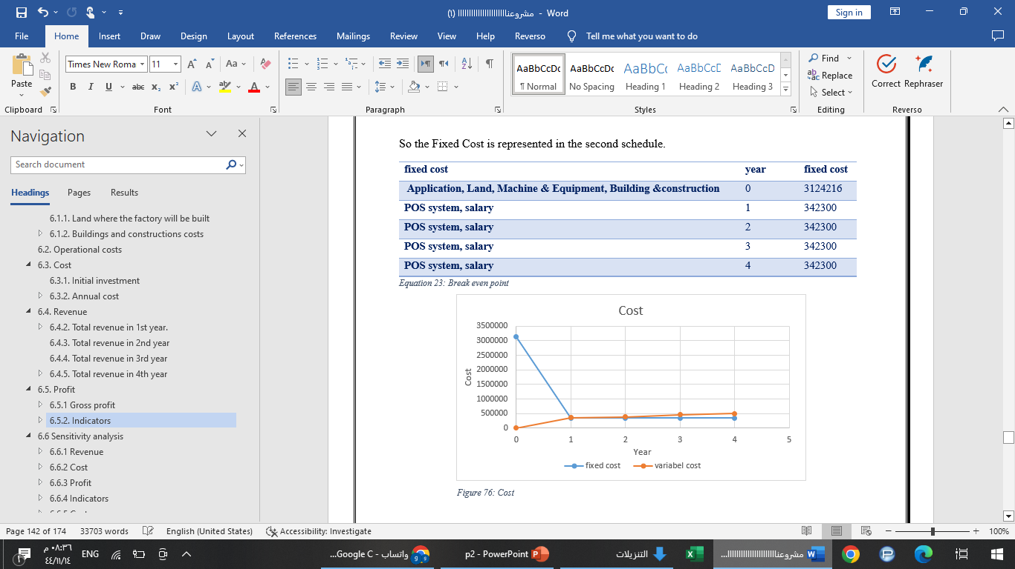
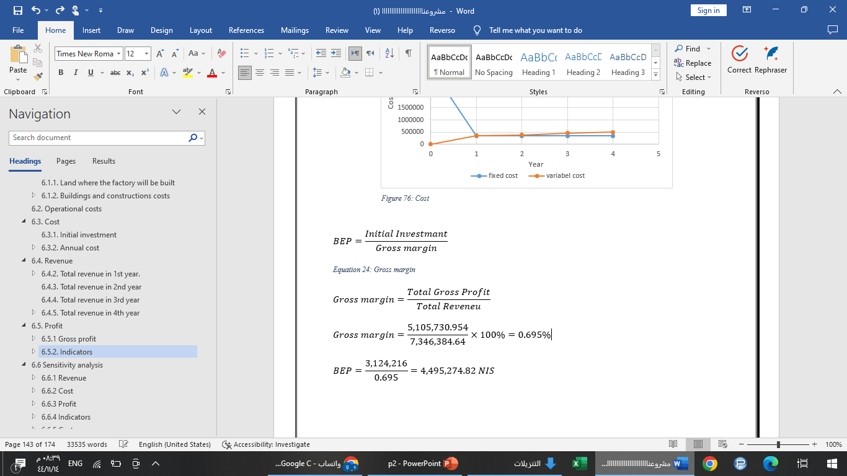
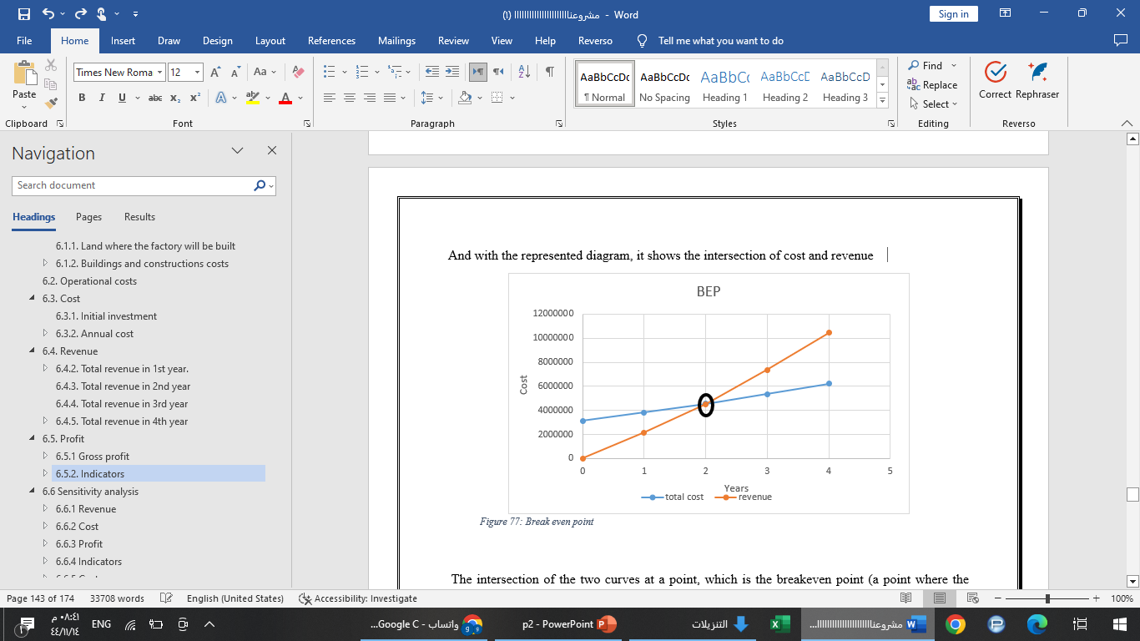
Break Even Point (BEP)

Slide 46
Break Even Point (BEP)
Variable Cost

Slide 47
Break Even Point (BEP)
Fixed Cost

Slide 48
Break Even Point (BEP)
Fixed Cost

Slide 49
Break Even Point (BEP)
Cost

Slide 50
Break Even Point (BEP)

Slide 51
Break Even Point (BEP)

Slide 52


      Rate of investment (ROI)
$ROI=\frac{Total Gross Profit−Initial Invesment}{Initial Invesment}$
$ROI=\frac{7,382,001.919−3,124,216}{3,124,216}=1.36=136\%$

Slide 53

      Rate Of Return (ROR)
$ROR={(\frac{Future amount}{start amount})}^{\frac{1}{Time}}−1$
$ROR=(({\frac{7,382,001.919}{3,124,216})}^{\frac{1}{4}}−1)×100\%$
$$=23.98\%$$

Slide 54

      Internal Rate of Return (IRR)
$\text{Trial} \text{and} \text{error} \text{to} \text{find} \text{an}\text{ (}\text{IRR}\text{)}$
$0=CF0+\frac{{CF}_{1}}{\left(1+IRR\right)}+\frac{{CF}_{2}}{{\left(1+IRR\right)}^{2}}+\frac{{CF}_{3}}{{(1+IRR)}^{3}}+…+\frac{{CF}_{n}}{{(1+IRR)}^{n}}$
By interpolation 50% & 30%
${IRR}_{1}+\left(\frac{{NPV}_{1}}{{NPV}_{1}+{NPV}_{2}}×({IRR}_{2}−{IRR}_{1})\right)$
$50+\left(\frac{385,711.12}{1,058,407.377}×−20\right)=42.7\%$

Slide 55
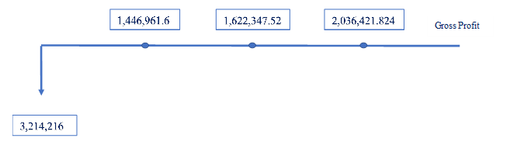

Sensitivity analysis
Net cash flow $for 20\%$(Good scenario)
$Profit in the end of 3 years=total gross profit−initial investment$
$Profit in the end of 3 years=5,105,730.954−3,124,216=1,981,514.954 NIS\text{.}$

Slide 56


Sensitivity analysis
Net cash flow $for 10\%$ (Bad scenario)
$Profit in the end of 3 years=total gross profit−initial investment$
$Profit in the end of 3 years=4,601,187.128−3,124,216=1,476,971.128 NIS$

Slide 57



Sensitivity analysis
$20\%$(Good scenario)
Payback period (PBP)= $1.8≈2 years$
Rate of investment (ROI) =$0.63=63\%$
Rate Of Return (ROR) =$17.78\%$
Break Even Point (BEP) =$4,495,274.82 NIS$
(IRR) By interpolation 15% & 30% =$27.7\%$
1$0\%$(Bad scenario)
Payback period (PBP) = $2.08 years\text{.}$
Internal Rate of Return (IRR) By interpolation 15% & 30% = $21.28\%$

Slide 58


Compare the IRR
20% = $27.7 \%$
10% = 21.28 %
The alternative method offered by the bank = 2.05%

Slide 59
Conclusion
The results of the market study were encouraging and gave us a motive to complete the technical study, which in turn clarified the possibility of applying the idea in terms of the availability of resources and through the administrative system that regulates all operations and the reflection of the technical study on the financial study by transferring the resources to Coast and examining the financial indicator of the performance of the project, which gave results encouraging investment to create a cloud Kitchen in the West Bank - Case Study in Nablus.

Slide 60
Recommendation
Adoption of the project for investment by investors in the chosen location.
Order collection boxes become fully automated, with each box containing a security code to increase security and reliability.
Determine the best route and link it with GPS
Expanding the area of the cloud kitchen to provide places for cookies, sweets and drinks.

Slide 61
Difficulties and challenges
The project is new and therefore studying it from scratch faces difficulties and challenges.
Arranging appointment with restaurant managers to conduct interviews, and the difficulty in communicating the idea of the cloud kitchen to restaurant owners.
Not finding anyone to design and program the application.

Slide 62
Any question?

