Slide 1

ANALYSIS AND DESIGN FOUNDATIONS OF AL-KAREEM BUILDING
GRADUATION PROJECT
By :Ashraf Bahar, Abdallah Soliman,
Abdelhafeez Shahadeh , Enad Abo Assidah
Under supervision of: Dr. Issam Jardaneh.

Slide 2
Presentation Contents
Introduction & Project Description.
Soil.
load combinations.
Materials.
Design of foundation.
Conclusion.

Slide 3
Introduction & Project Description
The building is a residential building in Nablus consists of nine floors.
In the first graduation project we analyzed the building and we got the type of soil and the loads on columns .
In second graduation project we designed mat foundation for the building by using ETABs program.

Slide 4
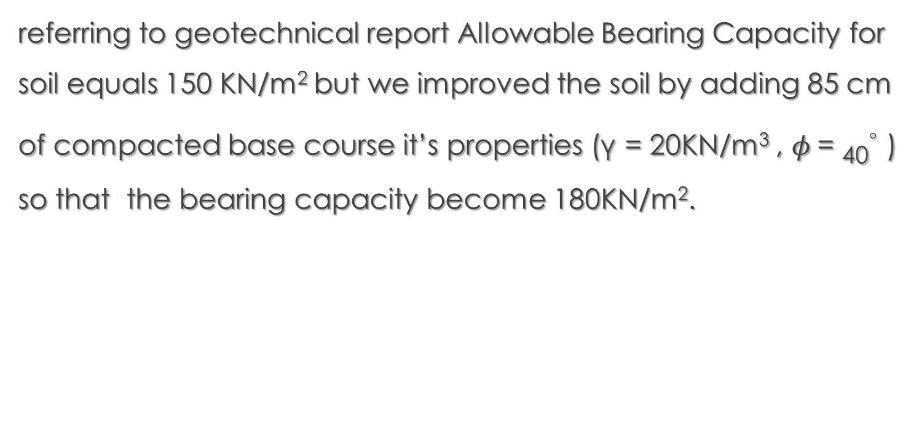
soil
referring to geotechnical report Allowable Bearing Capacity for soil equals 150 KN/m² but we improved the soil by adding 85 cm of compacted base course it’s properties (γ = 20KN/m³ , $φ$= ₄₀◦ ) so that the bearing capacity become 180KN/m².

Slide 5
Load combinations
Ultimate
U = 1.4D
U = 1.2D + 1.6L
Service
S = D+ L
Where D = Dead Load.
L = Live Load.

Slide 6
Materials
Mainly two materials, concrete and steel. And it’s properties defined as the following:
Concrete:
F’c: is the specified compressive strength (24 Mpa).
γ: the specific weight or unit weight (25 kn/m³ ).
Ec: concrete Modulus of elasticity (23025.2 Mpa ).
Steel:
Fy: Yield strength (420 Mpa).
E: Modulus of elasticity (2*10⁵ Mpa).

Slide 7
Design of foundation
the selection of mat foundation as a type of foundation isn’t come from space the idea of select mat foundation as a foundation system because the single footing which was the first option as the foundation type can not effort the loads on the columns.
The calculation in the next slides will show why the single footing system is ignored .

Slide 8
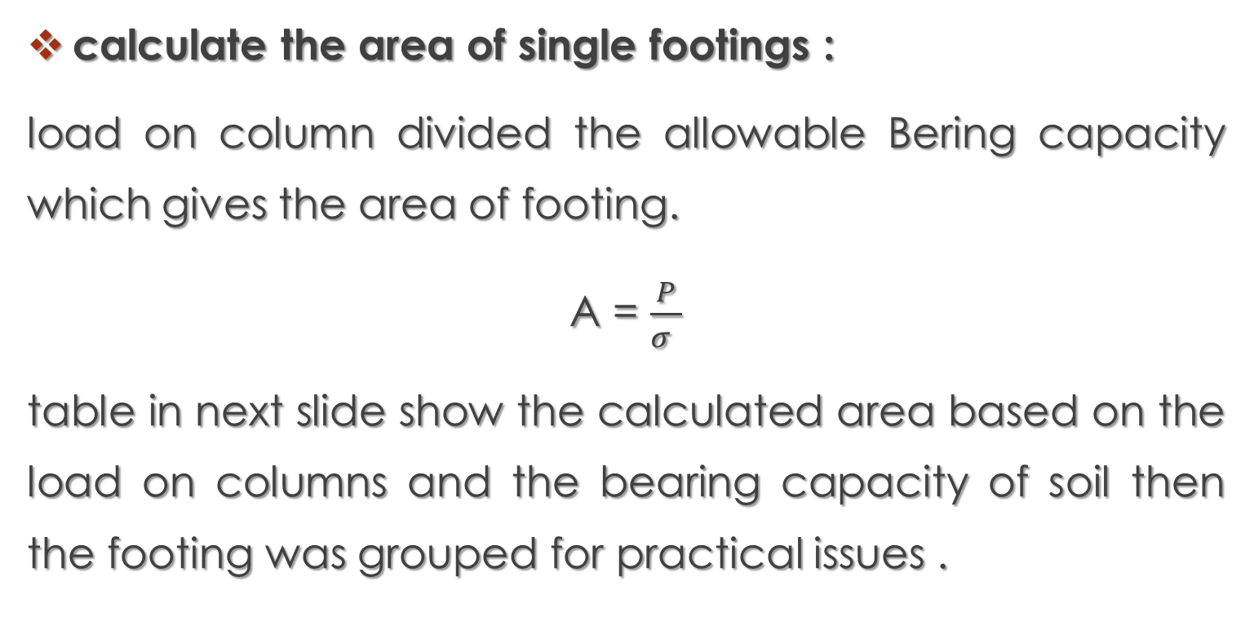
calculate the area of single footings :
load on column divided the allowable Bering capacity which gives the area of footing.
A = $\frac{P}{σ }$
table in next slide show the calculated area based on the load on columns and the bearing capacity of soil then the footing was grouped for practical issues .

Slide 9
column number | calculated area (m²) | design area(m²) | column number | calculated area(m²) | design area(m²) | column number | calculated area(m²) | design area(m²)
C2 | 1.6 | 2 | C22 | 1.8 | 2 | C17 | 2.2 | 2.5
C31 | 1.6 | 2 | C21 | 1.9 | 2 | C27 | 2.2 | 2.5
C32 | 1.6 | 2 | C26 | 1.9 | 2 | C6 | 2.3 | 2.5
C34 | 1.6 | 2 | C10 | 2 | 2 | C12 | 2.4 | 2.5
C23 | 1.7 | 2 | C9 | 2.1 | 2.5 | C14 | 2.4 | 2.5
C24 | 1.7 | 2 | C16 | 2.1 | 2.5 | C5 | 2.6 | 2.9
C25 | 1.7 | 2 | C20 | 2.1 | 2.5 | C8 | 2.6 | 2.9
C3 | 1.8 | 2 | C28 | 2.1 | 2.5 | C15 | 2.6 | 2.9
C18 | 1.8 | 2 | C4 | 2.2 | 2.5 | C7 | 2.9 | 2.9
C19 | 1.8 | 2 | C13 | 2.2 | 2.5

Slide 10
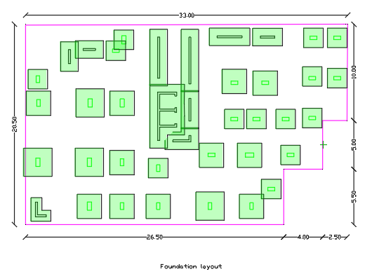
After calculate the area it was drawn.

Slide 11
From the figure we can notice that there are a lot of inter footing or close footing which leads to interaction of stress under the footing.
moreover the area of all footing equal the half of building area so it should executed as mat foundation .

Slide 12
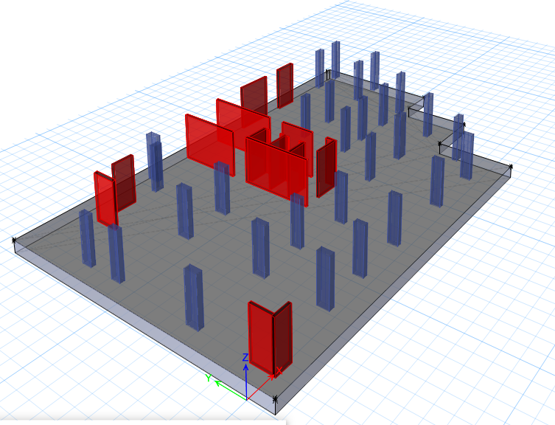
Determined the area of mat foundation :
The foundation should contained all the columns and wall in the building
as shown .

Slide 13
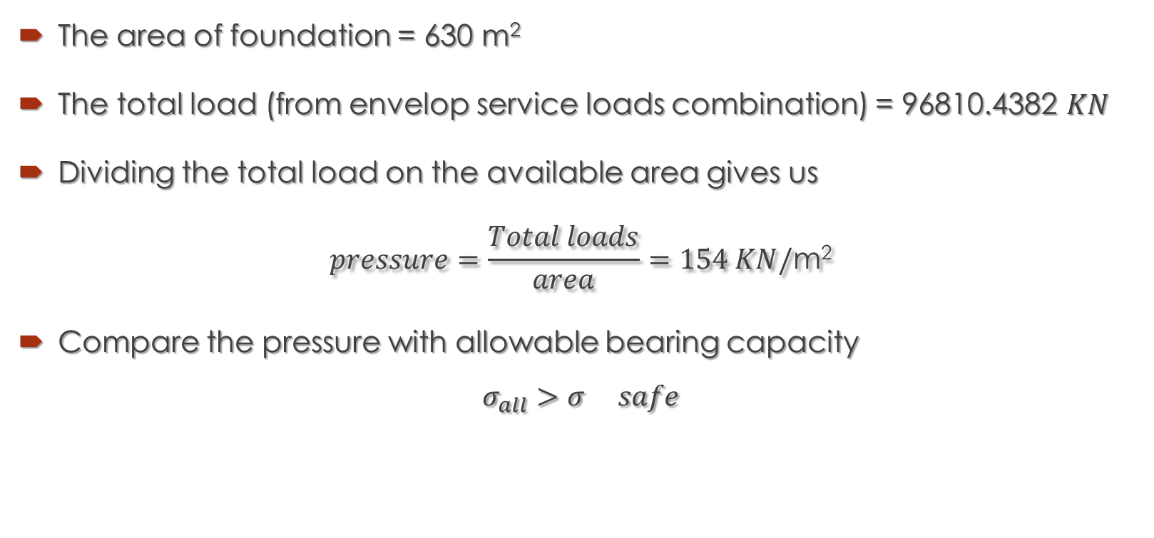
The area of foundation = 630 m²
The total load (from envelop service loads combination) = 96810.4382 $KN$
Dividing the total load on the available area gives us
$$pressure=\frac{Total loads}{area}=154 KN/\text{m}\text{2}$$
Compare the pressure with allowable bearing capacity
$$σ_{all}>σ safe$$

Slide 14
    Determined the thickness of mat foundation :
    We assumed the Height of foundation equals 850 mm.
    To check the adequacy thickness of foundation we need to calculate two types of shear.

Slide 15
      Two way shear :
the maximum axial load (from column was used in calculation because it’s the critical situation).
ØVc, p ≤Ø 1/6 (1+2/ß) √fc′ b˳ d =6133 KN
≤ Ø1/12 (αs∗d/b˳ +2) √fc′ b˳ d =10795 KN
≤Ø 1/3 √fc′ b˳ d =5918 KN
Where:
Bo : the parameter of critical crashing surface
ß=long side of column / short side of column
αs=(40 for middle column /30for edge column /20 for corner column )
Vu, p max = 3306 KN SAFE
d=790mm

Slide 16
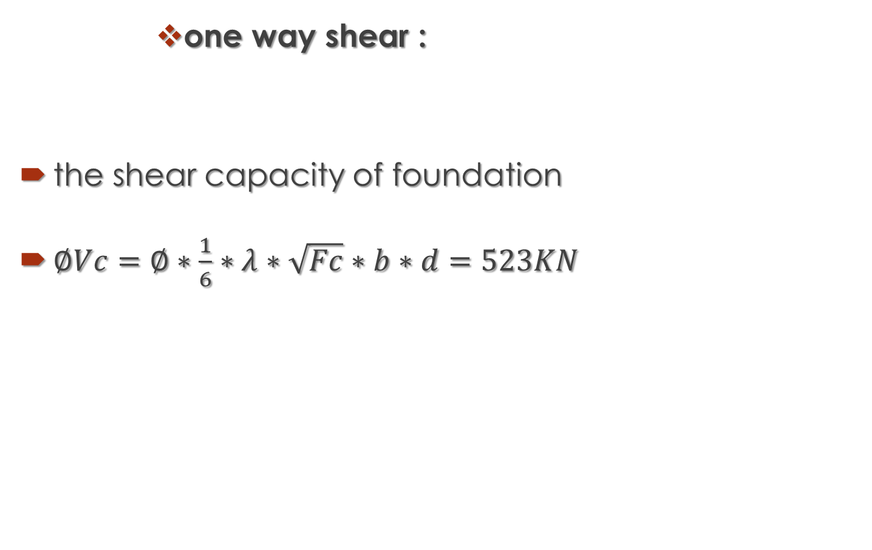
      one way shear :
the shear capacity of foundation
$∅Vc=∅∗\frac{1}{6}∗λ∗\sqrt{Fc}∗b∗d=523KN$

Slide 17
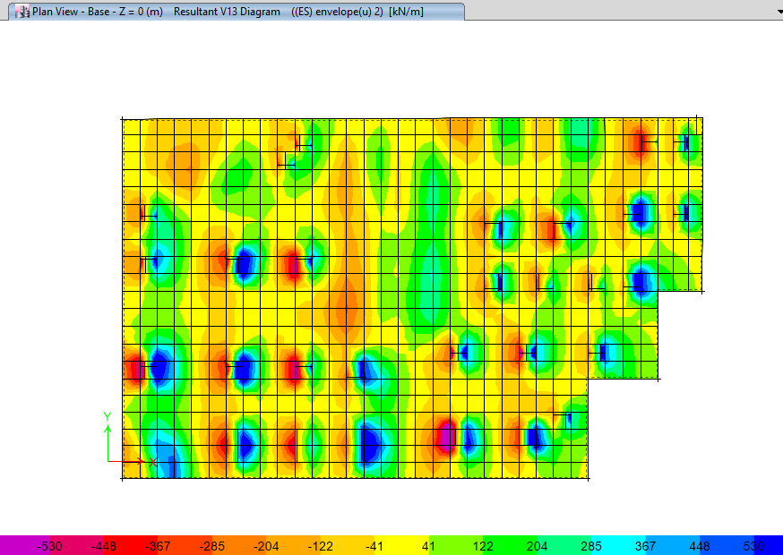
The shear force from ETABS
The shear force at critical surface of columns is less than the shear capacity
(note: the blue areas in the figure indicates that the shear stress is more than the limits but the shear force can be read at distance d from column’s face which gives values less than the maximum capacity )

Slide 18
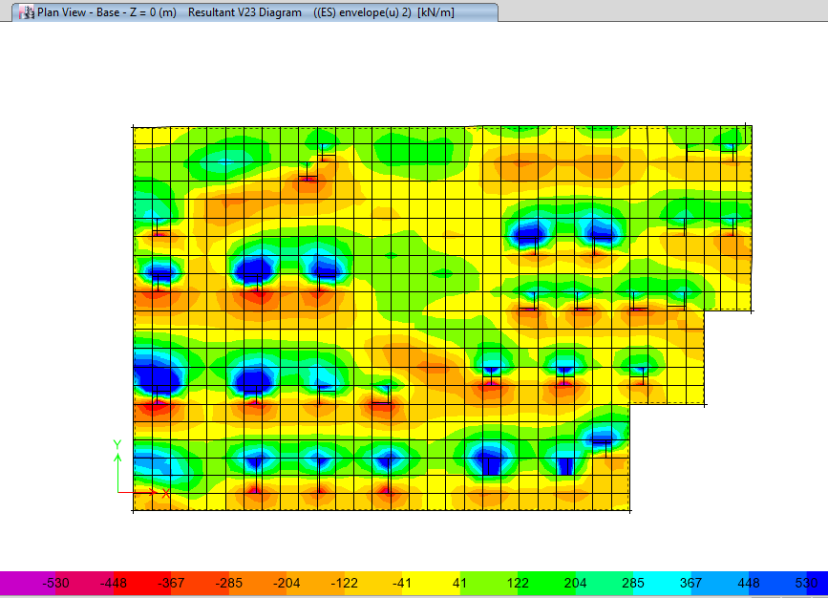
Check the one way shear in the other direction :
The shear force at critical surface of columns is less than the shear capacity.
Our assumption of foundation thickness is just safe so it will confirmed.

Slide 19
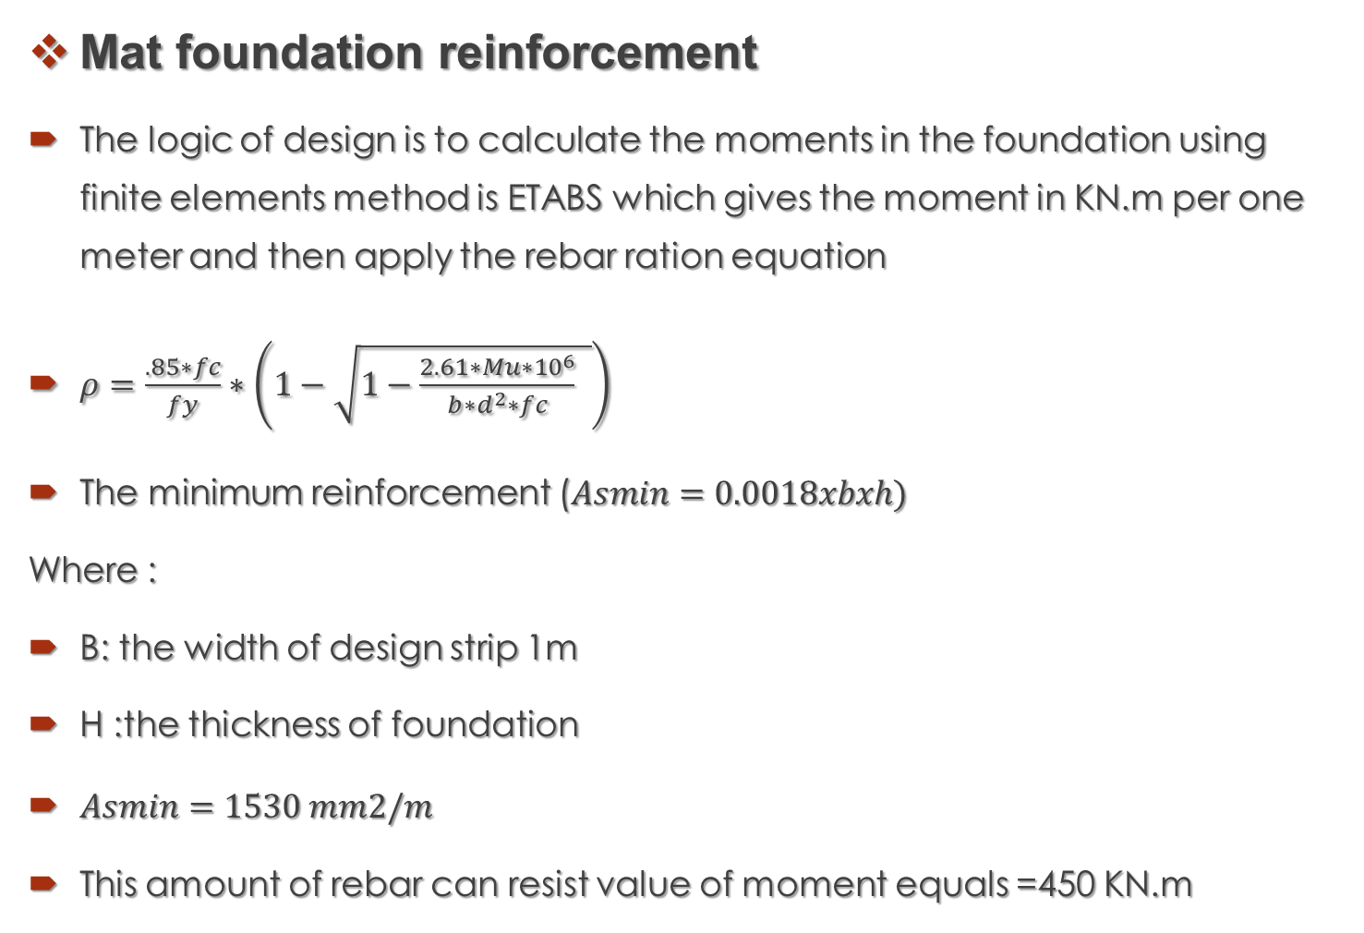
Mat foundation reinforcement
The logic of design is to calculate the moments in the foundation using finite elements method is ETABS which gives the moment in KN.m per one meter and then apply the rebar ration equation
$ρ=\frac{.85∗fc}{fy}∗\left(1−\sqrt{1−\frac{2.61∗Mu∗{10}^{6}}{b∗d^{2}∗fc} }\right)$
The minimum reinforcement ($Asmin=0.0018xbxh)$
Where :
B: the width of design strip 1m
H :the thickness of foundation
$Asmin=1530 mm2/m$
This amount of rebar can resist value of moment equals =450 KN.m

Slide 20
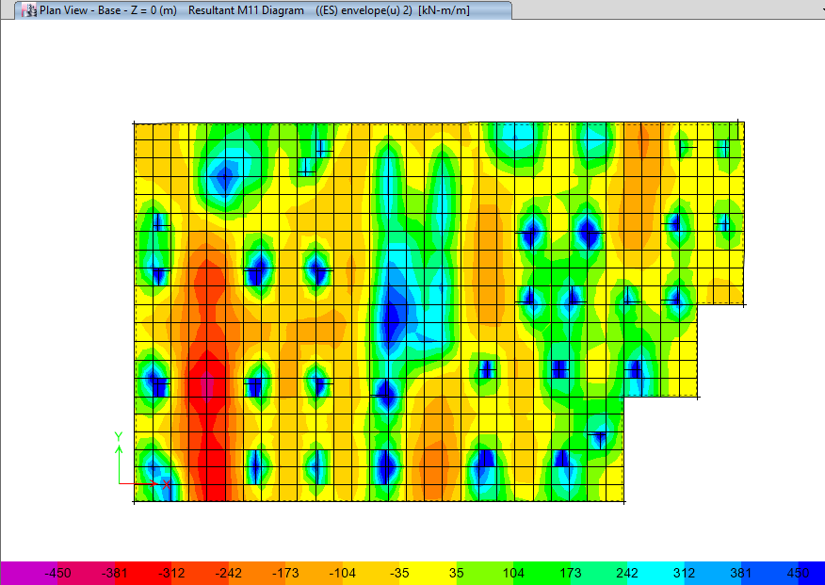
From the values of moment in X direction from ETABS we notice that the minimum reinforcement could be enough for foundation except in columns area (top side) .

Slide 21
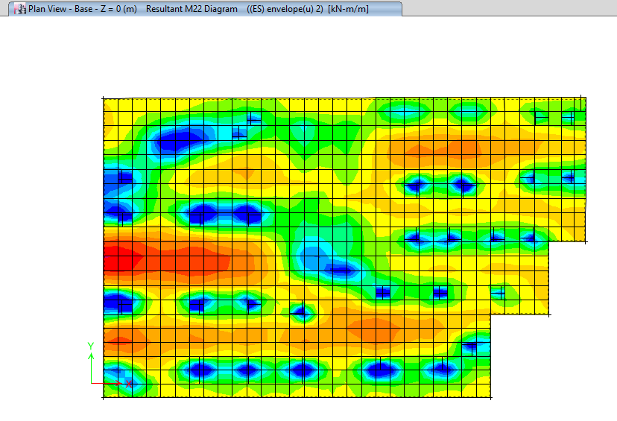
And the same case in the Y direction Moment .
The blue areas which have moments about 900KN.m

Slide 22
conclusion
From results we conclude
As min = 1530 mm2/m
Bar diameter = 20 mm
No of bar = 5 bars per meter bottom and top in X&Y directions
Blue areas
Moments = 900KN.m
As=3105 mm2/m
No of bas = 10bars per meter at top face in X&Y direction in columns and walls areas

Slide 23
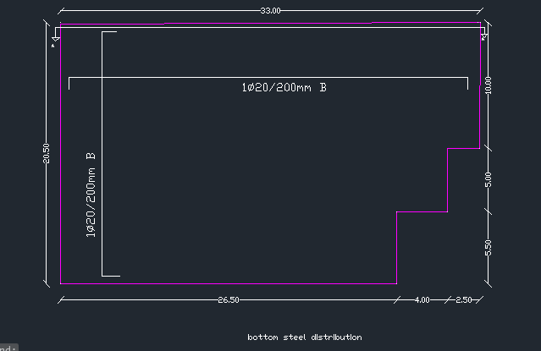
Bottom steel distribution

Slide 24
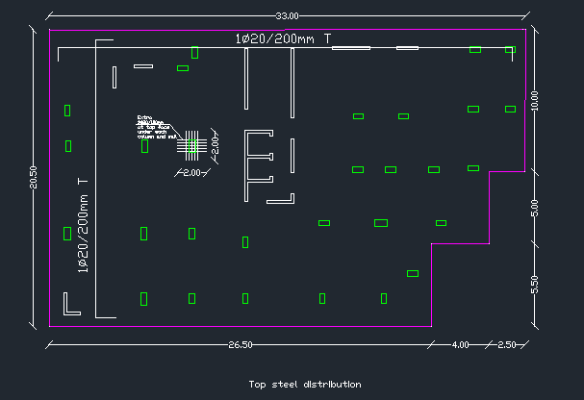
Top steel distribution

Slide 25


