Slide 1

Simulation of 1 Mw Organic rankine cycle coupled to parabolic trough collectors in Palestine
Supervised by:
Dr. Abdelrahim Abusafa
Prepared by:
Saja Abuzant

Slide 2
Outlines
Overview.
Objectives.
Methodology.
Site Selection.
Power Plant Description.
Results.
Conclusion and Recommendations.

Slide 3
Overview
Energy situation in Palestine is complicated, Palestine relies mainly on importing electricity from Israel, 88% is imported from Israel, 3% from Jordan and Egypt, with energy costs higher than in the neighboring countries.
Palestine could be one of the top locations for solar system applications.
Palestine has an average global radiation of 5.4 kWh/m2.day, and 3,000 sunshine hours per year.

Slide 4
Objectives
To present an ORC power plant driven by parabolic trough collectors in Palestine, by using SAM software.
To study the annual performance of the proposed power plant.
To study the feasibility of the PTC-ORC in Palestine.
To compare between a steam Rankine cycle and the proposed PTC-ORC with the same capacity.

Slide 5
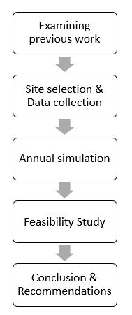
Methodology

Slide 6
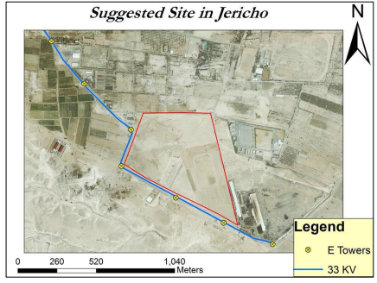

Slide 7
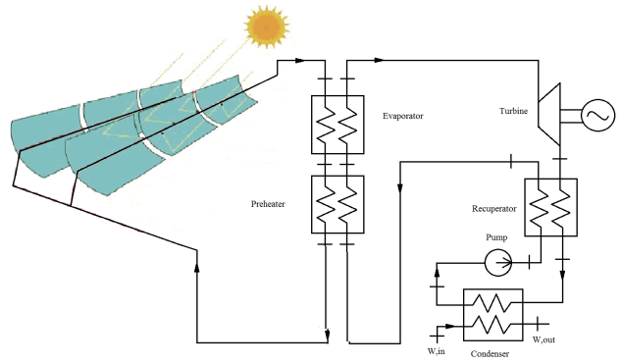
Figure 2: Solar ORC Layout

Slide 8
Power Block specifications
Evaporation Pressure | 2227 kPa
Condensation Pressure | 74 kPa
Design Cycle Thermal Input | 5.43 MWt
Gross Output Power | 1.11 MWe
Net Output Power | 1 MWe
Gross to Net Conversion Factor | 90%
Plant Thermal Efficiency | 20.7%

Slide 9
Design Point Parameters
Collector Orientation
Day & Hour
Latitude & Longitude
HTF Inlet & Outlet Temperature
DNI & Ambient Temperature

Slide 10
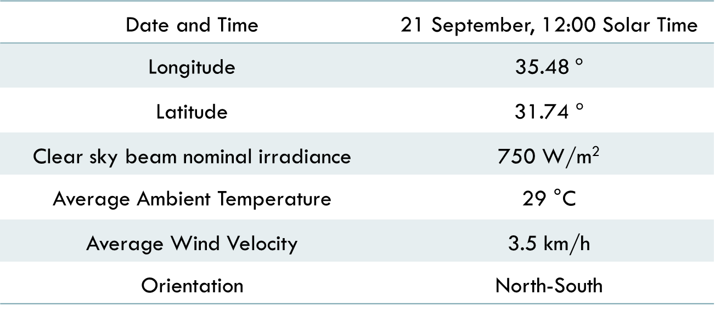
Design point parameters
Date and Time | 21 September, 12:00 Solar Time
Longitude | 35.48$°$
Latitude | 31.74 $°$
Clear sky beam nominal irradiance | 750 W/m²
Average Ambient Temperature | 29 °C
Average Wind Velocity | 3.5 km/h
Orientation | North-South

Slide 11
Solar Collector properties
Name | SkyTrough
Optical Efficiency | 74.4%
Mirror Reflectivity | 93%
Modules Per SCA | 8
SCA Aperture Area (m²) | 656
SCA Length (m) | 115
Receiver Tube | 80-mm Evacuated Receiver Tube

Slide 12
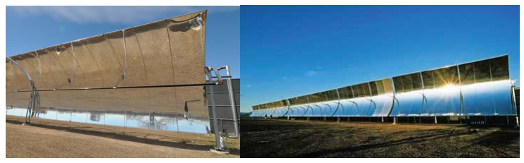
Figure 3: SkyTrough SCA (right) and Module (left)

Slide 13
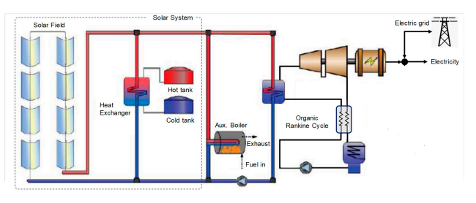
Thermal Energy Storage system

Slide 14
Solar field specifications
Solar Multiple | 2.6 | Maximum Power to Storage | 8.576 MWt
Full Load Hour of Storage | 14 hours | Total Aperture Reflective Area | 29,520 m²
HTF Inlet Temperature | 170 °C | Total Number of SCA | 45
HTF Outlet Temperature | 300 °C | Stow Angle | 170 °
Maximum Energy Storage | 75.04 MWht | Deploy Angle | 10 °

Slide 15
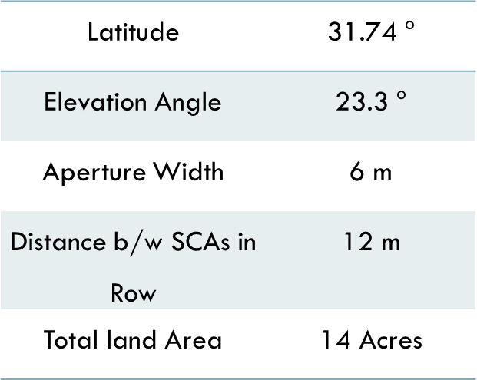

Shading Analysis
Row spacing (D) could be estimated from the following equation:
D = W ($\cos{α}$ / $\tan{(61°−∅)}$ +$\sin{α}$)
Latitude | 31.74 $°$
Elevation Angle | 23.3 $°$
Aperture Width | 6 m
Distance b/w SCAs in Row | 12 m
Total land Area | 14 Acres

Slide 16
Simulation Results
Annual Energy (kWh) | 4,018,483
Capacity Factor | 45.9%
LCOE (¢/kWh) | 14.6

Slide 17
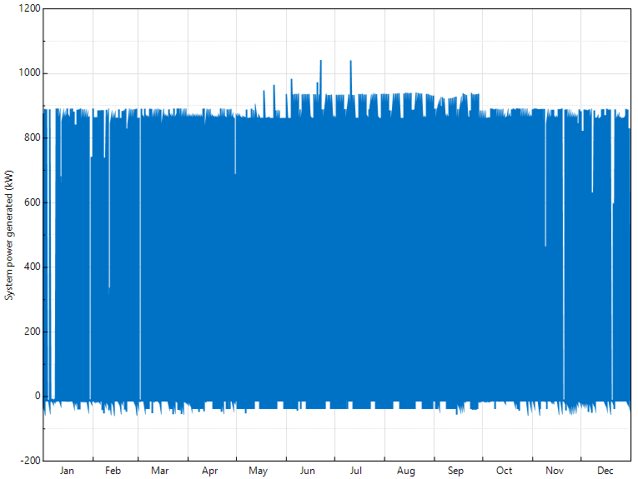
Figure 5 : Cycle net electrical power output (MWe)

Slide 18
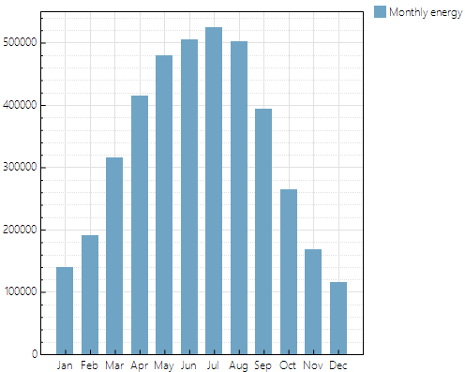
Figure 6: Monthly Energy (kWh)

Slide 19
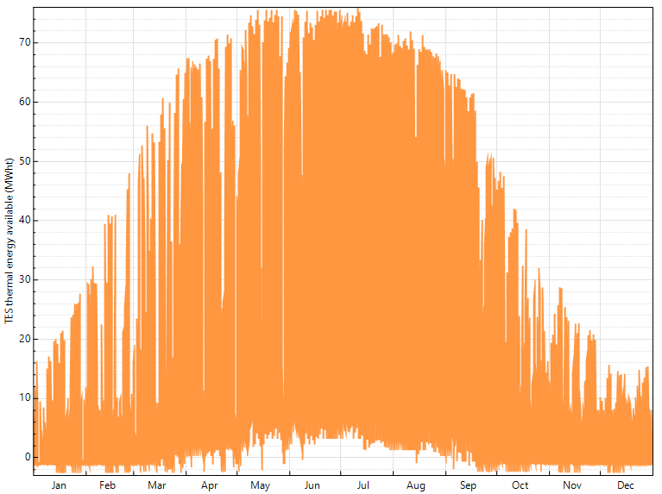
Figure 7: TES thermal energy available (MWht)

Slide 20
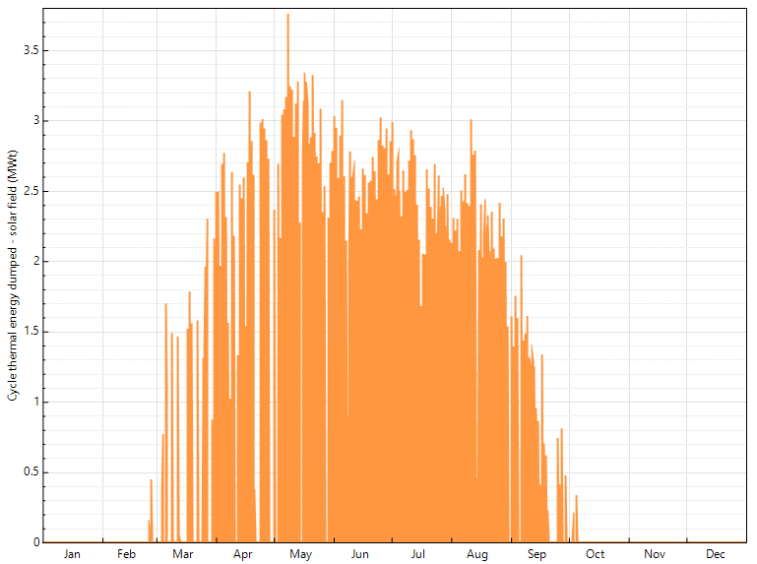
Figure 8: Cycle thermal energy dumped (MWt)

Slide 21
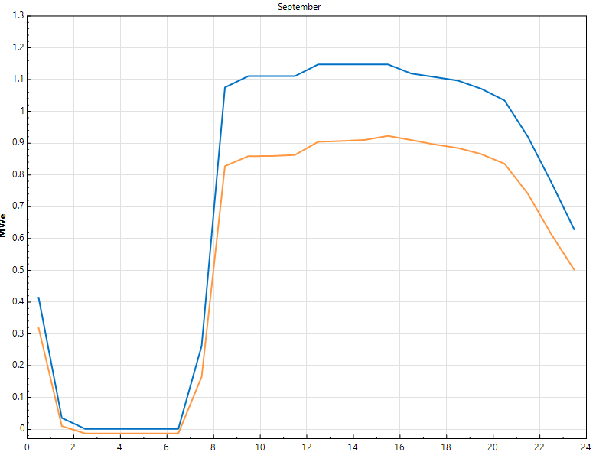
Figure 9: Hourly gross and net output power profile (MWe) during September

Slide 22
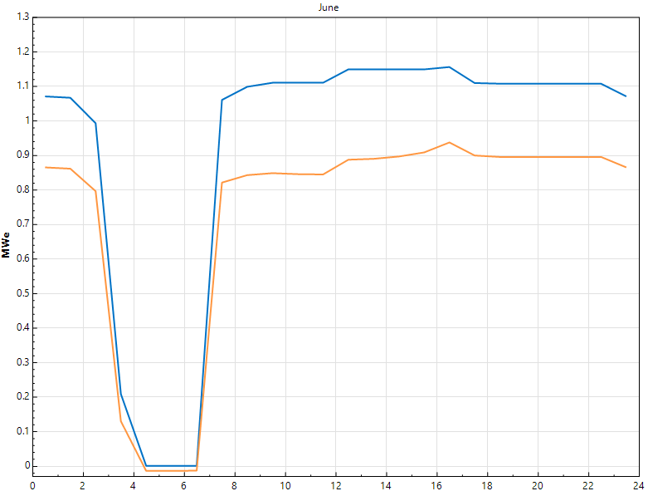
Figure 10: Hourly gross and net output power profile (MWe) during June

Slide 23
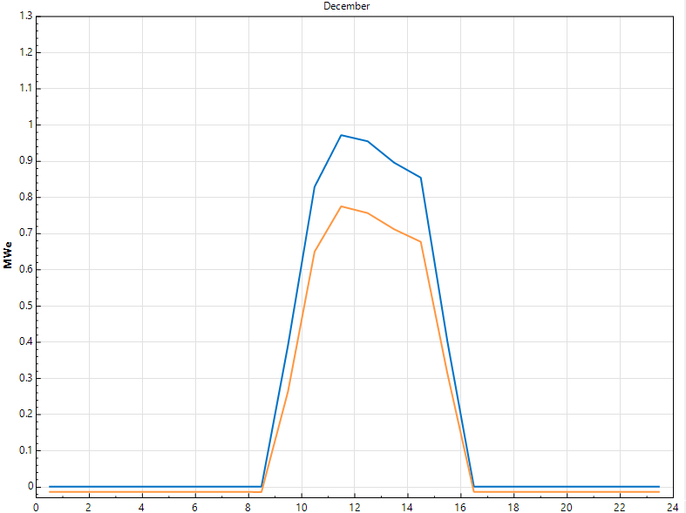
Figure 11: Hourly gross and net output power profile (MWe) during December

Slide 24
Economic Analysis
LCOE
Net Annual Savings
Simple Payback Period
Net Present Value
Internal Rate of Return
Profitability Index

Slide 25
LCOE | 14.6 ¢/kWh
Net Annual Savings | 906,657 ILS/year
Simple Payback Period | 20
Net Present Value | -9,949,313 ILS
Internal Rate of Return | 1%
Profitability Index | 0.46

Slide 26
Initial Investment = 18,496,278 ILS

Slide 27
SEGS SPECIFICATIONS
Power Block Thermal Efficiency | 37.49% | Maximum Power to Storage | 4.737 MWt
Design Gross Output | 1.11 MWe | Maximum Power from Storage | 3 MWt
Estimated Net Output at Design | 1 MWe | Storage Design Operating Hours | 14 hours
Design Thermal Input | 2.961 MWt | HTF Inlet Temperature | 170 °C
Maximum Thermal Input | 3.395 MWt | HTF Outlet Temperature | 300 °C
Minimum Thermal Input | 0.879 MWt | Total Aperture Reflective Area | 15,744 m²
Solar Multiple | 2.6 | Total Number of Assembles | 24
Maximum Energy Storage | 41.45 MWht | Total Land Area | 8

Slide 28
Comparison of Steam and Organic Rankine Cycles
 | Ormat | SEGS
Annual Energy (kWh) | 4,018,483 | 3,638,045
Capacity Factor | 45.9% | 41.6%,
LCOE (¢/kWh) | 14.6 | 16.12
Total Land Area (Acers) | 14 | 8

Slide 29
Conclusions
The ORC power plant can generate 4,018,483 kWh per the year with capacity factor of 45.9%.
LCOE for the solar ORC power plant is equal to 14.6 ¢/kWh.
All the mentioned financial parameters indicate that the project is not feasible.
Ormat ORC has a better performance than SEGS throughout the year. However, SEGS needs smaller areas.

Slide 30
Future Works and Recommendations
Designing and optimizing a more effective power block with Trilateral ORC by using EBSILON software.
Considering hybridization between parabolic trough collectors and biomass recourses, in order to obtain 24 operating hours.
Including a more detailed cost analysis taking in consideration taxes and power degradation.
This project would be more feasible if it wasn’t intended for generating electricity to commercial purposes. It is recommended to design it for energy consuming facilities.

