Slide 1
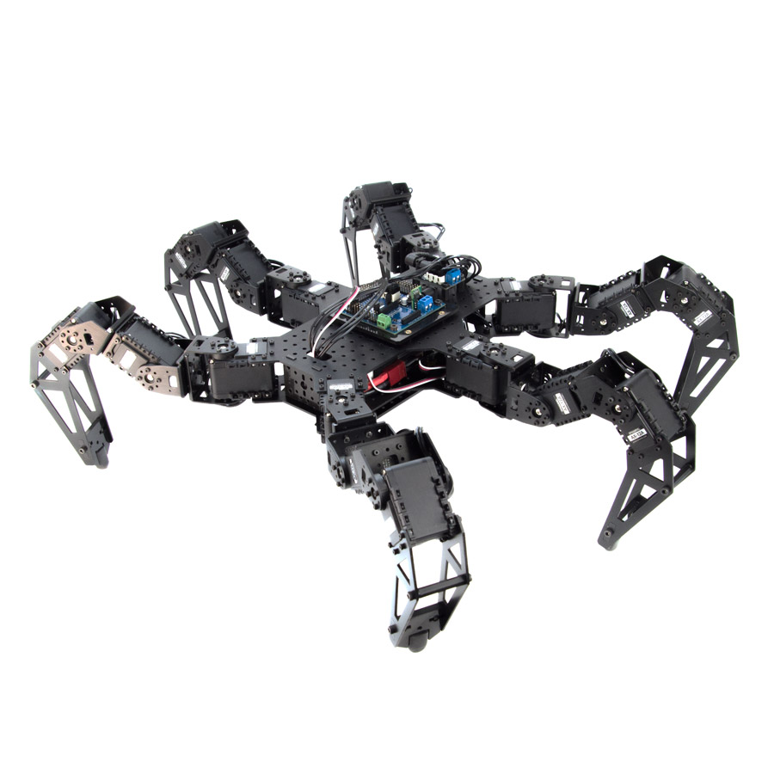
An-Najah National University
Faculty of Engineering & Information Technology
Computer Engineering Department
Design, Implementation & Control of Autonomous Hexapod Robot for Search and Rescue
by
Ali Naser & Jihad Hajaj
Under the supervision of
Dr. Omar Tamimi

Slide 2
Table of Contents
1
1
5
Introduction
Movement
2
6
Hexapod Anatomy and 3D Printed Parts
Demonstration
3
7
Hardware Setup
Challenges
4
8
Software
Future Enhancements

Slide 3

Introduction
Design, Implementation & Control of Autonomous Hexapod Robot for Search and Rescue

Slide 4
Introduction
Project Overview
The goal of this project
Key Components
Communication and Control
Power Management

Slide 5
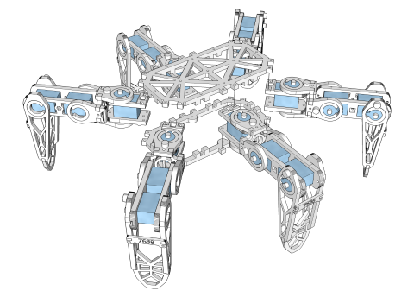
Hexapod Anatomy and 3D Printed Parts
The hexapod robot's mechanical structure is crucial for its stability, durability, and efficient movement

Slide 6
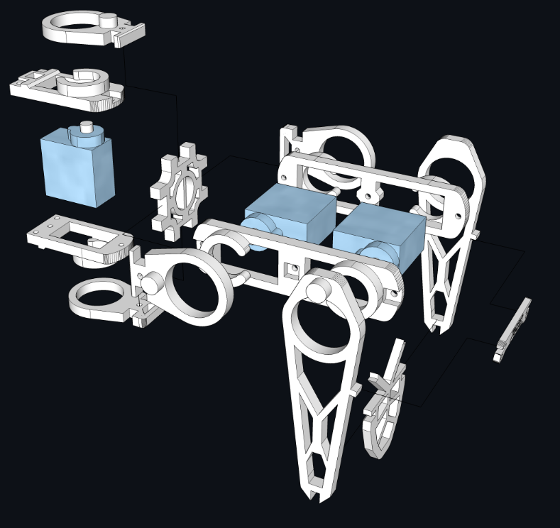
Hexapod Anatomy and 3D Printed Parts

Slide 7
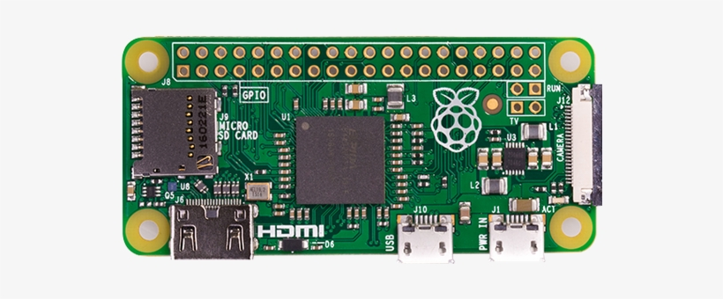

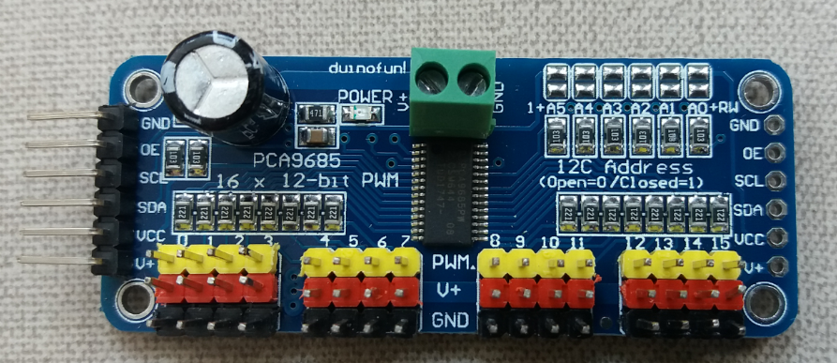
Hardware Setup
Raspberry pi zero w
Lithium Batteries
PCA9685

Slide 8
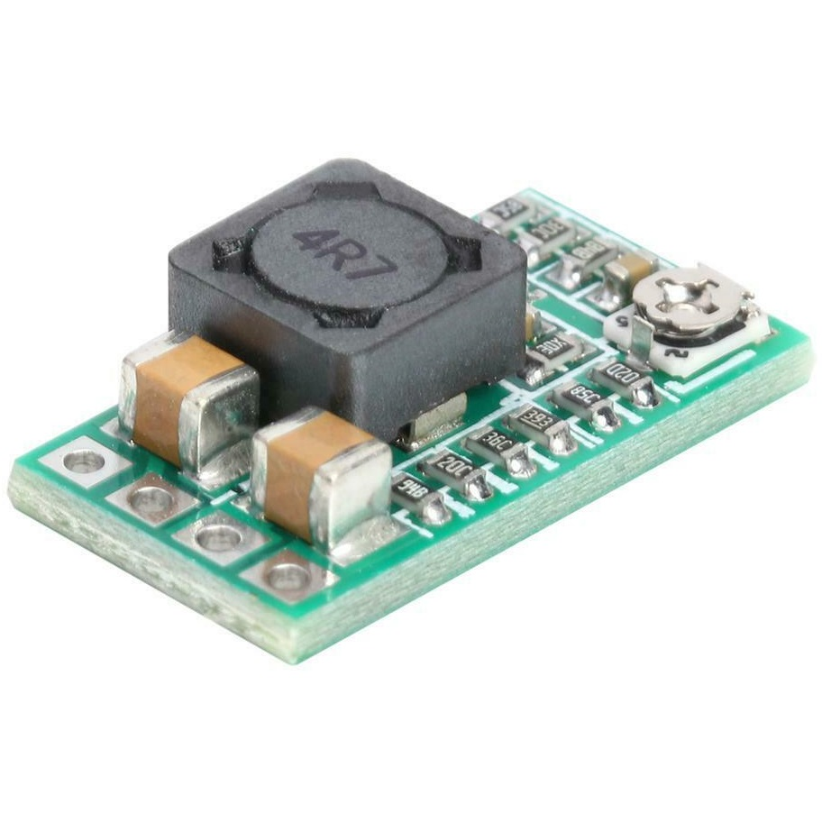
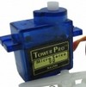
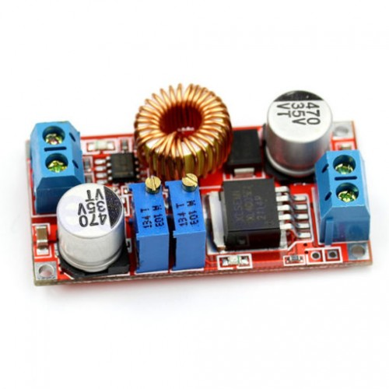
Hardware Setup
MP2315
Stepper Motors sg90
XL4015 Buck converter

Slide 9
Software
Programming language : python
Communication
    The Raspberry Pi Zero W, serving as the central microcontrolle.
    lunch TCP server over onboard WiFi module.
    communication between the software and the external device for remote control.

Slide 10
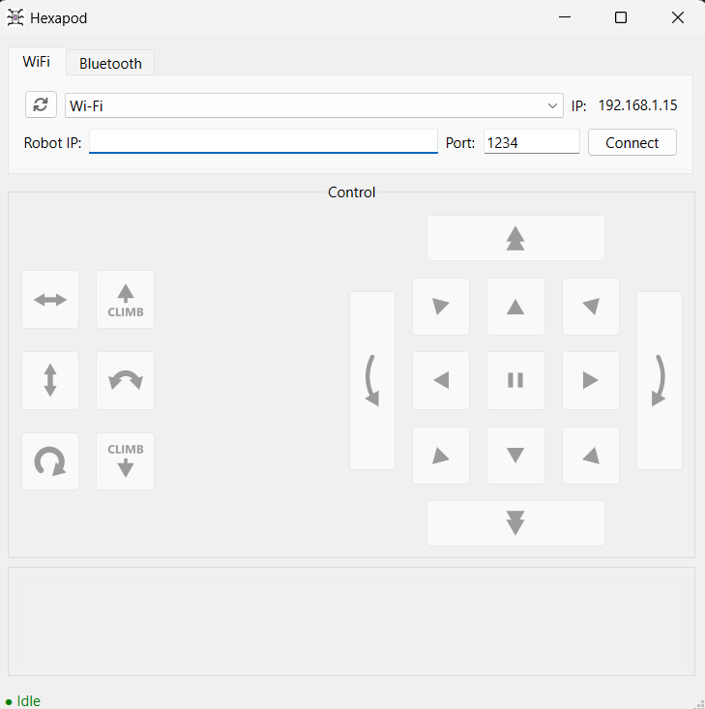
Software

Slide 11

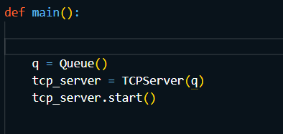
Software

Slide 12
Movement
Hexapod gait patterns:
    Tripod Gait
    Ripple Gait
    Wave Gait

Slide 13
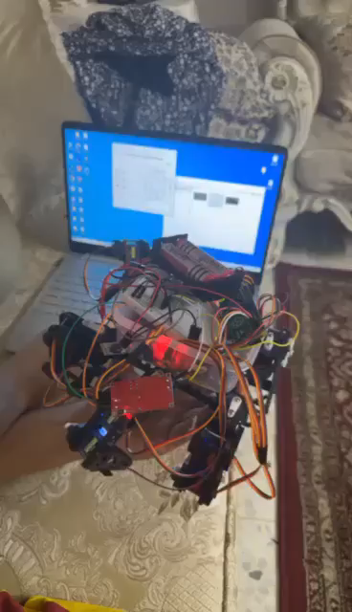
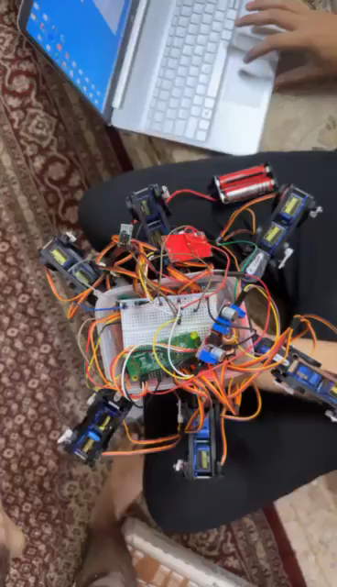
Demonstration
Before editing the code:
After editing the code:

Slide 14
Challenges
3D-printed parts issues.
Time wasted waiting for parts online, and never getting them.
Software: programming and understanding of the hexapod movement.
Testing (trial and error) because modifying and executing the code on rp-zero take so much time (its so slow). Also running out of power over and over again was devastating.

Slide 15
Future Enhancements
Infrared camera.
Automation (Ai integration)
Sensor Integration:
    ultra sonic.
    RFID

Slide 16
Extra pictures of our project

Slide 17
Thanks!
Do you have any questions?

