Slide 1

An-Najah National University
Faculty of Engineering & Information Technology
Mechatronics Engineering Department
Graduation Project 2
Pellet 3D Printer
25th Jun.2024
Done By:
Osama Daoud
Sabeeh Daher
Abdullah Assi
Supervisor:
Dr. Bahaa Shaqour

Slide 2
Contents
Introduction
Printer modification
Material used in printing
Preparing sample
Results and Analysis
Conclusion
Future Work
1

Slide 3
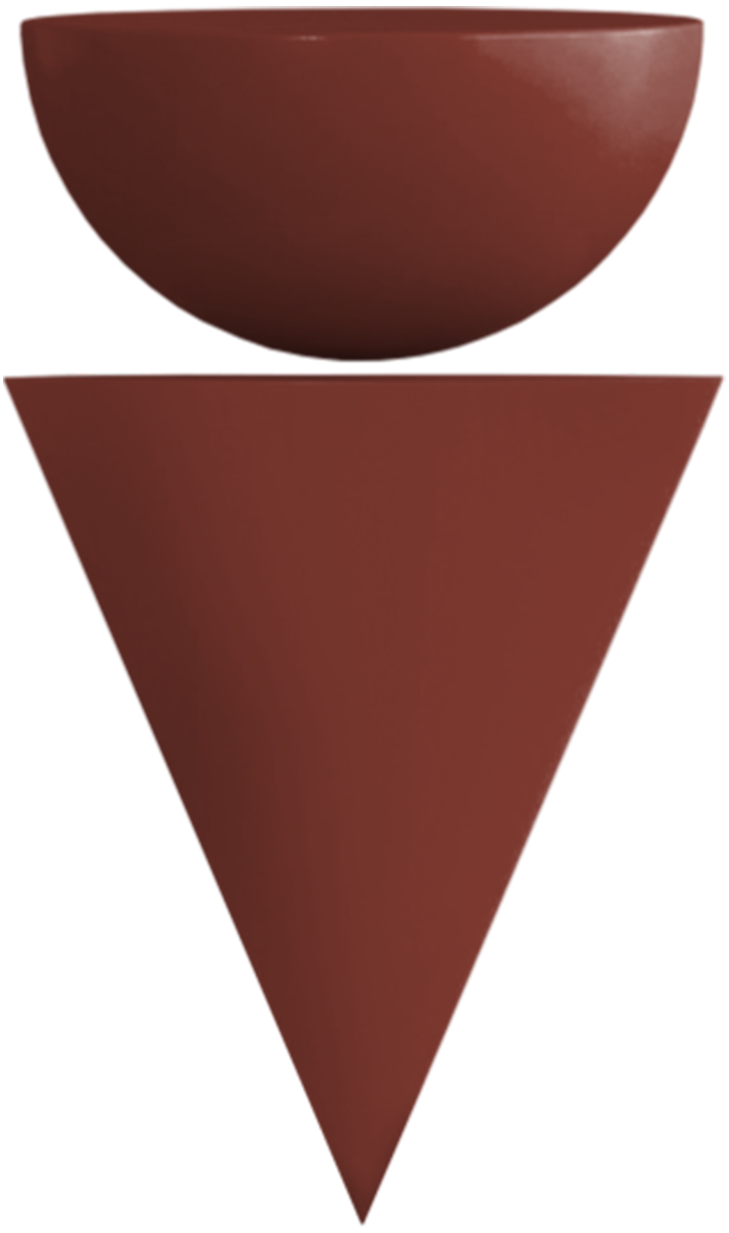
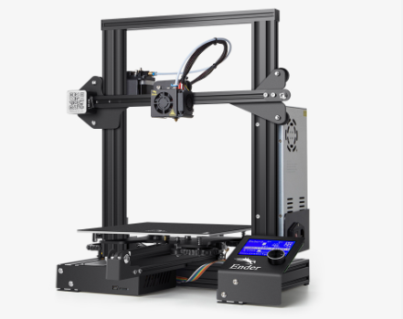
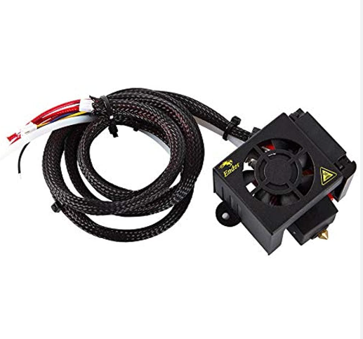
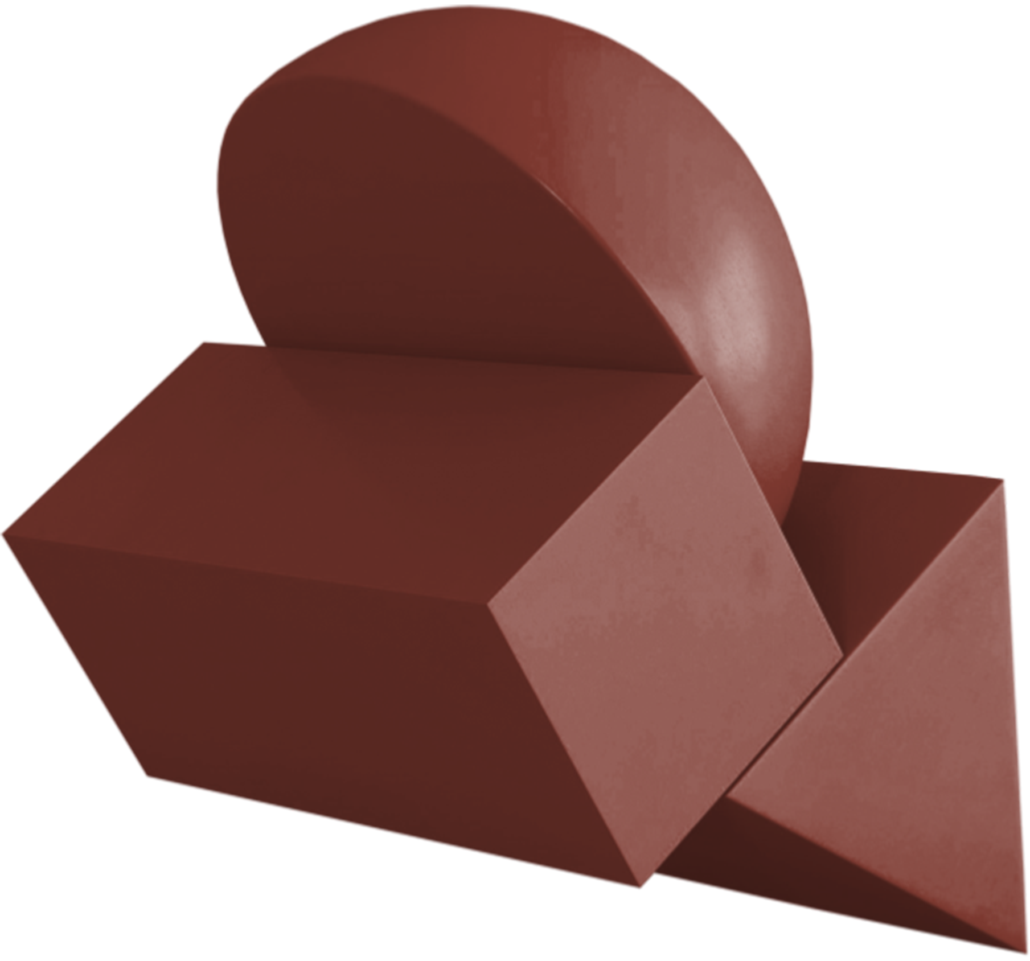
Introduction
A Pellet extruder is a part that combines a pellet melter and a pushing mechanism in one device. In this way they replace the extruder-melter assembly in our printer, so we must replace both elements with one of these pellet extruders.
The pellet extrusion process is important in various industries due to its versatility and efficiency in material processing .
2

Slide 4
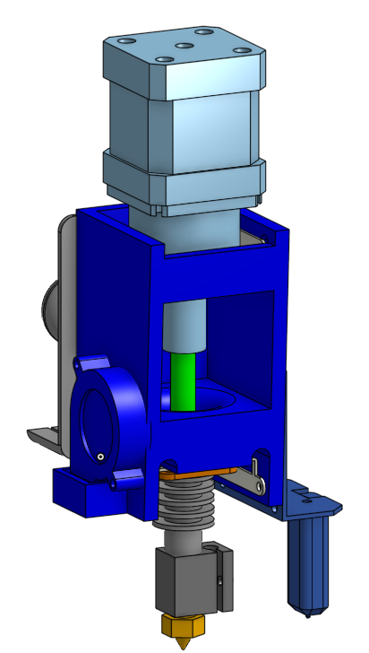
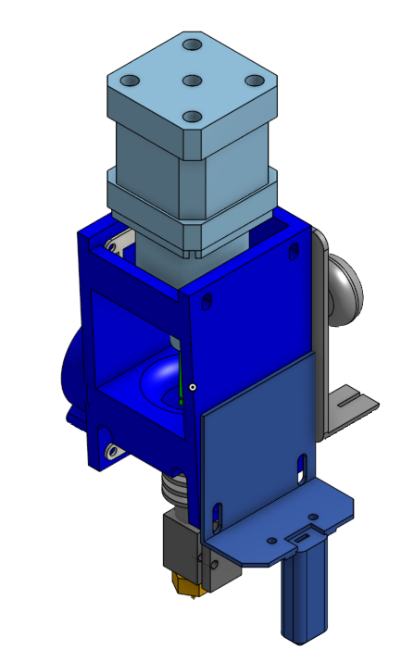
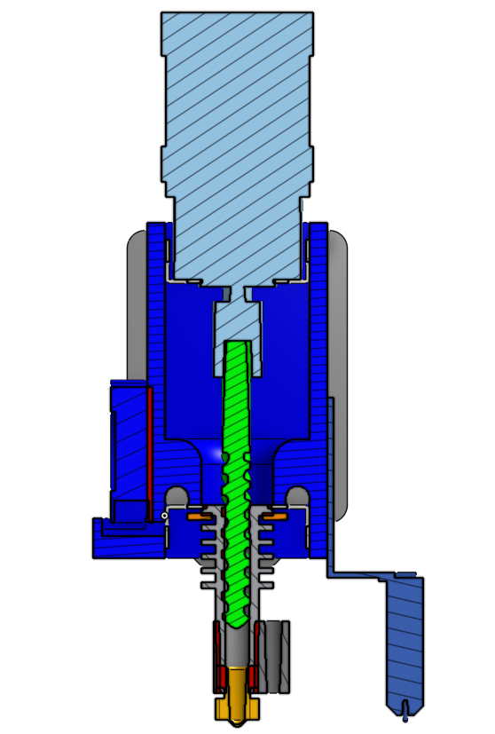
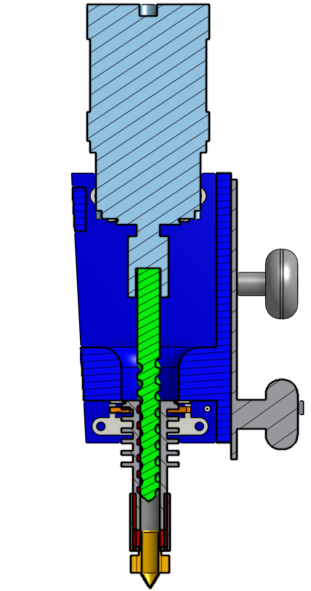
Printer modification
We used a ready-made printer creality ender 3, but we redesigned the original printer head to suit the project.
The figure show our pellet 3d printer head design of printer head design .
3

Slide 5
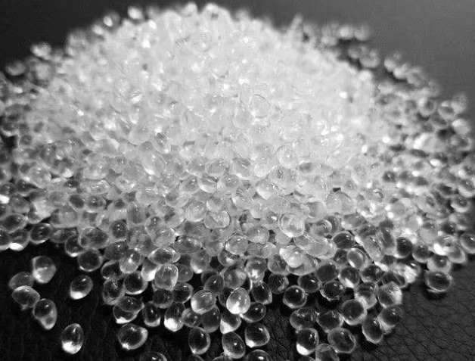
Material use in printing
TPU :
Thermoplastic polyurethanes (TPUs) are available in various hardnesses, colors, and radiopacifier formulations. Lubrizol offers a unique capability to fill Tecoflex TPUs with radiopacifiers and customize color matching to your specific application needs. Melting Point of TPU grades have melting points ranging from approximately 180°C to 220°C.
4

Slide 6
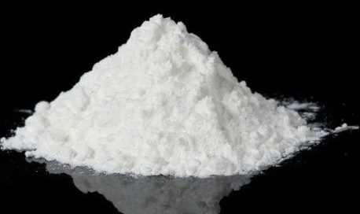
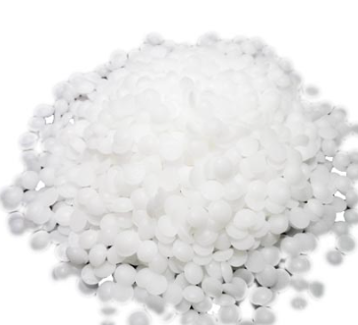
Material use in printing
Lidocaine :
Lidocaine is a widely used local anesthetic and antiarrhythmic drug. Melting Point of Lidocaine grades have melting points ranging from approximately 68°C to 69°C.
Witepsol :
Witepsol is a brand name for a range of hard fats primarily used as bases for suppositories and ovules. Melting Point of Witepsol grades have melting points ranging from approximately 31°C to 43°C.
5

Slide 7
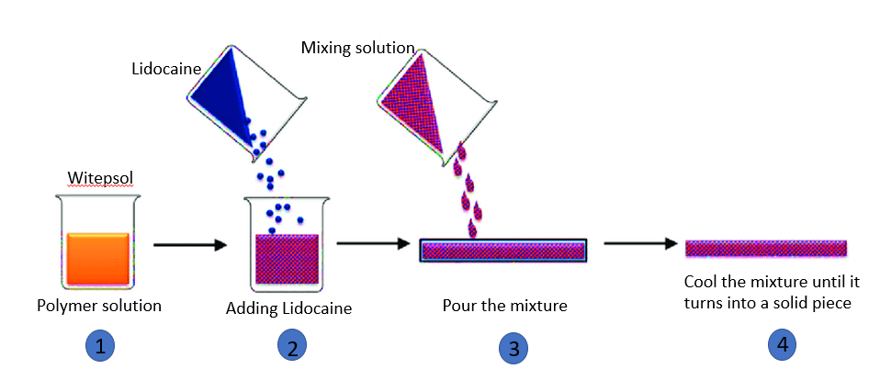
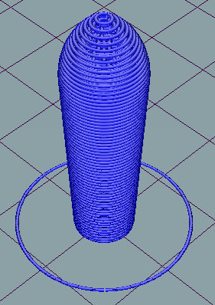
Preparing sample
To prepare the sample for printing (witepsol & lidocaine) It consists of five steps, first, dissolving the witepsol substance, then adding the lidocaine substance. The third step is stirring the mixture and pouring it into a bowl, then waiting until the mixture solidifies, and then grinding the substance into a pellet or powder.
6

Slide 8
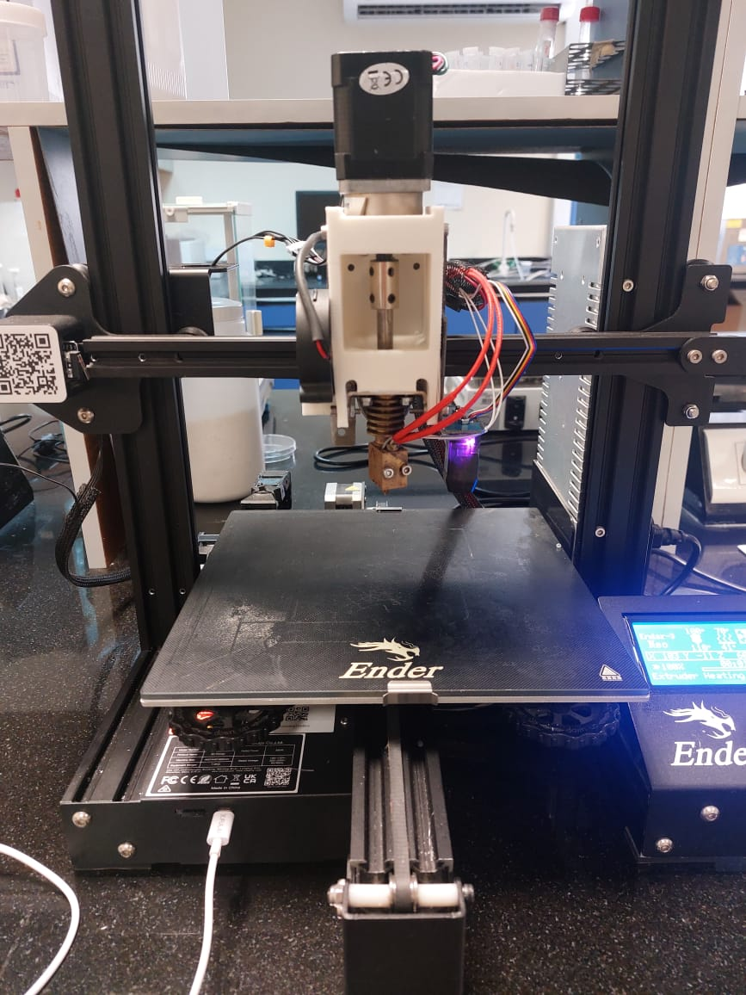
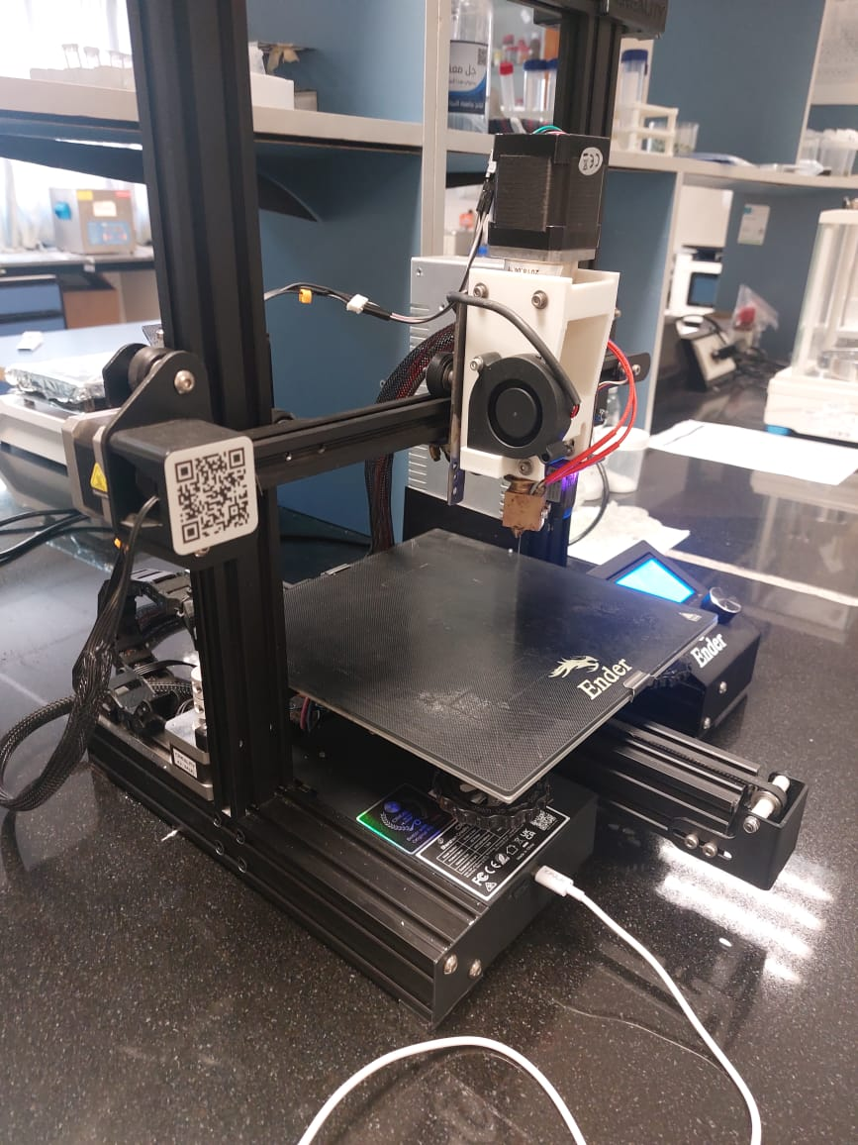
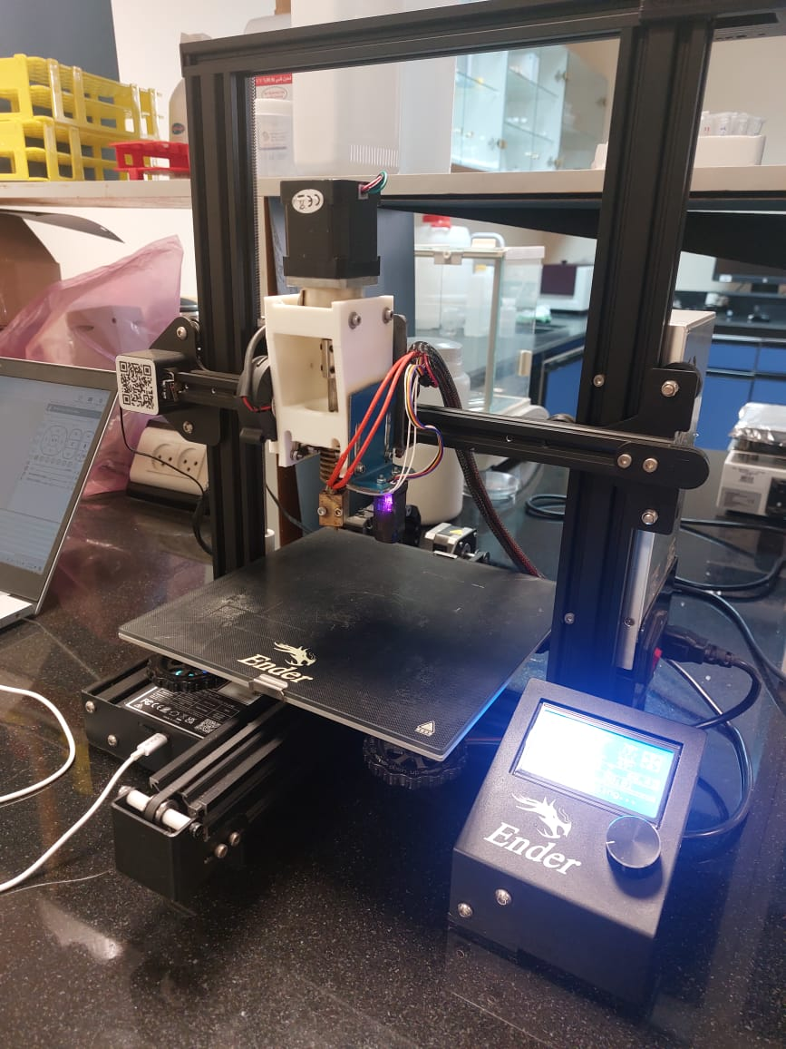
Results and Analysis
Assembly of the head:
After completing all the networking process, the figure below shows the head on the printer with all the pieces that have been added.
7

Slide 9
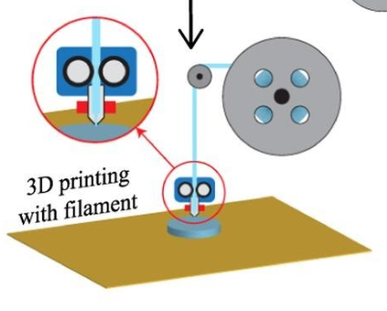
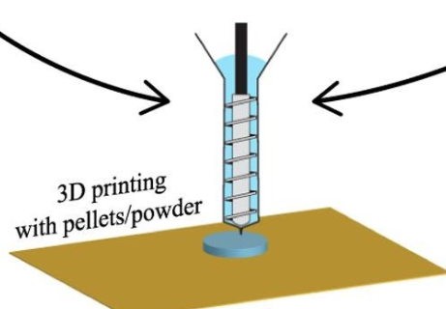
Results and Analysis
Calibration:
Calibrating the pellet extruder head is very important for ensuring optimal functionality of the 3D printer. To effectively calibrate the extruder, it is essential to comprehend how to regulate the quantity of pellets entering and exiting the extruder head.
To find the number of new extruder revolutions according to the following equation :
(L _{in} /L _{exp}) x Extrude –step
Extrude –step= 1000 rev/mm
Then the new extruder revolution = (10/7.5)*1000 =1317.4 rev/mm
8

Slide 10
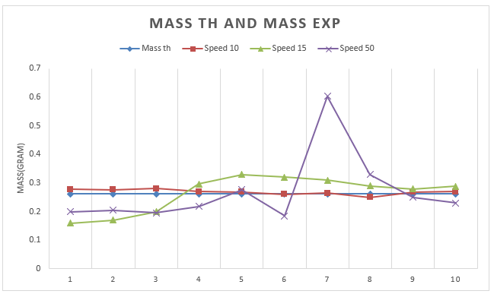
Results and Analysis
Calibration Curve:
9

Slide 11
Results and Analysis
Printed materials and printing parameters:
TPU:
During the printing process of this material, we faced some problems, and one of these problems was oozing, as during printing, when the ink moves from one point to another, a thin thread is left behind during the move, so we can reduce this problem by increasing the retraction value.
TPU
Layer height | 0.5mm
First layer height | 0.5mm
Speed | 6mm/s
Extrusion multiplier | 1.2mm/s
Nozzle Temperature | 180 C
Bed Temperature | 65-70 C
Nozzle diameter | 0.4 mm
E-step | 1225 rev/mm
10

Slide 12
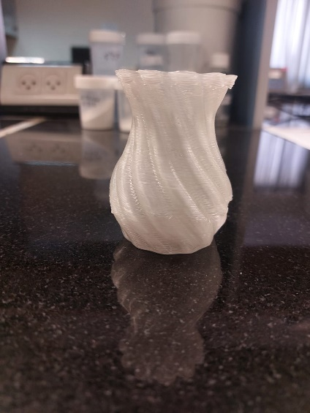
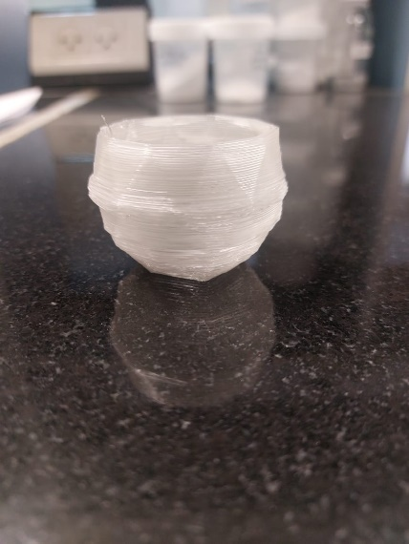
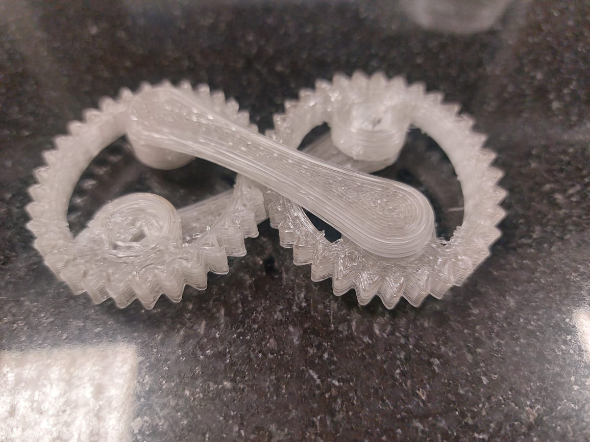
Results and Analysis
Printing sample :
The figure below shows the printing sample using TPU material.
11

Slide 13
Results and Analysis
Printed materials and printing parameters:
2% lidocaine 98% witepsol
After the mixture is ready, it is placed in the Hopper and then the nozzle temperature is set at 33 degrees, then the extruder is made for the substance through the screw rotation, and the material is pushed to the Cooling Throat and then to the nozzle.
Solid and shell 2% lidocaine 98% witepsol
Layer height | 0.6mm
First layer height | 0.6mm
Speed | 6mm/s
Extrusion multiplier | 1mm/s
Temperature | 33 C
Nozzle diameter | 0.8 mm
E-step | 1225 rev/mm
12

Slide 14
Results and Analysis
Printed materials and printing parameters:
10% lidocaine 90% witepsol
The table below represents the parameter used to print the sample concentration of 10% lidocaine and 90% witepsol.
Solid and shell 10% lidocaine 90% witepsol
Layer height | 0.5mm
First layer height | 0.5mm
Speed | 6mm/s
Extrusion multiplier | 1mm/s
Temperature | 33 C
Nozzle diameter | 0.8 mm
E-step | 1225 rev/mm
13

Slide 15
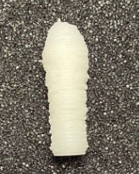
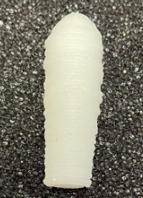
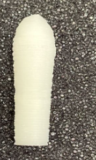
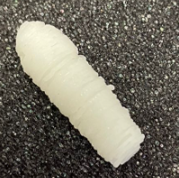
Results and Analysis
Printing sample :
2% lidocaine 98% witepsol
Shell:
Solid:
10% lidocaine 90% witepsol
Shell:
Solid:
14

Slide 16
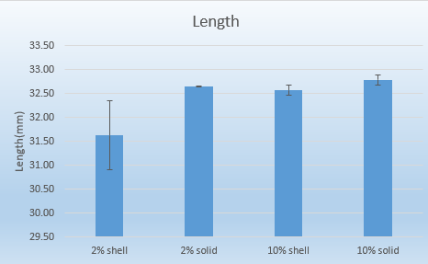
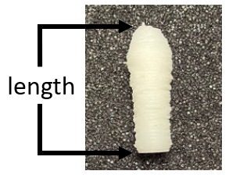
Results and Analysis
Printing sample :
Chart below illustrates the rate of length change and the standard deviation for printed sample at concentrations of 2% and 10%.
15

Slide 17
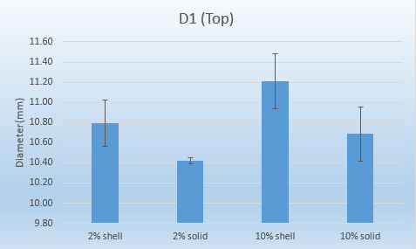
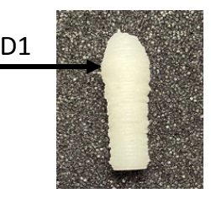
Results and Analysis
Printing sample :
The chart below illustrates the rate of diameter change at the top of the printed sample, along with their standard deviations, for concentrations of 2% and 10%.
16

Slide 18
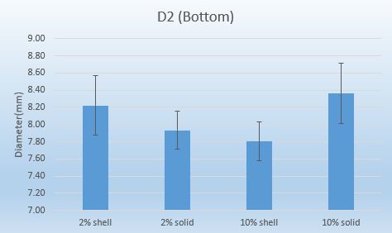
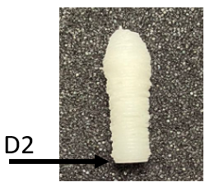
Results and Analysis
Printing sample :
The chart below illustrates the rate of diameter change at the bottom of the printed sample, along with their standard deviations, for concentrations of 2% and 10%.
17

Slide 19
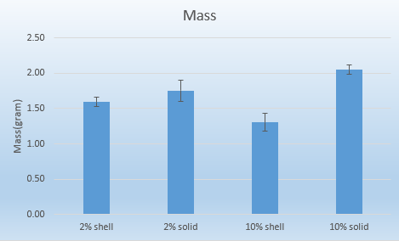
Results and Analysis
Printing sample :
The chart shows the rate of change in mass for the printed sample and their standard deviations at concentrations of 2% and 10%.
18

Slide 20
Conclusions
We have successfully demonstrated the feasibility and advantages of using pellets and powder as a cost-effective and versatile raw material for 3D printing.
The printer's ability to extrude a wide range of materials like (Thermoplastic Polyurethane, Lidocaine, and Witepsol) opens up new possibilities in printing felid, from producing large-scale prototypes.
Further refinements in design and functionality will undoubtedly improve its efficiency and usability, positioning pellet 3D printing as a compelling option in the additive manufacturing industry.
The new head reduces the amount of plastic wasted from regular printing by reusing the plastic used to support printed shapes and damaged shapes.
19

Slide 21
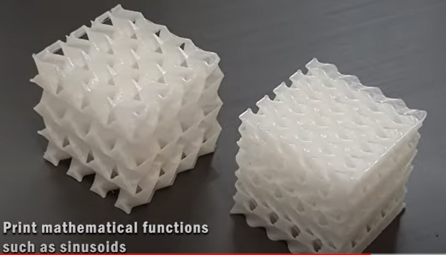
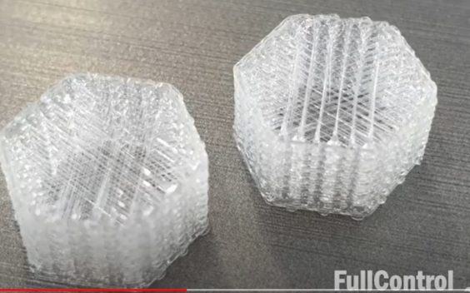
Future work
Our focus will be on enhancing the precision and resolution of the pellet 3D printer through refined extrusion systems and nozzle designs.
We aim to expand material compatibility by researching new plastics and composites and exploring more sustainable and bio-based materials.
Scaling up production capabilities is also a priority, with efforts directed toward larger build platforms, increased print speeds, and automated material handling.
Use it to identify the chemical and mechanical properties of these materials, ultimately printing samples and various shapes for further analysis.
20

Slide 22
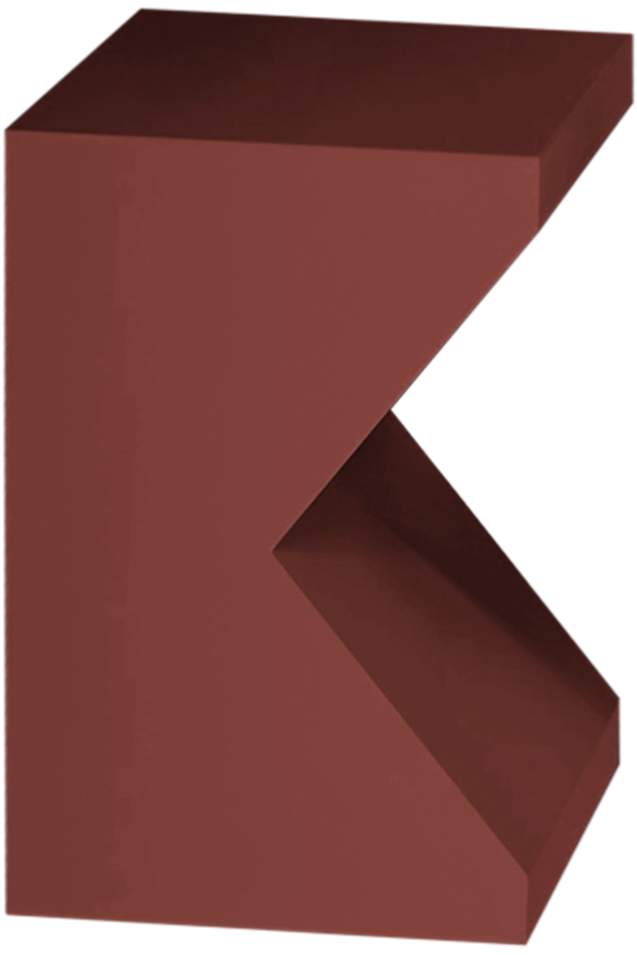
Thank you!
22

