Slide 1
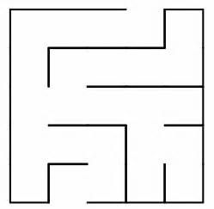
Maze Robot
Presented By: Naheel Sabbah & Salma Dweikat

Slide 2
Outline:
Introduction
App’s Idea
Used Tools
Features
Challenges
Future work
Demo

Slide 3
Introduction
Around the world, robots are being developed and used for a variety of purposes.
Contrary to popular media portrayals of robots, most use simple functions. Among these functions, the most common is looking for a target point. This technique is used in firefighting robots, rescue robots, and drones.
Although this robot was just solving a maze, This technique can be a fundamental element in the programming of other robots.

Slide 4
App’s Idea
The main objective of this project is to build an autonomous robot capable of solving any existing maze by moving away from any existing obstacles and detecting the void to reach the end point.

Slide 5
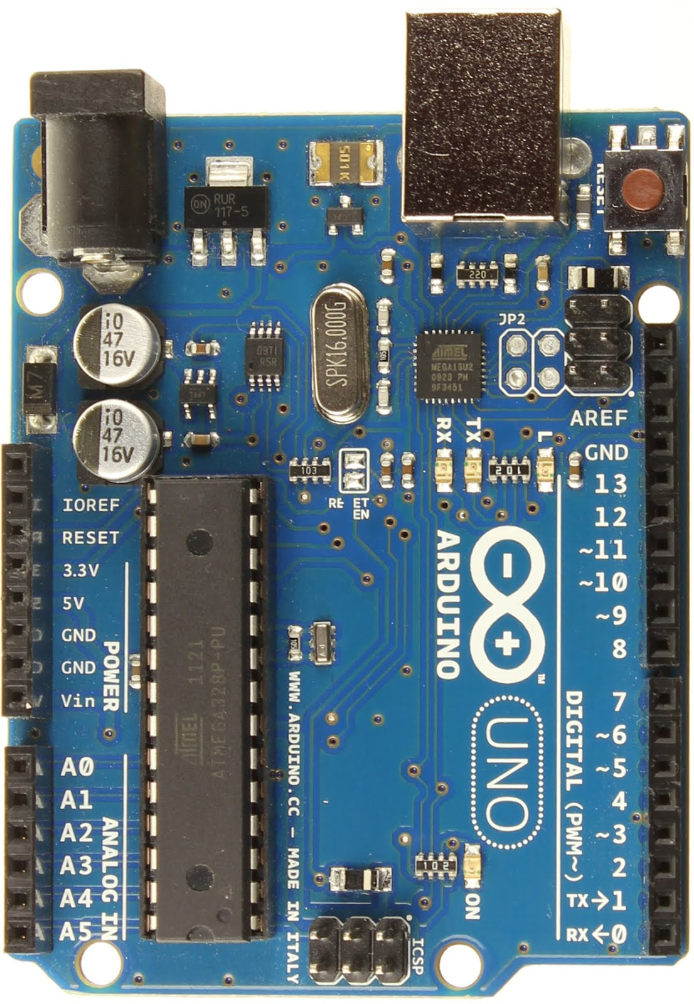
Used Tools
Hardware Tools:
Arduino Uno

Slide 6
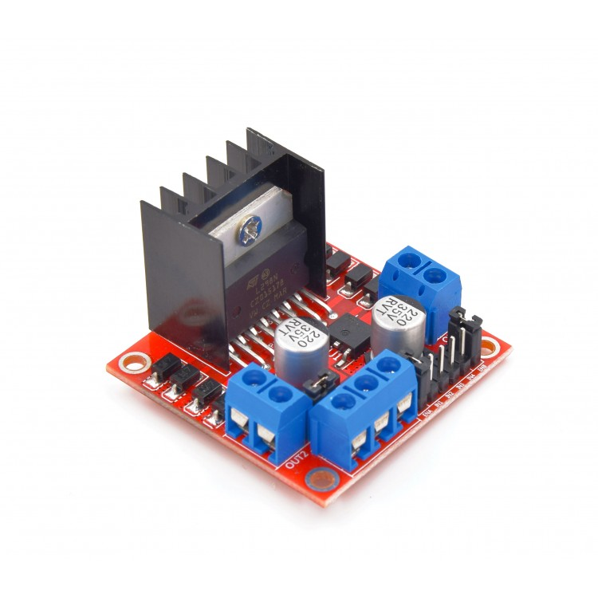
Used Tools
Hardware Tools:
L298N Motor Driver

Slide 7
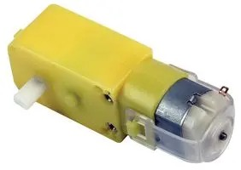
Used Tools
Hardware Tools:
DC motor

Slide 8
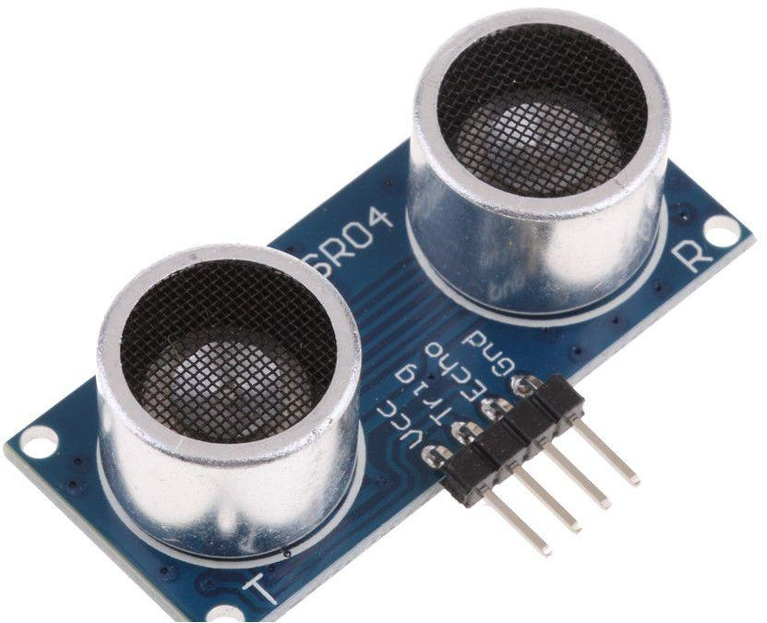
Used Tools
Hardware Tools:
Ultrasonic sensor

Slide 9

Used Tools
Software Tools
Arduino IDE

Slide 10
Features
Solve any maze.
Moving away from any existing obstacles and detecting the void .
Move without human assistance.

Slide 11
Challenges
The accuracy of sensors.
The driver of the motors consumed a lot of power.
The size of the maze is very large 3x3 m because of the robot’s size.

Slide 12
Future Work
Add more distance sensors.
Add LCD display , and the maze can be shown on it and showing where the robot is. and then it can be easily checked whether the robot is in the shortest path or not.
Dynamic robot

Slide 13
Demo

