Slide 1

HELLO!
ZEIN BANNA
DANA YOUNIS

Slide 2
Automating the plants growth monitoring by digital image processing

Slide 3
The Outline:
Motivation
Abstract
Methodology & Challenges
Conclusion & Future work
Discussion

Slide 4
Motivation
Monitoring plants growth is a real challenge in the field of agriculture .The complexity, effort, time and accuracy are critical factors for the tracking efficiency.
In traditional context, discovering potential problems are likely to be late, as well for knowing the reasons behind, as a subsequent consequences, a latency in remedy actions.
Automatic plants growth monitoring is an efficient method to lower the total effort of tracking and decision making.
However, in practice, most plants monitoring methods focus on controlling the environment based on information from sensor devices regardless plants condition.

Slide 5
Abstract
This research suggests using image processing techniques in extracting plants features i.e. (health, growth rate, condition...etc.) to help tracking plant's progress, care and access important gardening knowledge.
The proposed techniques are done in four steps:
1-Image enhancement .
2-Extraction of plants region using color spaces.
3-Feature extraction by applying three methodologies, which they are:
color intensity, structural differences measure and k-means cluster.
4-Applied analysis and interpretation for values to determine the growth
rate, florescence and age stage cluster.

Slide 6
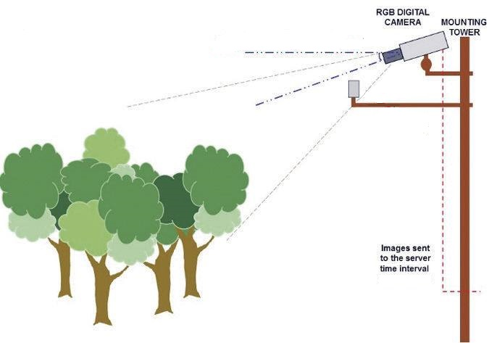
Images Acquisition

Slide 7
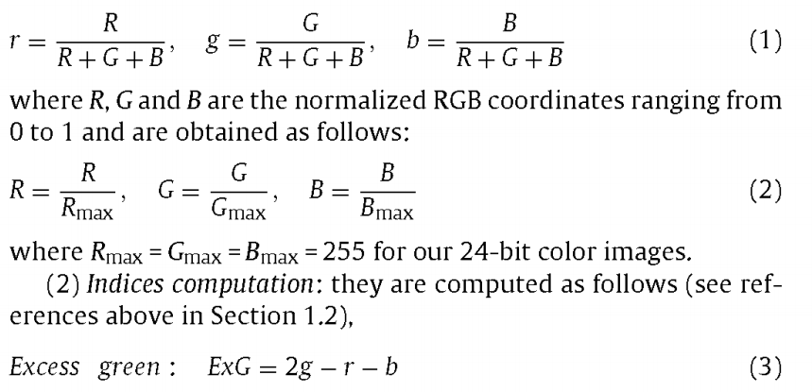
Plant area extraction using “Excess Green”

Slide 8
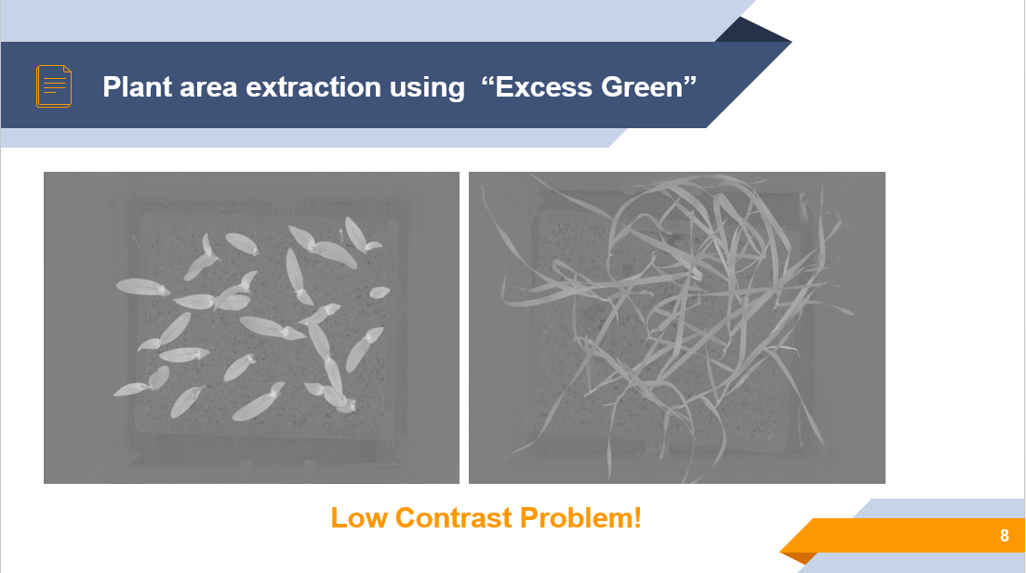
Notes:
low contrast looks like it has a gray wash to it. the blacks are more like a dark gray, and the whites a light gray.

Slide 9
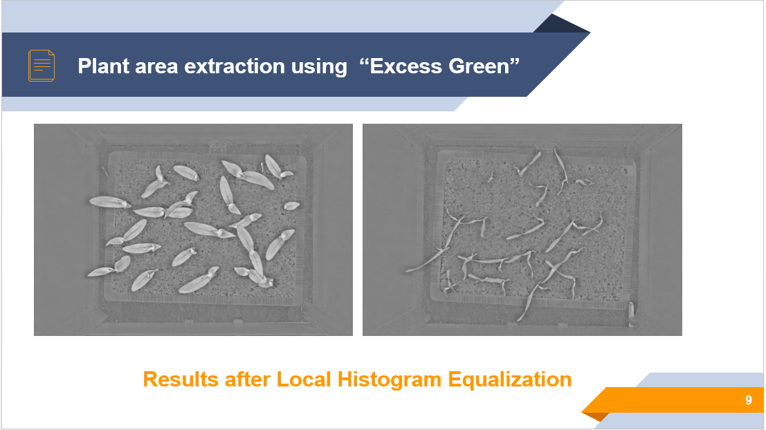
Notes:
Histogram Equalization. Histogram equalization is a technique for adjusting image intensities to enhance contrast.

Slide 10
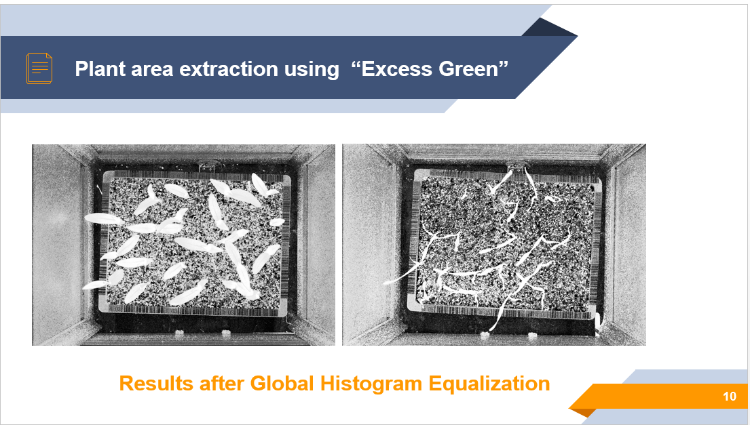

Slide 11
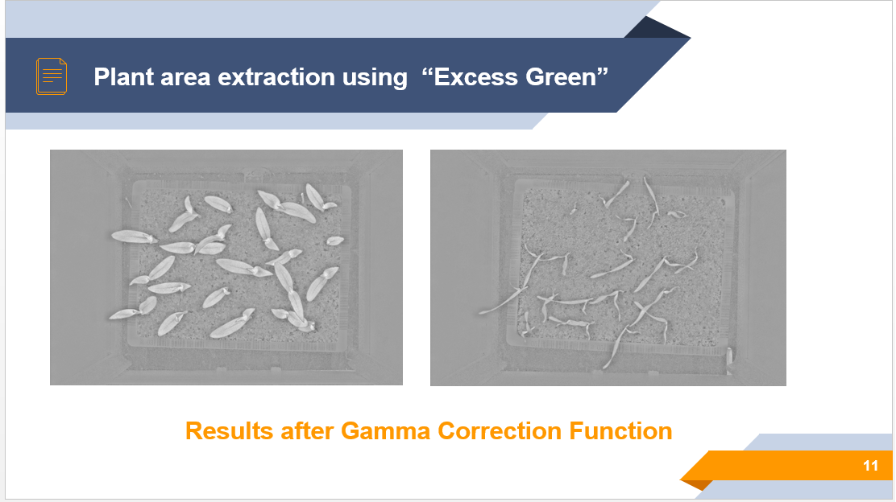

Slide 12
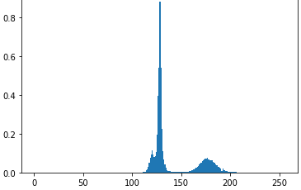
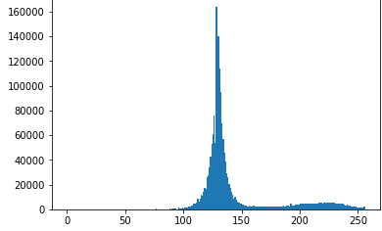
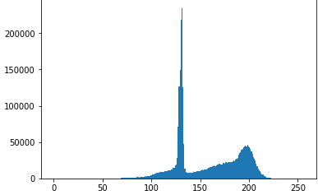
Plant area extraction using “Excess Green”
Global Equalization
Local Equalization
Gamma Correction

Slide 13
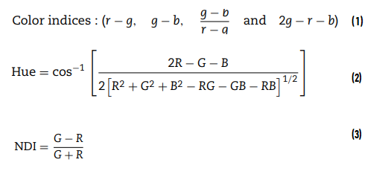
Techniques for plant area extraction
Normalized Excess Green:

Slide 14
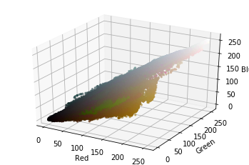
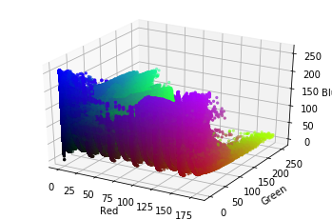
Plant area extraction using “Color Spaces”
RGB color Model
HSV color Model

Slide 15
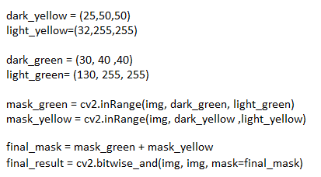
Plant area extraction using “Color Spaces”

Slide 16
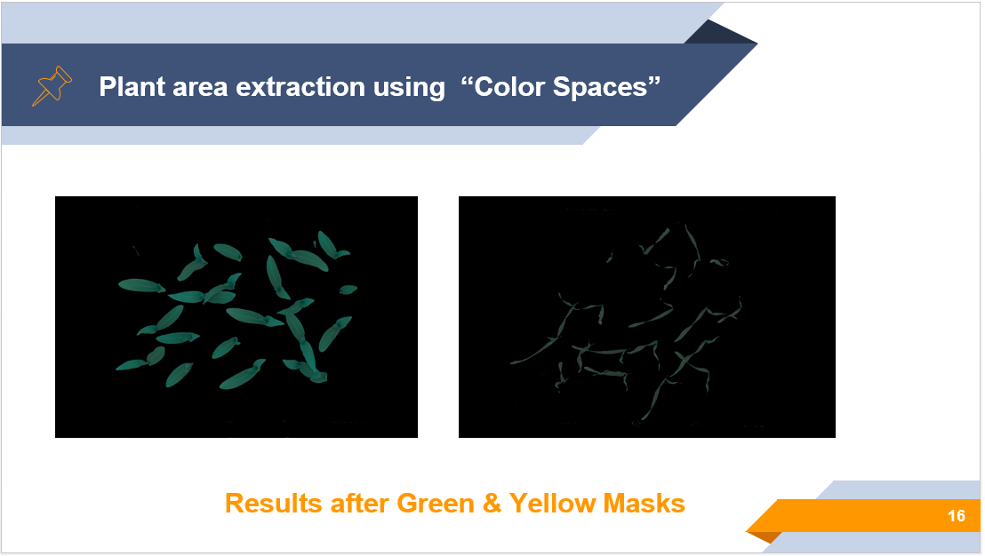

Slide 17
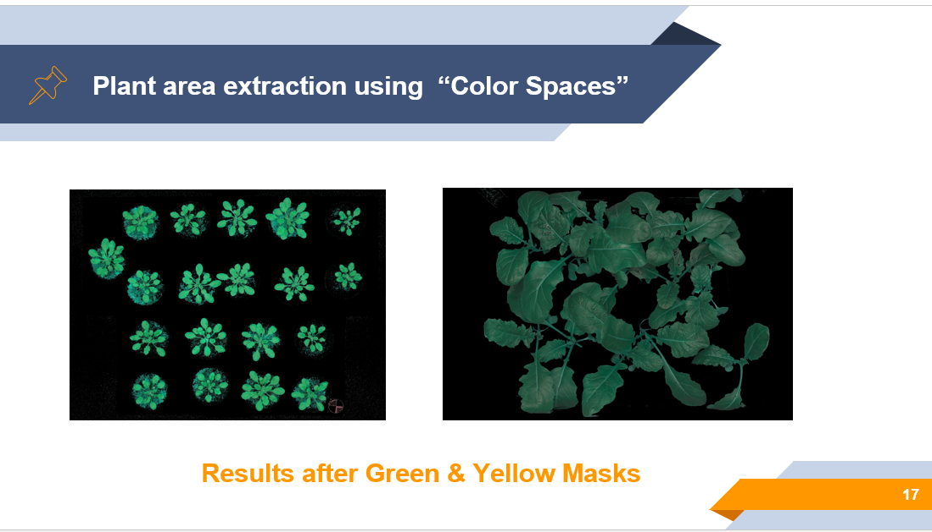

Slide 18
Plant area extraction using “Color Spaces”
The results are enhanced with :
The morphological operation: erosion (window of 3 X 3 pixel, iterations=3).
smoothing function: median blurring (aperture=9).
For removing noise, Isolating of individual elements, joining disparate elements in an image and finding of intensity bumps or holes in an image.

Slide 19
Plant area extraction using “Color Spaces”
The results are enhanced with :
The morphological operation: erosion (window of 3 X 3 pixel, iterations=3).
Smoothing function: median blurring (aperture=9).
For removing noise, Isolating of individual elements, joining disparate elements in an image and finding of intensity bumps or holes in an image.

Slide 20
Color intensity
Calculate the plant area.
For threshold step, we used two threshold functions:
OTSU Threshold.
Binary inverse Threshold.
The algorithm finds the optimal threshold value and returns the Thresholded output. As the OTSU result is white for background and black for the object we used BINARY_INV function to swipe between them.

Slide 21
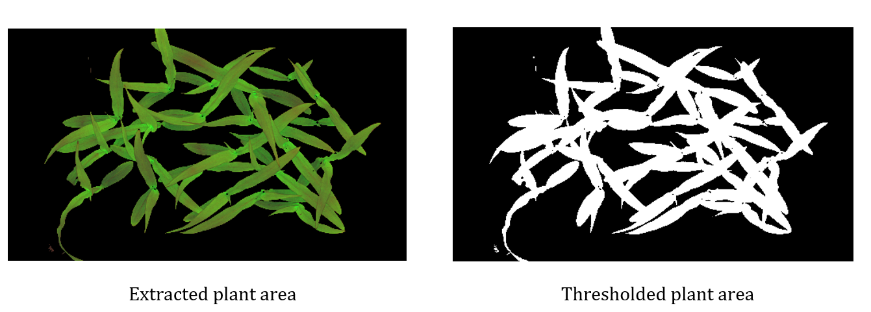
Color intensity

Slide 22
Color intensity
The results are enhanced with the morphological operations :
closing.
opening.
where opening is just another name of erosion followed by dilation, which is useful in removing noise and closing is the reverse of opening.

Slide 23
Color intensity
As now we have a binary image containing the plant area we can now calculate the ratio of area that plant dominate and use this ratio to compare with the next image will be taken after period to help in determining the growth state and ratio.
How to calculate this ratio? Simply we find the sum of white pixels in the binary image and divide it on the value of resolution for the image.

Slide 24
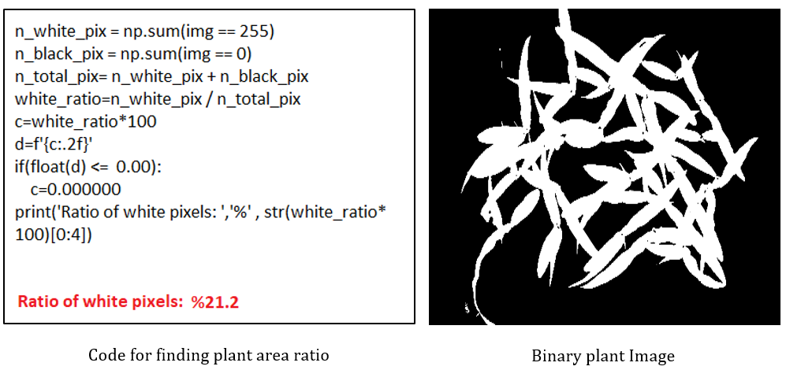
Color intensity

Slide 25
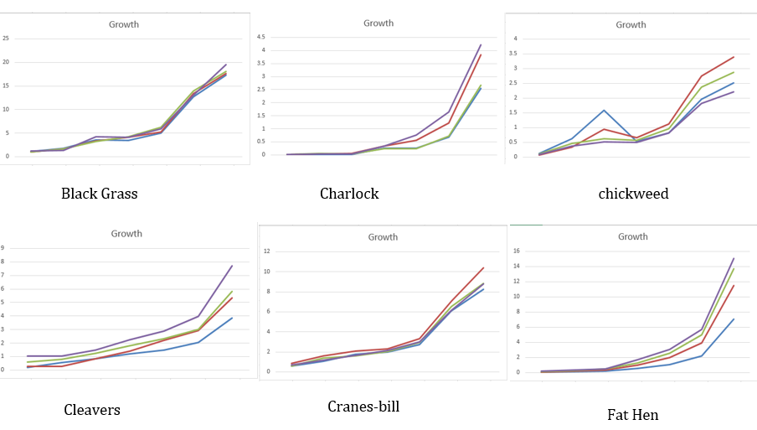
Color intensity

Slide 26
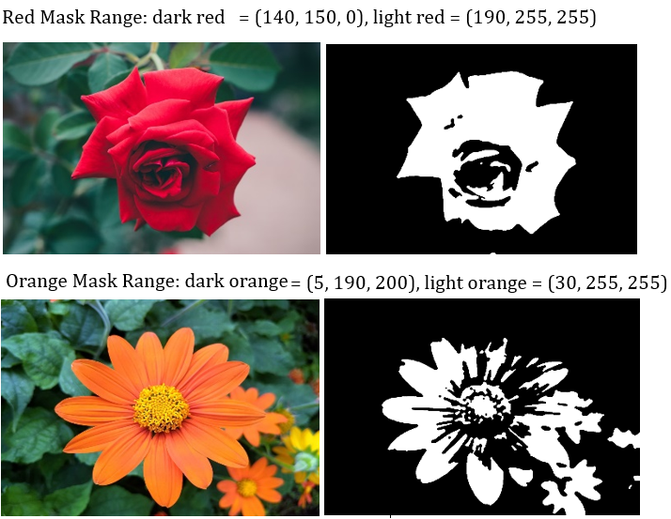
Color intensity

Slide 27
SDIM: Structural differences Index Measure
We need a measure that can tell the difference between phases in plants images.
The parameters include:
The (x, y) location of the N x N window in each image.
The mean of the pixel intensities in the x and y direction.
The variance of intensities in the x and y direction, along with the covariance.
The SDIM value can vary between 0 and 1, where 0 indicates no change.

Slide 28
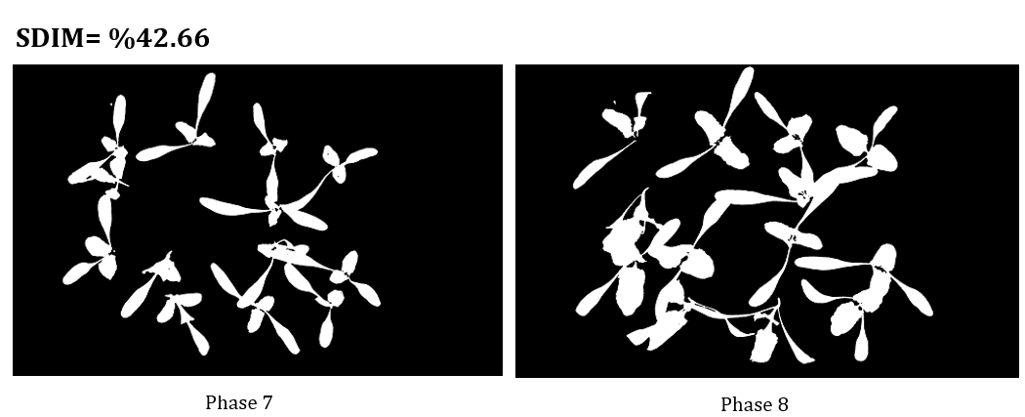
SDIM: Structural differences Index Measure

Slide 29
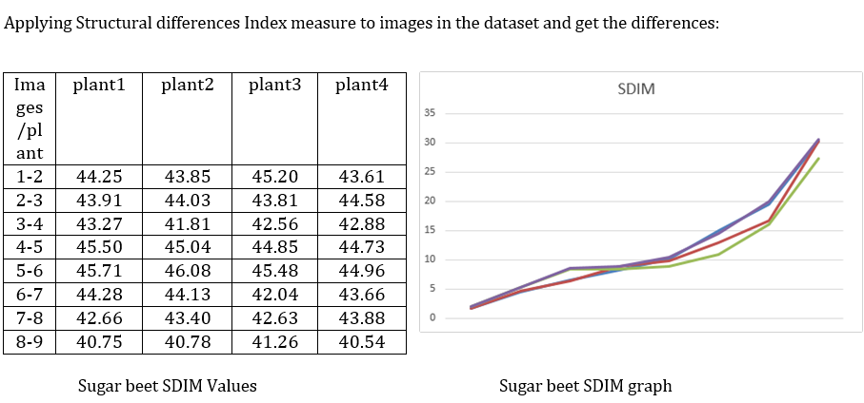
SDIM: Structural differences Index Measure

Slide 30
Analysis after applying color spaces, color intensity & SDIM Methods
Depending on the plant type and color, we apply the masks to extract the plant area as the color spaces method suggests.
Color intensity can determine the value of growth rate and also the flowering rate by comparing the given consequent images.
The result of compression may either an Increase or decrease or could be no change , so in this case , it’s very important to be sure what exactly happened to that plant , is it really no change in Its growth ? Well, we know can apply the SDIM to know what is going on, the value given by this measure can indicate the growth state and detect if any abnormal action or situation occurred.

Slide 31
The k-means cluster algorithm
The goal of this algorithm is to find groups in the data, with the number of groups represented by the variable K.
The clustering is made by considering the mean distance in the clusters.
Applying k-means cluster algorithm on image pixels values will help to determine the most dominant color in image, plant health and also can be used to know the percentage of fresh and old plant depending on the type of plant growth.

Slide 32
The k-means cluster algorithm
Depending on the plant color, let’s say green, as for the most plants color, the symptoms stages of the growth are identiﬁed by the change in color of the plant in every stage. As for the health indicator of the of the plant, the green color is identiﬁed as the healthy part , otherwise it considered unhealthy or abnormal .
With knowing already the saturation value of the color we can use measures like Euclidean distance to label this cluster as fresh or old.

Slide 33
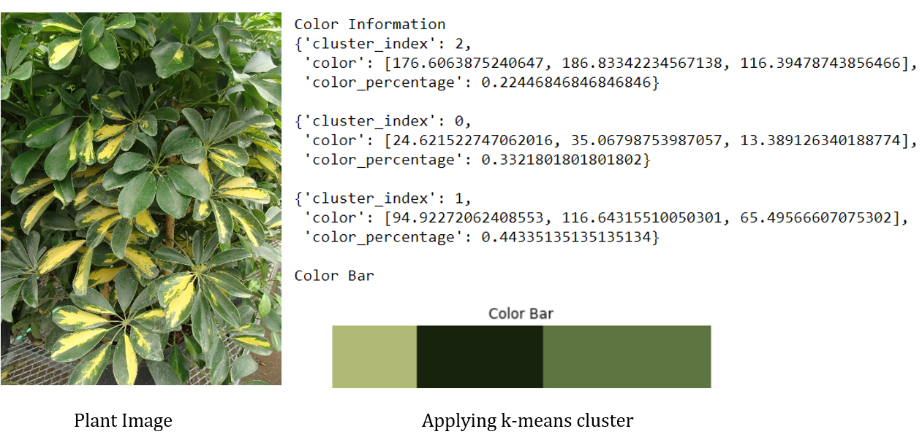
The k-means cluster algorithm

Slide 34
Conclusion
This method relies on the color intensity, color spaces, color distribution, pixel value location and pixel variance, all are employed and integrated in four techniques and measurements which are: color spaces, color intensity, structural differences index measure and k-means cluster algorithm that are being used beside the other enhancement techniques to form a good indicators to tracking plants growth.
The efficiency of the proposed method will be observable with specifying a plant type, features can easily be twined to convey the nature of plant and also other features can be added to be tracked , so this research is like a base stone to other researchers.

Slide 35
Future Work
For a future work that can be done is to integrate a machine learning techniques to use the plants data to learn a growth model to predict the growth rate, stage and also detect any anomaly in growth.

Slide 36
THANKS!
Any questions?

