Slide 1
Cinematic
The entertainment platform you seek

Slide 2
content
Introduction
explain what and why
Features
explain what makes Cinematic… Cinematic
Technologies used
explain how
Future work
explain what can be done next
QA
you ask and I answer

Slide 3
Introduction

Slide 4
What is Cinematic?
Cinematic is a revolutionary streaming platform directed for the Middle East.
Further evolve the entertainment industry in the area.
Transitioning from the classic TV channels to the trending online streaming platforms.
Provide cultural appropriate content to the Middle Eastern audience.

Slide 5
Why is Cinematic important?
Addresses the content limitations in the Middle East.
Faces the neglect the region faces from global platforms.
empowering local content creators.
connect the Middle East to the outer world. By showcasing the diverse cultural tapestry.

Slide 6
Features

Slide 7
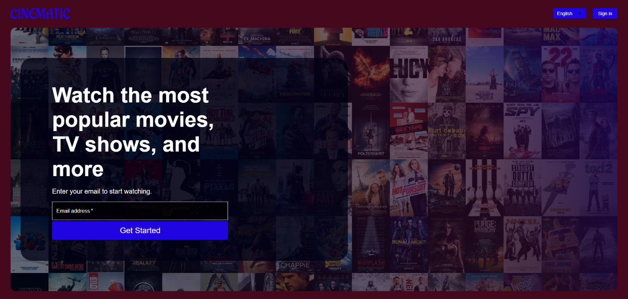
Landing page

Slide 8
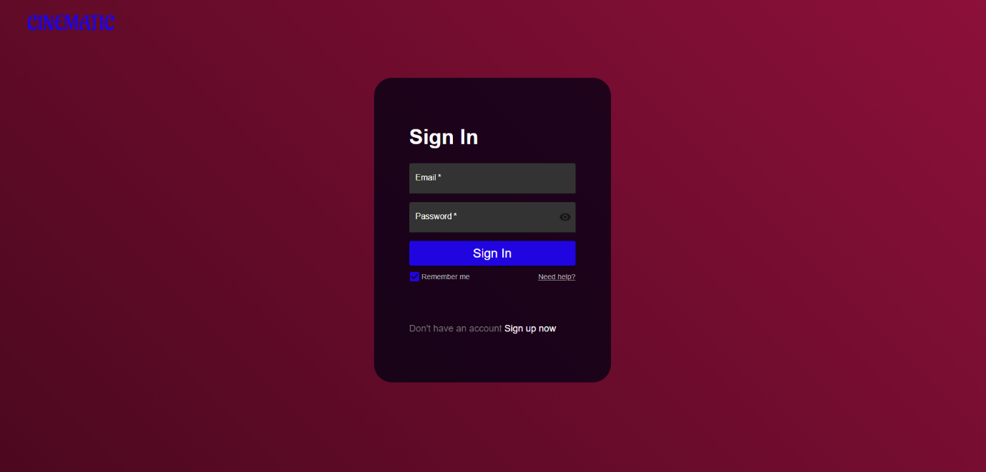
Sign in page

Slide 9
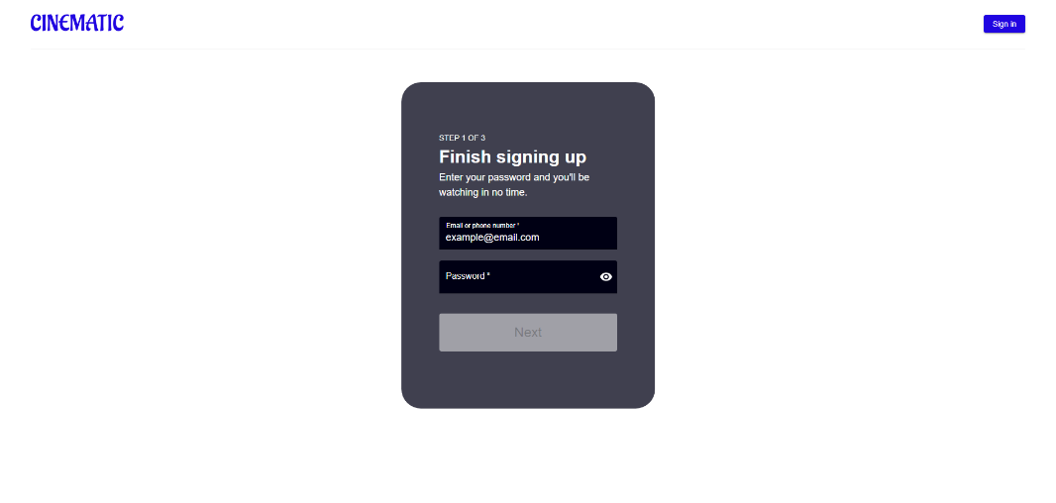
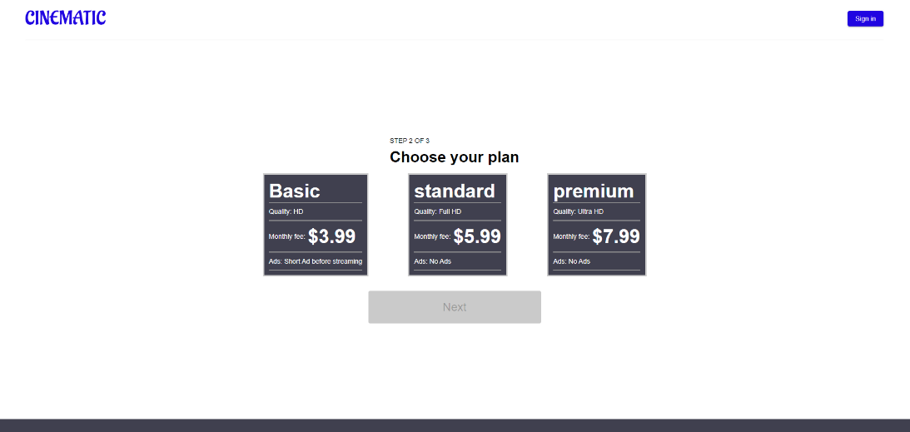
Sign up page

Slide 10
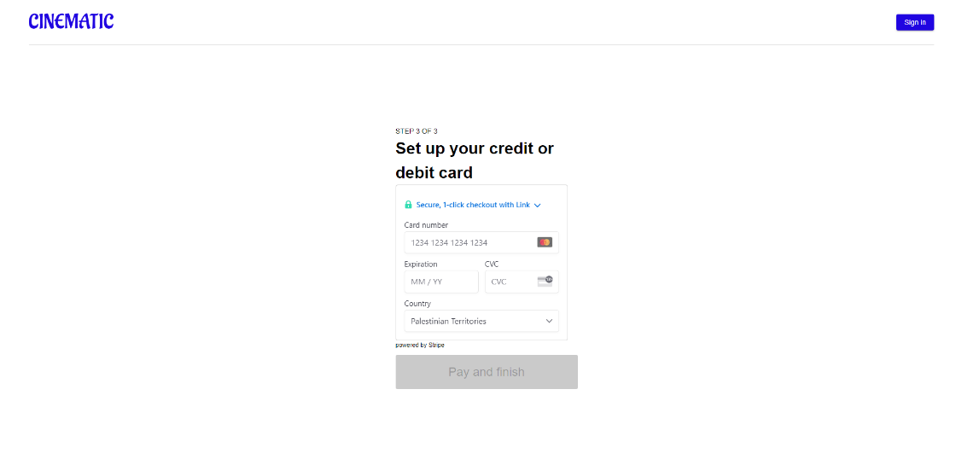
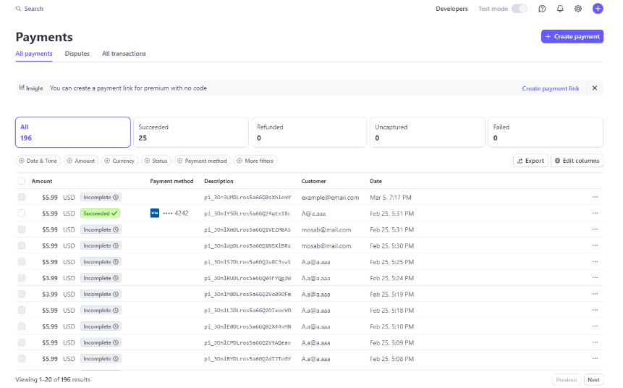
Payment

Slide 11
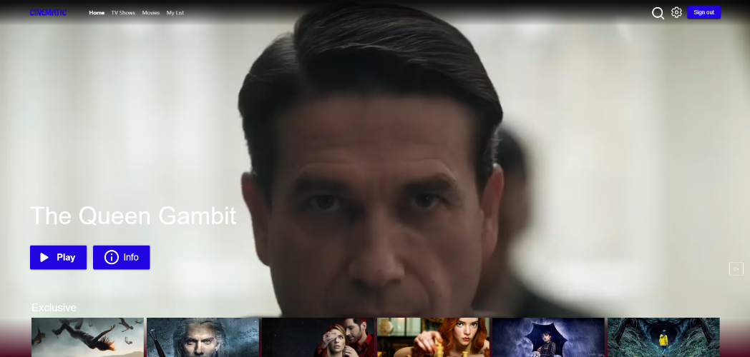
Home page

Slide 12
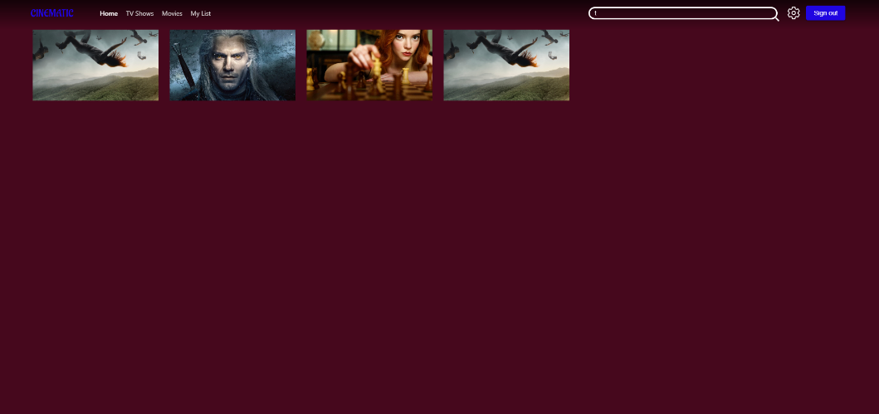
Search

Slide 13
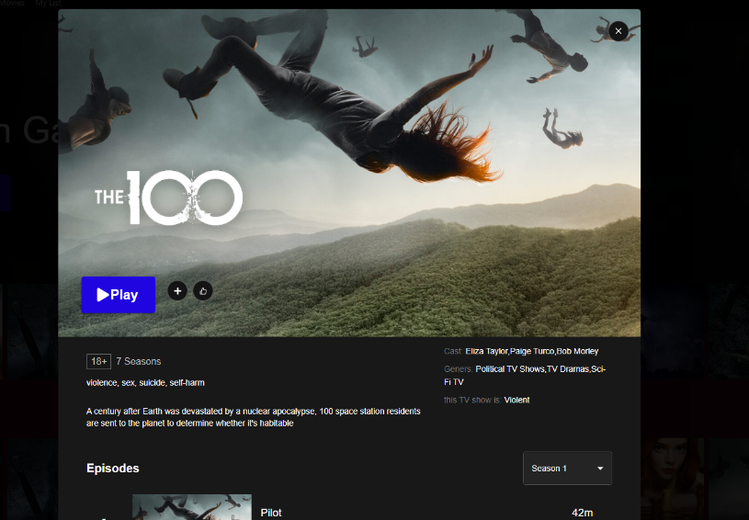
Info panel

Slide 14
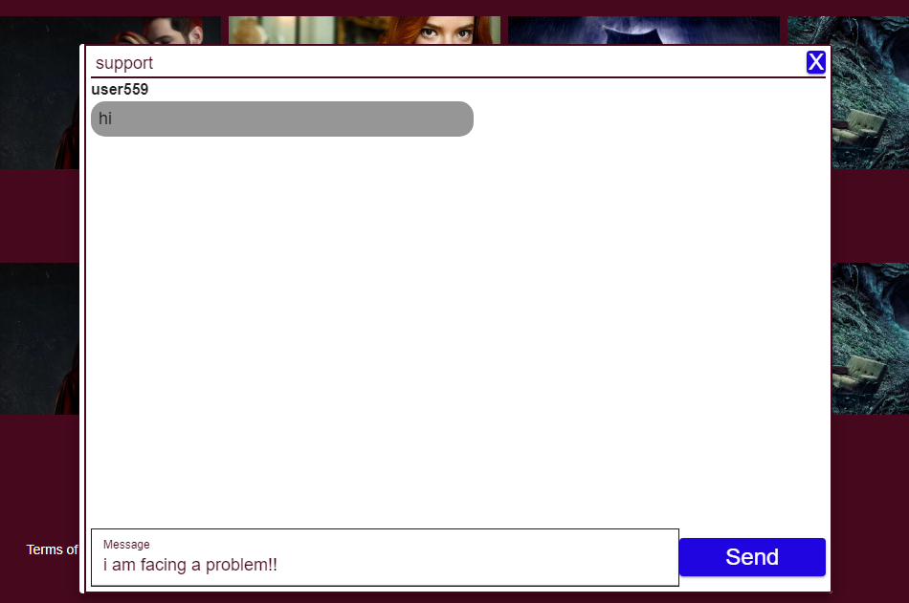
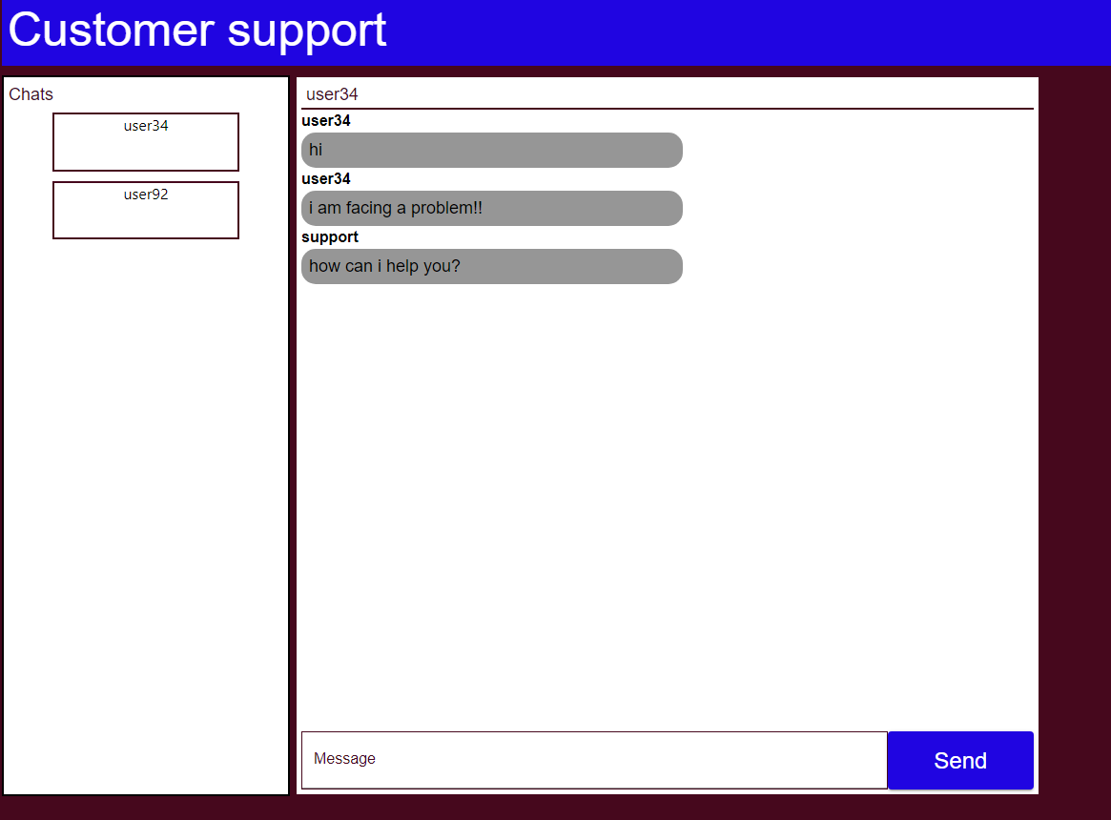
Customer support

Slide 15
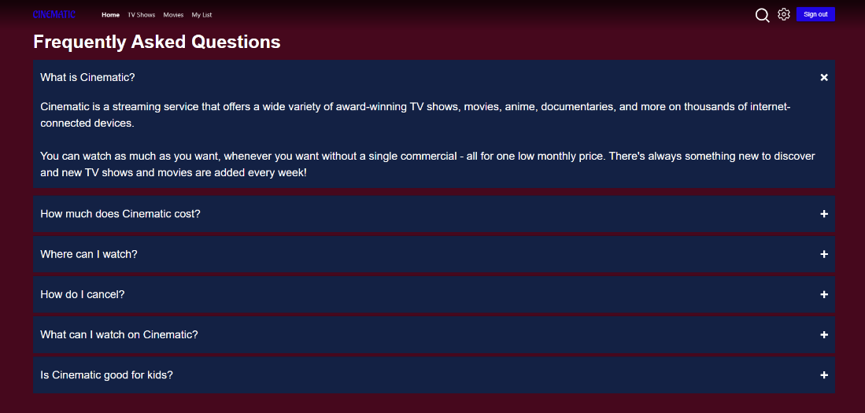
Help Center

Slide 16
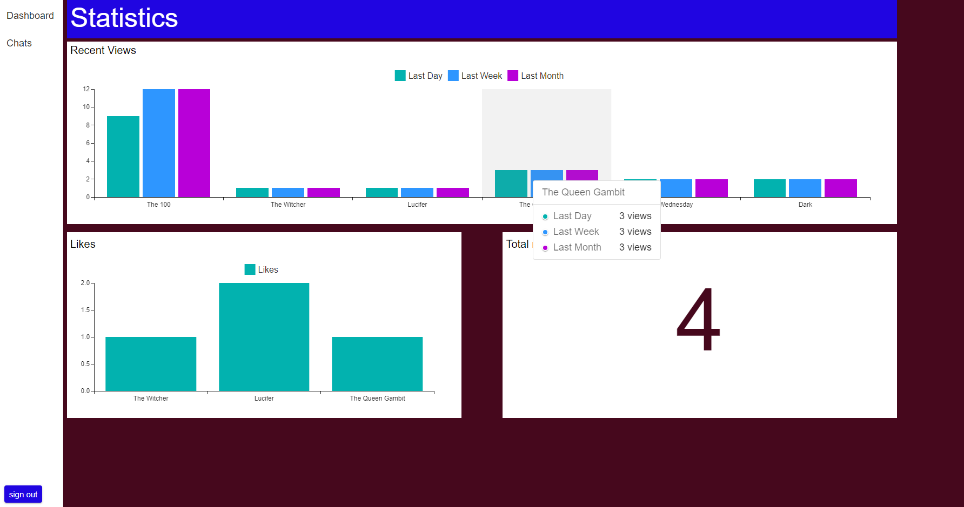
Statistics

Slide 17
Technologies used

Slide 18


Frontend

Slide 19


Backend

Slide 20



Backend cont.

Slide 21

Database

Slide 22
Future work

Slide 23
Content Enrichment and Original Productions.
Custom Video Player.
AI-Powered Content Recommendations.
Enhanced Statistical Analytics.
Evolved Chatting System and introducing support chatting bots

Slide 24
Thank You

Slide 25
Any Questions?

