Slide 1
Analysis and Design of Illar Water Distribution Network {WDN}
Prepared by :
Ahmad Qashou
Mahmood Al-Barri
Wael Mahameed
Under supervision of:
Dr. Sameer Shadeed

Slide 2
Contents
Objectives
Overview of Illar Town
Analysis of existing WDN
Design a new WDN
Cost estimation for new WDN
Discussion and Conclusion

Slide 3
Objectives
To analyze the current situation of WDN and to find out its problems
To suggest other water alternatives to enhance the water resources in the town to compatible the people needs of water
To design an excellent WDN that give fair amounts of water and within the design criteria’s allowed for WDNs

Slide 4
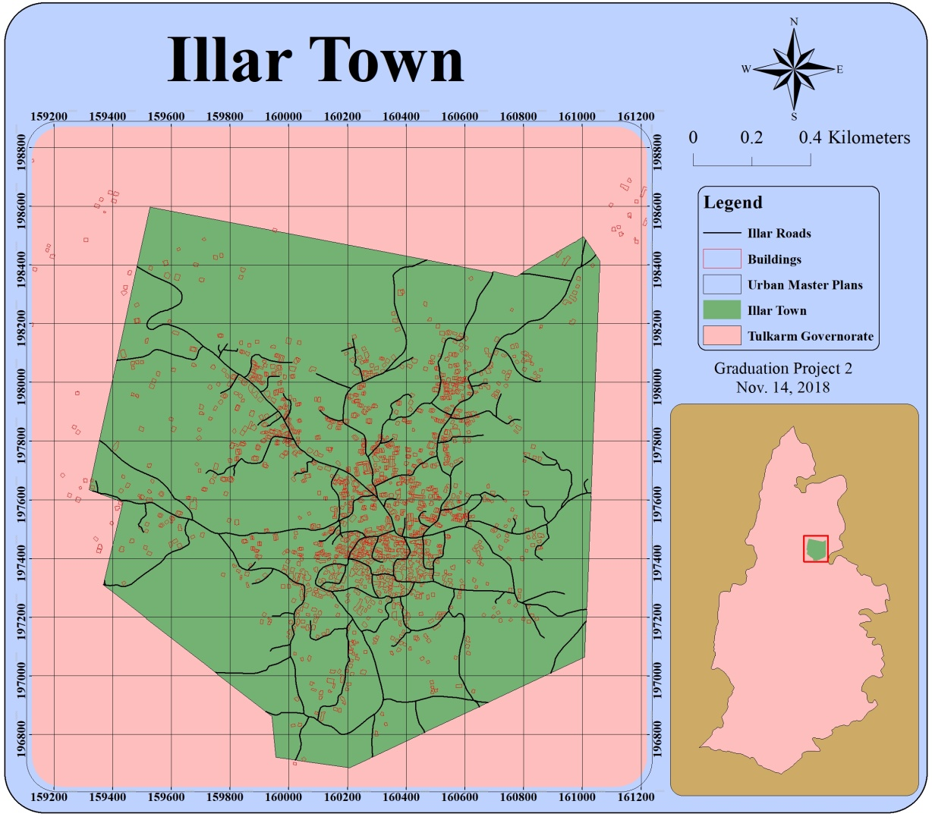
Overview of Illar Town
Location
It is located in the north-east of Tulkarem Governorate
Urban area
= 2.54 Km²

Slide 5
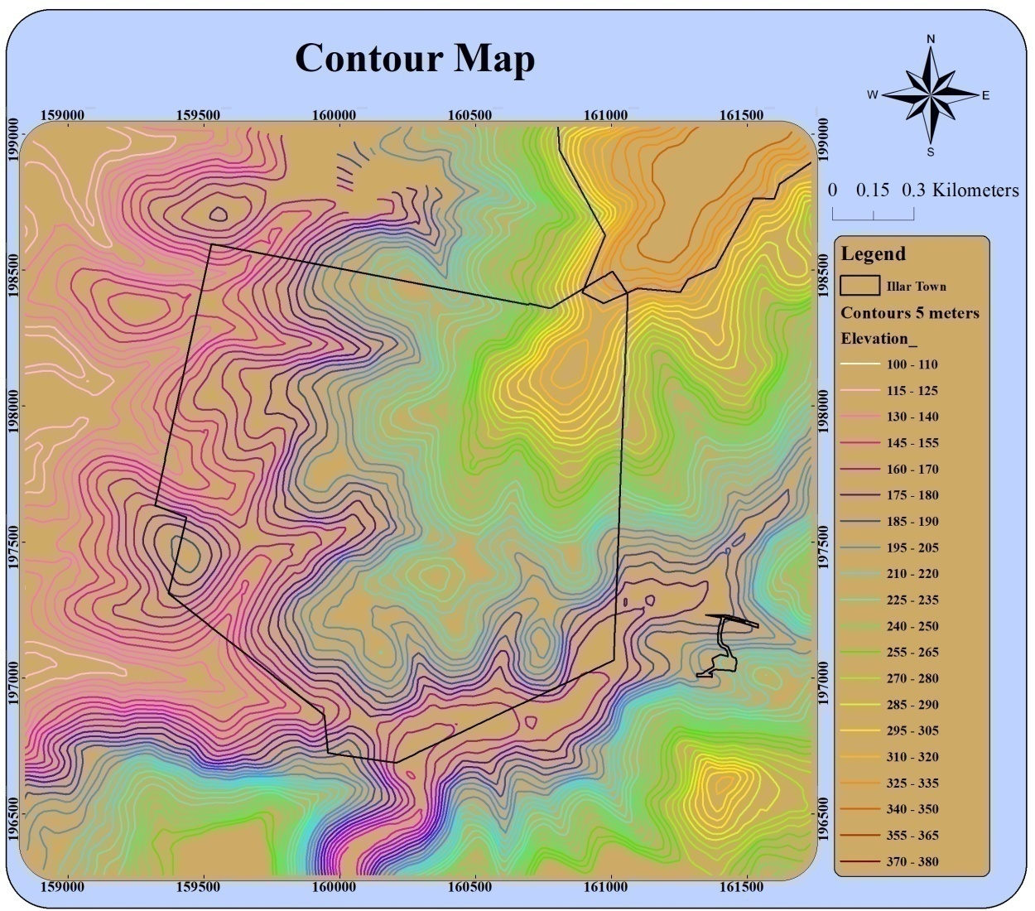
Overview of Illar Town
Topography
Illar town topography characterized as a hill
Elevations range from 100 to 380m above mean sea
level

Slide 6
Overview of Illar Town
Climate
The climate of Illar is a semi-arid. The average temperature are between (8-16C°) in winter and between (17-30C°) in summer.
Rainfall
The rainfall of Illar is following Tulkarm rainfall stations.
Annual rainfall in these areas range between 500 and 600 mm

Slide 7
Overview of Illar Town
Population
Based on Palestinian central Bureau of Statistics 2007 &2017 the annual growth rate was 1.97 %
Years | 2007 | 2017
Population | 6134 | 7456

Slide 8
Overview of Illar Town
Water recourses
Illar is above the Western aquifer basin and the groundwater wells forms the major source of water supply of the town.
Illar is provided from three major groundwater wells.

Slide 9
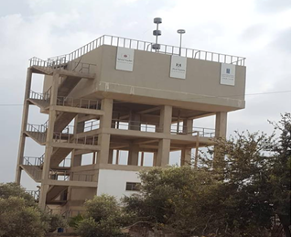
Overview of Illar Town

Slide 10
Design Criteria
Pressure range between (20-100) mH2O
Velocity range between (0.3-3) m/s

Slide 11
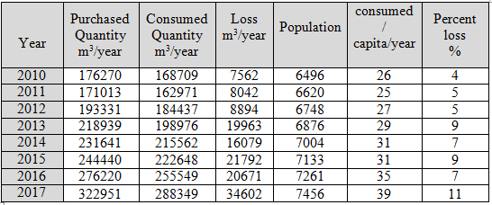
Analysis of existing WDN
In Illar water consumption is increasing as result of population increasing

Slide 12
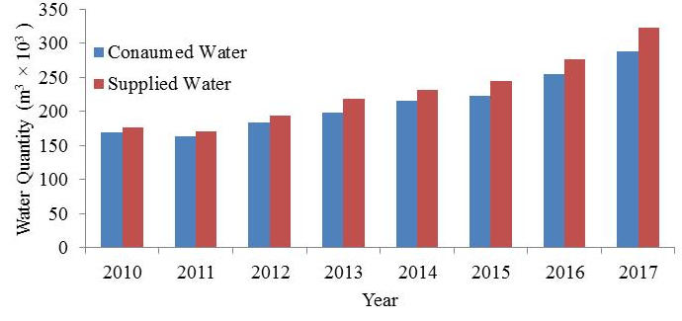
Analysis of existing WDN

Slide 13
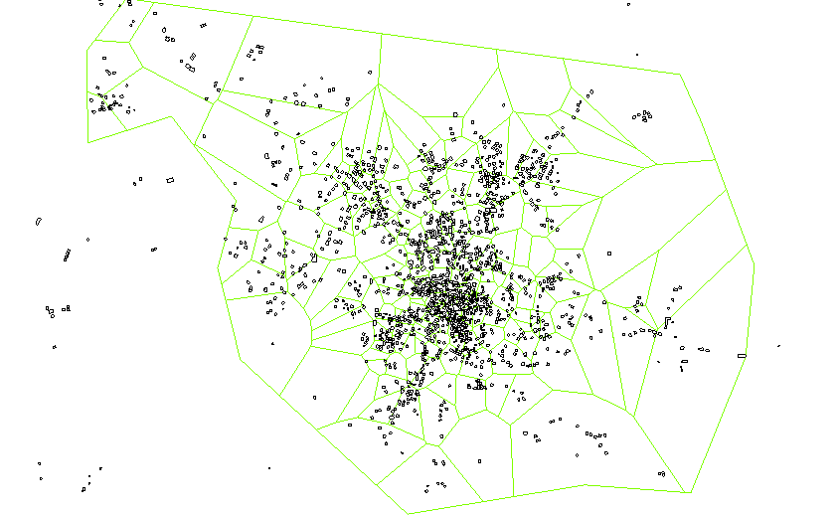
Analysis of existing WDN
Thiessen Polygon method was used to count number of building for each single node

Slide 14
Analysis of existing WDN
Elements of WDN
1- Reservoir : it is located at x=158473.23m and y=198824.56 m and elevation of 105m above mean sea level
2- Tank :is located at x = 160,949.55m and y= 198,262.85 ground elevation by contour is 311m; tank is 15m high above ground surface.
Tank has a square base (10 m × 10 m)
Volume of tank is 500 m³

Slide 15
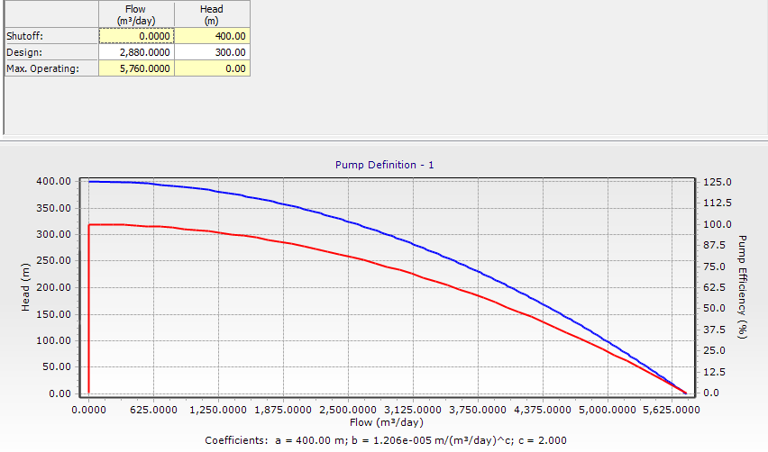
Analysis of existing WDN
3- Pump : with total head 300 m and flow rate of 120 m³ /h

Slide 16
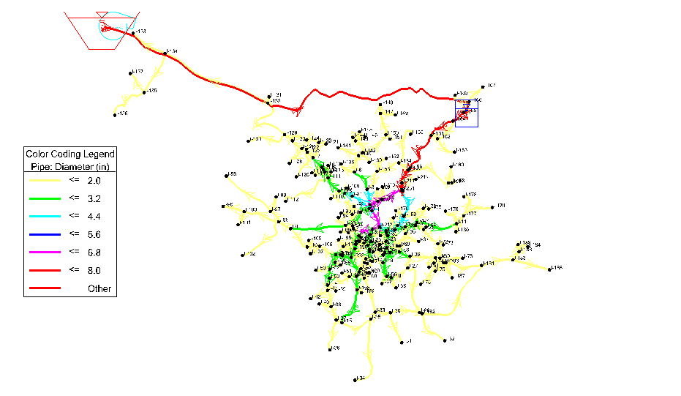
Analysis of existing WDN
4- Pipes : different pipes in diameters were used in WDN

Slide 17
Analysis of existing WDN
Hazen -William friction method was used in analysis of WDN
V = 0.849 × C_{HW} × R^{0.63} × (S_{ƒ})^{0.54}
V = Velocity (m/s)
R = Hydraulic radius of the pipe, since the WDN works as pressurized system, then it will be full-flow pipe.
C_{HW} = the resistance coefficient related to the pipe material and roughness condition.
S_{ƒ}= The slope of the energy grade line or friction slope.

Slide 18
Analysis of existing WDN
Water quantity to be inserted as demand is 84 L/capita.day
Which is the average supplied water between 2010-2017 years.
WaterCAD software was used to analyze existing WDN
After analysis of WDN we get results for both velocity and pressure .

Slide 19
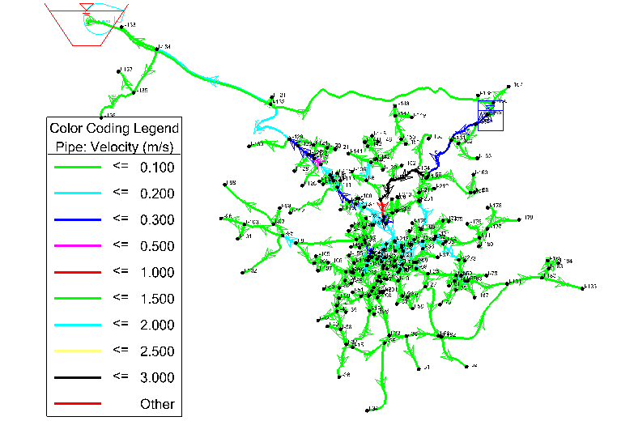
Analysis of existing WDN
analysis velocity values range from 0.00 m/s to 2.53 m/s

Slide 20
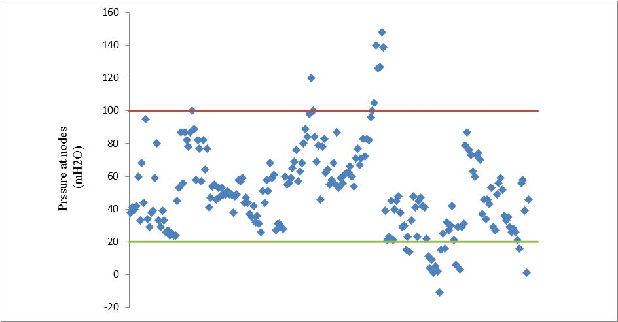
Analysis of existing WDN
Pressure : In general, water pressure values vary from -11(mH₂O) to 148 (mH₂O)

Slide 21
Design a new WDN
Main assumptions for design :
There should be a new tank in addition to the old one with a volume of 500 m³.
Design period is suggested to be 30 years.
Growth rate is 1.97%.
The future demand is suggested to be 150 L/c.d.
Head loss method is Hazen-william.
Peak flow factor used is 1.8 .

Slide 22
Design a new WDN
Future population and demand analysis :
Based on the growth rate, the expected population of Illar was 13650 capita.
Expected demand = 13650* 0.15*1.8 = 3686 m³/day.
Year | 2007 | 2017 | 2027 | 2037 | 2048
Population | 6134 | 7456 | 9062 | 11014 | 13650

Slide 23
Elements in the new design
Reservoirs : there are two reservoirs.
Pipes : the number of pipes used is 533 pipe, with different diameters from (1-8) inch.
Pressure reduce valves (PRV) : we used 19 PRV to decrease the high values of pressure.
The advantage of the new design is to use a full gravity system, (no pumps used), which is economical solution.

Slide 24
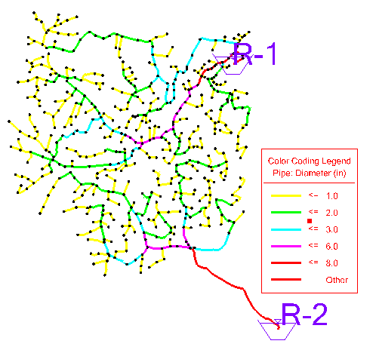
New WDN layout

Slide 25
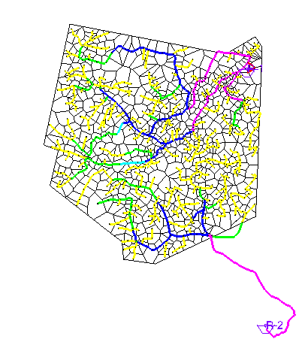
Demand calculation
The used method to calculate the demands is Theissen polyogn around junctions.

Slide 26
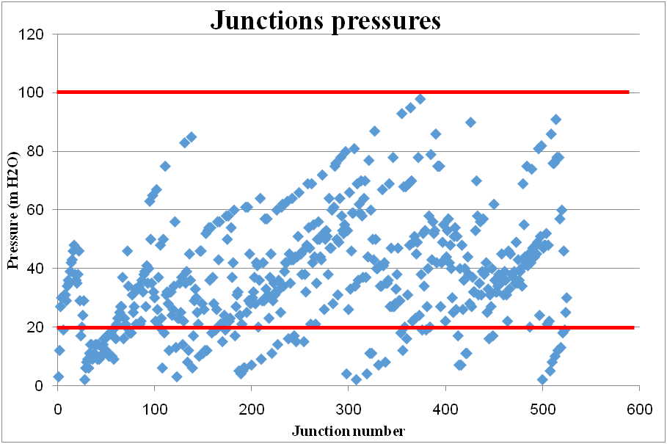
Results and comments
Pressures : the values of pressures differs between
(3-98)mH2O.

Slide 27
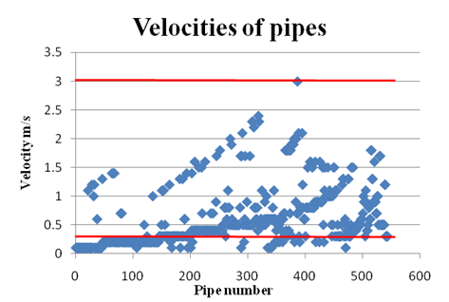
Velocity: velocity varries between (0.1-3)m/s.

Slide 28
Most of pressure values are within the range of (20-100)mH2O.
Velocity values are also acceptable.

Slide 29
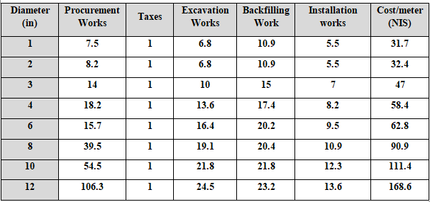
Cost estimation for new WDN

Slide 30
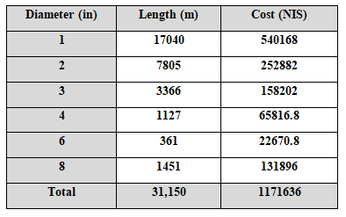
→ Cost of PRV = 7596 NIS
→ Total length of WDN = 31.15 Km.
→ Total cost of WDN = 1179236 NIS

Slide 31
Discussion and Conclusion
Depending on analysis results which shows a problems in both velocity and pressure values, we recommend to construct a new tank in southern part of the town with a volume of 500 m³, and divide the network to two parts, which will reduce pressure values at each single junction.

Slide 32
Thank you

