Slide 1
Graduation Project 2
Self-driving Car
Students Names: Supervisor Name:
1-Abdallah Adas Dr. Suleiman Abu Kharmeh
2-Mohammad Zaied

Slide 2
Self-driving Car
Presentation content:
  What are self-driving cars?
  Motivation and Importance
  Capabilities of our car
  Hardware and software tools:
    Hardware components.
    Software tools.
  Future Work
3

Slide 3
Self-driving Car
What are self-driving cars?

Slide 4
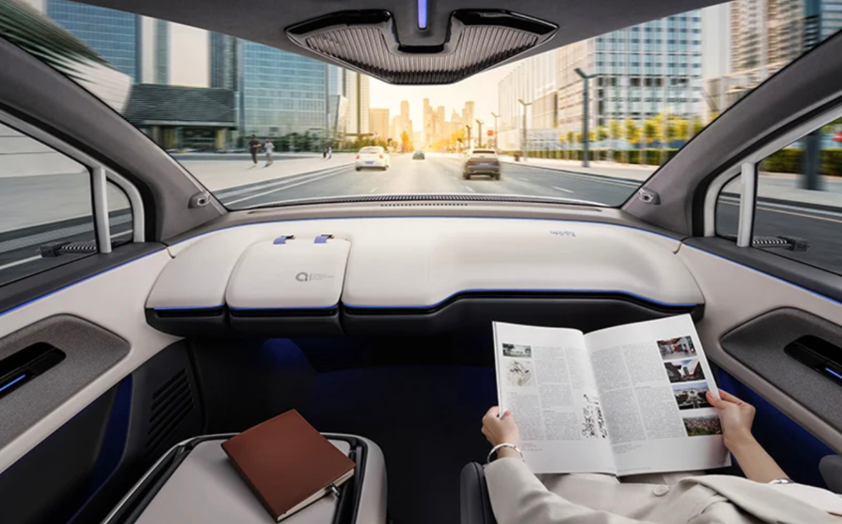
What are self-driving cars?
They are cars capable of moving without the need for human intervention.

Slide 5
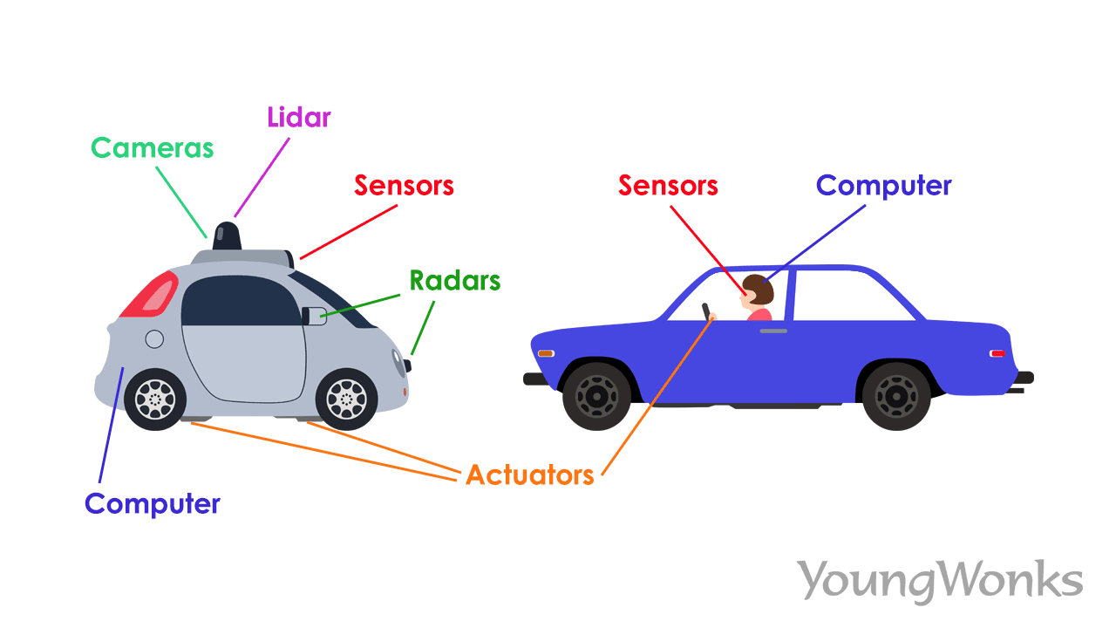
What are self-driving cars?
Self-driving cars rely heavily on image processing to perceive and understand the driving environment. Image processing involves collecting data from cameras and other sensors installed on the car, and then analyzing that data to extract information about the surroundings. This information is then used by the car to make driving decisions.

Slide 6
Self-driving Car
Motivation and Importance

Slide 7
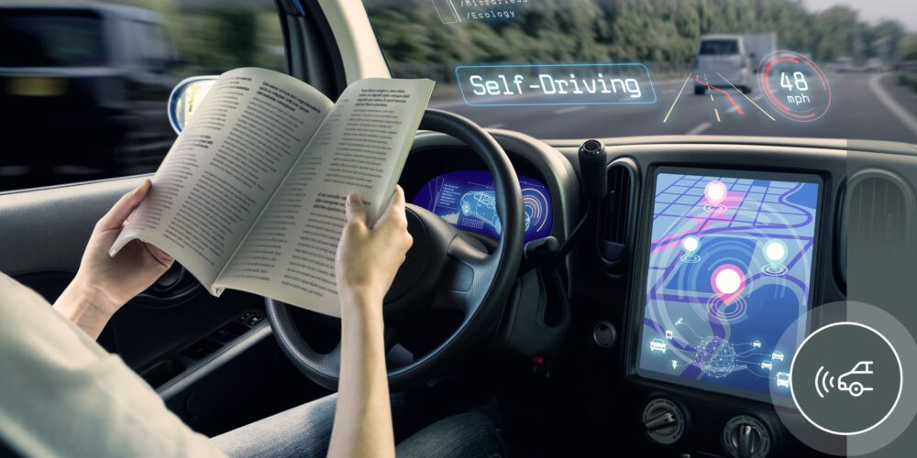
Motivation and Importance
The major goal of developing self-driving cars has been driven by the desire to improve road safety, reduce traffic congestion, and provide mobility to those who are unable to drive.

Slide 8
Self-driving Car
Capabilities of our car

Slide 9
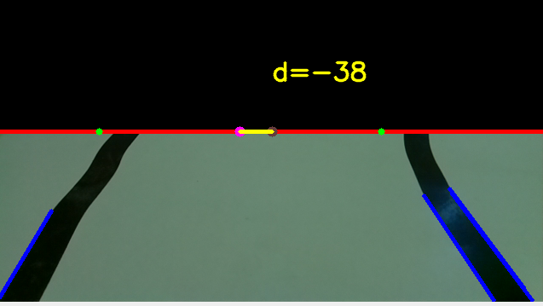
Capabilities of our car
Our car is able to recognize road lines and drive between them, and it is also able to recognize road curves and handle them.

Slide 10
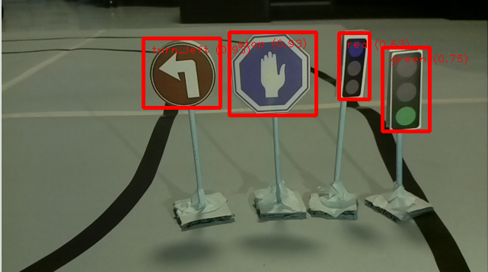
Capabilities of our car
Able to recognize some traffic signs and apply their own traffic laws.
Turn left Stop sign Red Traffic light Green Traffic light

Slide 11
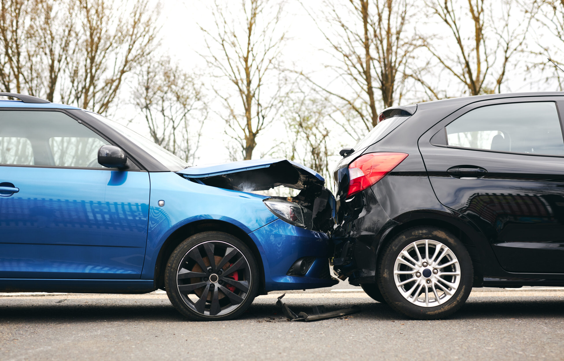
Capabilities of our car
Able to avoid obstacles and avoid collisions

Slide 12
Self-driving Car
Hardware and software tools

Slide 13
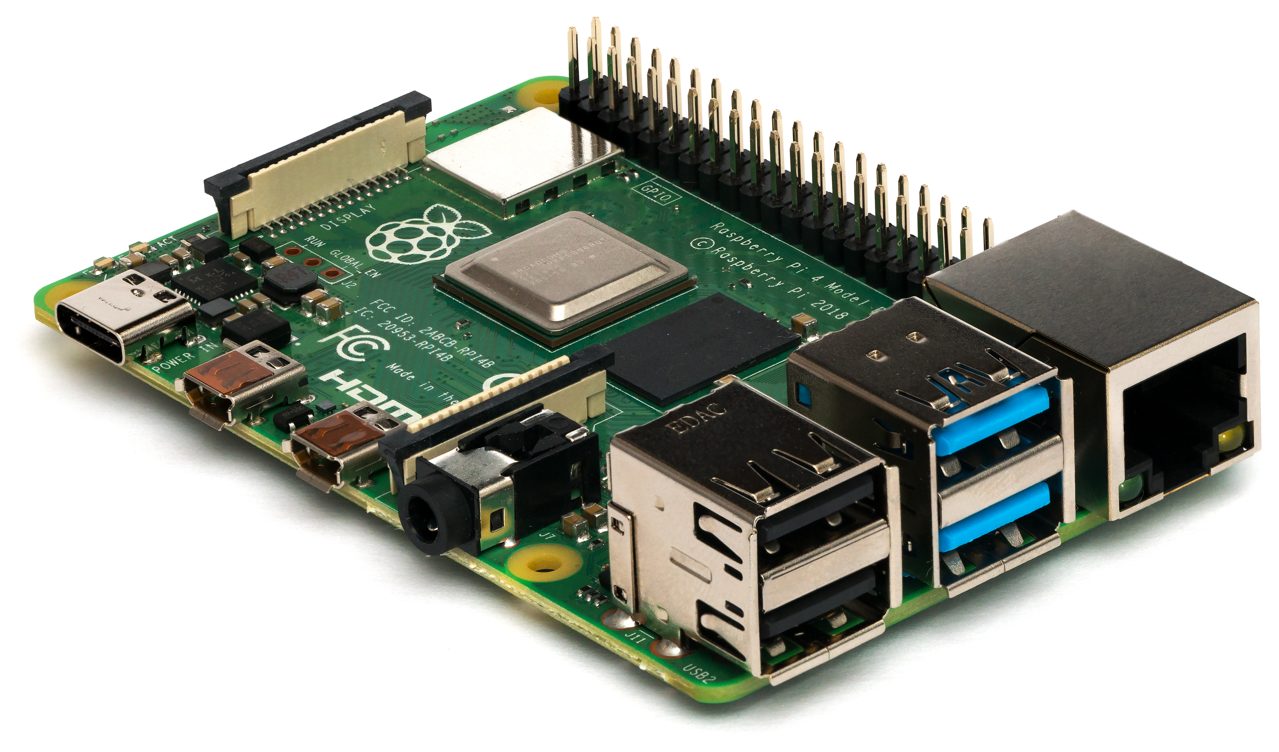
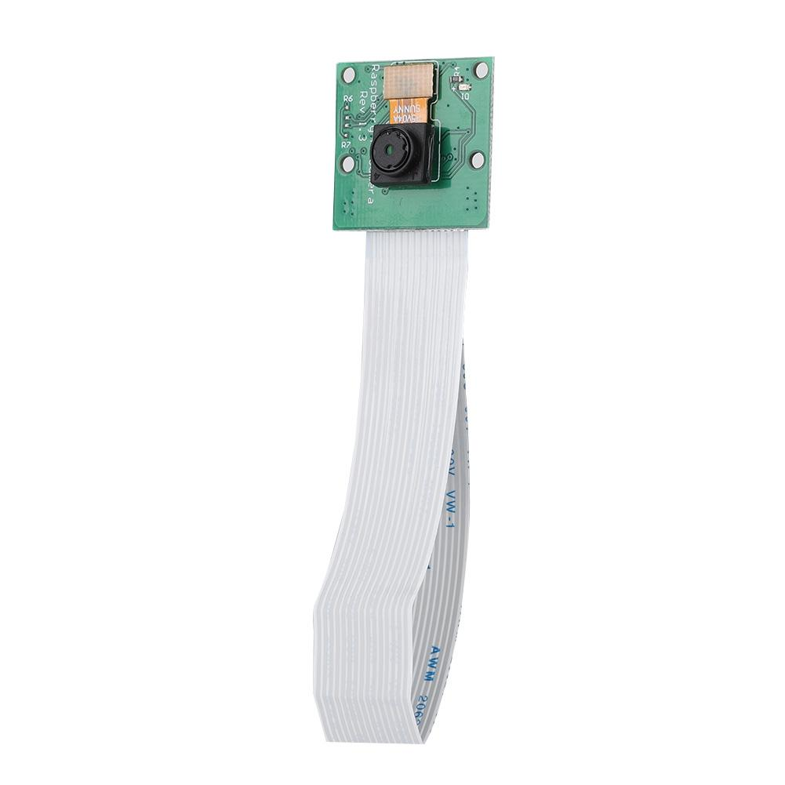
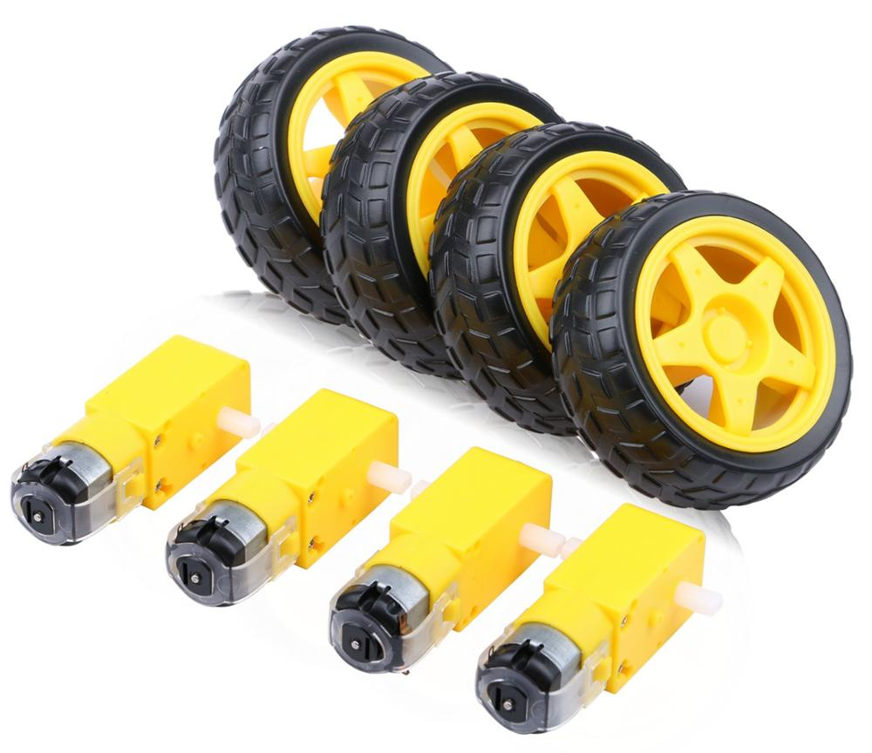
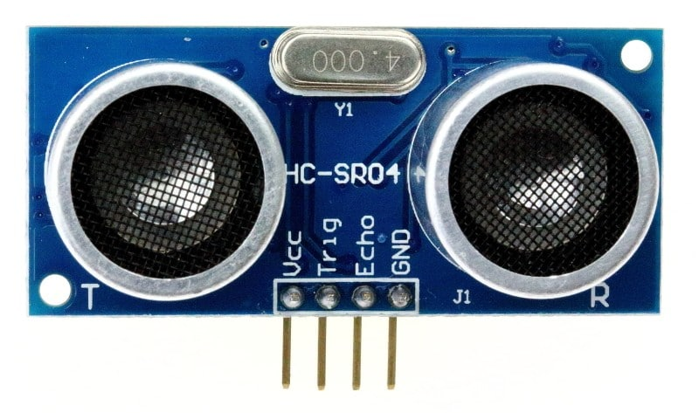
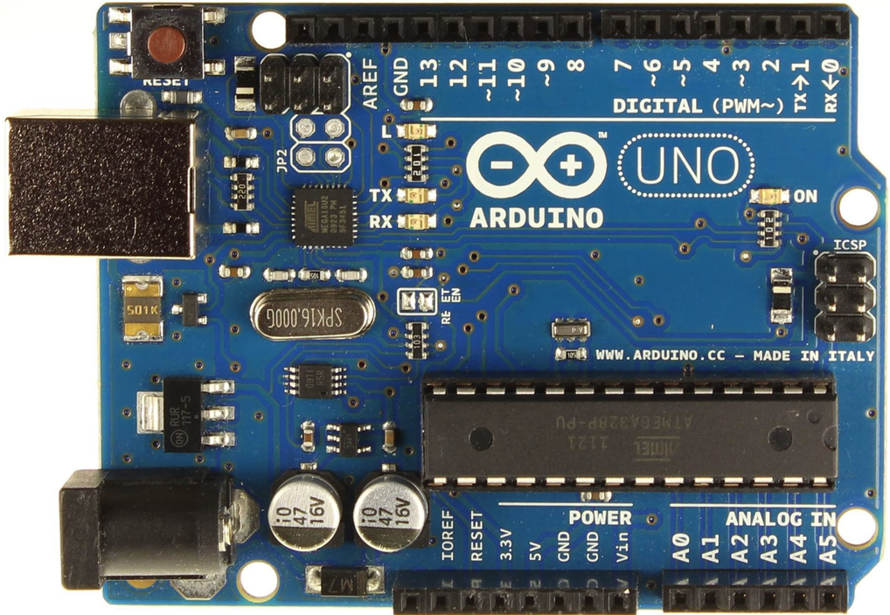
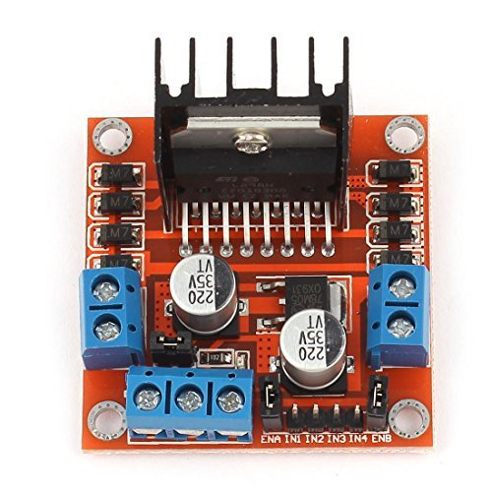
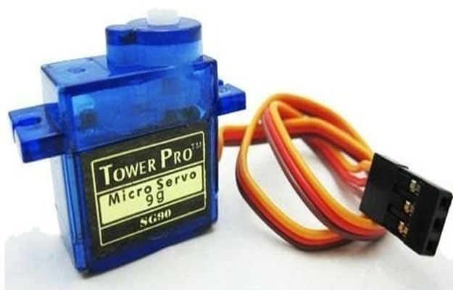
Hardware components
Raspberry PI
Camera
Raspberry PI 4
4 DC motors
Ultrasonic
Arduino UNO
Servo motor
H-Bridge

Slide 14





Software Tools

Slide 15
Self-driving Car
Future Work

Slide 16
Future Work
Train our model to be able to detect more traffic signs.
Improve car movement by using a car with front wheels directional control.
Add LiDAR and GPS.
Use a wide-angle camera and a good light source.

Slide 17


