Slide 1
The Effect of covid – 19 on projects
By : Ahed Akhras and Farah hesham
Submitted by : Eng. Reema Nassar

Slide 2
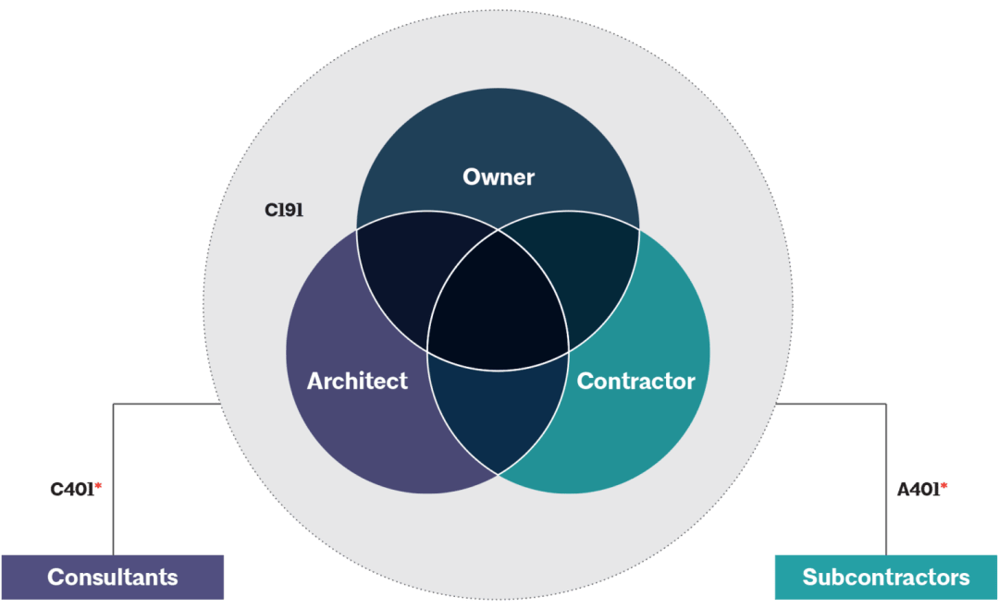
Project key participants

Slide 3
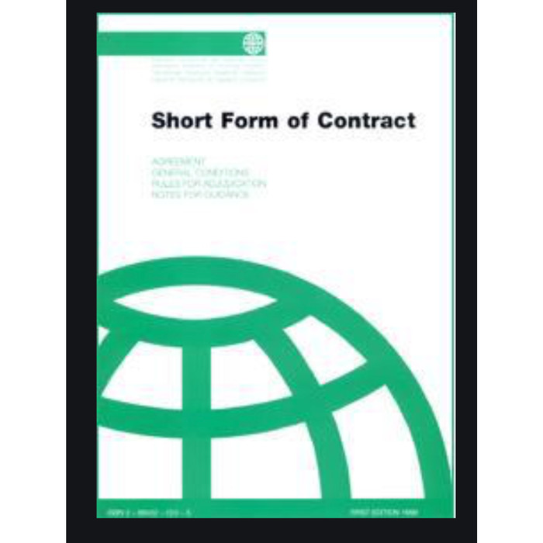

Slide 4
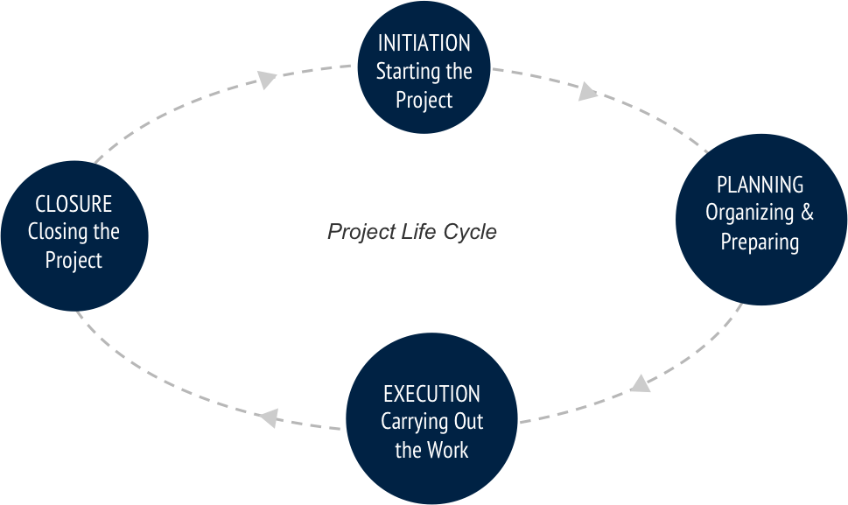
Project Life cycle

Slide 5


Slide 6
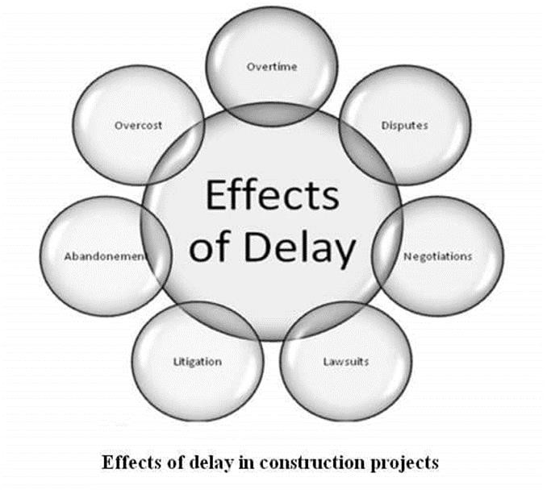

Slide 7
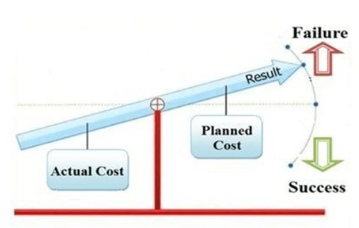
Cost overrun

Slide 8
METHODOLOGY
We attempt to study and analyze all the information contained in the publications of construction specialists about the types of impacts of COVID-19 on the local construction industry and then shed light on the most prominent of these influences, which had a global impact, and suggest strategies to reduce damages commensurate with the nature of these effects. The main objectives of the research are to investigate the impacts caused by the pandemic on construction projects and the relevant management strategies to combat cost and schedule overruns of the construction projects due to the pandemic.

Slide 9
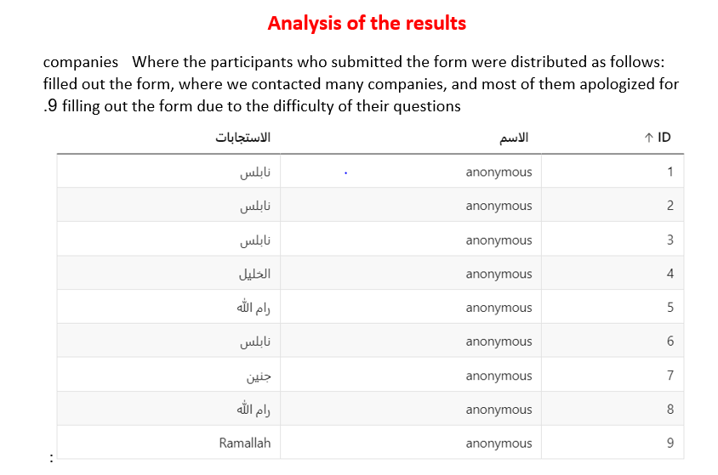

Slide 10
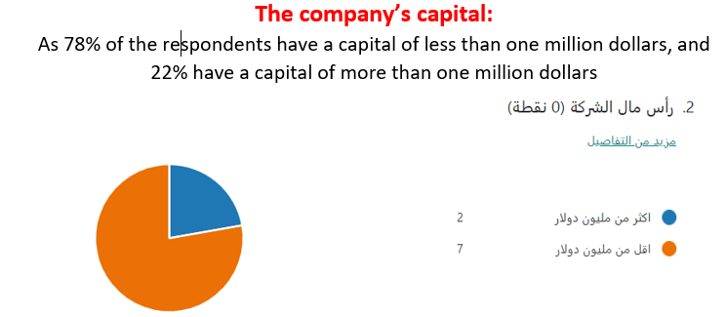

Slide 11
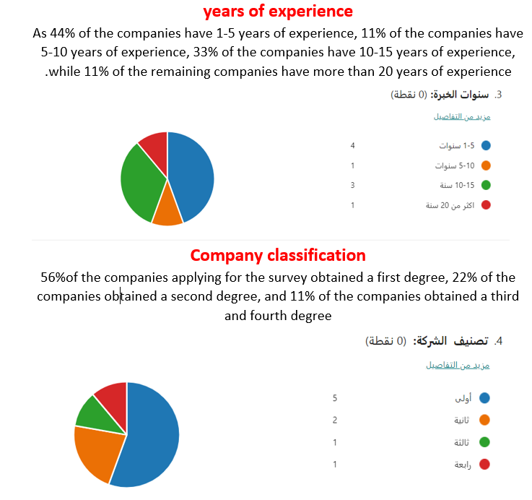

Slide 12
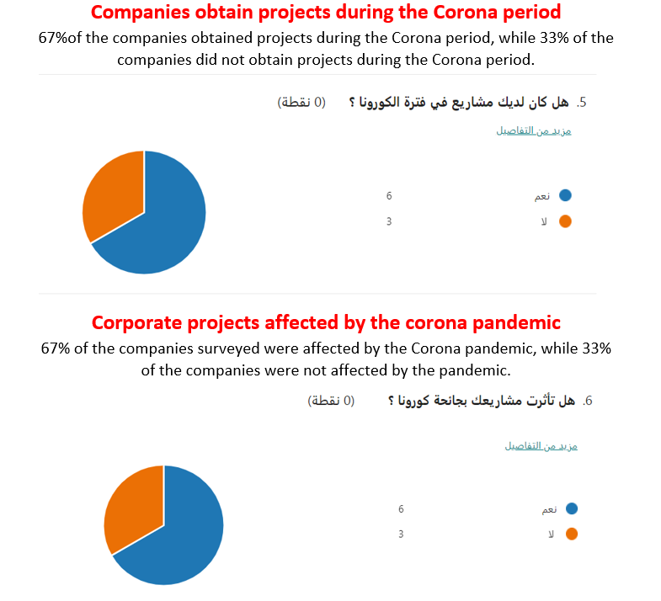

Slide 13
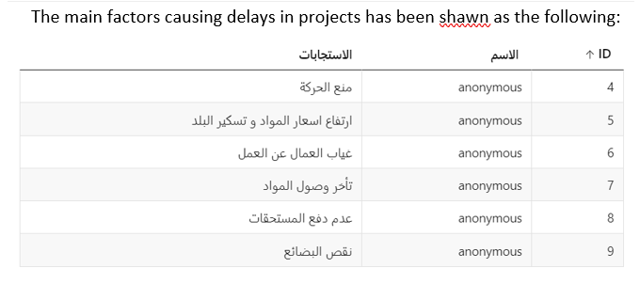

Slide 14
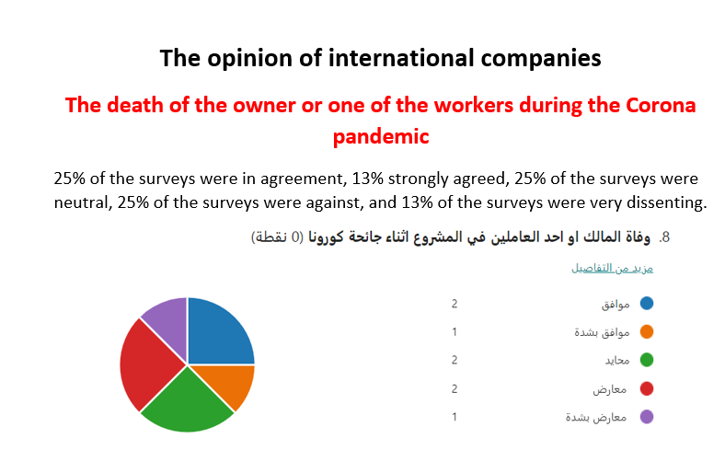

Slide 15
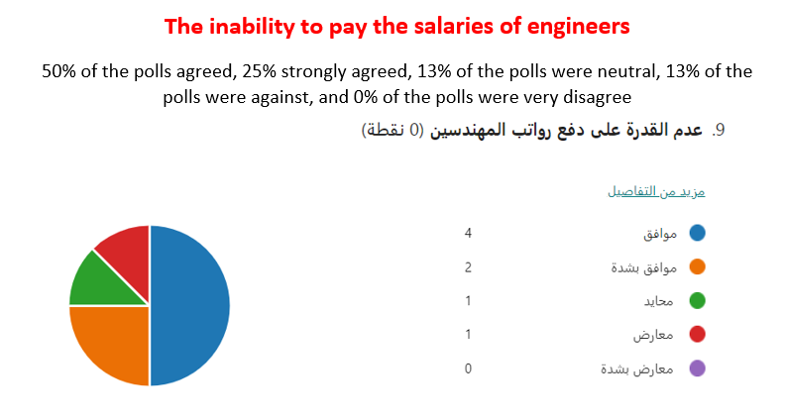

Slide 16
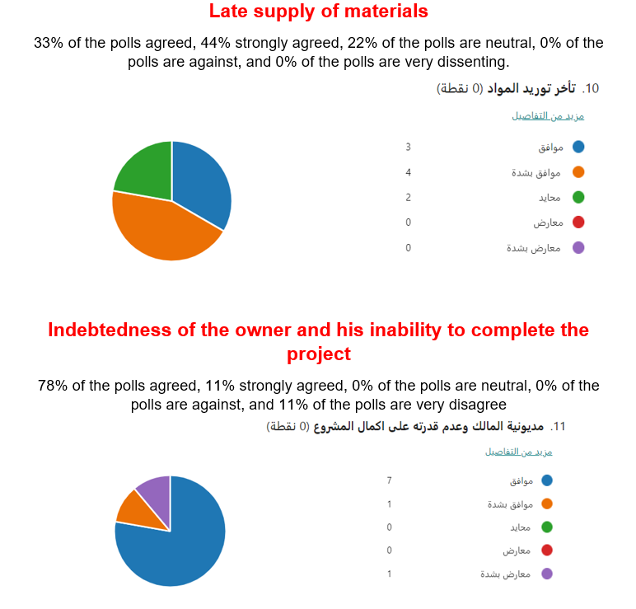

Slide 17
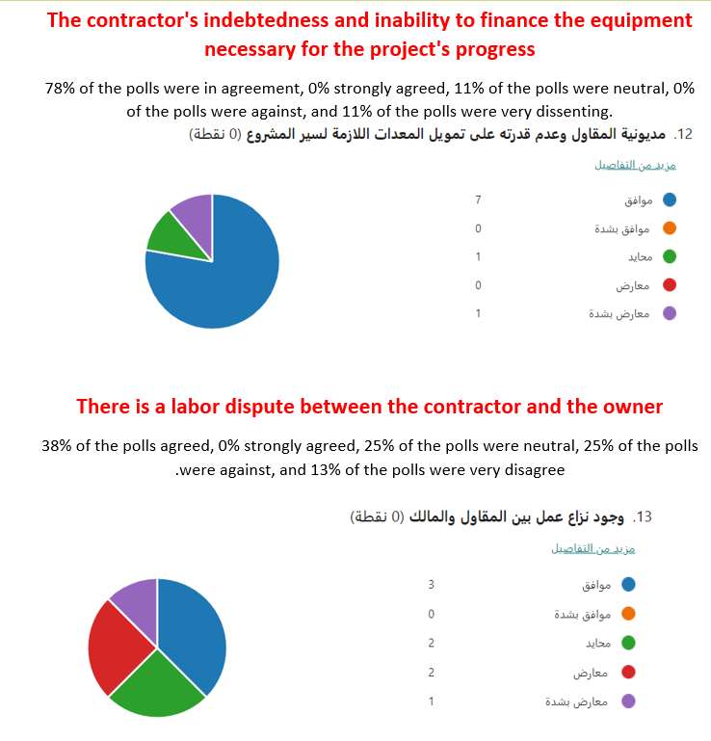

Slide 18
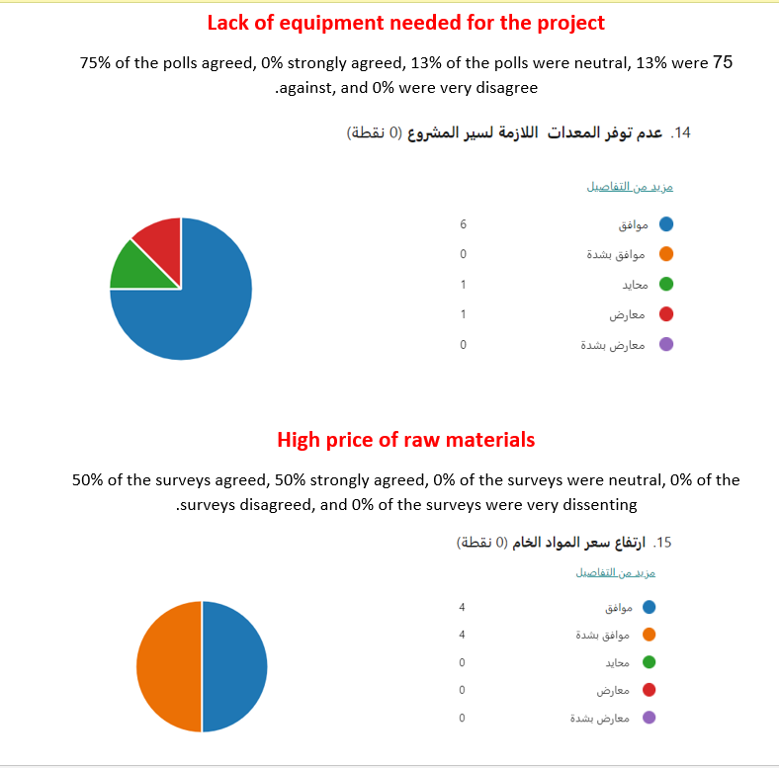

Slide 19
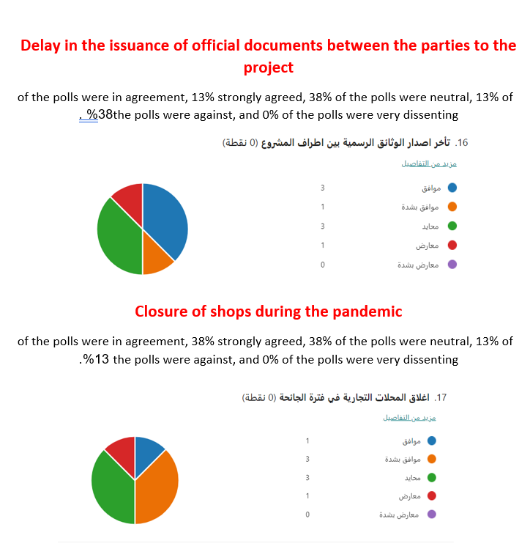

Slide 20
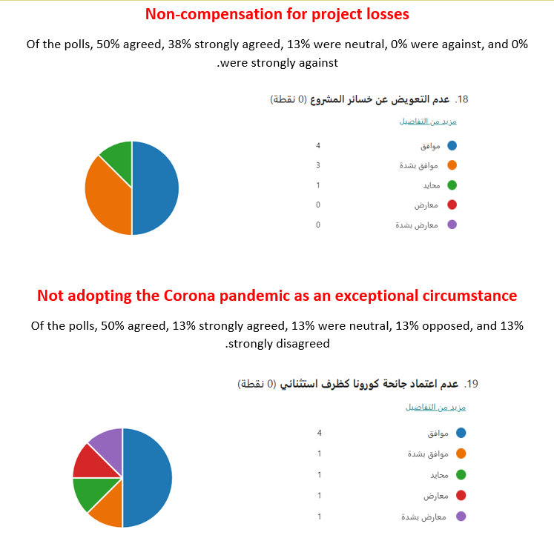

Slide 21
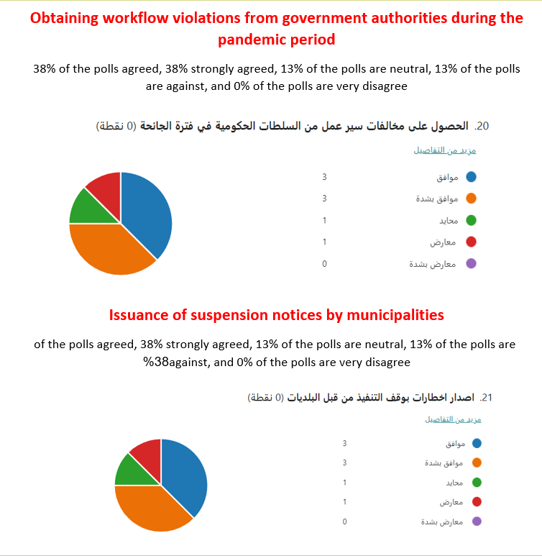

Slide 22
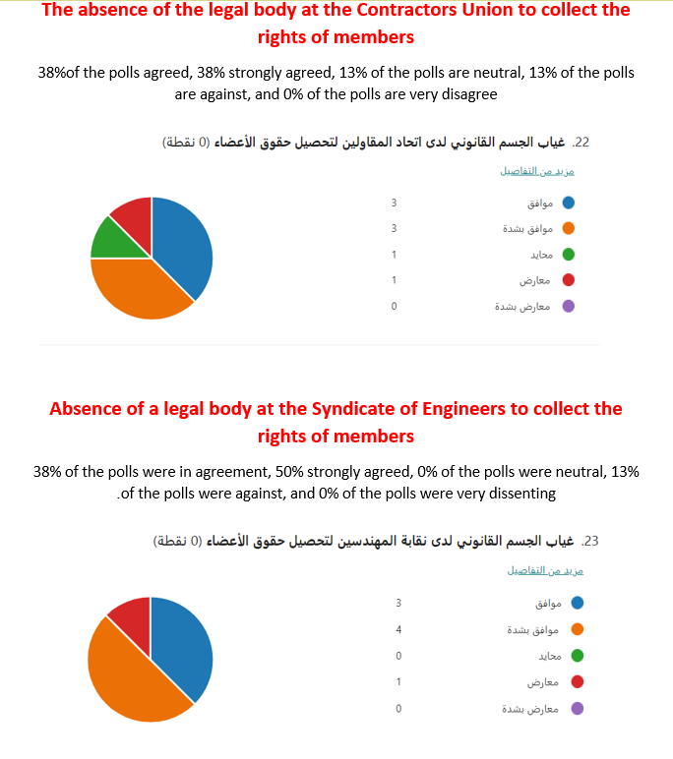

Slide 23
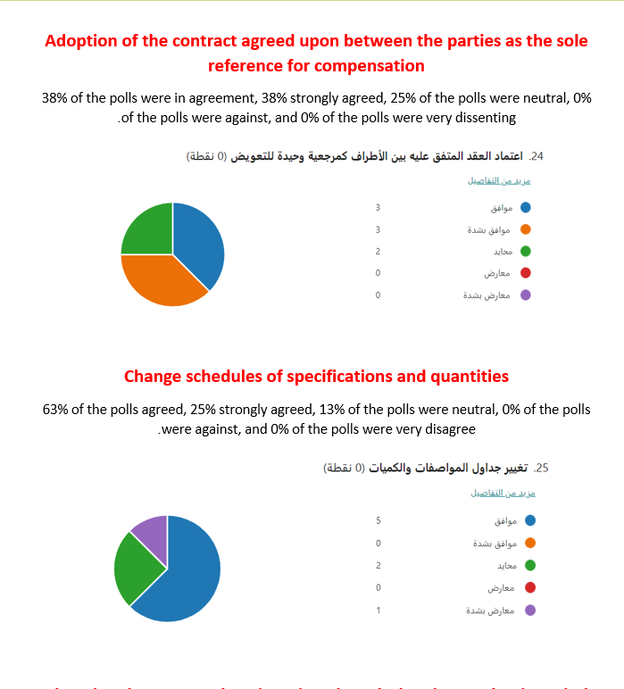

Slide 24
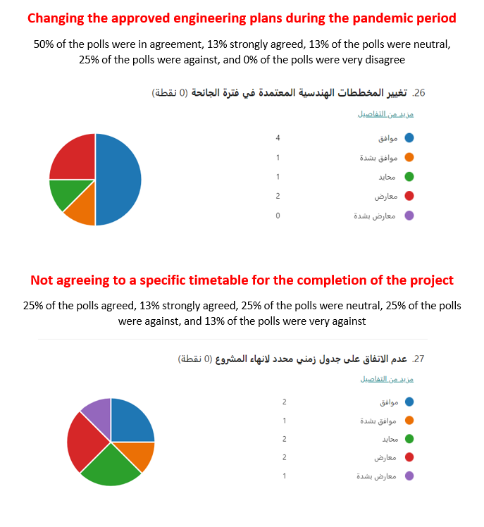

Slide 25
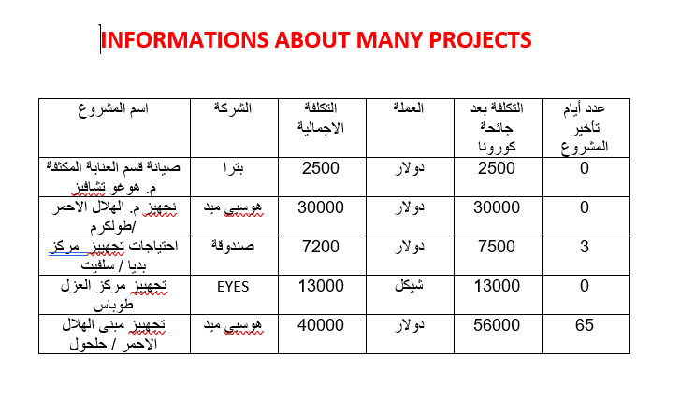

Slide 26
Conclusion and Recomendations
The Corona pandemic also affected the projects and caused an increase in the time and cost of completing the project and not completing it as required
After studying the opinion poll and analyzing it, we found that companies with great experience are the least harmful during the Covid-19 pandemic period. Therefore, knowledge of the nature of the market has a major role in dealing with projects during the pandemic, and that companies with few experience are the least fortunate in dealing with projects during the pandemic. The pandemic, and to give examples from reality, two companies were submitted to the questionnaire, the first from Jenin and the second from Ramallah, where the two companies have a capital of more than one million, but the experience of the first company does not exceed five years, and the second company has more than twenty years of experience, and this difference in itself It has a significant impact on the difference in the work of the two companies and the way they deal with projects during the Covid-19 pandemic, as the first company was unable to deal with the pandemic, while the second company was able to deal With projects during the pandemic, due to the presence of experience with the employees first and the capital secondly, despite the presence of obstacles and difficulties during the pandemic.

Slide 27
Therefore, we recommend companies with little experience not to apply for projects during the pandemic unless there is a consulting or reference company to consult on the obstacles that the company may face during the course of the pandemic. The project is under the circumstances of Covid-19, and we also recommend small companies not to apply to projects except by giving a real guarantee in contracts during the pandemic..

Slide 28
Any question?

Slide 29
References:
Al‐Reshaid, K. (2005). Construction Project Phases. Retrieved from Construction Project Phases: https://scholar.google.com/scholar?hl=ar&as_sdt=0%2C5&as_vis=1&q=Construction+Project+Phases&btnG=
Britton, B. K. (1991). Time Management. Retrieved from Time Management: https://psycnet.apa.org/record/1992-10822-001
Enshassi. (2006). construction in palestine.

