Slide 1
Time Management
Prepared By:
MOHAMMAD ABUBAKER
SAJI HAMMARSHI
MEELAD ABUBAKER

Slide 2
PROJECT DESCREPTION:
The assigned project is student’s schools which located in YABED; it was designed by Tubealh offices of the engineering design.
The contractor by AL.HAMEDYA for general contracting.
Funding came from the Palestinian Ministry Of Education And Higher Education fund .

Slide 3
Case Study:
The main problem that faces the project is time.
The maximum contract interval time is 180 calendar days
but when the contractor studied the project he found that the project needs more than 180 calendar days.
So, in this research it recommended to apply management techniques, and programs like primavera to control the time.

Slide 4
Objectives:
The main goal from this research is minimizing the time of the project by increasing the numbers of crews, and this leads to increase the productivity and thus reducing the time needed to complete the work.

Slide 5
Assumptions:
The increment in resources will reduce the project time.
Manage the sequences of the activities will reduce the time of the project.

Slide 6
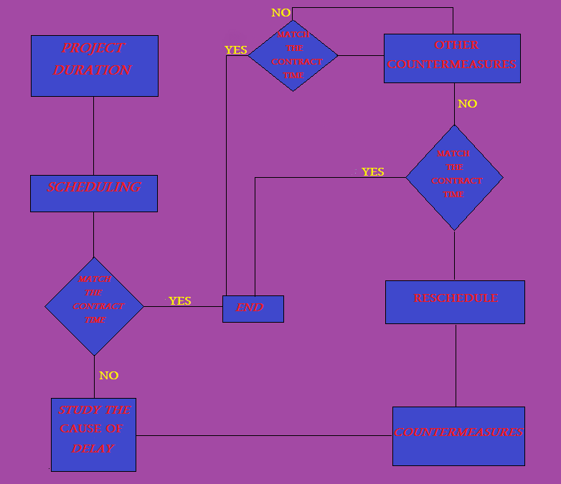
Methodology

Slide 7
Procedures
Quantification & scheduling
Take countermeasures & rescheduling

Slide 8
causes of delays:
Contractor caused delays for reasons under their control
Owner caused delays for reasons under their control
Delays for reasons beyond the contractor or owner’s control
Personality conflicts between the project’s team.

Slide 9
Conclusion
1) In this research the case study which was implementation of ya’bed school, the planned time was suggested to be 180 days.
Under usual conditions the time calculated to be 207 days as noticed in primavera software. But after managing the project time, the time was lessening to 170 days.
2) In this research, the increment of labors will minimize the project time, since the productivity of more labors will be increased.
3) Besides, good sequences for the main activity of the project will give the high opportunity to lessen the time of project.

Slide 10
THANK YOU

