Slide 1

Beats
Website and Application
Software Project
Supervised by : Dr Raed Al-Qadi
Students: Wala Janajreh - Taima Awwad

Slide 2



Project Idea

Slide 3
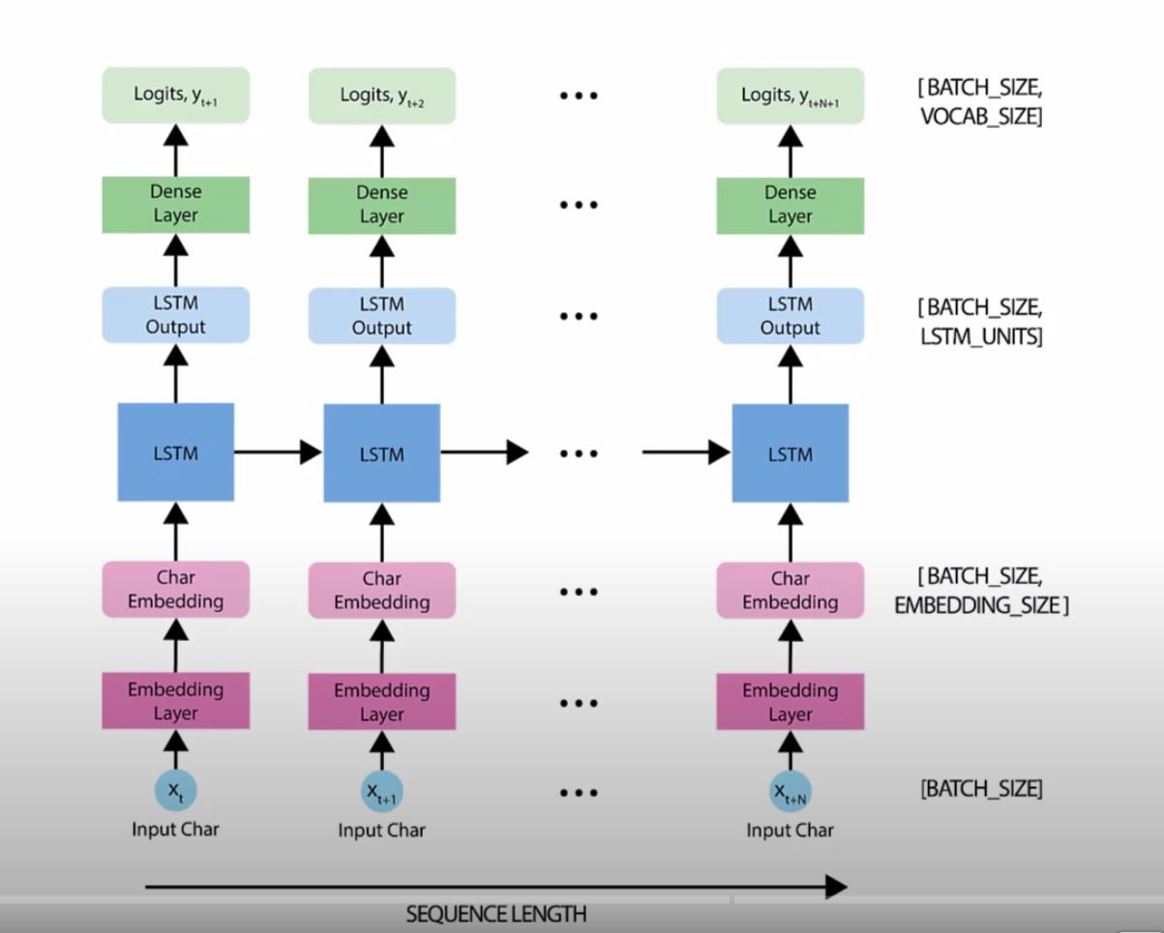

Deep Learning Generated Music

Slide 4

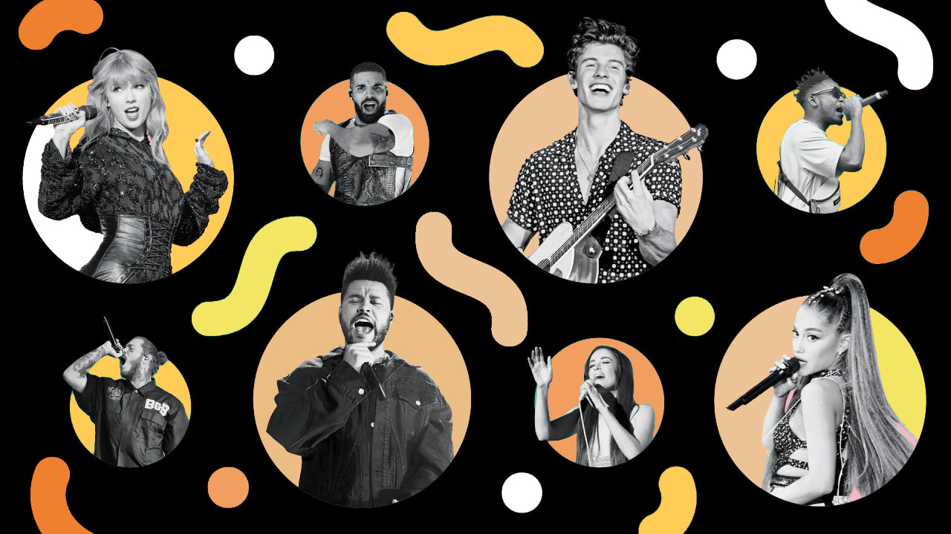

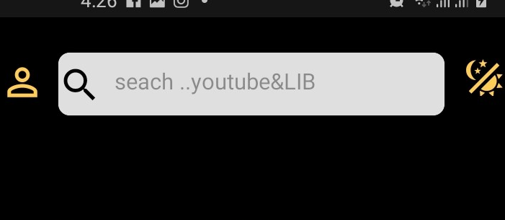
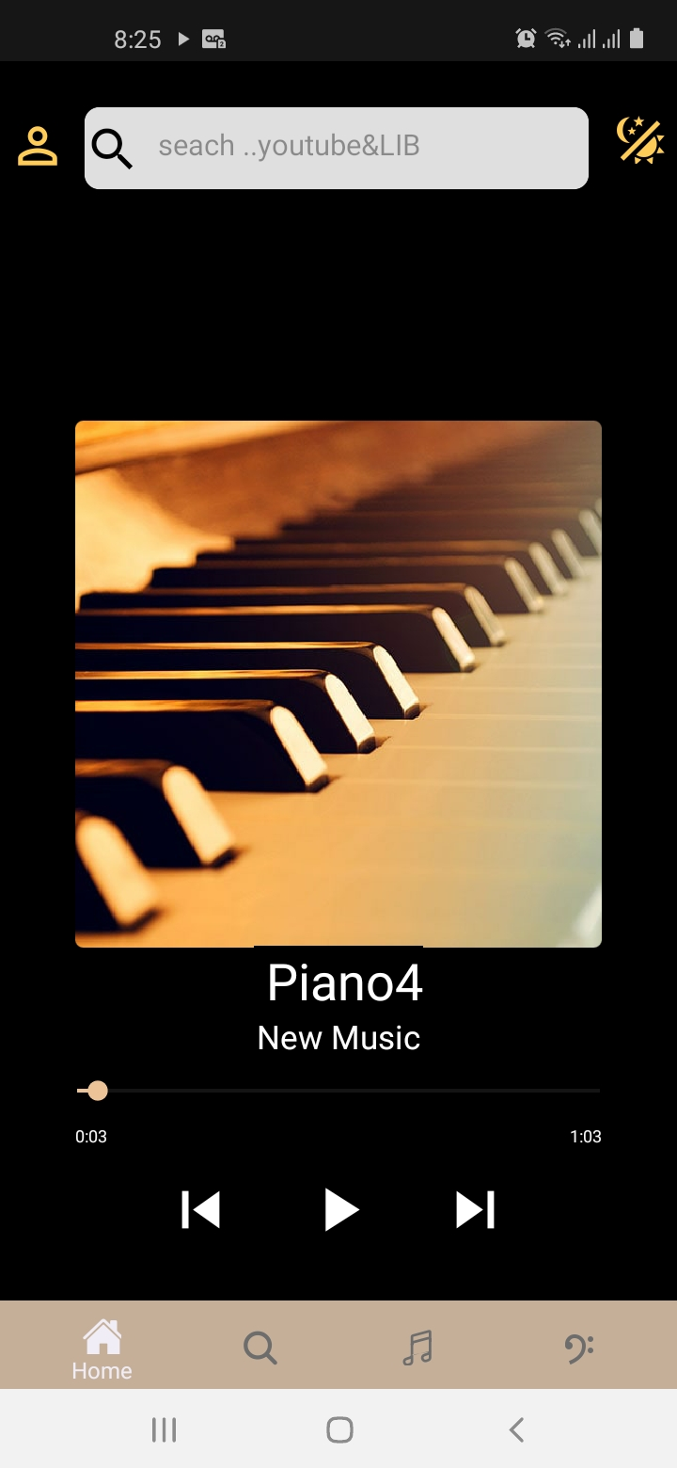
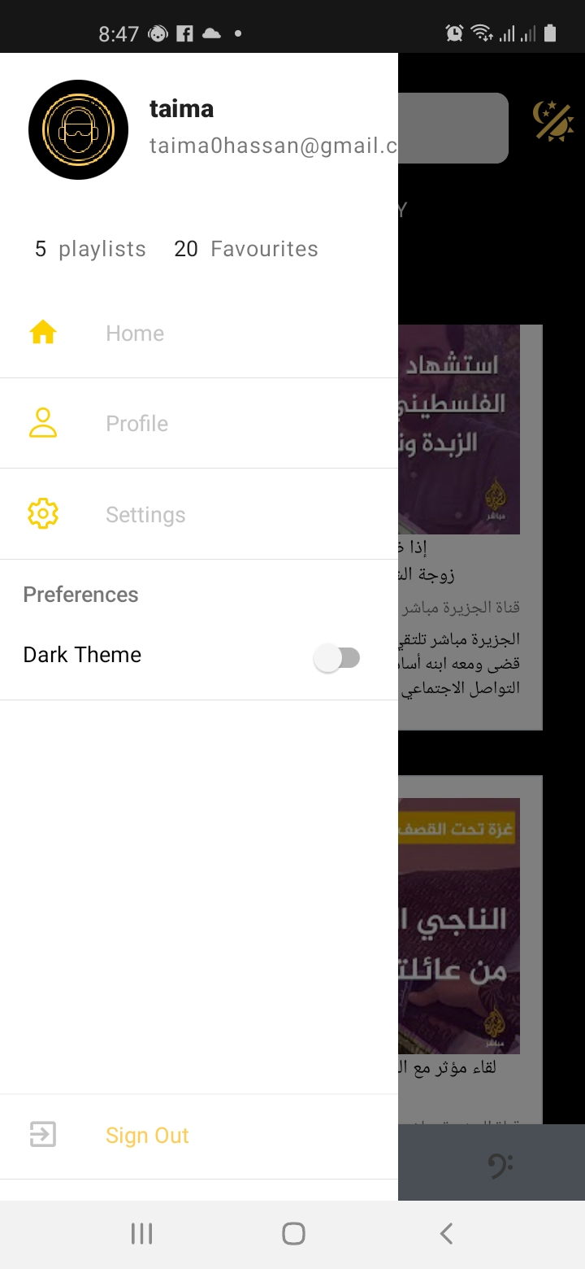
Beats
Mobile Application
Recently Played
Clips
Recently Added
Clips
Liked Music
Clips
Available Features :
YouTube and Library
Search
Personalized Player
Users Profile

Slide 5
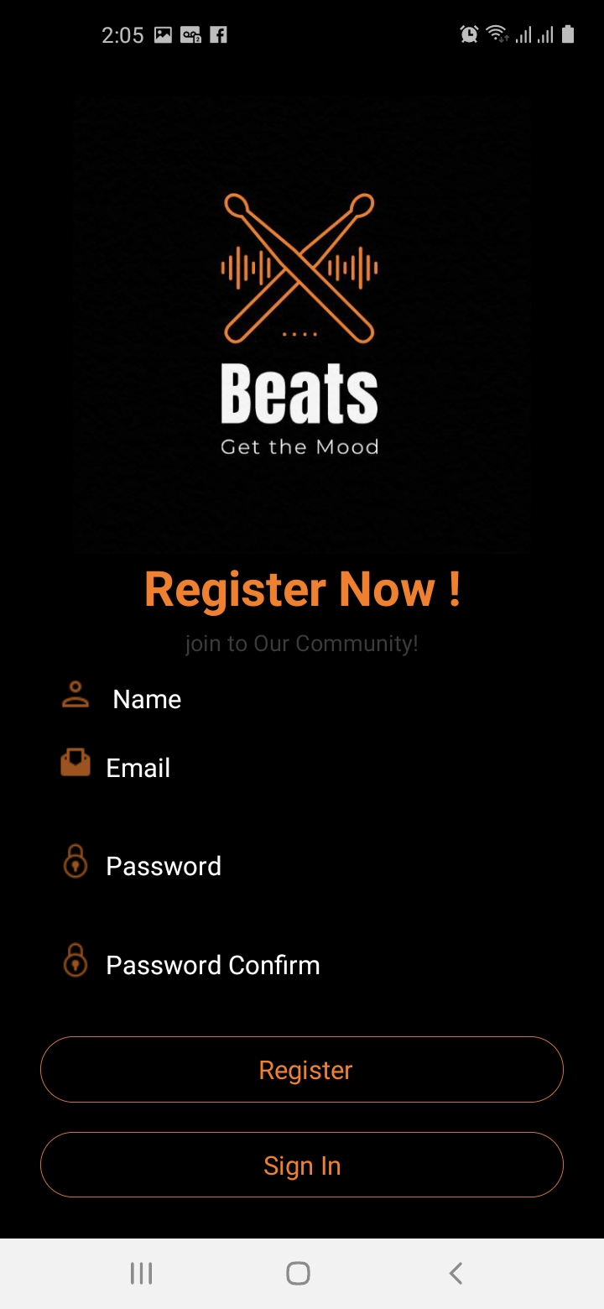
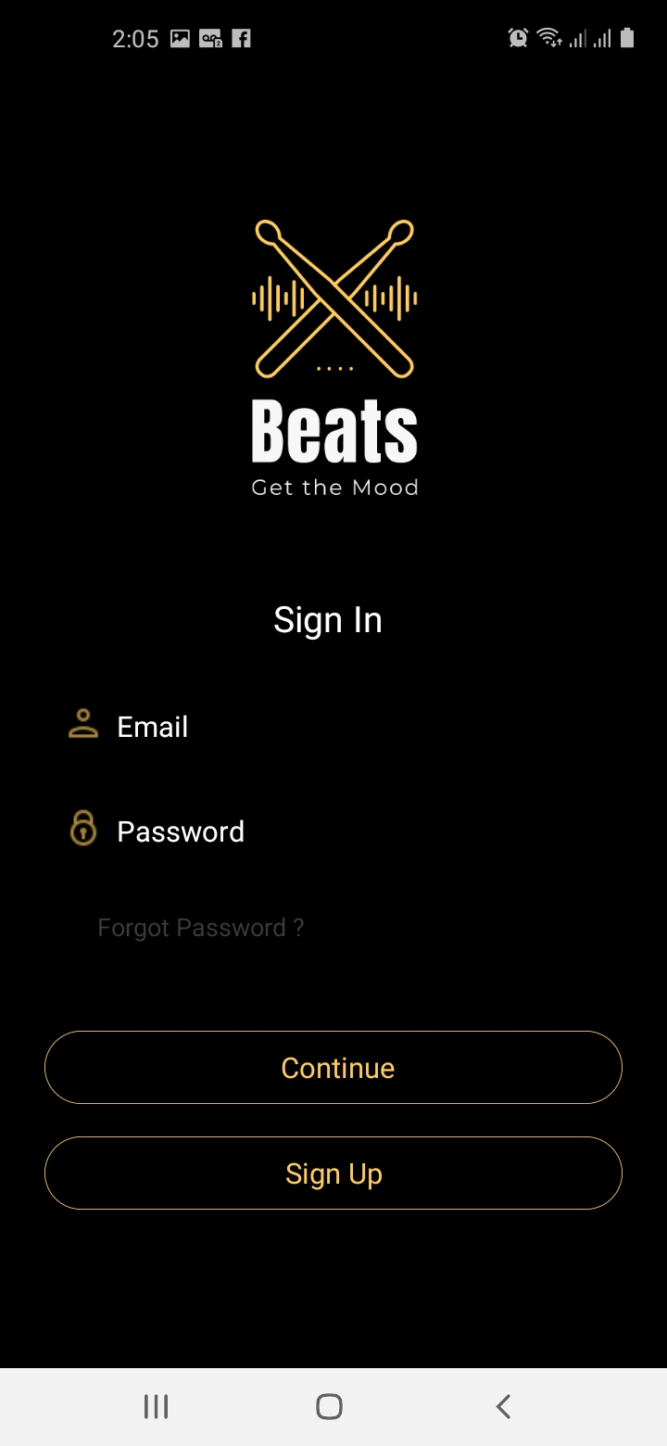
Registering & Signing In
clear & easy to follow .
modern design .
unified database.
Verification .

Slide 6
Beats
Website
Authentication
Responsive Modern Design
2
4
Sign-in/up then
access both App and Website
Get to know About Beats Community
1
3
Available Features :
Access to Beats Social media Accounts
View Beats Music
Categories
5
6

Slide 7
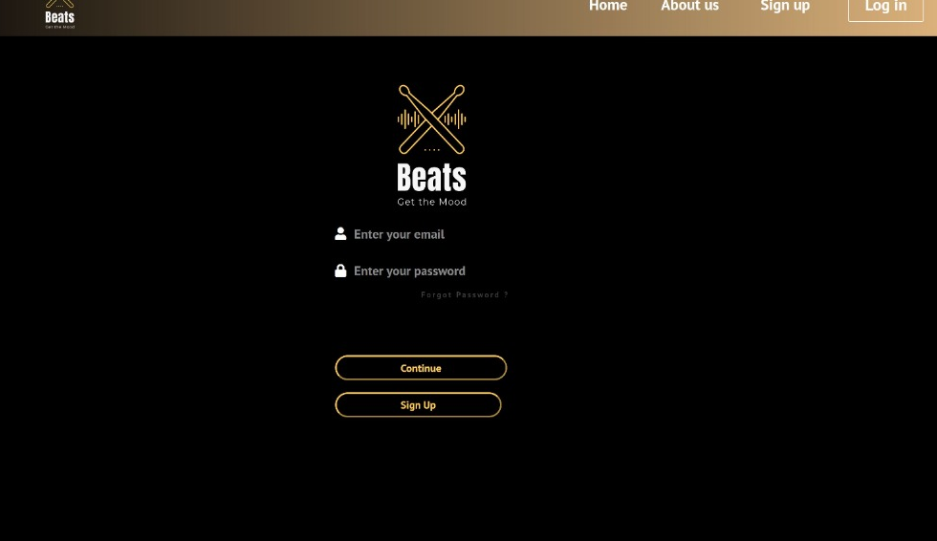
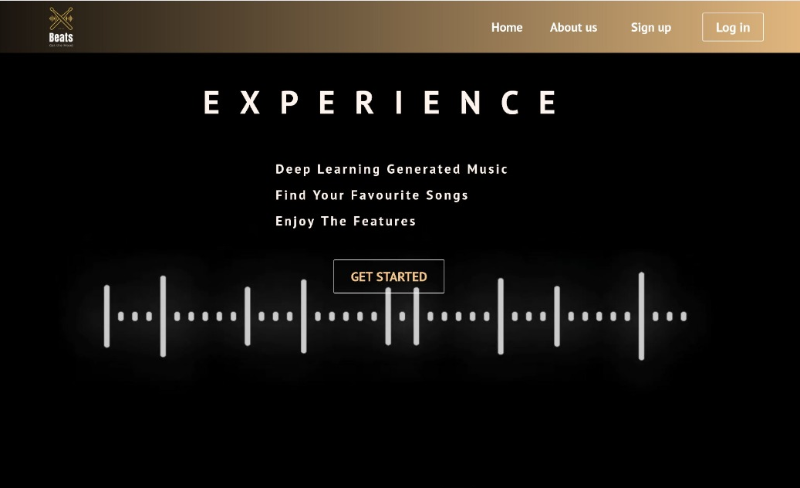
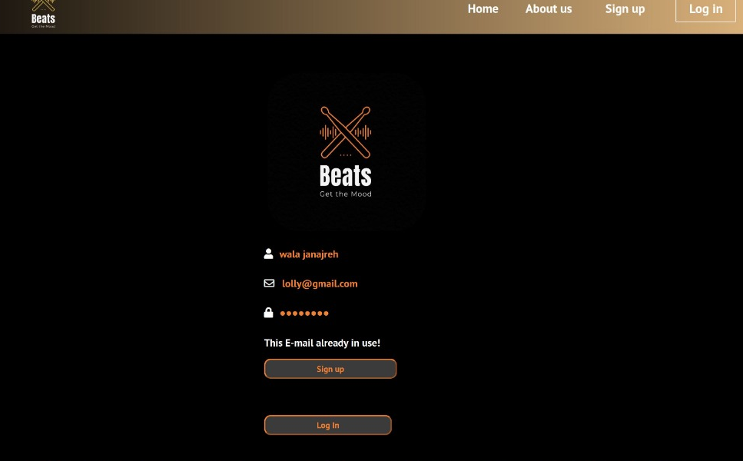
Home ,Log in & Sign up
User friendly
Responsive Design
Authentication
Unified Database
More About Beats Community

Slide 8
what we learned.
The final result.
Enhancements .
Conclusion:

Slide 9

Thank You
Enjoy your Beats Experience ☺

