Slide 1
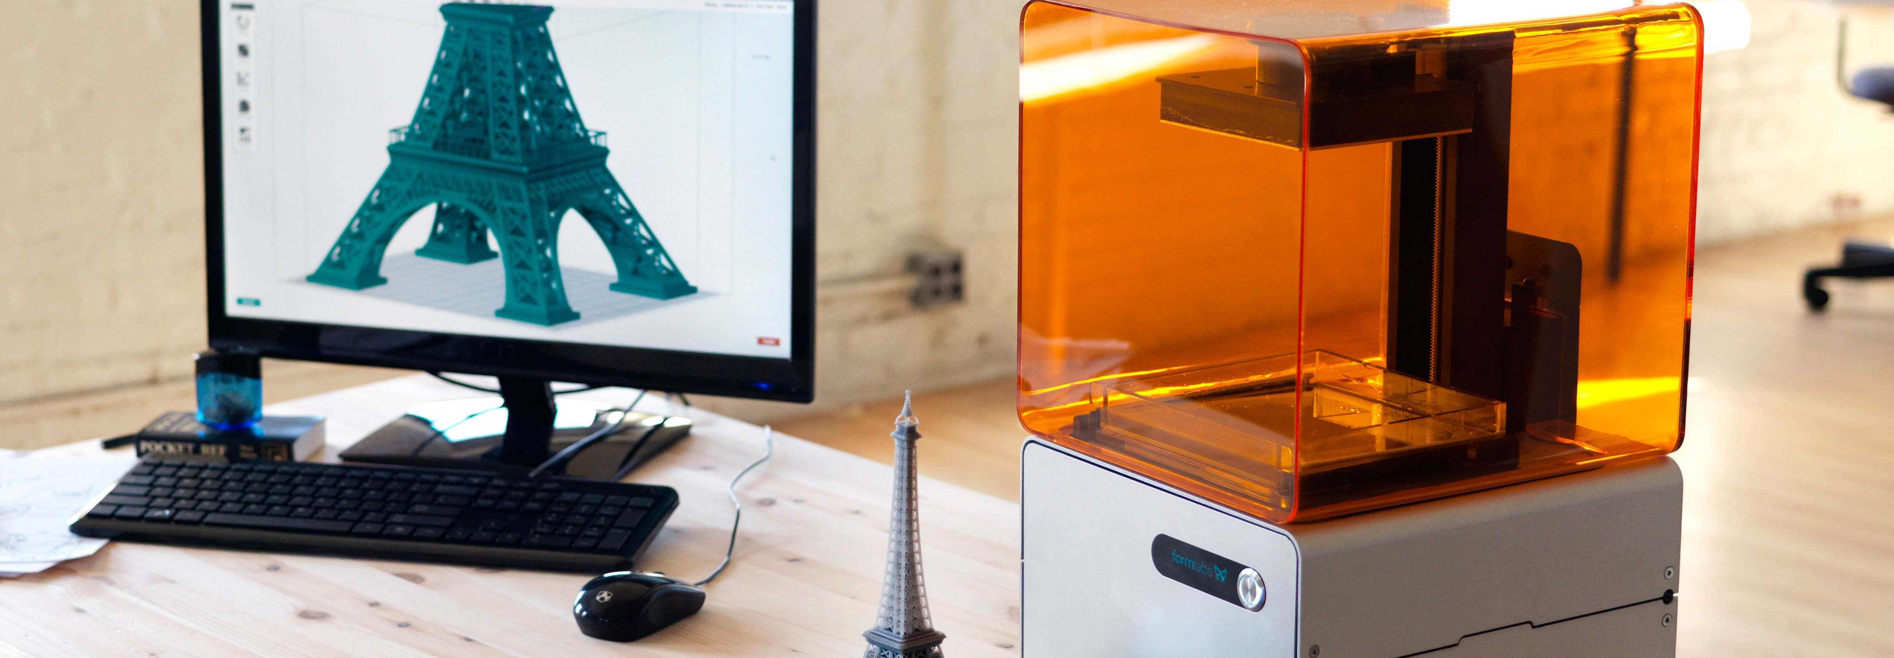

3-axis CNC Machine
Done By:
Shehab Khader
Ismael Suwan
Omar Yousef
Department of Mechatronics engineering
Supervisor:
DR. Basheer Nouri
6-7-2020
Notes:
https://unsplash.com/photos/m5P0c6ABWDs

Slide 2
Outline
Milling
Electrical
Mechanical
Milling process
Milling classifications
The frame
Conceptualization
Coordinate system
Electrical parts
Axis
G-code
Feed rate
Motion transition
GRBL
Other parts
softwares
speed
Example title
3-Axis Milling Machine

Slide 3

Milling classifications
Coordinate system
Introduction
Speed
Feed Rate
3-Axis Milling Machine

Slide 4
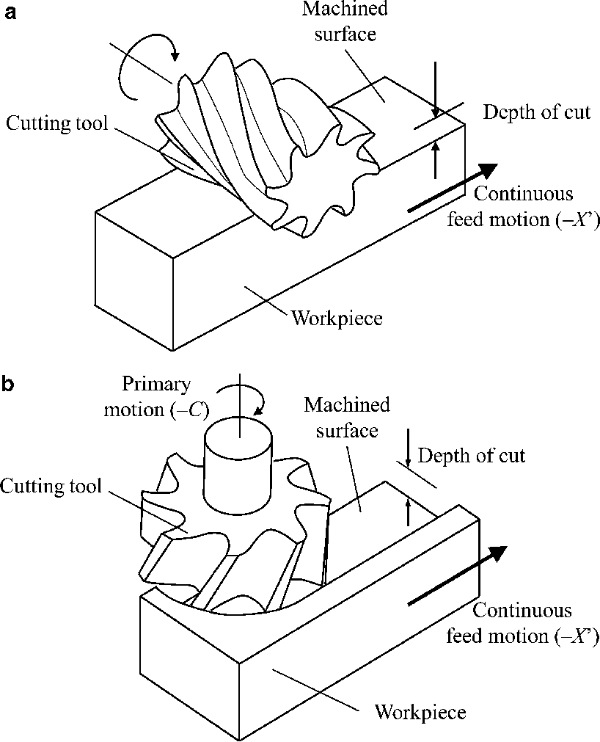
Milling classifications
Peripheral milling
Face milling
3-Axis Milling Machine

Slide 5
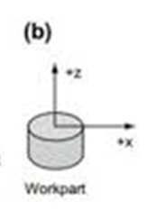
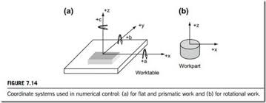
Coordinate system
Flat and prismatic
Rotational
3-Axis Milling Machine

Slide 6
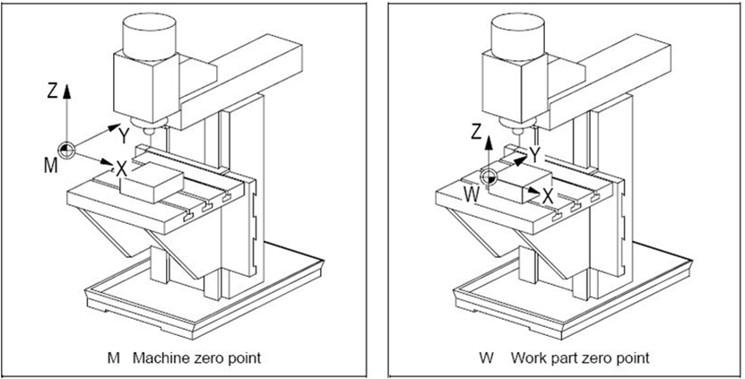
Frame of Reference
3-Axis Milling Machine

Slide 7


Speed
Speed: is the spindle speed in revolutions per minute (rpm).
$$speed = \frac{CS×4}{D}$$
3-Axis Milling Machine

Slide 8

Feed rate
$$fr = speed ×n×f$$
fr : feed rate in mm per minute (mm/min).
f: is the amount of material that each flute (tooth) will remove on each revolution. Each material/operation has a suggested value. It is measured in mm, sometimes written mm per tooth (mm/t).
n: is the number of flutes on the tool.
Speed: is the spindle speed in revolutions per minute (rpm).
3-Axis Milling Machine

Slide 9
Why feed rate is important?
-Feed rate, is directly related to safety, productivity, tool life, surface finish, part quality and so on.
-cutting too aggressively may distort the part and creates residual stress in such a way that it diminishes overall quality.
3-Axis Milling Machine

Slide 10
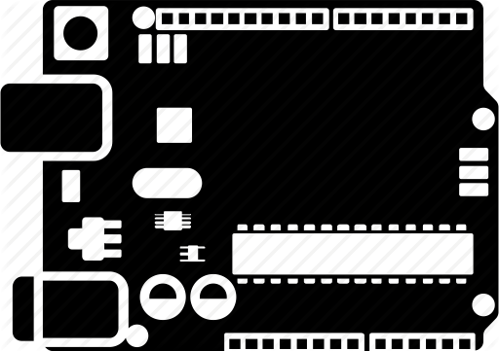



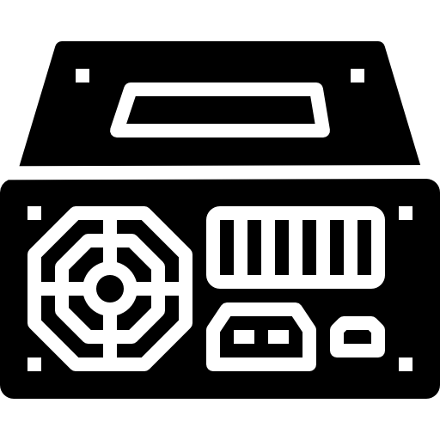

The electrical Components
Arduino
06
spindle
Connects all subsystems and controls the 3D milling process
Drilling tool
Drivers
02
01
Stepper motor
05
Controls the speed and direction of rotation of the motor
Responsible for the movement in the machine
04
03
Power Supply
Limit Switch
Supplies all of the subsystems with power
Determine the dimensions of work
3-Axis Milling Machine

Slide 11
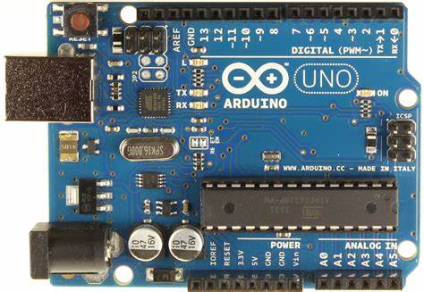
Free 3D Tetris Cube Diagram for PowerPoint
06
Controller:
Arduino uno
02
01
05
04
03
3-Axis Milling Machine

Slide 12
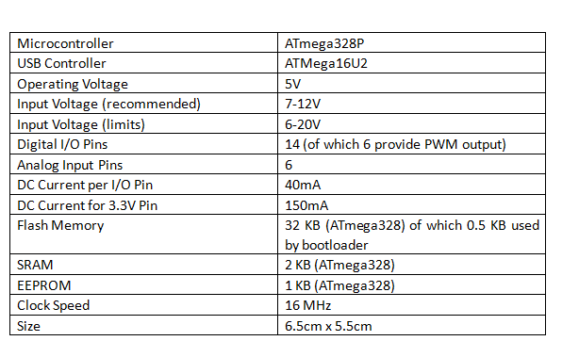
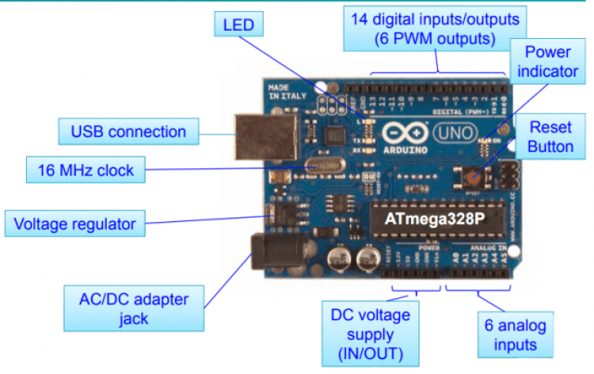
Hardware and Specifications
3-Axis Milling Machine

Slide 13
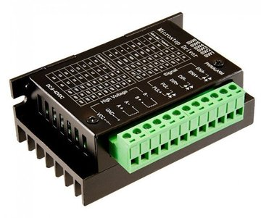
Free 3D Tetris Cube Diagram for PowerPoint
06
Drivers
allow user inputs to be translated as signs provide the required result to the motors for machines that, in turn.
02
01
05
04
03
3-Axis Milling Machine

Slide 14
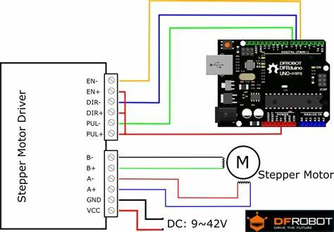
Hardware connection
3-Axis Milling Machine

Slide 15
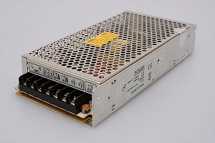
Free 3D Tetris Cube Diagram for PowerPoint
06
Power supply
For our project we have chosen a 24 Dc volt 20 amp 500watt for the motors and drivers
and another power supply for the spindle
02
01
05
04
03
3-Axis Milling Machine

Slide 16
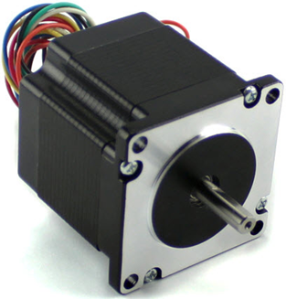
Free 3D Tetris Cube Diagram for PowerPoint
06
Stepper motor
02
01
05
04
03
3-Axis Milling Machine

Slide 17
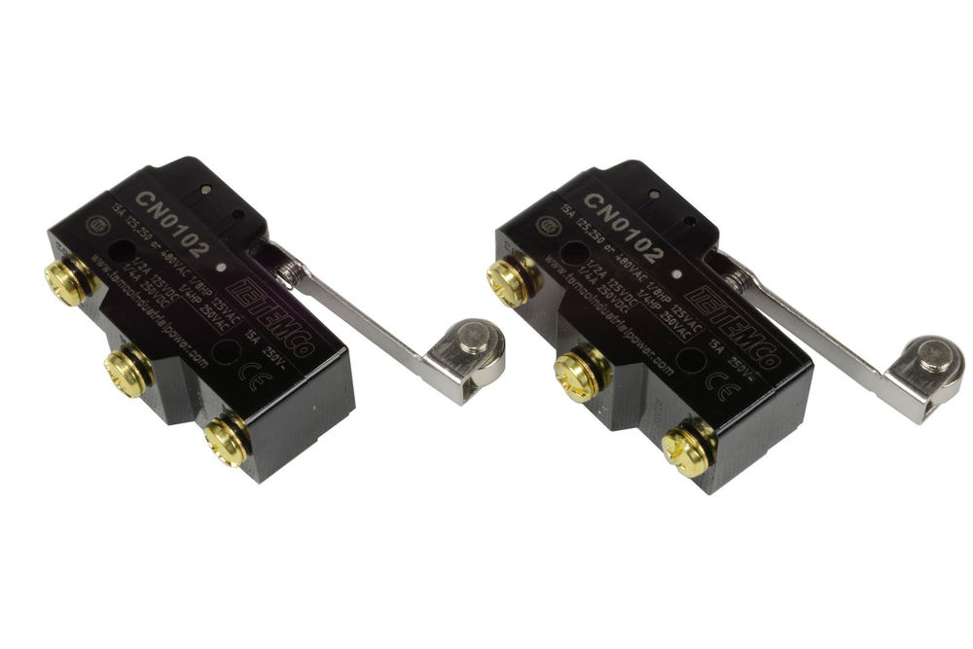
Free 3D Tetris Cube Diagram for PowerPoint
06
Limit Switch
Determine the boundaries of the Axis.
02
01
05
04
03
3-Axis Milling Machine

Slide 18
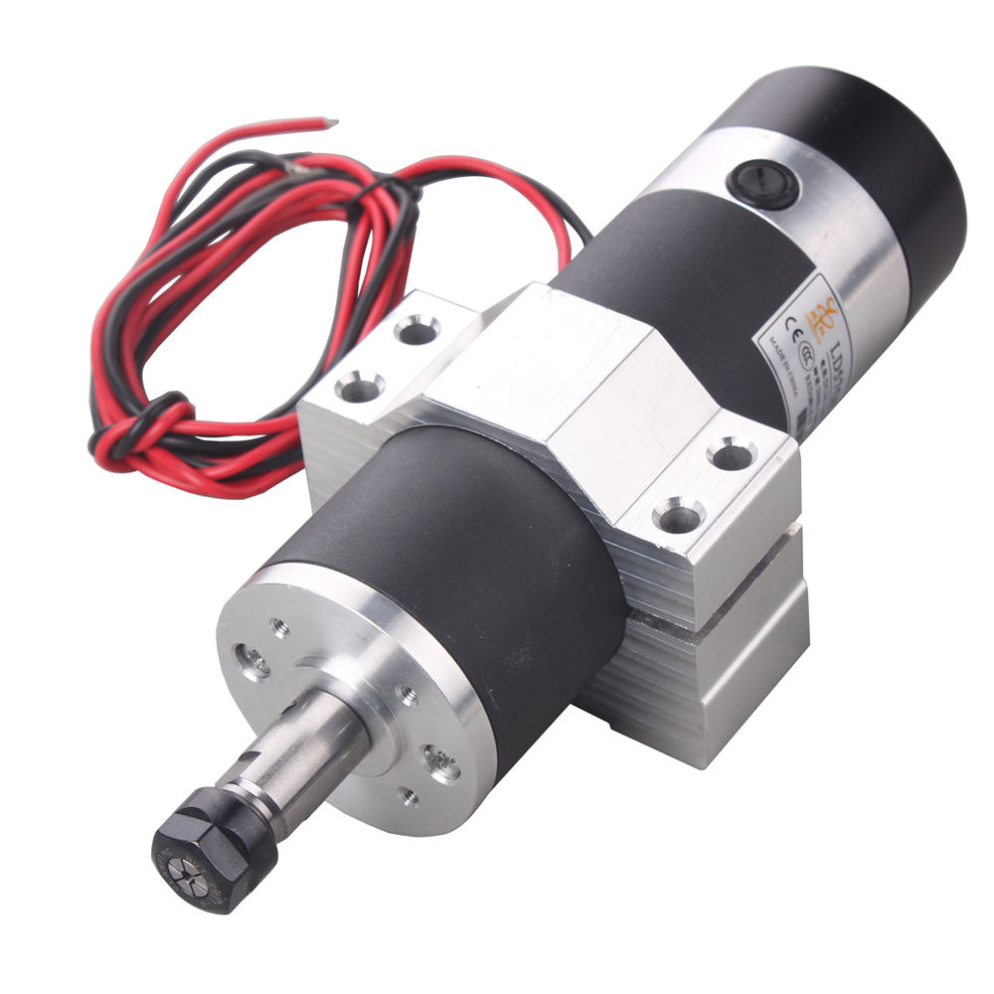
Free 3D Tetris Cube Diagram for PowerPoint
06
spindle
A brushless DC electric motor
02
01
05
04
03
3-Axis Milling Machine

Slide 19
Spindle specifications
3-Axis Milling Machine

Slide 20
Mechanical design
Motion
transition
The
axis
Other
parts
The
frame
Mechanical
design
3-Axis Milling Machine

Slide 21
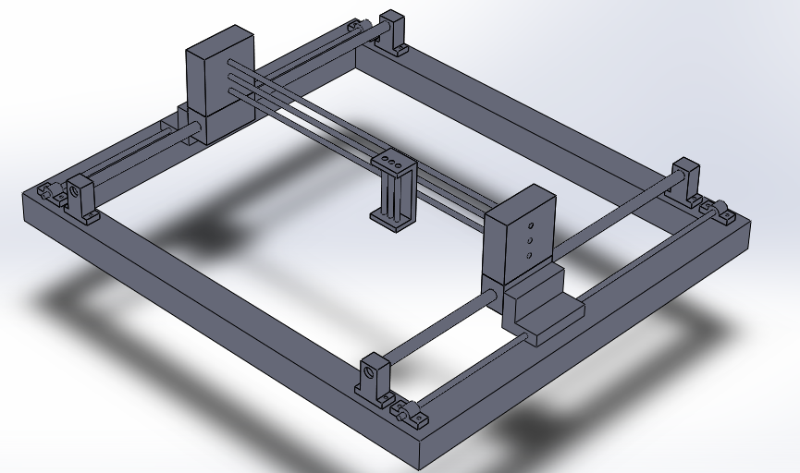
Overview of the machine
3-Axis Milling Machine

Slide 22
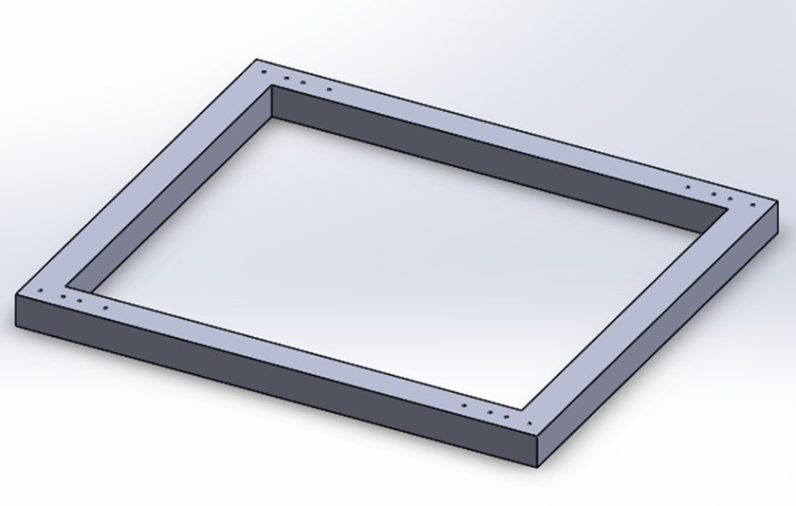
The
frame
3-Axis Milling Machine

Slide 23
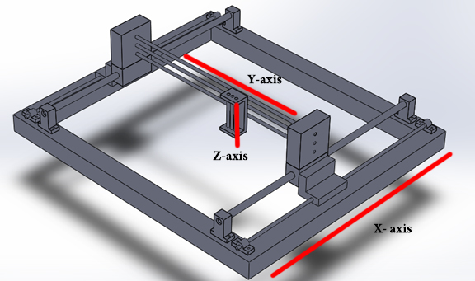
X-axis
The
axis
3-Axis Milling Machine

Slide 24
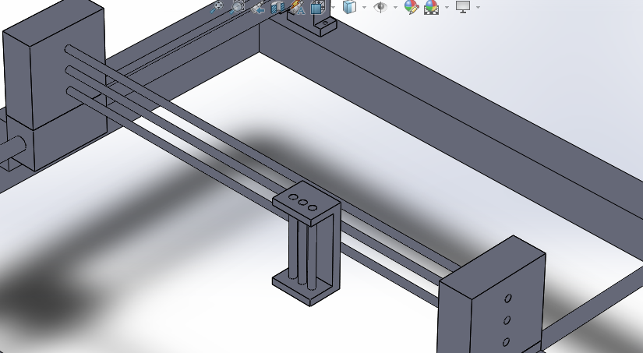
The Y-axis
The
axis
3-Axis Milling Machine

Slide 25
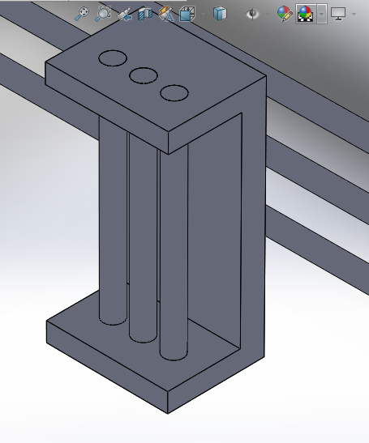
The z-axis
The
axis
3-Axis Milling Machine

Slide 26
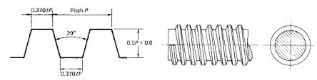
Motion
transition
power screw
easy to machine
can be used with split nuts
optimum efficiency of about 70%
3-Axis Milling Machine

Slide 27
Motion
transition
Torque and efficiency equation
The required motor torque
Inertial torque
static friction torque
torque to move the load
$$T =I×α$$
$Torque=\frac{load×lead}{2π×efficiency }$
3-Axis Milling Machine

Slide 28
Motion
transition
Anti-backlash
static frictional torque of 0.01 Nm
Higher pre-load forces -- higher frictional drag torques but better anti-backlash characteristics
3-Axis Milling Machine

Slide 29
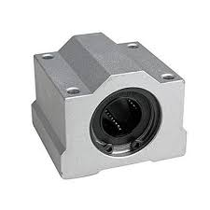
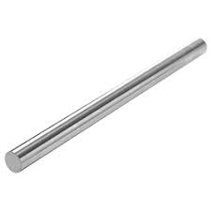
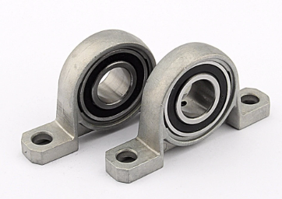
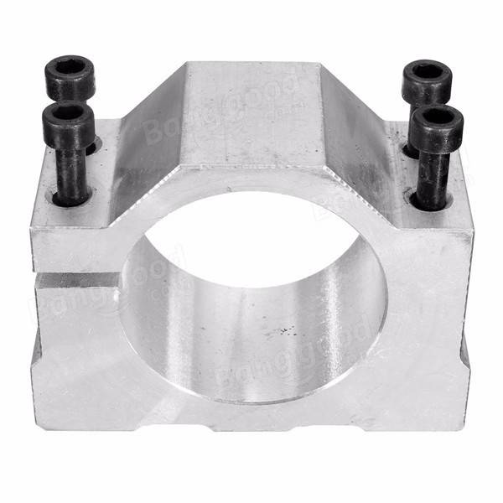
Other
parts
3-Axis Milling Machine

Slide 30

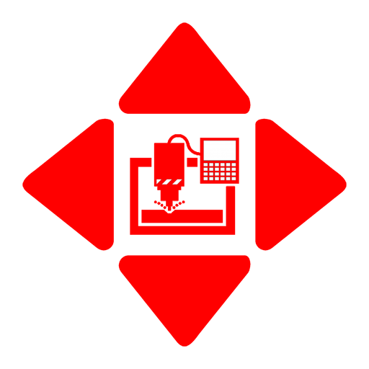

The Milling Process
CAD
GRBL
GRBL controller
G
GRBL
G-code
InkScape
3-Axis Milling Machine

Slide 31
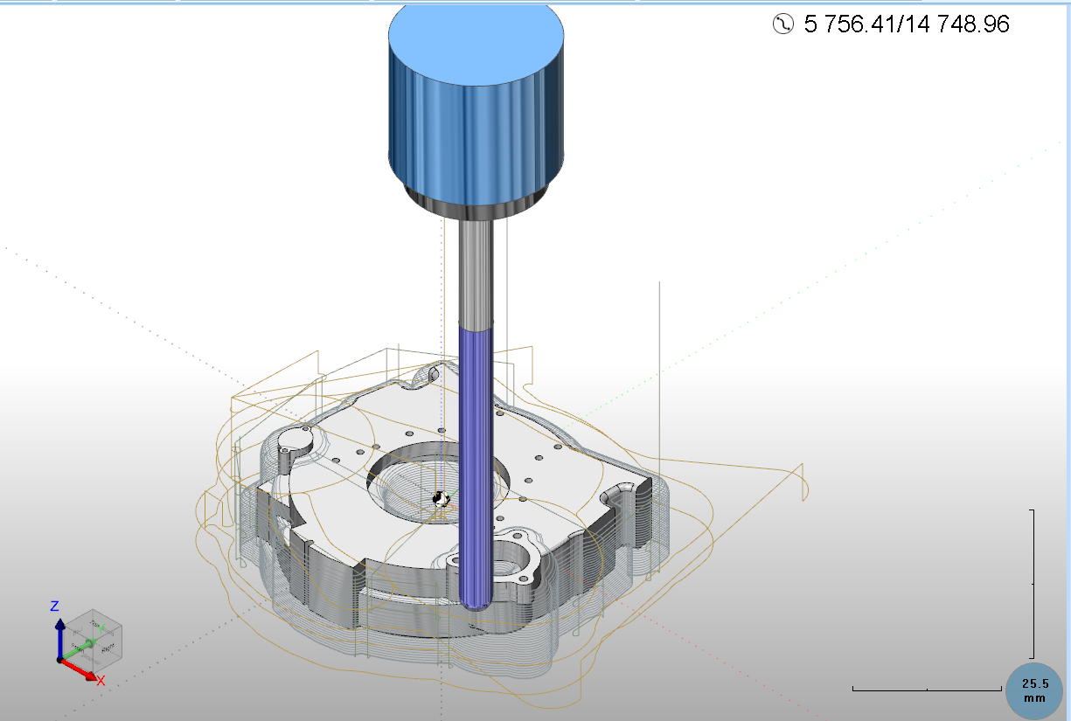
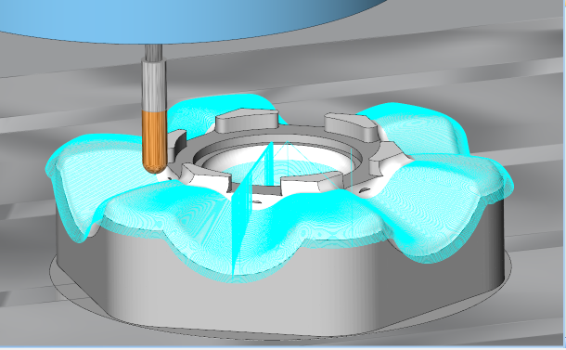
1-Conceptualization and CAD
3-Axis Milling Machine

Slide 32
2-G-Code
G
G-code is a programming
language for CNC that instructs
machines where and how to move.
It consists of a letter and 2 numbers which corresponds with a specific command to the CNC machine.
N## G## X## Y## Z## F## S## T## M##
3-Axis Milling Machine

Slide 33
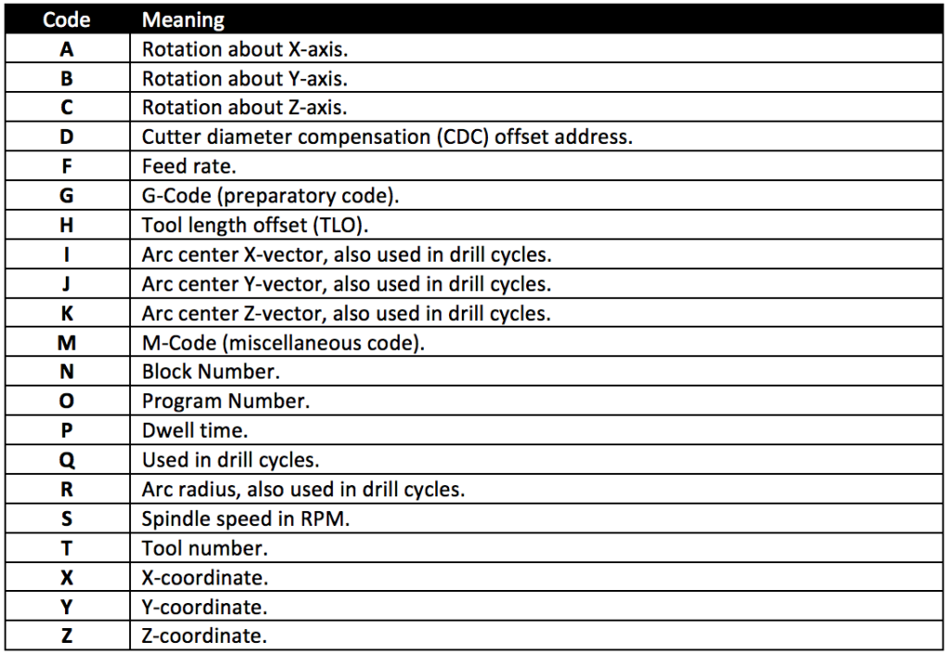
2-G-Code
G
3-Axis Milling Machine

Slide 34
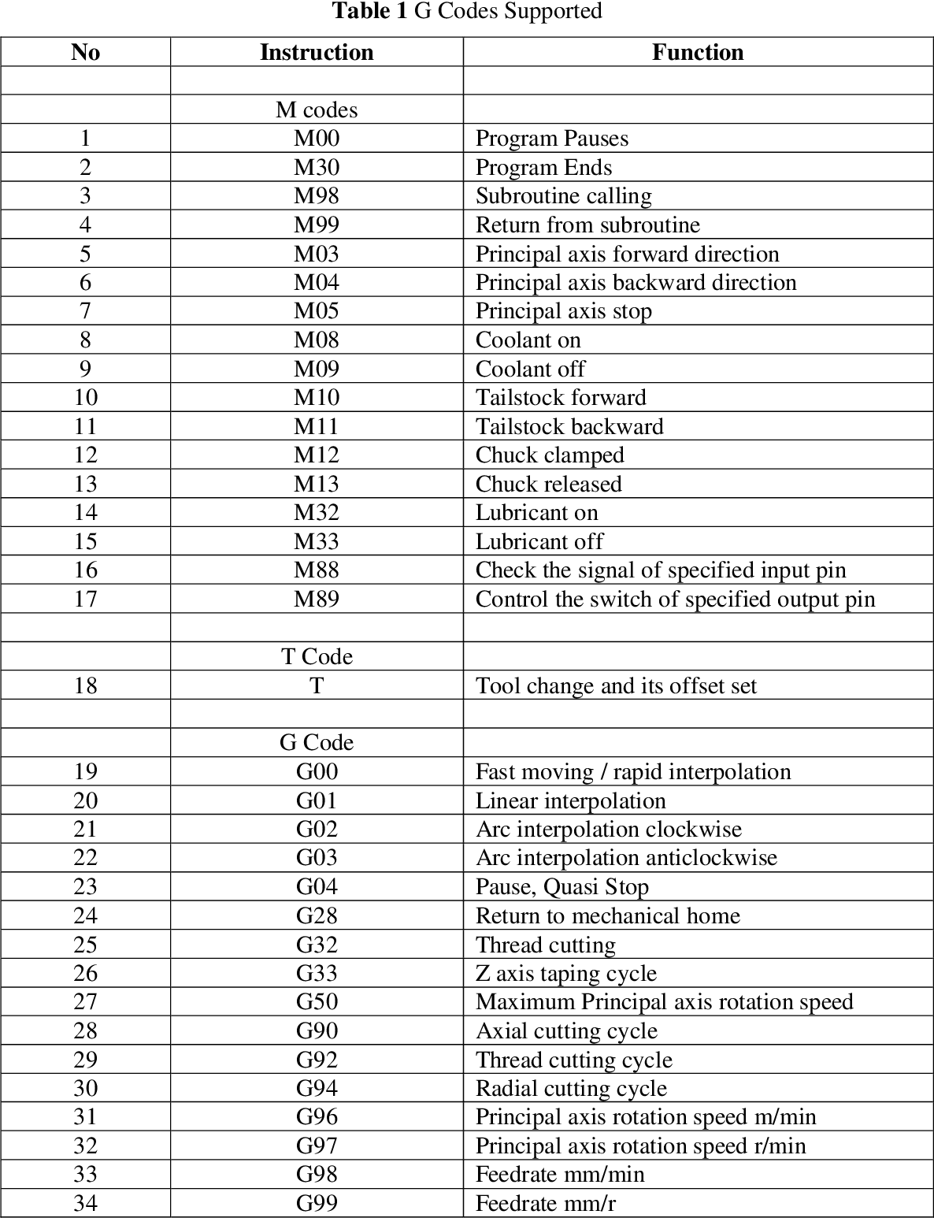
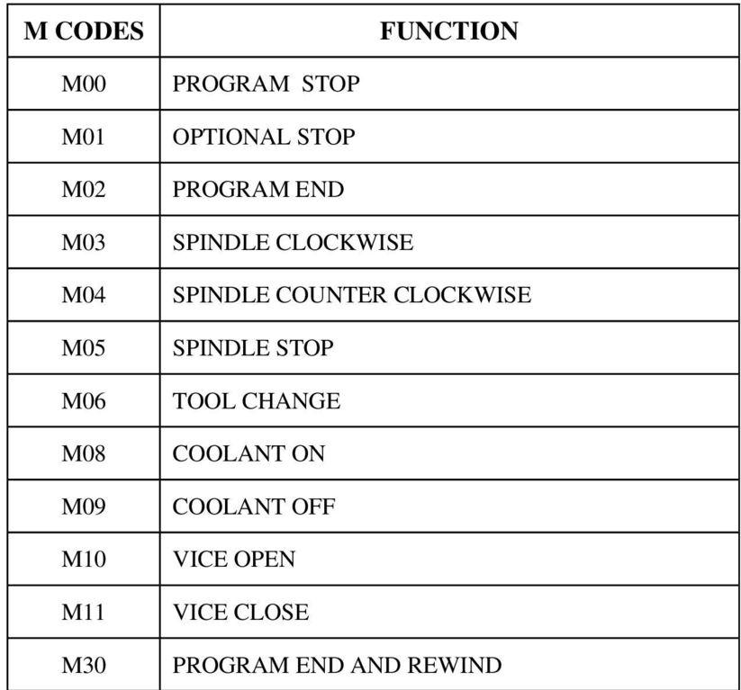
Commonly used G and M codes
3-Axis Milling Machine

Slide 35
3-GRBL
GRBL
-GRBL is a firmware for Arduino boards that controls stepper motors and spindles. GRBL uses G-Code as input and outputs signals via the Arduino pins.
-Firmware is a software program or set of instructions programmed on a hardware device.
-It provides the necessary instructions for how the device communicates with the other computer hardware.
What is GRBL?
3-Axis Milling Machine

Slide 36
3-Transfer to Machine and File Manipulation
GRBL
-Most industrial CNC machines uses parallel port controller that requires Those big purple connectors!
Thanks to GRBL firmware Arduino can translate G-Codes now!
Why do we need it?
To Install GRBL you need two things:
1-Arduino IDE
2-latest GRBL release
3-Axis Milling Machine

Slide 37
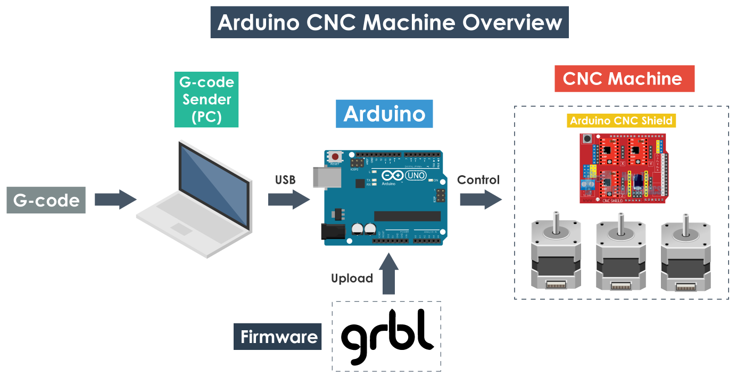
To sum up
3-Axis Milling Machine

Slide 38
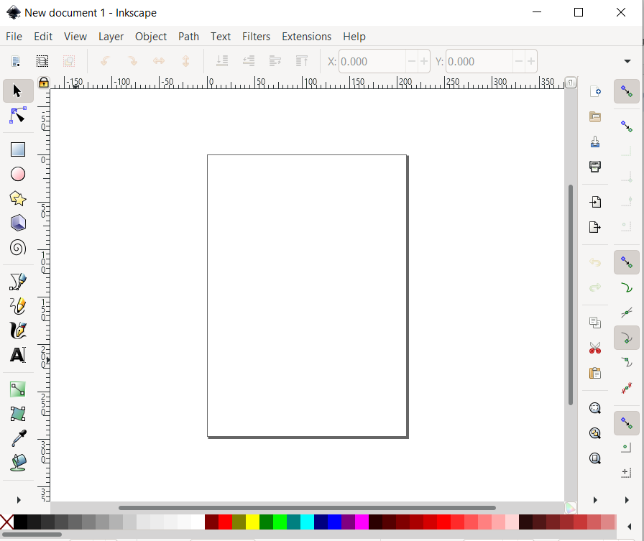


4- InkScape
1-convert any PNG or JPEG to G-Code
2-draw simple shapes and convert
it to G-code
3- controlling the dimensions
of workspace
3-Axis Milling Machine

Slide 39
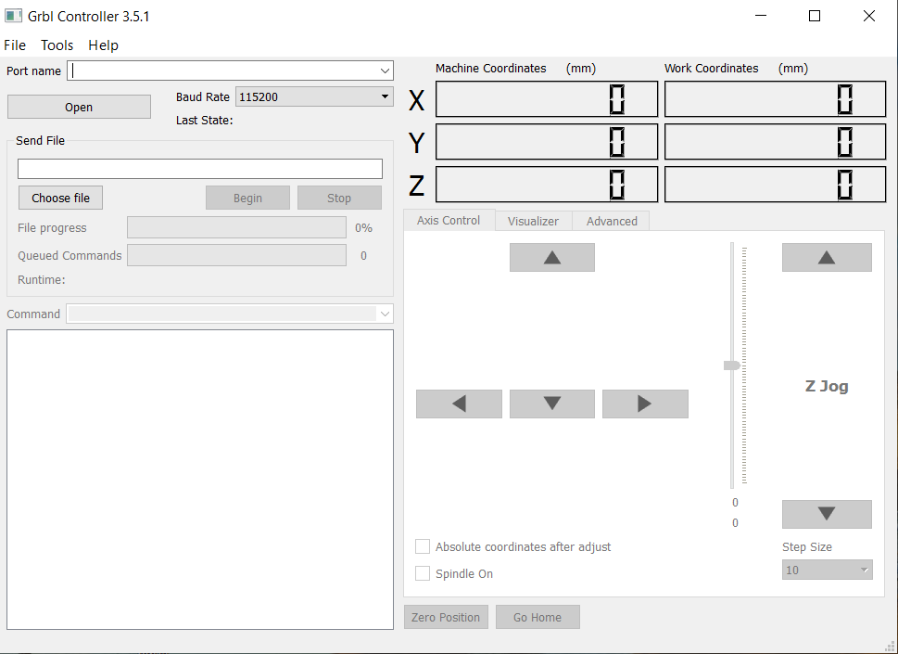
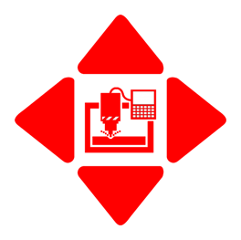
GRBL controller
3-Axis Milling Machine

Slide 40
Thank you !!
3-Axis Milling Machine

Slide 41

Any questions?
3-Axis Milling Machine

