Slide 1
Side impact beam
Supervisor: Prepared by:
Dr. Iyad Assaf Maram Mohammad
Tami Qabaha

Slide 2
Out line:
What is side impact beam.
Types of safety of side impact.
Material properties of side impact beam.
Finite element analysis.
Energy absorption.

Slide 3

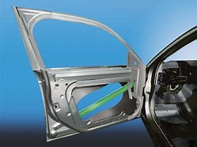
What is side impact beam

Slide 4
Side impact configuration &deformable barrier face

Slide 5
Types of safety of side impact
Types of safety of side impact
Beams
Steel or aluminum side impact beam
Fiber glass side impact beams
Air bag

Slide 6
Difference between aluminum and steel
 | Steel | Aluminum
Characteristics | Steel is durability, flexibility and strong. | Aluminum is a soft, durable, lightweight, ductile and malleable metal.
Strength | Stronger compared to aluminum | Weaker in general, though some aluminum alloys are stronger than steel
Weight | Heavier compared to aluminum | Lighter compared to steel
Stiffness | Less stiffer compared to aluminum | Aluminums are stiffer compared to steel
Corrosion | Is highly corrosive | Is less corrosive

Slide 7
Toughness

Slide 8
Different cross section
I-beam cross section
Square cross section
Hollow square cross section
Circular cross section
Hollow circular cross section

Slide 9
Finite element analysis

Slide 10
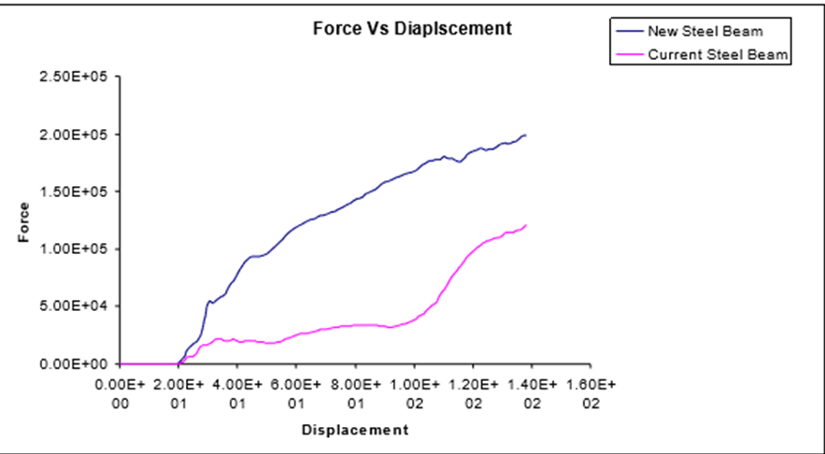
Energy absorption

Slide 11
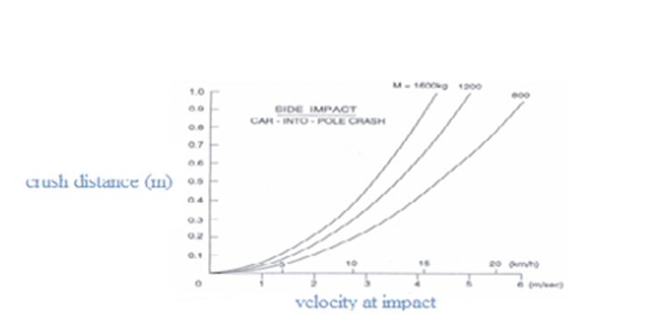
Energy absorption

Slide 12


