Slide 1


Home
Service
About Us
Contact
ADEL
SAAS WEBSITE FOR LAWYERS
An-Najah National University - Palestine
04/07/2024

Slide 2


<MEET OUR TEAM/>
Home
Service
About Us
Contact
<h1> Amr Qabaha & Zuhair Madmouj </h1>
<!-- Supervised by-->
<b> Dr. Mohammad Sharaf </b>
02

Slide 3

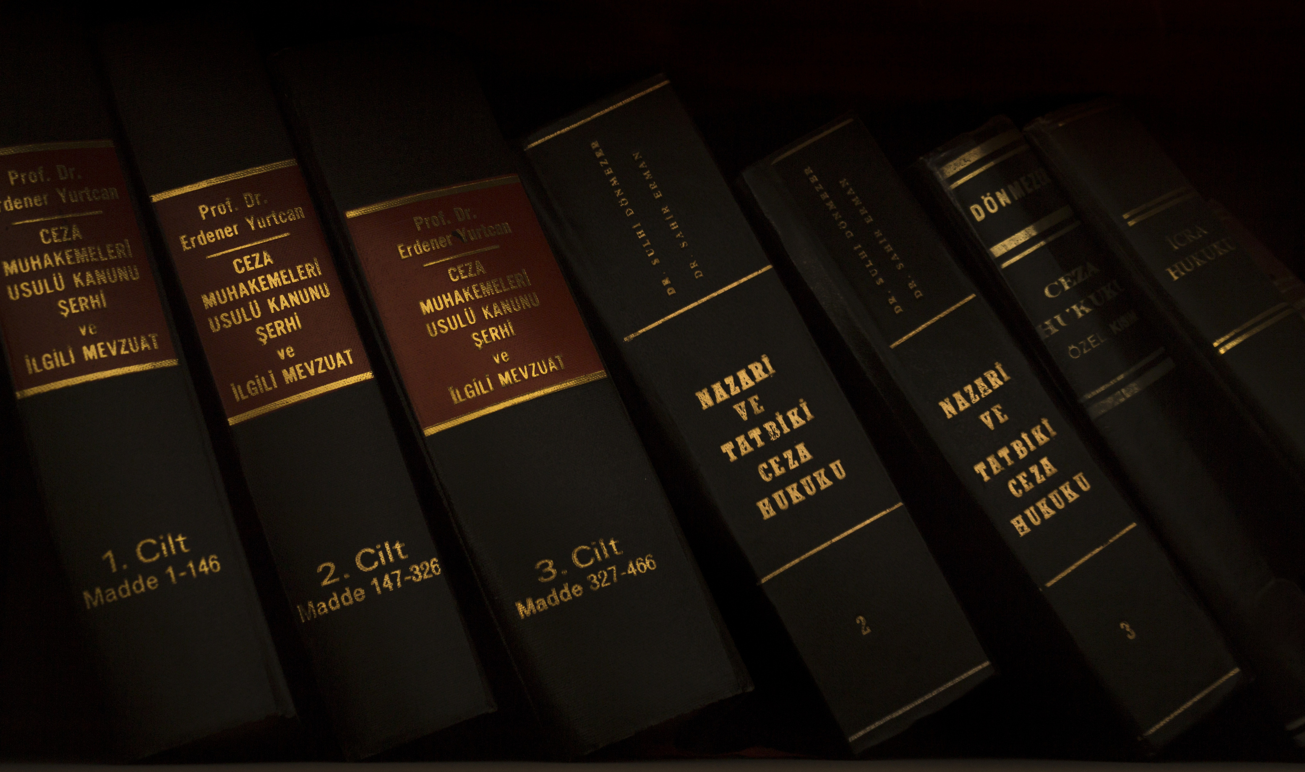
Home
Service
About Us
Contact
ADEL
Outline
01
What is ADEL? & Objectives.
02
Problem Statement & solution.
03
Similar platform & stand out.
04
Use case For Adel
05
ERD
06
Features of ADEL.
07
Look to Website.
08
Main technologies and tools were used.
09
Future vision for ADEL.

Slide 4

Home
Service
About Us
Contact
ADEL
ADEL: Simplifying Legal Workflows, Empowering Lawyers.
ADEL (Advanced Digital Environment for Lawyers): is a SaaS web application designed to digitize legal document management, enhance communication, and streamline scheduling and financial processes for law firms. It provides secure, efficient tools for clients, lawyers, and managers to improve their workflow and productivity.
Project Objectives:
  Digitize Legal Document Management: Streamline the handling, storage, and retrieval of legal documents to improve efficiency and reduce paper usage.
  Enhance Communication: Facilitate real-time communication between clients and lawyers, ensuring timely and effective interactions.
  Streamline Scheduling and Task Management: Provide robust calendar and task management features to help lawyers and clients manage their appointments and deadlines effectively.
  Simplify Financial Processes: Implement comprehensive billing, invoicing, and expense tracking systems to manage and track financial transactions seamlessly.

Slide 5

Home
Service
About Us
Contact
ADEL
Challenges Faced by lawyers and law firms :
Lawyers Problems:
Law Firms Problems:
  Wasting Time in Manual Document Searches: Lawyers spent excessive time searching through paper archives.
  Risk of Losing Legal Documents: Paper documents were prone to damage, loss, or accidental destruction.
  Inconvenient Timing: Lawyers often complain about clients contacting them at inconvenient and frequent times.
  Inefficient Task and Schedule Management: Law firms struggled to manage appointments and deadlines effectively.
  Complex Financial Tracking and Billing: Tracking billing, invoicing, and expenses was error-prone and time-consuming.
How ADEL Addresses These Problems:
  ADEL addresses the Inconvenient Timing issue by organizing appointments and communication through its messaging feature, allowing lawyers to respond to all requests at times that are convenient for them.
  Efficient Document Management: ADEL digitizes legal documents, enabling quick searches and secure storage, reducing time spent on manual handling and mitigating the risk of document loss or damage.
  Enhanced Communication and Scheduling: ADEL provides robust calendar and task management systems, ensuring effective appointment scheduling, deadline management, and streamlined communication between clients and lawyers.
  Simplified Financial Processes: ADEL offers comprehensive tools for billing, invoicing, and expense tracking, ensuring accurate and efficient financial management for law firms.

Slide 6

Home
Service
About Us
Contact
Similar Platform
ADEL
01
Clio.
02
MyCase.
How Does ByteMentor Stand Out From Other Platforms ?!
  Multilingual Support: Unlike other platforms that support only one language, ADEL supports multiple languages, catering to a diverse user base.
  Unique User Experience(User-Friendly Application Tracking ): ADEL's architecture is designed to provide a unique user experience by creating a robust foundation that is ready for mobile app deployment without starting from scratch.
  AI Integration: ADEL leverages artificial intelligence to simplify form filling and document writing through its OCR feature, which scans and processes legal documents efficiently.

Slide 7
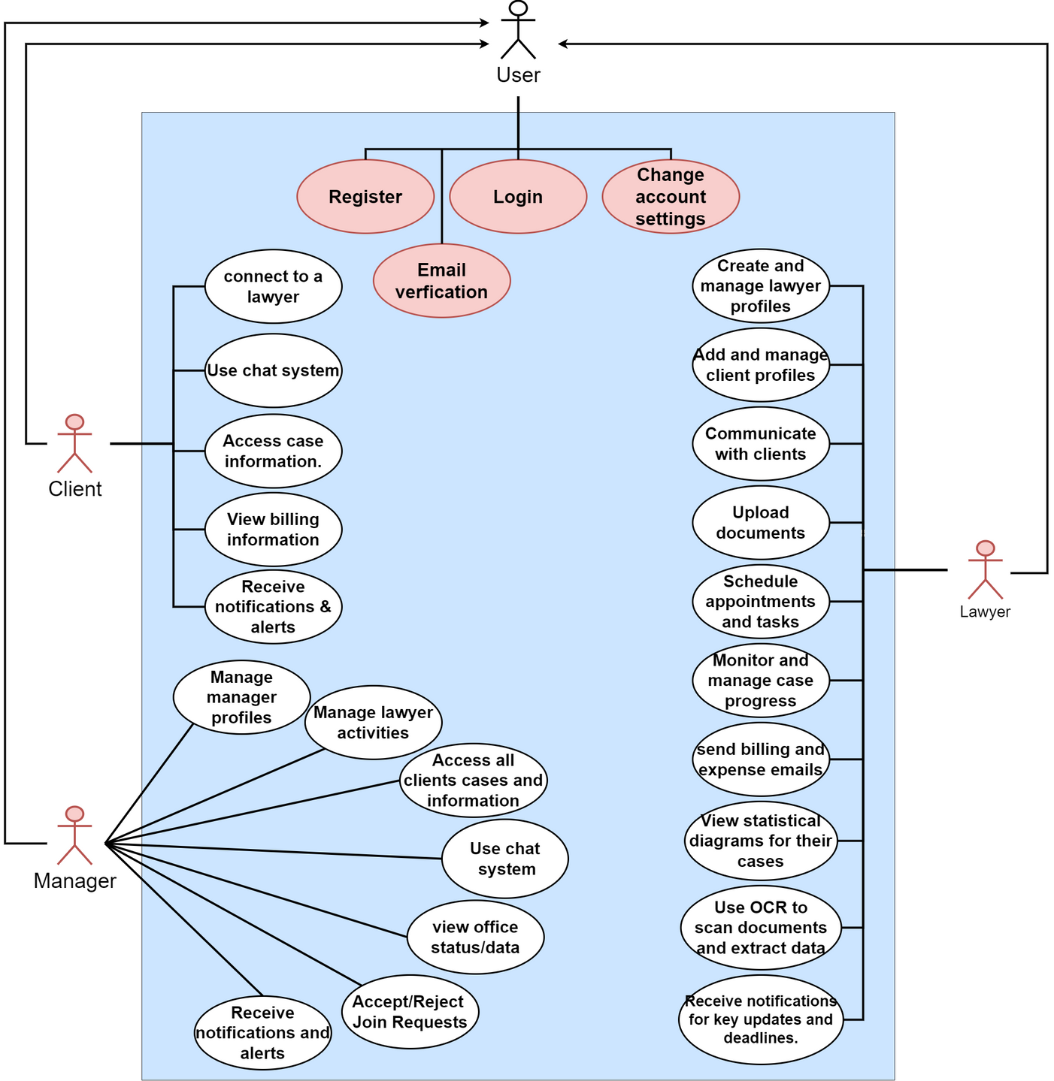
ADEL
Adel Use Case Diagram:

Slide 8
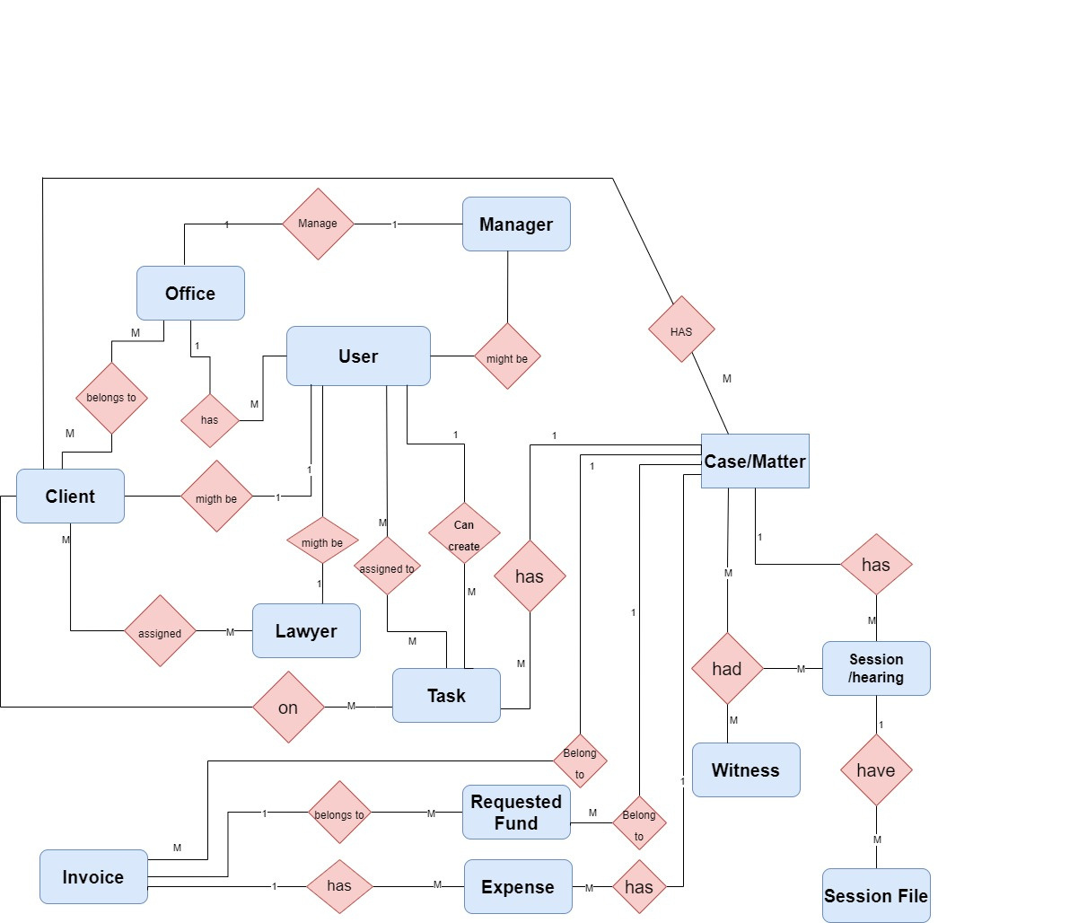
Home
Service
About Us
Contact
ADEL
ADEL ERD | 2024

Slide 9
Home
Service
About Us
Contact
ADEL
WATCH THE VIDO TIME !

Slide 10









Aldenaire & Partners
Home
Service
About Us
Contact
<TOOLS/>
ADEL

Slide 11
Home
Service
About Us
Contact
ADEL
FUTURE VISION...
  Mobile Application Development.
  Recommender system the guiding clients to the right lawyer based on their specific problem and location.

Slide 12
THANK YOU !!
ADEL

