Slide 1


An-Najah National University
Faculty of Engineering and Information Technology
Civil Engineering Department
The Design of the Foundation of a multi-story Building in Al-Basateen Area in Nablus
Under supervision of
Dr. Mohammad Ghazal
Prepared by:
Ahmad Aqqad: 11541340
Ahmad Husni: 11823084
Tala Musmar: 11612069
June-2021

Slide 2
Project Description:
This project is to design the foundation of a multi-story building, the total plan area 9092 m², the building consists of 11 floors, three floors are underground and eight floors are above ground level with different floors areas for each one.

Slide 3
Brief problem definition
The main problem in the project is the water level is close to street level and low bearing capacity of the soil is about 180 KN/m2 (1.8 kg/cm2).
This will be taken into consideration when analyzing and designing the appropriate type of foundation in order to avoid the occurrence of any foundations settlement problem.

Slide 4
Matt Foundation
Mat foundation is the first option because the allowable soil capacity is low compared with the high loads and to reduce differential settlement of soils.

Slide 5
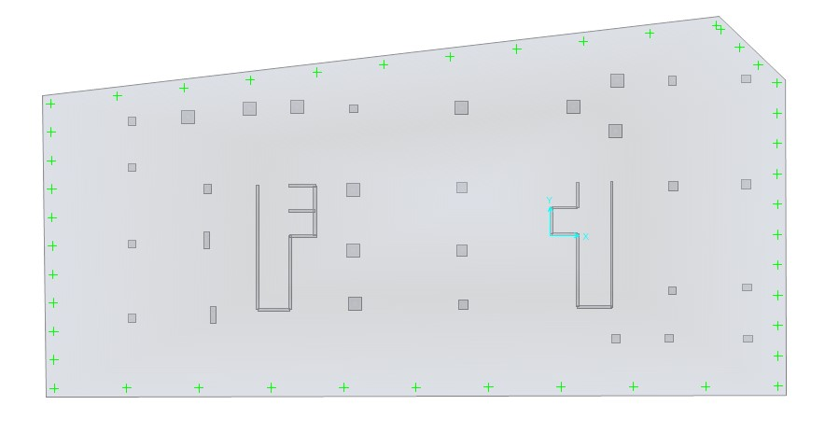

Slide 6
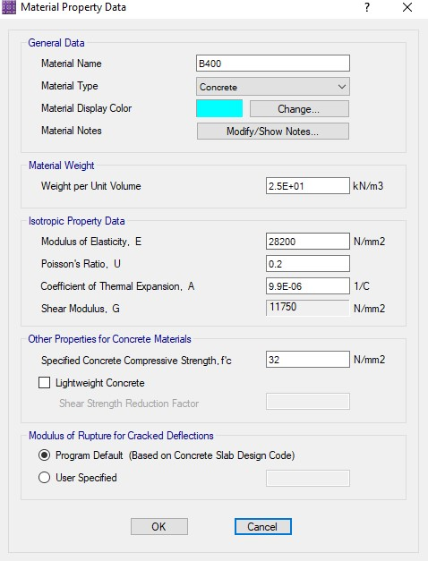
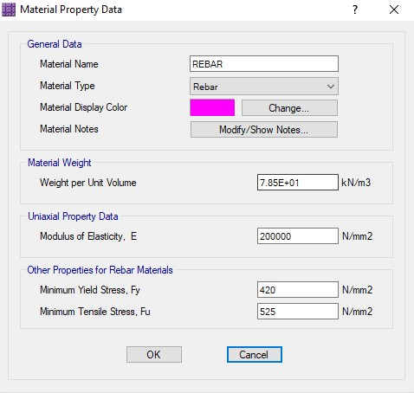

Slide 7
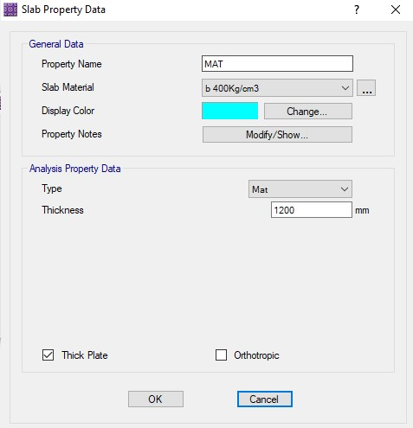
The thickness was assumed 1.2 meters as an initial value and then the analysis was performed to check the settlement and shear.

Slide 8
Check of Settlement
The max. limit of settlement in Mat foundation = 50 mm
The max. limit from deformed shape = 11 mm < 50 mm

Slide 9
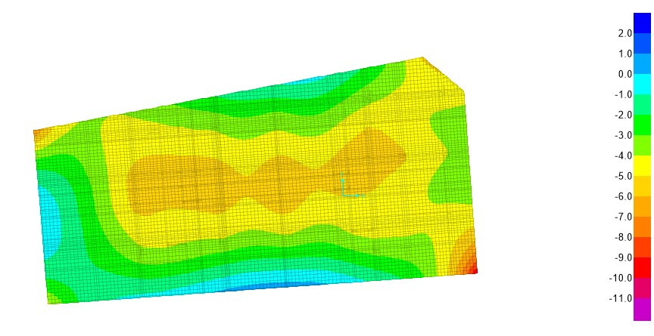

Slide 10
Check of shear
The one-way shear capacity of foundation
ØVc = 0.75 * 1/6∗ 1∗ √fꞌc* b*d / 1000
= 0.75 * 1/6∗ 1∗ √32* 1200*1000 / 1000
= 848.5 KN.

Slide 11
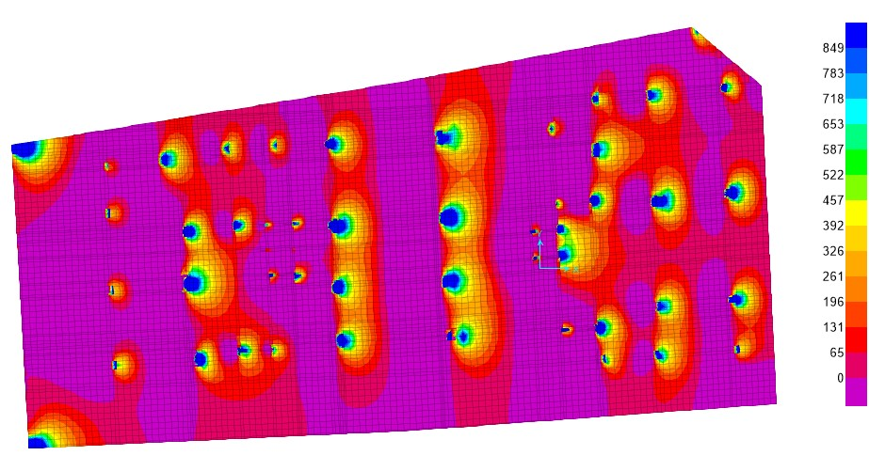

Slide 12
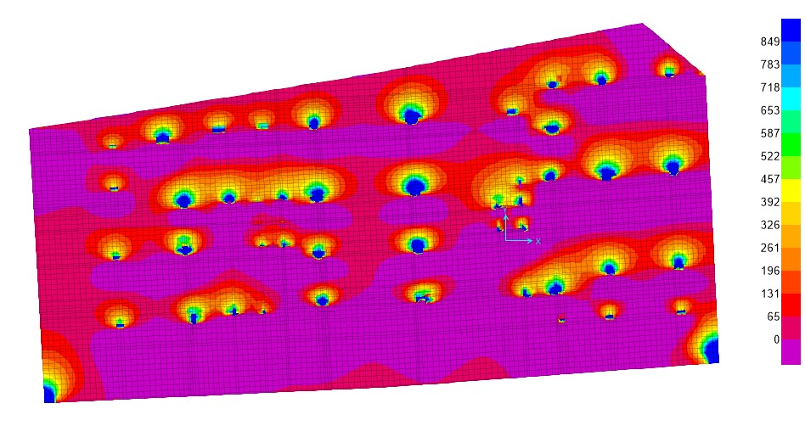

Slide 13
The shear force at critical surface of columns is less than the shear capacity.
(Note: the blue areas in the figure indicates that the shear stress is more than the limits
but the shear force can be read at distance d from column’s face which gives values
less than the maximum capacity)
Our assumption of foundation thickness is just safe so it will be confirmed.

Slide 14
Reinforcement
The logic of design the foundation using Finite Elements
Method in SAFE.
Asmin = 2160 mm2/m
(let take Ø 20)
No. of Bars = 2160/ 314
= 6.8 bars
Spacing = 100/7
= 14.2 cm (take it 12 cm)

Slide 15
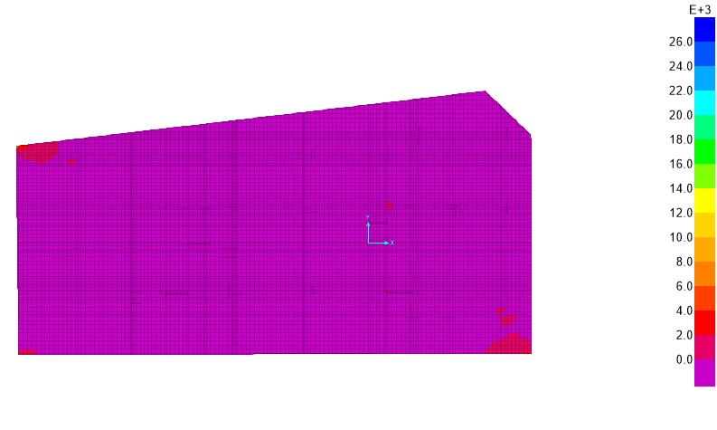
Top Rebar X Direction

Slide 16
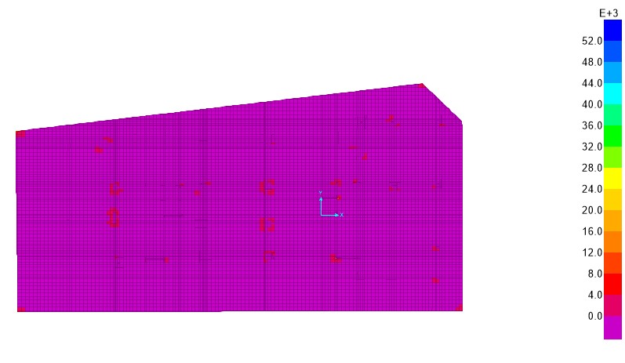
Bottom Rebar X Direction

Slide 17
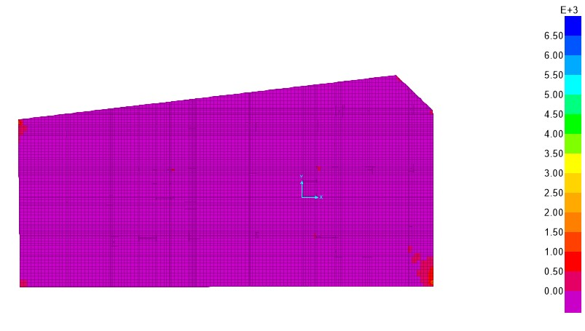
Top Rebar Y Direction

Slide 18
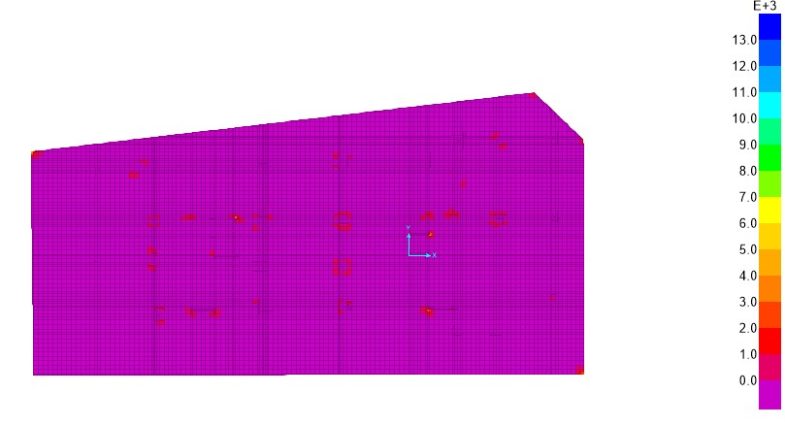
Bottom Rebar Y Direction

Slide 19
The minimum reinforcement could be enough for foundation except in columns area (bottom side).
Use additional bars per meter at bottom in X&Y direction in columns areas.

Slide 20
Pile Foundation
The pile foundation is the second option for the footing.
Pile foundation was designed manually.
We design all piles in max load which equal 7800 kN
Using factor of safety = 3

Slide 21
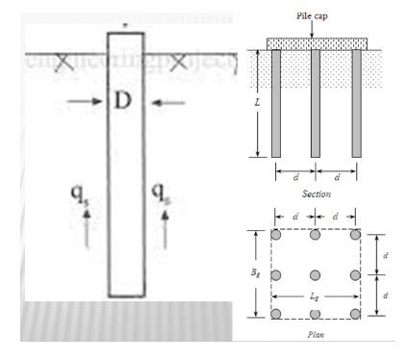
Assumption:
The circular shape has been selected.
The Width was assumed = 60 cm
The Depth was assumed = 10 m

Slide 22
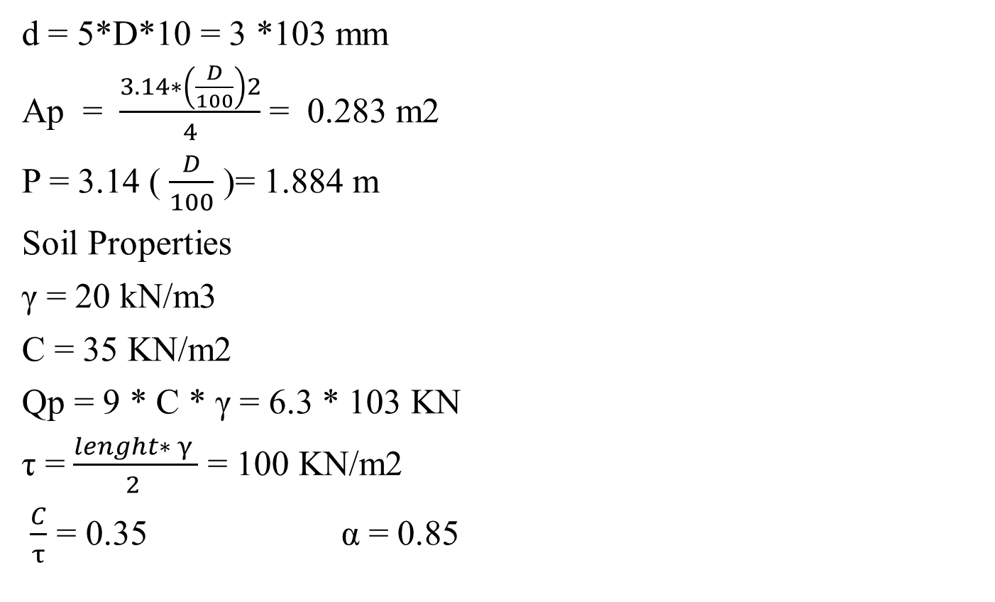
d = 5*D*10 = 3 *103 mm
Ap = $\frac{3.14∗\left(\frac{D}{100}\right)2}{4}$ = 0.283 m2
P = 3.14 ( $\frac{D}{100}$ )= 1.884 m
Soil Properties
γ = 20 kN/m3
C = 35 KN/m2
Qp = 9 * C * γ = 6.3 * 103 KN
τ = $\frac{lenght∗ γ }{2 }$ = 100 KN/m2
$\frac{C}{τ}$ = 0.35 α = 0.85

Slide 23
Qu = (7*6) (Qp+ α*p*length) = 2.653 * 105 KN ….(1)
X = 7 Y=6
Lg= (y-1) (D/100 + d/1000 ) = 18 m
Bg = (X-1) (d/1000 + D/100 ) = 21.6 m
Lg/Bg = 0.833 Nc= 8.8
Qg = Lg*Bg*9*C + 2*(Lg + Bg) *length*C = 1.502 * 105 KN … (2)
Q all = Qg/3 = 5.006 * 104 KN

Slide 24
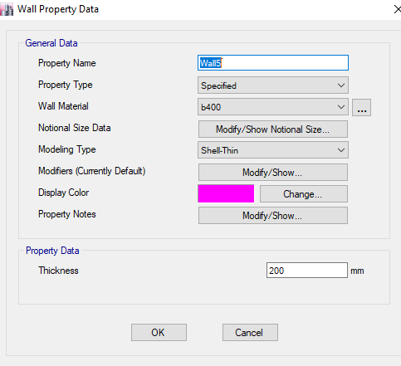
Shear Wall
The Shear wall was designed using Etabs
The thickness was assumed 20 cm

Slide 25
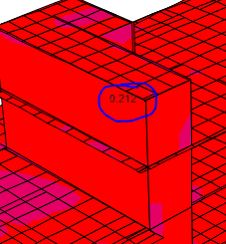
Reinforcement
Moment from analysis = 0.212
We have minimum moment in this shear wall so we use minimum reinforcement in this shear wall
AS min = 0.0033*200*1000 = 600 mm2
use 6Ø12/m or use 1Ø12/200 mm in longitudinal and normal direction.

Slide 26
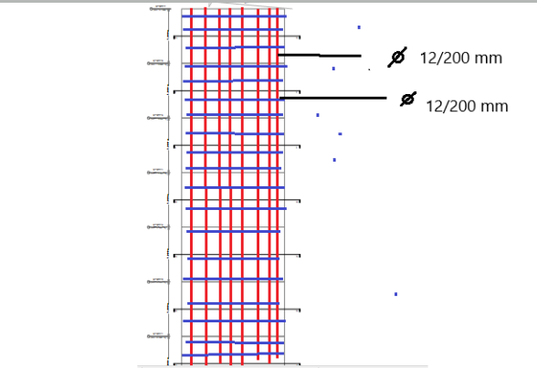
Shear wall Reinforcement

Slide 27
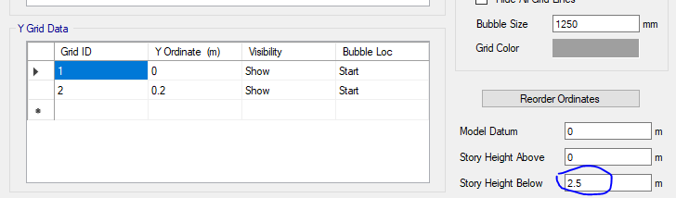
Retaining Wall
The Retaining wall was designed using Etabs software
The Height below was assumed 2.5 m
The Thickness was assumed 0.2 m

Slide 28
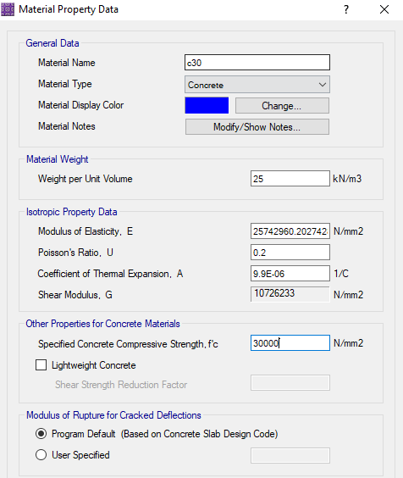
The concrete of the wall was assumed that b300 (f’c =30 Mpa).

Slide 29
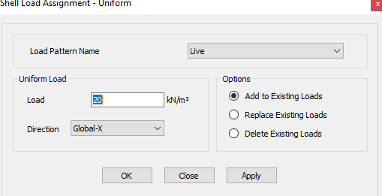
The most critical condition of the soil was assumed (γ = 16.2 kN/m3)
The pressure below = 6.4 * 2.5 = 16 kN/m2
To convert pressure to point load = 0.5 * 2.5 * 16 = 20 kN/m2
The point load on the wall area, it was assumed as uniform load (per square meter)
to take critical case and to increase factor of safety.

Slide 30
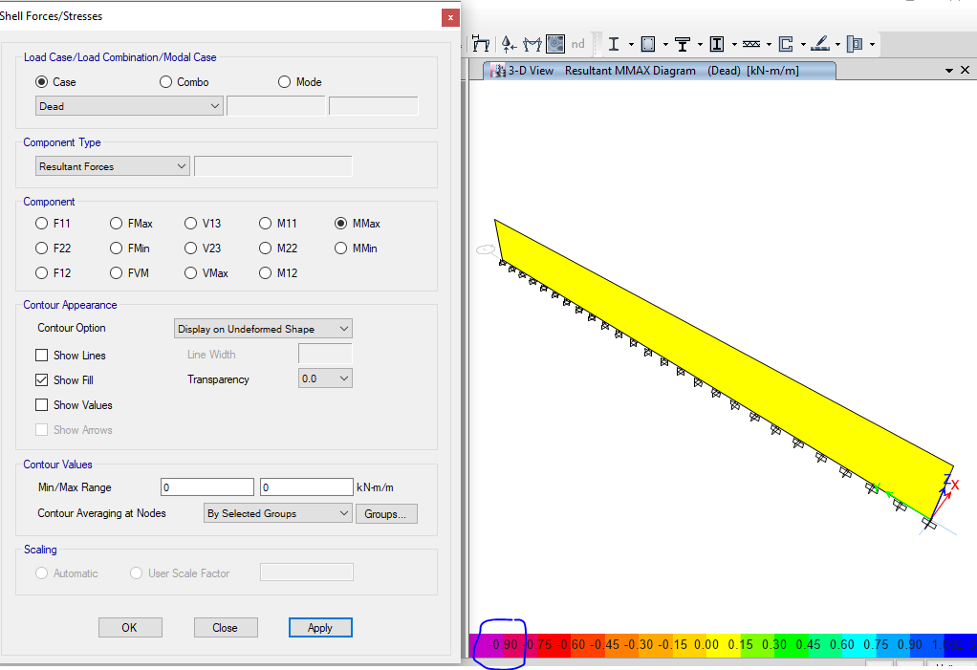
The Moment from analysis = 0.9 KN.m/m
use AS min = 0.0033 * 1000* 200 = 600 mm
use 6Ø12/m or use 1Ø12/200 mm in longitudinal and normal direction.

Slide 31
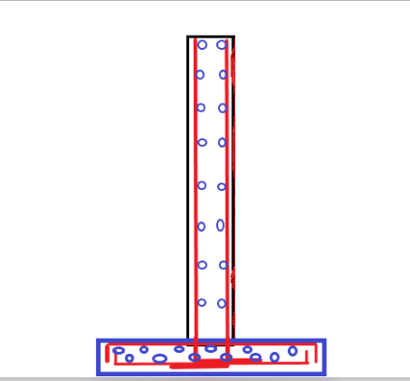
Retaining Wall Reinforcement

